Slide 1

Web Tracking and FINGERPRINTING
Vitaly Shmatikov

Slide 2


Slide 3
Why Do Websites Do This?
Global digital ad spending: $292 billion
Deliver relevant advertising
Measure and attribute engagement
Differentiate real users from bots and fraudsters
Provide best experience for user's device, location, etc.

Slide 4
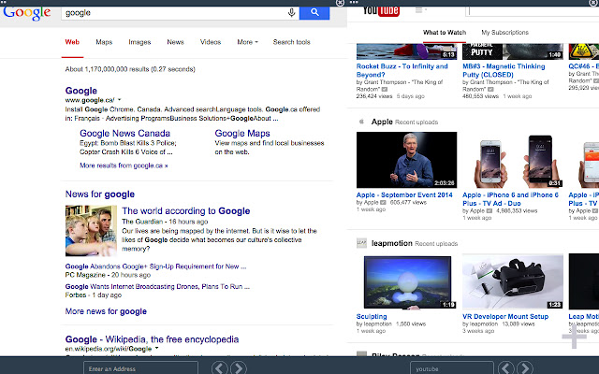


Frames
“Third party”
“First party”
included in the page from another origin
named in the URL bar
A
B
A
A
Browser window may contain frames from different origins
visible or hidden

Slide 5
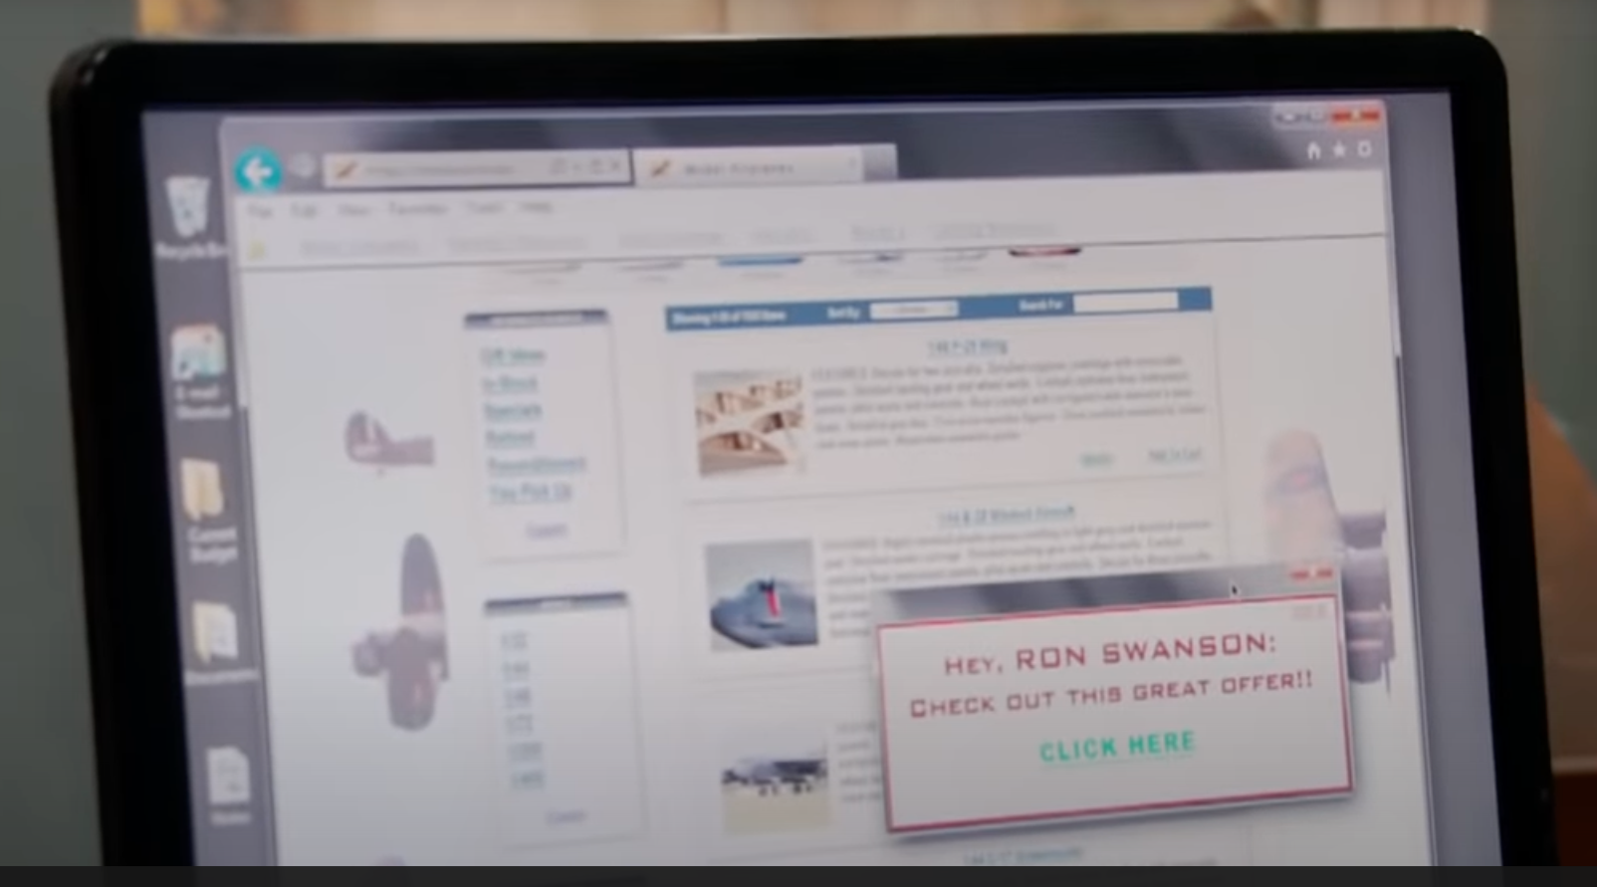

First party
Third party

Slide 6

URL Request
Source: Cyphers and Gebhart. “Behind the One-Way Mirror”.

Slide 7
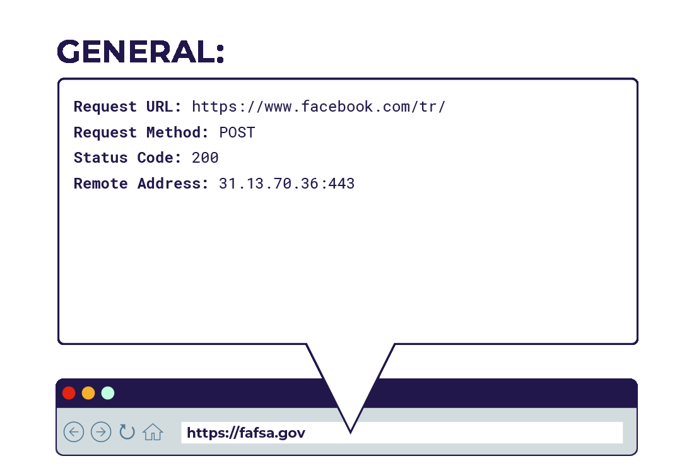
Information Sent to Website
Source: Cyphers and Gebhart. “Behind the One-Way Mirror”.

Slide 8
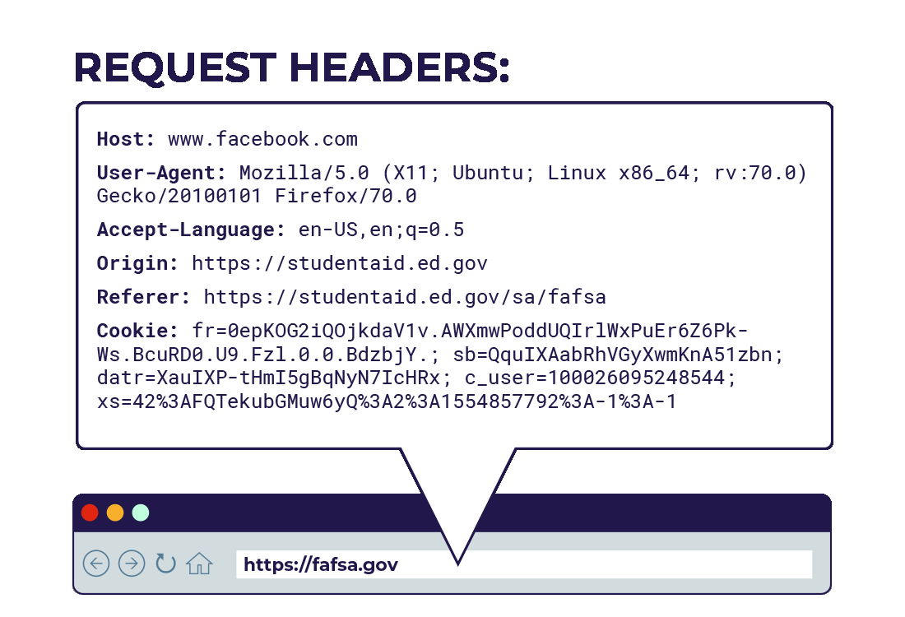
Information Sent to Website
Source: Cyphers and Gebhart. “Behind the One-Way Mirror”.

Slide 9
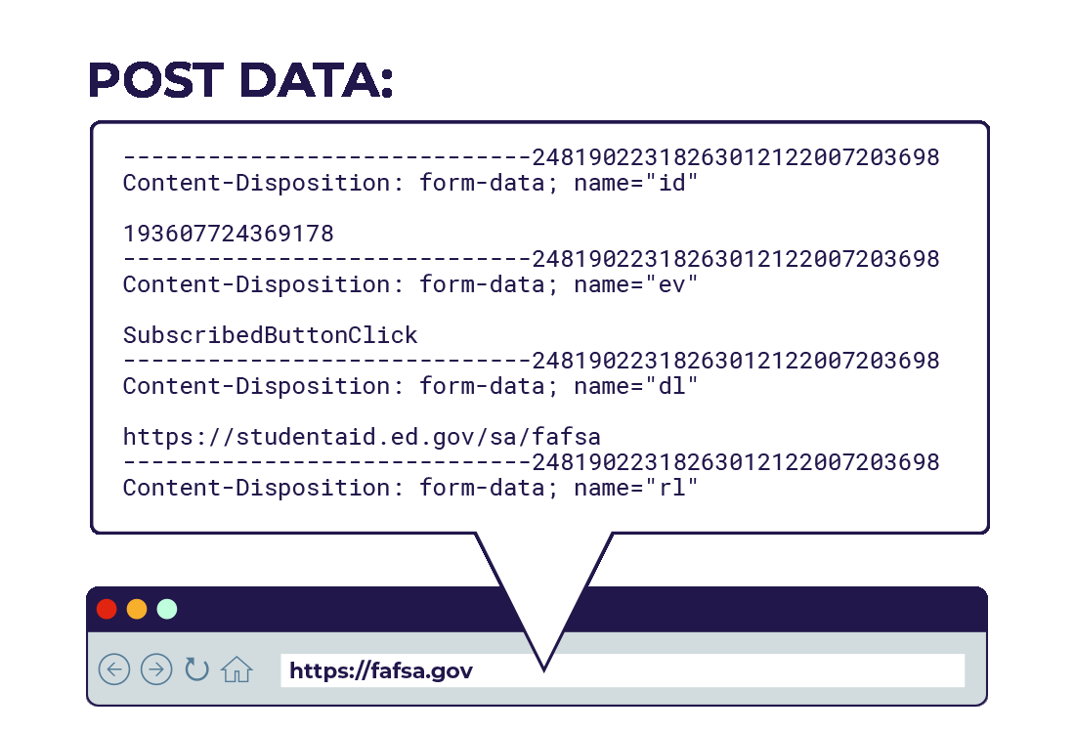
Information Sent to Website
Source: Cyphers and Gebhart. “Behind the One-Way Mirror”.

Slide 10
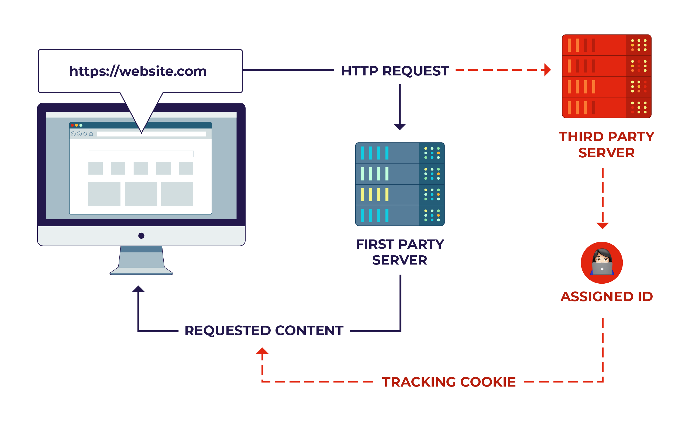
First Party vs. Third Party
Third-party tracking:
collection of personal information by companies that users do not intend to interact with
Source: Cyphers and Gebhart. “Behind the One-Way Mirror”.

Slide 11
Tracking via Cookies
Cookie: value set by Web server, automatically sent by the browser on subsequent requests to same(ish) origin
Link two sessions at same site
  Authentication, personalization, etc.
Link sessions between different sites
Can be combined with user-identifying information
Third-party cookies

Slide 12
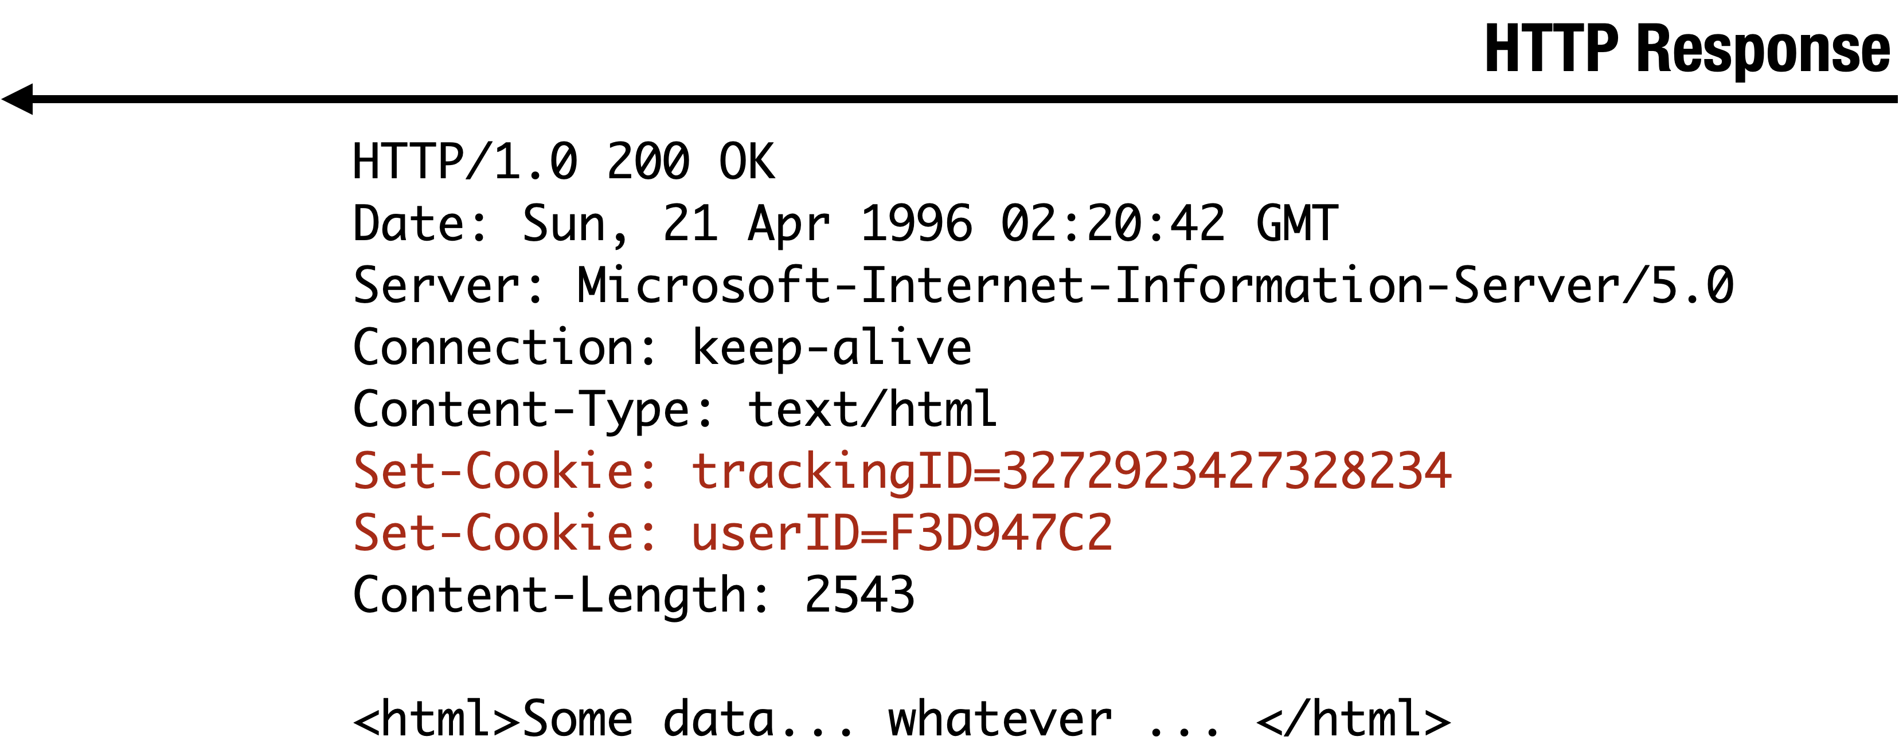
Website Storing Info In Browser
A cookie is a file created by a website to store information in the browser
HTTP request
Server
Browser

Slide 13
Same Origin Policy for Cookies
GET //URL-domain/URL-path
Cookie: NAME = VALUE
Server
Browser
Browser sends all cookies in URL “scope”
cookie-domain is domain-suffix of URL-domain
cookie-path is prefix of URL-path
only over HTTPS if cookie is “secure”
JavaScript can read cookie via DOM
… if cookie is from same domain, port, protocol

Slide 14
Same Origin Policy for iFrames
A
Each frame of a page has an origin
  Origin = protocol://domain:port
Frame can access objects from its own origin
  Network access, read/write DOM, cookies and localStorage
Frame cannot access objects associated with other origins
A
B
A
B

Slide 15

Same Origin Policy for iFrames
Shop.com
shop.com
Referer:
shop.com
Hey, Ron Swanson
Tracker.com
Any iframe can set and read cookies in its origin
Which server sees which cookies?
How does tracker.com know that you are visiting shop.com?

Slide 16





Tracking with Third-Party Cookies

Slide 17





Behavioral
Targeting
Ad network
Advertisers
Publishers

Slide 18
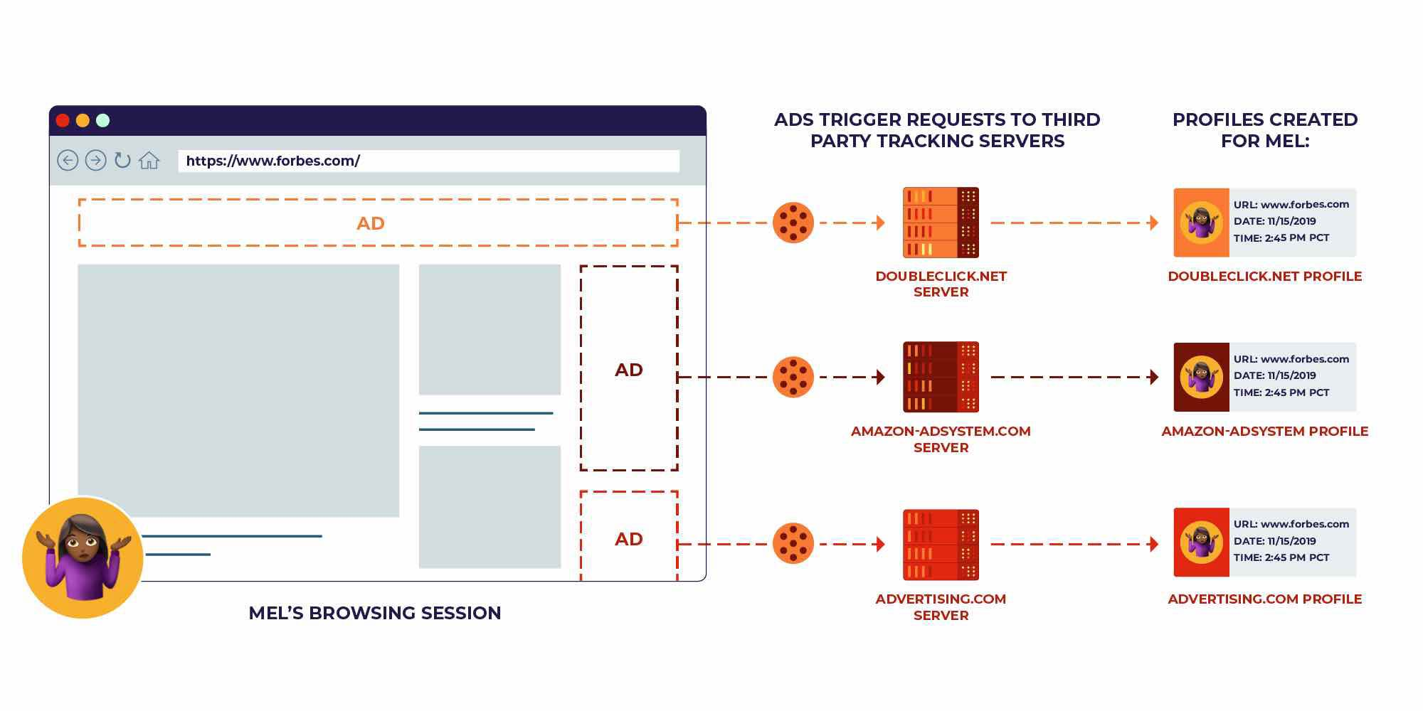
Source: Cyphers and Gebhart. “Behind the One-Way Mirror”.

Slide 19
Any HTML Content Is a Tracking Opportunity
Source: Cyphers and Gebhart. “Behind the One-Way Mirror”.
Analytics scripts of first-party publishers
Analytics scripts of third-party advertisers
For example, verify if the impression is shown to a human or a bot
Invisible, 1x1 pixel images (“tracking pixels”)
Embedded media players
Social media widgets
CAPTCHAs
ReCAPTCHA v3 records “interactions with website”, generates a behavioral fingerprint, sends to Google, Google’s ML model decides if the user is human
Session replay services (record every keystroke, mouse movement, tap, swipe)

Slide 20
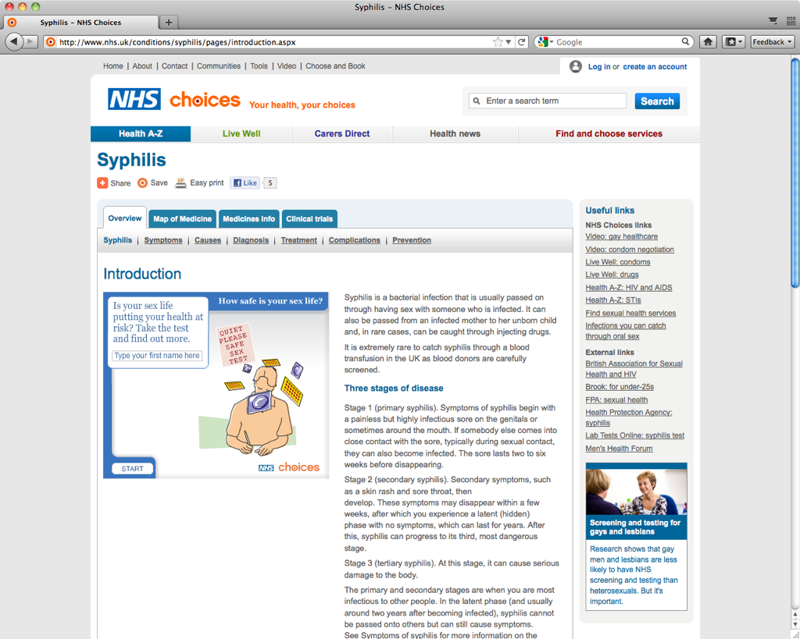

Slide 21
Direct Inclusion of Third-Party Scripts
Shop.com
shop.com
Hey, Ron Swanson
Tracker.com
Many pages include third-party scripts in their own (i.e., first-party) origin.
Why?
For example, analytics scripts need access to the DOM of the hosting page.

Slide 22
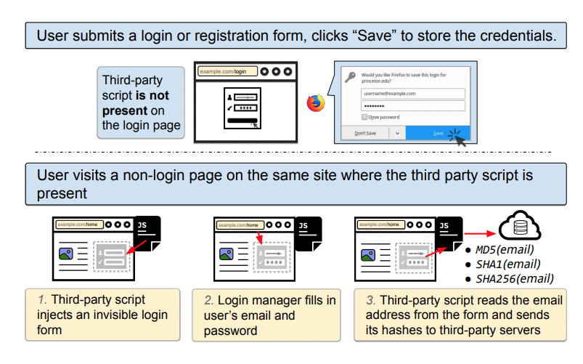
Login Manager Misuse
Why is this permitted by same origin policy?
Acar et al. “No boundaries: data exfiltration by third parties embedded on web pages” (2020).

Slide 23
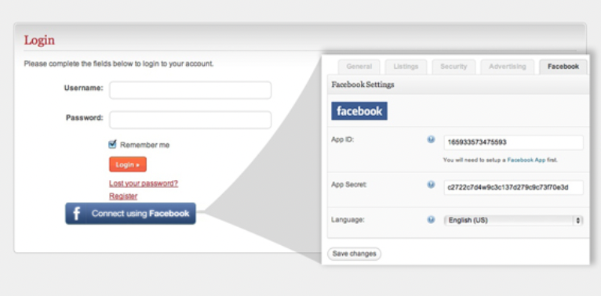
Social Data Exfiltration
Website supports login via FB
Third-party script can query FB API for any information that user granted access to the site
Note: FB user ID is specific to site
What’s the right way to include social-media widgets into a webpage?
Acar et al. “No boundaries: data exfiltration by third parties embedded on web pages” (2020).
Image: https://www.presstigers.com/facebook-login-api-integration-in-your-website/

Slide 24

Whole-DOM Exfiltration
Websites include third-party scripts to collect analytics
  Example: session replay – understand how page was rendered for the user and how user interacted with it
Third-party script can capture the entire HTML page
  Including top-level context (names, emails) and all forms (addresses, credit card and social security numbers, account balances, medical history, etc.)
Why is this possible?
Note: many analytics companies explicitly forbid and try to prevent collection of sensitive user information via their services
Acar et al. “No boundaries: data exfiltration by third parties embedded on web pages” (2020).

Slide 25


Slide 26
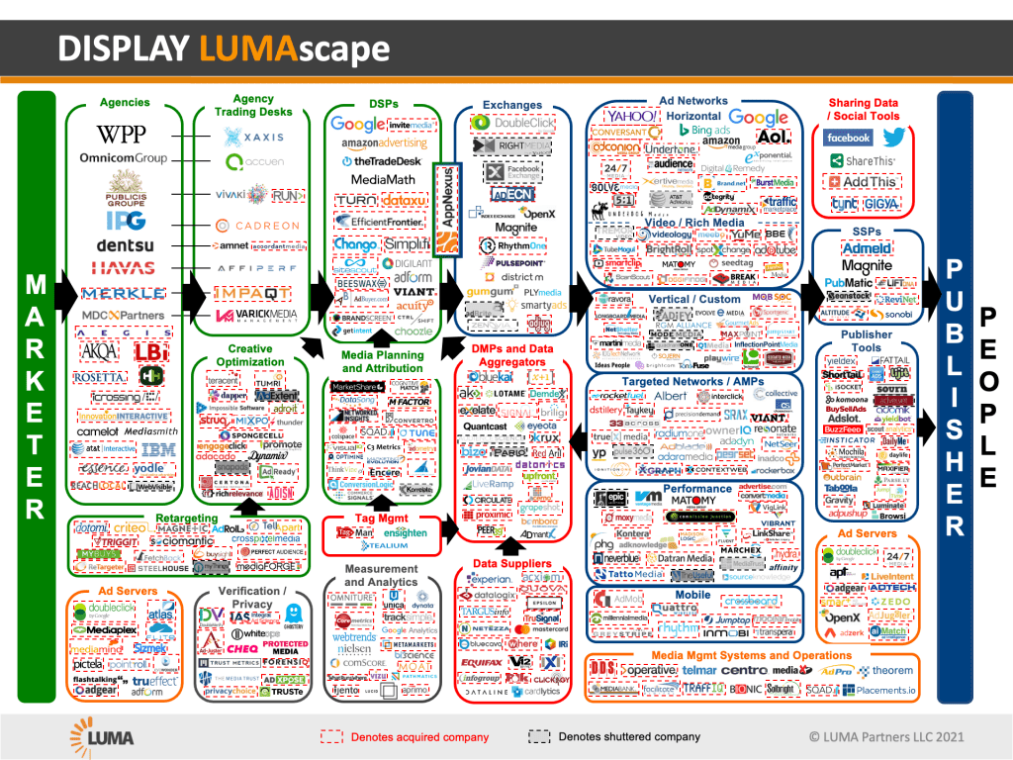


Slide 27
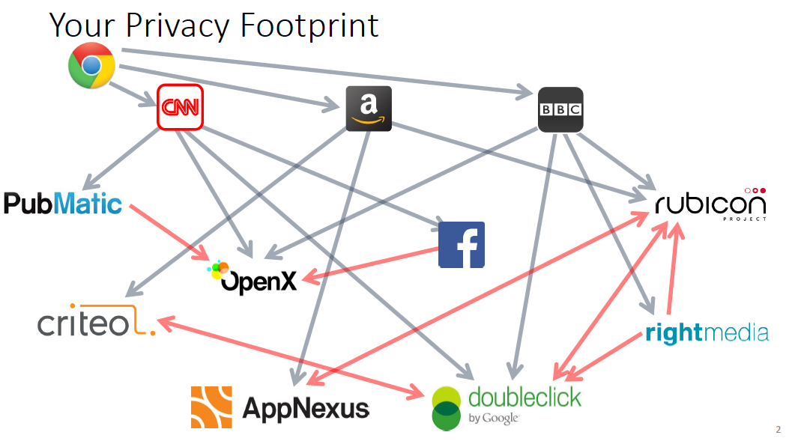
Bashir et al. “Tracing Information Flows
Between Ad Exchanges Using Retargeted Ads”

Slide 28
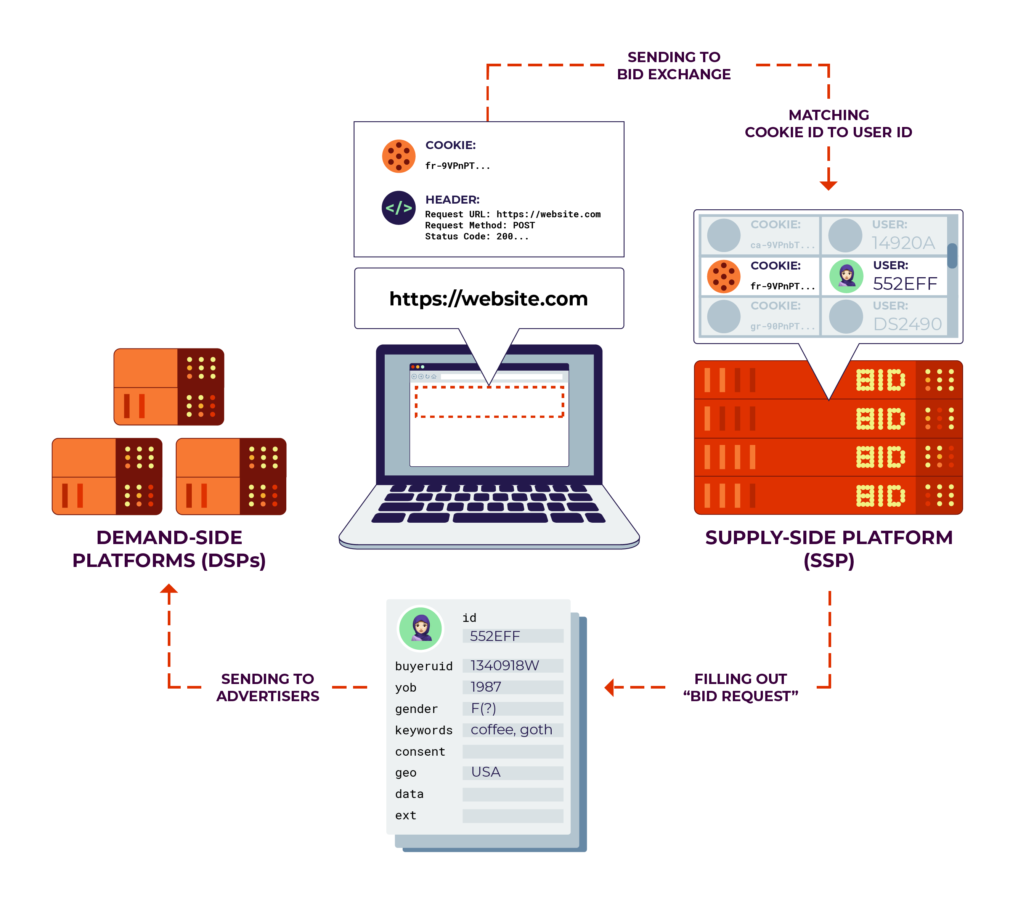
Source: Cyphers and Gebhart.
“Behind the One-Way Mirror”.

Slide 29
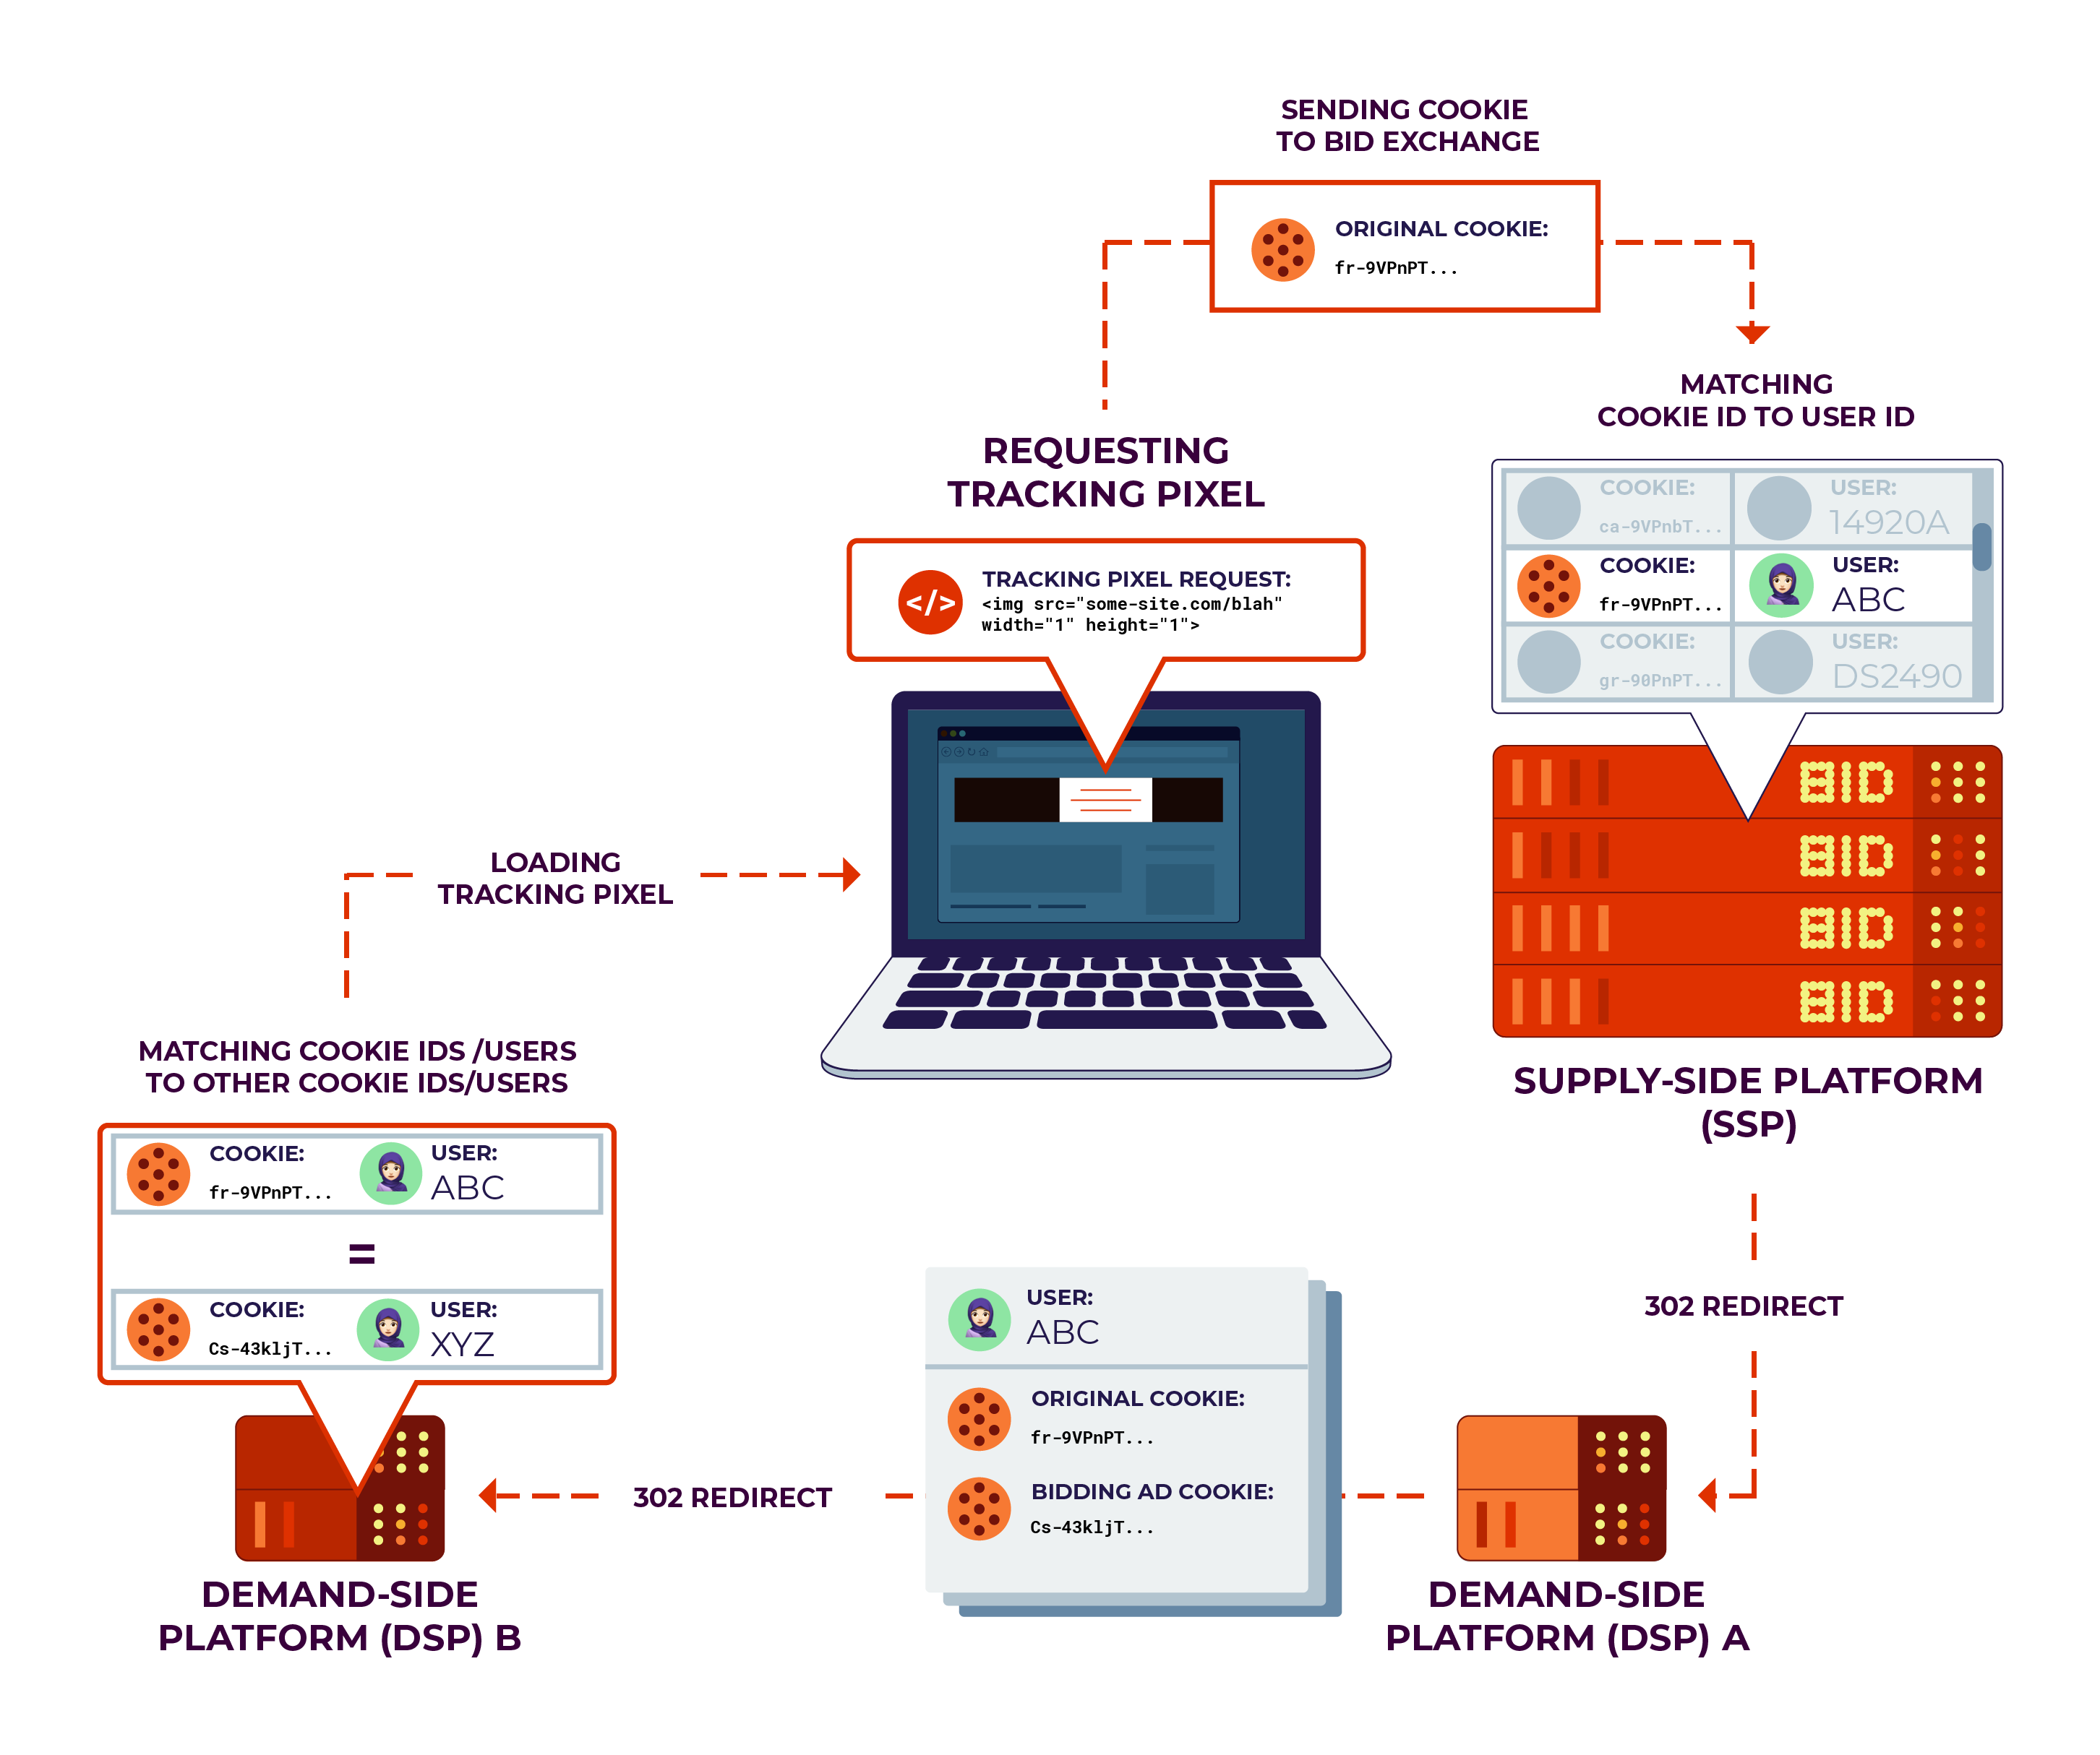
Cookie
Syncing
Source: Cyphers and Gebhart. “Behind the One-Way Mirror”.

Slide 30
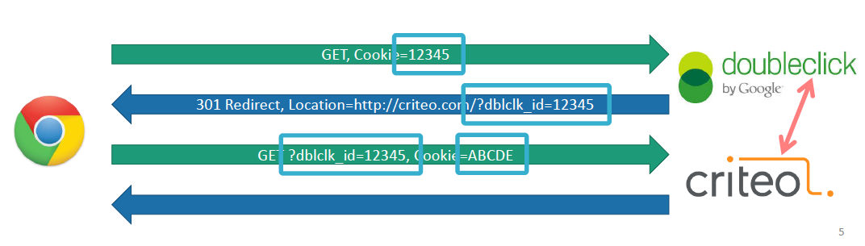
Cookie Syncing in Action
Site A (doubleclick) informing site B (criteo) about user’s identity -- via user’s browser
Allows aggregation across multiple trackers
Bashir et al. “Tracing Information Flows
Between Ad Exchanges Using Retargeted Ads”

Slide 31
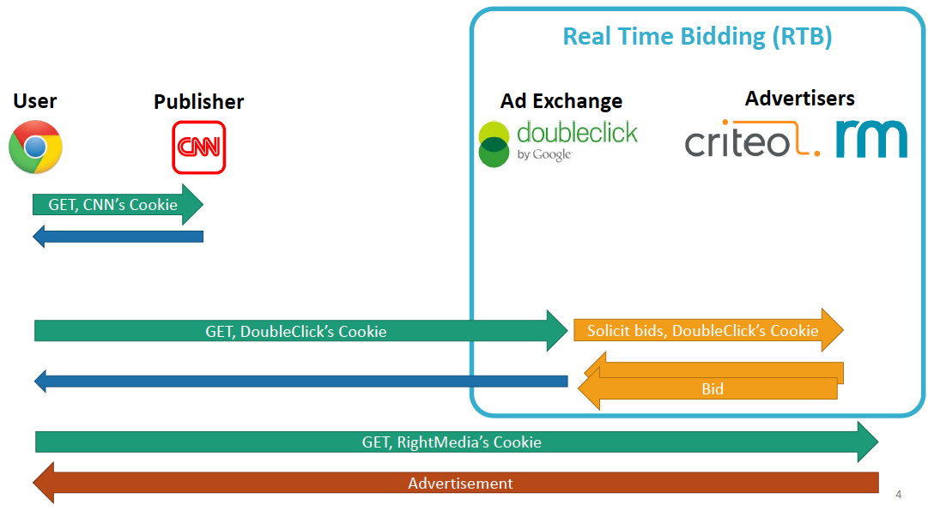
Bashir et al. “Tracing Information Flows
Between Ad Exchanges Using Retargeted Ads”

Slide 32
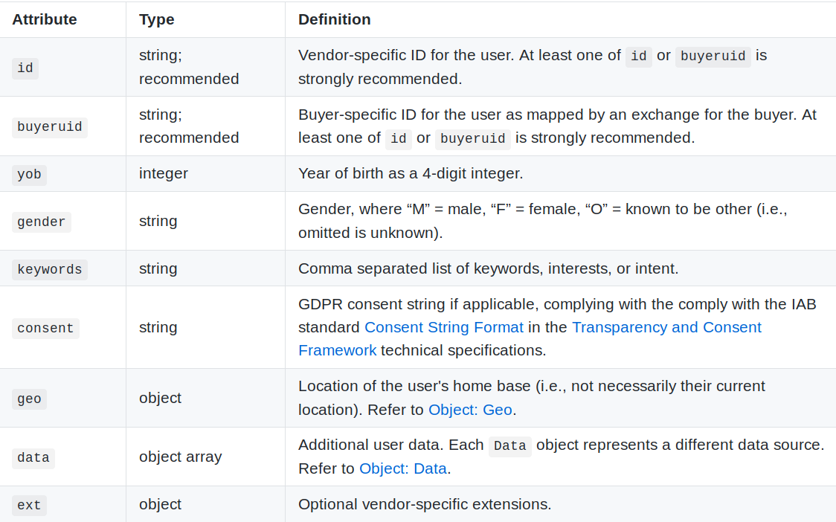
”User” Object in an OpenRTB Bid Request
Unique user ID
Interests
Location
Source: Cyphers and Gebhart. “Behind the One-Way Mirror”.

Slide 33
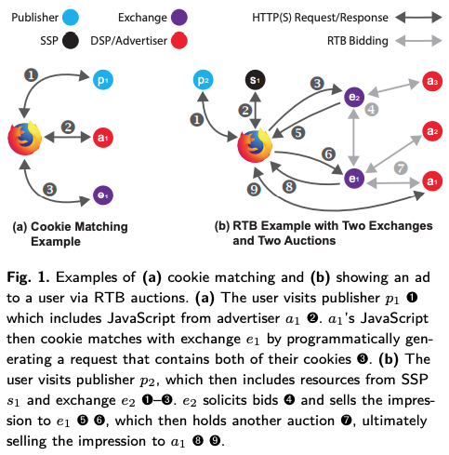
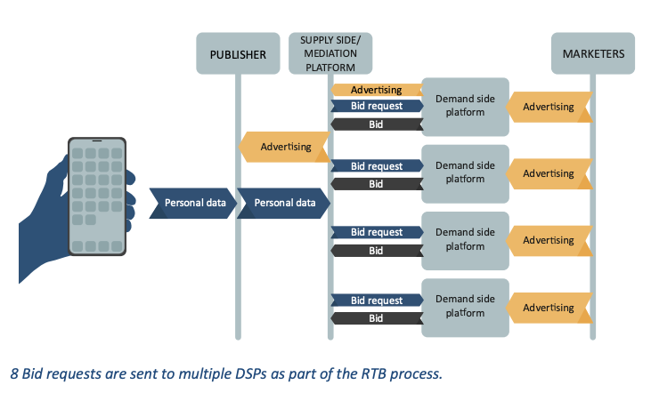
Information Flows in RTB
https://fil.forbrukerradet.no/wp-content/uploads/2020/01/2020-01-14-out-of-control-final-version.pdf
Bashir and Wilson. “Diffusion of User Tracking Data in the Online Advertising Ecosystem”.

Slide 34
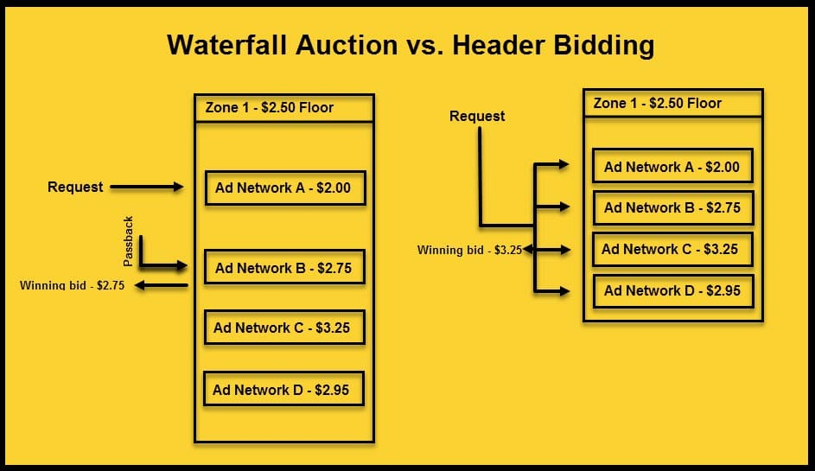
https://instapage.com/blog/what-is-header-bidding

Slide 35
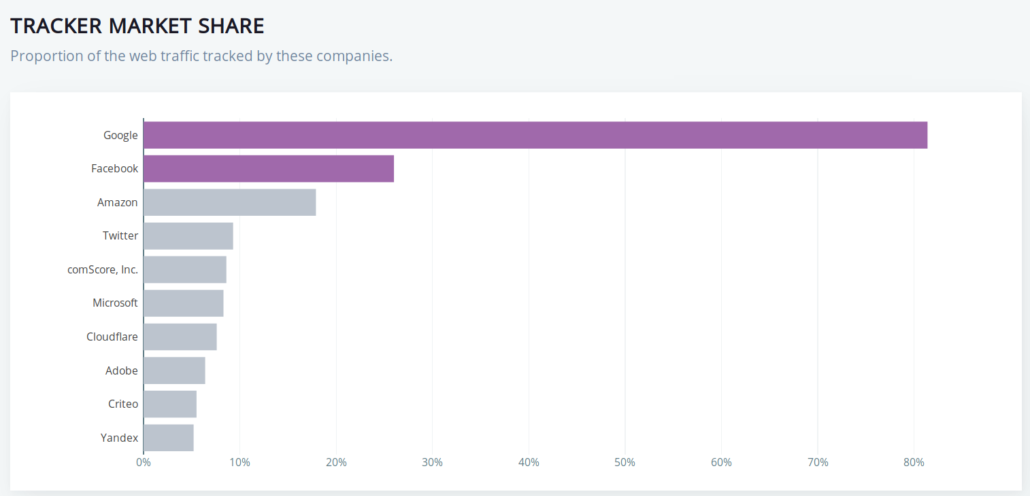

52% of global digital ad spending (~ $150 billion)
40% of money from advertisers to publishers on the open Internet (outside closed systems such as Google Search, YouTube, FB) goes through Google’s ad buying tools
Source: Cyphers and Gebhart. “Behind the One-Way Mirror”.

Slide 36
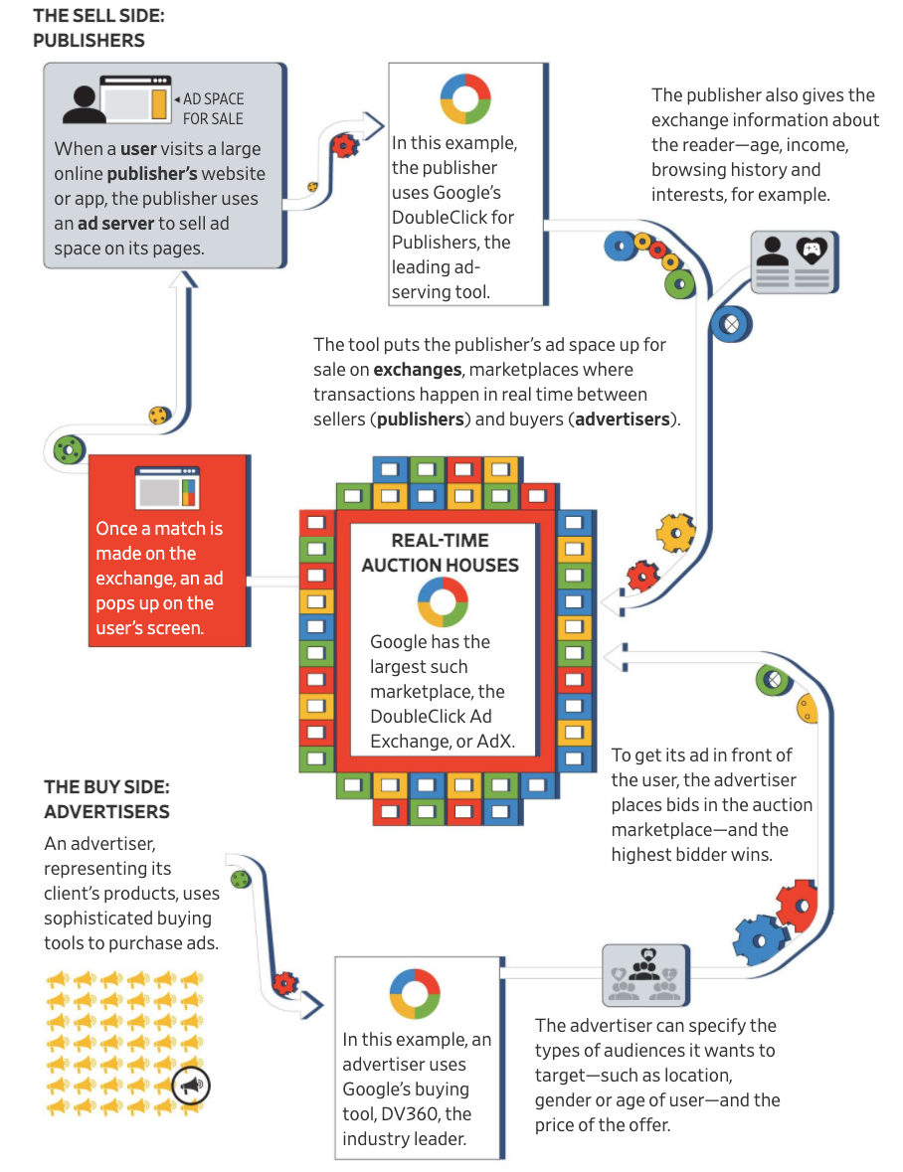
Google Ad Machine
How is this information obtained?
In a deal with Facebook, Google promised to identify 80% of mobile and 60% of Web users to help FB target ads
Image source: WSJ

Slide 37
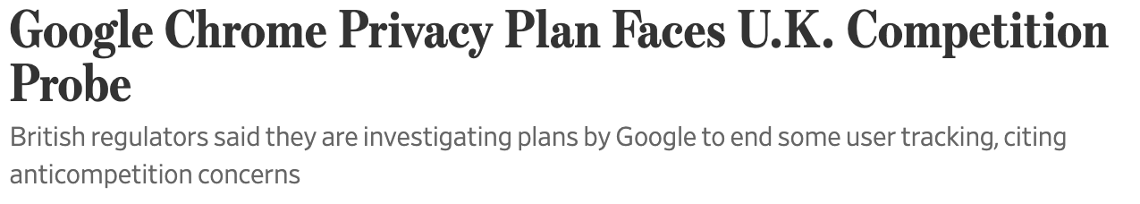
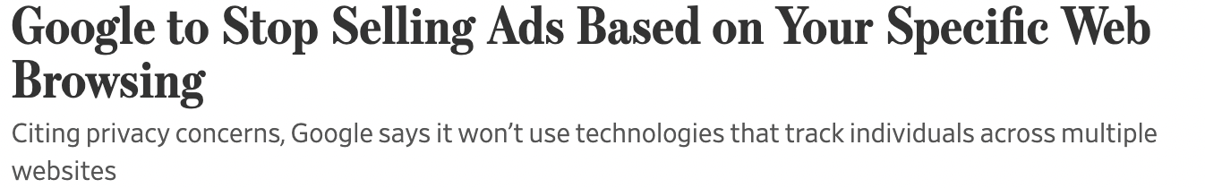

why?
No replacement for third-party cookies
Does not apply to Google’s first-party data or mobile ads

Slide 38
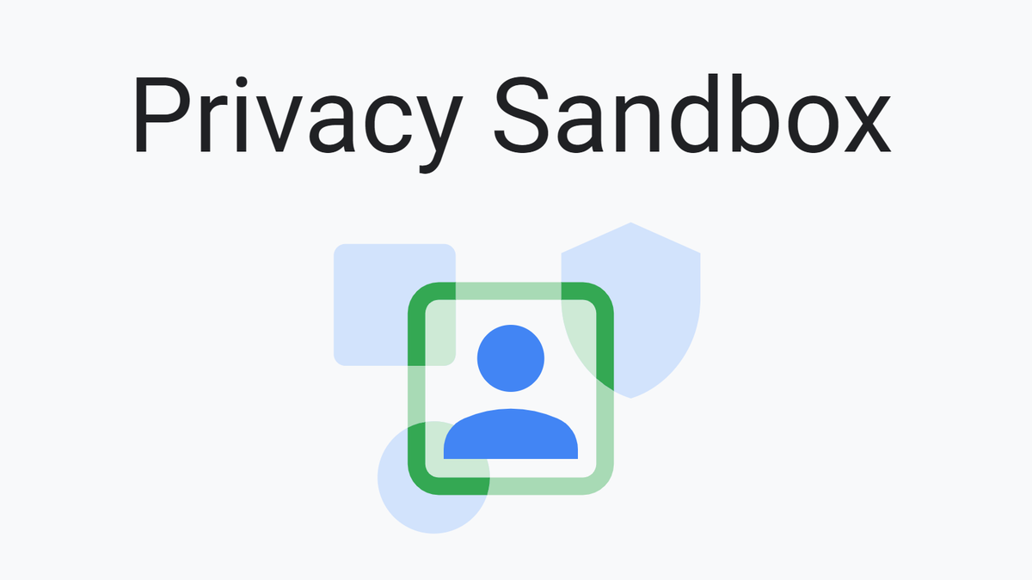
Chrome “Privacy Sandbox”
More about this later
Ad relevance (interest groups): FLoC Topics
Ad relevance (retargeting): FLEDGE/TURTLEDOVE
Identity: WebID federated identity
Ad conversion and reach measurement: secure multi-party computation
Fraud detection: trust tokens

Slide 39
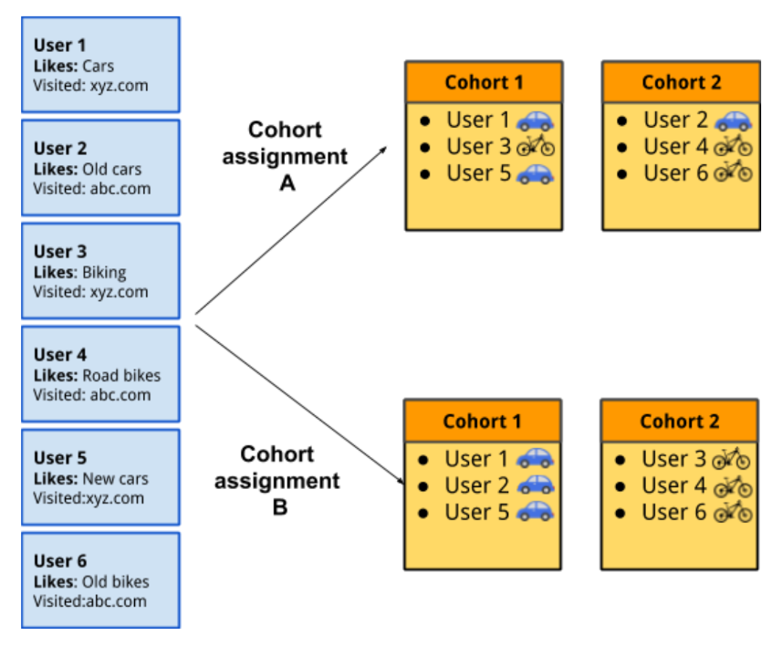


Showing Relevant Ads with FLoC
Replaces third-party cookies with “cohort ids”
Cohort = group of users with similar interests
January 25, 2022
Original proposal: 10,000s of automatically generated cohorts
New proposal: human curators will generate 1000+ “topics”, users will be able to see and remove “topics” associated with them
Better? Worse? WDYT?
Image: TechCrunch

Slide 40
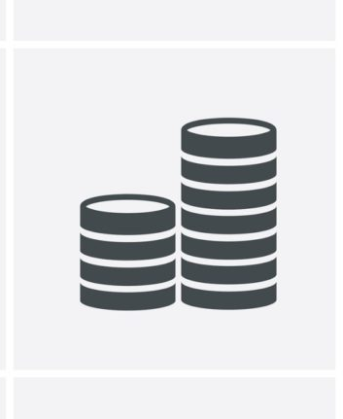

Preventing Ad Fraud with Trust Token
How to prevent advertising fraud from bots masquerading as human users without a stable, global, per-user identifier?
trusted website
website
Redemption protocol proves that the token is valid, but issuer cannot tell to whom this token was issued

Slide 41
Tracking Without Third-Party Cookies
Third party is the first party
(content publisher also runs an ad network)
  Google collects data from users when they browse using Chrome, use search, maps, email, other Google products…
  “Google is defining first-party cookies the way they want to define it”
    https://www.wsj.com/articles/google-chrome-to-phase-out-third-party-cookies-in-effort-to-boost-privacy-11579026834
Browser and device fingerprinting

Slide 42
Tracking Is Pervasive
64
independent tracking mechanisms in an average top-50 website

Slide 43
Tracking Technologies
HTTP Cookies
HTTP Auth
HTTP Etags
Content cache
IE userData
HTML5 protocol and content handlers
HTML5 storage
Flash cookies
Silverlight storage
TLS session ID & resume
Browsing history
window.name
HTTP STS
DNS cache

Slide 44

“A browser is a bunch of caches linked together by fingerprinting techniques”
“There is no turn-off switch for fingerprinting and tracking, just cost/benefit analysis for trackers”

Slide 45
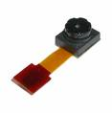
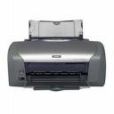


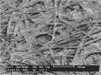


Everything Has a Fingerprint

Slide 46
Fingerprinting Web Browsers
User agent
HTTP ACCEPT headers
Browser plug-ins
MIME support
Clock skew
Installed fonts
Cookies enabled?
Browser add-ons
Screen resolution

Slide 47
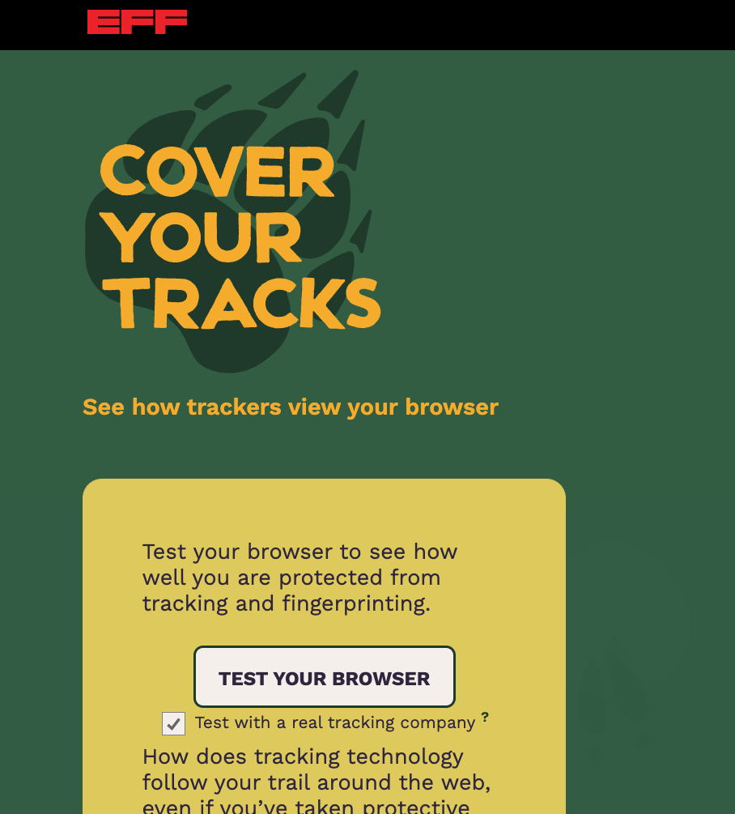
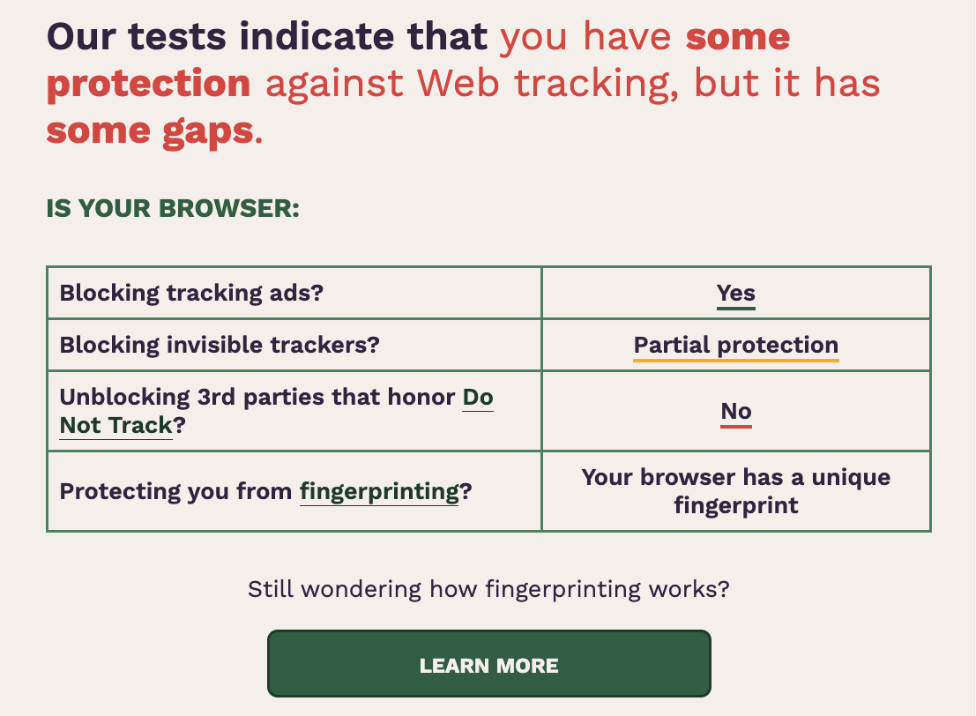

Slide 48
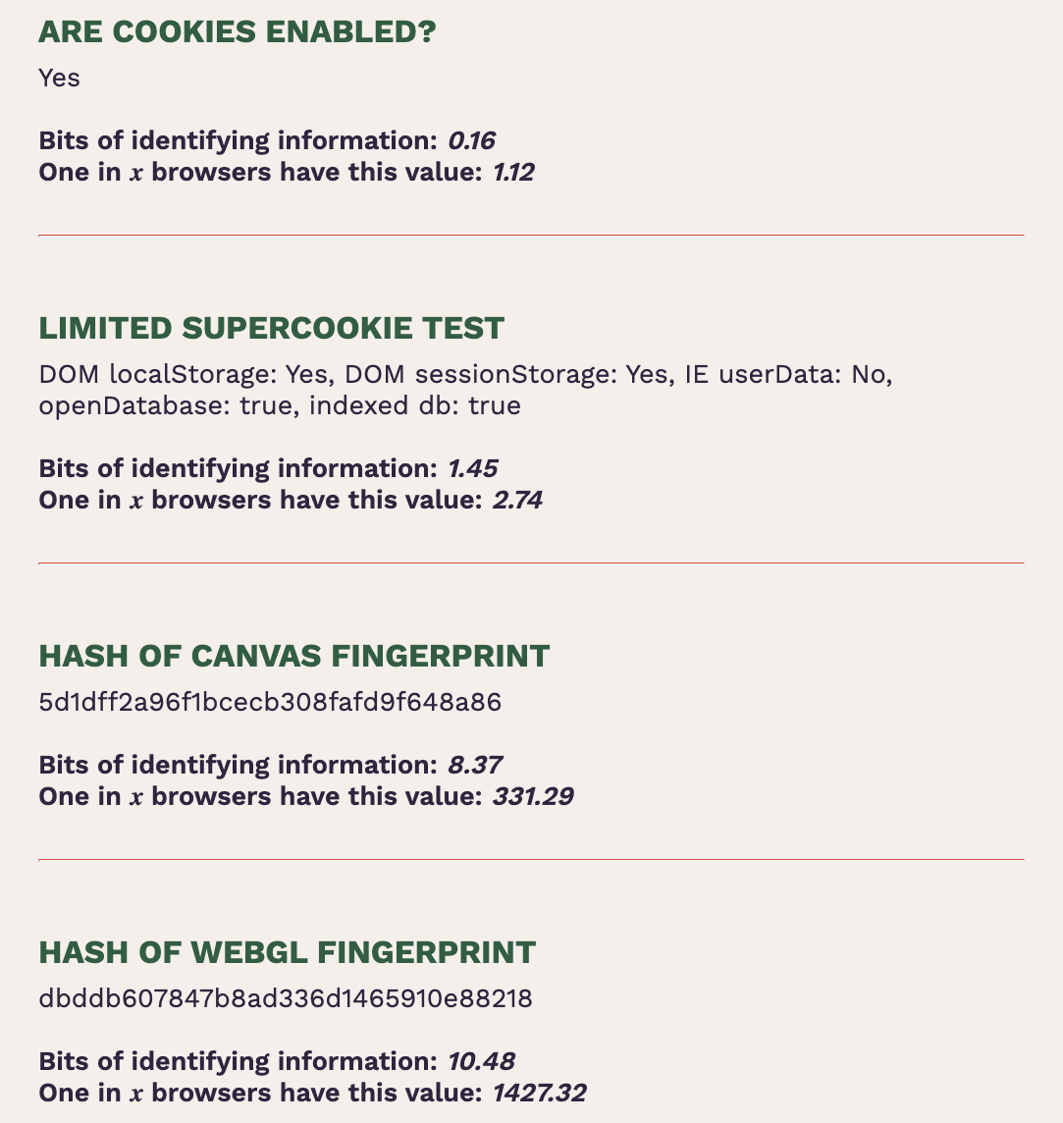
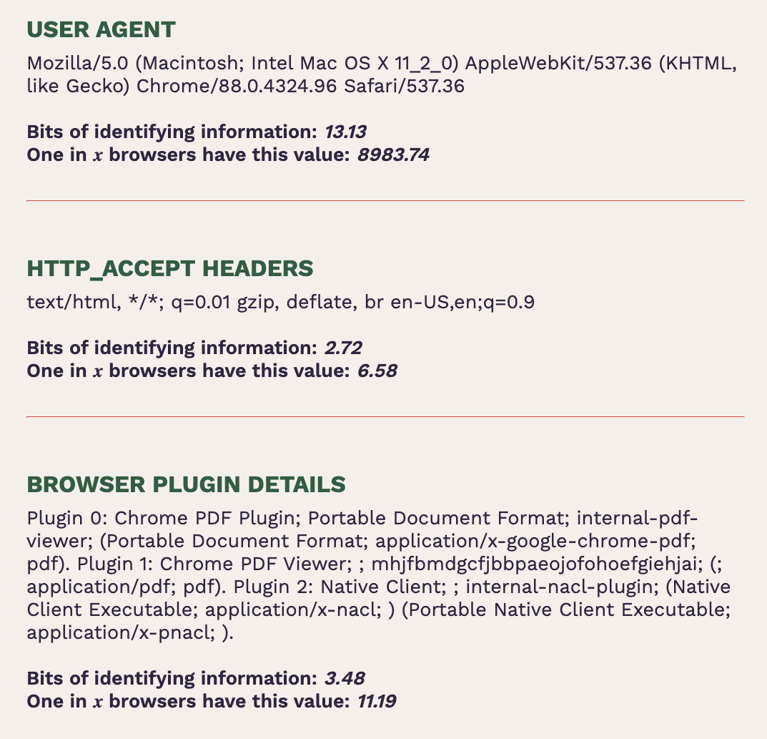
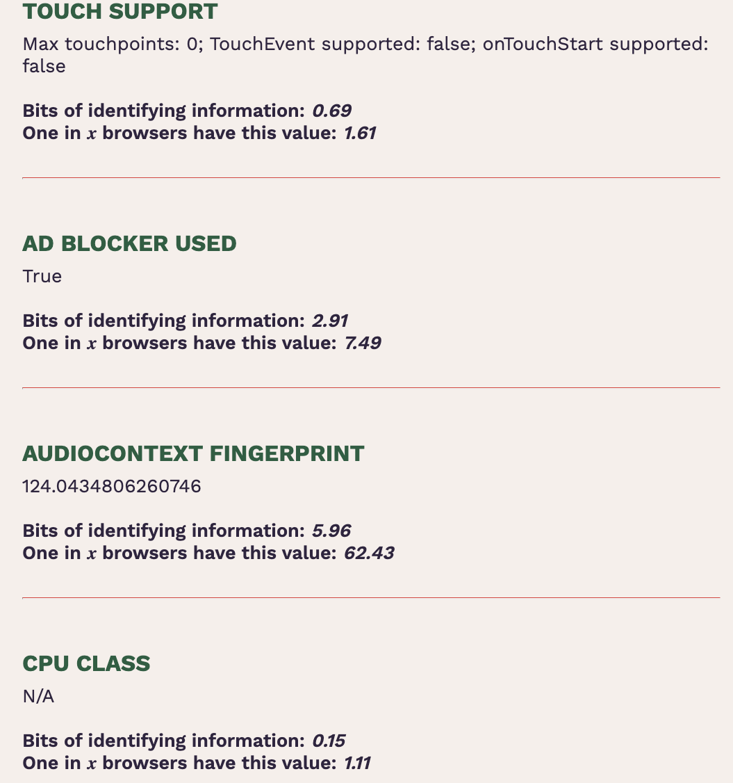
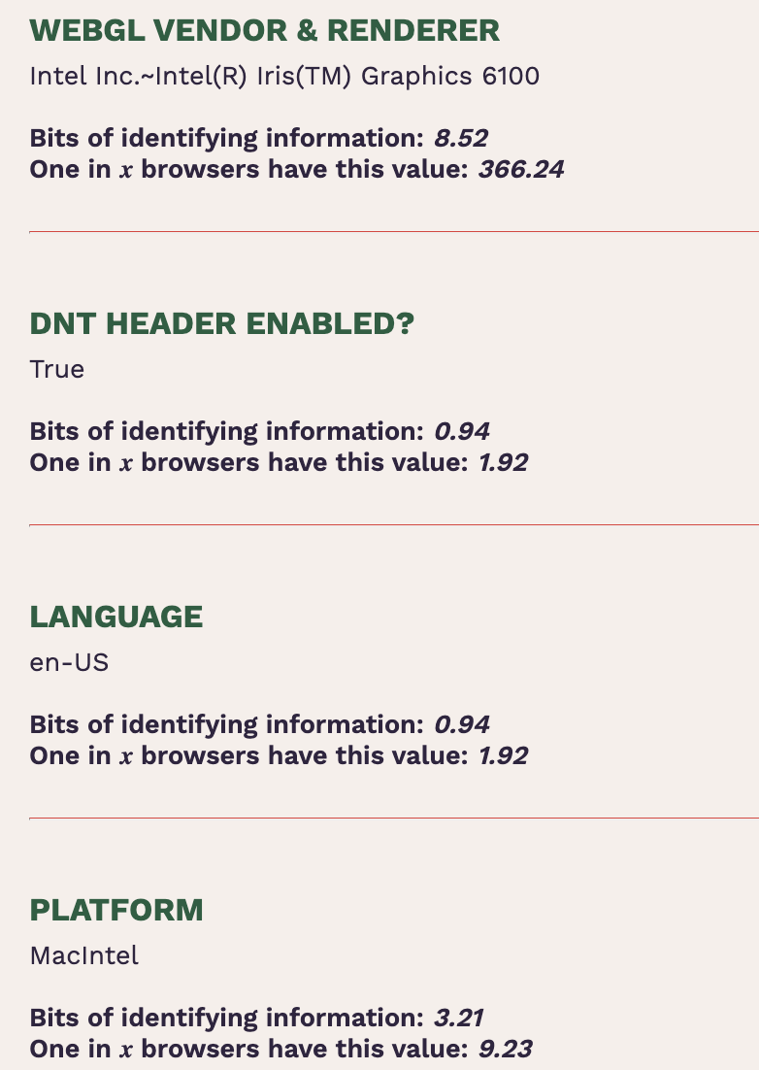
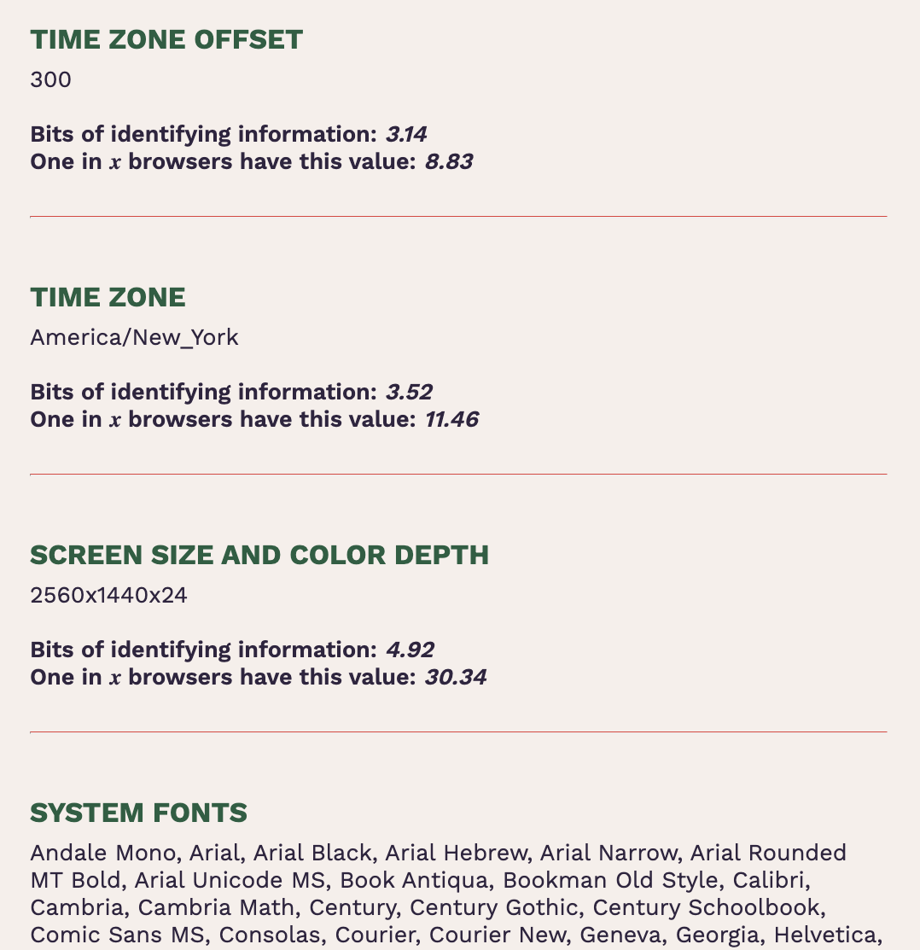
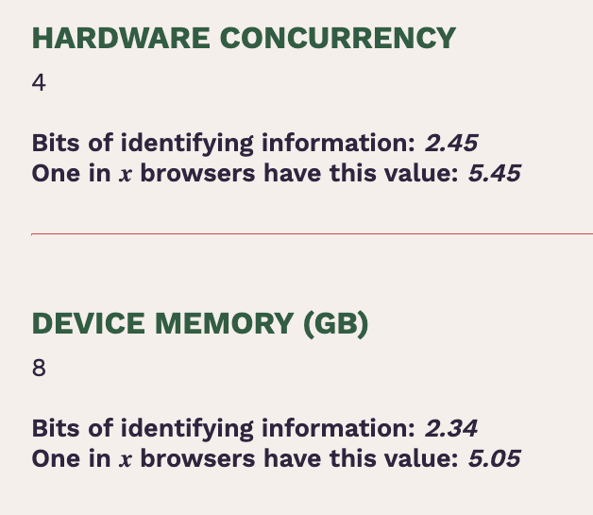

Slide 49
HTML <CANVAS> Element
Programmatic drawing in the browser
Draw shapes, add text, 3D (via WebGL)
Access to drawn pixels
Array of RGBA values
PNG-encoded data URL

Slide 50
Text Rendering
<script type="text/javascript">
var canvas =
document.getElementById("drawing");
var context = canvas.getContext("2d");
context.font = "18pt Arial";
context.textBaseline = "top";
context.fillText("Some letters", 2, 2);
</script>

Slide 51
Text Inspection
<script type="text/javascript">
var canvas =
document.getElementById("drawing");
var context = canvas.getContext("2d");
context.font = "18pt Arial";
context.textBaseline = "top";
context.fillText("Some letters", 2, 2);
var pixels =
canvas.toDataURL("image/png");
</script>

Slide 52
WebFonts
Problem: clients ship with ugly fonts
Solution: browsers should download fonts from the Internet on demand!
@font-face { font-family: 'Sirin Stencil'; font-style: normal; font-weight: 400; src: url(http://themes.googleusercontent.com/static/fonts/sirinstencil/v1/[...].woff) format('woff');}

Slide 53
45 Ways To Sirin Stencil
context.font = "12pt 'Sirin Stencil'";
Windows
OS X
Linux

Slide 54
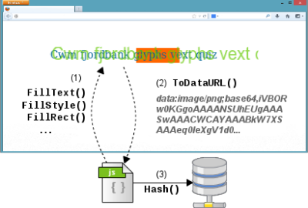
Canvas Fingerprinting
Mowery and Shacham. “Pixel Perfect” (W2SP 2012).
Reveals:
Operating system family
Browser family
(except Chrome, Safari on OS X)
Installed fonts
Font smoothing parameters

Slide 55
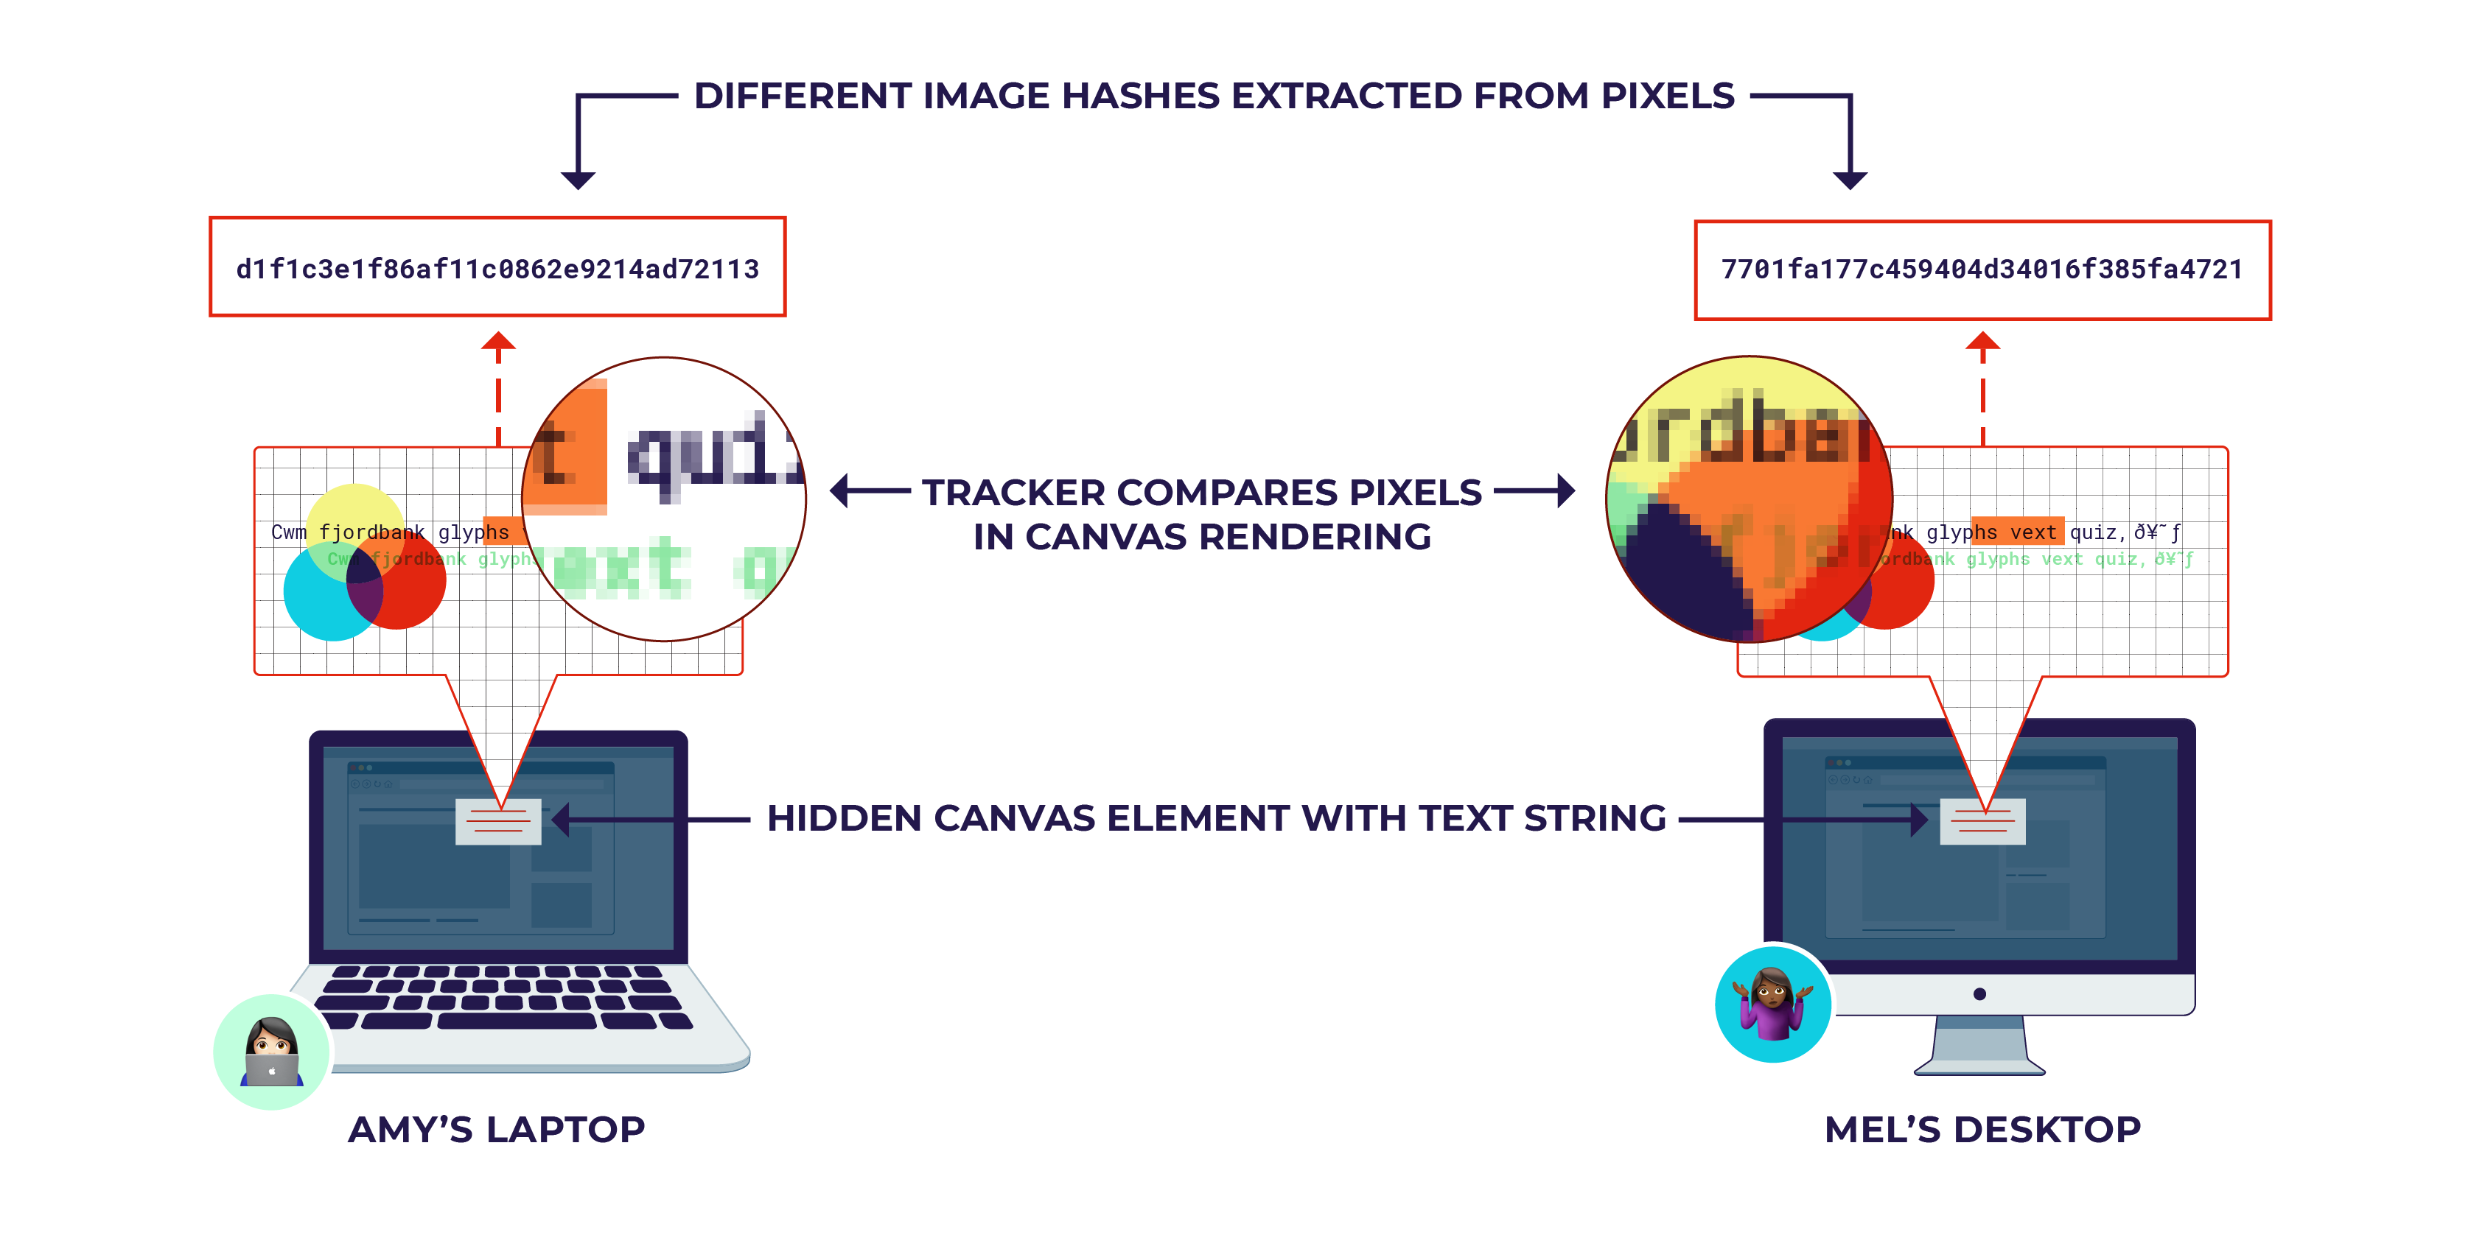
Canvas Fingerprinting
Source: Cyphers and Gebhart. “Behind the One-Way Mirror”

Slide 56
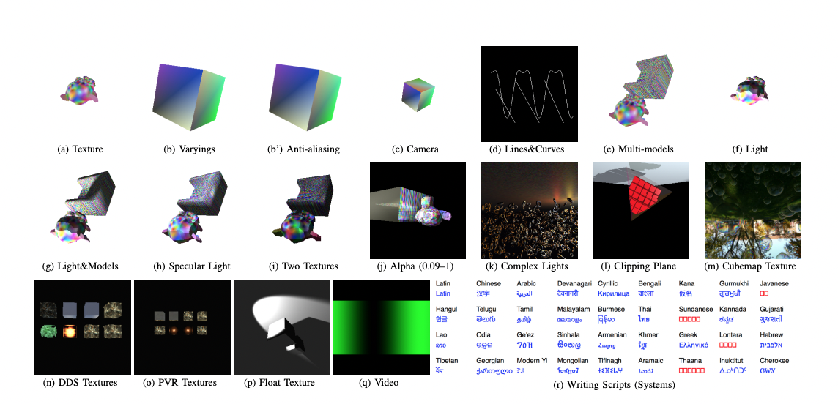
Cross-Browser Tracking with Rendering
How these are rendered depends on OS and hardware
Cao et al. “(Cross-)Browser Fingerprinting via OS and Hardware Level Features” (2017).

Slide 57
“Don’t Worry, It’s All Anonymous”
What’s the difference between
“anonymous”
“pseudonymous”
“identified”
Which technology changed data collection from anonymous to pseudonymous?

Slide 58
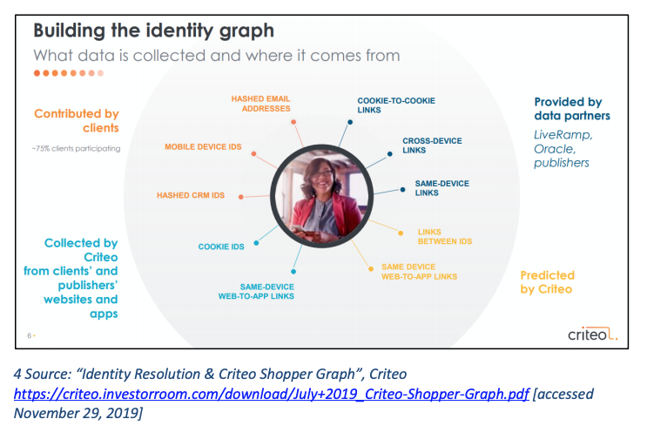
Key: robust identifiers!!

Slide 59
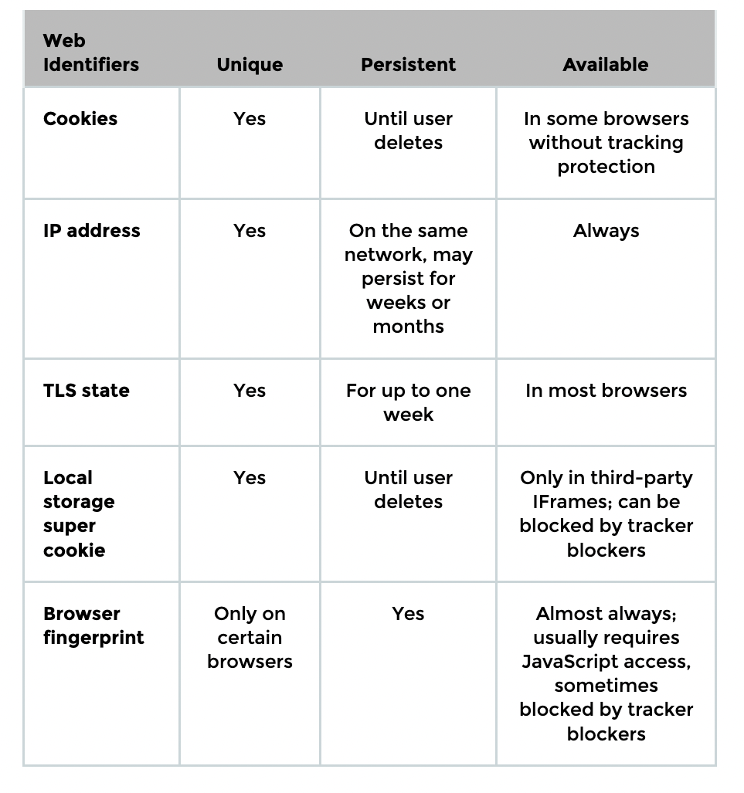


Identifiers
Unique
  Points only to you or your device
Persistent
  Does not change often
Available
  Easy for advertiser to access
Examples: name, email, phone number
Source: Cyphers and Gebhart. “Behind the One-Way Mirror”.

Slide 60
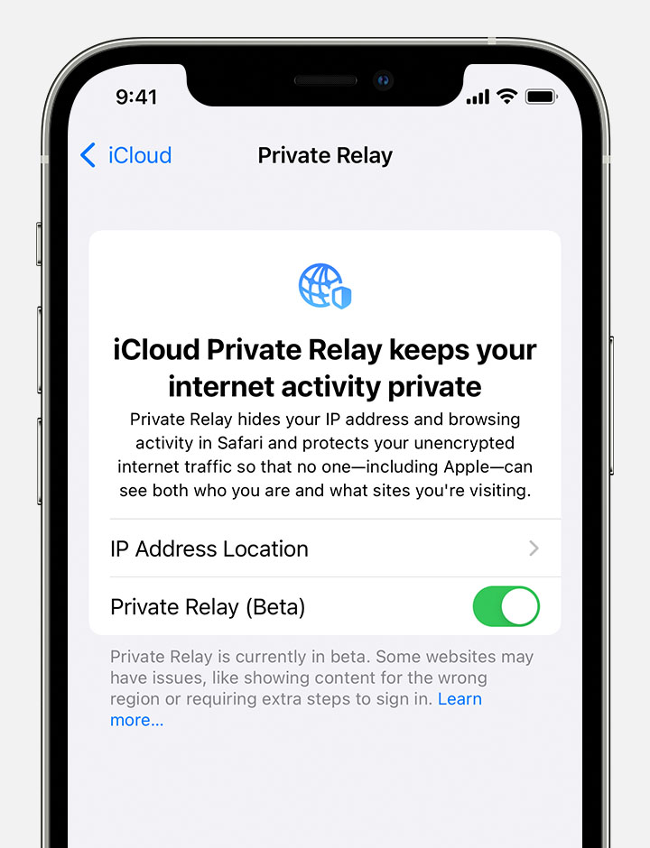
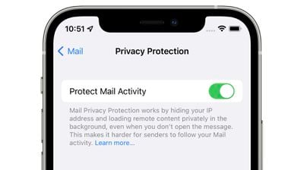
Hiding IP Addresses (Apple)
Safari will hide users’ IP addresses from websites
“Private relay” feature in iCloud+
  Redirects user’s Web traffic through multiple relays to hide IP address (similar to VPN)
Blocking tracking pixels in emails
  “Mail privacy protection” option in iOS and MacOS email clients hides IP address and loads all remote content privately in the background, via multiple relays

Slide 61
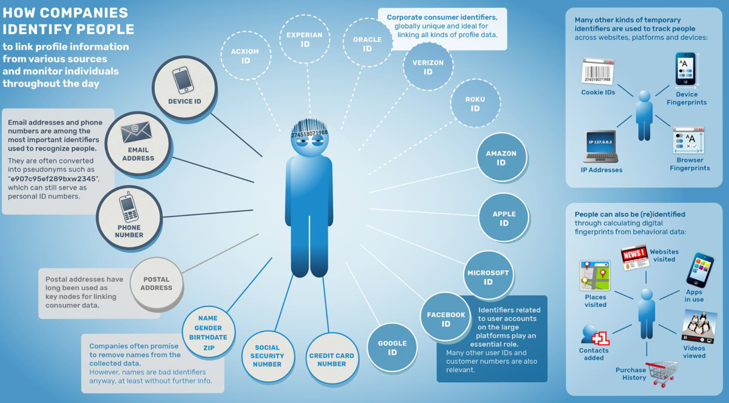
Source: Wolfie Christl. “Corporate Surveillance in Everyday Life”.

Slide 62
How Websites Get Your Identity
Third party is the first party
Leakage of identifiers
  GET http:/​/ad.doubleclick.net/adj/...
  Referer: http:/​/submit.SPORTS.com/...?email=jdoe@email.com
  Cookie: id=35c192bcfe0000b1...
Security bugs
  Example: XSUH (cross-site URL hijacking)
Third party buys your identity

Slide 63
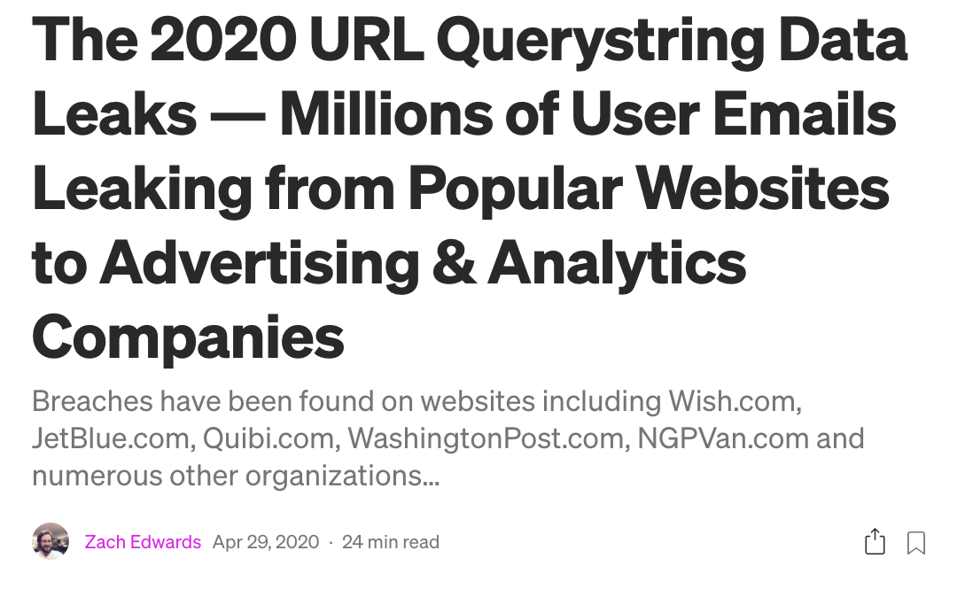
https://medium.com/@thezedwards/the-2020-url-querystring-data-leaks-millions-of-user-emails-leaking-from-popular-websites-to-39a09d2303d2

Slide 64
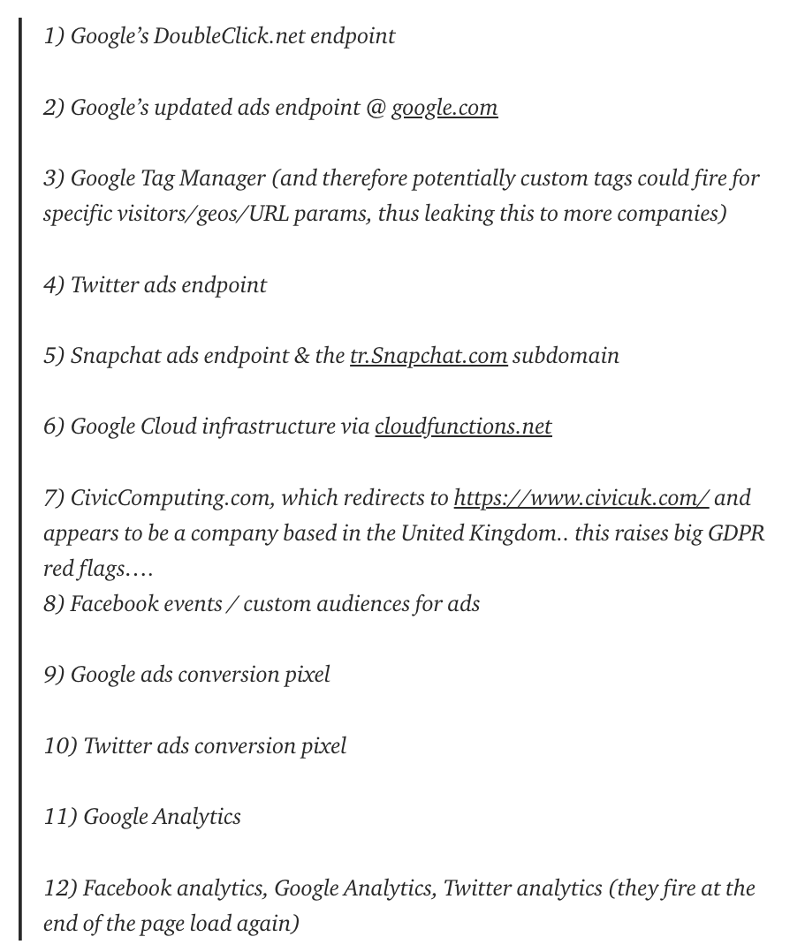

Leaked via “Referer” URL header to any advertising and analytics JavaScript included in the webpage!
New user email confirmation
Sign-up forms
Links in marketing emails
Unsubscribe requests
https://medium.com/@thezedwards/the-2020-url-querystring-data-leaks-millions-of-user-emails-leaking-from-popular-websites-to-39a09d2303d2

Slide 65
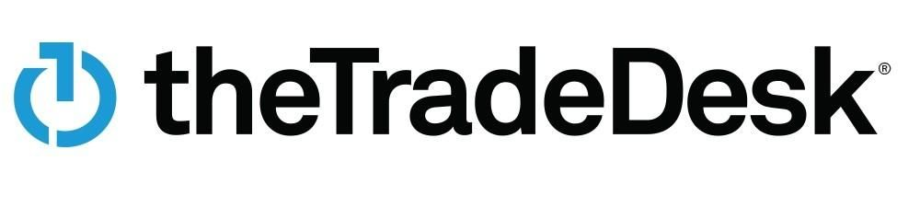


Largest independent platform for data-driven digital advertising
Profiles of 50+ million users
”Built from hashed and encrypted email addresses, this ID will remain open and ubiquitous while introducing significant upgrades to consumer privacy and transparency.”

Slide 66


Political affiliation
Religious belief
Sexual identity and activity
Race and ethnicity
Education level
Income bracket
Purchasing habits
Physical and mental health
Browsing history
App usage
Purchases
Geolocation data
...
Every click, impression, tap, and movement
BEHAVIORAL
PROFILE
Some of it wrong!
Linked by identifiers
Source: Cyphers and Gebhart. “Behind the One-Way Mirror”.

Slide 67

Source: Cyphers and Gebhart. “Behind the One-Way Mirror”.
retailers
financial technology companies
medical research companies
online advertisers
cellular providers
IoT device manufacturers
local governments
advertisers
real estate agents
market research companies
colleges
governments
private bounty hunters
other data brokers
DATA
BROKERS
https://www.fastcompany.com/90310803/here-are-the-data-brokers-quietly-buying-and-selling-your-personal-information

Slide 68

Source: Wolfie Christl. “Corporate Surveillance in Everyday Life”.

Slide 69

Example:
Financial Categories
(Experian)
https://www.experian.com/assets/marketing-services/product-sheets/audience-lookbook.pdf

Slide 70
Health-Related Categories
“Expectant Parent”
“Diabetes Interest”
“Smoker in Household”
“Buy Disability Insurance”
“Cholesterol Focus”
Mental-health diseases
Cancer
HIV/AIDS
Domestic violence victims
Rape sufferers
from 2014 FTC study
from 2013 World Privacy Forum report

Slide 71

Do Not Track
Privacy protections
HTTP header (DNT: 1)
Standardization
Browser support
Very little adoption by websites ☹
No third-party tracking across sites
  … but who is the “third” party?
No intrusive tracking
Limits on regular log data
Exceptions for fraud prevention, etc.
Can’t be based on domain
Example: amazonaws.com, ad.hi5.com …

Slide 72





?
Browser extension that lets users signal their privacy preferences to websites

Slide 73


Third-party cookies still work but cannot be shared across sites

Slide 74

What Is the Real Privacy Problem?
Third-party tracking?
or
Behavioral advertising?

Slide 75





In a World Without Third-Party Tracking…
Do they have more power or less?
How do online advertisers find users who might be interested in their products?
Search queries
Locations
Contacts

Slide 76



Companies’ Response:
Amass First-Party Data
Loyalty programs, sweepstakes, quizzes, newsletters, polls, QR codes…
Goal: golden record of all interactions with the customer
  Hundreds of data points: visited store locations, items bought, spending, all interactions on website, demographic info
Google will let marketers use their own customer data to target individuals
For a chance to win this truck, scan QR code (revealing device ID), enter name, birthday, email, phone number
https://www.wsj.com/articles/big-tech-privacy-moves-spur-companies-to-amass-customer-data-11638456544

Slide 77



Opens an app or website that collects personal information
Links offline and online activities, ties them to customer phone number and credit cards
Provides upsell opportunities

Slide 78


Giving Users Control?
“… people who experienced a miscarriage and don’t want to see campaigns for baby clothes, people recovering from eating disorders who don’t want to see pitches for diets, and teetotalers who don’t want to see alcohol ads”
Why do companies enable users to opt out of certain categories?
Because it increases the rates they charge to advertisers (why?)
https://www.wsj.com/articles/tech-companies-are-relinquishing-some-control-of-online-ads-to-users-11660730402

