Slide 1

Location “PRIVACY”

Slide 2

Location is identity
“You are where you are”
A location trace is not only a set of positions on the map. The contextual information attached to a trace tells much about our habits, interests, activities, and relationships.

Slide 3

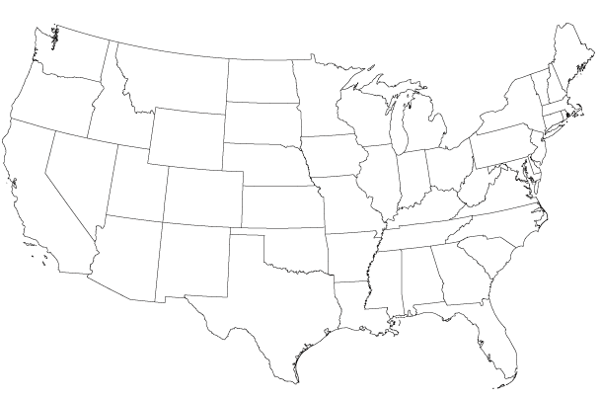

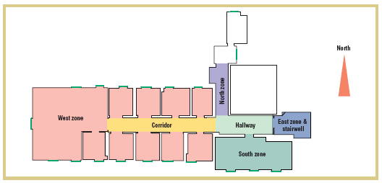
Uniqueness of locations
All anonymized employees in an office identified based on their most visited location
  Beresford and Stajano. “Location privacy in pervasive computing” (2003).
Home and work locations are pretty unique even at a coarse-grained location scale
  Golle and Partridge. “On the anonymity of home/work location pairs” (2009).

Slide 4

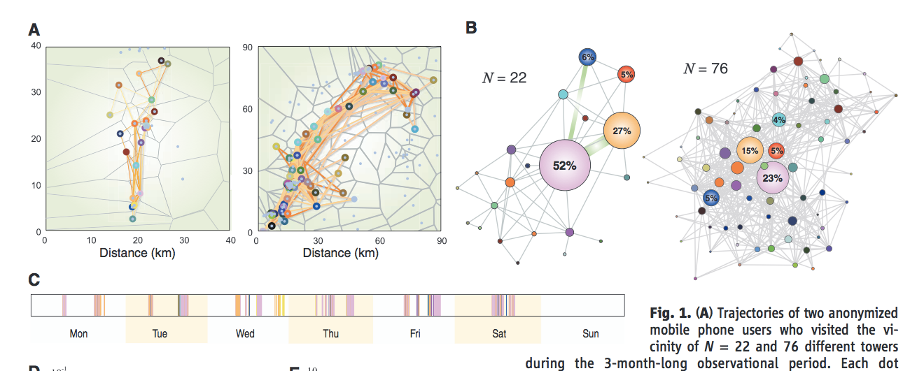
Predictability of human mobility
Humans follow simple, predictable location patterns
Predictability is invariant to the traveled distance
  Song et al. “Limits of predictability in human mobility” (2010).

Slide 5


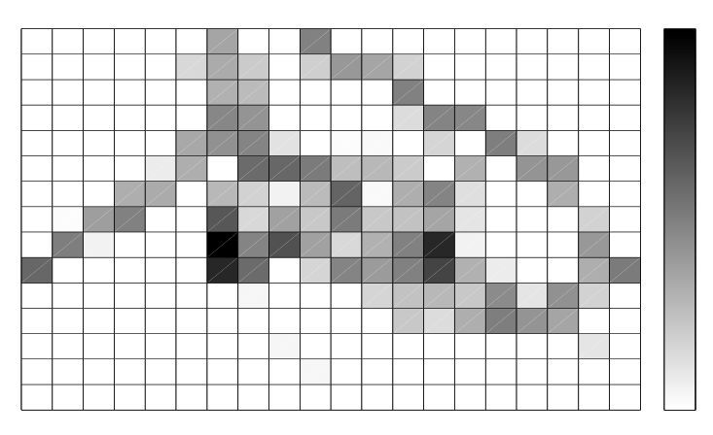
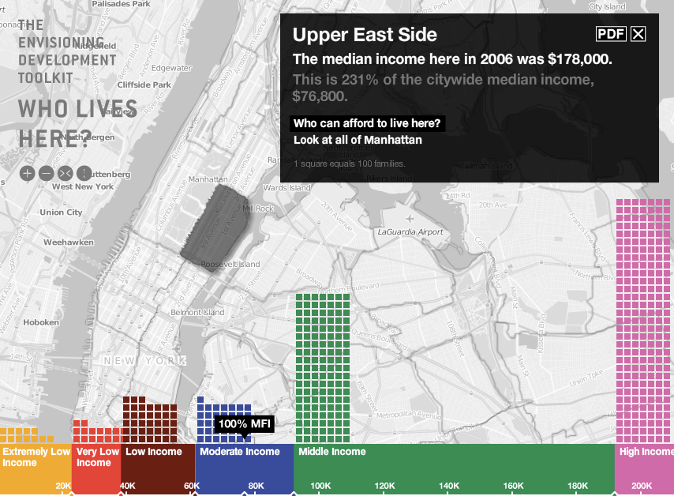
Location profiling
Given the significant predictability of human mobility, an adversary can construct a mobility profile of the target that helps him to re-identify or track the target in the future
Location profiles reveal information about income, ethnicity, religion…

Slide 6
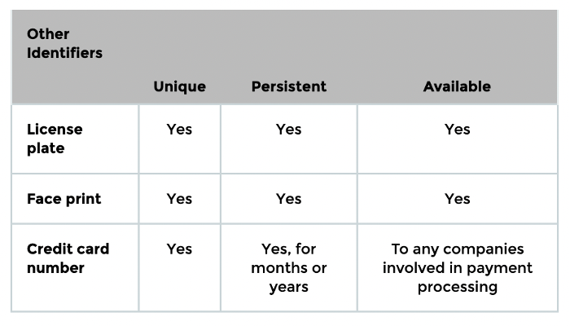
Identifiers
Unique
  Points only to you or your device
Persistent
  Does not change often
Available
  Easy for advertiser to access
Examples: name, email, phone number
Source: Cyphers and Gebhart. “Behind the One-Way Mirror”.

Slide 7
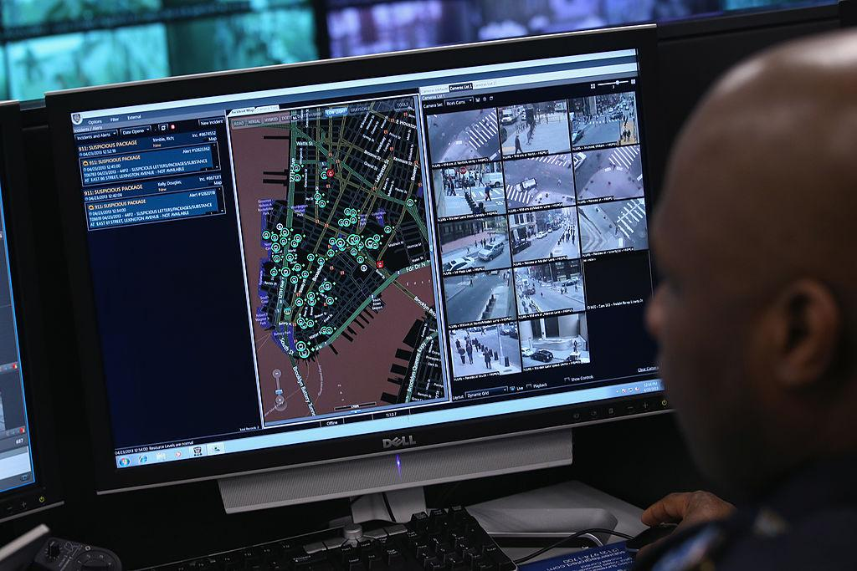
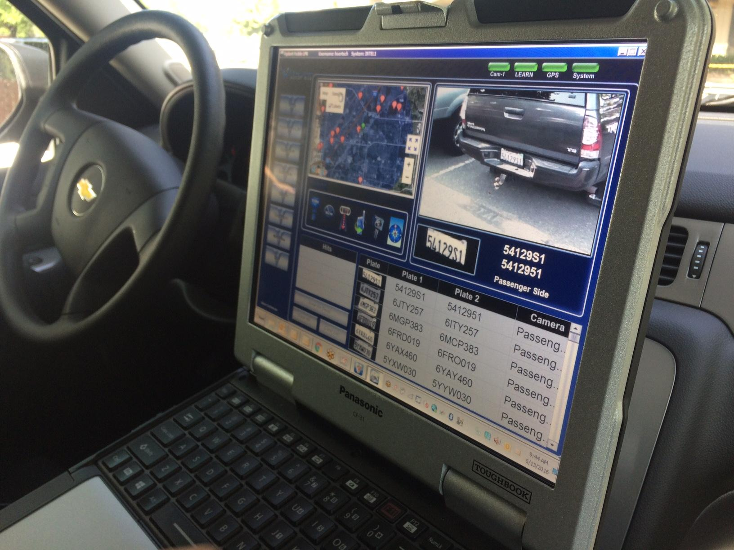
Automated license plate tracking
2016 statistics:
Used by 71% of police forces in the U.S.
One of the providers (Vigilant Solutions) holds a database of 2.8 billion plate scans, growing 70 million a month
180 scans per minute
https://www.ibtimes.com/police-are-tracking-your-car-technology-even-if-youve-done-nothing-wrong-2373069

Slide 8


Law enforcement uses of Vigilant data
More about Ring and surveillance later
Hartford, CT:
Police used the company’s database to track the movements of a dented green Mitsubishi that showed up on an Amazon Ring surveillance doorbell video as the potential vehicle of a suspect. The Vigilant database turned up multiple scans of the Mitsubishi parked at a nearby Hartford home, allowing police to place a GPS tracking device on the car.
A suspect was later charged with the theft in late 2019 of more than $1,200 of goods from numerous homes.
Requires a warrant… more about the 4th Amendment later
https://www.wsj.com/articles/license-plate-scans-aid-crime-solving-but-spur-little-privacy-debate-11615384816

Slide 9
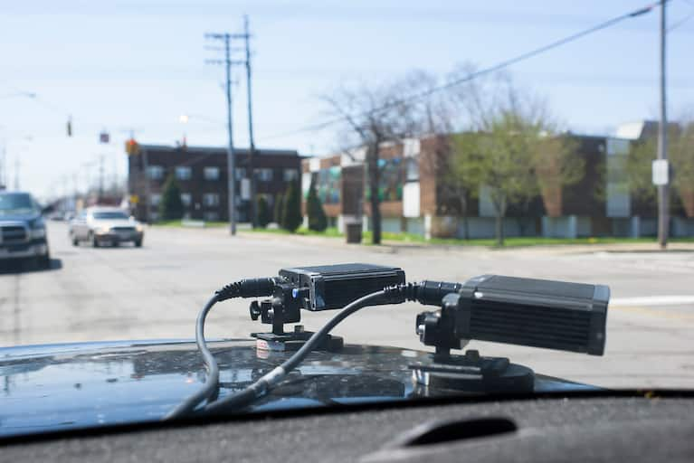
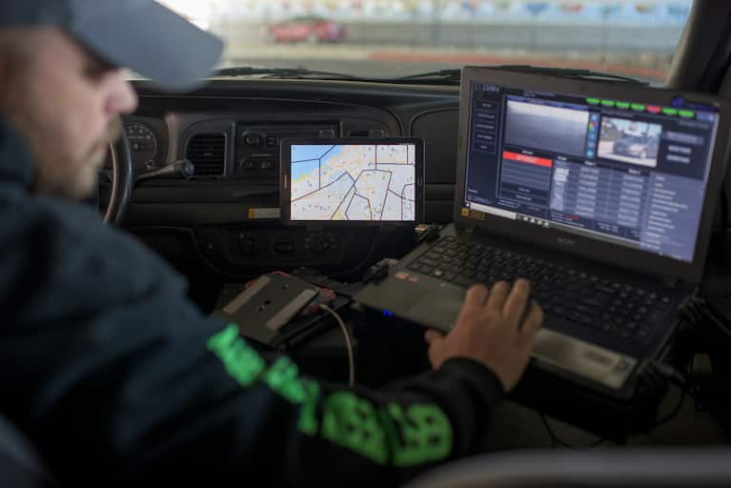
Repo men, too
Relentless [a repo company in Ohio] scanned 28 million license plates in 2017
The company’s goal is to capture every plate in Ohio and use that information to reveal patterns. A plate shot outside an apartment at 5 a.m. tells you that’s probably where the driver spends the night, no matter their listed home address.
https://www.washingtonpost.com/business/economy/the-surprising-return-of-the-repo-man/2018/05/15/26fcd30e-4d5a-11e8-af46-b1d6dc0d9bfe_story.html

Slide 10
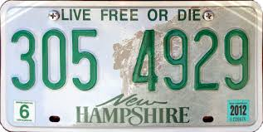
Regulation of license plate scanning
Largely unregulated, access supposedly limited to law enforcement
LAPD in response to EFF/ACLU suits: “all license plate data is investigatory”
16 states have statutes explicitly addressing privacy and retention of automatically scanned license plate data, many different retention policies (60 days, 2 years …)
Repo agents are responsible for the majority of the billions of license plate scans produced nationwide. But they don’t control the information. Most of that data is owned by Digital Recognition Network (DRN), a Fort Worth company that is the largest provider of license-plate-recognition systems. And DRN sells the information to insurance companies, private investigators — even other repo agents.
DRN is a sister company to Vigilant Solutions, which provides the plate scans to law enforcement, including police and U.S. Immigration and Customs Enforcement..
https://www.ibtimes.com/police-are-tracking-your-car-technology-even-if-youve-done-nothing-wrong-2373069
https://www.washingtonpost.com/business/economy/the-surprising-return-of-the-repo-man/2018/05/15/26fcd30e-4d5a-11e8-af46-b1d6dc0d9bfe_story.html

Slide 11
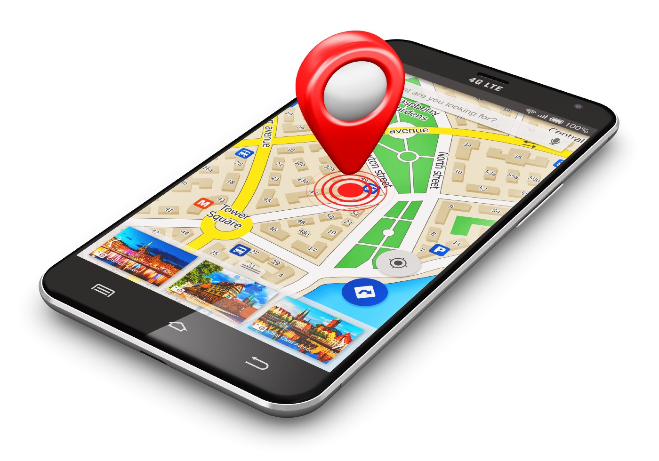
Image: https://medium.com/wolfmatrix/gps-tracking-in-android-and-here-sdk-for-android-950596452835

Slide 12
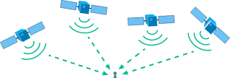
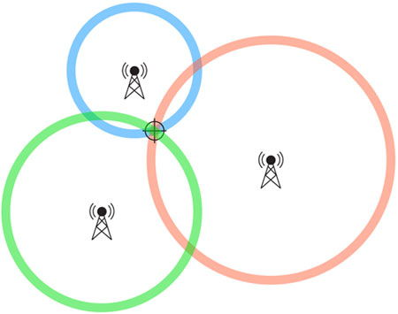
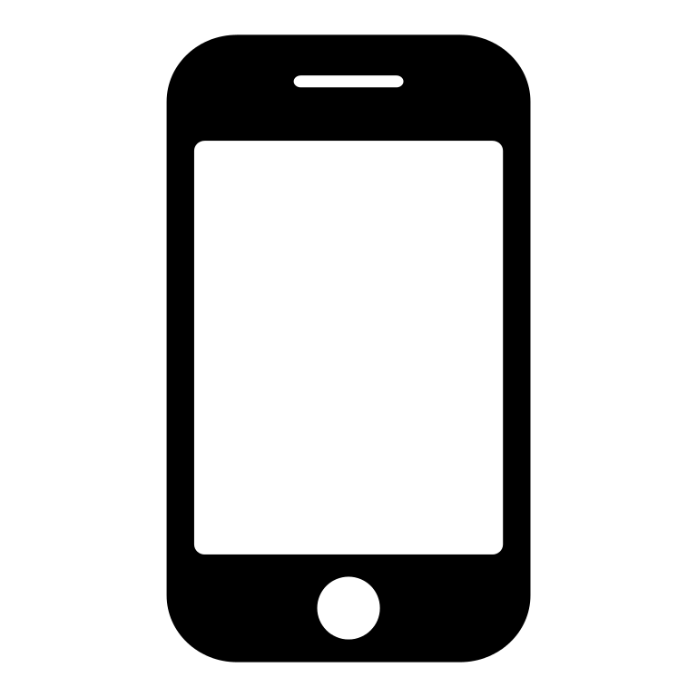
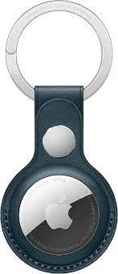
Geolocation
UWB
accuracy: 1 square inch
GPS
accuracy: 16 square feet
Cell towers
accuracy: ¾ square mile

Slide 13

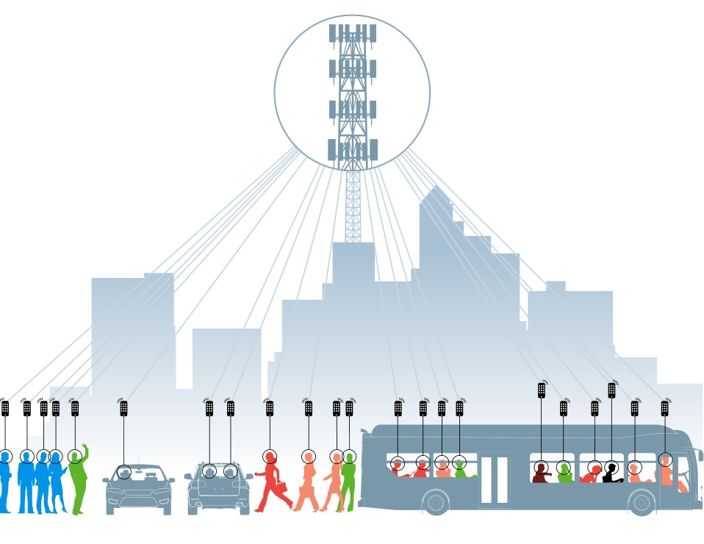
NSA collects 5 billion location records a day on cellphones
Co-Traveler Program
Source: Washington Post

Slide 14
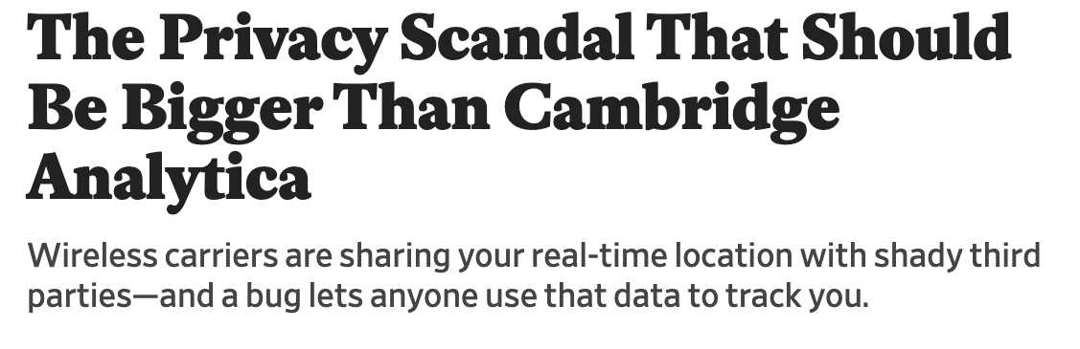
Four largest US wireless carriers share location-tracking data with third parties, including a ”location aggregator” called LocationSmart
LocationSmart shares with 3CInteractive, a mobile marketer
3CInteractive shares with Securus, a prison phone provider
As long as they are following their own privacy policies, carriers “are largely free to do what they want with the information they obtain, including location information, as long as it’s unrelated to a phone call,” said Albert Gidari, the consulting director of privacy at the Stanford Center for Internet and Society and a former technology and telecommunications lawyer. Even when the phone is not making a call, the system receives location data, accurate within a few hundred feet, by communicating with the device and asking it which cellphone towers it is near.
https://www.nytimes.com/2018/05/10/technology/cellphone-tracking-law-enforcement.html
https://slate.com/technology/2018/05/the-locationsmart-scandal-is-bigger-than-cambridge-analytica-heres-why-no-one-is-talking-about-it.html

Slide 15
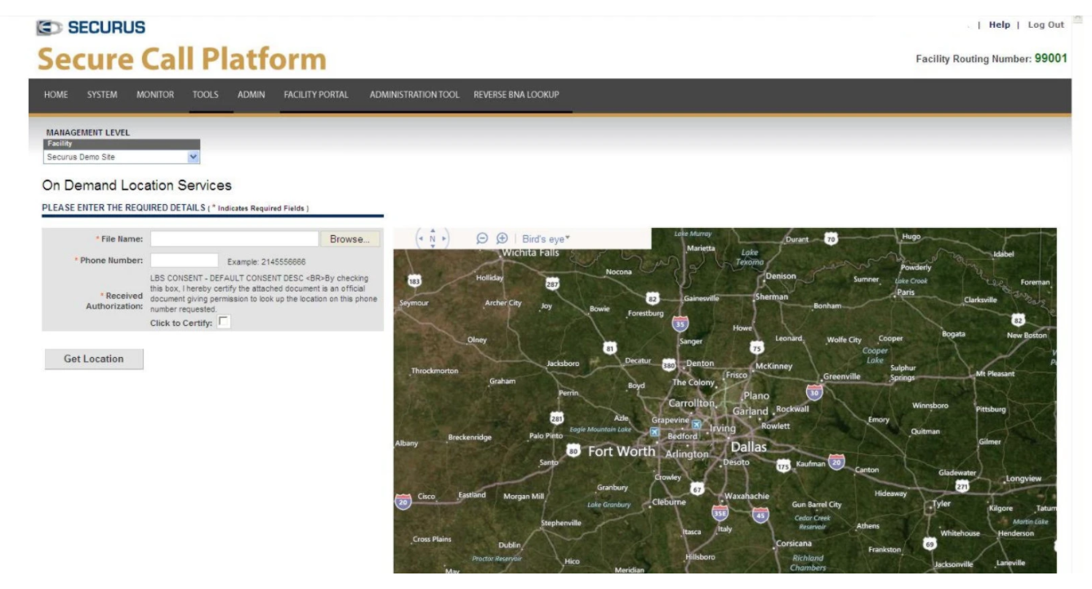
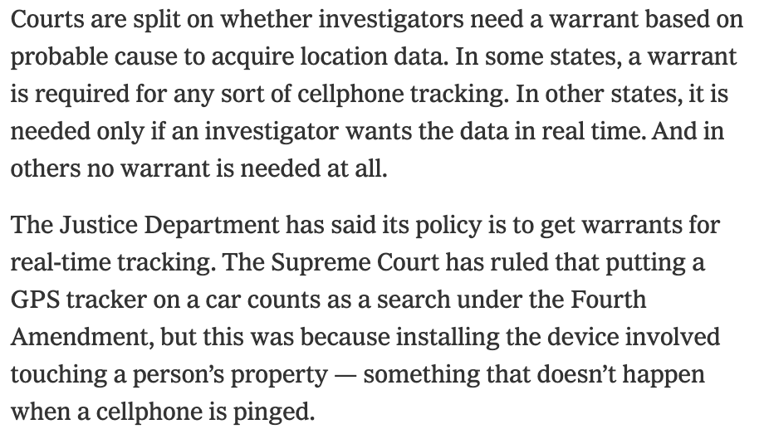
Real-time cellphone locator for law enforcement and corrections officials
Requires users to upload a warrant or affidavit but does not “conduct any review of surveillance requests”
Abused by a Missouri sheriff to keep tabs on 11 people, including fellow officers and a judge
Hacked, credentials of 2800 authorized users stolen
https://www.nytimes.com/2018/05/10/technology/cellphone-tracking-law-enforcement.html

Slide 16
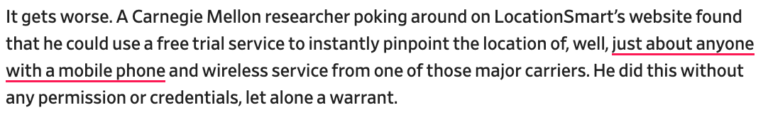
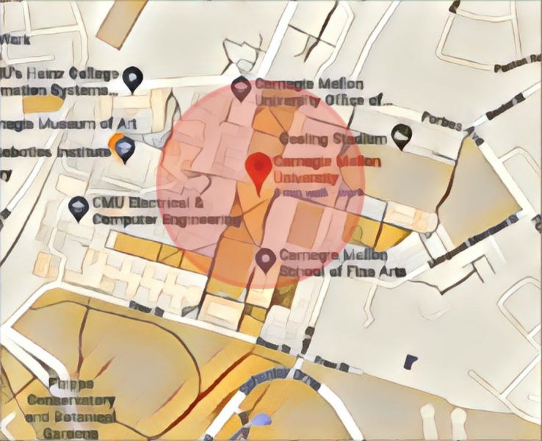
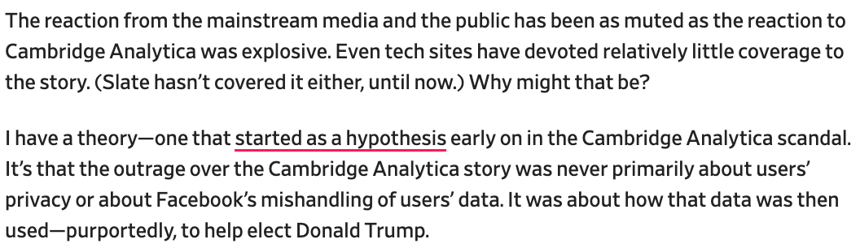
https://slate.com/technology/2018/05/the-locationsmart-scandal-is-bigger-than-cambridge-analytica-heres-why-no-one-is-talking-about-it.html

Slide 17
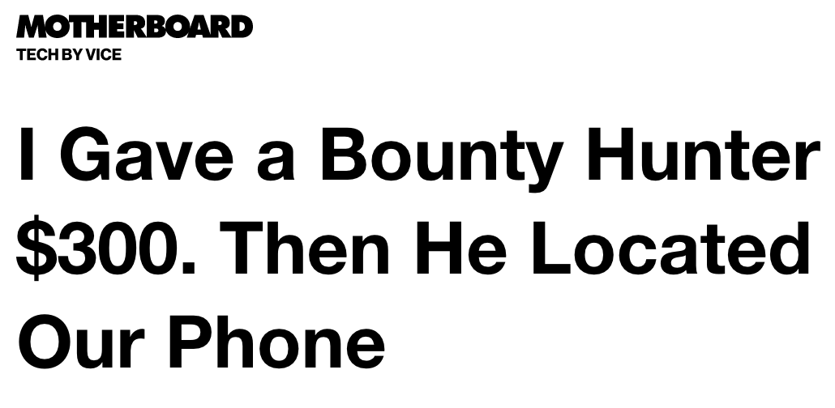
https://www.vice.com/en/article/nepxbz/i-gave-a-bounty-hunter-300-dollars-located-phone-microbilt-zumigo-tmobile

Slide 18
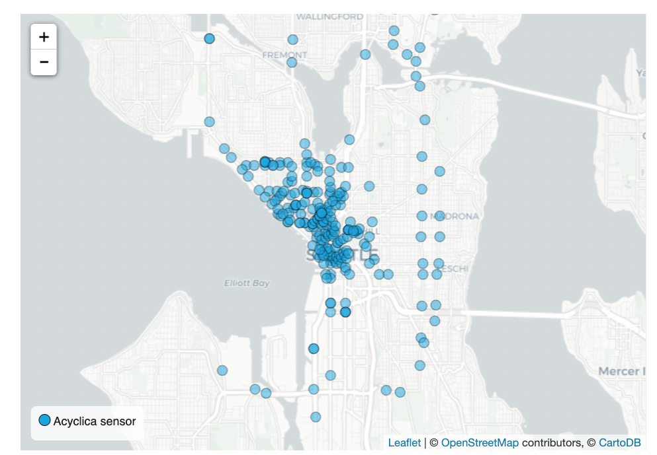
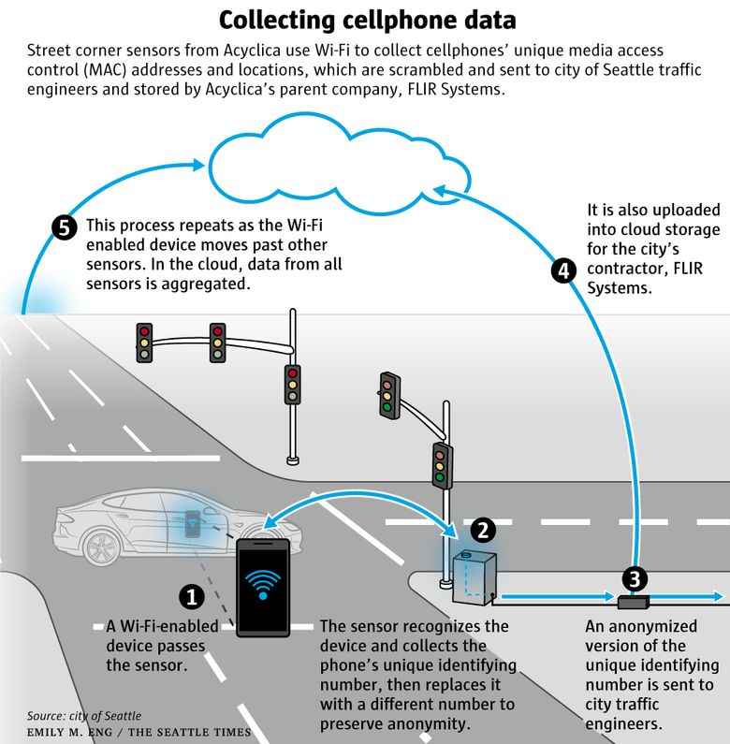

Seattle, LA, Denver contracted a company called Acyclica to collect traffic data
https://www.seattletimes.com/seattle-news/times-watchdog/seattles-surveillance-contractor-has-history-of-illegal-sales-bribery-worrying-privacy-advocates/

Slide 19

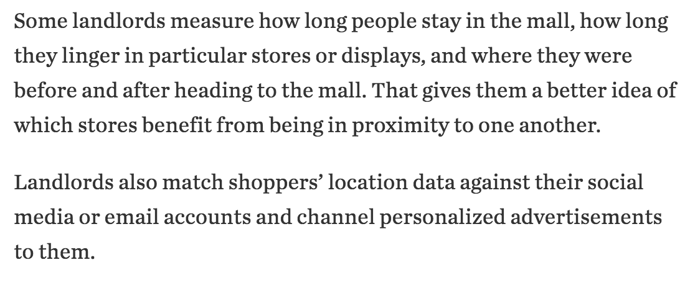
https://www.wsj.com/articles/shopping-malls-are-tracking-your-every-move-1489483800

Slide 20

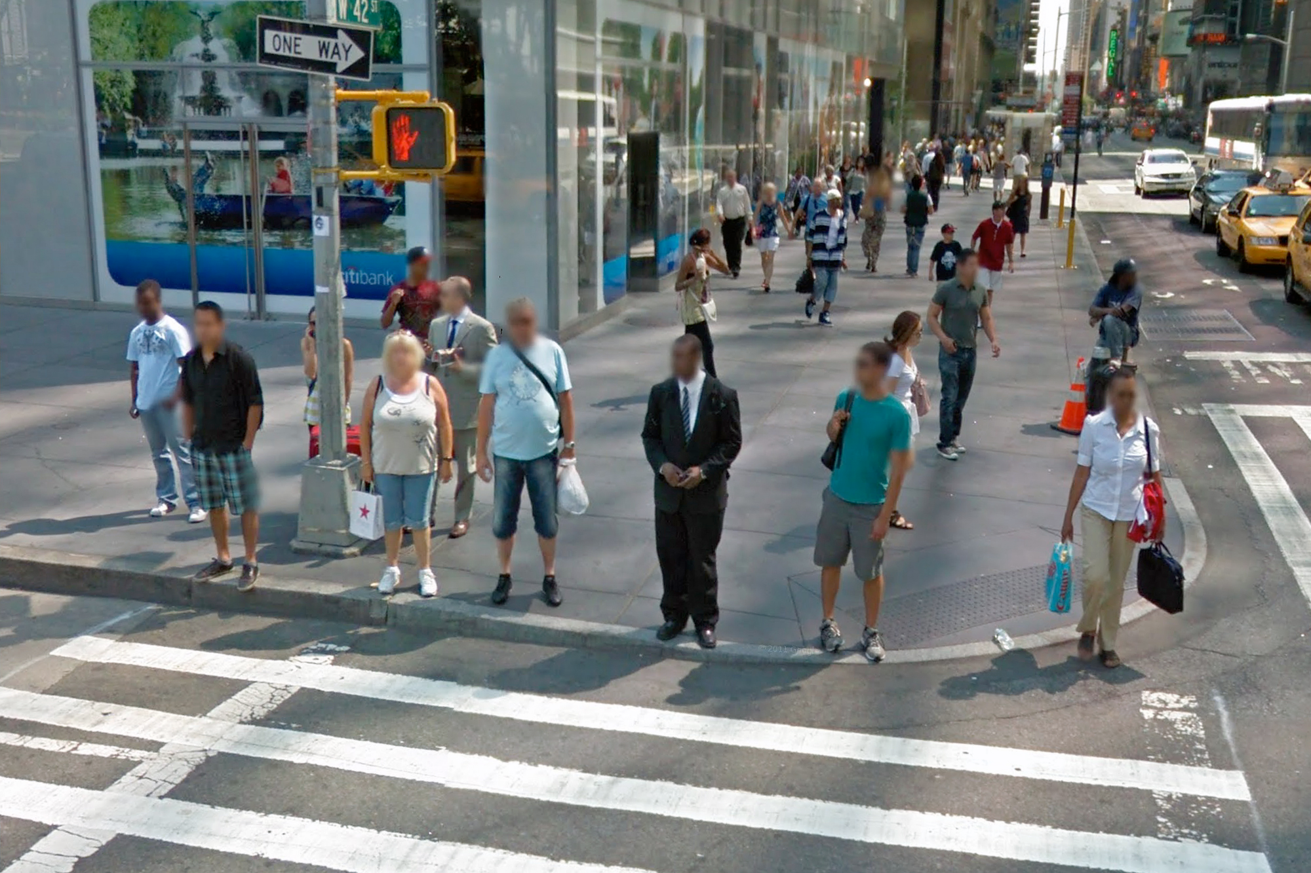


Disclosed by others
Appear in others’ photos
“Checked-in” to a location by friends

Slide 21

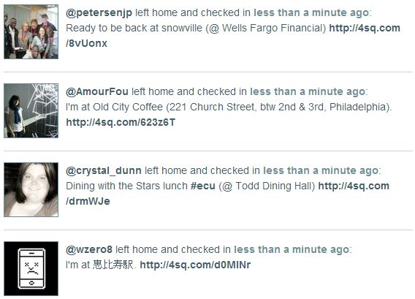
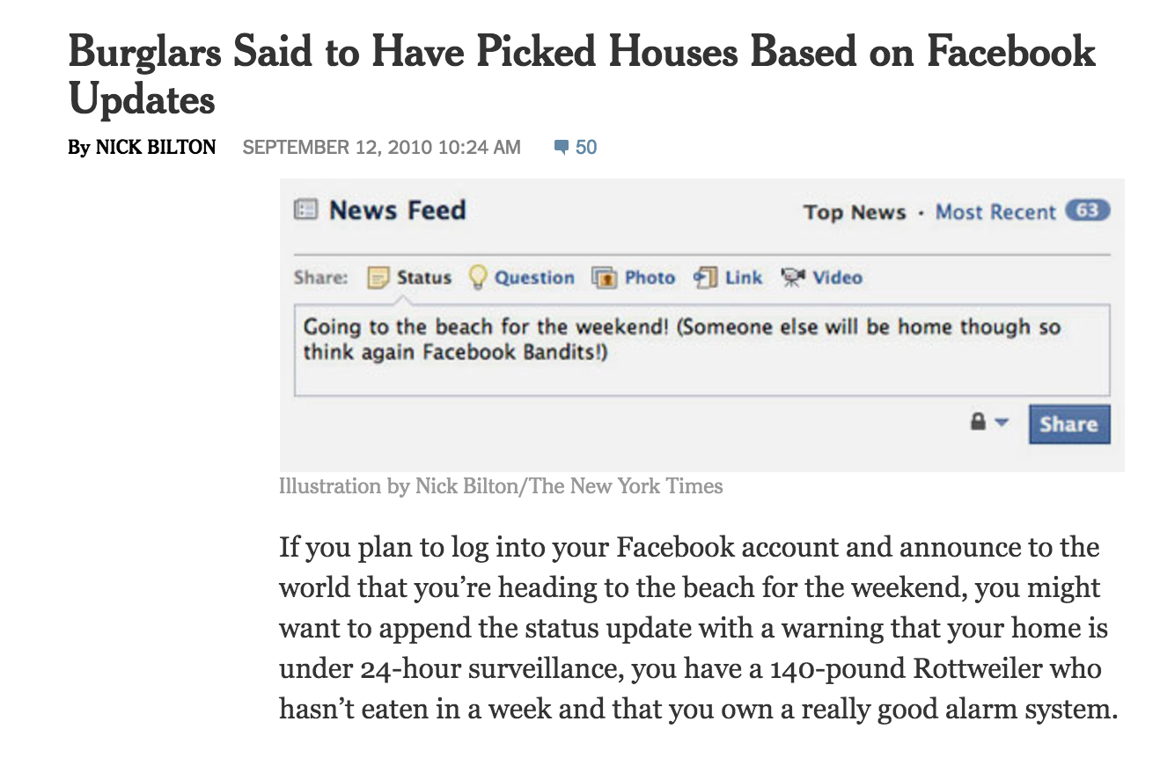
Absence disclosure

Slide 22
Geolocation
UWB
accuracy: 1 square inch
GPS
accuracy: 16 square feet
Cell towers
accuracy: ¾ square mile

Slide 23
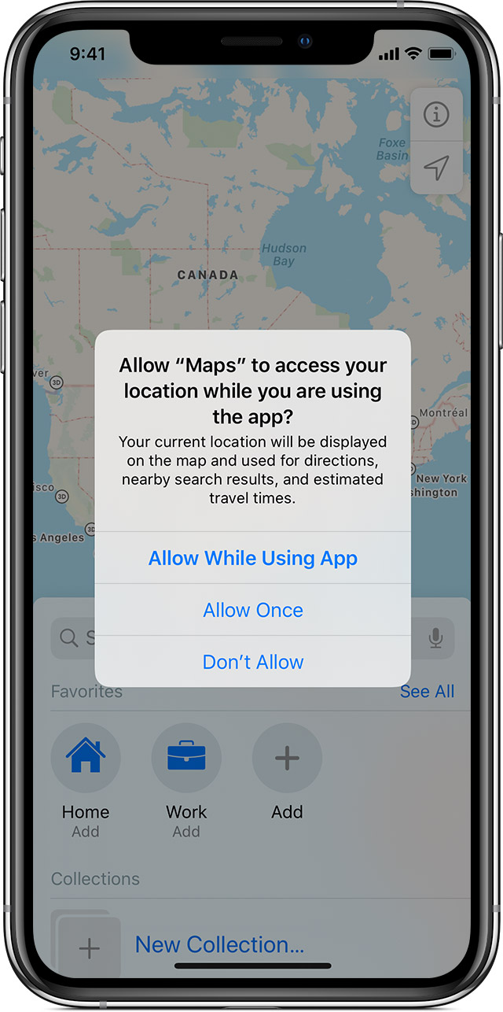
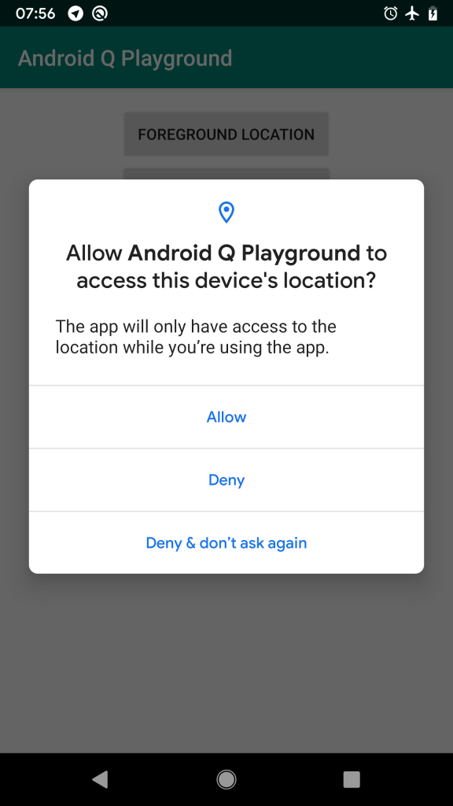

Slide 24

At least 75 companies receive anonymous, precise location data from apps whose users enable location services to get local news and weather or other information... Several of those businesses claim to track up to 200 million mobile devices in the United States — about half those in use last year. The database reviewed by The Times — a sample of information gathered in 2017 and held by one company — reveals people’s travels in startling detail, accurate to within a few yards and in some cases updated more than 14,000 times a day.
https://www.nytimes.com/interactive/2018/12/10/business/location-data-privacy-apps.html

Slide 25
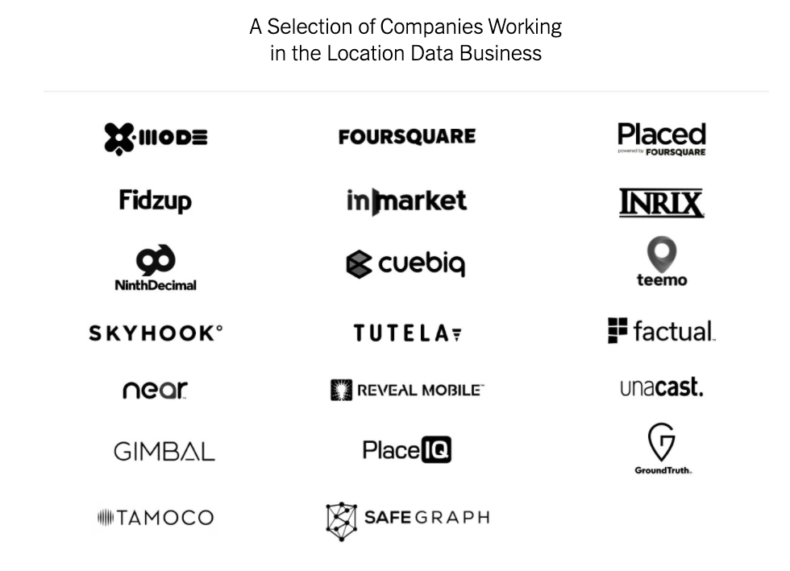
https://www.nytimes.com/interactive/2019/12/19/opinion/location-tracking-cell-phone.html

Slide 26
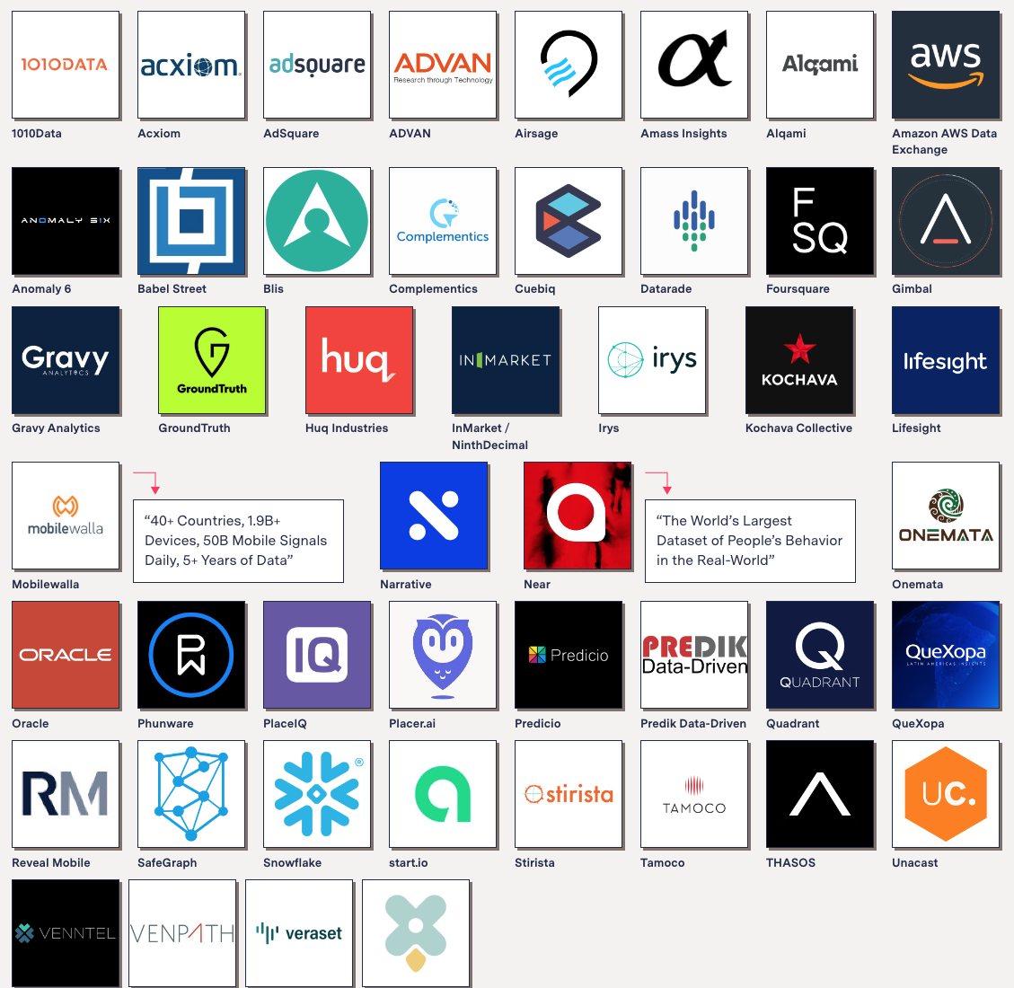
$12 billion market for location data
Massive datasets:
“1.6B people across 44 countries”
“40+ countries”
“50B mobile signals daily”
“25%+ of the adult U.S. population”
Complex ecosystems of app SDKs, brokers, online marketplaces, analytics vendors
Many firms promise that privacy is at the center of their businesses and that they’re careful to never sell information that can be traced back to a person
Investigation by The Markup
https://themarkup.org/privacy/2021/09/30/theres-a-multibillion-dollar-market-for-your-phones-location-data

Slide 27
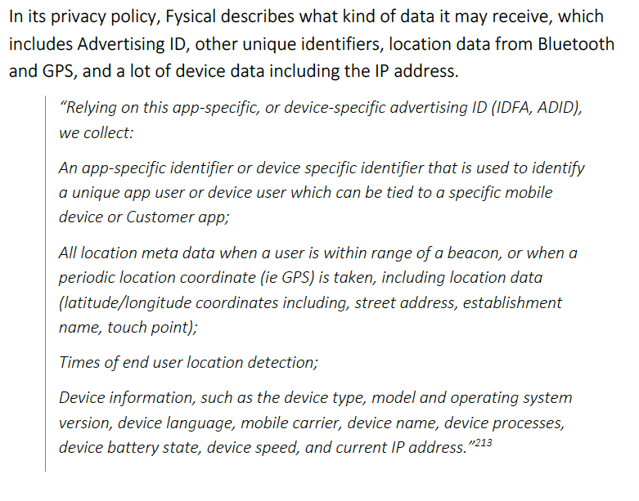
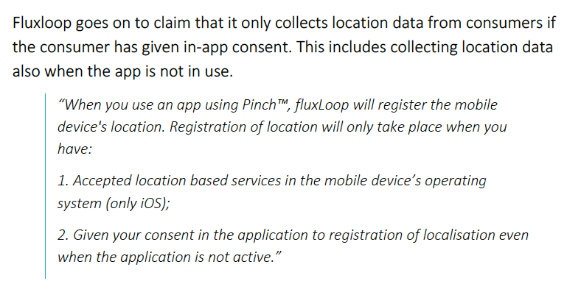
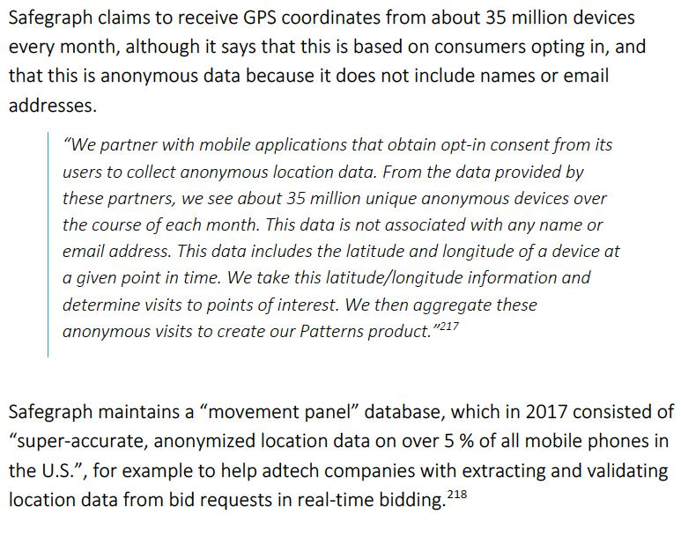
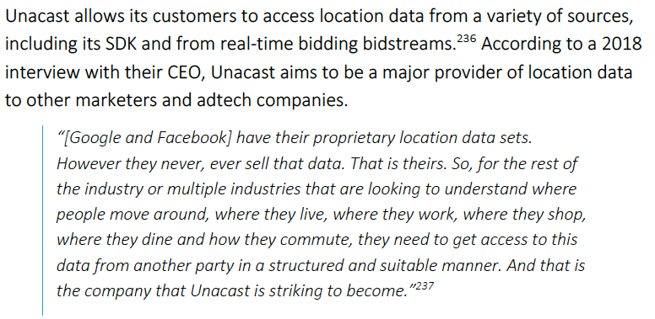
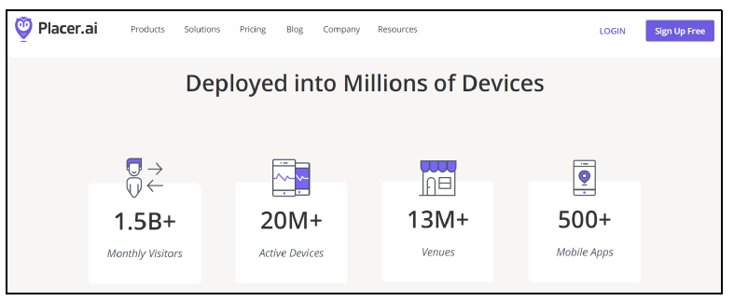
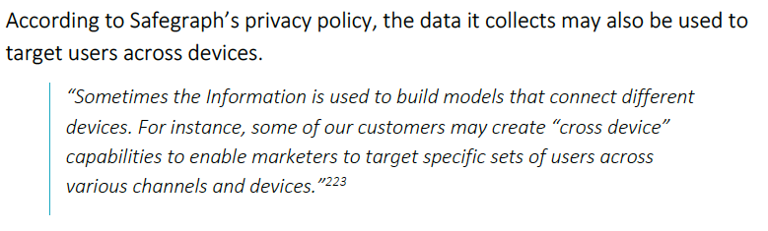




https://fil.forbrukerradet.no/wp-content/uploads/2020/01/2020-01-14-out-of-control-final-version.pdf

Slide 28


“This data is not associated with any name or email address.” -- Safegraph
“… may use de-identified personal data … to target a specific audience” -- Fluxloop
“The data provided by our Partners and the data collected by means of the SDK does not include data that directly identifies you, such as your name, mobile phone number, or your email address” -- Unacast
“Generally, the information we collect is not information that identifies you personally… Placer’s technology collects data, such as geolocation data, which is scrubbed of any personally identifiable information to protect the privacy of Consumers” -- Placer
https://fil.forbrukerradet.no/wp-content/uploads/2020/01/2020-01-14-out-of-control-final-version.pdf

Slide 29

The technical testing showed location data being transmitted to several third party companies that can be classified as location data brokers. These companies use detailed geolocation derived from GPS coordinates and other sources to create profiles, audience segments, or aggregated data sets, which they can sell or otherwise share with or give access to other companies. They may collect very detailed movement histories of individual consumers, including data on hospital stays, visits to mental health professionals, and pub visits, often without the consumer being aware that this is happening
Information about where and how we move can reveal a lot about us. Most of us are easily identified just from where we live and where we go to work. Other movement data can reveal our religious affinity (‘visits a synagogue weekly’), sexuality (‘frequents gay bars’) or political views (‘attends climate strikes’). Studies have demonstrated that just four approximate location data points is sufficient to identify individuals in 95% of cases.
https://fil.forbrukerradet.no/wp-content/uploads/2020/01/2020-01-14-out-of-control-final-version.pdf

Slide 30
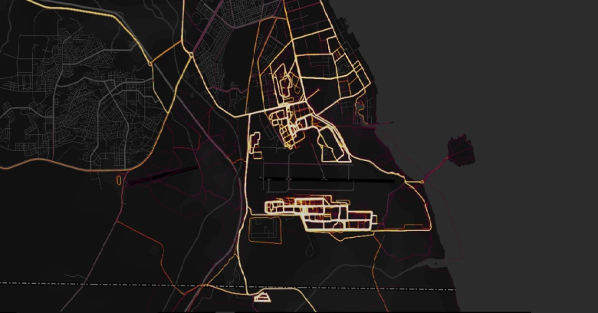
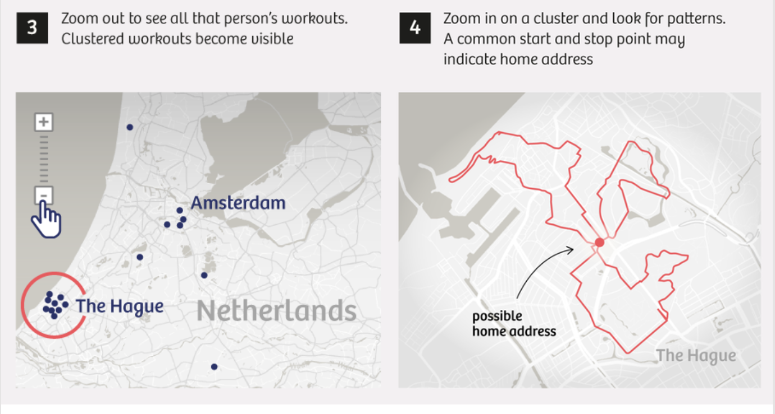
Some location-collecting apps publish aggregate statistics
    Example: “heat maps” of user’s fitness activities
… reveal locations of secret military objects, home addresses of military and intelligence officers
Strava ”heat maps”
Publicly shared user profiles in Polar
https://slate.com/technology/2018/07/fitness-tracking-apps-strava-polar-privacy-flaws-show-the-cost-of-sharing-activity-data.html

Slide 31

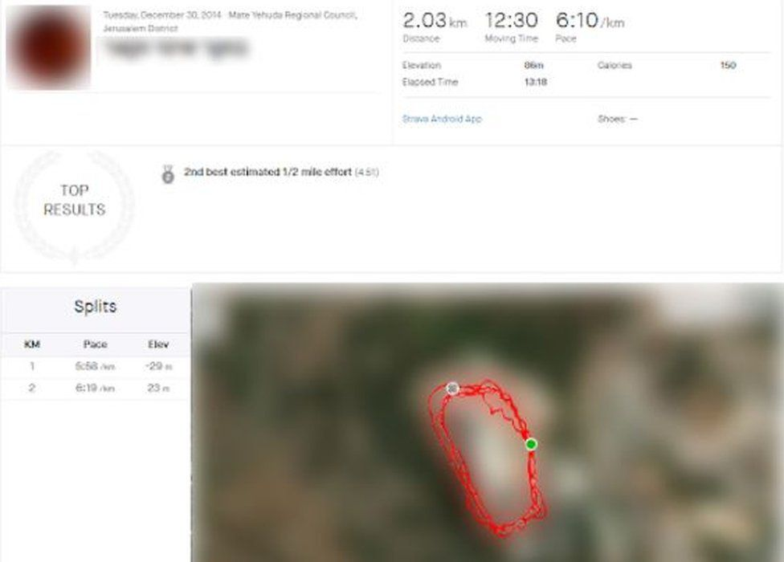
User uploaded fake GPS data with running “segments” in the vicinity of Israeli military facilities
App revealed photos, home addresses, identities of family members of users who ran similar segments
… even if they had their accounts set to “private”
100 individuals compromised
https://www.bbc.com/news/world-middle-east-61879383

Slide 32
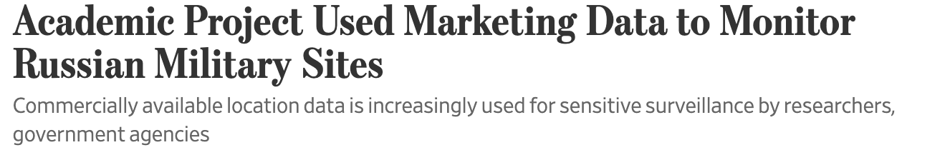
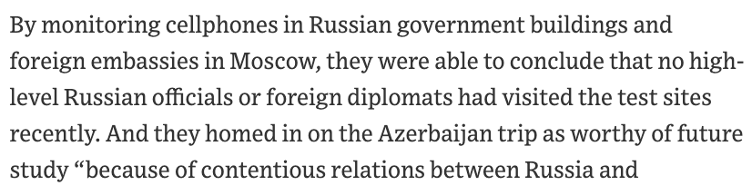
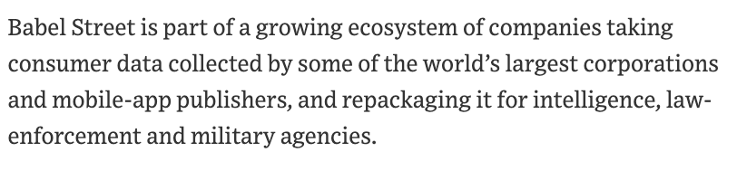
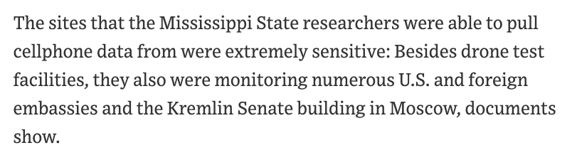
Anonymous cellphone location profiles used to find military sites: look for phones located in government buildings, embassies, etc., then search for other locations they visited
https://www.wsj.com/articles/academic-project-used-marketing-data-to-monitor-russian-military-sites-11595073601

Slide 33
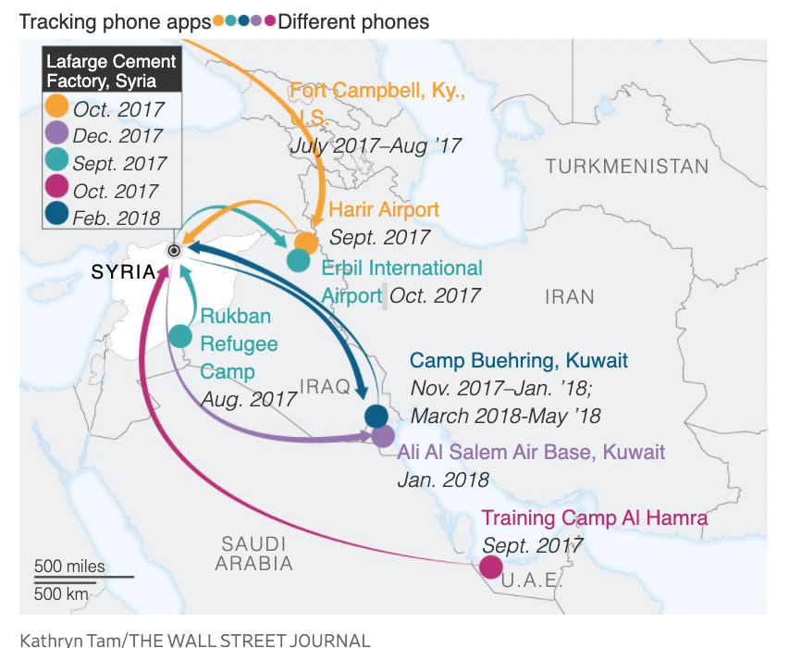



Movements of phones that appeared at the staging area for US special forces in Syria
Source: commercial DB of location data collected from apps, linked by advertising ID
https://www.wsj.com/articles/the-ease-of-tracking-mobile-phones-of-u-s-soldiers-in-hot-spots-11619429402

Slide 34

“Location data can be extremely valuable and must be protected. It can reveal details about the number of users in a location, user and supply movements, daily routines (user and organizational), and can expose otherwise unknown associations between users and locations”
-- NSA bulletin

Slide 35
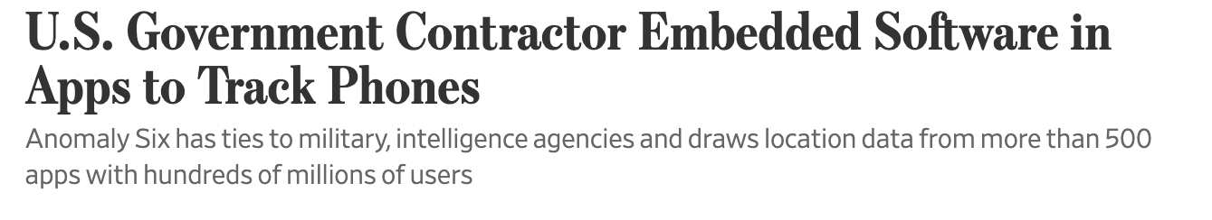
SDK maker pays app publishers to embed SDK into their apps
Presence of SDKs not disclosed in privacy policies
SDK has the same permissions as app, collects data
https://www.wsj.com/articles/u-s-government-contractor-embedded-software-in-apps-to-track-phones-11596808801

Slide 36
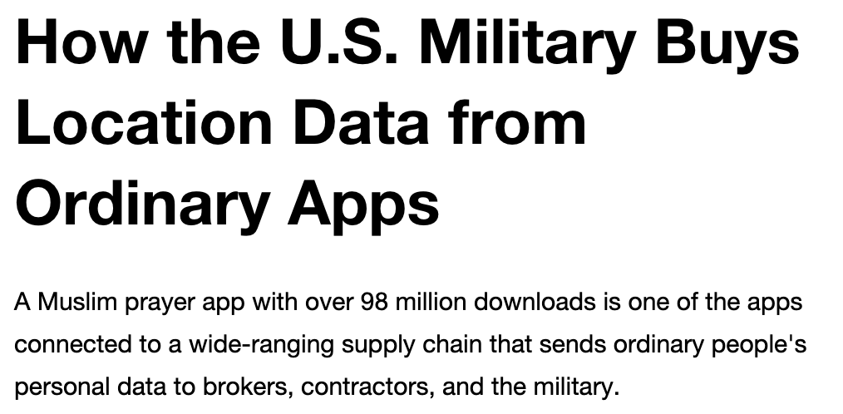


X-Mode CEO said the company tracks 25 million devices inside the United States every month, and 40 millions elsewhere… its SDK is embedded in around 400 apps.
https://www.vice.com/en/article/jgqm5x/us-military-location-data-xmode-locate-x

Slide 37



Governments use cellphone location data for Covid response
  Density of people at various places, mobility levels, etc.
  Commercially harvested data, not exposure notification apps
… also ”smart” device data, eg, Kinsa thermometers to track fever
https://www.wsj.com/articles/once-pariahs-location-tracking-firms-pitch-themselves-as-covid-sleuths-11592236894

Slide 38



https://www.nytimes.com/2020/03/23/technology/coronavirus-surveillance-tracking-privacy.html

Slide 39



Mandatory for all daily activities (shops, transport, etc.)
Sends user’s location and entire location history to local authorities
Used for comprehensive surveillance
Used to thwart protests by bank depositors
Code turns red, people grabbed at train stations, put into quarantine
https://www.wsj.com/articles/in-one-chinese-city-protesters-find-themselves-thwarted-by-a-red-health-code-11655437726

Slide 40


Source: location data harvested from tens of millions U.S. phones by SafeGraph
Potential use cases: monitoring curfews and movement restrictions, neighbor-to-neighbor visits, visits to churches, schools, pharmacies… also visits to parks and green spaces, tracking physical activity… “will support numerous CDC priorities”
same company that sells Planned Parenthood data
https://www.vice.com/en/article/m7vymn/cdc-tracked-phones-location-data-curfews

Slide 41


Legal protections for individual movements
More about this later

Slide 42



U.S. v. Chatrie (2022)
Robbery of a credit union in Virginia
Police requested data from Google for all cellphone users within 500 feet of the credit union in a 2-hour window around the robbery
“geofence warrant”
In March 2022, federal judge ruled geofence warrant unconstitutional (privacy + imprecision of location history)
… but did not dismiss evidence because police acted in good faith, sentenced robber to 12 years
https://slate.com/technology/2022/05/google-geofence-warrants-chatrie-location-tracking.html

Slide 43

Using “anonymous” location data
In January 2020, a 14-year-old girl was reported missing from her home in Missouri
Someone from a nonprofit that assists law enforcement used a commercial service to search for devices that were in the vicinity of the girl’s home
Identified a device that traveled from Wichita, KS to the girl’s home and back. Owner appeared to work at a Pizza Hut and lived at an apartment nearby.
Information turned over to the FBI and Kansas police. Device’s owner arrested and sentenced to 87 months.
No warrant required
Image: kansas.com
https://www.wsj.com/articles/law-enforcements-use-of-commercial-phone-data-stirs-surveillance-fight-11631707201

Slide 44


EFF investigation
“Fog Reveal” – paid service for law enforcement agencies to search historical data on devices linked to specific locations
Data is ”anonymous”, thus no search warrant required
Federal users can learn device’s Advertising ID
Why is this important?
https://www.eff.org/deeplinks/2022/08/fog-revealed-guided-tour-how-cops-can-browse-your-location-data

Slide 45







IRS attempted to use location data
Also used by DHS for immigration enforcement
https://www.wsj.com/articles/irs-used-cellphone-location-data-to-try-to-find-suspects-11592587815

Slide 46

“The data that Venntel uses is pseudonymized. Due to the confidential nature of our clients’ businesses and/or missions, we are not able to comment further,” Venntel President Chris Gildea said in an email.”
https://www.wsj.com/articles/irs-used-cellphone-location-data-to-try-to-find-suspects-11592587815

Slide 47



Defense Intelligence Analysts have searched for the movements of Americans within a commercial database in five investigations over the past two and a half years
https://www.nytimes.com/2021/01/22/us/politics/dia-surveillance-data.html
https://www.wsj.com/articles/military-intelligence-agency-says-it-monitored-u-s-cellphone-movements-without-warrant-11611350374

Slide 48

Remember SignalFrame?
Scans surroundings for Bluetooth signals, identifies devices, combines with precise location from the X-Mode SDK
https://www.wsj.com/articles/apple-and-google-to-stop-x-mode-from-collecting-location-data-from-users-phones-11607549061

Slide 49


NYT smartphone tracking project
Obtained a dataset of 50 billion locations from 12 million phones
  Anonymous, but linked, so can track the same phone over time
Source: location-tracking apps
“Really precise, longitudinal geolocation information is absolutely impossible to anonymize. D.N.A. is probably the only thing that’s harder to anonymize than precise geolocation information.” -- Paul Ohm
https://www.nytimes.com/interactive/2019/12/19/opinion/location-tracking-cell-phone.html

Slide 50


https://www.nytimes.com/interactive/2018/12/10/business/location-data-privacy-apps.html

Slide 51


https://www.nytimes.com/interactive/2018/12/10/business/location-data-privacy-apps.html

Slide 52
The inauguration weekend yielded a trove of personal stories and experiences: elite attendees at presidential ceremonies, religious observers at church services, supporters assembling across the National Mall
Protesters were tracked just as rigorously … We spotted a senior official at the Department of Defense walking through the Women’s March, beginning on the National Mall and moving past the Smithsonian National Museum of American History that afternoon. His wife was also on the mall that day, something we discovered after tracking him to his home in Virginia. Her phone was also beaming out location data, along with the phones of several neighbors… The official’s data trail also led to a high school, homes of friends, a visit to Joint Base Andrews, workdays spent in the Pentagon and a ceremony at Joint Base Myer-Henderson Hall with President Barack Obama in 2017
… rioters, too. Filtering the data to that precise time and location led us to the doorsteps of some who were there. Police were present as well, many with faces obscured by riot gear. The data led us to the homes of at least two police officers who had been at the scene.
We lacked the mobile advertising IDs or other identifiers that advertisers often combine with demographic information like home ZIP codes, age, gender, even phone numbers and emails to create detailed audience profiles used in targeted advertising
https://www.nytimes.com/interactive/2019/12/19/opinion/location-tracking-cell-phone.html

Slide 53




Risks to users
https://www.nytimes.com/interactive/2019/12/19/opinion/location-tracking-cell-phone.html

Slide 54


But users know, right?
https://www.nytimes.com/interactive/2019/12/19/opinion/location-tracking-cell-phone.html

Slide 55


Companies that use location data say that people agree to share their information in exchange for customized services, rewards and discounts. Ms. Magrin, the teacher, noted that she liked that tracking technology let her record her jogging routes.
Brian Wong, chief executive of Kiip, a mobile ad firm that has also sold anonymous data from some of the apps it works with, says users give apps permission to use and share their data. “You are receiving these services for free because advertisers are helping monetize and pay for it,” he said, adding, “You would have to be pretty oblivious if you are not aware that this is going on.”
https://www.nytimes.com/interactive/2018/12/10/business/location-data-privacy-apps.html

Slide 56
Even industry insiders acknowledge that many people either don’t read those policies or may not fully understand their opaque language. Policies for apps that funnel location information to help investment firms, for instance, have said the data is used for market analysis, or simply shared for business purposes.
“Most people don’t know what’s going on,” said Emmett Kilduff, the chief executive of Eagle Alpha, which sells data to financial firms and hedge funds. Mr. Kilduff said responsibility for complying with data-gathering regulations fell to the companies that collected it from people.
https://www.nytimes.com/interactive/2018/12/10/business/location-data-privacy-apps.html

Slide 57


https://www.nytimes.com/2021/02/05/opinion/capitol-attack-cellphone-data.html

Slide 58

Political groups use cellphone locations to identify participants in protests and rallies, target them for political advertising
https://www.wsj.com/articles/how-political-groups-are-harvesting-data-from-protesters-11592156142

Slide 59


January 6, 2021
https://www.nytimes.com/2021/02/05/opinion/capitol-attack-cellphone-data.html

Slide 60

https://gizmodo.com/parler-users-breached-deep-inside-u-s-capitol-building-1846042905

Slide 61



An email was matched to the phone’s anonymous advertising ID
https://www.nytimes.com/2021/02/05/opinion/capitol-attack-cellphone-data.html

Slide 62


https://www.nytimes.com/2021/02/05/opinion/capitol-attack-cellphone-data.html

Slide 63

Much more later about the use of surveillance technologies to identify Capitol riot participants
https://www.wired.com/story/capitol-riot-google-geofence-warrant/

Slide 64

https://www.nytimes.com/2021/02/05/opinion/capitol-attack-cellphone-data.html

Slide 65

Legal developments (2022)
“track consumers to sensitive locations, such as therapists’ offices, addiction recovery centers, medical facilities, and women’s reproductive health clinics”
FTC sues data broker Kochava for selling location data
Data broker Kochava sues FTC
“manipulative attempt…to give the appearance that it is protecting consumer privacy despite being based on completely false pretenses”
Claims to remove healthcare locations,
FTC does not understand how its business works

Slide 66





Slide 67

Location controls (iOS 15)
Can share approximate location instead of precise one
Can turn off and erase signification locations
iPhone’s record of places you visited
https://www.nytimes.com/2021/12/08/technology/personaltech/phone-privacy-protection-tools.html

Slide 68

Location controls (Android 12)
Location history is associated with Google account, used for ad targeting
https://www.nytimes.com/2021/12/08/technology/personaltech/phone-privacy-protection-tools.html

Slide 69

Disable location services?
Exposure API requires Bluetooth
(to record beacons of nearby phones)
To scan for Bluetooth devices,
location services must be turned on
Once location services are turned on, Google can determine user’s precise location using cell tower signals, Wi-Fi signals, and Bluetooth beacons
also sensor information, including MAC addresses and signal strength of nearby devices, battery status, GPS elevation, barometric pressure, and how the user is moving (e.g., car or bicycle)
https://qz.com/1183559/if-youre-using-an-android-phone-google-may-be-tracking-every-move-you-make/

Slide 70

Location History
Once user opts in, Google collects location history across every app and every device associated with the user
  Based on GPS data, Bluetooth beacons, proximity to cellphone towers, IP addresses, strength of Wi-Fi signals
  Location logged every 2 minutes, on average
  Logging continues even after app that prompted opt-in is deleted
“Confidence interval” circle (as little as 3 meters across)
Google Location Accuracy (Android only) further pinpoints location using Wi-Fi access points, cell networks, and other signals in the vicinity of the device

Slide 71


Google uses a variety of avenues to collect user location data, according to the documents, including WiFi and even third-party apps not affiliated with Google, forcing users to share their data in order to use those apps or, in some cases, even connect their phones to WiFi.
Google continued collecting location data even when users turned off various location-sharing settings, made popular privacy settings harder to find, and even pressured LG and other phone makers into hiding settings precisely because users liked them
https://www.azag.gov/sites/default/files/2021-05/Chai_Exhibit_201.pdf
https://www.businessinsider.com/unredacted-google-lawsuit-docs-detail-efforts-to-collect-user-location-2021-5

Slide 72

January 24, 2022
Claims:
Google has a powerful financial incentive to make it difficult for users to opt out of location tracking… “Even when a user’s mobile device is set to deny Google access to location data, the Company finds a way to continue to ascertain the user’s location.” Google can still collect and store location data through other Google services, WiFi and Bluetooth scans, or location data shared with Google by its marketing partners.
Misleading, ambiguous, and incomplete descriptions of these settings all but guarantee that consumers will not understand when their location is collected and retained by Google or for what purposes.
The company made false claims between 2014 and 2019 about what information it was collecting when people turned off the “location history” setting.
The company also used dark patterns, such as alerting users that certain apps wouldn’t function properly if they turned their location sharing off, to encourage people to keep these settings activated.
https://www.washingtonpost.com/technology/2022/01/24/google-location-data-ags-lawsuit/

Slide 73
Legal developments (2022)
Google pays $392 million in settlement with 40 states for tracking users after location tracking has been turned off
Google pays $85 million in settlement with Arizona for deceptively using location tracking in order to serve ads

Slide 74

By analyzing data from public, zero-permission Android APIs (per-app data-usage statistics, ARP traces from local networks, speaker on/off status), an app can infer the user’s location, driving route, Twitter handle, disease-specific web pages the user is browsing…
ACM CCS 2013

