Slide 1
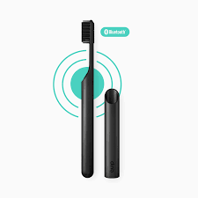
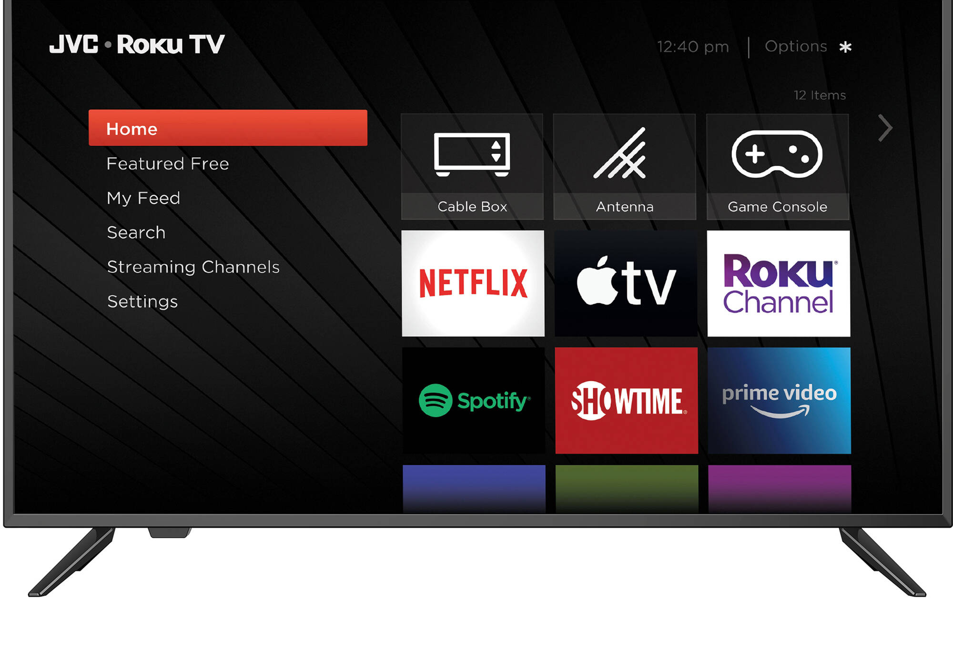
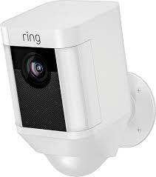
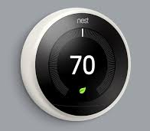
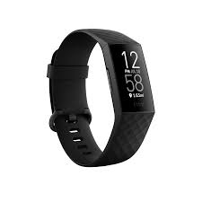
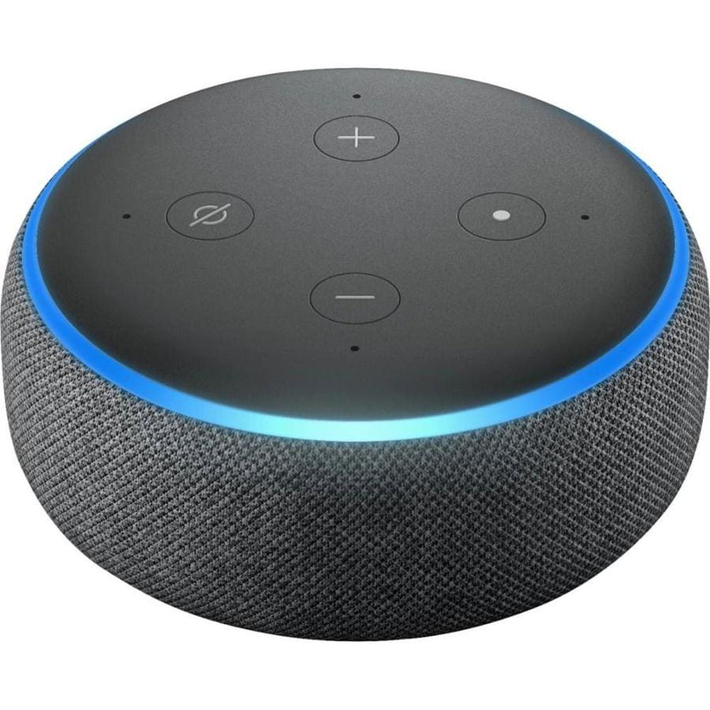
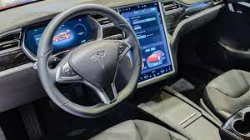
PRIVACY of “SMART” DEVICES

Slide 2
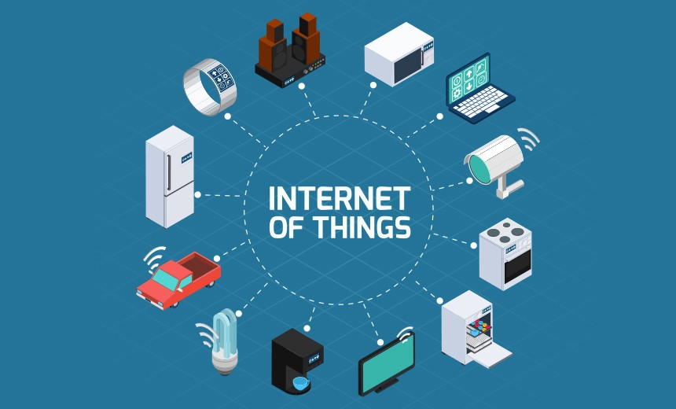

Slide 3
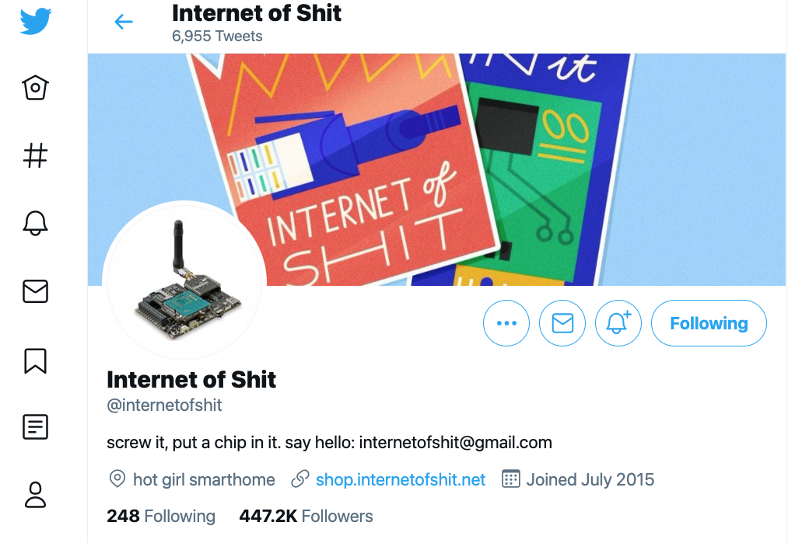

Slide 4
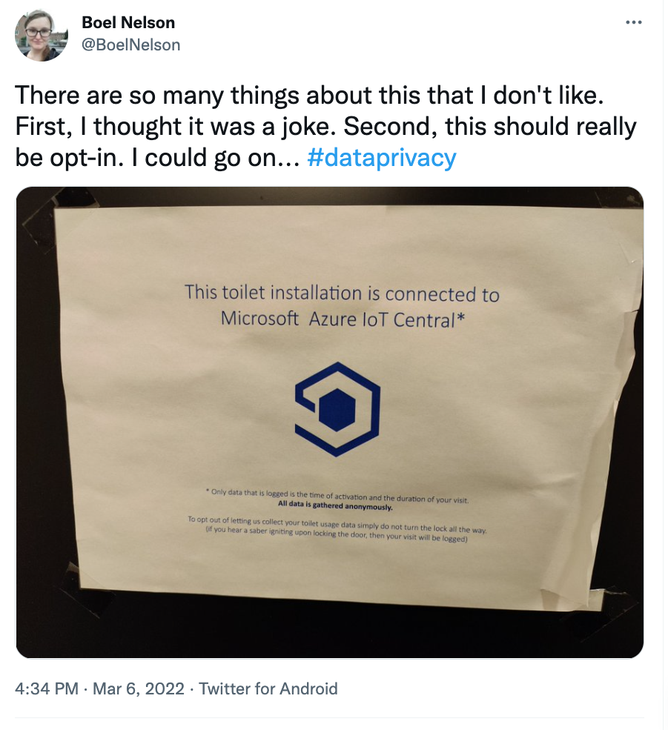

Slide 5
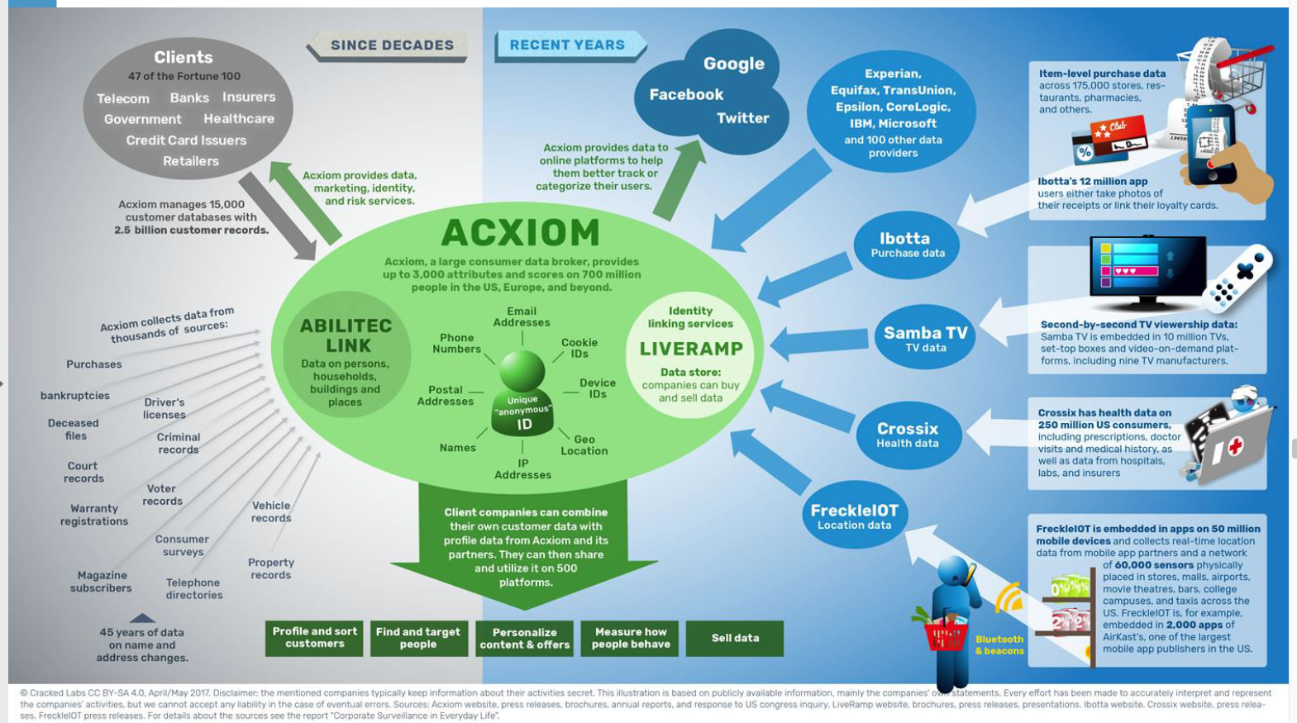

Slide 6
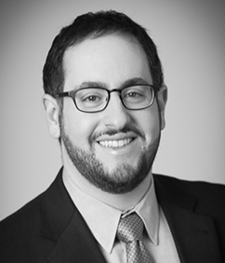
We shouldn’t be celebrating seasonal surveillance. It’s really a terrible message for kids. No one should be looking at you in your bedroom without your consent.
Albert Fox Cahn
Surveillance Technology Oversight Project
You better watch out
Look up on the shelf
Don’t accept spies just because they are elves
Santa’s spy is watching your kids
Hides in a different spot in the home each day before Christmas, reports children’s behavior to Santa Claus
Calli Schroeder
EPIC Global Privacy Counsel
https://www.nytimes.com/2021/12/23/style/elf-shelf-privacy.html

Slide 7
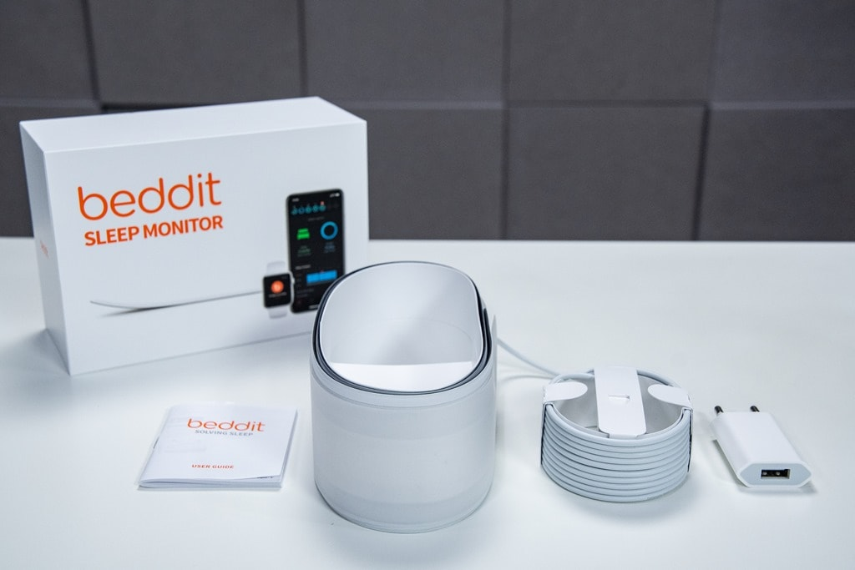
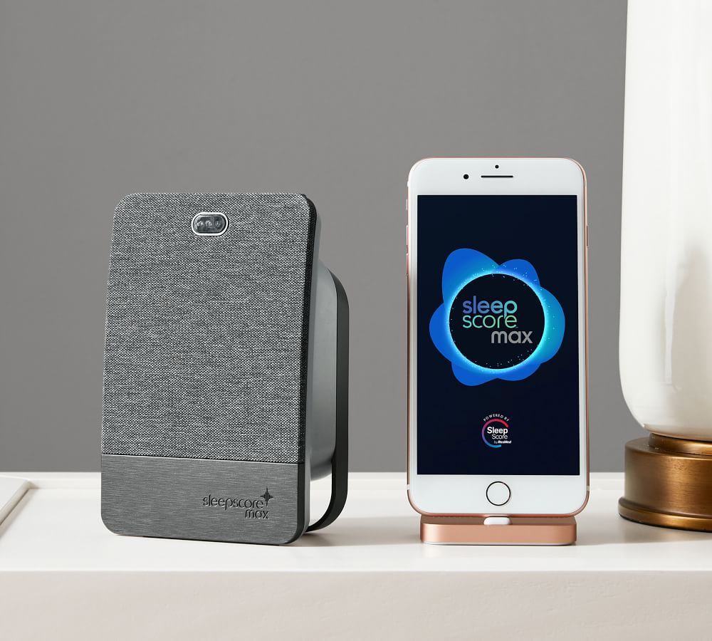
Also:

Slide 8
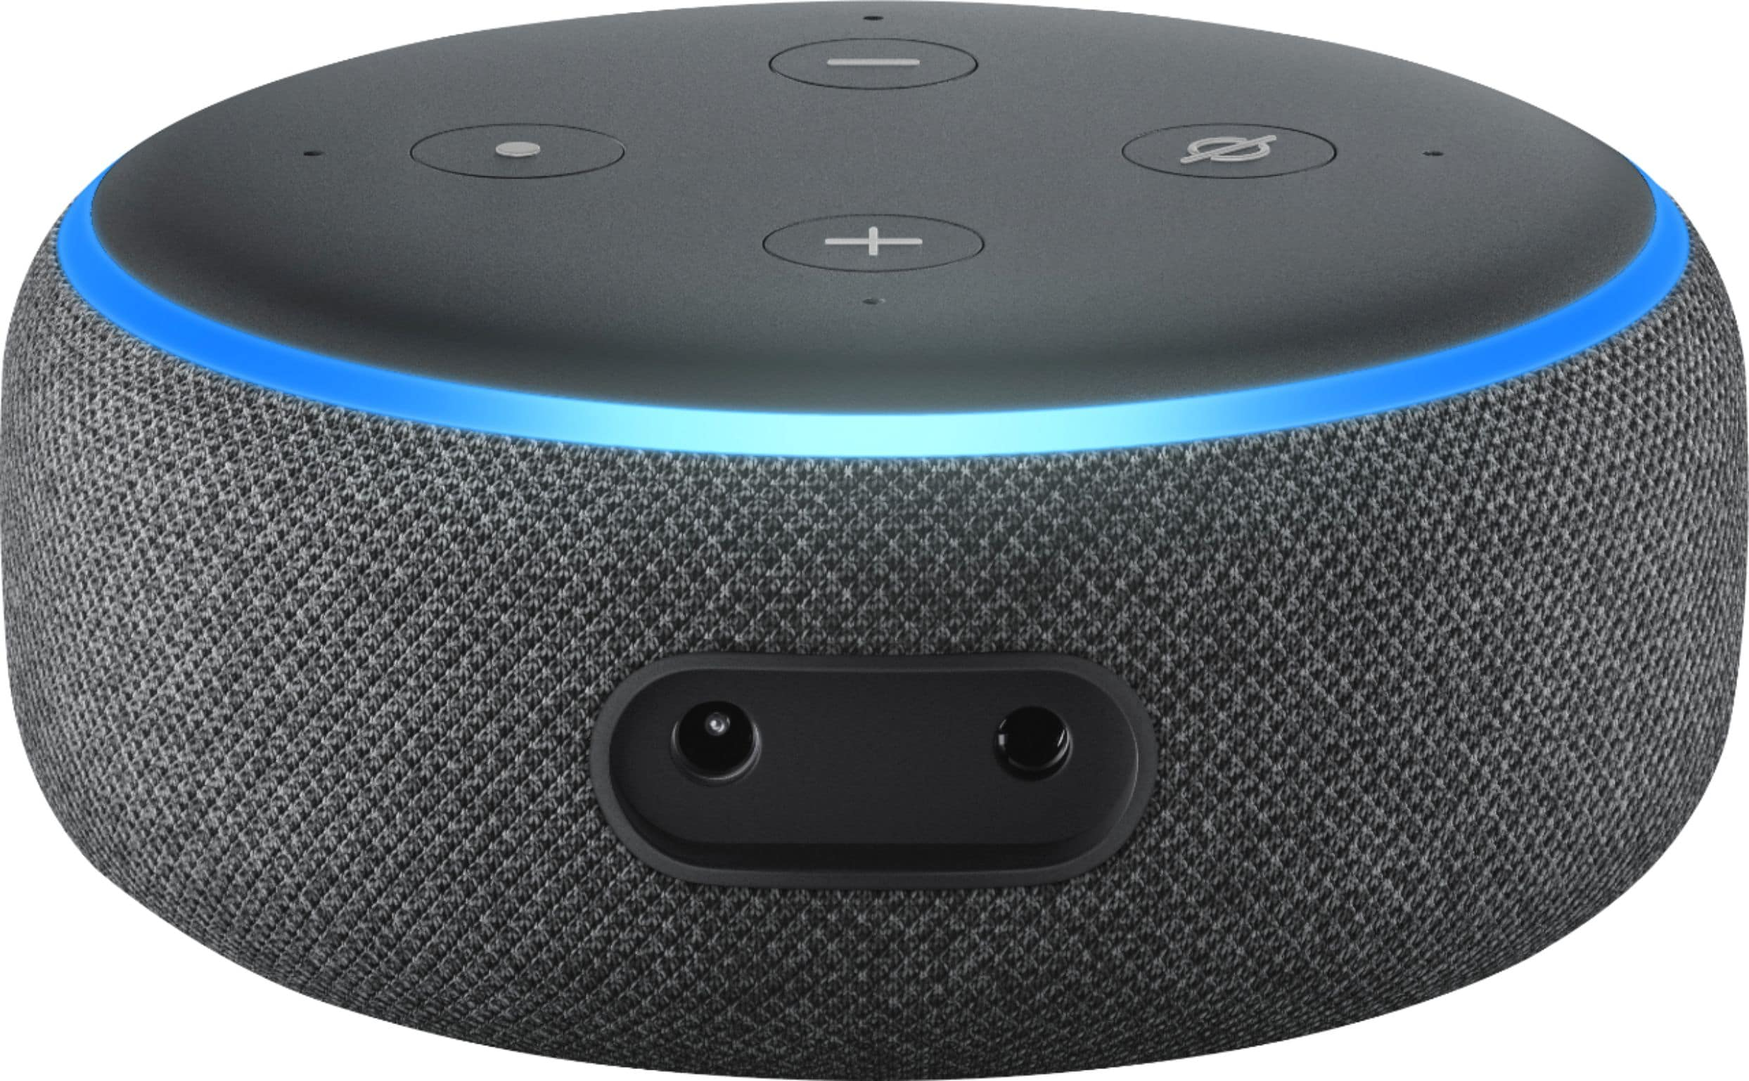
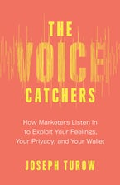
Voice commands reveal users’ intentions (explicit)
… also moods and medical conditions (implicit)
Academics and entrepreneurs are rushing to develop technology to diagnose and predict everything from manic episodes to heart disease to concussions based on an unusual source of data: How you talk.
Companies should be barred from analyzing what we say and how we sound
https://www.theatlantic.com/technology/archive/2018/10/alexa-emotion-detection-ai-surveillance/572884/
https://www.statnews.com/2016/06/29/speech-diagnosis-technology/

Slide 9
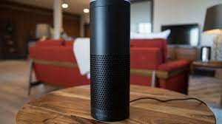

Slide 10
Device is always listening to detect the “wake word”

Slide 11
Device is always listening to detect the “wake word”
Only starts recording and transmitting to servers after the “wake word” is detected

Slide 12
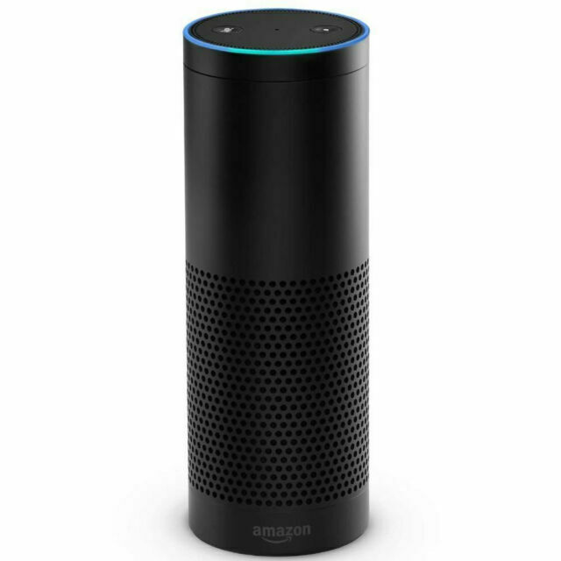
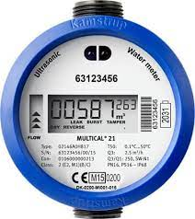
"Amazon does not seek to obstruct any lawful investigation, but rather seeks to protect the privacy rights of its customers when the government is seeking their data from Amazon, especially when that data may include expressive content protected by the First Amendment"
A body was found in a hot tub in the backyard of a house in Arkansas.
Police charged a man who lived in the house with murder, seized Amazon Echo, and served as search warrant on Amazon for 2 days’ worth of recordings.
Amazon moved to quash the warrant on First Amendment grounds, but relented after the suspect gave permission.
Police also used information from a smart water meter, alleging that an increase in water use in the middle of the night suggests a possible cleanup around the crime scene.
Police eventually dropped prosecution.

Slide 13
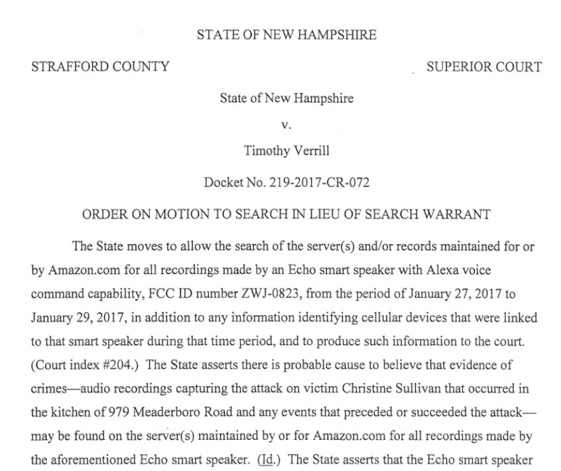
New Hampshire state judge orders Amazon to turn over recordings from an Echo present at the scene of a double homicide.
Note: there is no evidence that the wake word was uttered.
If mere presence of a smart device is a probable cause to search its data, what are the privacy implications?
“The court finds there is probable cause to believe the server(s) and/or records maintained for or by Amazon.com contain recordings made by the Echo smart speaker from the period of Jan. 27 to Jan. 29, 2017 … and that such information contains evidence of crimes committed against Ms. Sullivan, including the attack and possible removal of the body from the kitchen.”

Slide 14
Users opt-in to share footage to Ring’s ”Neighbors” social network
To seek out Ring video that has not been publicly shared, officers can use a special interface to designate a time range and local area, and get Ring to send an automated email to all users within that range, alongside a case number and message from police.
Sgt. William Pickering, an officer with the Norfolk Police Department in Virginia, which is working with Ring, compared the system’s expansion to the onset of DNA evidence in criminal cases — a momentous capability, unlocked by new technology, that helps police gain the upper hand.
https://www.washingtonpost.com/technology/2019/08/28/doorbell-camera-firm-ring-has-partnered-with-police-forces-extending-surveillance-reach/

Slide 15
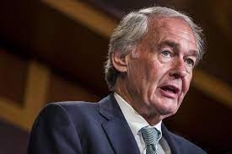
“Connected doorbells are well on their way to becoming a mainstay of American households, and the lack of privacy and civil rights protections for innocent residents is nothing short of chilling”
Ed Markey
US Senator for Massachusetts (D)
“Users must expressly choose to assist police, the same way they would traditionally answer the door or respond to a public request for tips”
Police officers who download videos captured by homeowners’ Ring doorbell cameras can keep them forever and share them with whomever they’d like without providing evidence of a crime.
https://www.washingtonpost.com/technology/2019/11/19/police-can-keep-ring-camera-video-forever-share-with-whomever-theyd-like-company-tells-senator/

Slide 16
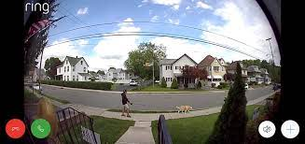
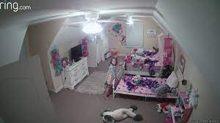
Bystander Privacy
Issue: doorbell cameras can accidentally capture children and other passersby without their knowledge and consent
Ring’s terms of service: users must install the cameras so they do not record beyond the boundary of a user’s property (such as public road or sidewalk)
Ring does not verify compliance since this would require viewing users’ videos
Ring’s privacy policy: Ring does not “knowingly” collect personal information online from children under the age of 13
“Ring has no way to know or verify that a child has come within range of a device”
https://www.washingtonpost.com/technology/2019/11/19/police-can-keep-ring-camera-video-forever-share-with-whomever-theyd-like-company-tells-senator/

Slide 17
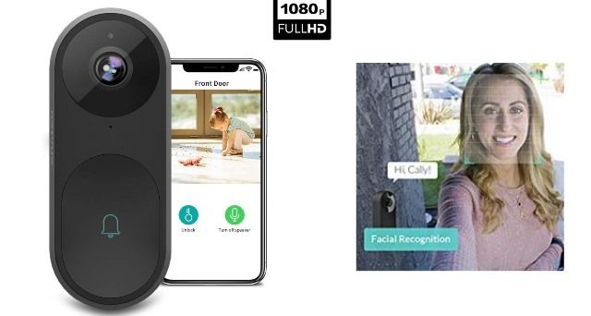
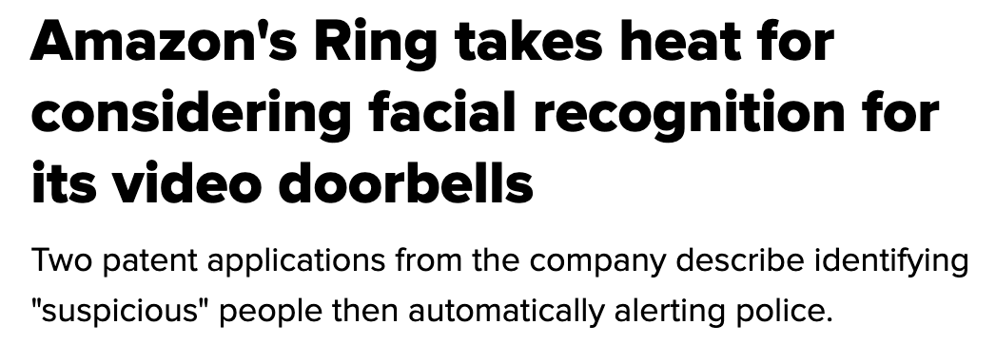
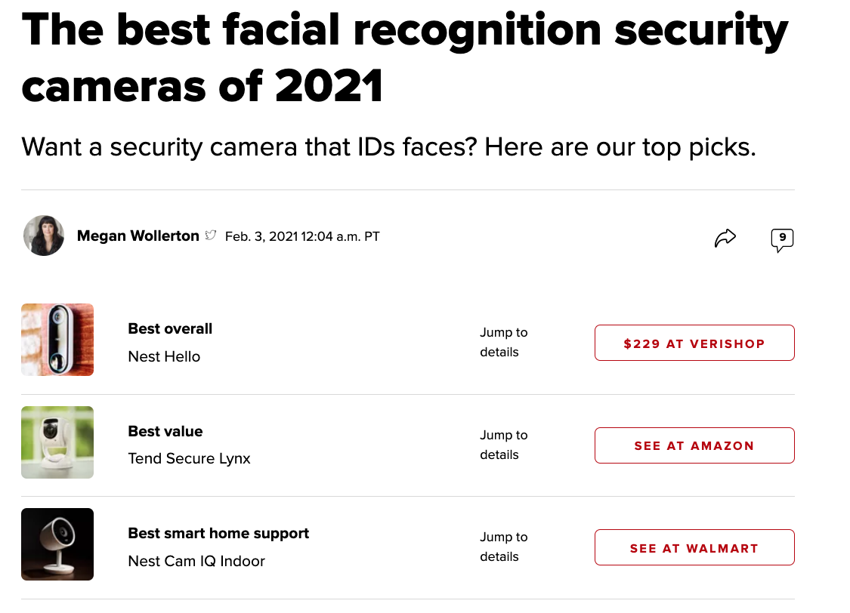
Ring’s Stance on Facial Recognition Technology
Ring does not use facial recognition technology in any of its devices or services, and will neither sell nor offer facial recognition technology to law enforcement.

Slide 18
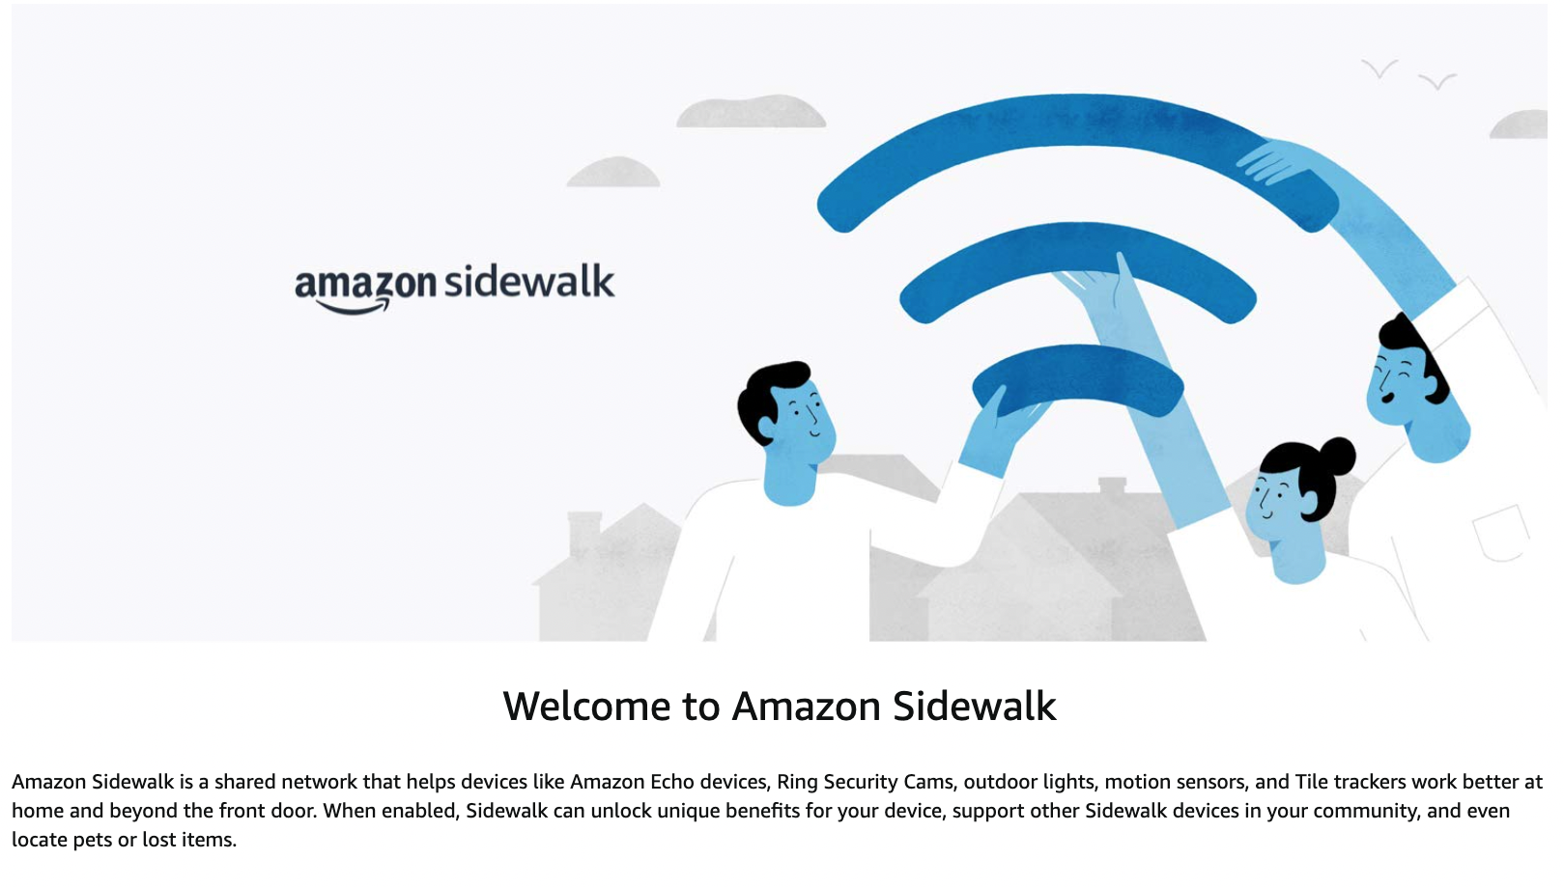
Sidewalk connects Alexa and Ring devices, Tile trackers, IoT devices, etc. into one network
All devices automatically enrolled unless user opts out
Long-range connections with other people’s devices
Data sent between devices is encrypted
Is this sufficient to ensure privacy?
Leakage of information from individual devices?
Location tracking?
Comprehensive surveillance of all activities?

Slide 19
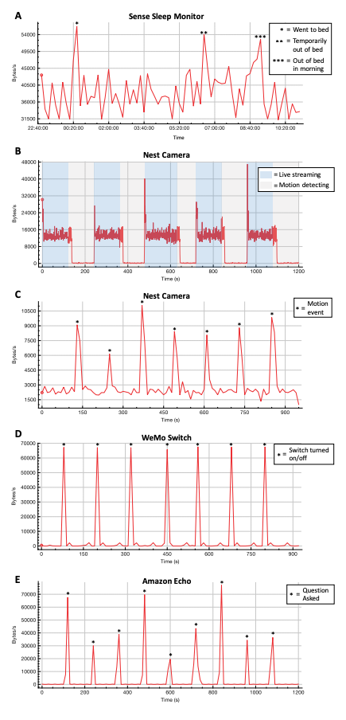
Privacy Vulnerabilities of IoT Traffic
What can passive observers (e.g., ISPs) infer from encrypted traffic of IoT devices?
Apthorpe et al. https://arxiv.org/pdf/1705.06805.pdf

Slide 20
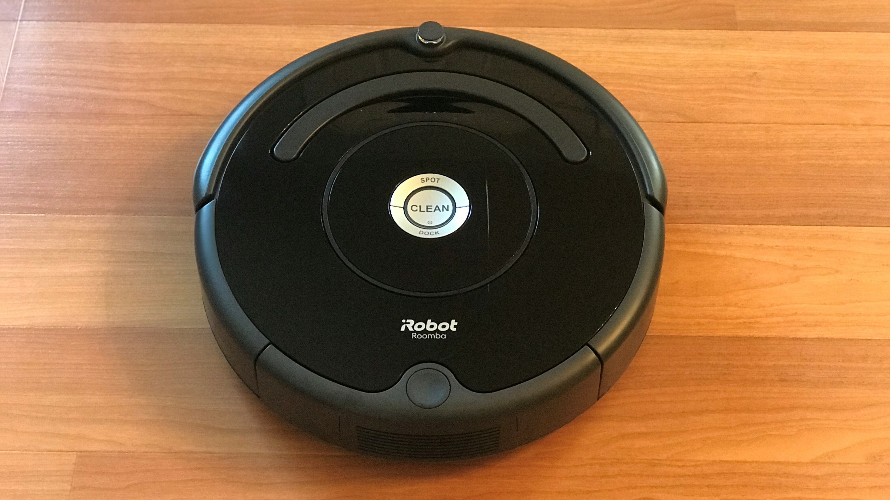
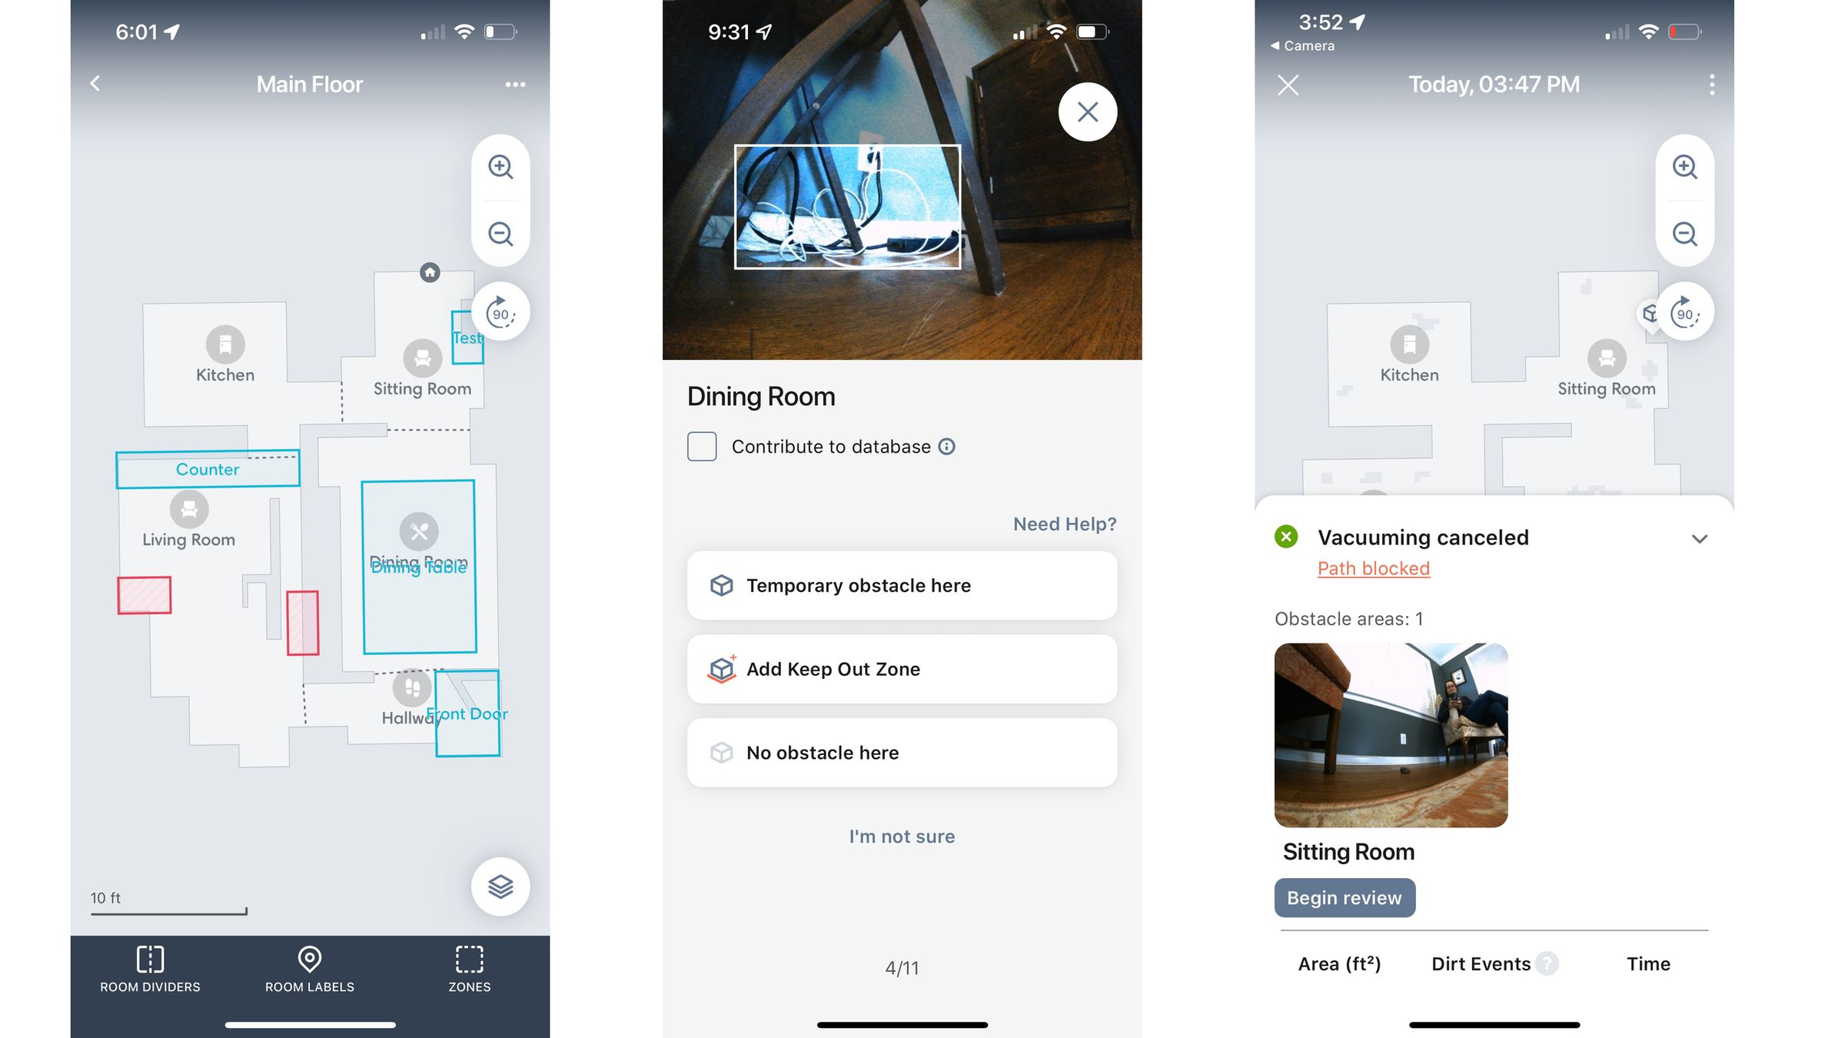
Roomba has detailed house maps: where different rooms are and how they change over time (new furniture, room turned into a nursery, etc.)
“There’s an entire ecosystem of things and services that the smart home can deliver once you have a rich map of the home that the user has allowed to be shared,” said [iRobot CEO Colin] Angle.
Acquired by Amazon (2022)
Image: https://www.theverge.com/23293687/amazon-irobot-acquisition-purchase-smarthome-intelligence-privacy-analysis

Slide 21
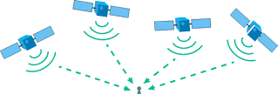
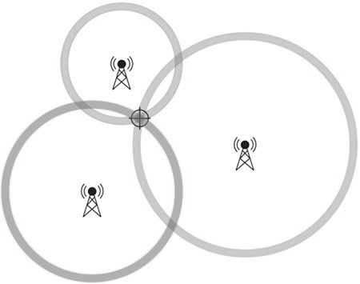
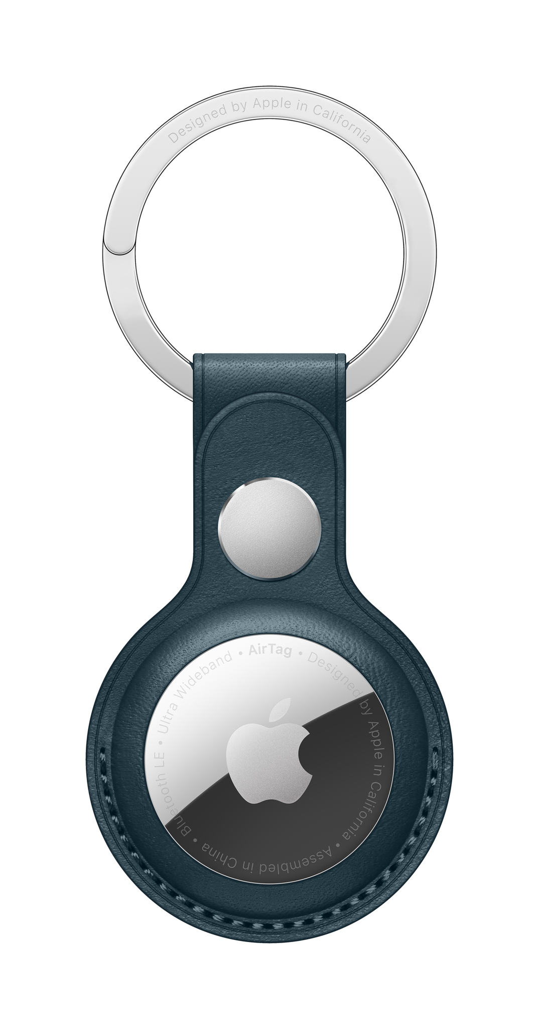
Geolocation
UWB
accuracy: 1 square inch
GPS
accuracy: 16 square feet
Cell towers
accuracy: ¾ square mile

Slide 22
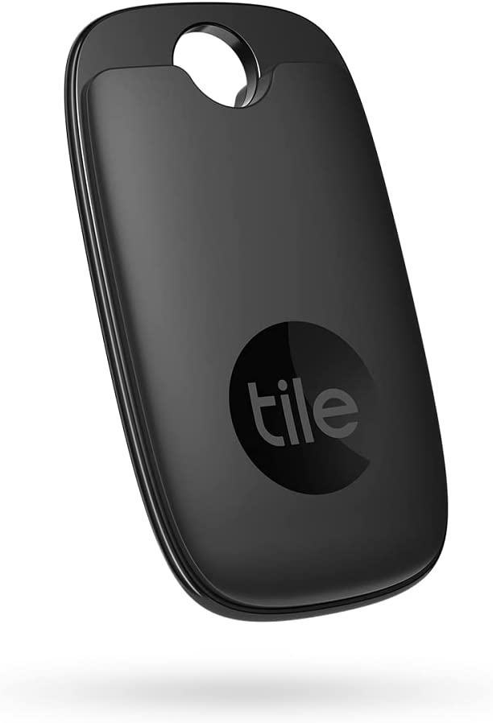
Wearable Trackers
Emit signal detectable by mobile devices
Devices report where the tracker was seen
All iOS devices form a network that AirTags use to report their location
https://www.tiktok.com/@_ashleyscarlett/video/7007304917652212998

Slide 23
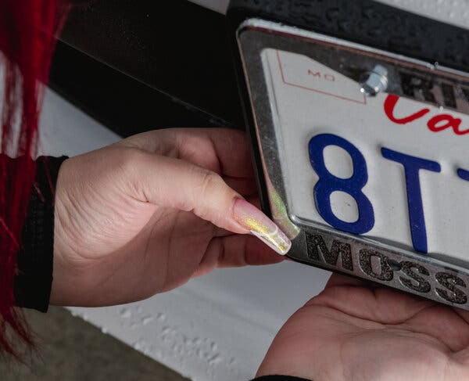
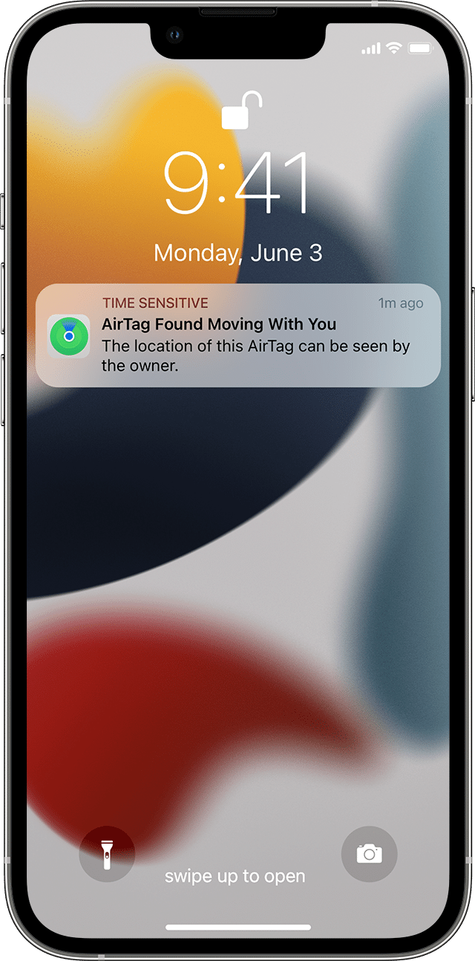
Problem: Involuntary Placement
Users notified if an unknown tag seems to be moving with them
after how long?
hours, days… depends on iOS and location settings
Tag starts beeping if away from the owner’s devices for more than a day
Stalking people
Tracking cars to be stolen later
https://www.nytimes.com/2021/12/30/technology/apple-airtags-tracking-stalking.html

Slide 24
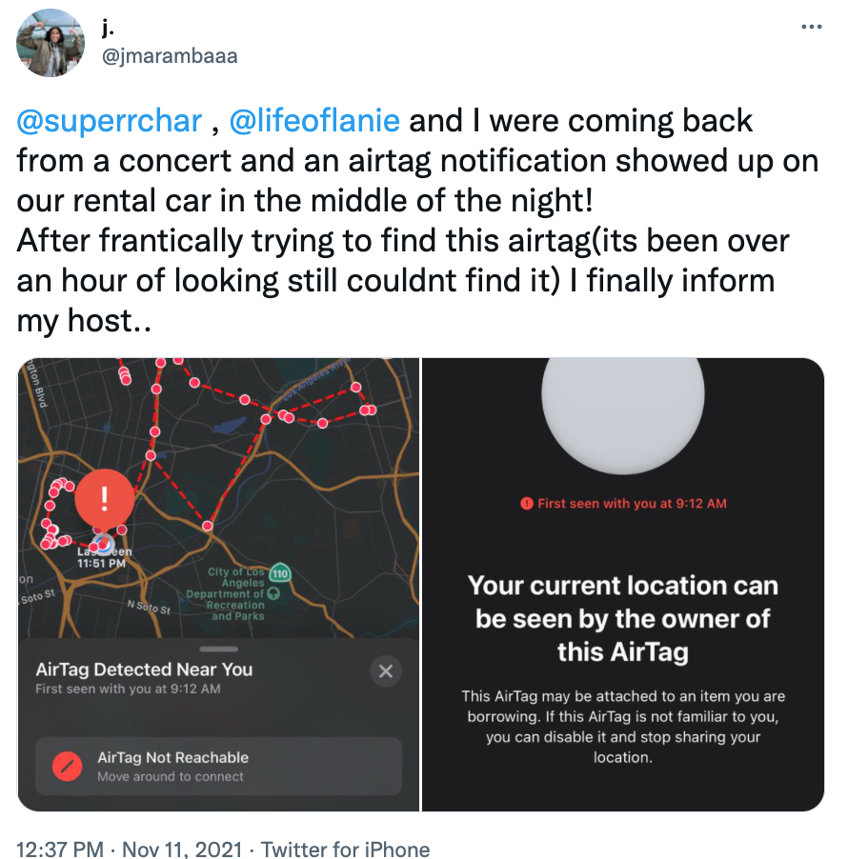
Need to find the tag
Need to ask police to ask Apple to identify the tag’s owner
?
Android users need to download and use a special app
https://twitter.com/jmarambaaa/status/1458851472741830657

Slide 25
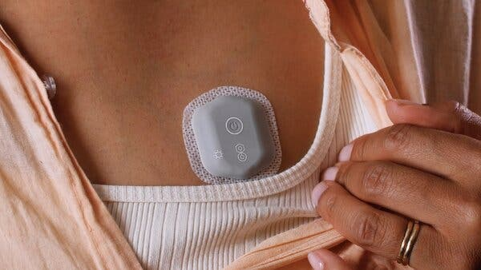
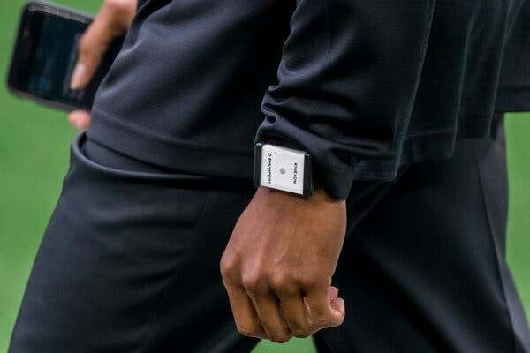
The BioButton uses algorithms to try to detect early signs of Covid-19
EverSmart traces contact anonymously between facility occupants through badges, wristbands, and keyrings
Kinexon proximity detection device
https://www.nytimes.com/2020/11/15/technology/virus-wearable-tracker-privacy.html

Slide 26
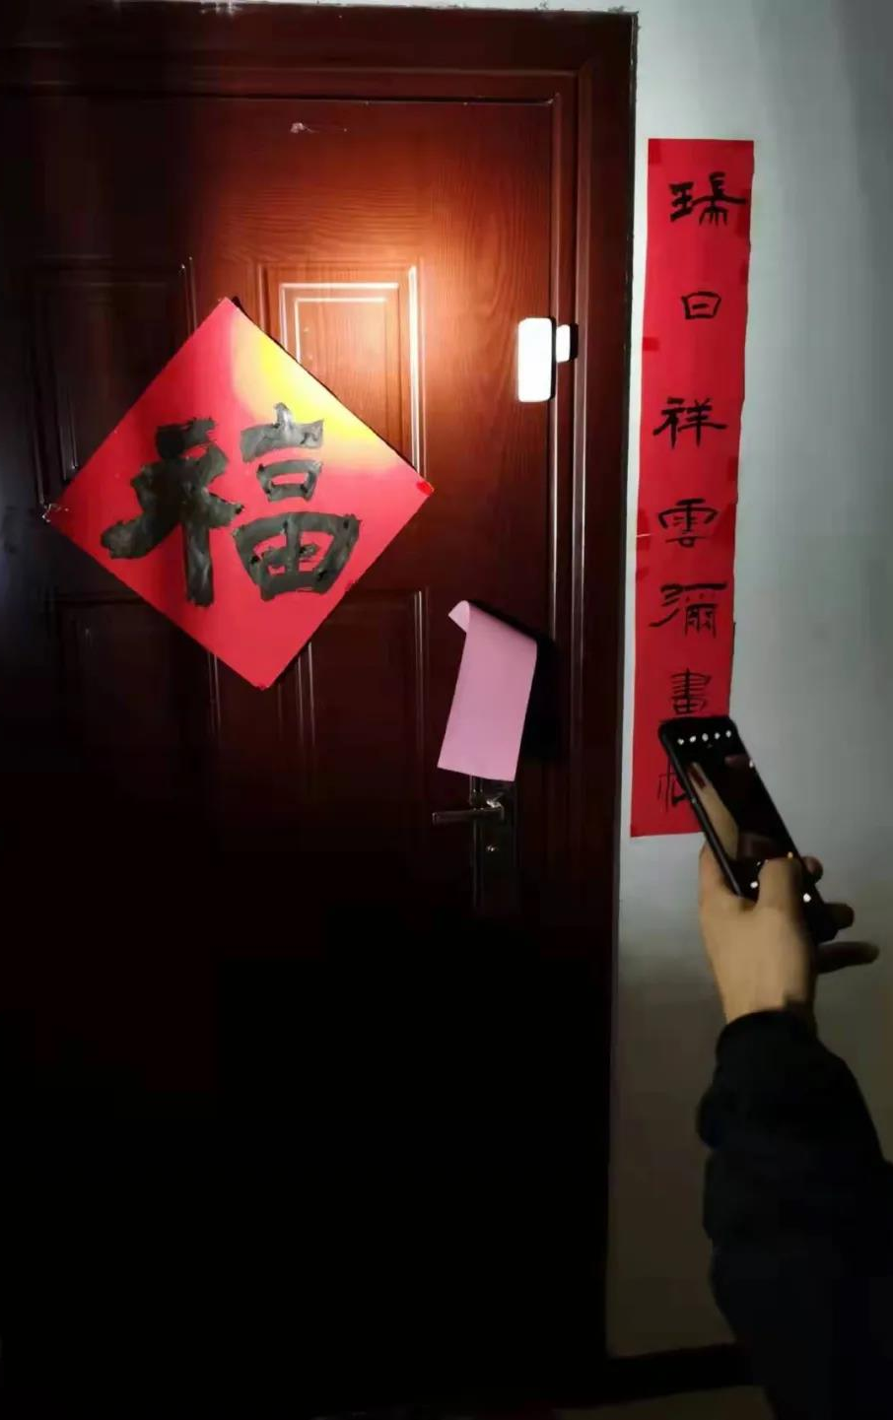
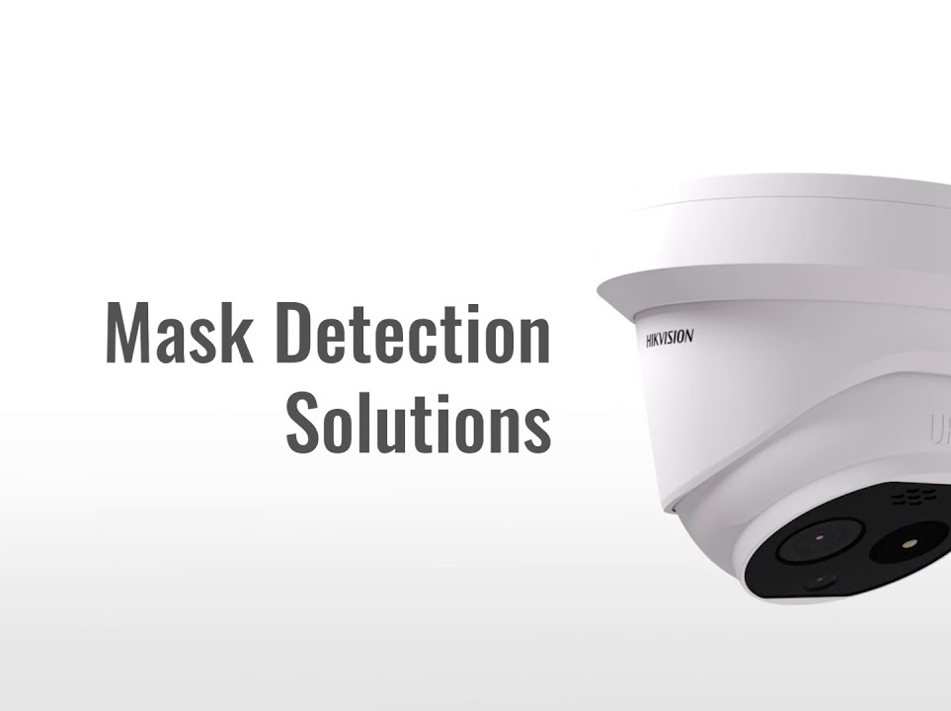
Over in Asia…
Mandatory Bluetooth wearables to enforce contact tracing (Singapore)
Video cameras to enforce mask wearing (Hangzhou)
Power consumption monitoring to enforce compliance with quarantine orders (Hangzhou)
Door sensors to prevent people in quarantine from leaving home (Luoyang)

Slide 27
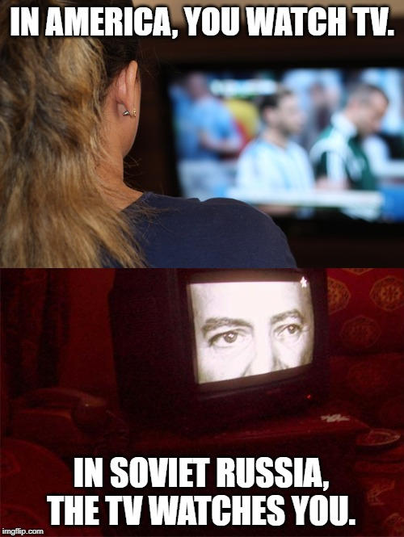

Slide 28
Smart TVs collect detailed information about everything users watch.
ACR (automatic content recognition): capture pixels on screen, compute fingerprint, compare with database of known content.
Analyze ACR to identify household interests, use them to target ads across multiple devices (linked by IP address).
Claim: this cannot violate privacy because ACR data is not “personally identifiable information”.
https://www.washingtonpost.com/technology/2019/09/18/you-watch-tv-your-tv-watches-back/

Slide 29
90% of users opt in
https://www.washingtonpost.com/technology/2019/09/18/you-watch-tv-your-tv-watches-back/

Slide 30
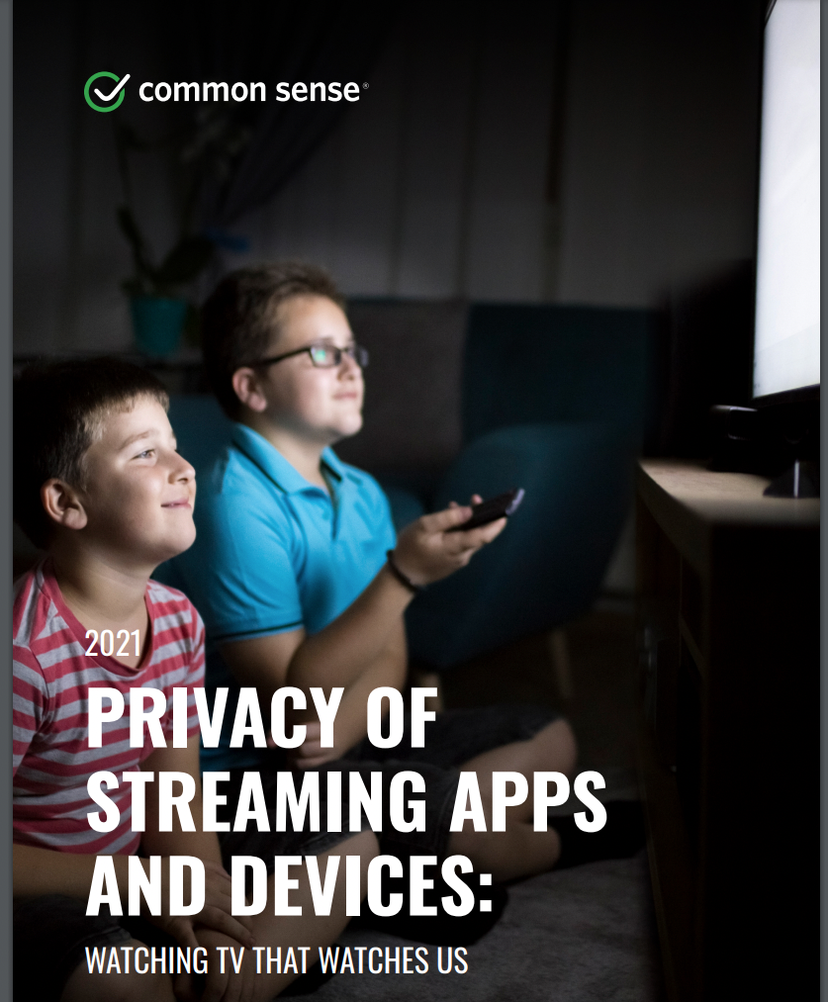
Comprehensive analysis of streaming apps
First-party and third-party tracking
Privacy policies
Network security
“Privacy ratings”
https://www.commonsensemedia.org/research/privacy-of-streaming-apps-and-devices-2021

Slide 31
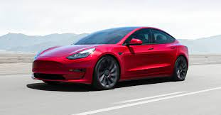
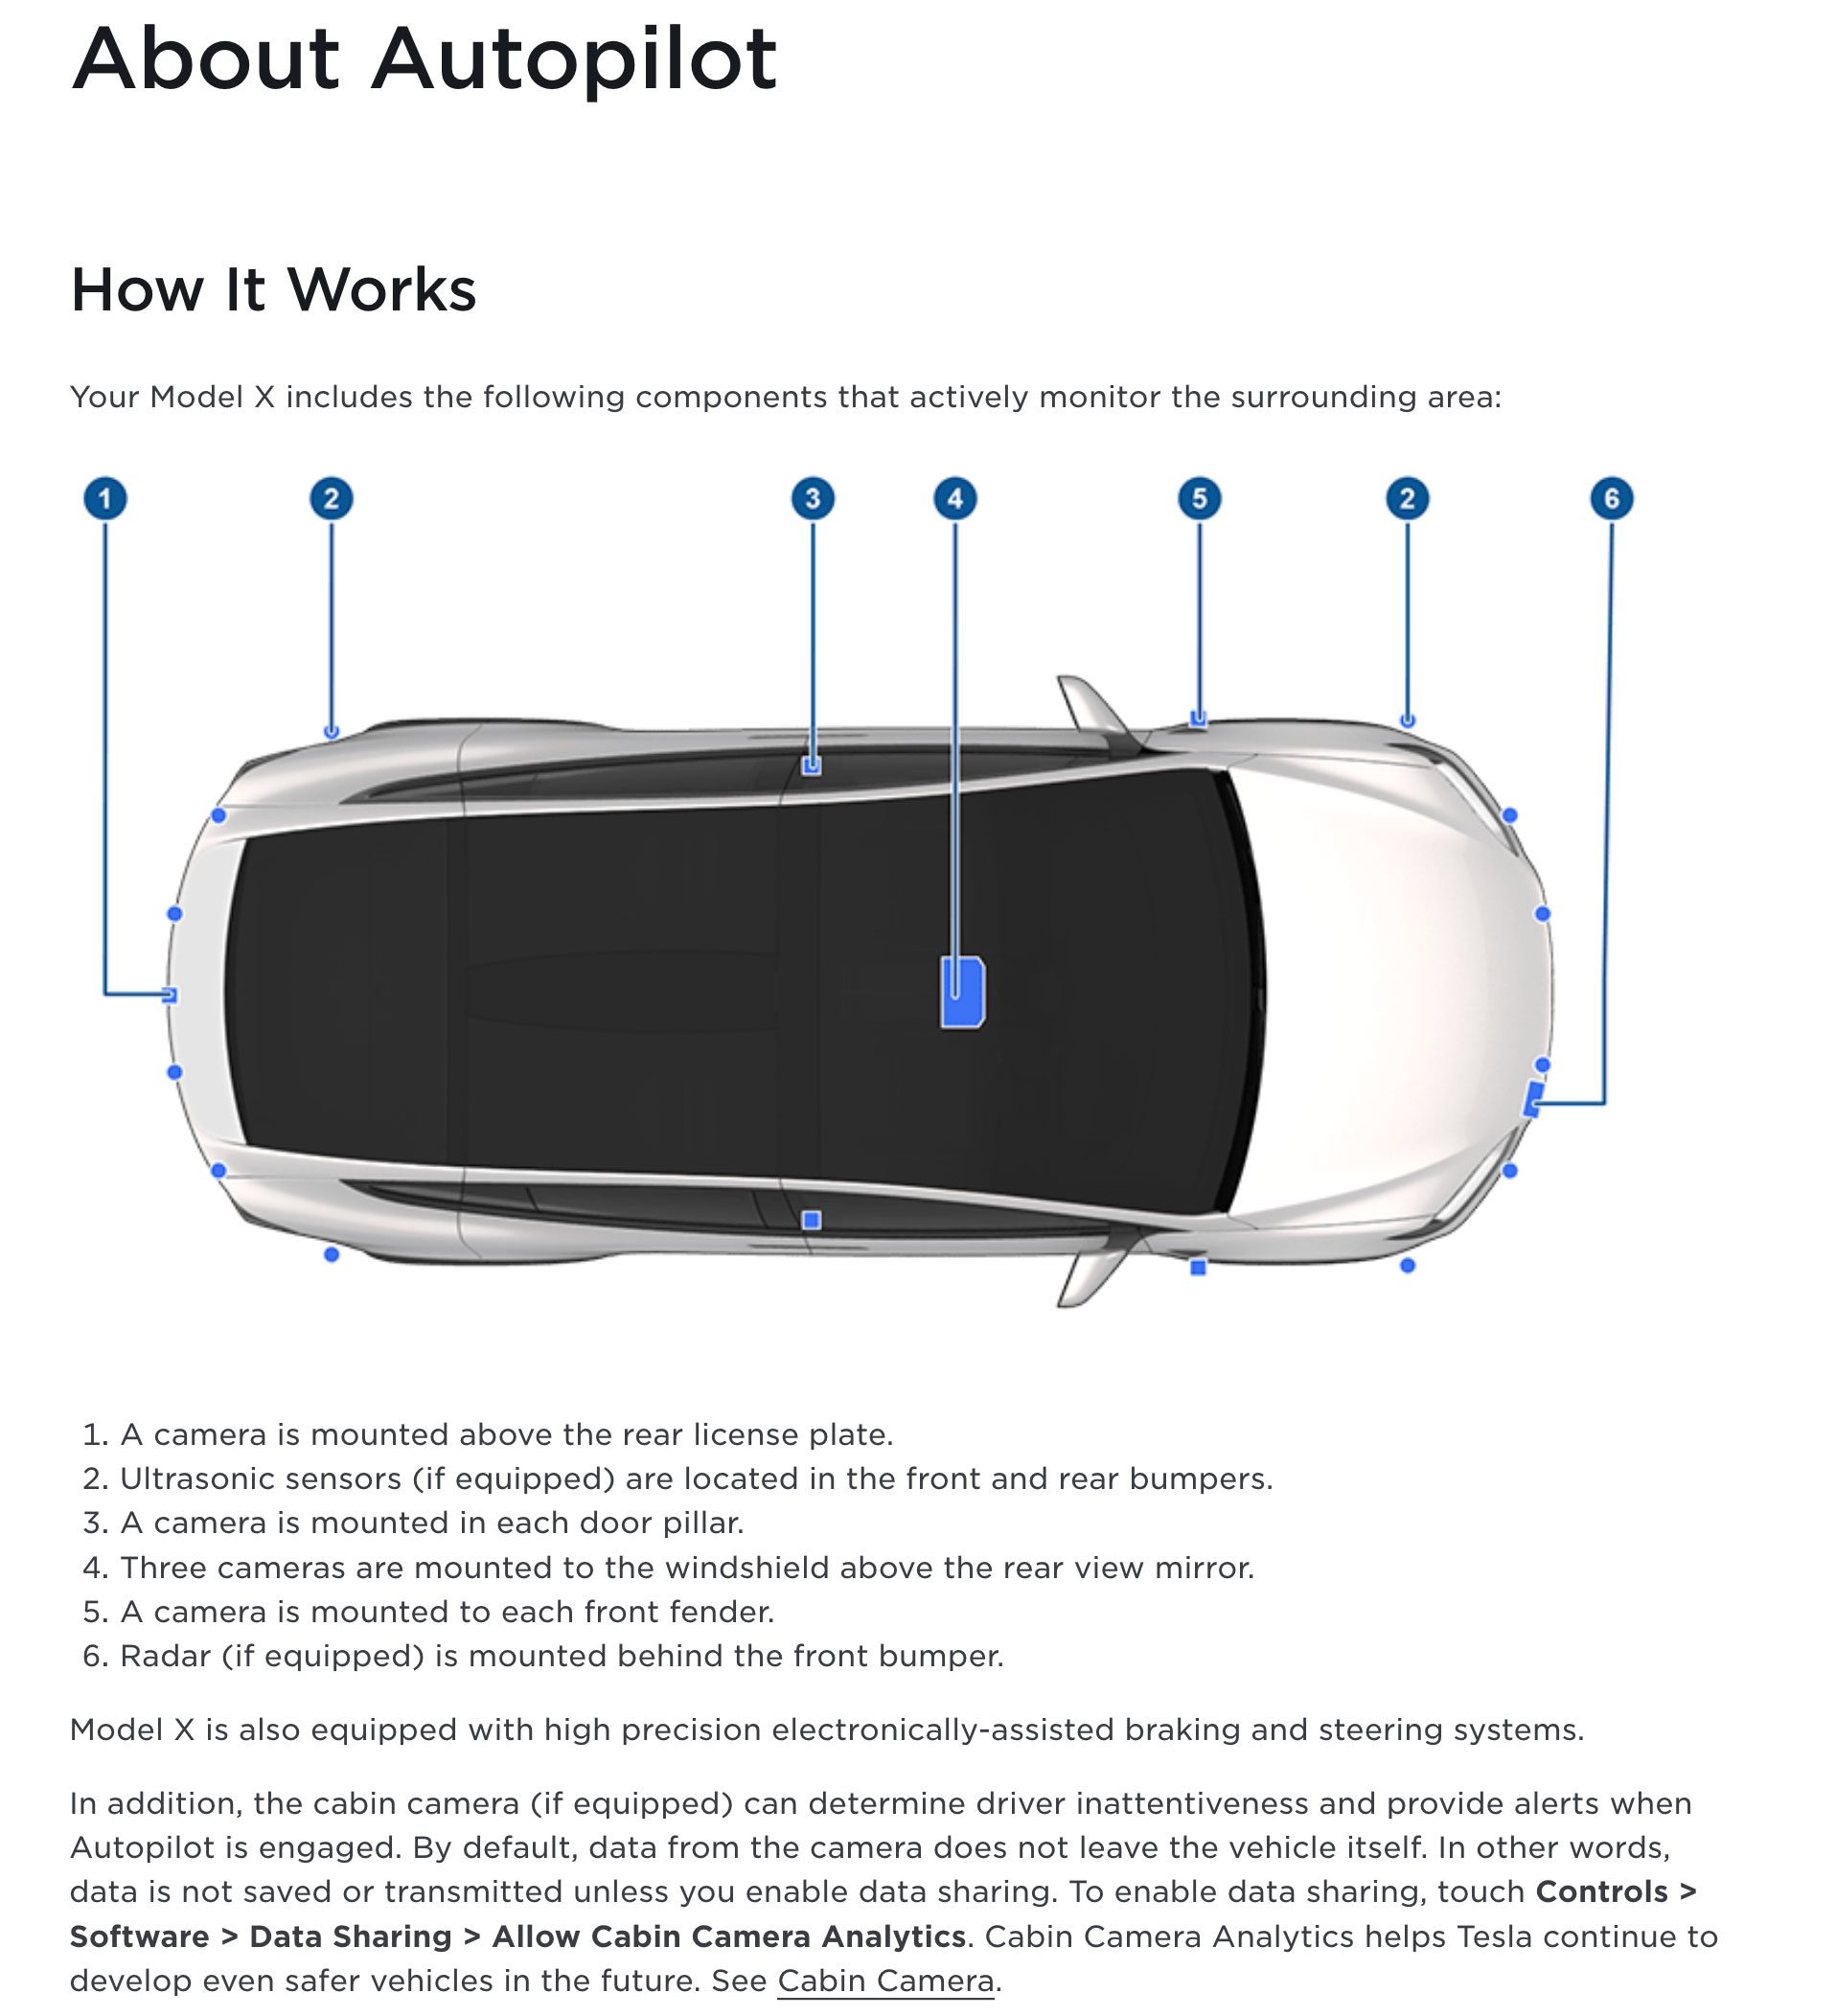
8 surround cameras
12 ultrasonic sensors
Radar
Collected data sent to Tesla servers (to improve driver-assistance systems)
Camera recordings if user opts in
(used to label object in images to train Tesla’s AI systems)
Between 2019 and 2022, groups of Tesla employees privately shared via an internal messaging system sometimes highly invasive videos and images recorded by customers’ car cameras
Crashes, road-rage incidents, families, bystanders…
https://www.reuters.com/technology/tesla-workers-shared-sensitive-images-recorded-by-customer-cars-2023-04-06/

Slide 32
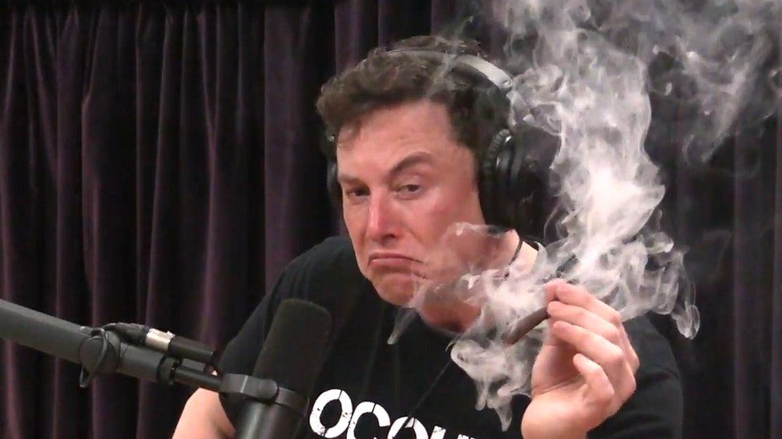
Government agency employees to stop driving Tesla cars to work. Tesla cars also banned from driving into housing compounds of families with personnel working in sensitive industries and state agencies. The restriction applies to all individuals in military complexes, government agencies and sensitive state-owned enterprises such as aerospace firms.
“Whether it’s Chinese or U.S., the negative effects if a commercial company did engage in spying—the negative effects for that company would be extremely bad,” Mr. Musk said. If Tesla used its cars to spy in any country, he said, it would be shut down everywhere, which he called “a very strong incentive for us to be very confidential.”
https://www.wsj.com/articles/china-to-restrict-tesla-usage-by-military-and-state-personnel-11616155643
https://www.wsj.com/articles/tesla-says-its-car-cameras-arent-activated-in-china-11617804602

Slide 33
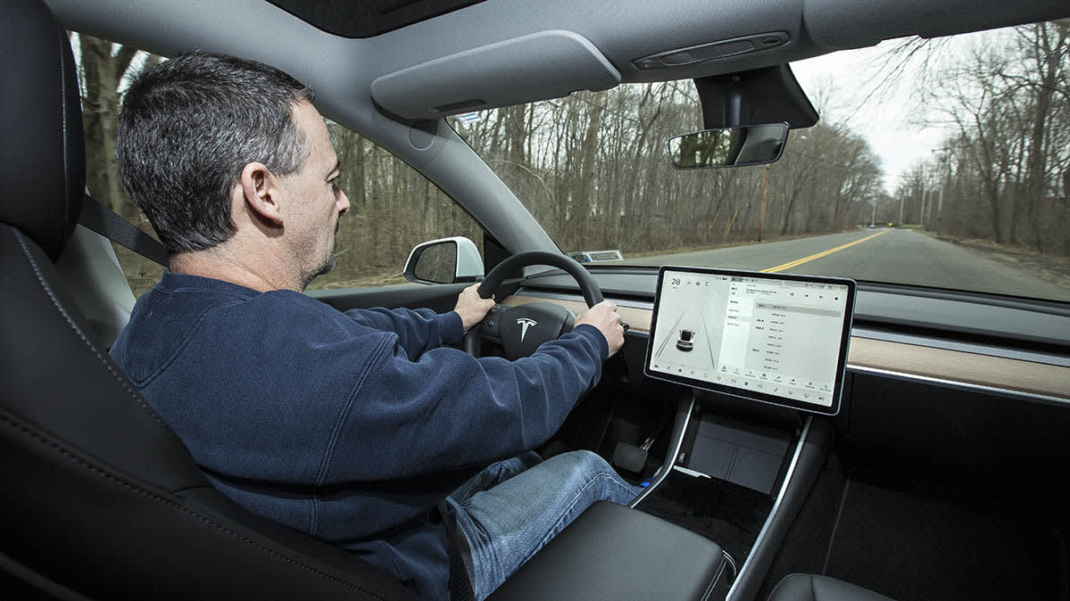
Tesla Cabin Cameras
Driver monitoring system aims to make sure drivers are paying attention.
If enabled by driver, cabin cameras record and transmit video of driver and passengers.
Will share video clips of the moments before a crash or automatic emergency brake activation.
https://www.consumerreports.org/privacy/teslas-in-car-cameras-raise-privacy-concerns/

Slide 34
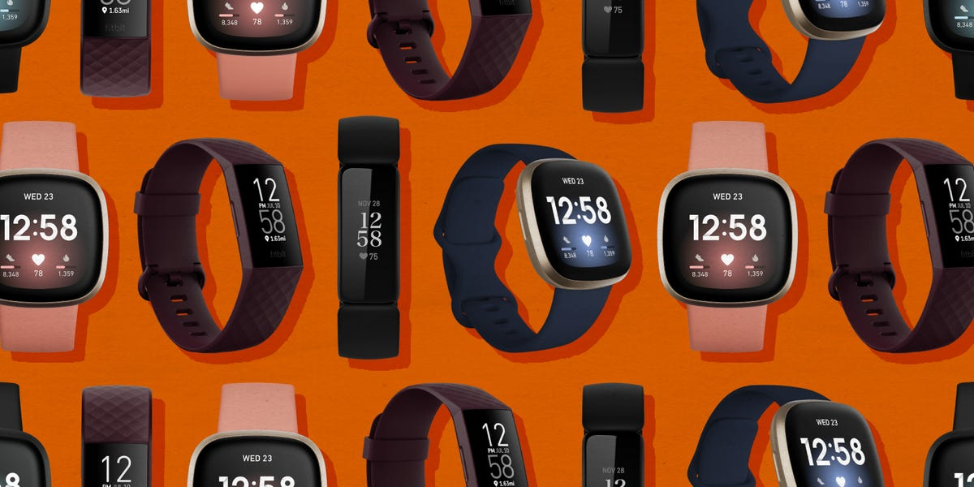
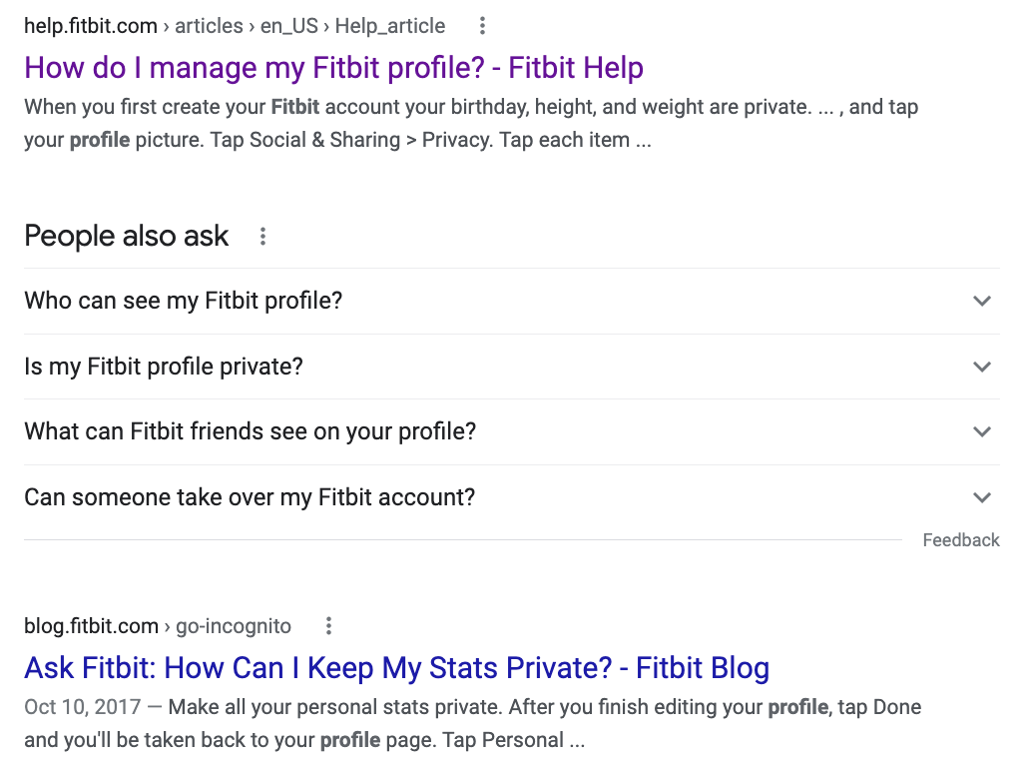

Slide 35
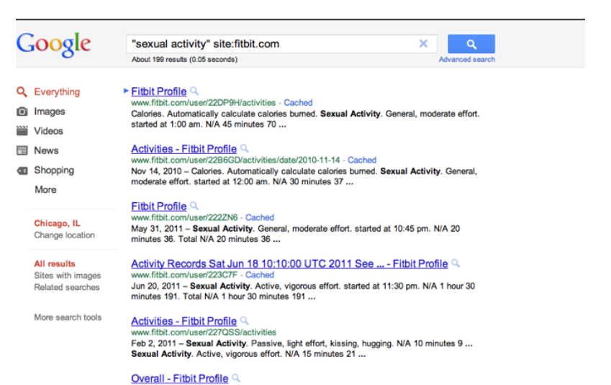
https://techcrunch.com/2011/07/03/sexual-activity-tracked-by-fitbit-shows-up-in-google-search-results/

Slide 36
Fitbit Can Still Reveal Secrets
“Sexual activity” is no longer available as a category but…

Slide 37
Bluetooth-enabled sex toys
Controlled from a smartphone, can give anyone in the world control of the device
The app collects information about how often the device is used and with what settings… also user’s email address
$3.75 million class action settlement
https://www.npr.org/sections/thetwo-way/2017/03/14/520123490/vibrator-maker-to-pay-millions-over-claims-it-secretly-tracked-use

