Slide 1
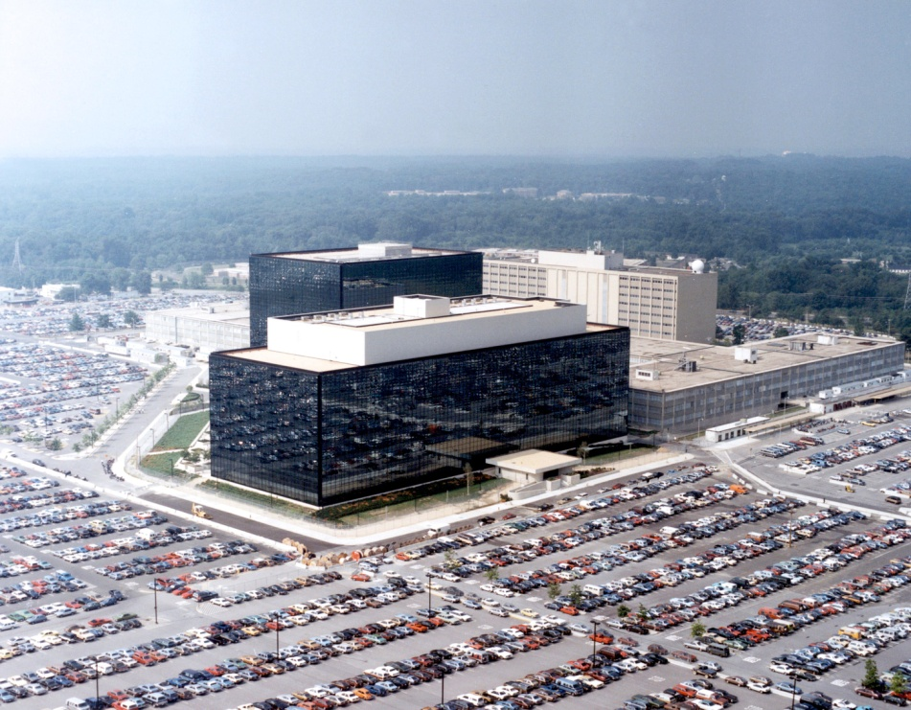
PriVACY IN THE DIGITAL AGE HELEN NISSENBAUM Vitaly Shmatikov
TAs: Ben Laufer
Kenny Peng

Slide 2
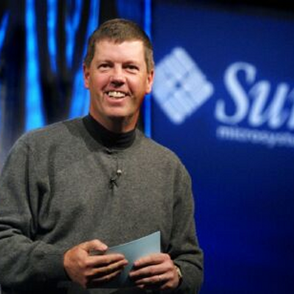
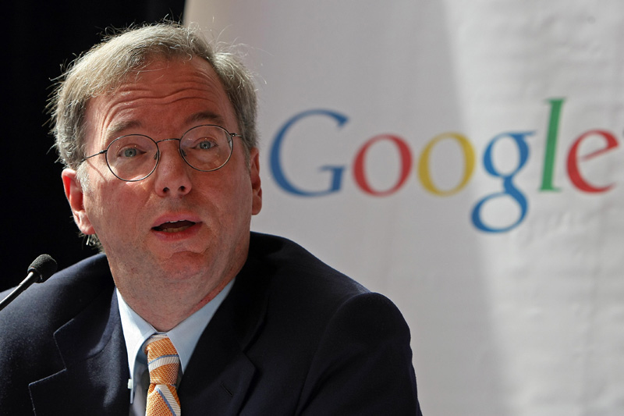
“Get over it”
“No one cares”
2010
2009
1999
“If you’ve done nothing wrong…”

Slide 3
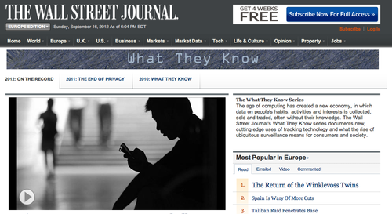
WSJ investigative series (2011-2012)

Slide 4
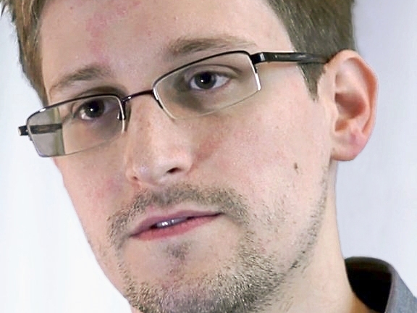
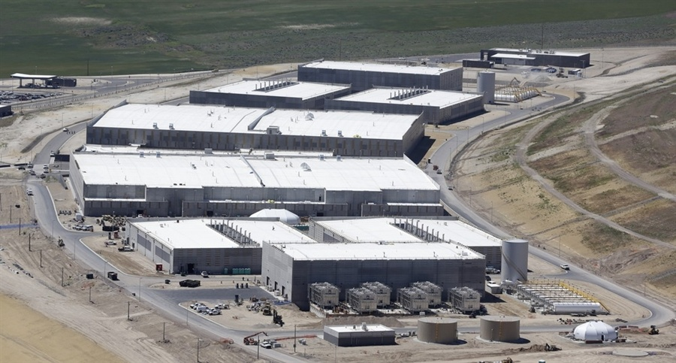

Slide 5
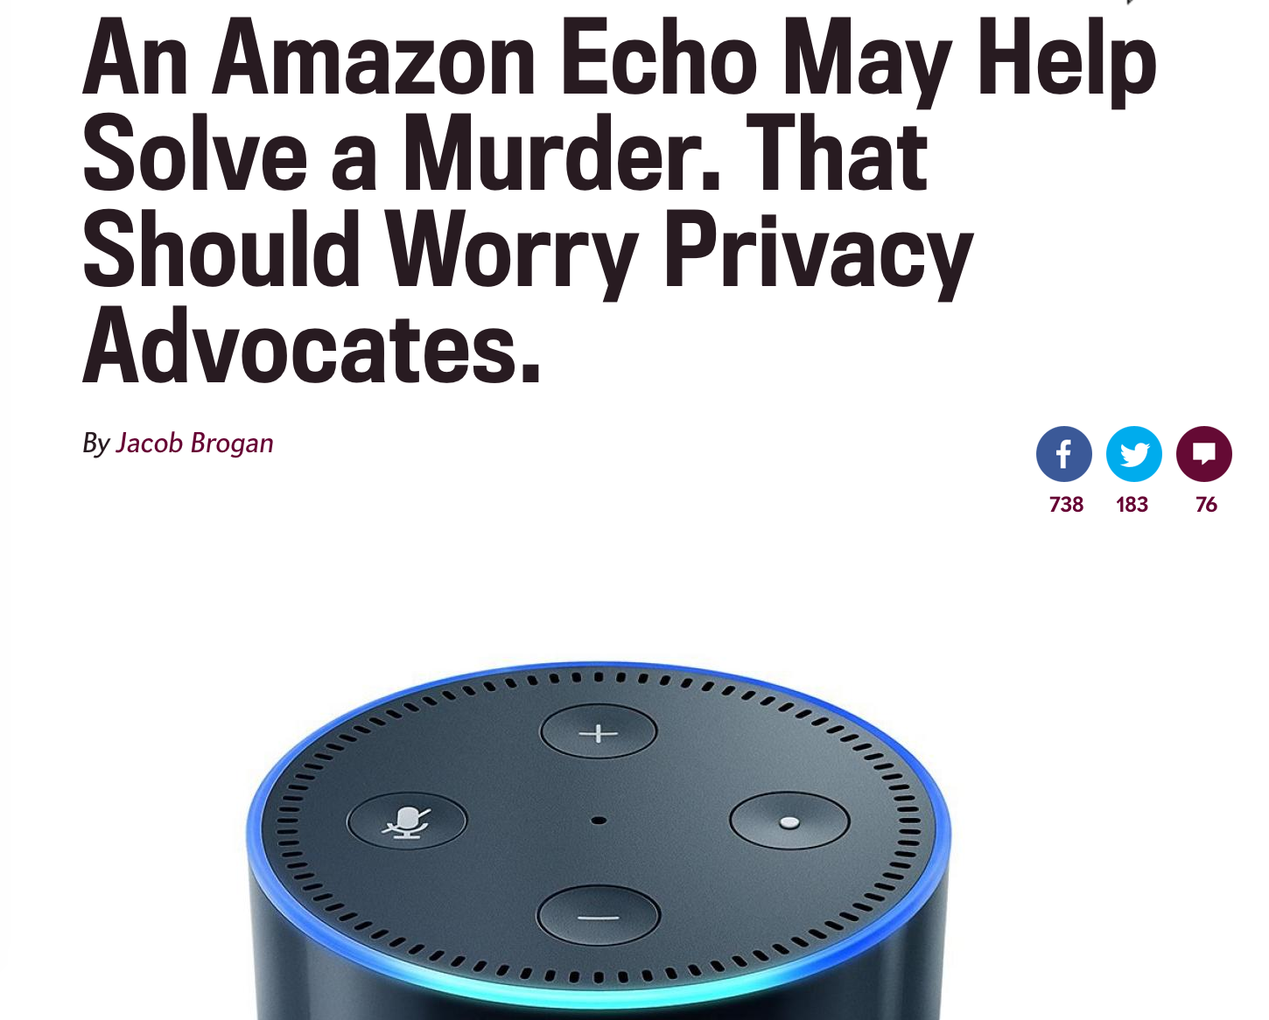
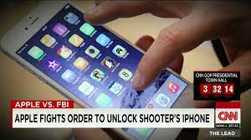

Slide 6
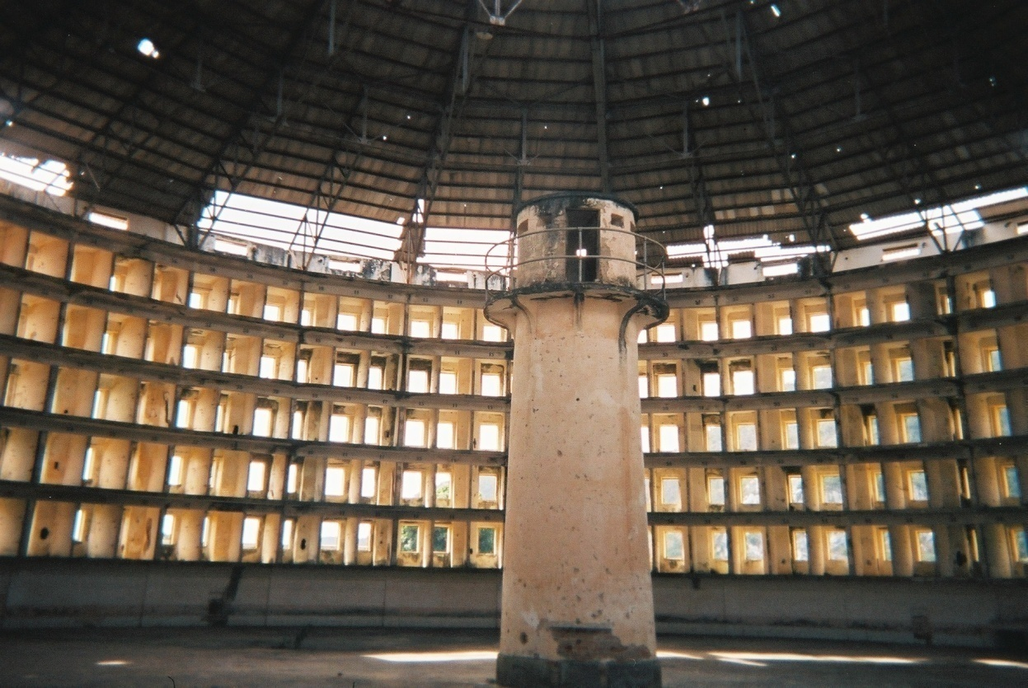
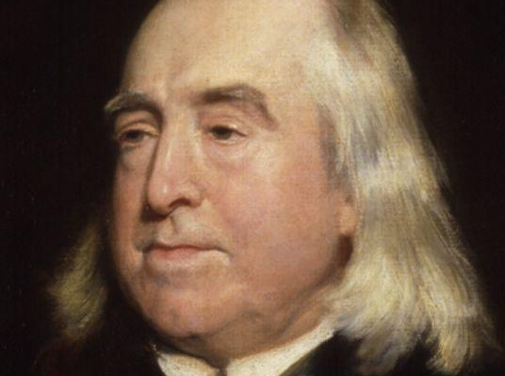
THE Internet Panopticon

Slide 7
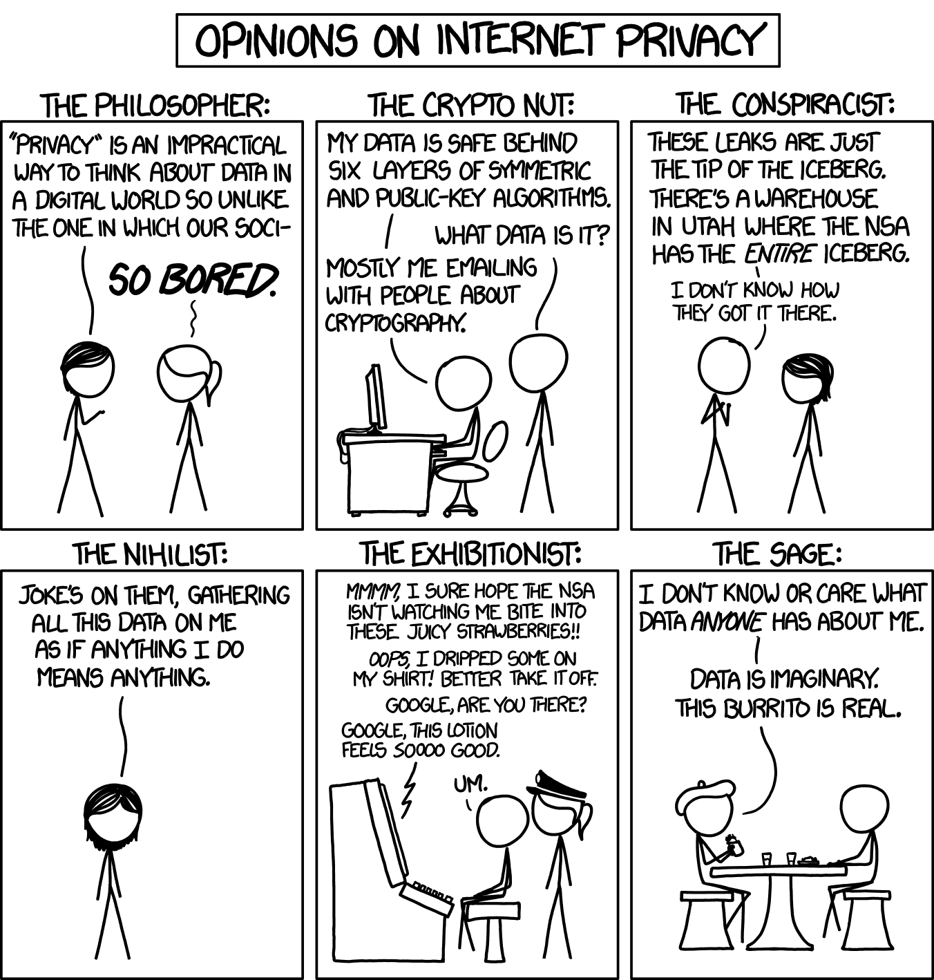
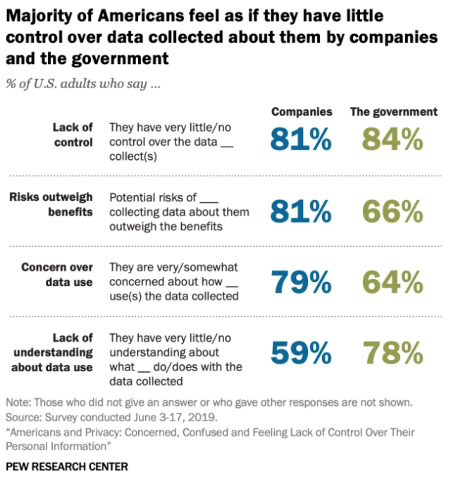

Slide 8
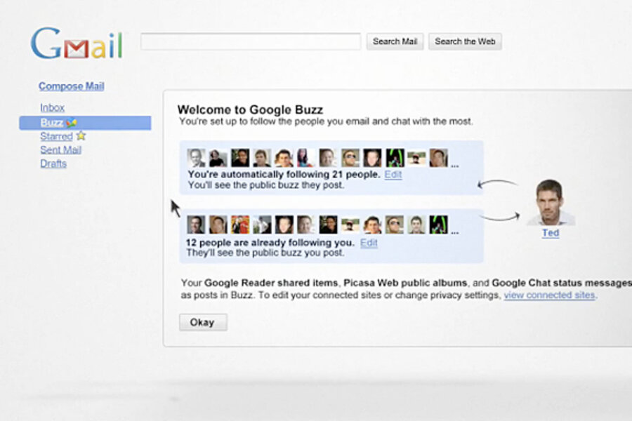
Anyone Remembers This One?
Image: Christian Science Monitor

Slide 9
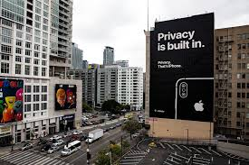
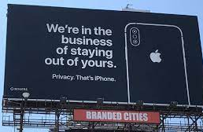
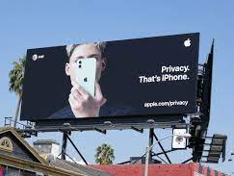
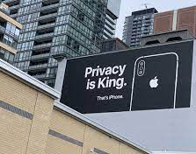
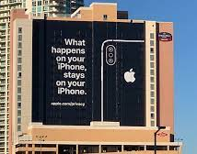

Slide 10
Prerequisites: In some combination of these
Expert knowledge of Web and mobile technologies
Knowledge of computer networking (at the level of an undergraduate CS course)
Knowledge of algorithms (at the level of an undergraduate CS course)
Familiarity with key machine learning techniques, especially deep learning
Eagerness to devote time and energy to non-technical material
Undergraduate-level coursework in one or more of the following: social science, philosophy, ethics
Ability to program
Familiarity with Web and mobile technologies
Introductory-level understanding of computer networking and machine learning
Willingness to try your hand at implementation

Slide 11
TECHNOLOGY
ETHICS
PRIVACY
POLICY
PHILOSOPHY
LAW

Slide 12
Syllabus
Web and mobile tracking
Location privacy
Data analytics and differential privacy
Communication privacy and “going dark”
Privacy in machine learning
Face recognition and biometrics
Genomic privacy
IoT privacy
Contextual integrity
Ethical and philosophical approaches to privacy
Legal landscape of privacy
Privacy engineering
Behavioral studies and empirical methods
Privacy policies
User studies and HCI issues

Slide 13
Some things change Some things stay the same
GPS, mobile, implantable devices, RFID, CCTV, sensors, networked sensors, image, video and audio, Web cookies, Flash cookies, Web bugs, cross-device, browser tracking
“Big Data”, databases, data aggregation, mining, predictive modeling, machine learning, data science, data analytics, AI, biometrics, facial recognition
Internet, Web, IoT, social computing, social networks, Email, mobile tech, “gig” work, social media platforms
Track
Surveil
Monitor
Profile
Predict
Target Manipulate
Communicate Socialize

Slide 14
Tech and Ethics Together: Solving the Right Problem
Keeping data secret?
Giving data subjects control?
Preventing bad uses of data?
Punishing bad uses of data?

Slide 15
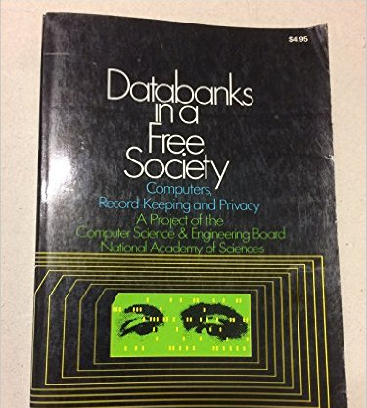
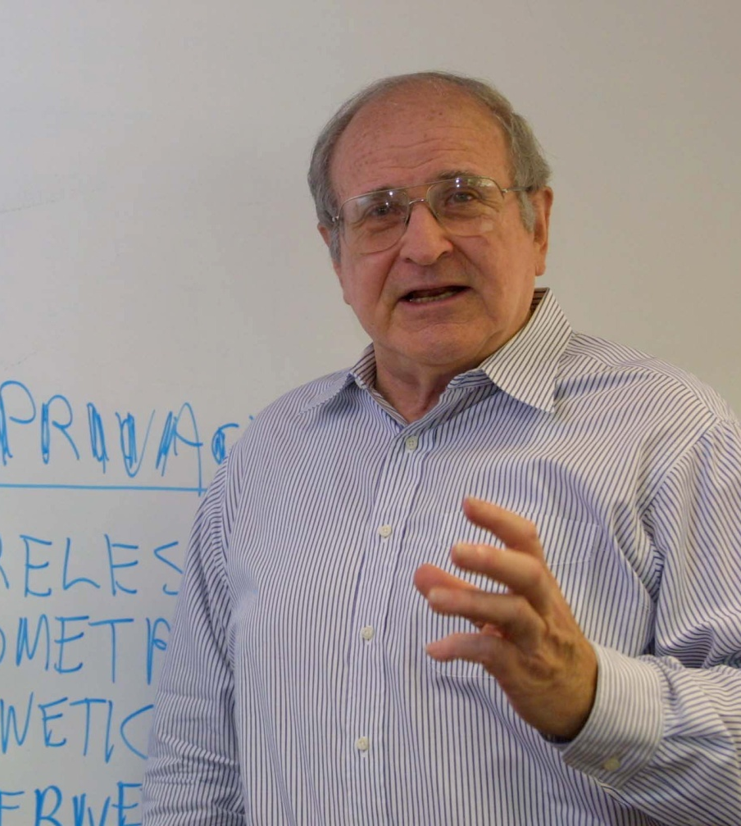
Philosophy & Ethics Meaningful privacy

Slide 16
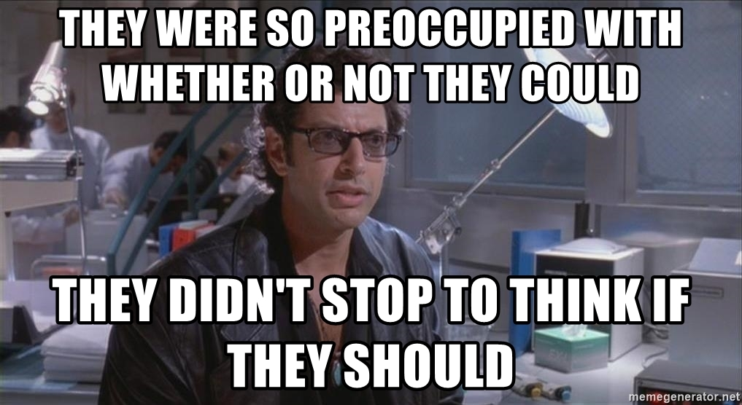
What does this mean? Right OR Wrong? + Individual action and decision + Societal policy (law, regulation, practice)
An Ethical Perspective on Privacy
RUTH GAVISON
PRIS REGAN
ISAIAH BERLIN
CHRIS HOOFNAGLE

Slide 17
Our textbook

Slide 18
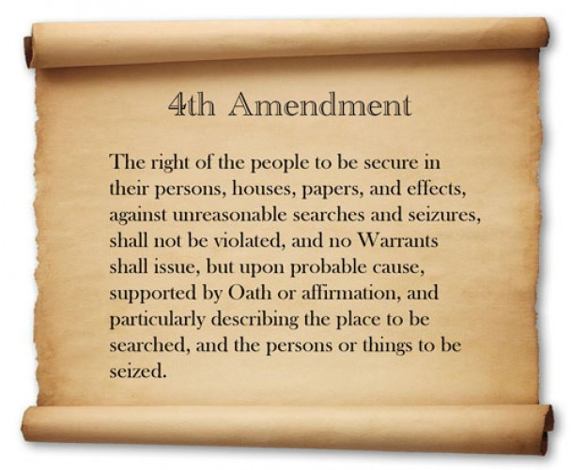
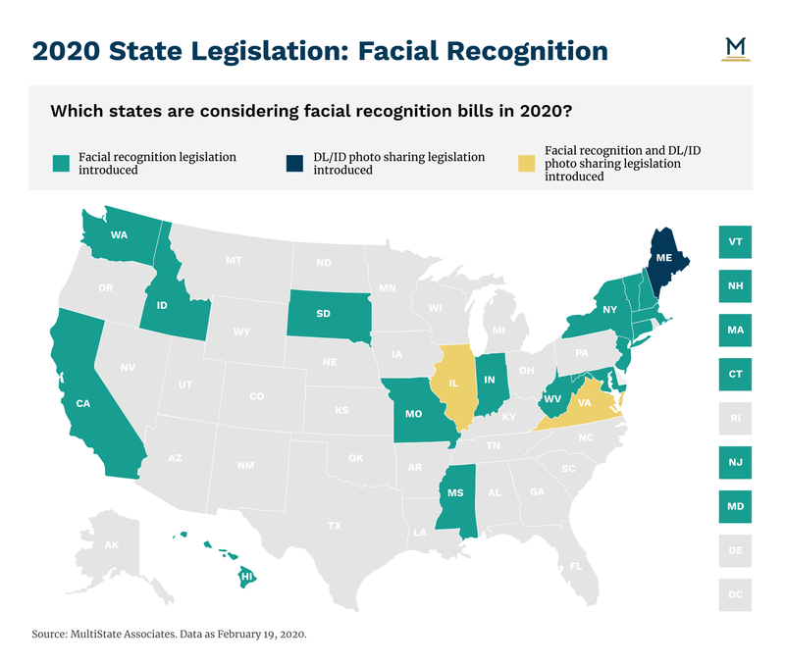
Legal Perspectives

Slide 19
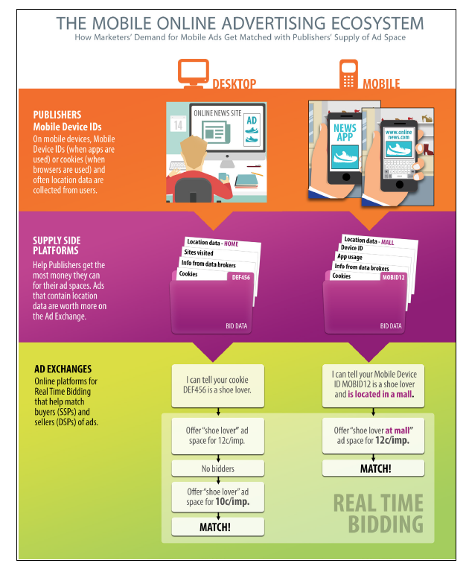
Policy Perspectives
Industry
Government

Slide 20
Course Logistics
Assignments will be a mix of questions. Some required for all students; others, pick your own among questions that are
• more technical,
• more with reading and writing, emphasis on ethical aspects
Grading
72% : four homeworks (18% each)
18% take-home final exam
10% class participation
Website (schedule, readings)
https://www.cs.cornell.edu/~shmat/courses/cs5436/
Slack (lecture notes, discussion)
Also see material on Canvas
Be sure to join Slack!

Slide 21
Homework Logistics
Teaming policy will be announced for each homework
Late submission policy: each student gets 2 slip days for the entire course
Use them as you see fit, but late submissions will not be accepted after the slip days are used
No slip days for the take-home final

Slide 22
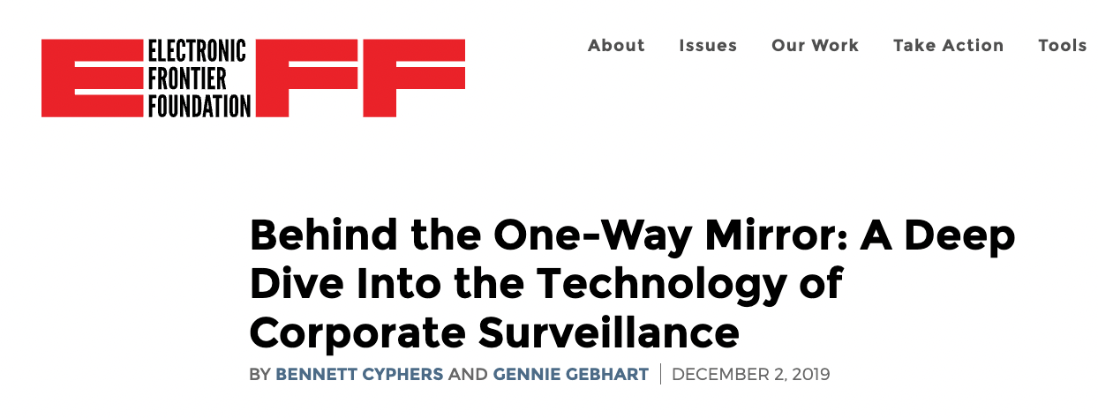
Assigned Reading

