Slide 1
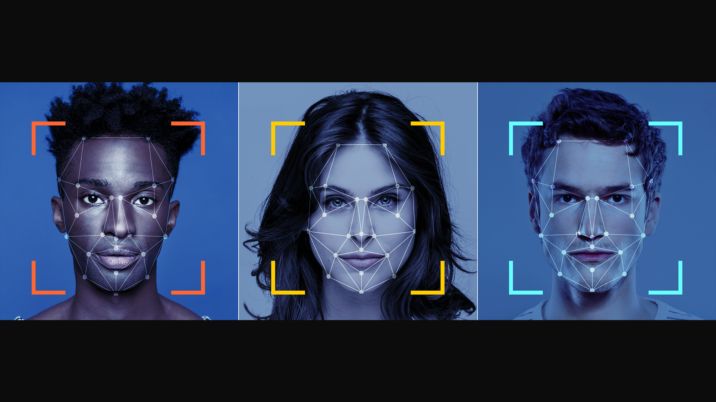
FACE RECOGNITION
PRIVACY OF BIOMETRICS

Slide 2
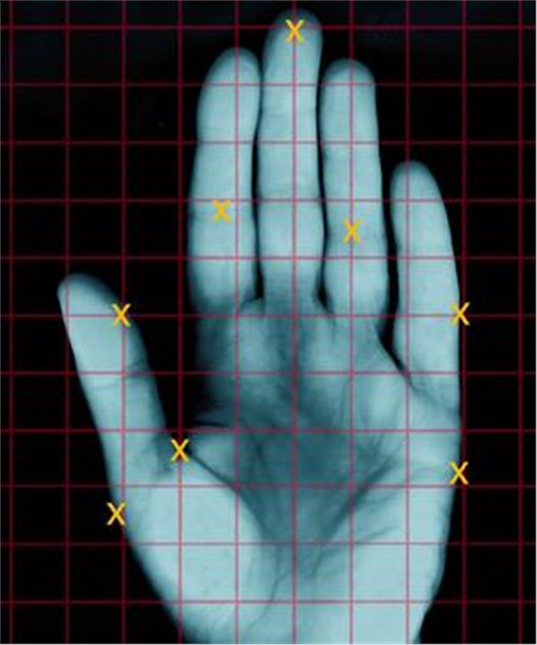
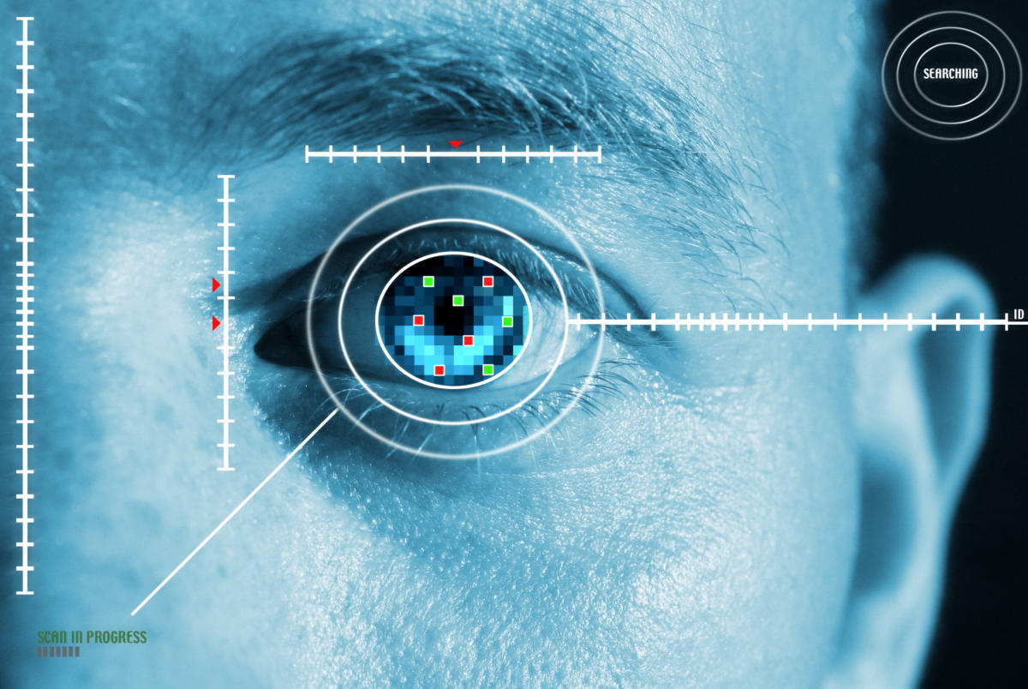
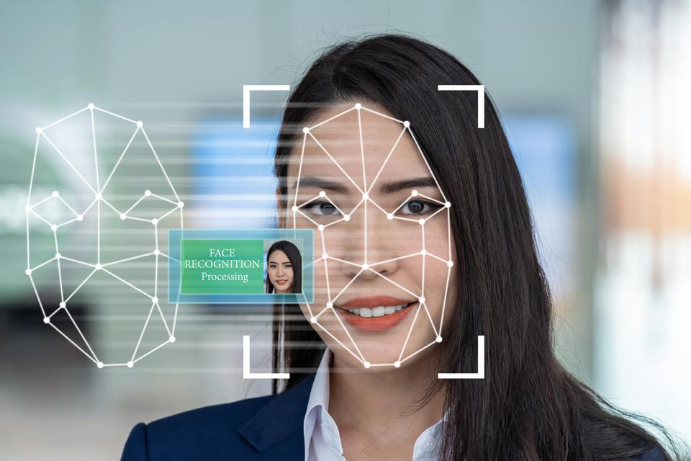
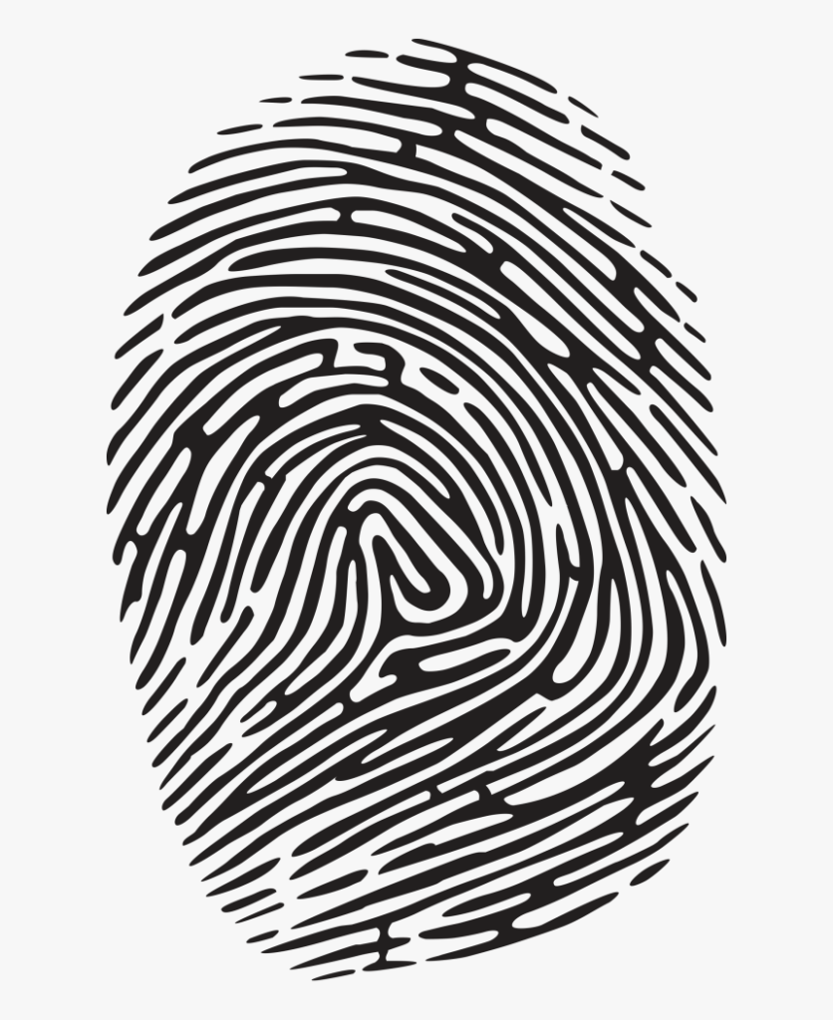

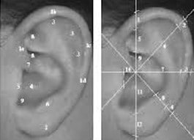
Biometrics

Slide 3
Identification vs Authentication
Authentication
  Verify that a person is who they claim they are
Identification
  Identify a person who was in a particular location at a particular time, or performed a certain action, or provided data
http://www.rogerclarke.com/DV/Biometrics.html

Slide 4

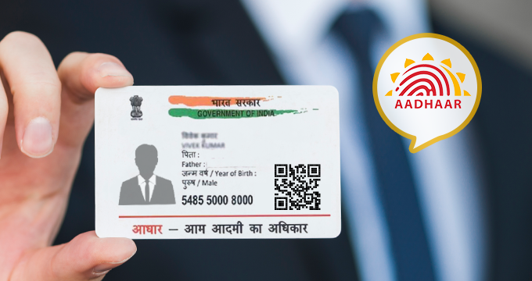
Biometrics for Government Services
Fingerprints: welfare recipients in New York, California, other states
Facial identification: many federal agencies
Aadhaar identity card (world’s largest biometric ID system)
Fingerprints and iris scans

Slide 5
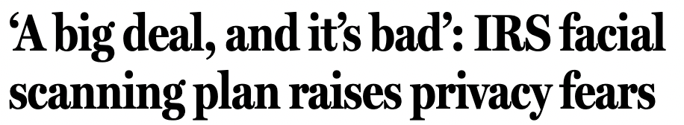
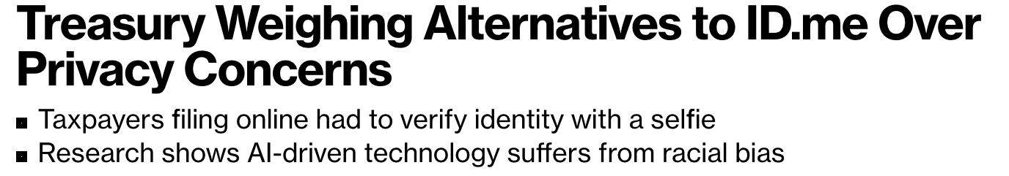
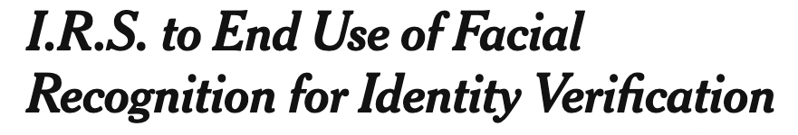
using ID.me

Slide 6
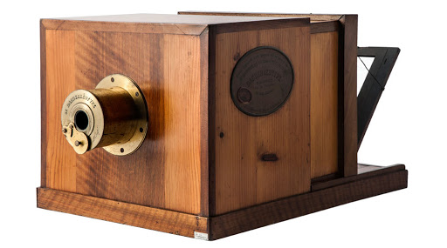
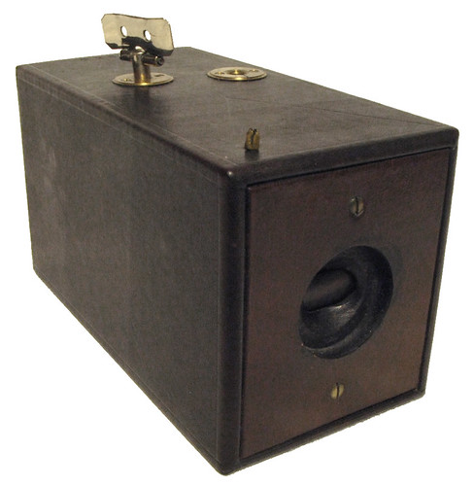
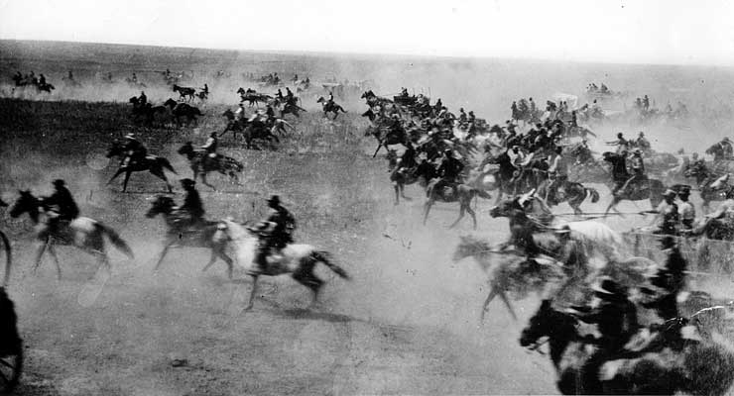
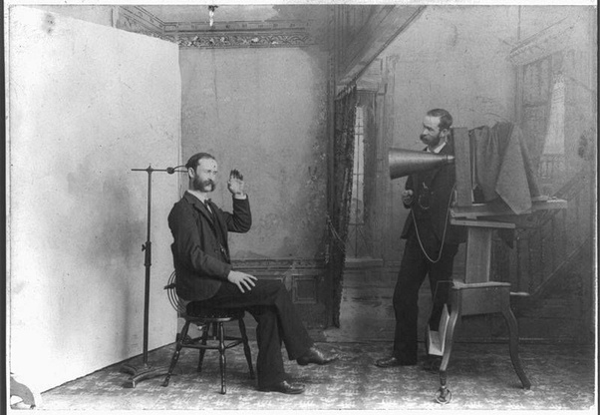
The Kodak No. 1 camera (1888)
The Daguerreotype camera (1839)
15 minutes to take a photo

Slide 7
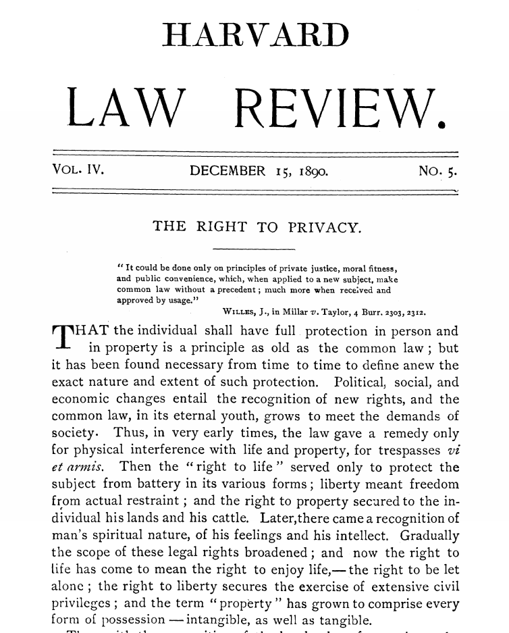
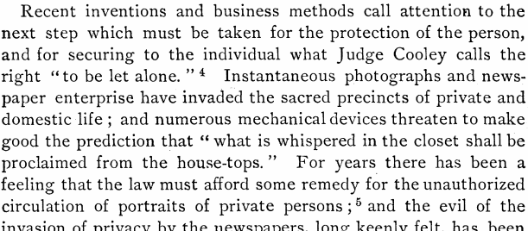


Remember Warren and Brandeis?

Slide 8
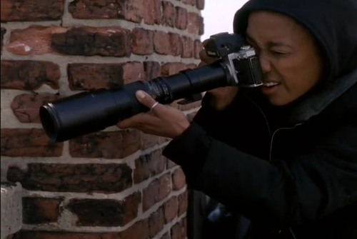
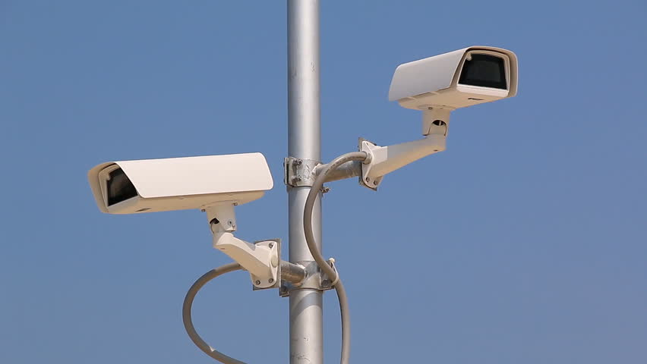
What’s Special About Faces?
can be captured at a distance
… on a massive scale
… and linked to identity

Slide 9
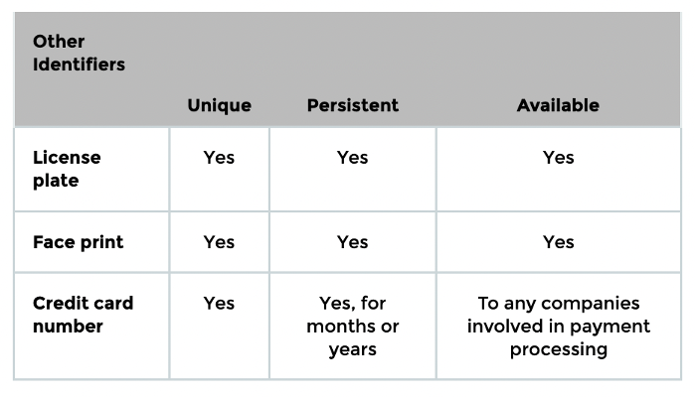
Identifiers
Unique
  Points only to you or your device
Persistent
  Does not change often
Available
  Easy for advertiser to access
Examples: name, email, phone number
Source: Cyphers and Gebhart. “Behind the One-Way Mirror”.

Slide 10
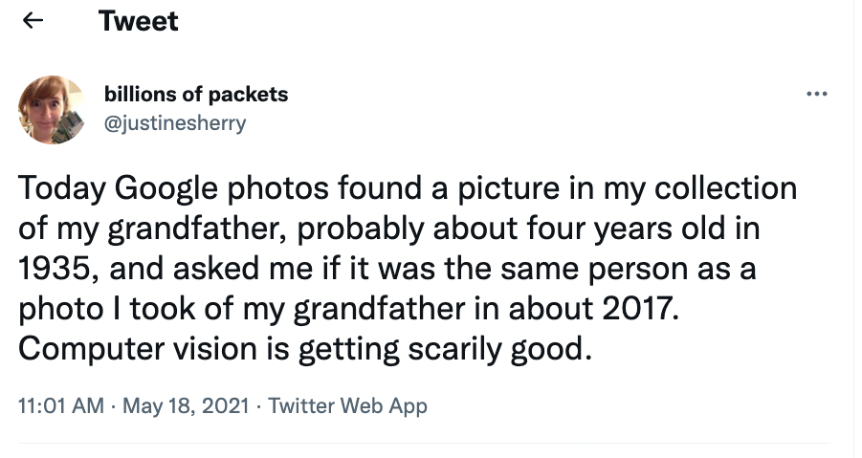

Slide 11
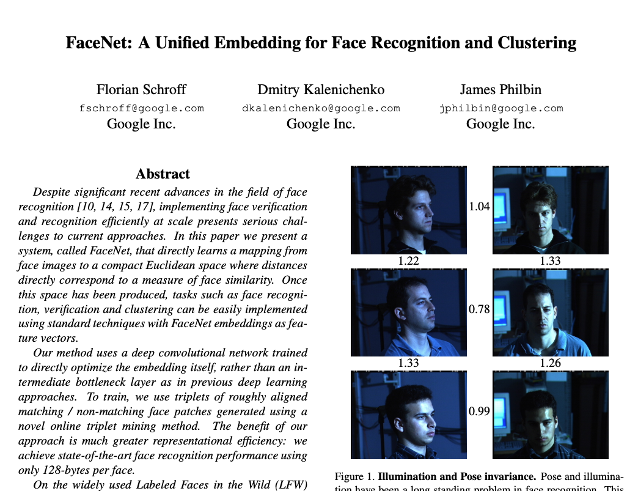
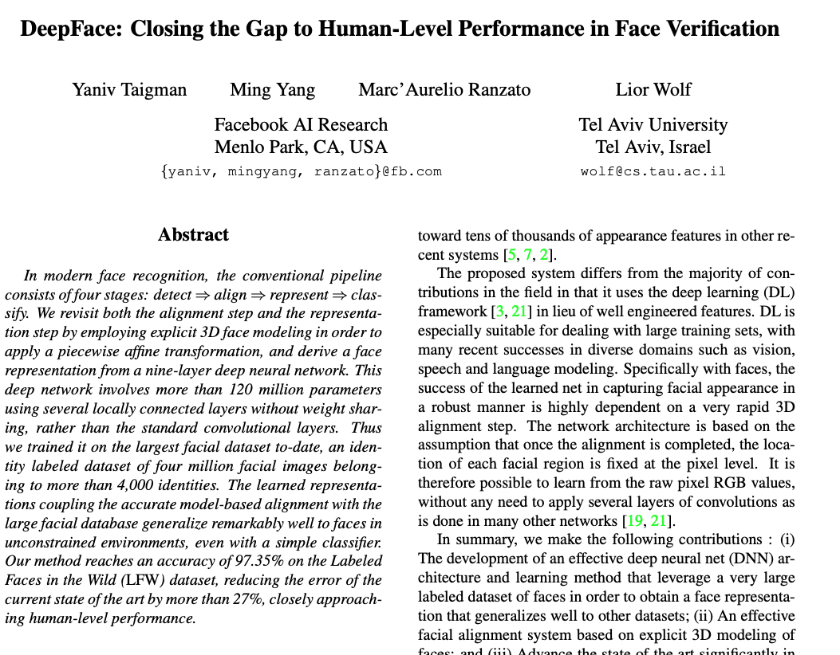
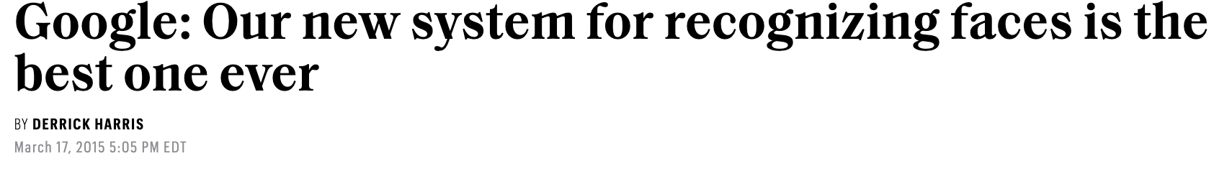
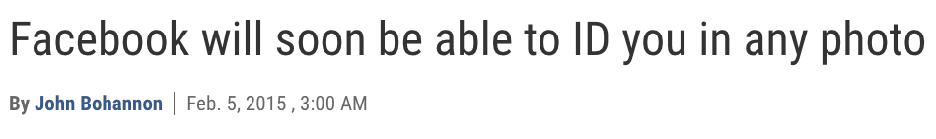

Slide 12
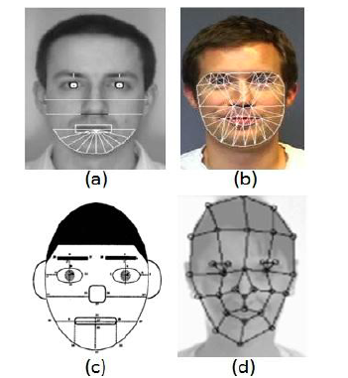
Faceprints
Divide the face into geometric shapes, map distances between “landmarks” such as nose, eyes, mouth, compute a unique code
Goal: code is based on a set of features that are specific to the individual and robust under different angles and lighting conditions
Image source: Feng and Prabhakaran. “Facilitating Fashion Camouflage Art”.

Slide 13
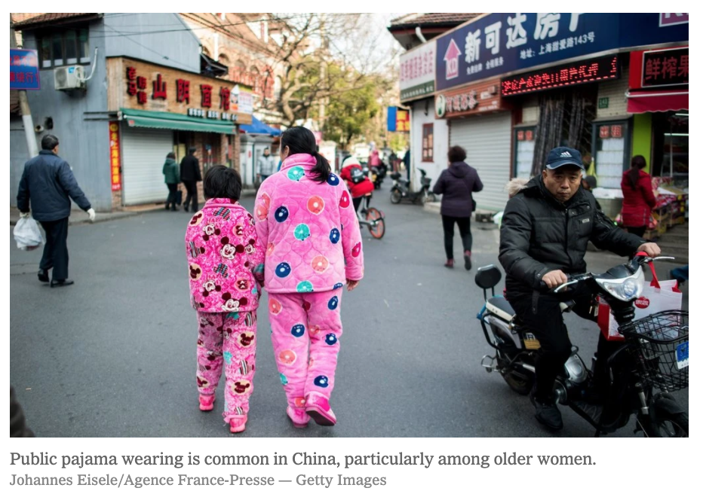



The urban management department of Suzhou, a city of six million people in Anhui Province, sparked outrage online when it published surveillance photos taken by street cameras of seven residents wearing pajamas in public along with parts of their names, government identification numbers and the locations where their “uncivilized behavior” had taken place.
https://www.nytimes.com/2020/01/21/business/china-pajamas-facial-recognition.html

Slide 14
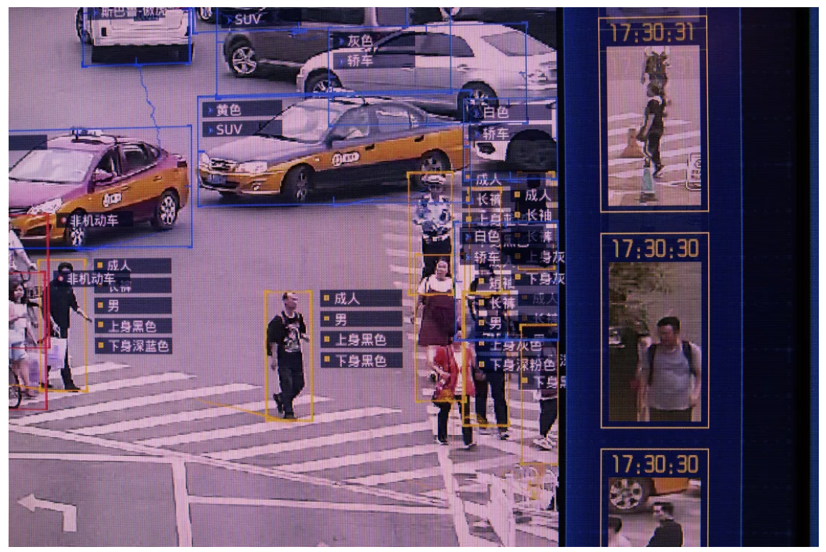

SenseNets database leak (2019)
Chinese company accidentally leaked database online
Faces recorded by 1,039 cameras across China
2.5 million records on people, including their ID card number, address, birthday, locations
6.8 million locations logged in 24 hours
  Police stations, hotels, tourist spots, parks, cafes, mosques…
https://www.cnet.com/news/chinese-facial-recognition-company-left-database-of-peoples-location-exposed/

Slide 15
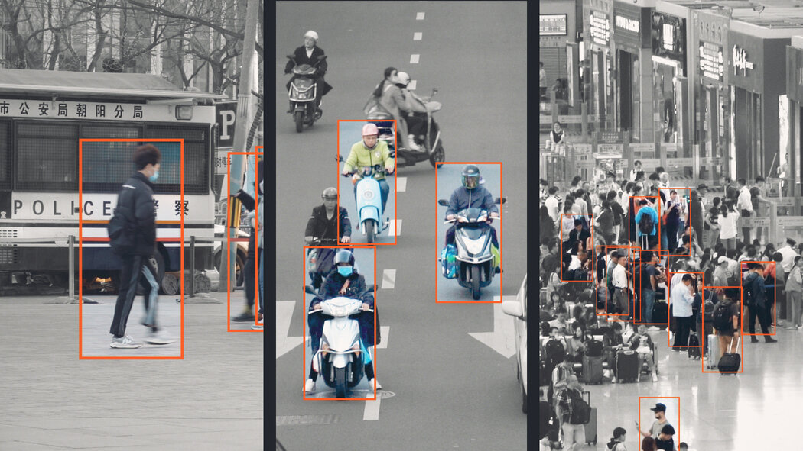
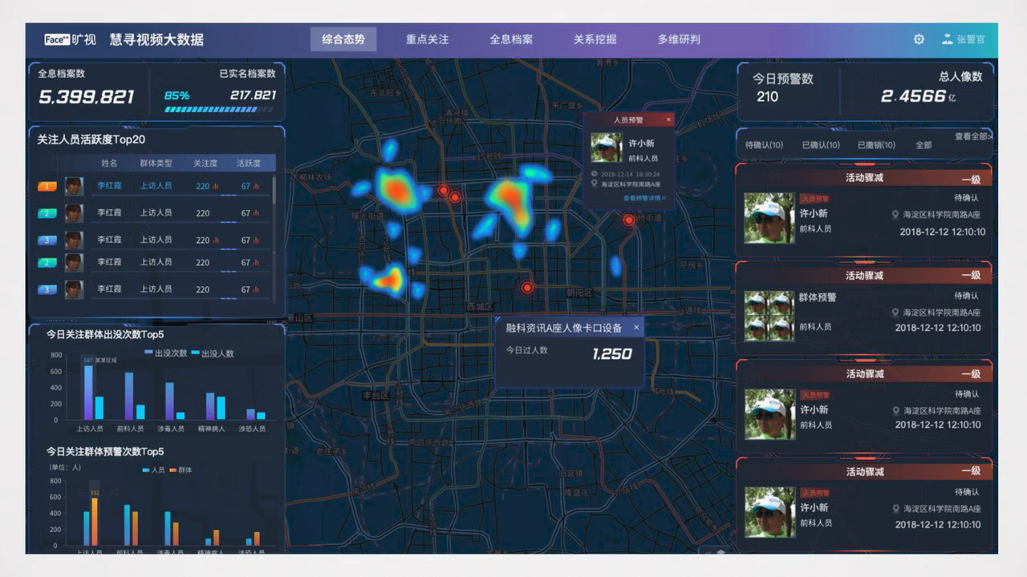
China’s Surveillance State
Integrated, comprehensive monitoring of faces, locations, movements, purchases
Target certain categories of citizens
Search for patterns associated with undesirable behaviors
Predictive policing: prevent crimes before they happen
https://www.nytimes.com/2022/06/25/technology/china-surveillance-police.html

Slide 16
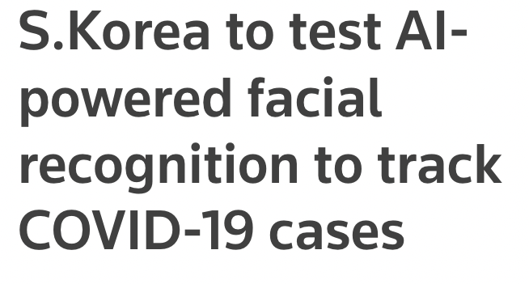
The system uses an AI algorithms and facial recognition technology to analyse footage gathered by more than 10,820 CCTV cameras and track an infected person’s movements, anyone they had close contact with, and whether they were wearing a mask
Similar system in Western Australia to enforce quarantine orders
https://www.reuters.com/world/asia-pacific/skorea-test-ai-powered-facial-recognition-track-covid-19-cases-2021-12-13/

Slide 17
U.S. Capitol Riot (Jan 6, 2021)
https://www.washingtonpost.com/technology/2021/04/02/capitol-siege-arrests-technology-fbi-privacy/

Slide 18
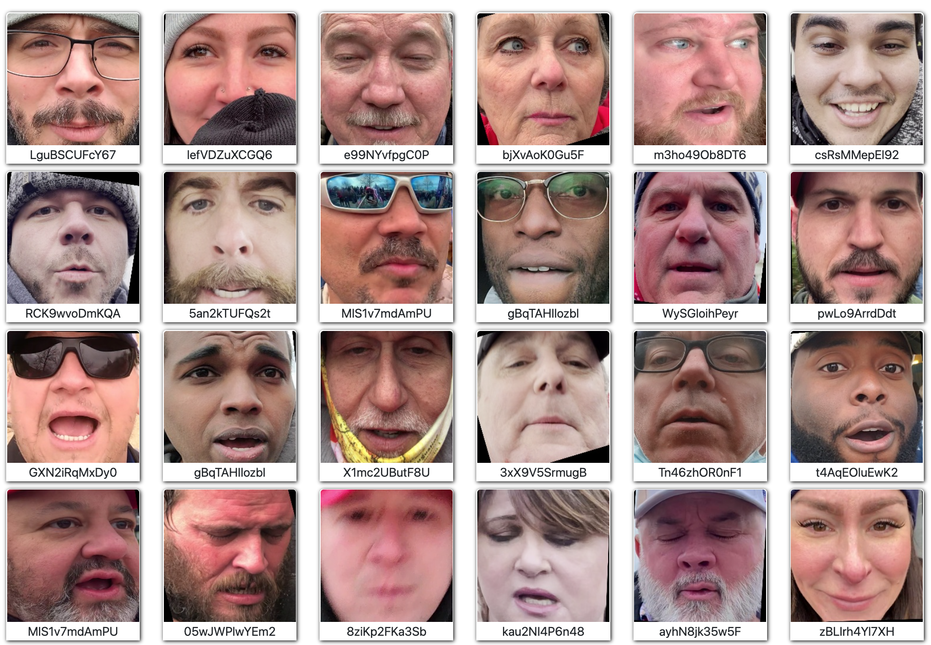

Faces of the Riot
A bug in Parler enabled unlimited download of every message, photo, and video posted to the site, along with geolocation metadata
Faces of the Riot cataloged and published every face appearing in the videos of the Jan 6, 2021 Capitol riot (over 6000 faces)

Slide 19
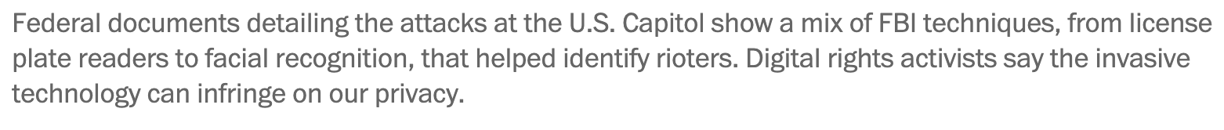
“Put your mask on,” warned her fiance, as the couple stood beneath an unblinking array of surveillance cameras. “I don’t want them to see you.”
It was too late.
https://www.washingtonpost.com/technology/2021/04/02/capitol-siege-arrests-technology-fbi-privacy/

Slide 20
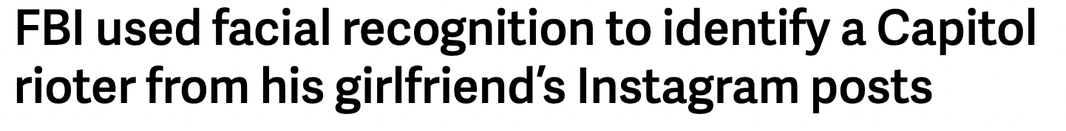
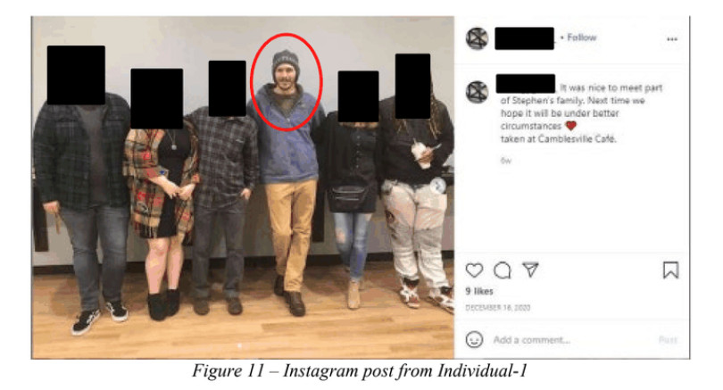
federal agents tracked down an individual named Stephen Chase Randolph using crowdsourced images from the riots (including those shared on Twitter by a group known as SeditionHunters). They searched these pictures on the web using “an open source facial recognition tool, known to provide reliable results,” and this led to a public Instagram page apparently belonging to Randolph’s girlfriend which contained “numerous images” of the suspect.
https://www.theverge.com/2021/4/21/22395323/fbi-facial-recognition-us-capital-riots-tracked-down-suspect

Slide 21
A sprawling mix of FBI techniques: license plate readers that captured suspects’ cars on the way to Washington; cell-tower location records that chronicled their movements through the Capitol complex; facial recognition searches that matched images to suspects’ driver’s licenses or social media profiles; and a remarkably deep catalogue of video from surveillance systems, live streams, news reports and cameras worn by the police who swarmed the Capitol that day.
900 search warrants in all 50 states and D.C. against all major telecom providers and social media services.
Investigators also sent “geofence” search warrants to Google, asking for the account information of any smartphone Google had detected on Jan. 6 inside the Capitol via GPS satellites, Bluetooth beacons and WiFi access points. Investigators then compiled an “exclusion list” of phones owned by people who were authorized to be in the Capitol on Jan. 6, including members of Congress and first responders. Everyone else was fair game.
Federal officials filed similarly broad search warrants to Facebook, demanding the account information associated with every live stream that day from inside the vast complex.
https://www.washingtonpost.com/technology/2021/04/02/capitol-siege-arrests-technology-fbi-privacy/

Slide 22
Vogel had his round-trip voyage to D.C. photographed by license plate readers at least nine times on Jan. 6… no license plate scanners captured his car in D.C. [but] a photo that morning from a stretch of Interstate 95 northeast of Baltimore showed a comically oversized “Make America Great Again” hat on Vogel’s dashboard. Agents matched it to a Facebook selfie in which he appeared to be wearing “the same large red hat.”
Beckley… deleted his Facebook and removed his phone’s SIM card… agents were still able to match his face in cellphone videos and Capitol photos to his Kentucky driver’s license. (Federal investigators in Kentucky and other states are legally authorized to view state Department of Motor Vehicles records, no subpoena required.)
Investigators also filed a 33-page search warrant with Facebook demanding virtually everything Beckley had done on the site dating back to Nov. 1: all messages, draft messages, posts, comments, photos, videos, audio recordings, video calls, “pokes,” “likes,” “tags,” searches, location check-ins, privacy settings, session times and durations, calendar items, event postings (past and future), friend requests (approved and rejected), address books, friend lists and relationship status updates, as well as all dates, times, IP addresses, location information and other metadata linked to each item, plus any information he’d shared with the company, including his passwords, security questions, home address, phone number and any linked credit cards or bank accounts.
The Miami police team has run 129 facial recognition searches through Clearview
The FBI also has been aided by the online army of self-proclaimed “sedition hunters”
https://www.washingtonpost.com/technology/2021/04/02/capitol-siege-arrests-technology-fbi-privacy/

Slide 23

“Whenever you see this technology used on someone you don’t like, remember it’s also being used on a social movement you support… Once in a while, this technology gets used on really bad people doing really bad stuff. But the rest of the time it’s being used on all of us, in ways that are profoundly chilling for freedom of expression.”
Evan Greer
Fight for the Future
https://www.washingtonpost.com/technology/2021/04/02/capitol-siege-arrests-technology-fbi-privacy/

Slide 24
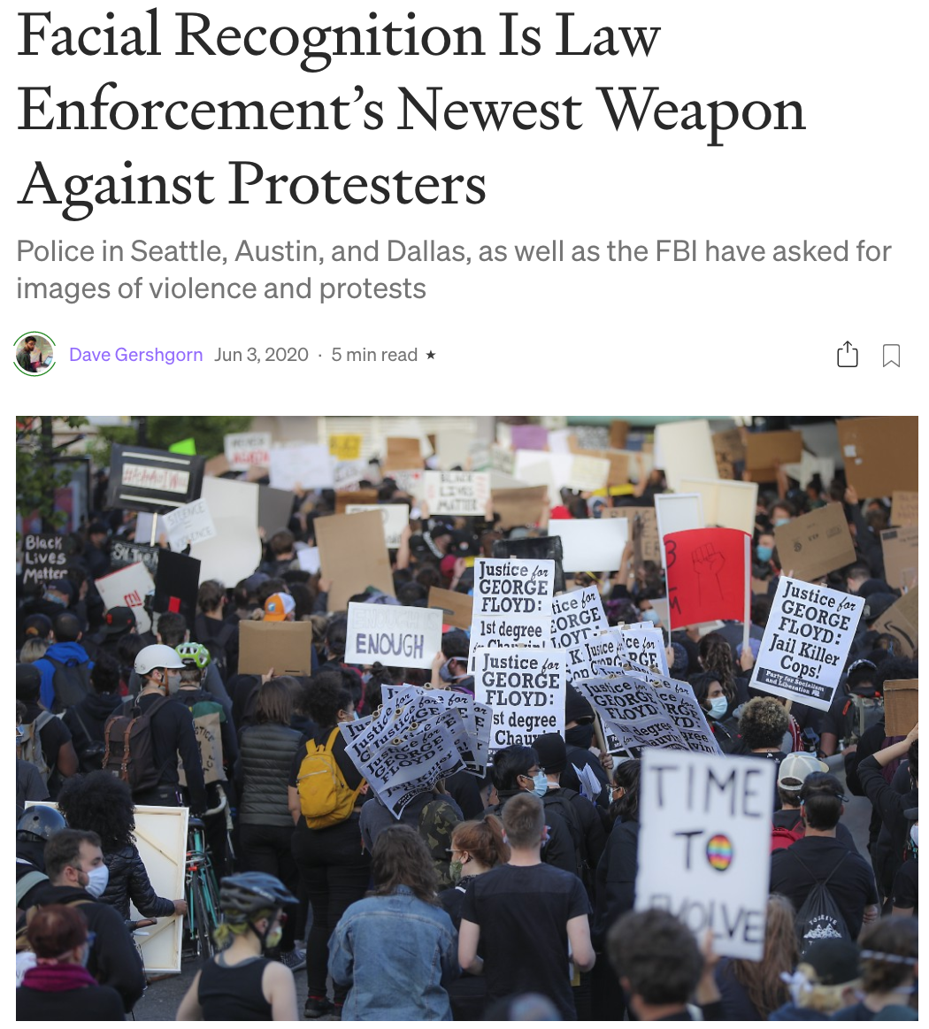
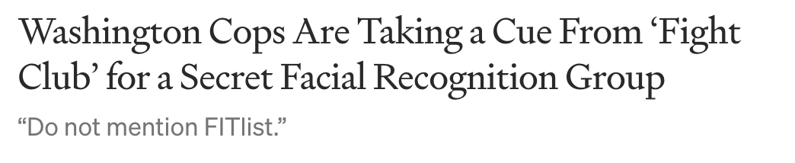
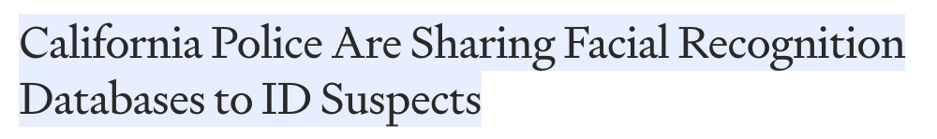
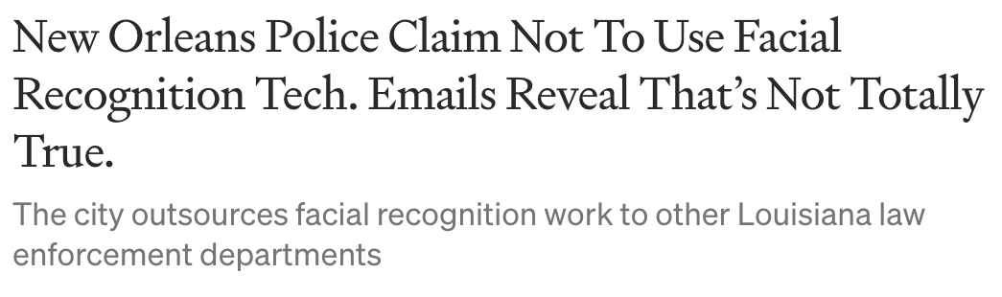


Technology and data sharing law enforcement networks
https://onezero.medium.com/facial-recognition-is-law-enforcements-newest-weapon-against-protestors-c7a9760e46eb
https://onezero.medium.com/california-police-are-sharing-facial-recognition-databases-to-id-suspects-3317726d31ad
https://onezero.medium.com/new-orleans-police-claim-not-to-use-facial-recognition-tech-emails-reveal-thats-not-totally-true-465f8cd9a71c
https://onezero.medium.com/secret-emails-reveal-how-washington-state-cops-shared-facial-recognition-tech-db8a799c6de6

Slide 25
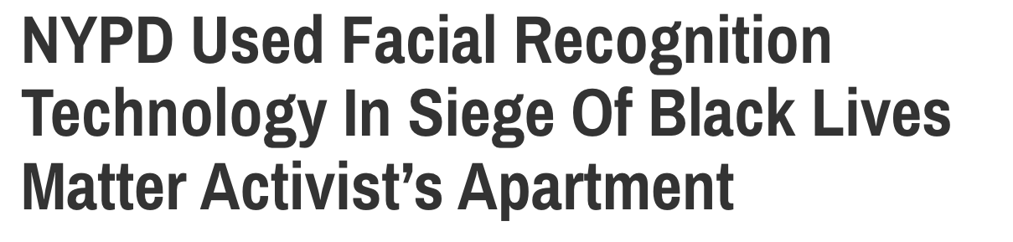
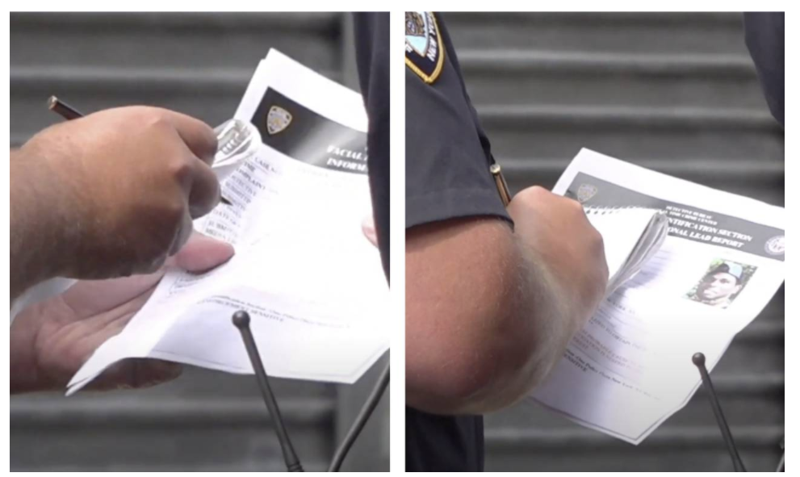
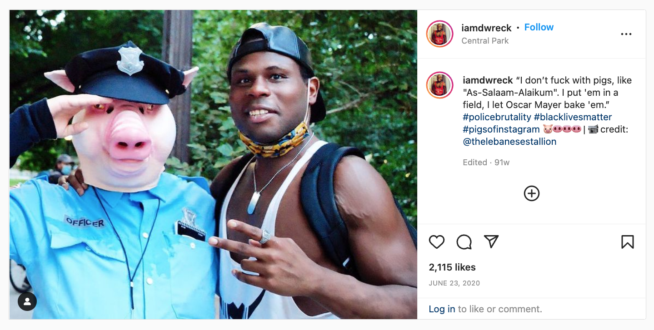


“Facial Identification Section Informational Lead Report”
"The NYPD uses facial recognition as a limited investigative tool, comparing a still image from a surveillance video to a pool of lawfully possessed arrest photos"
Derrick Ingram, activist
https://gothamist.com/news/nypd-used-facial-recognition-unit-in-siege-of-black-lives-matter-activists-apartment

Slide 26
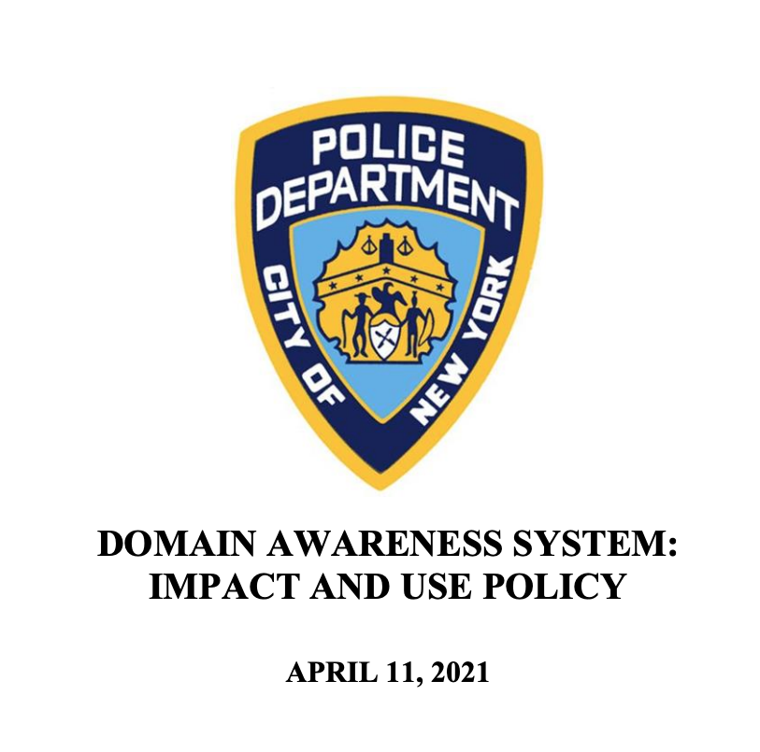
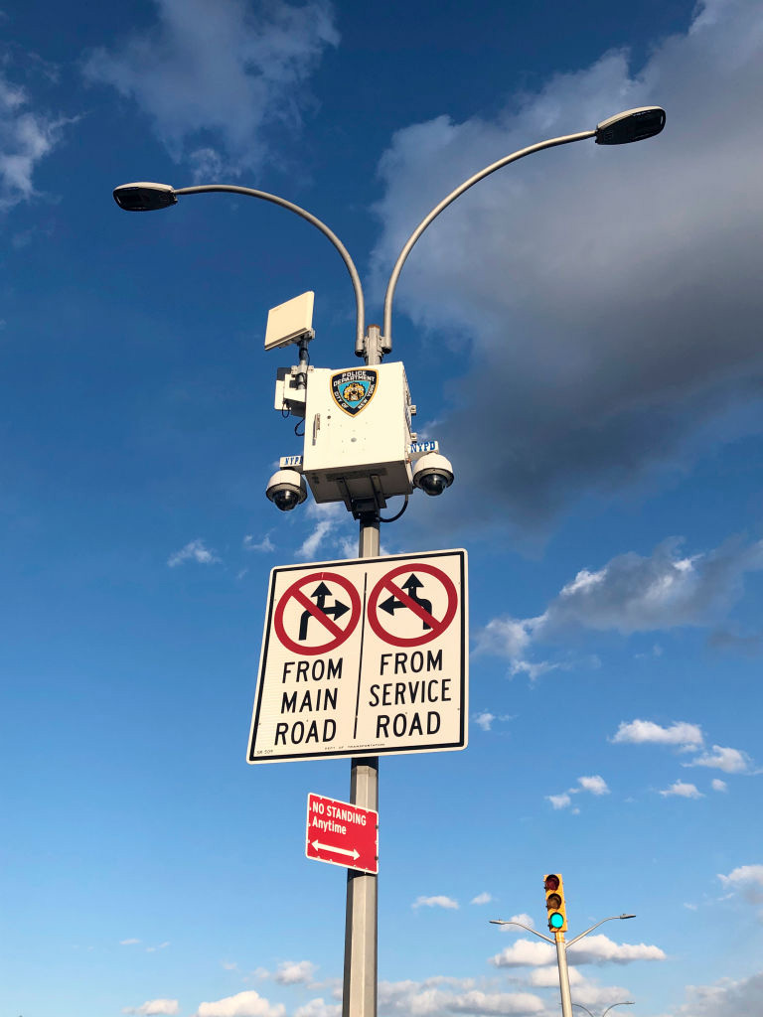
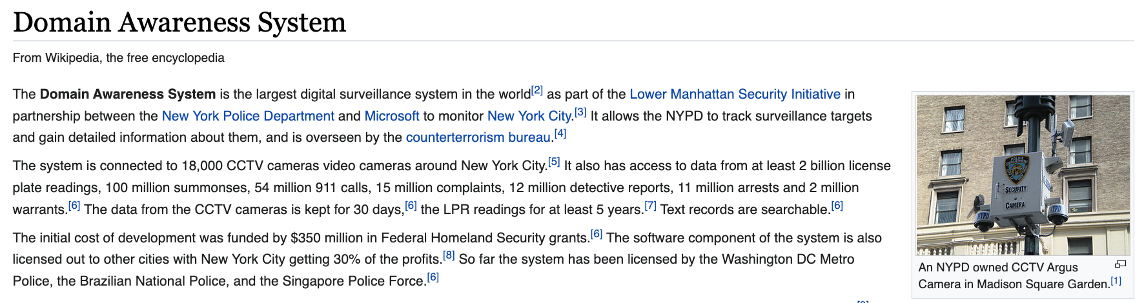


NYPD Argus dome surveillance camera

Slide 27
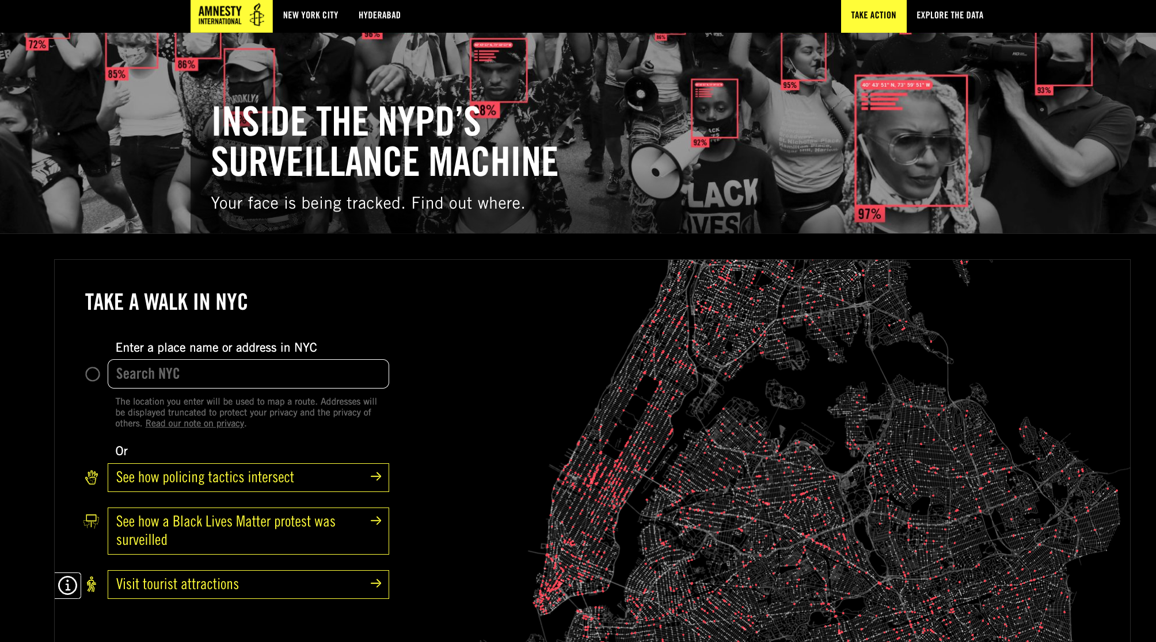
https://banthescan.amnesty.org/decode/

Slide 28
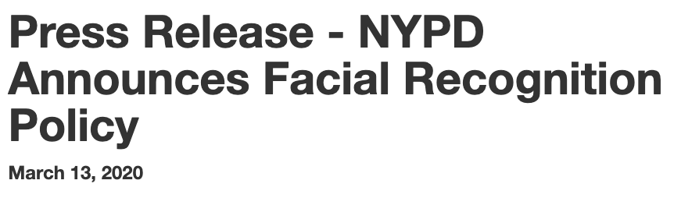
Authorized uses
a) To identify an individual when there is a basis to believe that such individual has committed, is committing, or is about to commit a crime,
b) To identify an individual when there is a basis to believe that such individual is a missing person, crime victim, or witness to criminal activity,
c) To identify a deceased person,
d) To identify a person who is incapacitated or otherwise unable to identify themselves,
e) To identify an individual who is under arrest and does not possess valid identification, is not forthcoming with valid identification, or who appears to be using someone else's identification, or a false identification, or
f) To mitigate an imminent threat to health or public safety (e.g. to thwart an active terrorism scheme or plot, etc).

Slide 29
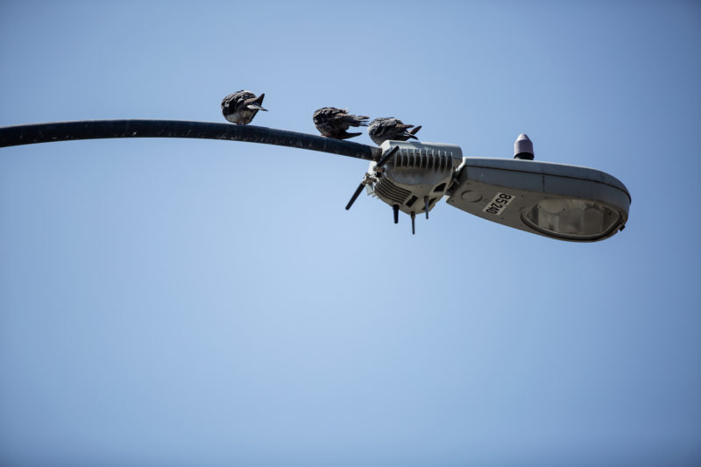
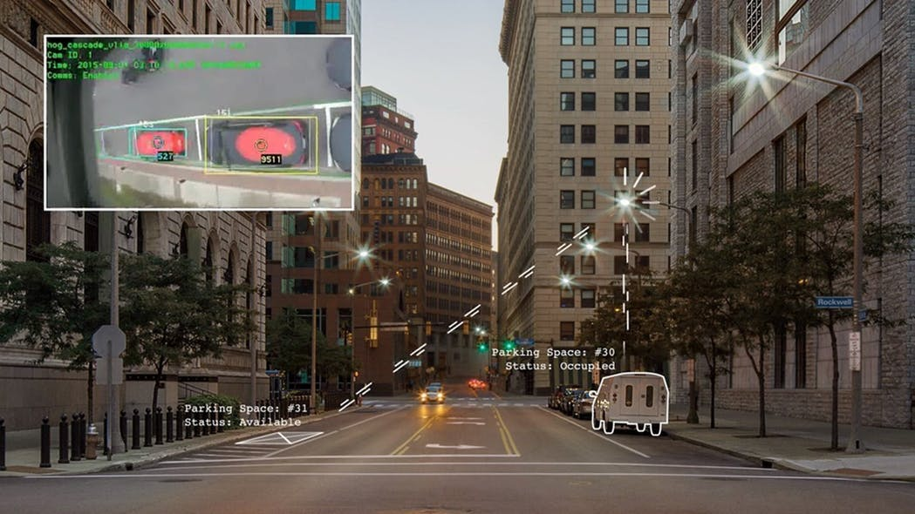
San Diego “smart streetlights”
Round-the-clock video uploaded to cloud storage
  Records private property, which is then “scrubbed” by software
Microphones (currently disabled?)
Environmental sensors
All data supposed to be publicly available in “anonymized” form, for the benefit of civic entrepreneurs
CityIQ “smart city” platform (GE, now Ubicquia)
They own the data, city only has subscription access
City funding for the program cut in the summer of 2020 due to public pressure…
… cameras cannot be turned off because streetlights would go dark
… cameras still recording (footage retained for 5 days) but city officials no longer have access
https://voiceofsandiego.org/2020/11/02/san-diego-cant-actually-turn-its-smart-streetlights-off/

Slide 30
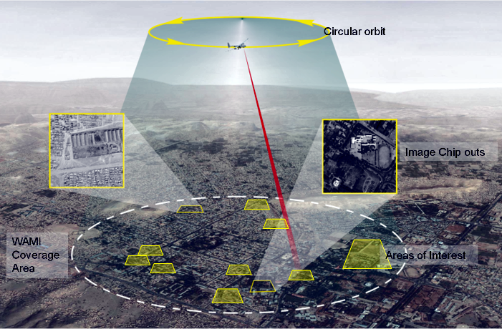

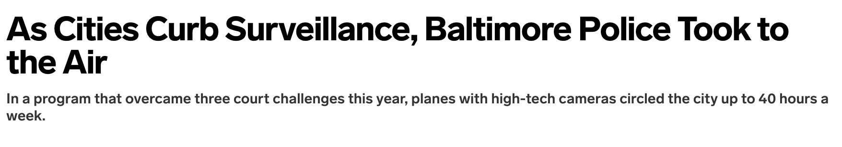


Persistent Surveillance Systems
March 2021

Slide 31

Axon, the biggest seller of Tasers and body cameras for law enforcement, is actively considering using facial recognition with its camera technology
Devices linked to cloud-based Evidence.com database used by over 200,000 public-safety professionals... all digital data including PDFs, crime scene photos, CCTV footage, in-car cameras, and now DJI drone video can be associated to a single case file
https://slate.com/technology/2018/06/axon-and-dji-are-teaming-up-to-make-surveillance-drones-and-the-possibilities-are-frightening.html

Slide 32

Tools developed to identify police officers who fought with protesters in Hong Kong, Portland, Chicago, Belarus
“Facebook has been a particularly helpful source of images… Here they all are at a barbecue or whatever, in uniform sometimes”
OpenOversight: a public, crowd-sourced, searchable database of law enforcement officers, asks users to upload photos of uniformed officers and matches them to names or badge number
https://www.nytimes.com/2020/10/21/technology/facial-recognition-police.html

Slide 33





What Is the Norm?
like all police departments with similar programs, it tends to talk out of both sides of its mouth, insisting the law-abiding have nothing to fear while denying that they have any privacy interest in their public movements in the first place. But the legal precedents cited by police rely on an unspoken assumption that resource constraints operate as their own kind of protection. Police don’t have the time or money to track and monitor every person moving about public byways and property, so they will necessarily limit their monitoring to those suspected of criminal activity. The average citizen’s anonymity is protected, while public safety is enhanced.
In an age of technologies such as license plate readers, “geofencing” (which uses smartphones’ GPS capability to map social networks and track personal data), and especially facial recognition, this unspoken assumption has been upended. Surveillance and monitoring data can be collected and stored on a mass basis, giving law enforcement the ability to build astonishingly detailed portraits of people’s lives. When the plaintiff in the Coral Gables case obtained his license plate reader records under a state sunshine law, the report ran for more than 80 pages. In our mass surveillance future, every trip to the doctor’s office, girlfriend’s apartment, library, church, gay bar, pharmacy, or liquor store can be identified, stored, and analyzed by law enforcement—with no need for individualized monitoring or individualized suspicion.
vs
https://slate.com/technology/2020/11/law-enforcement-facial-recognition-technology.html

Slide 34


Similar laws considered by other states
San Francisco, Boston, other cities ban any government use of face recognition.
Washington state law (promoted by Microsoft) permits use with restrictions
- If a government agency wants to use facial recognition, it has to first give public notice, hold at least three community meetings, and publish a report outlining the technology’s potential impact on civil liberties.
- Police could use facial recognition for ongoing surveillance or real-time identification of people but they will need a warrant or court order first.
- Can’t be used to make significant government decisions without “meaningful human review,” and government employees must be trained on the technology’s limitations
- A company providing [facial recognition technology] to the government has to allow for independent third-party testing of the system, checking for accuracy or bias.
https://www.wsj.com/articles/washington-state-oks-facial-recognition-law-seen-as-national-model-11585686897

Slide 35

Maine’s L.D. 1585
Toughest facial recognition law in the U.S. (effective Oct 2021)
Prohibits use of facial recognition across all levels of government (state, county, municipal)
Limited exceptions for law enforcement use
  Probable cause to believe an unidentified person in an image committed a serious crime
  Identifying deceased or missing person
  State police and Bureau of Motor Vehicles must keep records of every requested and performed search
Facial recognition data alone cannot establish a probable cause

Slide 36
Proposed EU Bill (April 2021)
Part of proposed regulations for “high-risk uses of AI”
Gives regulators power to scrutinize algorithms and systems that identify people’s biometric information (faces, fingerprints)
Blocks police from using remote biometric identification systems in public places in real time
  Long list of exceptions: abducted children, imminent terrorist threats, locating crime suspects

Slide 37
Not Just Governments
a TikTok spokesperson could not offer more details on the company’s plans for biometric data collection or how it may tie in to either current or future products.
https://www.businessinsider.com/tiktok-privacy-policy-update-lets-it-collect-users-biometric-data-2021-6
https://techcrunch.com/2021/06/03/tiktok-just-gave-itself-permission-to-collect-biometric-data-on-u-s-users-including-faceprints-and-voiceprints/

Slide 38


In the UK, the Billboard Watches You
Face analysis helps decide which ads to show
Next stage: what people are wearing, which car brands they are driving…
Combine with “anonymous” phone location data for ad re-targeting
What does this mean?
https://bigbrotherwatch.org.uk/wp-content/uploads/2022/10/The-Streets-Are-Watching-You.pdf

Slide 39


Mainly lawyers involved in litigation with MSG
Legal quirk: cannot be denied admission if they already hold tickets to a concert or show (does not apply to sporting events)
New York law passed in 1941 to prevent theater owners from banning hostile critics
Sources: NYT, NBC

Slide 40


Venues Using Face Recognition
https://slate.com/technology/2023/03/madison-square-garden-facial-recognition-stadiums-list.html

Slide 41

username and password for admin account found on the Internet
24,000 organizations in total
including live video feeds from Tesla factories
Face recognition capabilities
+ filtering individuals by gender, color of clothes, etc.
+ detecting “meaningful events” as determined by the camera’s AI
https://www.vice.com/en/article/wx83bz/verkada-hacked-facial-recognition-customers

Slide 42
Any commercial establishment that collects, retains, converts, stores or shares biometric identifier information of customers must disclose such collection, retention, conversion, storage or sharing, as applicable, by placing a clear and conspicuous sign near all of the commercial establishment’s customer entrances notifying customers in plain, simple language, in a form and manner prescribed by the commissioner of consumer and worker protection by rule, that customers’ biometric identifier information is being collected, retained, converted, stored or shared, as applicable
New York City law (since 2021)

Slide 43


Filed March 16, 2023
“The new sign fails to disclose that Amazon converts and retains biometric identifier information. Even worse, the sign informs customers that Amazon will not collect biometric identifier information on them unless they use the Amazon One palm scanner to enter the Amazon Go store, even though Amazon Go stores do collect biometric identifier information on every single customer, including information on the size and shape of every customer’s body.”
https://www.nbcnews.com/tech/security/amazon-sued-not-telling-new-york-store-customers-facial-recognition-rcna75290

Slide 44
In May 2019, Yahoo found sexual abuse photos in a Syrian user’s account.
One grainy photo showed a man’s face at an oblique angle.
A child-crime investigator in New York ran the face through the Clearview AI app.
The app turned up an Instagram photo of a heavily muscled Asian man and a female fitness model, posing on a red carpet at a bodybuilding expo in Las Vegas. Neither looked like the suspect.
Upon closer inspection, you could see a white man in the background, at the edge of the photo’s frame, standing behind the counter of a booth for a workout-supplements company. That was the match. On Instagram, his face would appear about half as big as your fingernail.
The agent contacted the supplements company and obtained the booth worker’s name: Andres Rafael Viola. Another investigator found Viola’s public Facebook profile with photos of a room that matched one from the images, as well as pictures of the victim, a 7-year-old. Law-enforcement officers arrested Viola in June 2019. He later pleaded guilty to sexually assaulting a child and producing images of the abuse and was sentenced to 35 years in prison.
https://www.nytimes.com/interactive/2021/03/18/magazine/facial-recognition-clearview-ai.html

Slide 45


Clearview AI
Scraped over 30 billion photos from social media and other public websites
Face recognition app used over 1 million times by 2,400 U.S. law enforcement agencies
Researching face-identifying augmented reality glasses
Surveillance video from the lobby of a Manhattan building, one of 70,000 videos found in Clearview’s misconfigured cloud storage
Claim: the product “saves lives,” “saves time” and “improves health” by increasing social distancing and keeping officers’ hands free to grab their weapons
https://techcrunch.com/2020/04/16/clearview-source-code-lapse/

Slide 46


Face Recognition in a War Zone
Identification (??) of war criminals
First major conflict with large-scale use of facial recognition technology
War zones being used as testing grounds for surveillance tools
https://www.nytimes.com/2022/04/07/technology/facial-recognition-ukraine-clearview.html

Slide 47


Defense attorneys used Clearview to find this witness by matching him to a photo from a Tampa night club
Witness testified the defendant was the passenger, not the driver, in a deadly car crash
Police officer’s bodycam footage
https://www.nytimes.com/2022/09/18/technology/facial-recognition-clearview-ai.html

Slide 48


Matched photos of faces to profiles in VK social network (popular in Russia)
App no longer available but technology integrated into Moscow’s camera surveillance system, used in 2020 for lockdown enforcement
“… can complete a search in under 10 seconds and largely works even people are wearing face masks by identifying them by their eye line”
https://www.washingtonpost.com/news/morning-mix/wp/2016/05/18/russias-new-findface-app-identifies-strangers-in-a-crowd-with-70-percent-accuracy/
https://abcnews.go.com/International/russia-facial-recognition-police-coronavirus-lockdown/story?id=70299736

Slide 49





https://onezero.medium.com/this-simple-facial-recognition-search-engine-can-track-you-down-across-the-internet-518c7129e454
https://www.nytimes.com/2022/05/26/technology/pimeyes-facial-recognition-search.html

Slide 50


Help people keep tabs on their online reputation
Ethical uses only: users should search only for their own faces
User must click a box on the website
absurd
Giorgi Gobronidze
owner of PimEyes
“Digital card catalog”
Company does not store photos, only links to URLs for images associated with individuals’ facial features
https://www.nytimes.com/2022/05/26/technology/pimeyes-facial-recognition-search.html

Slide 51

Illinois Biometric Privacy Act of 2008
similar laws in WA and TX
First state law to regulate collection of biometric identifiers
(retina or iris scan, fingerprint, voiceprint, or scan of hand or face geometry)
Companies doing business in Illinois must inform the subjects and obtain their written consent before collecting biometric identifiers
Biometric identifiers must be protected like any other “confidential and sensitive” information
Allows private individuals to file lawsuits
(violation is enough, no need to show harm)

Slide 52


Texas Sues Meta (Feb 2022)
Suit seeks hundreds of billions in civil penalties
Users were always provided with notice and an opportunity to consent when they used these [now defunct] services
Facebook has been secretly harvesting Texans’ most personal information—photos and videos—for its own corporate profit… Texas law has prohibited such harvesting without informed consent for over 20 years.
Ken Paxton
Texas AG
… while holding itself out as a trusted meeting place for Texans to connect and share special moments with family and friends, Facebook was secretly capturing, disclosing, unlawfully retaining—and profiting off of—Texans’ most personal and highly sensitive information: records of their facial geometries, which Texas law refers to as biometric identifiers
https://www.wsj.com/articles/texas-sues-meta-over-facebooks-facial-recognition-practices-11644854794

Slide 53
Texas Sues Google (Oct 2022)
Google’s indiscriminate collection of the personal information of Texans, including very sensitive information like biometric identifiers, will not be tolerated
Google Photos: search for photos of a particular person
Nest camera: recognizes (or not) people at the door
Google Assistant: recognizes users’ voices (to give personalized answers)
Ken Paxton
Texas AG
Google has now spent years unlawfully capturing the faces and voices of both nonconsenting users and nonusers throughout Texas

Slide 54




Clearview: does not need consent from Canadians to use facial biometric information because it comes from photos on the public Internet.
Canada’s privacy commissioner: What Clearview does is illegal mass surveillance. Information collected from public websites, such as social media or professional profiles, and then used for an unrelated purpose, does not fall under the ‘publicly available’ exception.
+ 10 class-action lawsuits
https://www.nytimes.com/2021/02/03/technology/clearview-ai-illegal-canada.html
https://www.marketwatch.com/story/facial-recognition-company-clearview-ai-sued-by-california-activists-01615344732

Slide 55


Prohibition on Clearview violates the company’s constitutional right to free speech
Scraping of photos is Ok, but creating “faceprints” from them is conduct, not speech
Clearview is simply searching public photos
Precedent: 2003 case where Google argued that search results are speech and it’s free to rank them as it sees fit
What’s the difference between Clearview and Google?
Settled in May 2022
Clearview agreed not to sells its database to private companies (except financial institutions)
Sales to governments, law enforcement still Ok
Sales of recognition algorithm (not DB) still
Floyd Abrams
(eminent First Amendment lawyer)
https://www.nytimes.com/interactive/2021/03/18/magazine/facial-recognition-clearview-ai.html

Slide 56


Clearview Opt-out
Also tried to delete IL residents’ faces by looking at photo metadata and geolocation info
IL residents can request removal by uploading photos of themselves

Slide 57



Claim: Facebook’s practice of tagging people in photos using facial recognition without their consent violated BIPA law
1.6 million Illinois residents will receive at least $345
Ongoing class action suits against Microsoft, Amazon, Google, Clearview…
TikTok settled for $92 mil
https://techcrunch.com/2021/03/01/facebook-illinois-class-action-bipa/

Slide 58




70 civil rights organizations
+ petition with 150,000 signatures

Slide 59

Facebook Turns Off Face Recognition (Nov 2021)
more than a third of FB users had face recognition turned on in their accounts
https://about.fb.com/news/2021/11/update-on-use-of-face-recognition/

Slide 60

June 2022
https://www.nytimes.com/2022/06/21/technology/microsoft-facial-recognition.html

Slide 61
What’s Special About Faces?
Faces are hard to change; can be captured remotely and cheap to obtain and store in the cloud
There is an existing legacy of name and face databases
  Driver licenses, arrest mugshots, social media profiles, etc.
Devices for capturing and recognizing faces are already widespread
  CCTV, officer-worn body cams
Tipping point creep
  Existing databases can be re-purposed for real-time recognition
Faces are central to our identity (unlike other biometrics)
https://medium.com/s/story/facial-recognition-is-the-perfect-tool-for-oppression-bc2a08f0fe66

Slide 62


by Hartzog and Selinger (2018)
Mere existence harms civil liberties because people act differently when they are surveilled
Disproportionate impact on people of color and other minority and vulnerable populations
Denial of fundamental rights, such as protection against arbitrary government tracking of one’s movements, habits, relationships, interests, and thoughts
The normalized elimination of practical obscurity
The amplification of surveillance capitalism
image: NYT
https://medium.com/s/story/facial-recognition-is-the-perfect-tool-for-oppression-bc2a08f0fe66

Slide 63






CV Dazzle by Adam Harvey
Fashion that foils face detection technology (algorithm-specific!)

