Slide 1
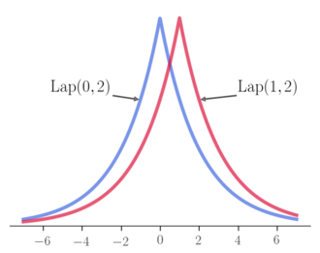
DIFFERENTIAL PRIVACY
Vitaly Shmatikov

Slide 2
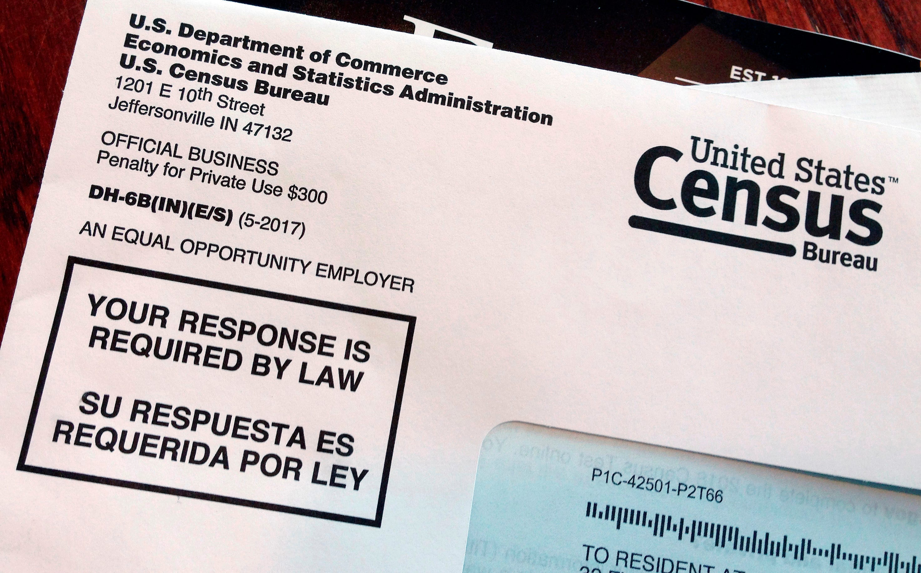

Slide 3

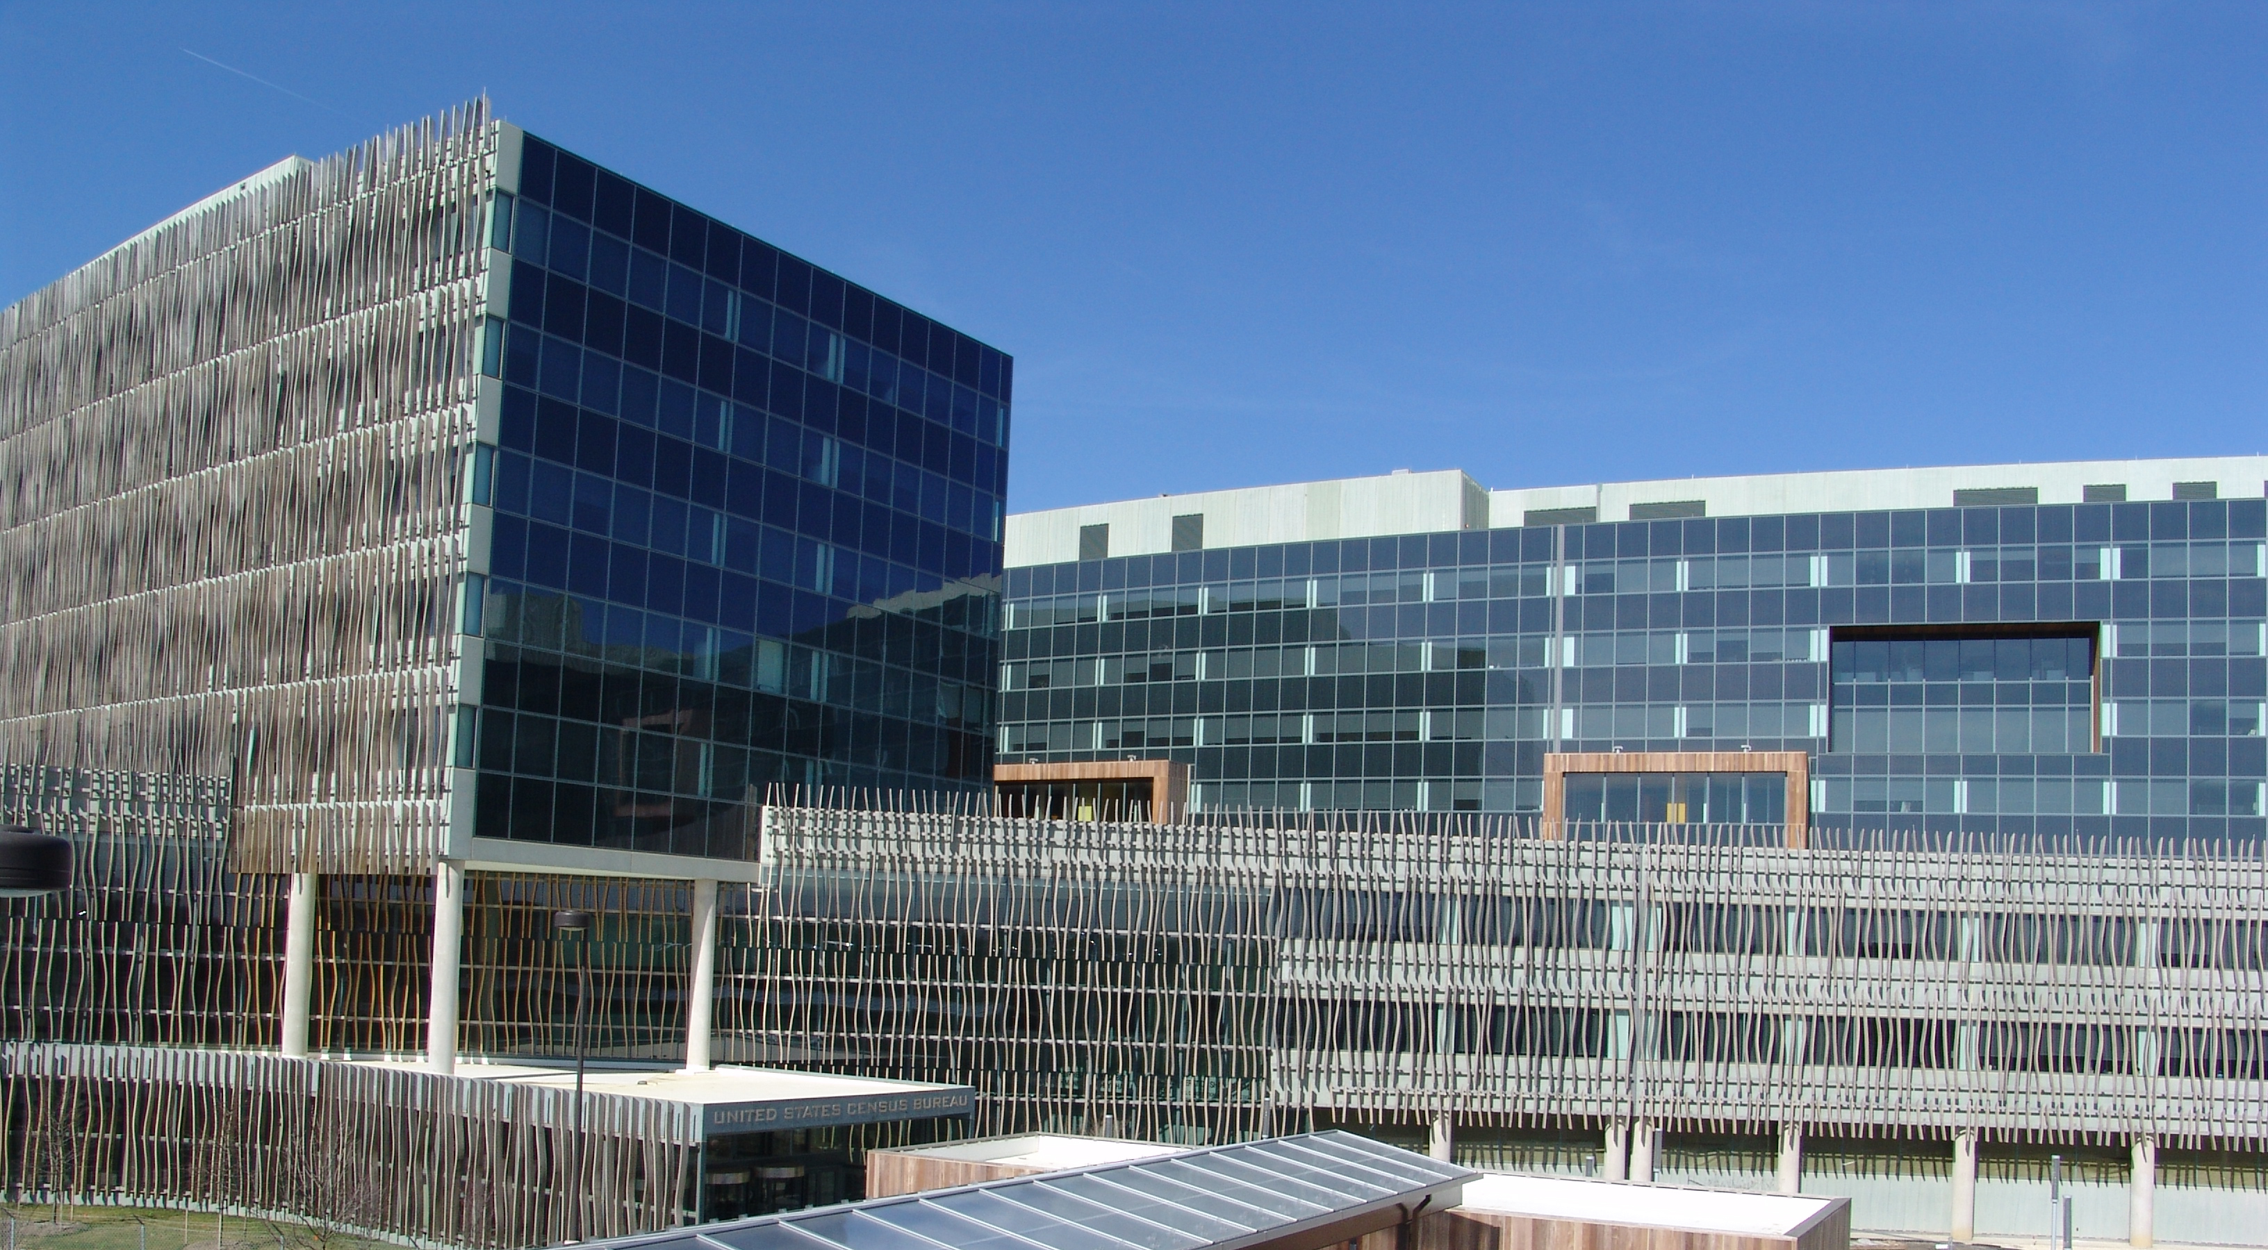
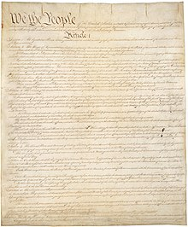
Must collect data and release statistics
From Article I, Section 2
Representatives and direct Taxes shall be apportioned among the several States which may be included within this Union, according to their respective Numbers, … The actual Enumeration shall be made within three Years after the first Meeting of the Congress of the United States, and within every subsequent Term of ten Years, in such Manner as they shall by Law direct

Slide 4
Must keep collected data confidential
We pledge:
  Collected data will be used only for statistical purposes.
  Collected data will be kept confidential.
  Data from individuals or establishments
  won’t be identifiable in any publication.
Fines and prison await any Census Bureau employee who violates this pledge

Slide 5
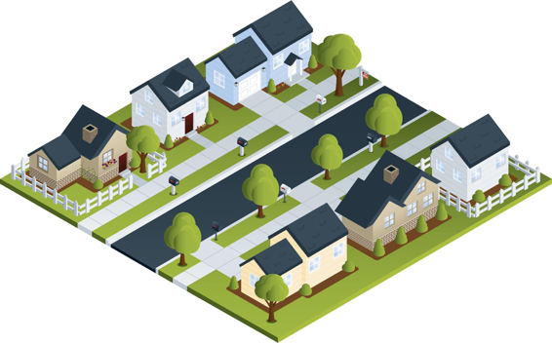
Statistical Agencies Are Trusted Curators
Respondents
Confidential Database
Published Statistics
 | # | Median Age | Mean Age
Total | 7 | 30 | 38
Women | 4 | 30 | 33.5
Male | 3 | 30 | 44
Black | 4 | 51 | 48.5
White | 3 | 24 | 24
Married | 4 | 51 | 54
Black F | 3 | 36 | 36.7
Age Sex Race/MS
8 FBS
18 MWS
24 FWS
30 MWM
36 FBM
66 FBM
84 MBM
Source: Simson Garfinkel

Slide 6
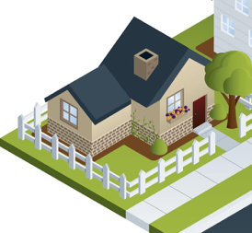
Statistics for a Single Household
 | Count | Median | Mean
Total | 1 | 24 | 24
Female | 1 | 24 | 24
White | 1 | 24 | 24
Single | 1 | 24 | 24
White F | 1 | 24 | 24
This would immediately result in improper disclosure
24 yrs Female White Single (24 FWS)
Source: Simson Garfinkel

Slide 7
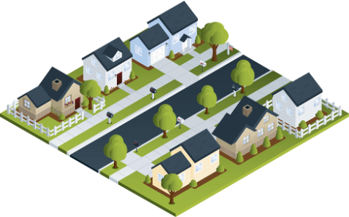
Solution: Aggregate Households
 | Count | Median | Mean
Total | 7 | 30 | 38
Female | 4 | 30 | 33.5
Male | 3 | 30 | 44
Black | 4 | 51 | 48.5
White | 3 | 24 | 24
Source: Simson Garfinkel

Slide 8
Risk: Reverse-Engineering of Stats
 | Count | Median | Mean
Total | 7 | 30 | 38
Female | 4 | 30 | 33.5
Male | 3 | 30 | 44
Black | 4 | 51 | 48.5
White | 3 | 24 | 24
66 FBM & 84 MBM
30 MWM & 36 FBM
This table can be expressed by 164 equations.
Solving them takes 0.2 seconds on a 2013 MacBook Pro.
8 FBS
18 MWS
24 FWS
Source: Simson Garfinkel

Slide 9
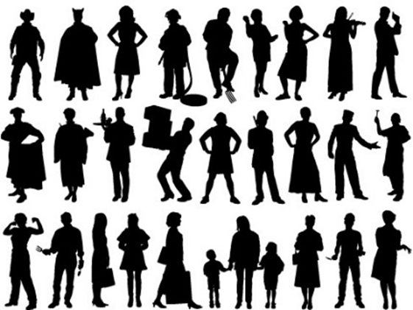
2010 U.S. Census
Confidential data in red
Public data in blue
Decennial
Response File
Pre-specified tabular summaries:
PL94-171, SF1, SF2 (SF3, SF4, … in 2000)
Raw data from respondents
Hundred percent Detail File
Statistical
processes
Special tabulations and post-census research
1,852,473,228 collected values
(308,745,538 people x 6 variables/person)
Source: Simson Garfinkel

Slide 10
Summary of Census Publications
Publication | Released counts
PL94-171 Redistricting | 2,771,998,263
Balance of Summary File 1 | 2,806,899,669
Summary File 2 | 2,093,683,376
Public-use micro data sample | 30,874,554
Lower bound on published statistics | 7,703,455,862
Published Statistics/person | 25
Source: Simson Garfinkel

Slide 11




Re-identification Experiment
Reconstructed (anonymous) individual records from released Census statistics
  Age, sex, Census block, race, ethnicity
Linked reconstructed records to 4 commercial databases of the US population
  Databases have age, sex, address, name
  Link rate: 45%
Compared resulting linked database of identified individual records to Census Bureau confidential data: 38% success rate (17% of US population)
  Success = correct reconstruction of all attributes
proof of concept by U.S. Census Bureau researchers

Slide 12
Not Just Government Statistics
Chrome: which plugins are most likely to cause browser to crash?
iOS: how often are different emojis used?
Microsoft: how much time do users spend in a particular application?
Uber: what is the average trip length in a city?

Slide 13
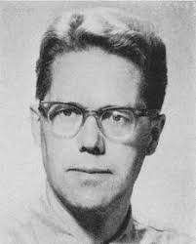
Classical Intution for Privacy
Dalenius (1977): “If the release of statistics S makes it possible to determine the value [of private information] more accurately than is possible without access to S, a disclosure has taken place”
“Privacy” means that anything that can be learned about a respondent from the statistical database can be learned without access to the database

Slide 14


Lithuanian Women
Terry Gross is 2 inches shorter than the average Lithuanian woman
Lithuania publishes a database allowing anyone to compute the average height of Lithuanian women
Did publication of this database breach Terry Gross’s privacy?

Slide 15

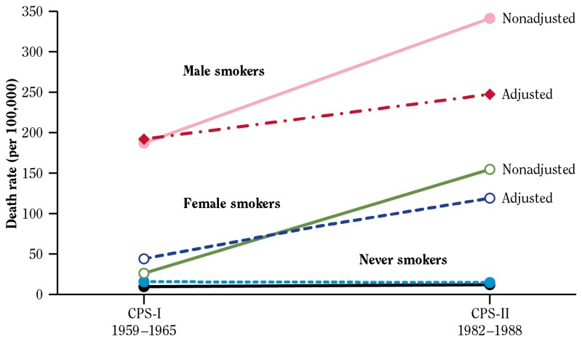

Smoking Causes Cancer
Yul Brynner is a smoker
A medical research study finds a causal relationship between smoking and lung cancer
Conclusion: Brynner has a higher risk of developing lung cancer
Did the study breach Brynner’s privacy?
This is true regardless of whether Brynner participated in the study or not

Slide 16
Differencing Attacks
Can ask statistical queries about a community, but answers with low counts are suppressed
  How many people are HIV+?
  How many people are named Freddie?
X: How many people are HIV+?
Y: How many people are HIV+ and not named Freddie?
X-Y reveals Freddie’s HIV status
What if X-Y > 1?

Slide 17


Database ”Privacy” Is Impossible!
Dinur
Given enough noisy answers to arbitrary statistical queries, can always reconstruct the original database
Nissim
… unless the amount of noise so large that the answers are useless

Slide 18
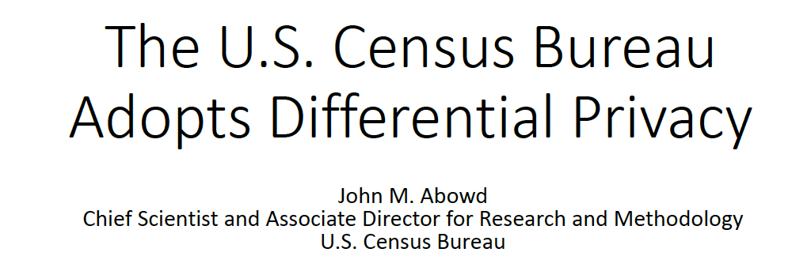

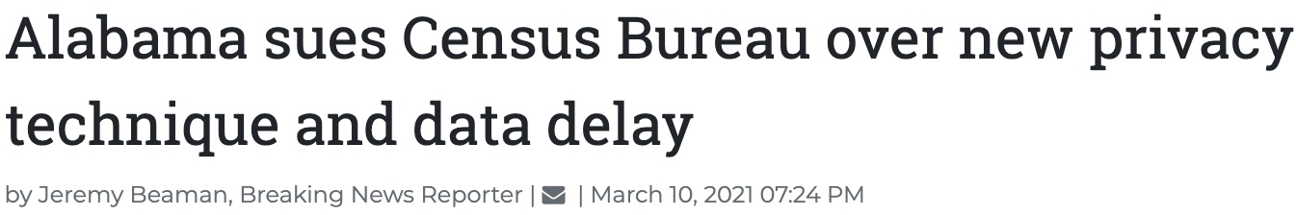
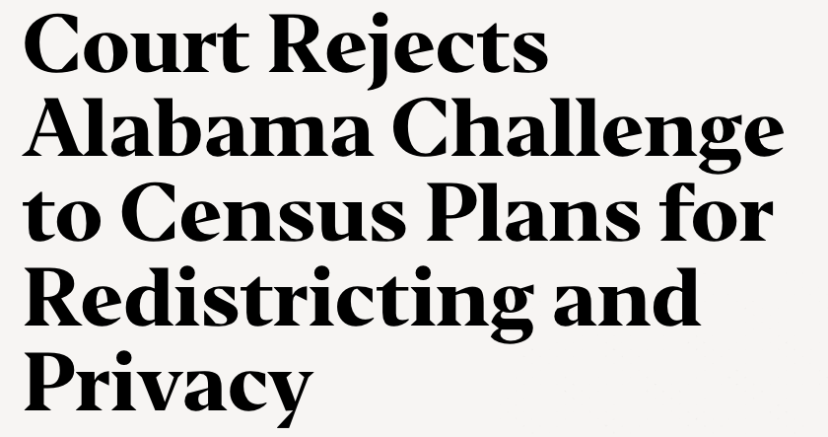
Claim: DP will produce manipulated population counts

Slide 19
Differential Privacy: Rough Idea
35 yrs Female Black Single (35 FBS)
ADD NOISE
Use “noise” to create uncertainty about private data
Impact of the noise ≈ impact of a single person
Impact of noise on aggregate statistics decreases with larger population
24 yrs Female White Single (24 FWS)
Source: Simson Garfinkel

Slide 20
What Is Differential Privacy?
A mathematical definition of privacy loss
Specific mechanisms that …
  Add the smallest amount of noise necessary for a given privacy outcome
  Structure the noise to have minimal impact on the more important statistics
  (so far) this is the “curator” model: a trusted entity collects the data and adds noise when answering statistical queries

Slide 21
Statistics Must Reveal Information
Database teaches that smoking causes cancer
  Smoker S’s insurance premiums rise
  This is true even if S not in database!
Learning this statistical fact is the whole point
  Smoker S enrolls in a smoking cessation program…
Key idea:
Not revealing information about individual records is impossible!
Instead, limit the harm of participation.
almost
  Outcome of any analysis is equally likely, independent of whether any individual joins, or refrains from joining, the dataset

Slide 22
Differential Privacy
x₁
query 1
x₂
Curator
answer 1
DB=
x₃


query T
x_{n-1}
x_{n}
answer T
Adversary
“Lithuanian women” example: adversary learns Terry Gross’ height even if she is not in the database
Limiting the harm of participation: “Whatever is learned would be learned regardless of whether or not Terry Gross participates in the database”
  Dual: Whatever is already known, situation won’t get worse

Slide 23
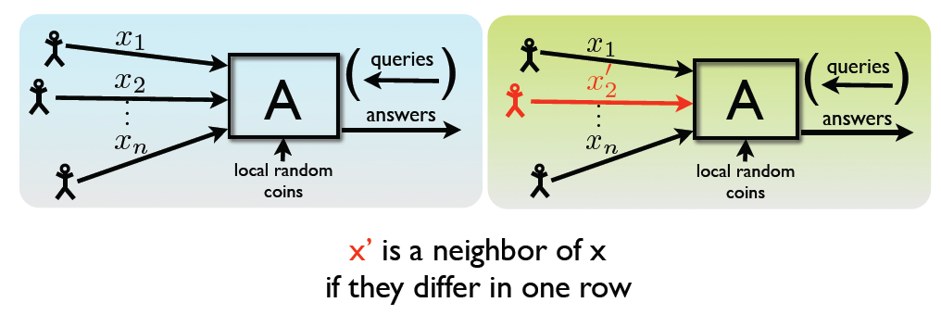




Differential Privacy: Definition
For all neighboring databases x and x’, for all possible outputs S
Pr[A(x) є S] ≤ e^{ε} Pr[A(x’) є S]

Slide 24
Output Perturbation
x₁
…
x_{n}
Tell me f(x)
DB
f(x)+noise
User
Intuition: f(x) can be released accurately when f is insensitive to individual entries x₁, … x_{n}
Global sensitivity GS_{f} = max_{neighbors x,x’} ||f(x) – f(x’)||₁
  Example: GS_{count} = 1 for any predicate
  Example: GS_{average} = 1/n for sets of bits
Lipschitz
constant of f

Slide 25
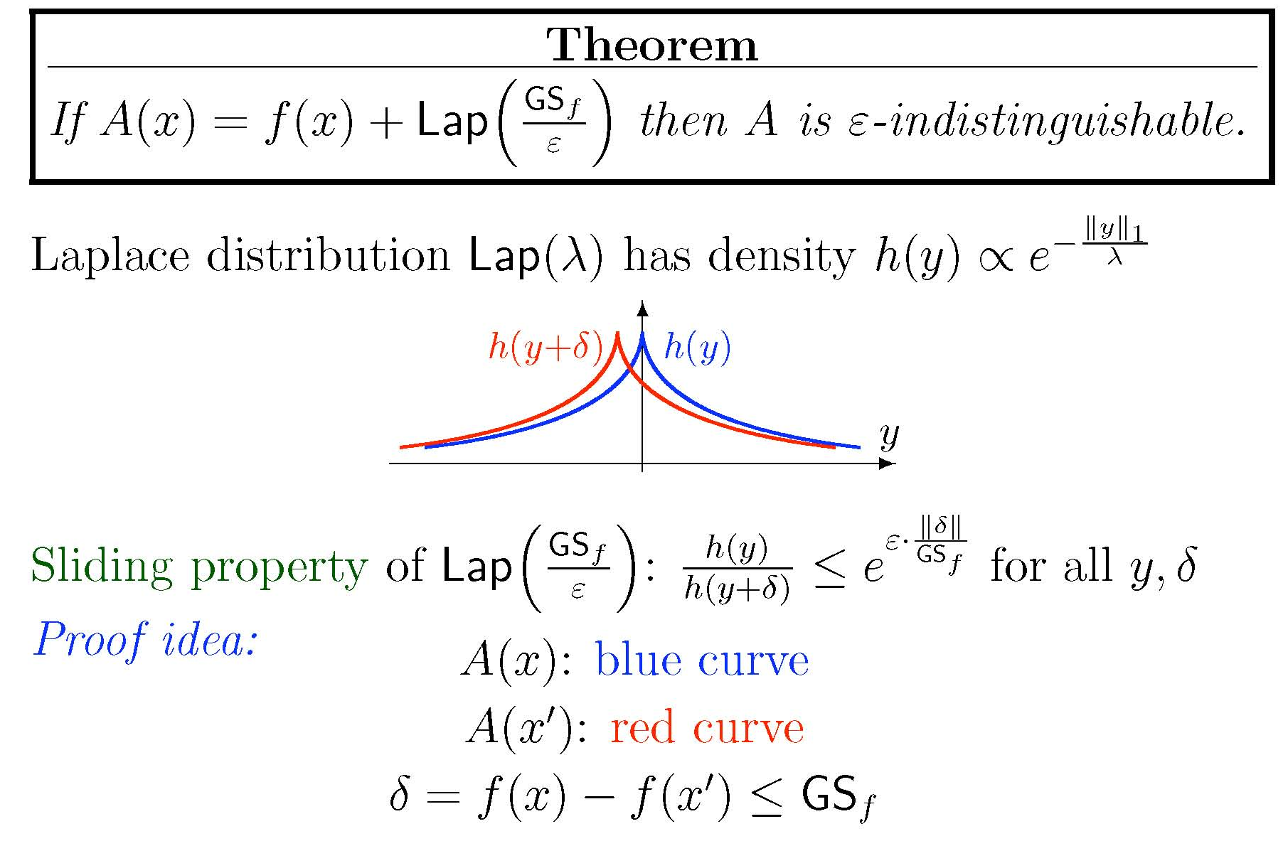
Laplace Mechanism

Slide 26
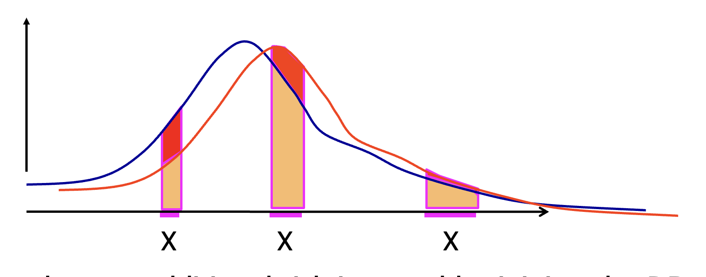


Intuition
Anything adversary can learn about me from the DB, it could learn without my data in the DB
Privacy parameter ε is the bound on this gap
Probability of answer X
with me
without me
… thus no additional risk incurred if I let my data be used in the DB

Slide 27
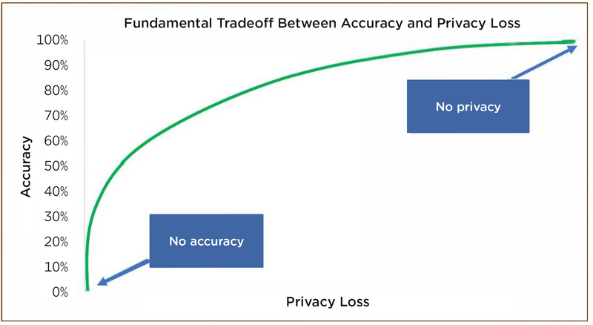
Privacy / Accuracy Tradeoff
Epsilon is the privacy cost of any query
Curator must set a “privacy budget” in advance, subtract epsilon from it for each query
Higher epsilon = less noise = more accurate answers = higher privacy cost
When privacy budget is exhausted, cannot ask any more queries about this database
What is the “correct” value of epsilon?
Where should the accuracy be allocated?
Image: US Census Bureau
For 2020 Census data, US Census Bureau set
ε = 17.14 for statistics based on people
ε = 2.47 for statistics based on housing units

Slide 28
Controversy about Accuracy of DP Statistics
… will reduce or even eliminate the usability of public use data for many common research and policy applications
Differential privacy is the only known way to protect against
reconstruction attacks
… inconsistent with the statutory obligations, history, and core mission of the Census Bureau
… futureproof
… adversary agnostic, will provide protection regardless of the motivation or financial, computational, and informational assets of the adversary
… measurable, allowing the public to quantify cumulative privacy loss as data are analyzed and re-analyzed, shared, and linked
… wreak havoc on the accuracy of almost all US Census data products and defeat the very purpose for comprehensive Census data collection without any meaningful gain in the (already adequate) privacy protections

Slide 29
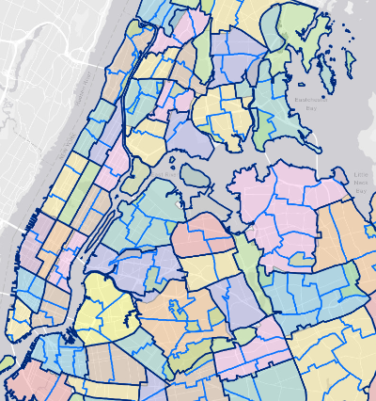
Census Blocks
Smallest geographic units for which the Census Bureau releases tabulated data based on all houses
Problem: if a block has low population, tabulations can be reverse-engineered to identify respondents
For example, if the block contains one Asian American single mother, summary statistics on Asian Americans and single parents in that block would reveal her status
Before 2020, Census Bureau would swap easily identifiable respondents between blocks

Slide 30
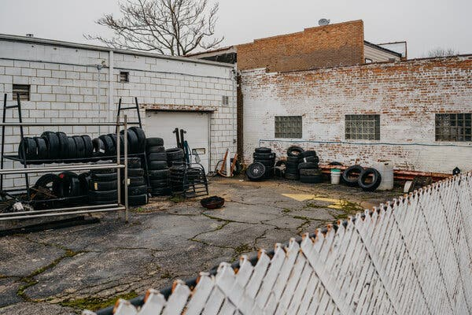

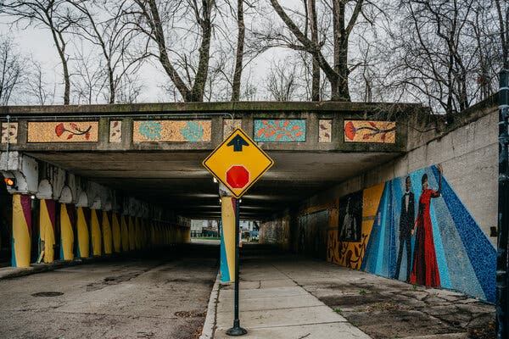
Differentially Private Census Block Statistics
3 houses here with 13 people total, all 18 or younger
13 adults and 1 child live under this river bend
Is this better or worse than swapping?
More secure against reconstruction
Only affects statistical outliers
Problem for redistricting and drawing political boundaries, e.g., city-council wards
1 in 8 Census blocks in NY state
This underpass has one home with 86 people
https://www.nytimes.com/2022/04/21/us/census-data-privacy-concerns.html

Slide 31
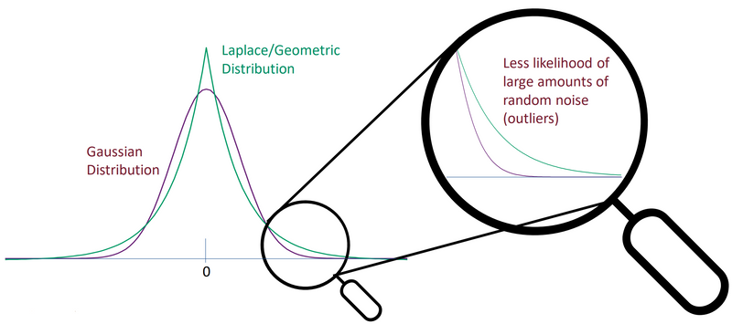
Zero-Concentrated Differential Privacy
Image: US Census Bureau

Slide 32
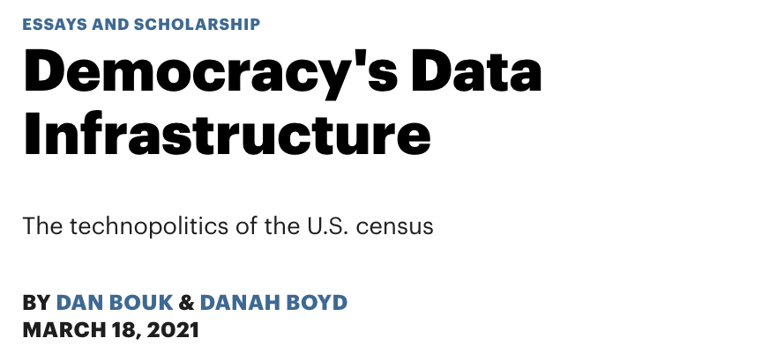
A detailed look at the history of confidentiality protections for the US Census data and the current controversy over differential privacy

Slide 33
Not Just Government Statistics
Chrome: which plugins are most likely to cause browser to crash?
iOS: how often are different emojis used?
Microsoft: how much time do users spend in a particular application?
Uber: what is the average trip length in a city?
Who is the “curator”?

Slide 34
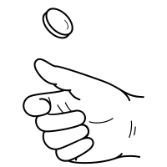
Randomized Response
Warner 1965
”Have you ever cheated on your partner?”
Method for polling stigmatizing questions
Each participant privately flips a coin
Heads: tell the truth
Tails: flip another coin,
if Heads, say “yes”
if Tails, say “no”
Specific answers are deniable (“plausible deniability”), aggregate results valid
“Do you use cocaine?”
“Did you ever violate Cornell’s Academic Integrity Code?”
Each participant lies with known probability

Slide 35

Randomized Response: Example
”Do you like disco music?”
Each participant privately flips a coin
Heads: tell the truth
Tails: flip another coin,
if Heads, say “yes”
if Tails, say “no”
Goal: estimate p, % of users who like disco music
Expected # of “yes” answers:
Y = p (½ * 1 + ½ * ½) + (1-p) (½ * 0 + ½ * ½) = ½ p + ¼
Estimate p:
p ~ 2Y – ½

Slide 36
Local Differential Privacy
Rough idea: each user runs a DP algorithm on their own data, then combine results
Example: N users, each has 0 or 1, estimate sum
  Each user adds independent Laplace noise with mean 0, variance 2/ε²
  Sum = true answer + sum of N Laplace distributions
  Error is a random variable with mean 0, variance 2N/ε²
Numeric example:
    if N=1M, true answer=N/2, ε = 1, the sum of noisy answers will be 500K ± 2800 (about 1% uncertainty)
    Error in the centralized (trusted curator) case would be close to 1 (0.001%)
Due to huge amounts of noise, need very large N for answers to be accurate

Slide 37
Randomized Response and LDP
Each participant privately flips a coin
Heads: tell the truth
Tails: flip another coin,
if Heads, say “yes”
if Tails, say “no”
Goal: estimate p, % of users who like disco music
P1 = Pr (“Yes” | likes disco) = Pr (Heads on 1st flip) + Pr (Tails, then Heads) = ¾
P2 = Pr (“Yes” | does not like disco) = Pr (Tails on both flips) = ¼
P1/P2 = 3, so ε = ln 3

Slide 38
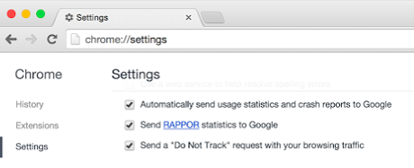

Google’s RAPPOR
Goal: gather statistics about users’ browsers
Each user has one value out of many possibilities
  Example: home-page URL …
  Think of this as a binary vector with a single 1
Naïve approach: run randomized response for all possible values
  Satisfies 2ε-LDP (if user’s choice were different, 2 bits would in her vector would change: 1 → 0, 0 → 1)
  Slow: sends 1 bit for every possible index in the vector
  Limited: can’t handle new possibilities being added

Slide 39
Bloom Filters
item
0
1
0
0
0
1
0
0
1
0
Compactly encode set membership
  k hash functions map items to m-bit vector k times
  Update: Set all k entries to 1 to indicate item is present
  Query: Can lookup items, store set of size n in O(n) bits
  Choose k and m to obtain small false positive probability
Can be merged by OR-ing vectors (of same size)
  Duplicate insertions do not change Bloom filters

Slide 40
Counting Bloom Filters + Randomized Response
Idea: apply Randomized Response to the bits in a Bloom filter
  Many fewer bits in the filter than all possibilities
Each user maps their input to at most k bits in the filter
  Privacy guarantee with parameter 2kε
Combine all user reports and observe how often each bit is set
item
0/1
1/0
0/1
0/1
…
…
…
…
…
…

Slide 41
Decoding Noisy Bloom Filters
Given a noisy Bloom filter, where each bit has a probability, estimate the frequency of a particular value
  Look up its bit locations in the Bloom filter
  Compute the unbiased estimate of the probability that each location is 1
  Take the minimum of these estimates as the frequency
  More advanced decoding heuristics to decode all at once
Subsequent work: to find frequent strings (without knowing them in advance), build them up character by character

Slide 42

RAPPOR in Practice
Implemented in the Chrome browser (no longer deployed?)
  Collects data from opt-in users, tens of millions per day
  Open source implementation available
Tracks settings in the browser (e.g. home page, search engine)
  Sample use: if many users unexpectedly change home page → possible malware
Typical configuration: 128 bit Bloom filter, 2 hash functions, ε~0.5
  Needs about 10K reports to identify a value with confidence

Slide 43
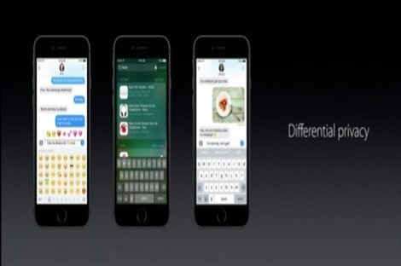
Local DP at Apple
Similar problem to RAPPOR: count frequencies of many items
Instead of Bloom filters, use sketches
  Similar idea, but better suited to capturing frequencies
  Discrete Fourier transforms to reduce the size of sketches for communication, while preserving characteristics of the distribution

Slide 44
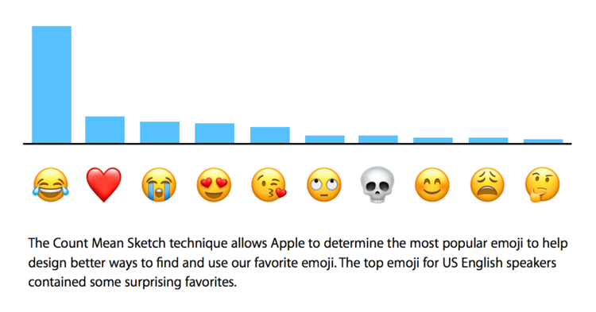
Local DP at Apple in Practice
Used to collect local data from iOS and MacOS users
  Popular emojis: (heart) (laugh) (smile) (crying) (sadface)
  “New” words: bruh, hun, bae, tryna, despacito, mayweather
  Which websites to mute, which to autoplay audio on
  Which websites drain energy, are prone to crashes, etc.
Deployment settings: w=1000, d=1000, ε=2-8 (some criticism)
  Privacy budget “replenished” daily (apparently)

Slide 45

Microsoft Telemetry
Microsoft collects data on application usage
  How much time was spent on a particular app today?
  Patterns over time
Multiple subroutines:
  1BitMean to collect numeric data
  dBitFlip to collect (sparse) histogram data
  Memoization and output perturbation to allow repeated probing
Has been implemented in Windows since 2017

Slide 46
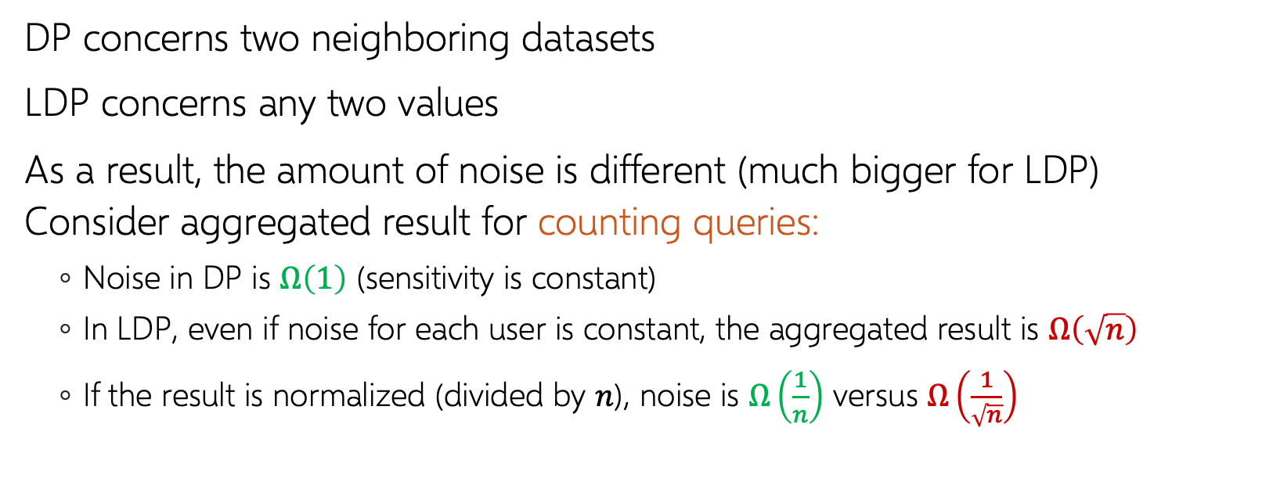
Centralized DP vs. Local DP
DP concerns two neighboring datasets
LDP concerns any two values
As a result, the amount of noise is different (much bigger for LDP) Consider aggregated result for counting queries:
  Noise in DP is $Ω\left(1\right)$ (sensitivity is constant)
  In LDP, even if noise for each user is constant, the aggregated result is $Ω\left(\sqrt{n}\right)$
  If the result is normalized (divided by $n$), noise is $Ω\left(\frac{1}{n}\right)$ versus $Ω\left(\frac{1}{\sqrt{n}}\right)$

