Slide 1
Anonymization and
Re-Identification
Vitaly Shmatikov

Slide 2


Slide 3




Tastes and Purchases

Slide 4











Social Networks

Slide 5






Health Care and Genetics

Slide 6



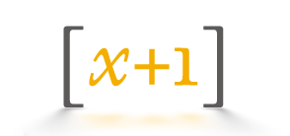






Web and Mobile Tracking

Slide 7





Online-Offline Aggregators

Slide 8

Solution: Anonymity!
“The critical distinction … between the use of personal information for advertisements in personally-identifiable form, and the use, dissemination, or sharing of information with advertisers in non-personally-identifiable form.”

Slide 9




Credit Bureaus
Routinely sell data to marketers
Example: Experian sold an anonymized dataset with info on 120 million Americans, 248 attributes per household
  Demographics, life events, finances, property…
  Stored in an unprotected AWS S3 bucket, exposed in a massive 2017 hack

Slide 10
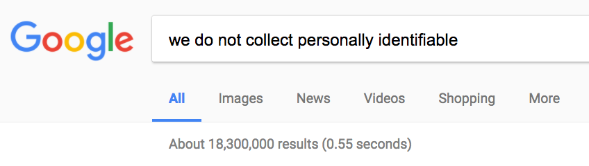
Phew…

Slide 11
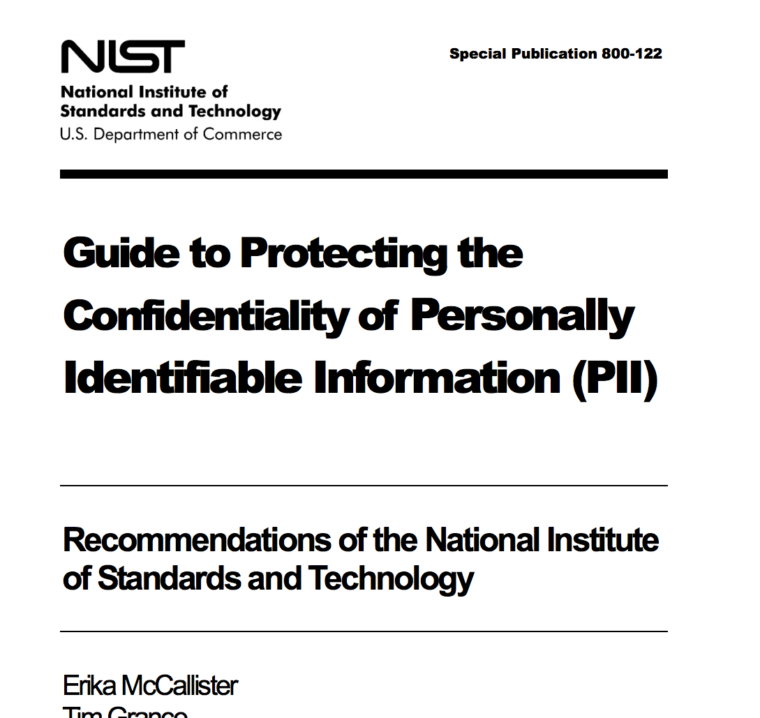

Slide 12



“Release and Forget”
x₁
x₂
x₃

x_{n-1}
Privacy!
“anonymization”
“de-identification”
“sanitization”
x_{n}
Data

Slide 13
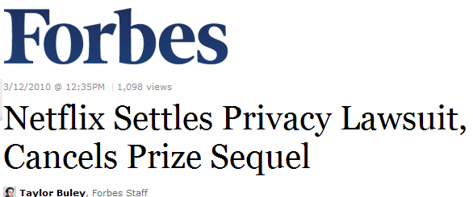

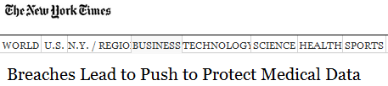
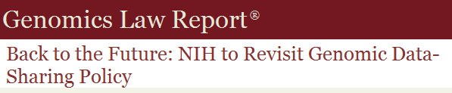
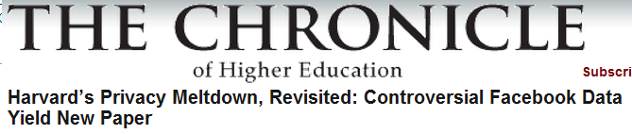
Anonymized Data… Isn’t
What went wrong?

Slide 14
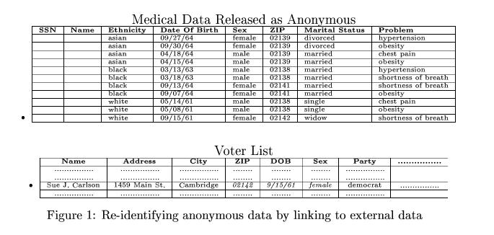

Latanya Sweeney’s Attack (1997)
Massachusetts hospital discharge dataset
Public voter dataset
Identified the discharge record of the governor of Massachusetts

Slide 15
Record Linkage
Microdata
Voter registration data
ID
Name
Alice
Betty
Charles
David
Emily
Fred
QID |  |  | SA
Zipcode | Age | Sex | Disease
47677 | 29 | F | Ovarian Cancer
47602 | 22 | F | Ovarian Cancer
47678 | 27 | M | Prostate Cancer
47905 | 43 | M | Flu
47909 | 52 | F | Heart Disease
47906 | 47 | M | Heart Disease
Name | Zipcode | Age | Sex
Alice | 47677 | 29 | F
Bob | 47983 | 65 | M
Carol | 47677 | 22 | F
Dan | 47532 | 23 | M
Ellen | 46789 | 43 | F

Slide 16
Quasi-Identifiers
Key attributes
  Name, address, phone number - uniquely identifying!
  Always remove before release
Quasi-identifiers
  (5-digit ZIP code, birth date, gender) uniquely identify 87% of the population in the U.S.
  Can be used for linking anonymized datasets with other datasets

Slide 17



HIPAA Privacy Rule
"Under the safe harbor method, covered entities must remove all of a list of 18 enumerated identifiers and have no actual knowledge that the information remaining could be used, alone or in combination, to identify a subject of the information."
“The identifiers that must be removed include direct identifiers, such as name, street address, social security number, as well as other identifiers, such as birth date, admission and discharge dates, and five-digit zip code. The safe harbor requires removal of geographic subdivisions smaller than a State, except for the initial three digits of a zip code if the geographic unit formed by combining all zip codes with the same initial three digits contains more than 20,000 people. In addition, age, if less than 90, gender, ethnicity, and other demographic information not listed may remain in the information. The safe harbor is intended to provide covered entities with a simple, definitive method that does not require much judgment by the covered entity to determine if the information is adequately de-identified."

Slide 18
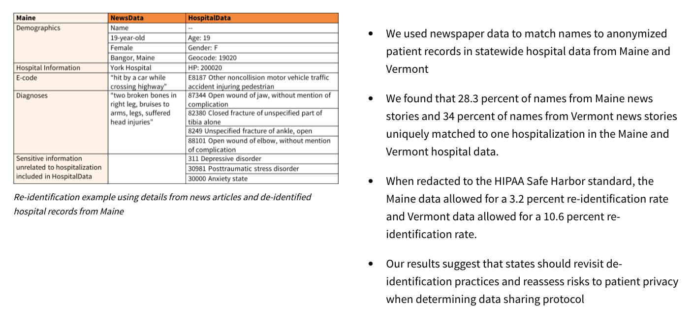

Anonymized to HIPAA standards
Soo et al. “Risks to Patient Privacy: A Re-identification of Patients in Maine and Vermont Statewide Hospital Data” (2018)

Slide 19
AOL Search Logs
In August 2006, AOL released anonymized search query logs
  657K users, 20M queries over 3 months
Opposing goals
  Analyze data for research purposes, provide better services for users and advertisers
  Protect privacy of AOL users
    Government laws and regulations
    Search queries may reveal income, evaluations, intentions to acquire goods and services, etc.

Slide 20


AOL User 4417749
AOL query logs have the form
<AnonID, Query, QueryTime, ItemRank, ClickURL (truncated URL)>
Sample queries of user with AnonID 4417749:
  “numb fingers”, “60 single men”, “dog that urinates on everything”, “landscapers in Lilburn, GA”, several people with the last name Arnold
    Only 14 citizens with the last name Arnold near Lilburn
  NYT reporter contacted the 14 citizens, found out AOL User 4417749 is 62-year-old Thelma Arnold

Slide 21
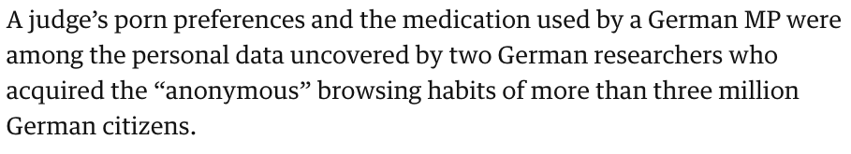
Fast Forward to 2017
“Anonymized” dataset of 3 billion URLs visited by 3 million German users (source: browser plugins)
Private Twitter analytics URLs contain username
Google Translate URLs contain full queries
Probabilistic “fingerprints”
  10 URLs enough to identify someone (eg, employer + bank + hobby + mobile provider + …)
https://www.theguardian.com/technology/2017/aug/01/data-browsing-habits-brokers

Slide 22
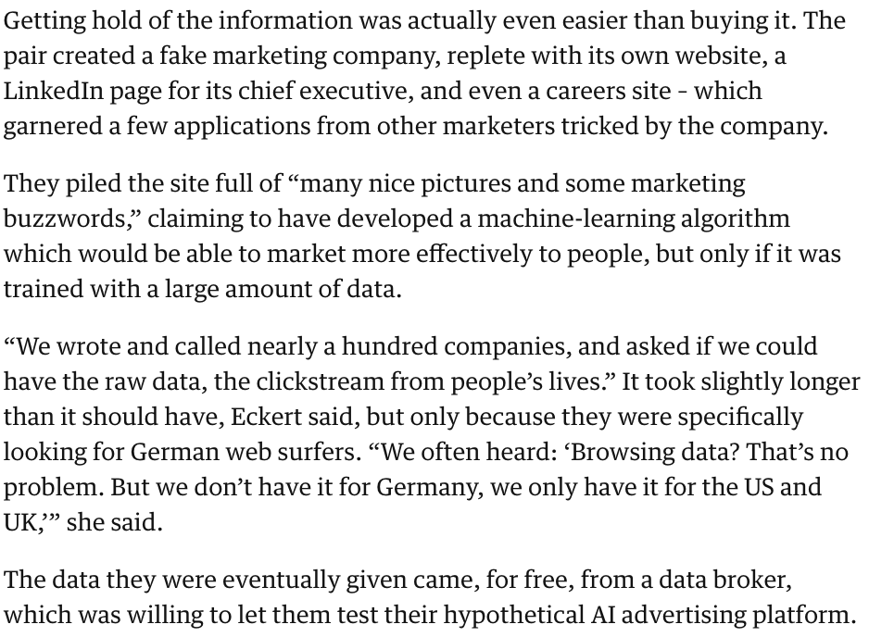

https://www.theguardian.com/technology/2017/aug/01/data-browsing-habits-brokers

Slide 23
Anonymization Considered Harmful
Syntactic
  Focuses on data transformation, not on what can be learned from the anonymized dataset
  Anonymized dataset can leak sensitive info
The “Quasi-identifier” fallacy
  Assumes a priori that attacker will not know certain information about his target
Relies on locality
  Destroys utility of many real-world datasets

Slide 24
The Myth of the PII
Data are “anonymized” by removing personally identifying information (PII)
  Name, Social Security number, phone number, email, address… what else?
Problem: PII has no technical meaning
  Defined in disclosure notification laws (if certain information is lost, consumer must be notified)
  In privacy breaches, any information can be personally identifying

Slide 25


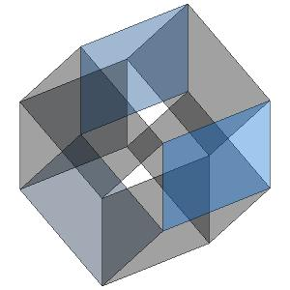
The Curse of Dimensionality
Item 1
Item 2
Item M
Row = user record
Column = dimension
Thousands or millions of dimensions
  Movie ratings in the Netflix Prize dataset: 35,000
  Amazon purchases: 10⁷
User 1
User 2
User N

Slide 26
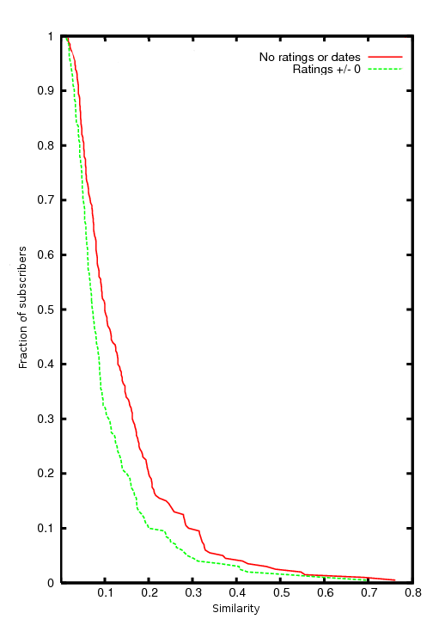
Sparsity and the “Long Tail”
Average record has no “similar” records
Fraction of subscribers
Netflix Prize dataset:
Considering just movie names, for 90% of records there isn’t a single other record which is more than 30% similar
Similarity

Slide 27
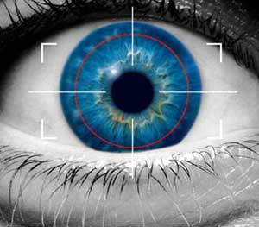
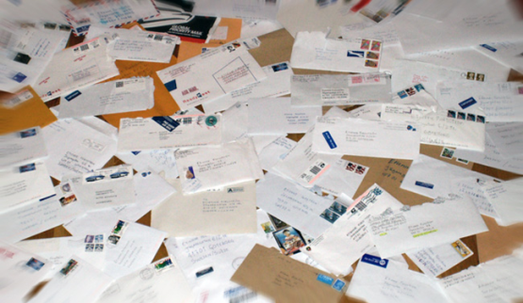


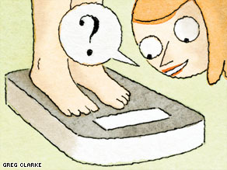
Privacy Threats
Spammers
Abusive advertisers and marketers
Global surveillance
All of these know “something” (a few attributes) about you
Phishing
Employers, insurers,
stalkers, nosy friends

Slide 28
It’s All About the Aux
Item 1
Item 2
Item M
User 1
What can the adversary learn by combining this with auxiliary information?
User 2
Information available to the
adversary outside of the
normal data release process
User N
No explicit identifiers

Slide 29



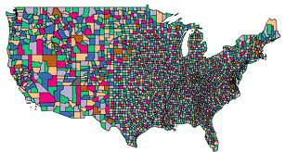


De-anonymizing Sparse Datasets
Auxiliary
information

Slide 30
The Adversary’s Objectives
Fix some target record r in the original dataset
Goal: learn as much about r as possible
Subtler than “identify r in the released dataset”
  Even if can’t identify the “right” record, the released dataset can leak information about r
    For example, find a cluster with common attributes
  Don’t fall for the k-anonymity fallacy!
    Silly example: released dataset contains k copies of each original record – this is k-anonymous yet leaks everything
Notes:
30

Slide 31
De-anonymization Challenges
Auxiliary information is noisy
  Can’t use standard information retrieval techniques
Released records may be perturbed
Only a sample of records has been released
False matches
  No oracle to confirm success!

Slide 32



Aux as Noisy Projection

Slide 33
What De-anonymization Is Not
Not linkage (statistics, Census studies)
Not search (information retrieval)
Not classification (machine learning)
Not fingerprinting (forensics)

Slide 34
“Scoreboard” Algorithm
Scoring function
  Assigns a score to each record in the released sample based on how well it matches Aux
    Σ_{i∈supp(aux)} Similarity(aux_{i}, r_{i}) / log(|support(i)|)
    gives higher weight to rarer attributes
Record selection
  Use “eccentricity” of the match
  to separate true and spurious matches
Intuition: weight is
a measure of entropy
An extremely versatile paradigm
Notes:
34

Slide 35
How Much Aux Is Needed?
How much does the adversary need to know about a record to find a very similar record in the released dataset?
  Under very mild sparsity assumption, O(log N), where N is the number of records
What if not enough Aux is available?
  Identifying a small number of candidate records similar to the target still reveals a lot of information

Slide 36
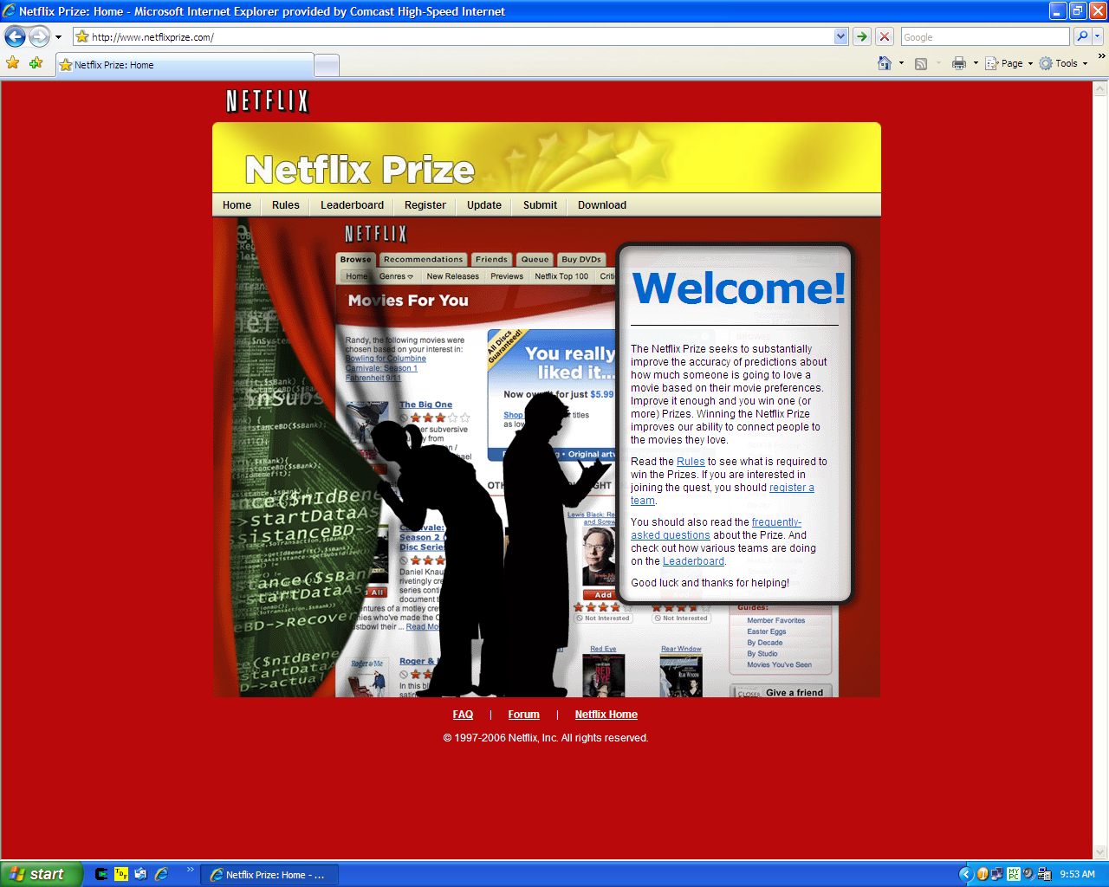

Slide 37
De-anonymizing the Netflix Dataset
500K users, 18,000 movies
213 dated ratings per user, on average
Two is enough to reduce to 8 candidate records
Four is enough to identify uniquely (on average)
Works even better with relatively rare ratings
    “The Astro-Zombies” rather than “Star Wars”
The “long tail” effect:
most people watch obscure crap

Slide 38
Self-testing
Methodological question: how does the attacker know the matches aren’t spurious?
No de-anonymization oracle or “ground truth”
Compute a score for each record: how well does it match the auxiliary information?
Heuristic: (max-max₂) / σ ≥ φ
Best score
Second-best
score
Eccentricity
threshold

Slide 39
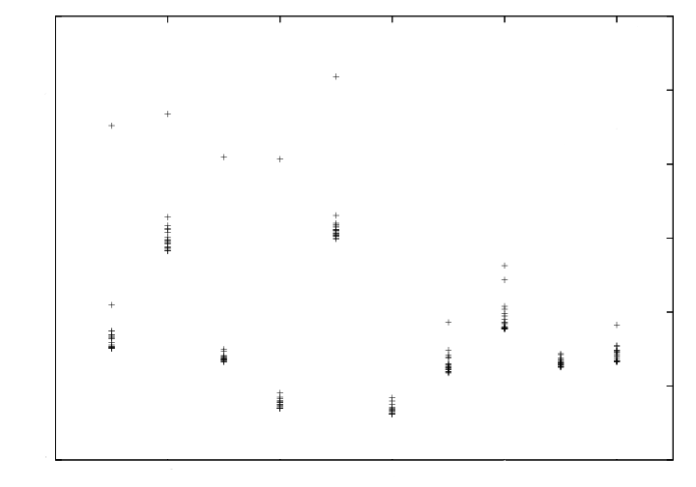
Eccentricity in the Netflix Dataset
Algorithm applied to Aux of
a record in the dataset
score
σ
max – max₂
σ
… to Aux of a record
not in the dataset
aux
Notes:
39

Slide 40
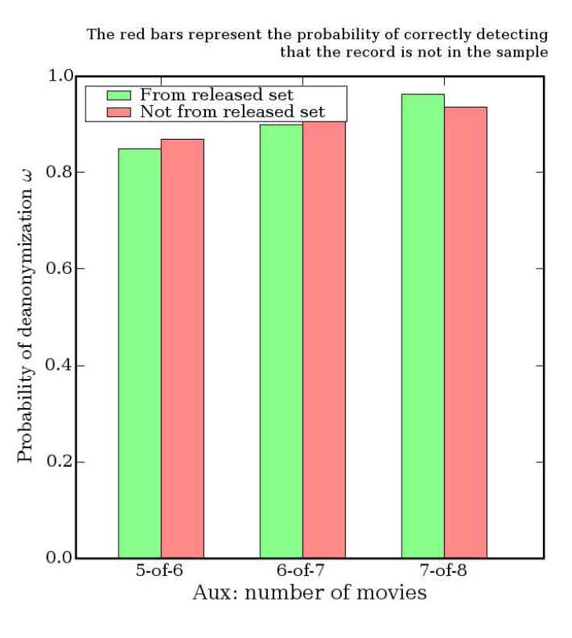
Self-testing: Experimental Results
After algorithm finds a match, remove the found record and re-run
With very high probability, the algorithm now declares that there is no match
Notes:
40

Slide 41
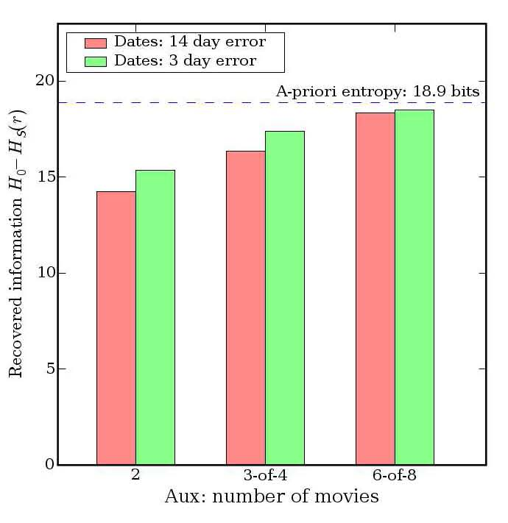
Robustness
With 6 approximately correct &
2 completely wrong ratings,
recover all entropy
Algorithm is robust to errors in attacker’s Aux
  Dates and ratings may be known imprecisely, some may be completely wrong
  Perturbation = noise in the data = doesn’t matter!
  Nearest neighbor is so far, can tolerate huge amount of noise and perturbation

Slide 42
Lesson #1:
De-anonymization Is Robust
33 bits of entropy identifies anyone
  6-8 movies, 4-7 friends, etc.
Perturbing data to foil de-anonymization often destroys utility
Can estimate confidence in re-identification even without the ground truth
Accretive and iterative:
more de-anonymization →
better de-anonymization

Slide 43
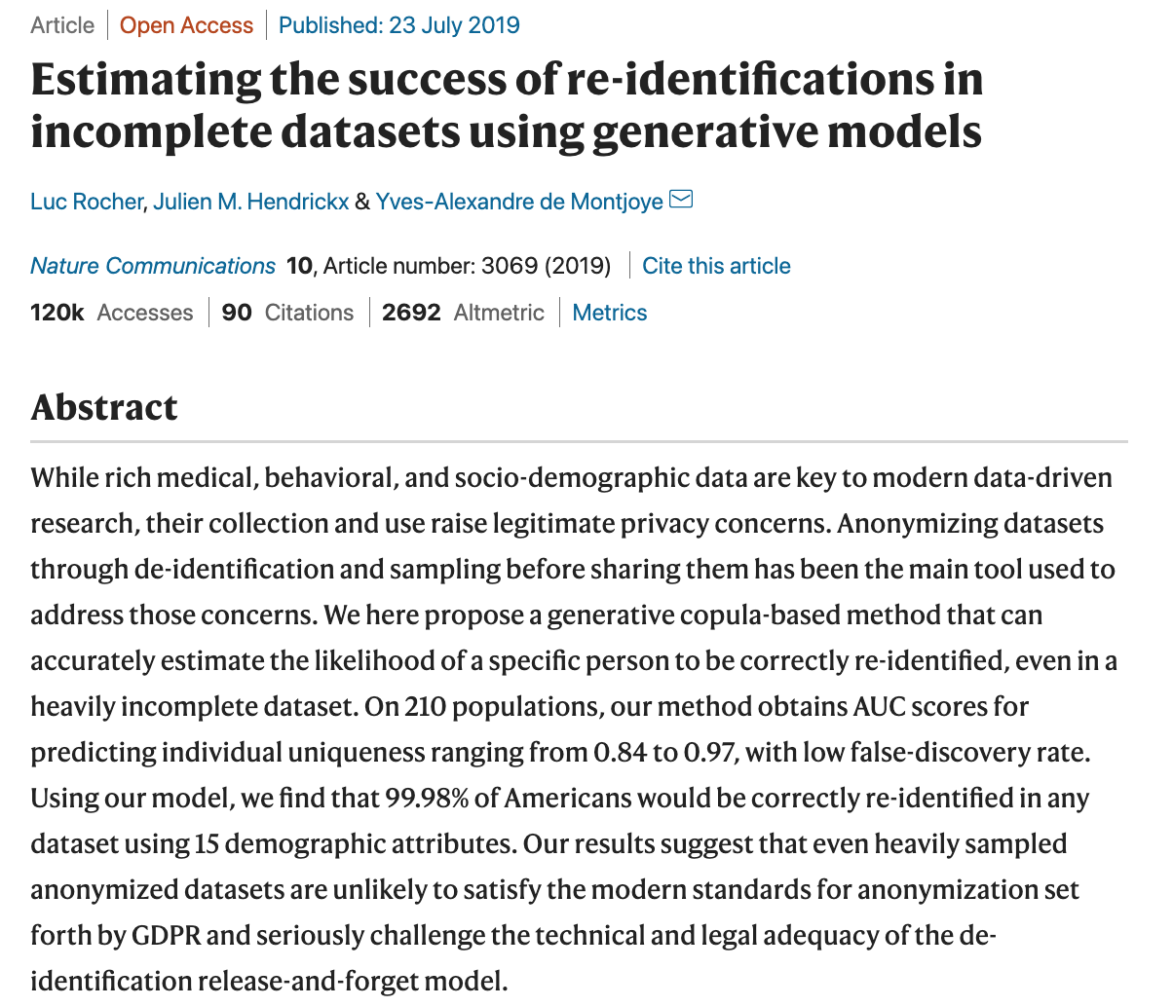



Slide 44
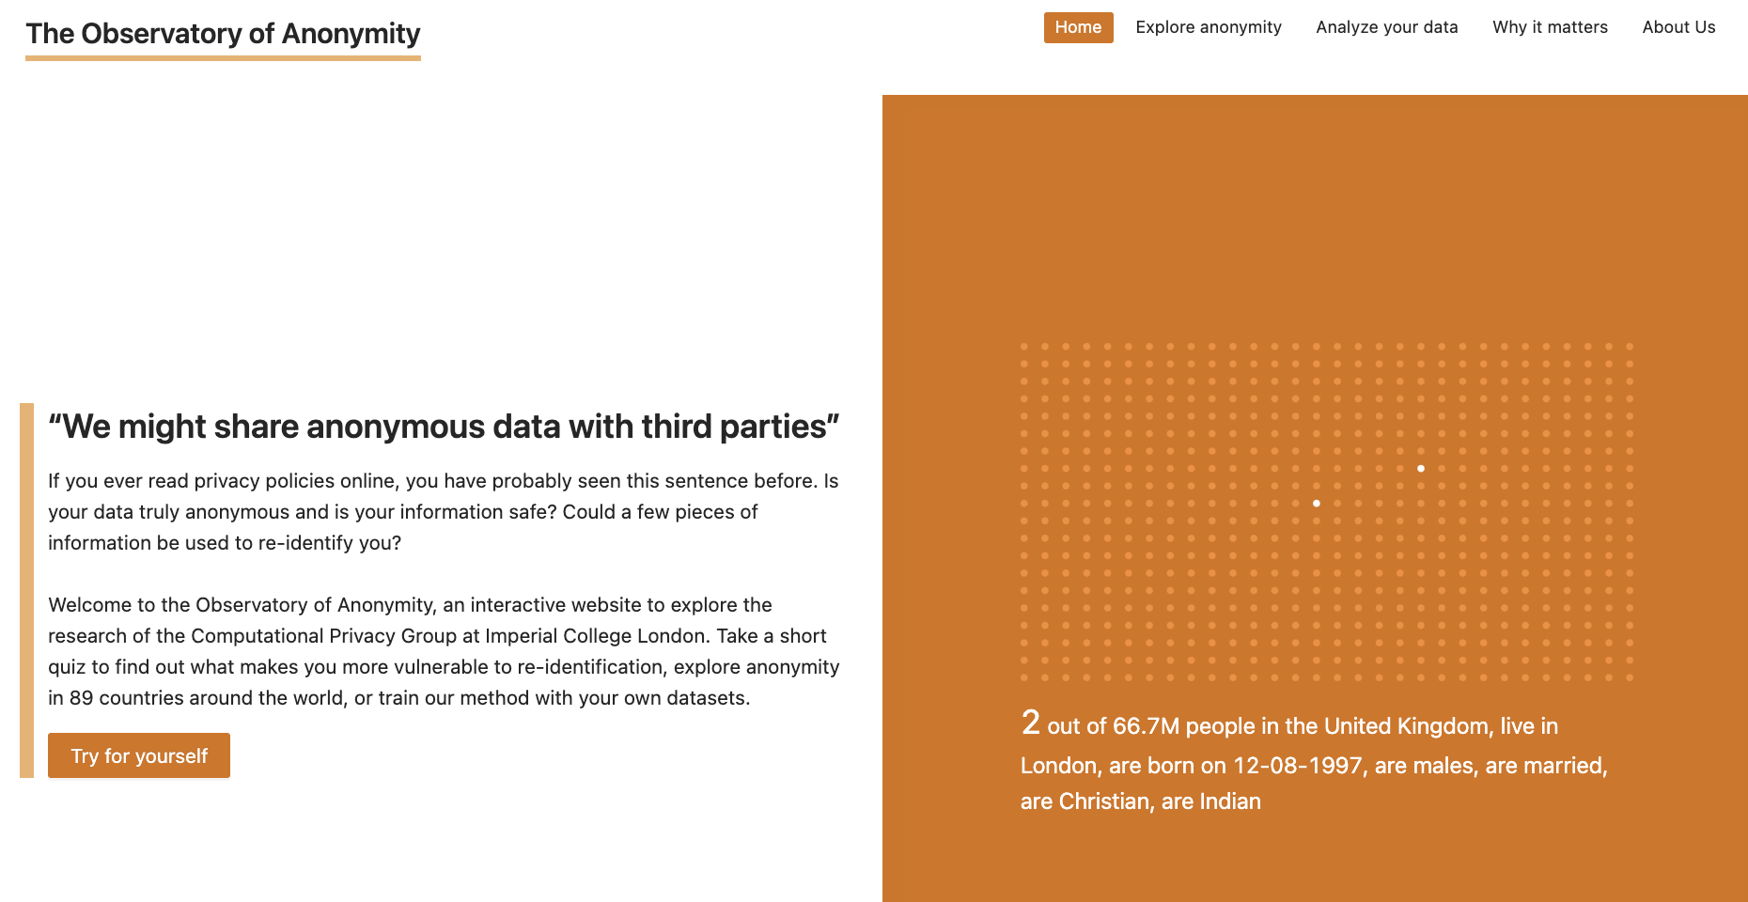
https://cpg.doc.ic.ac.uk/observatory/

Slide 45
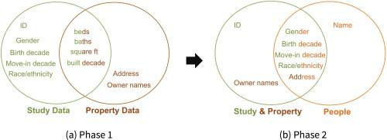


Re-Identifying Data from an Environmental Health Study
Anonymized survey data from known California locations
Sweeney et al. (2018): https://www.ncbi.nlm.nih.gov/pmc/articles/PMC6344041/

Slide 46
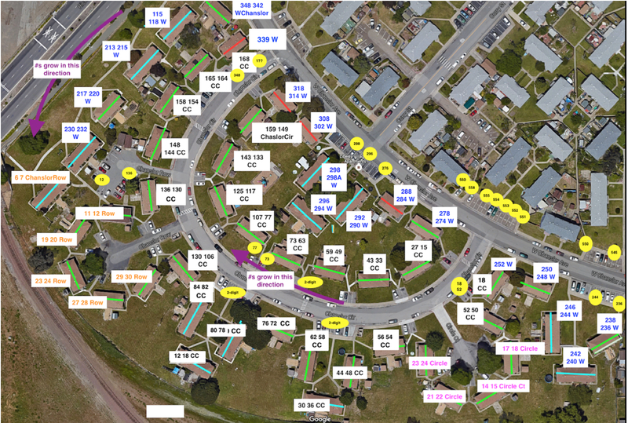
Anonymous Housing Data →
Owner Names
Number of pathways = number of rental units
Visible parking spot numbers → street addresses
Roof size → number of bedrooms
Use a public broker website to find out who lived at each address
Google Earth
Sweeney et al. (2018): https://www.ncbi.nlm.nih.gov/pmc/articles/PMC6344041/

Slide 47
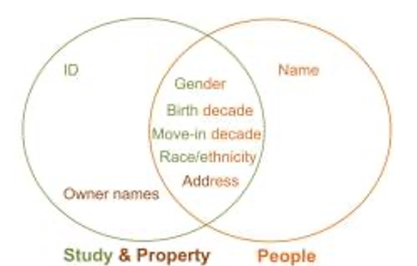
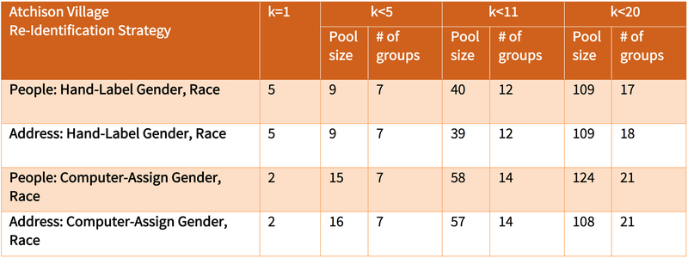
Owner Names →
Survey Participants
Match residents to anonymous survey participants based on gender, race, birth decade, move-in date, address
If no unique match, then a small group
Success rate of unique re-identification depends on demographic makeup and quality of property data
Sweeney et al. (2018): https://www.ncbi.nlm.nih.gov/pmc/articles/PMC6344041/

Slide 48


Sander v. State Bar of California
Lawsuit sought information from the State Bar of California on race, undergrad GPA, LSAT, law school, law school GPA, year of graduation, bar exam score, bar exam result for every individual who attempted to pass the California bar examination between 1972 and 2007
Plaintiffs proposed 4 methods for anonymizing the data
Lost for another reason
Sweeney et al. demonstrated many anonymized records could be re-identified using online commencement data, dates of graduations and bar exams, attorney licensing data, online bios, alumni lists, club memberships, online photos…
Black, Hispanic, Asian students especially vulnerable (why?)
Even incorrect re-identifications are harmful (why?)
Sweeney et al. (2018): https://techscience.org/a/2018111301/

Slide 49
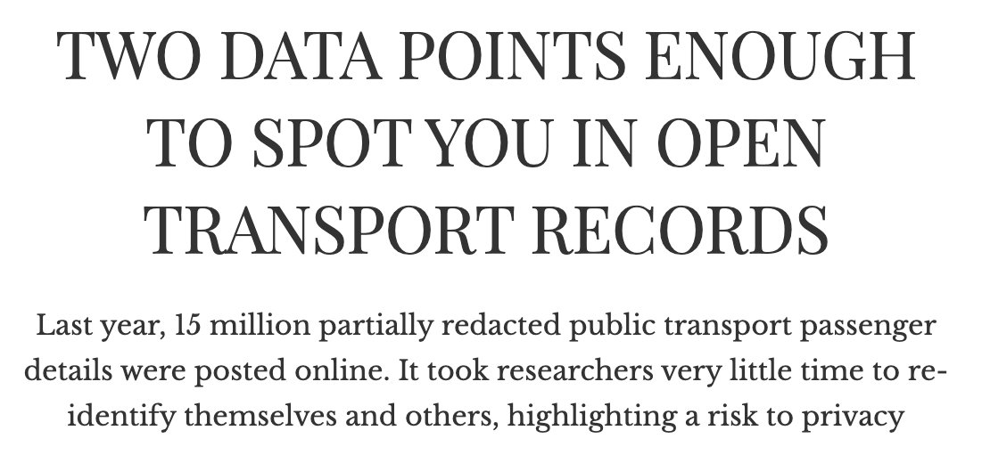

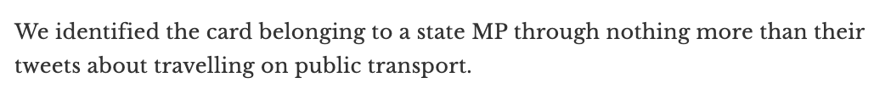


https://pursuit.unimelb.edu.au/articles/two-data-points-enough-to-spot-you-in-open-transport-records

Slide 50
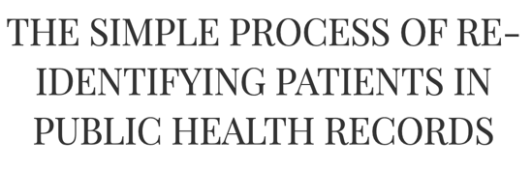
Australia’s federal Department of Health published anonymized medical billing history of 2.9 million Australians, including all publicly reimbursed bills for selected patients for 30 years (1984-2014)
Researchers at the University of Melbourne showed how to identify records of prominent Australians by linking them to publicly available information (news stories, unusual medical procedures, birthdates of their children found in Wikipedia, etc.)

Slide 51

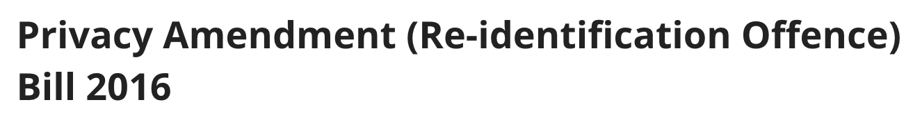
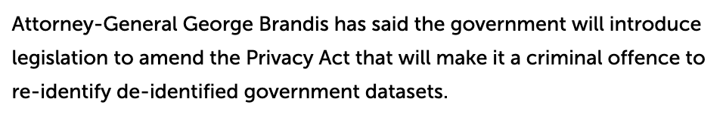
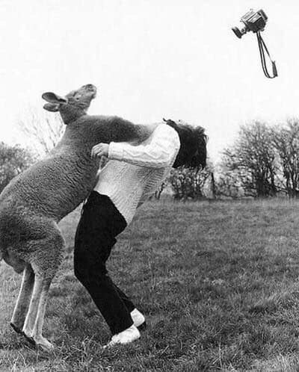
Solution: Make It Illegal?
Did not pass but government not giving up …

Slide 52
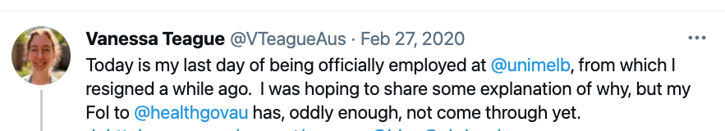
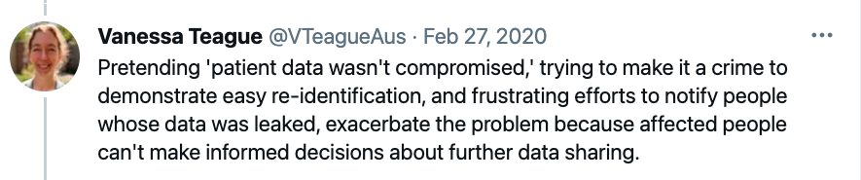
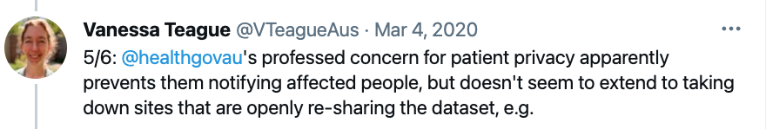

”A prominent university professor has quit after the health department pressured her university to stop her speaking about the Medicare and PBS history of over 2.5 million Australians being re-identifiable online due to a government bungle”
https://www.theguardian.com/australia-news/2020/mar/08/melbourne-professor-quits-after-health-department-pressures-her-over-data-breach

Slide 53


Lesson #2:
“PII” Is Technically Meaningless
PII is info “with respect to which there is a reasonable basis to believe the information can be used to identify the individual.”
Problem: any piece of data can be used for re-identification!
“blurring of the distinction between personally identifiable information and supposedly anonymous or de-identified information”

Slide 54
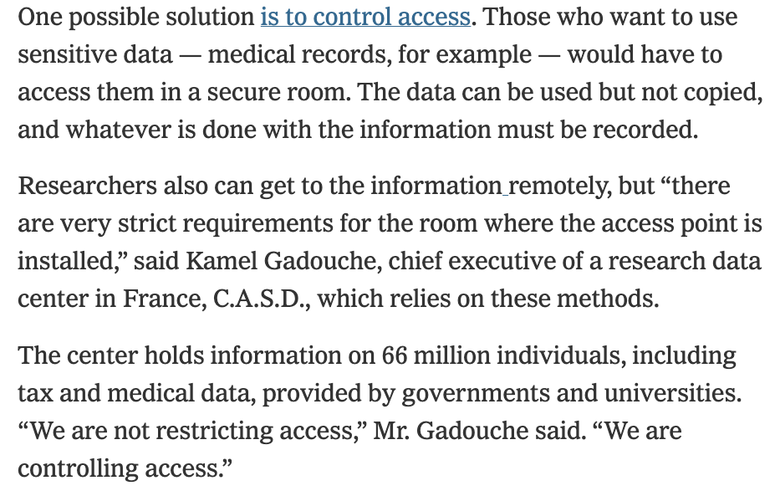
Solution: Access Control?
https://www.nytimes.com/2019/07/23/health/data-privacy-protection.html

Slide 55
Whose Data Is It, Anyway?
“Everyone owns and should control
their personal data”
Social networks
  Information about relationships is shared
Genome
  Shared with all blood relatives
Machine learning
  Complex algorithms make it impossible to trace origin of data

