Slide 1

Algorithm Selection and Scheduling
Serdar Kadioglu Brown University
Yuri Malitsky Brown University
Ashish Sabharwal IBM Watson
Horst Samulowitz IBM Watson
Meinolf Sellmann IBM Watson

Slide 2
Algorithm Portfolios: Motivation
Cryptosat
Walksat
CSPs
Minisat
SAPS
SAT
Precosat
MIP
MarchEq
Clasp
Combinatorial problems such as SAT, CSPs, and MIP have several competing solvers with complementary strengths
  Different solvers excel on different kinds of instances
Ideal strategy: given an instance, dynamically decide which solver(s) to use from a portfolio of solvers

Slide 3
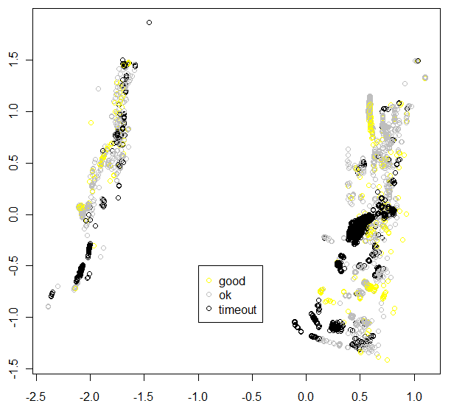
Algorithm Portfolios: Motivation
space of 5437
SAT instances
VBS: virtual best solver
A1 : one algorithm
algorithm is good
on the instance
(≤ 25% slower
than VBS)
algorithm is ok
on the instance
(> 25% slower
than VBS)
algorithm is bad
on the instance
(times out after
5000 sec)
A1

Slide 4
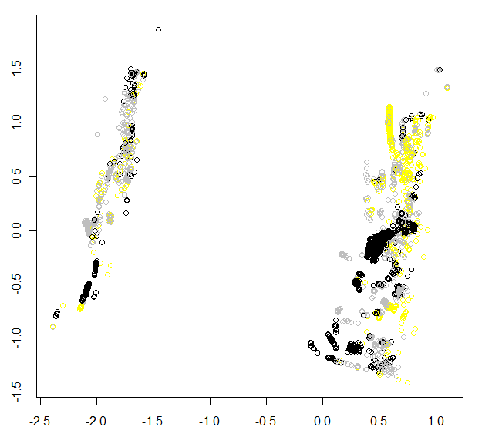
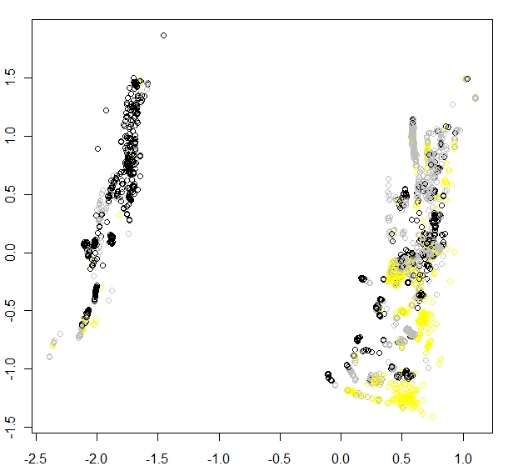
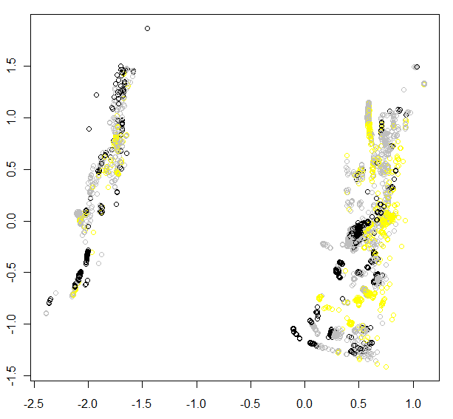
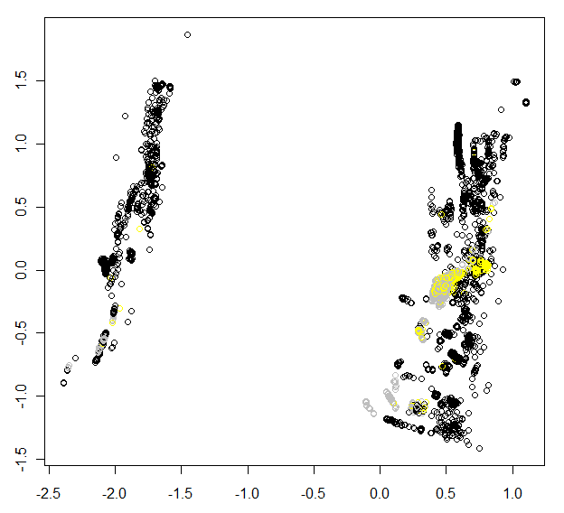
Algorithm Portfolios: Motivation
space of 5437
SAT instances
algorithm is good
on the instance
algorithm is ok
on the instance
algorithm is bad
on the instance
A1
A3
A7
A10
A37

Slide 5
Algorithm Portfolios: How?
A1
A2
j
A3
A4
A5
Given a portfolios of algorithms A1, A2, …, A5, when an instance j comes along, how should we decide which solver(s) to use without actually running the solvers on j?

Slide 6
Algorithm Portfolios: Use Machine Learning
A1
A2
j
A3
A4
A5
Exploit (offline) learning
from 1000s of training instances
Pre-compute how long each Ai takes on each training instance
“Use this information” when selecting solver(s) for instance j

Slide 7
Flavor 1: Algorithm Selection
How?
A1
A2
j
A3
A4
A5
Exploit (offline) learning
from 1000s of training instances
Output: one single solver that is expected to perform the best on instance j in the given time limit T

Slide 8
Flavor 2: Algorithm Scheduling
How?
A1
300 sec
A2
j
20 sec
A3
A4
remaining
time
A5
Exploit (offline) learning
from 1000s of training instances
Output: a sequence of (solver,runtime) pairs that is expected to perform the best on instance j in total time T
Should the schedule depend on j? If so, how?

Slide 9
Our Contributions
Focus on SAT as the test bed
  many training instances available
  impressive success stories of previous portfolios (e.g., SATzilla)
A simple, non-model-based approach for solver selection
  k-NN rather than inherently ML biased empirical hardness models that have dominated portfolios for SAT
Semi-static and fixed-split scheduling strategies
  a single portfolio that works well across very different instances
  first such solver to rank well in all categories of SAT Competition [several medals at the 2011 SAT Competition]
  works even when training set not fully representative of test set

Slide 10
Rest of the Talk
k-NN approach for solver selection
  made robust with random sub-sampling validation
  enhanced with distance-based weighting of neighbors
  enhanced with clustering-based adaptive neighborhood sizes
Computing “optimal” solver schedules
  IP formulation with column generation for scalability
Semi-static and fixed-split schedules
  some empirical results (many more in the paper)
  performance at SAT Competition 2011 (sequential track)
[SAT 2011]

Slide 11
Related Work
Several ideas by Rice [1976], Gomes & Selman [2001], Lagoudakis & Littman [2001], Huberman et al [2003], Stern et al [2010]
Effective portfolios for SAT and CSP:
  SATzilla [Xu et al 2003-2008] : uses empirical hardness models, impressive performance at past SAT Competitions
  CP-Hydra [O’Mahony et al 2008] : uses dynamic schedules, won CSP 2008 Competition
  Silverthorn and Miikkulainen [2010-2011] : solver schedule based on Dirichlet Compound Multinomial Distribution method
  Streeter et al [2007-2008] : online methods with performance guarantees
Related work on algorithm parameterization / tuning
Many others… [cf. tutorial by Meinolf Sellmann at CP-2011]

Slide 12
A. k-NN Based Solver Selection

Slide 13
Solver Selection: SATzilla Approach
Brief contrast: previously dominating portfolio approach in SAT based on learning an empirical hardness model for each Ai
f_{A1}(features)
A1
j
f_{A2}(features)
A2
Idea: predict runtimes
of all Ai on j and choose
the best one
Issue: accurate runtime
prediction is very hard,
especially with a rather
simplistic function
linear model
for log-runtime
A3
A4
f_{A5}(features)
A5
composite features
static features, e.g., formula size,
var occurrence, frac. of 2-clauses, etc.
dynamic features based
on briefly running a solver

Slide 14
k-NN Based Solver Selection
Simpler alternative: choose k “closest” neighbors N(j) of j in the feature space, and choose Ai that is “best” on N(j)
PAR10 score
A1
(k=3)
A2
j
A3
Non-model based
Only thing to “learn” is k
too small: overfitting
too large: defeats the
purpose
For this, use sub-sampling
validation (100x)
A4
A5
Already improves, e.g., upon SATzilla_R, winner
of 2009 Competition in random category

Slide 15
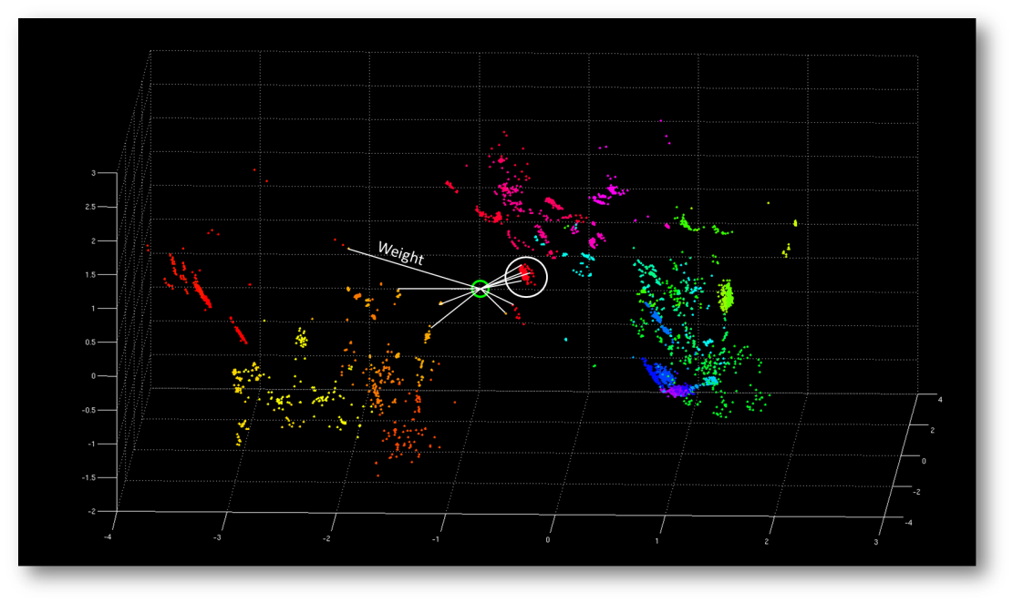
Enhancing k-NN Based Solver Selection
Distance-based weighting
of neighbors
  listen more to closer neighbors
Clustering-guided adaptive neighborhood size k
  cluster training instances using PCA analysis
  “learn” the best k for each cluster (sub-sampling validation per cluster)
  at runtime, determine closest cluster and use the corresponding k

Slide 16
B. Computing Optimal Solver Schedules

Slide 17
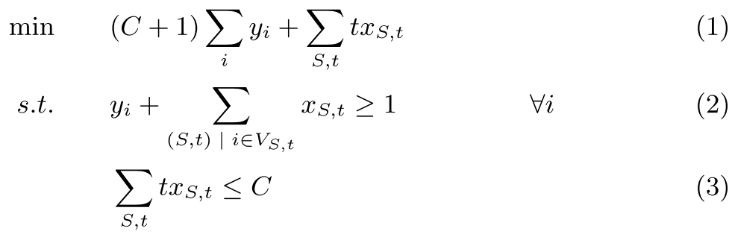
Solver Schedules as Set Covering
Question: given a set of training instances, what is the best solver schedule for these?
Set covering problem; can be modeled as an IP
  binary variables x_{S,t} : 1 iff solver S is scheduled for time t
  penalty variables y_{i} : 1 iff no selected solver solves instance i
Minimize number of unsolved instances
Minimize runtime (secondary obj.)
Time limit

Slide 18
Column Generation for Scalability
Issue: poor scaling, due to too many variables
  e.g., 30 solvers, C = 3000 sec timeout ⇒ 30000 x_{S,t} vars
  even being smart about “interesting” values of t doesn’t help
  recall: cluster-guided neighborhood size determination and 100x
  random sub-sampling validation requires solving this IP a lot!
Solution: use column generation to identify promising (S,t) pairs that are likely to appear in the optimal schedule
  solve LP relaxation to optimality using column generation
  use only the generated columns to construct a smaller IP,
  and solve it to optimality (no branch-and-price)
Results in fast but still high quality solutions (empirically)

Slide 19
C. Solver Schedules that Work Well:
Static, Dynamic, or In-Between?

Slide 20
Static and Dynamic Schedules: Not So Great
Static schedule: pre-compute based on training instances and solvers A1, A2, …, Am
  completely oblivious to the test instance j
  works OK (because of solver diversity) but not too well
Dynamic schedule: compute k neighbors N(j) of test instance j, create a schedule for N(j) at runtime
  instance-specific schedule!
  somewhat costly but manageable with column generation
  can again apply weighting and cluster-guided adaptive k
  however, only marginal gain over k-NN + weighting + clustering

Slide 21
Semi-Static Schedules: A Novel Compromise
Can we have instance-specific schedules without actually solving the IP at runtime (with column generation)?
Trick: create a “static” schedule but base it on
solvers A1, A2, …, Am, A_{kNN-portfolio}
  A_{kNN-portfolio} is, of course, instance-specific! i.e., it looks at features of test instance j to launch the most promising solver
  nonetheless, schedule can be pre-computed
  ⇒ Best of both worlds!
Substantially better performance than k-NN but …

Slide 22
Fixed-Split Schedules: A Practical Choice
  Observation #1: a schedule can be no better than VBS performance limited to the runtime of the longest running solver in the schedule!
    ⇒ give at least one solver a relatively large fraction of the total time
  Observation #2: some solvers can often take just seconds on an instance that other solvers take hours on
    ⇒ run a variety of solvers in the beginning for a very short time
Fixed-split schedule: allocate, e.g., 10% of time limit to a (static) schedule over A1, …, Am; then run A_{kNN-portfolio} for 90% of the runtime
  performed the best in our extensive experiments
  our SAT Competition 2011 entry, 3S, based on this variant

Slide 23
Empirical Evaluation

Slide 24
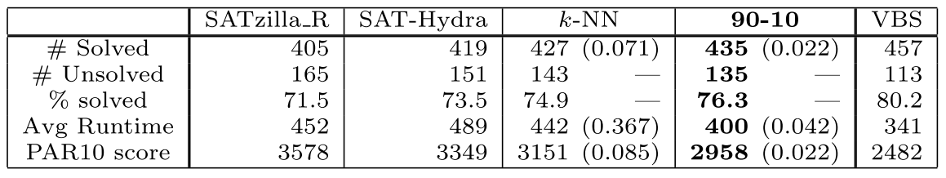
Empirical Evaluation: Highlights #1
Comparison of Major Portfolios for the SAT-Rand benchmark from 2009
  570 test instances, 1200 sec timeout
SATzilla_R, winner of 2009 Competition, itself dramatically improves performance over single best solver (which solves 293 instances; not shown)
“SAT” version of CP-Hydra, and k-NN, get closer to VBS performance
90-10 fixed-split schedule solves 435 instances, i.e., 95% of VBS

Slide 25
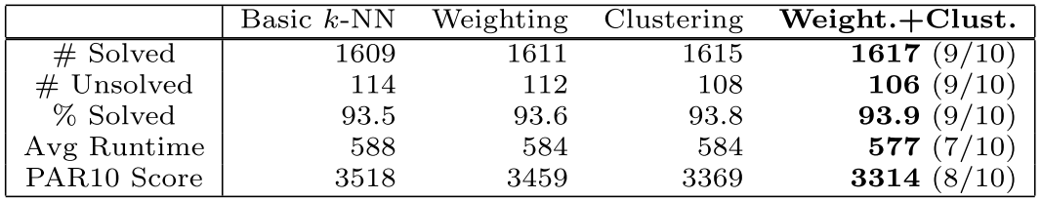
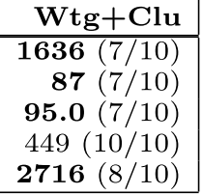
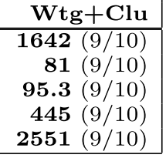
Empirical Evaluation: Highlights #2
A highly challenging mix of 5464 application, crafted, & random instances from SAT Competitions and Races 2002-2010
10 training-test 70-30 splits created in a “realistic” / “mean” fashion
  entire benchmark families removed, to simulate real life situations
  data reported as average over the 10 splits, along with number of splits in which the approach beats the one to its left (see paper for Welch’s T-test)
90-10
fixed-split
schedule
Semi-static
schedule
Algorithm Selection

Slide 26
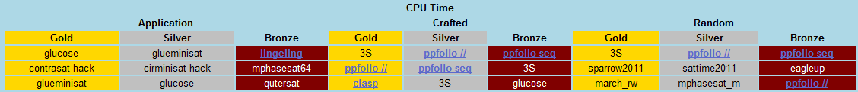
SAT Competition 2011 Entry: 3S
37 constituent solvers – DPLL with clause learning and lookahead solvers
(with and without SATElite preprocessing), local search solvers
90%-10% fixed-split schedule; 100x random sub-sampling validation
www.satcompetition.org
SAT+UNSAT
SAT only
UNSAT only
* 3S ranked #10 in Application SAT+UNSAT category out of 60+ solver entries
(note: 3S is based on solvers from 2010 and has limited training instances from application category)
3S is the only solver, to our knowledge, in SAT Competitions to win in two categories and be ranked in top 10 in the third
3S winner by a large margin when all application + crafted + random instances are considered together (VBS solved 982, 3S solved 771, 2nd best 710)

Slide 27
Summary
A simple, non-model-based approach for solver selection
  k-NN rather than empirical hardness models that have dominated portfolios for SAT
Computing “optimal” solver schedules
  IP formulation with column generation for scalability
Semi-static and fixed-split scheduling strategies
  a single portfolio that works well across very different instances
  first such solver to rank well in all categories of SAT Competition
  works even when training set not fully representative of test set
Currently exploring these ideas for a “CPLEX portfolio”

Slide 28
EXTRA SLIDES

Slide 29
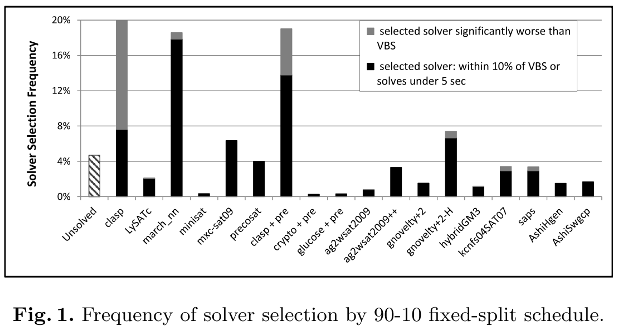

Slide 30
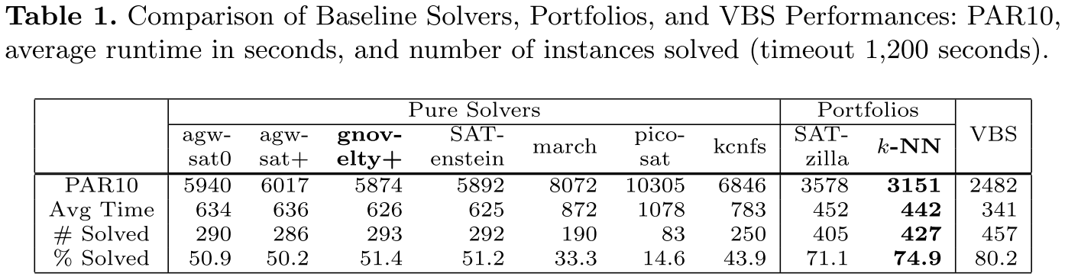

Slide 31
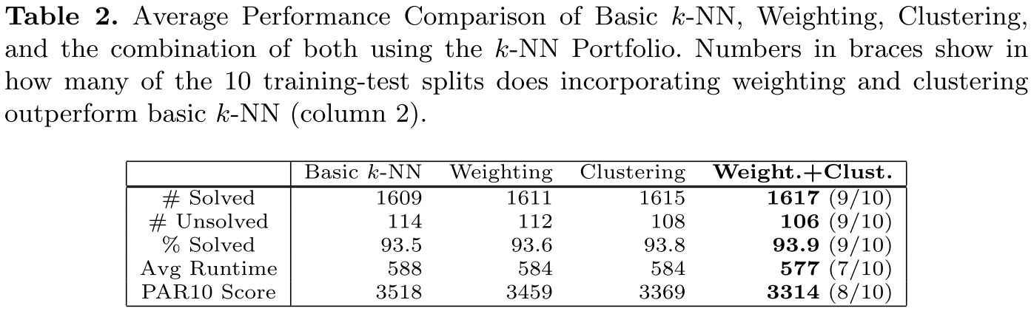

Slide 32
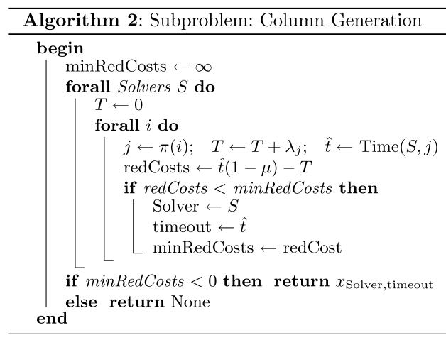

Slide 33
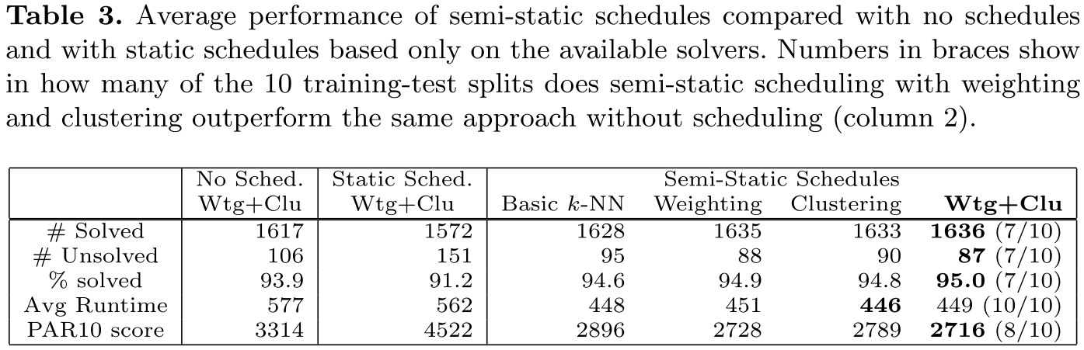

Slide 34
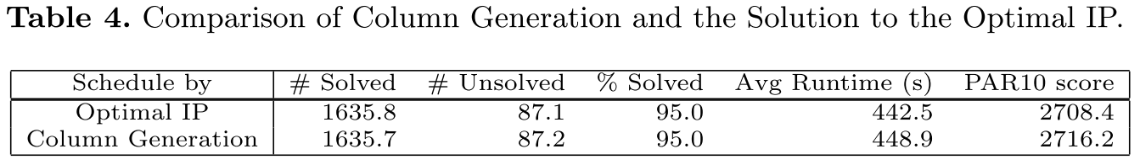

Slide 35
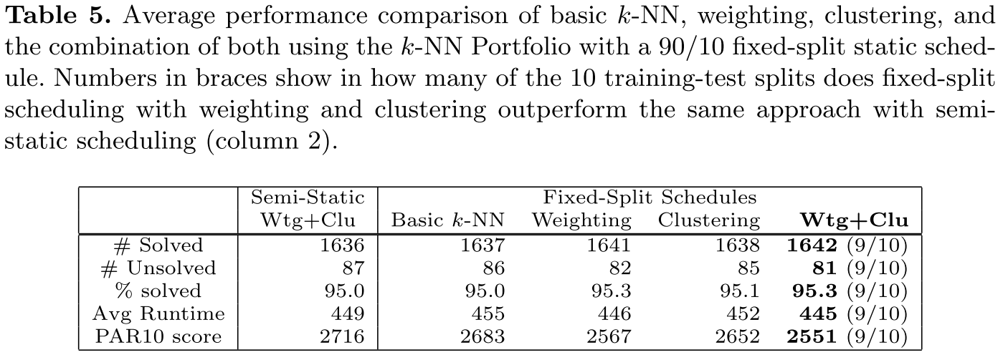

Slide 36
