Slide 1

Printing Arbitrary Meshes with a 5DOF Wireframe Printer
Rundong Wu Huaishu Peng
François Guimbretière Steve Marschner
Cornell University
Notes:
Hello everybody, today I’ll talk about our algorithm that enables a 5DOF wireframe printer to print arbitrary input meshes.

Slide 2
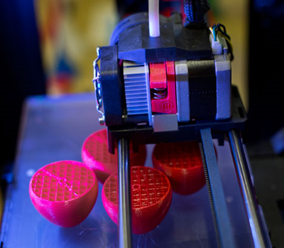
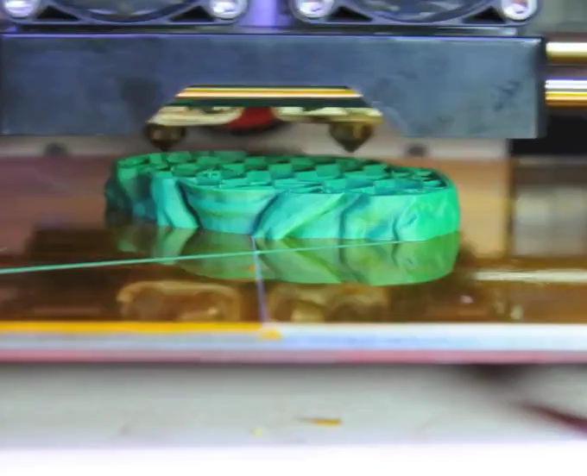

Traditional 3D Printing
Notes:
Traditional 3D printers fabricate objects by depositing materials layer-by-layer.
(http://www.bloomberg.com/news/articles/2013-06-19/makerbot-sells-out-to-3d-printings-old-guard-for-403-million Photograph by Victor J. Blue/Bloomberg)
(http://3dprinterplans.info/our-five-most-anticipated-upcoming-3d-printers/ )

Slide 3
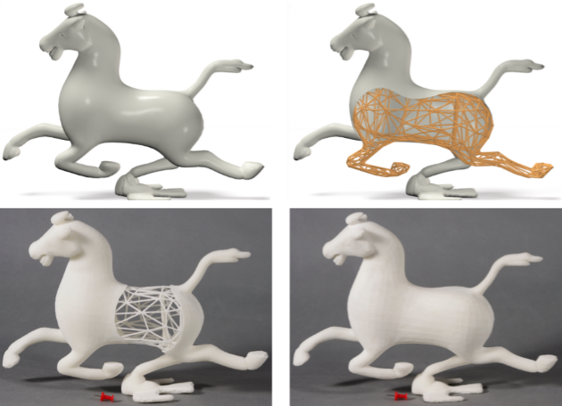
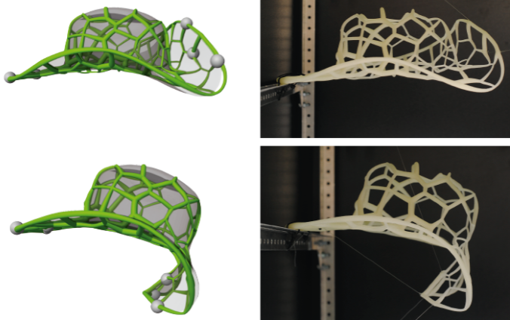
[Wang et al. 2013]
[Peréz et al. 2015]
Notes:
Recent research shows interest in printing strut (stress) networks in order to save materials, or control elasticity.
But these works also fabricate the wireframe structures in the traditional layer-wise way.

Slide 4
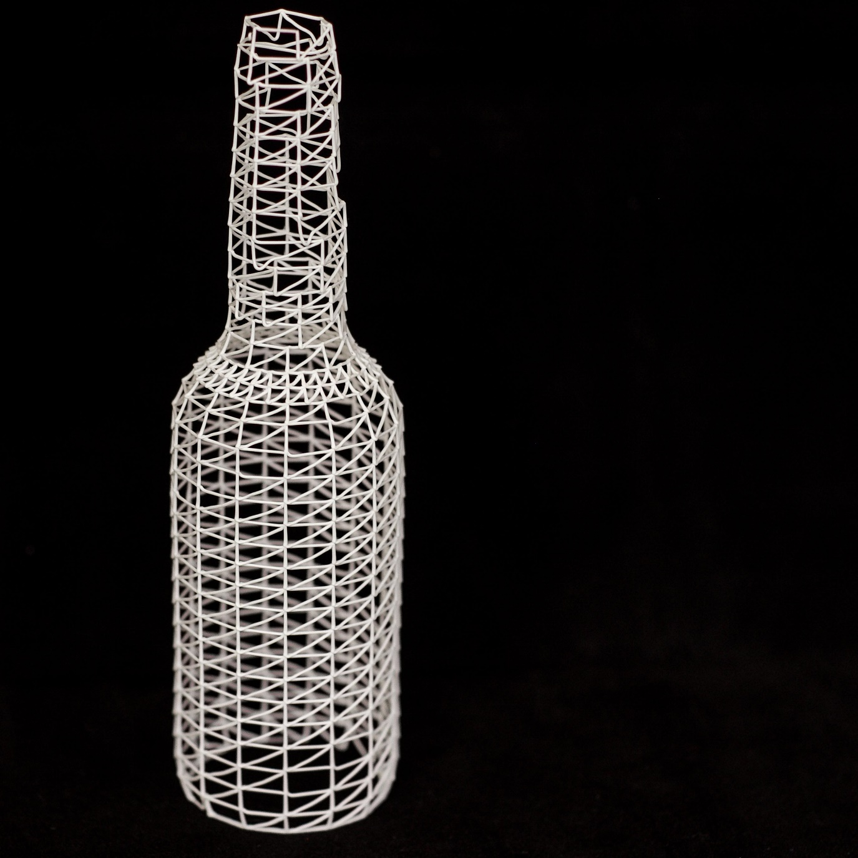
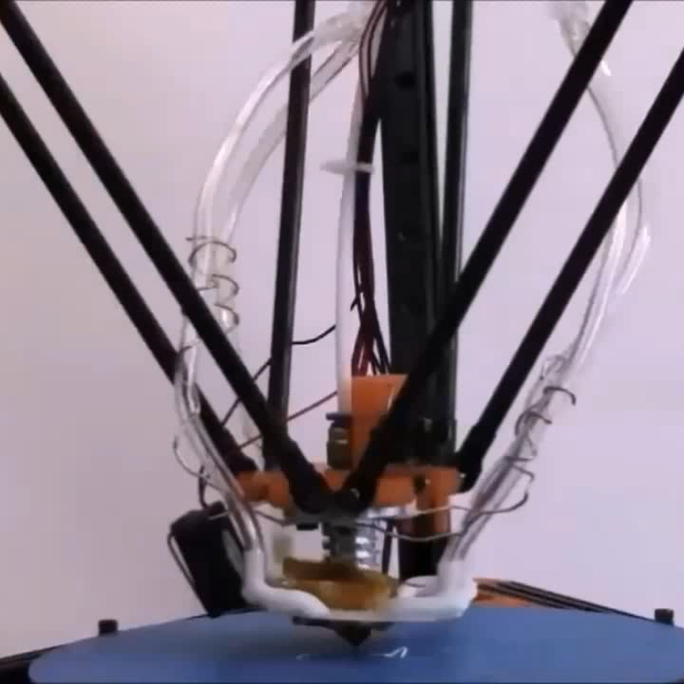
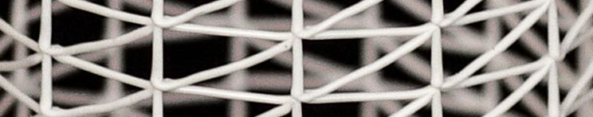
WirePrint System
Directly extrude filament in 3D space, creating one edge in a single stroke.
Model sliced horizontally and filled with zigzags.
The meshing is heavily constrained.
[Mueller et al. 2014]
Notes:
In 2014 Mueller et al introduced a system called WirePrint. The idea is to only print wireframes instead of solid objects, so as to save printing time and provide a fast preview to the designer.
As you’ve seen in the video, in this system the printer can directly extrude filament in 3D space, to create one edge in a single stroke.
And in order to easily schedule the printing and avoid collision, the model is sliced into horizontal pieces and each slice is filled with zigzags, which heavily constrains the meshing.
For example, as shown in the bottom right, the diagonals of the zigzags cannot be too steep, otherwise it will collide with the nozzle.

Slide 5
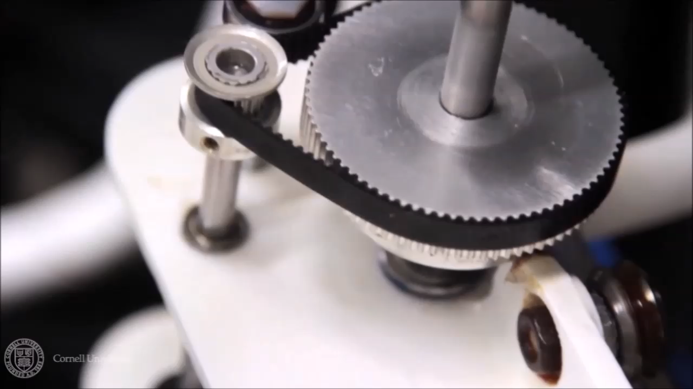
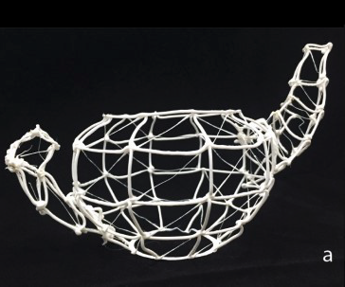
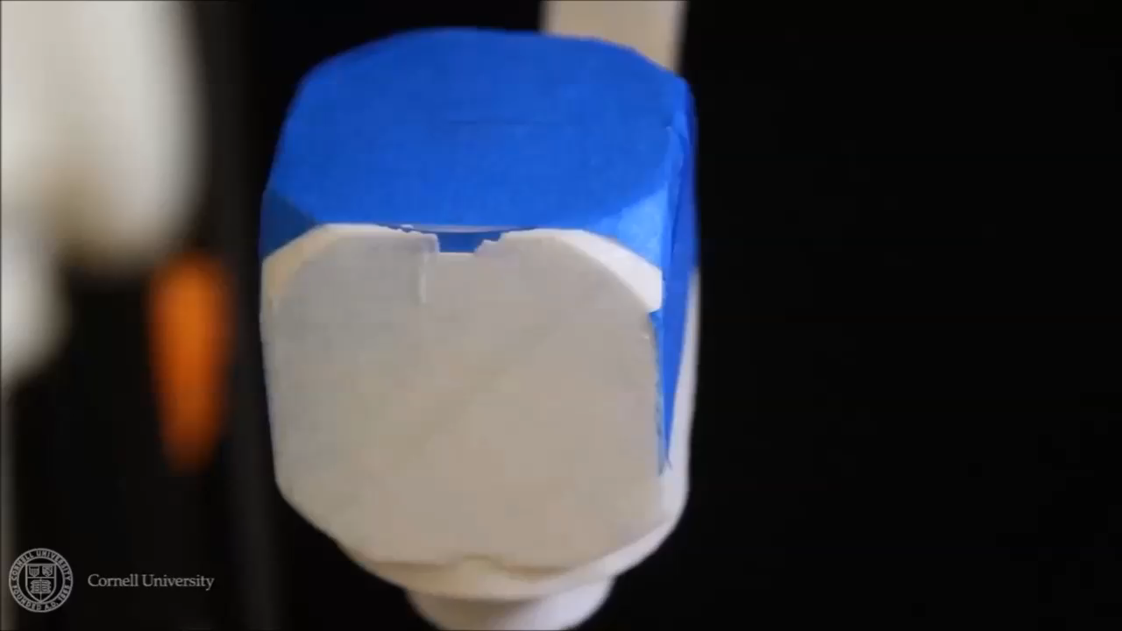
On-the-Fly Print System
Two extra degrees of freedom.
The nozzle can approach the model from different orientations to print the edges.
Mesh generated from UV map.
Simple strategy for scheduling.
[Peng et al. 2016]
Notes:
In this year’s CHI conference, we introduced a new system called On-the-Fly Print, which uses a 5DOF printer to print the wireframes.
As you can see, a round rail is installed on the machine, so that this carriage can move along the rail and the printing platform can rotate around this axis.
In addition, the platform of the machine can also rotate around the other axis.
Therefore, in the model’s frame of reference, the nozzle can approach from any orientation in the upper hemisphere to print the edges.
With these two extra degrees of freedom, one might imagine that the 5DOF printer ought to be able to print arbitrary input meshes.
However, On-the-Fly print does not achieve this because it prints the edges in a fixed order. This strategy often results in unprintable edges, which cannot be approached from any orientation without making the nozzle collide with the existing edges, such as the top of the teapot handle.
So, both WirePrint and On-the-Fly Print can only print specially designed meshes, which constrains their ability to render the shapes.

Slide 6
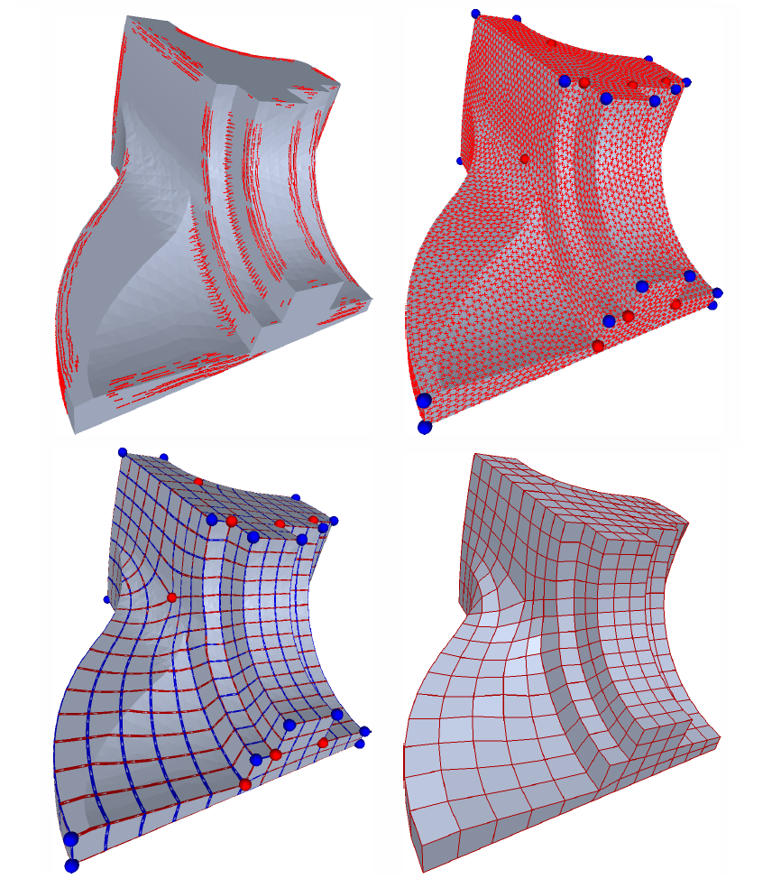
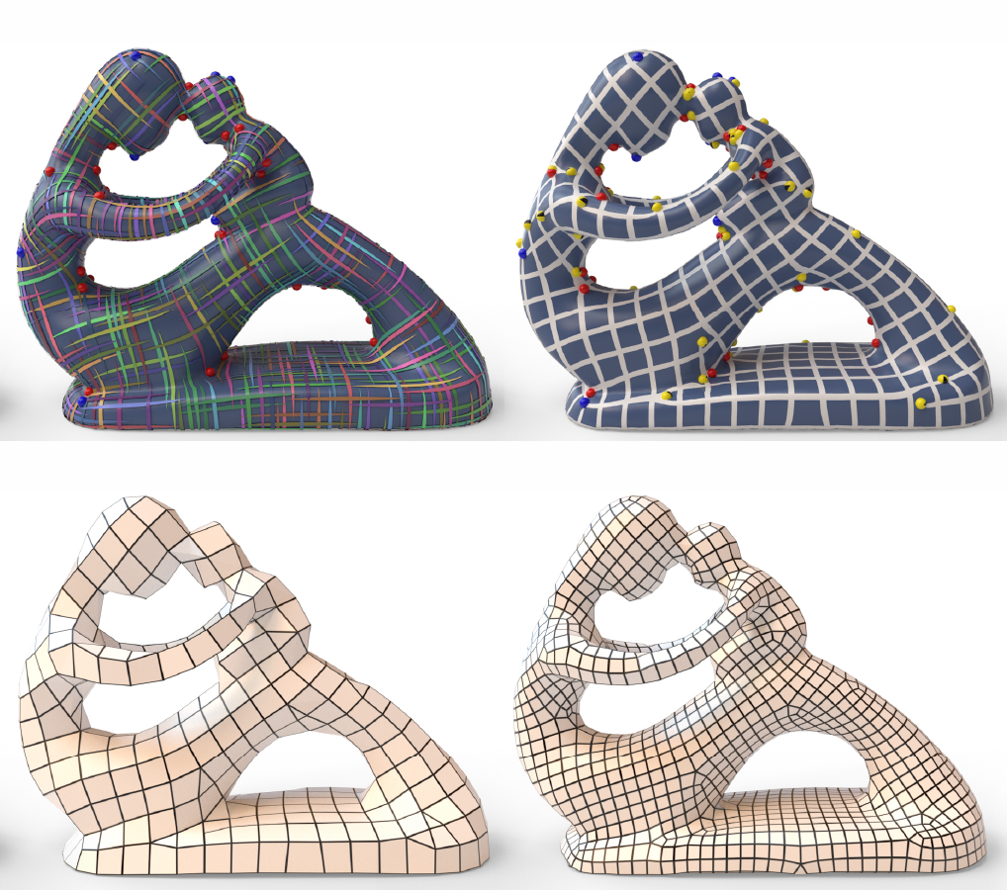
[Bommes et al. 2009]
[Jakob et al. 2015]
Notes:
On the other hand, a lot of methods have been proposed to generate high quality triangular or quadrangular meshes. For example, the features lines of the fandisk model can be well preserved by a quad mesh on the left. If we can print such meshes, it will enable the WirePrint technology to benefit from these approaches‘ ability to better represent the shapes.

Slide 7
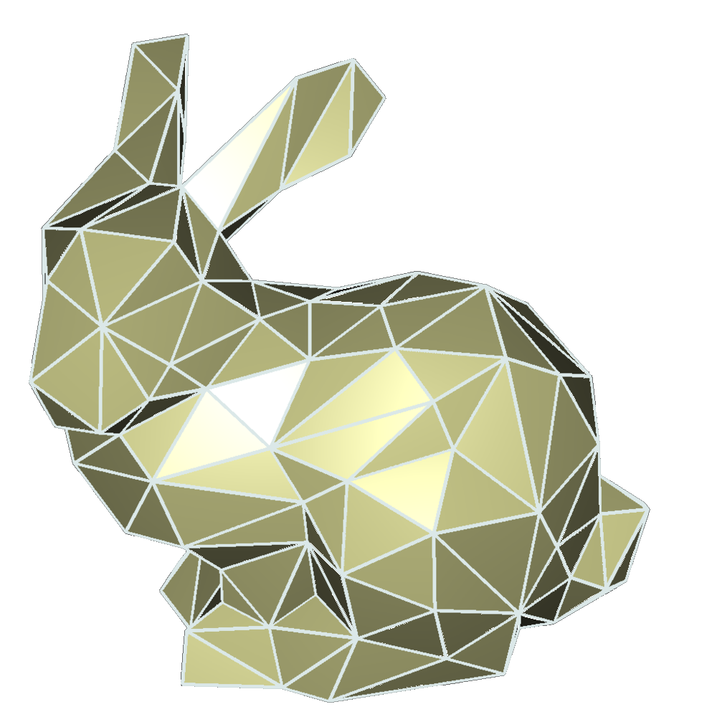
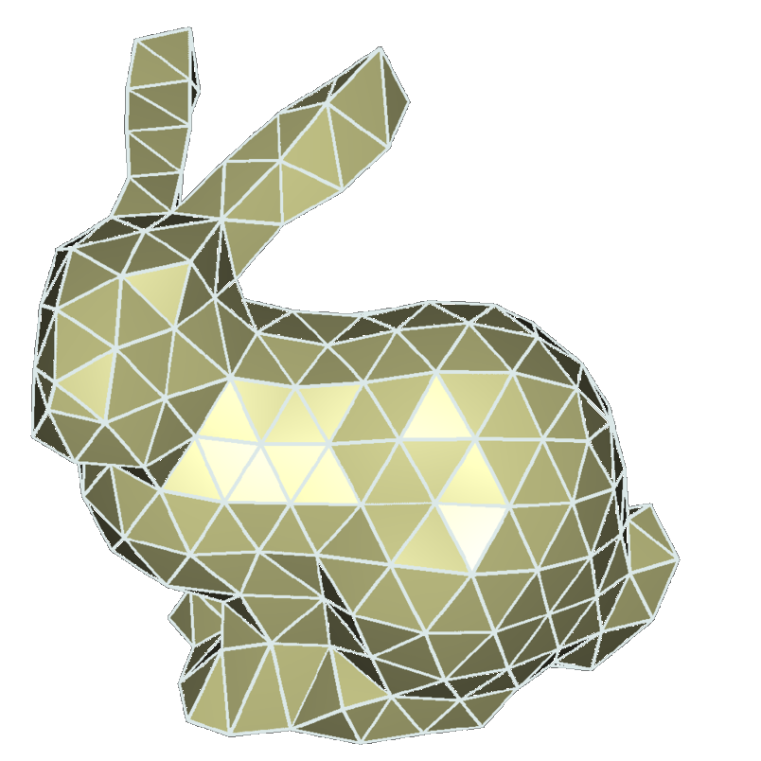
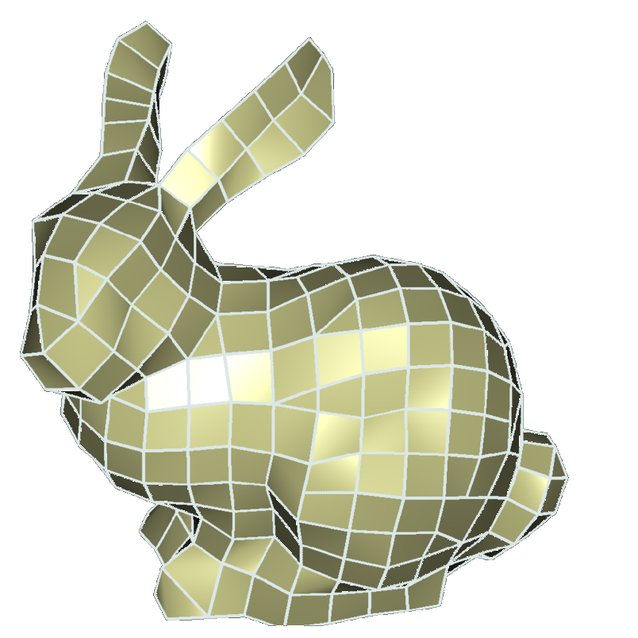
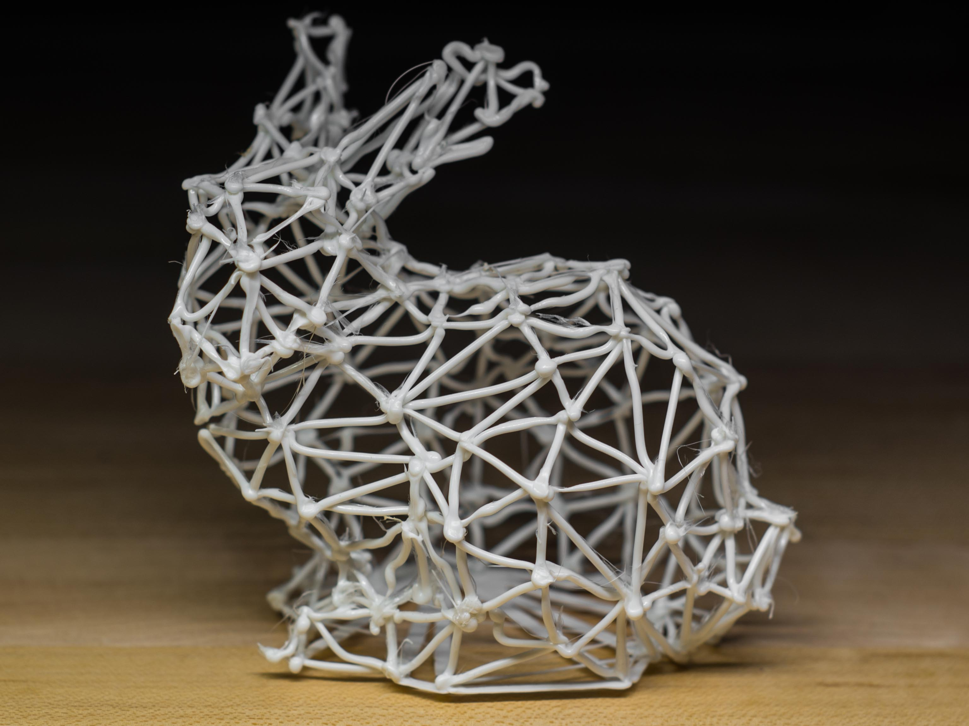
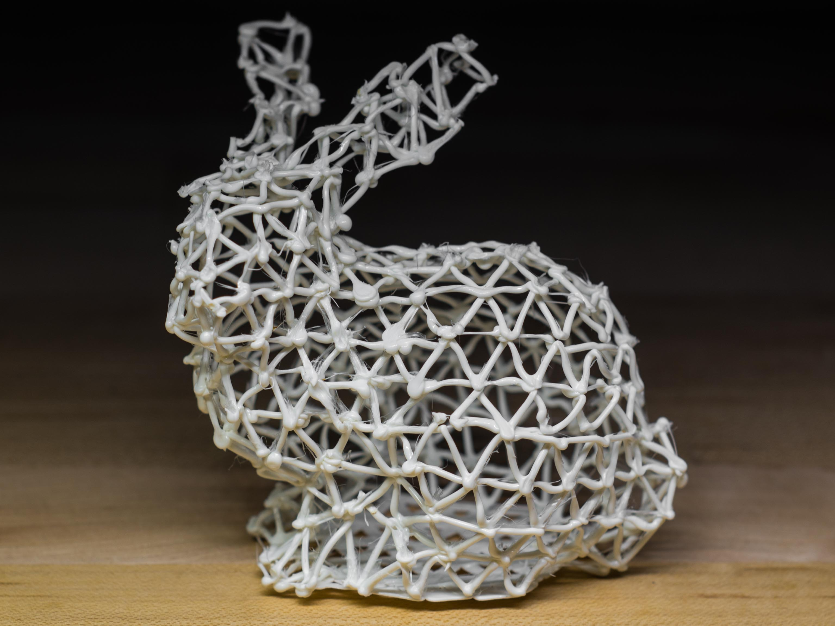
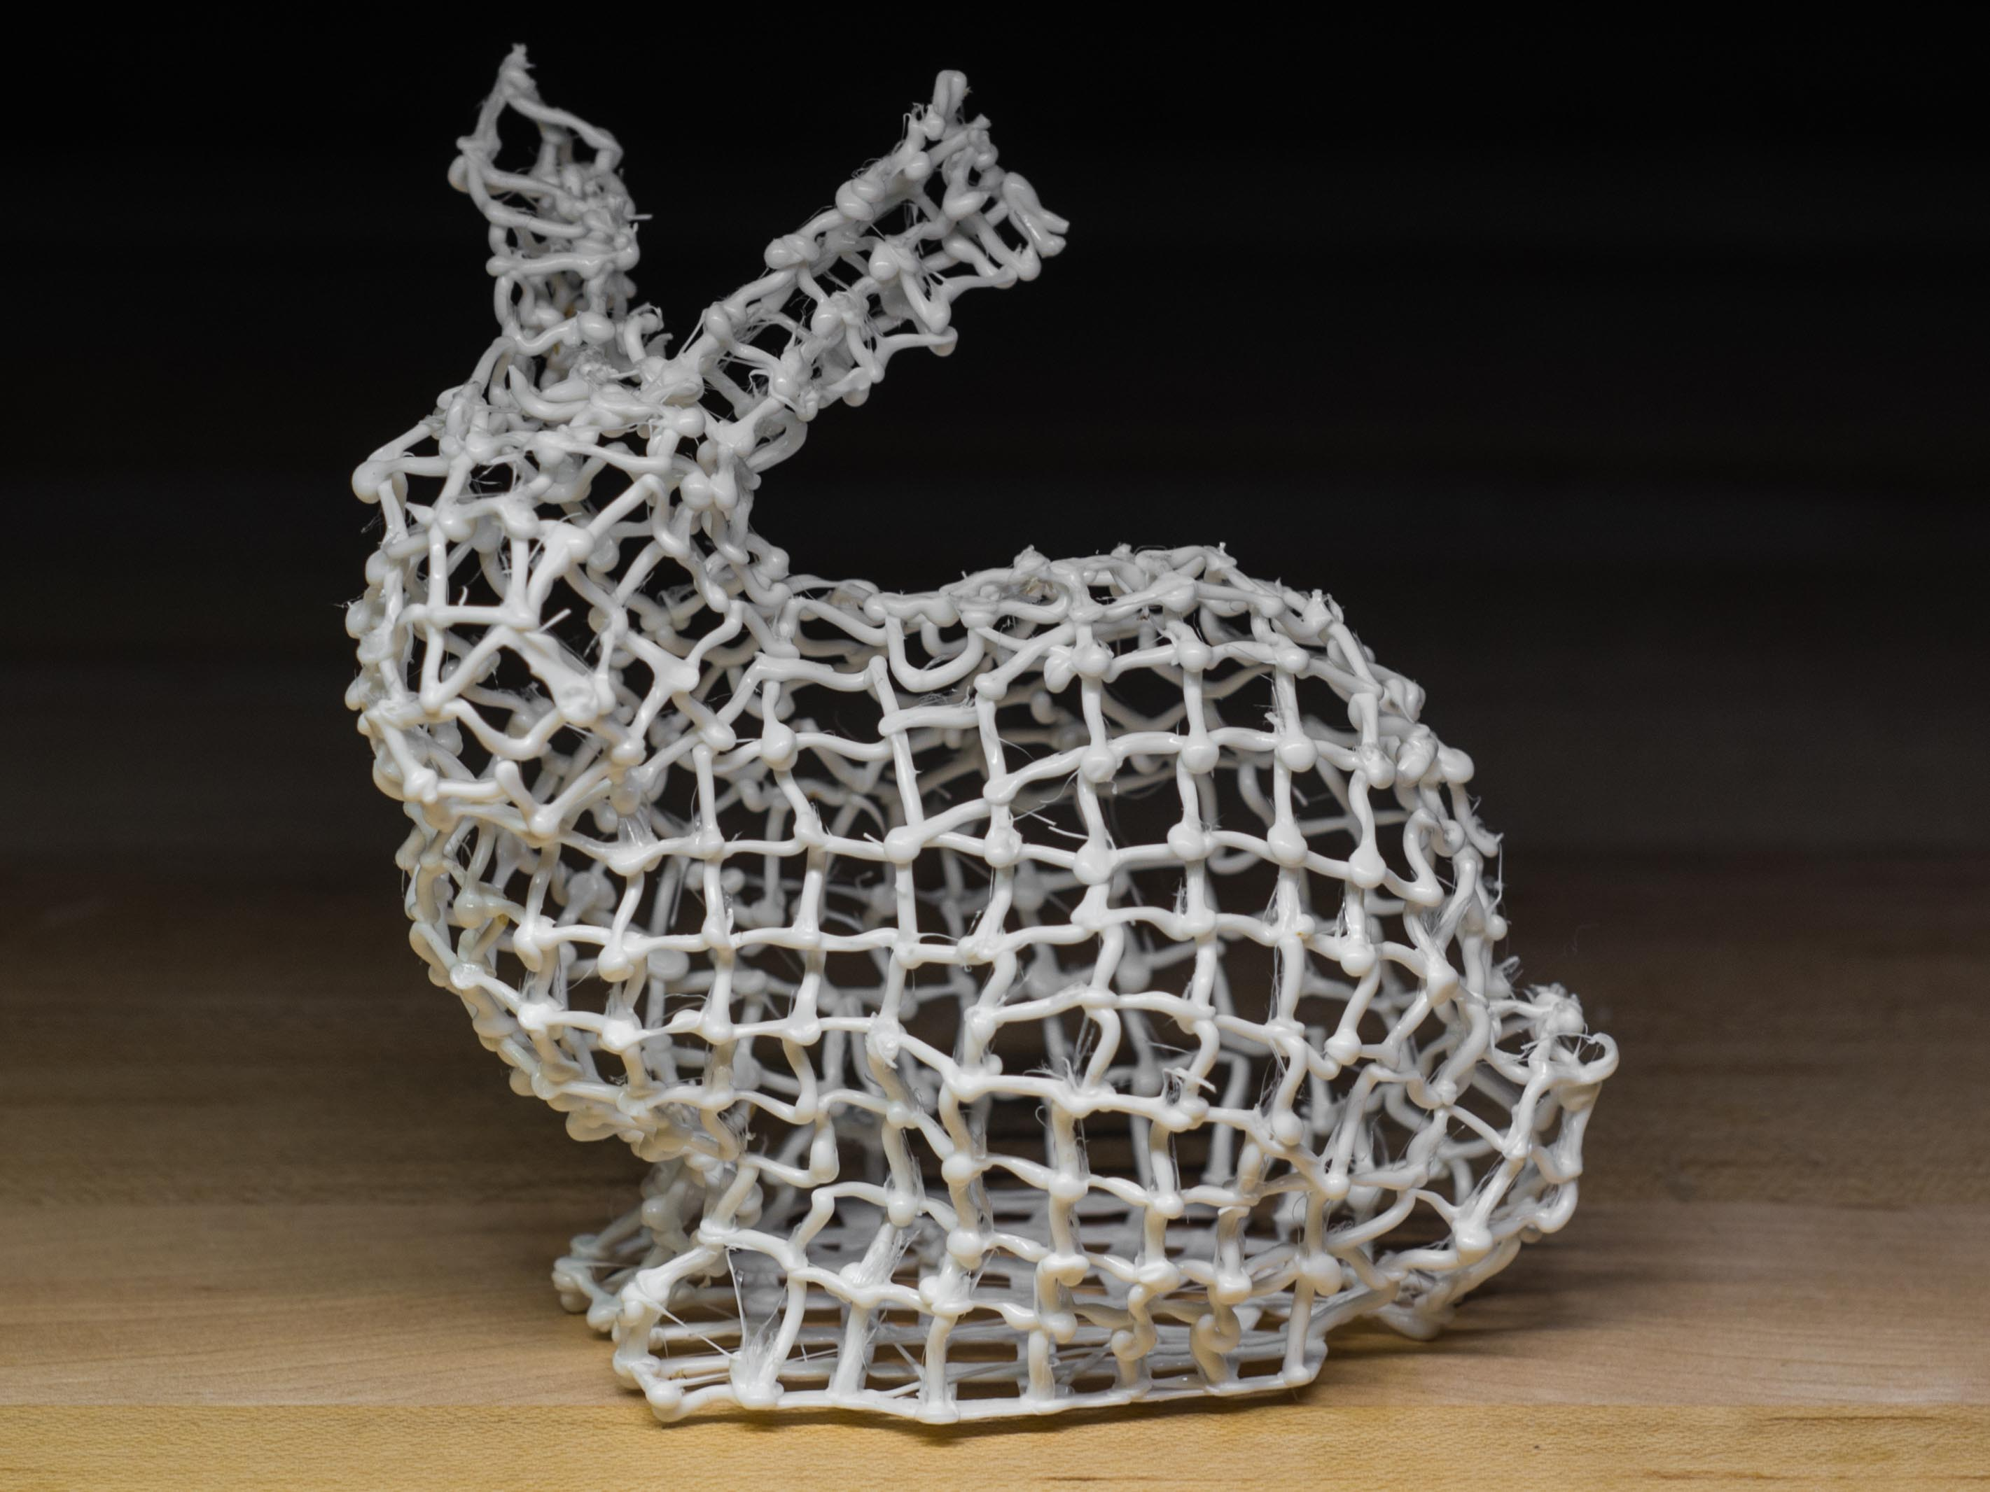
Notes:
For example, here are some nice-looking meshes of the bunny model.
None of the previous methods are able to WirePrint such meshes due to the difficulty in scheduling, but we managed to print them.

Slide 8
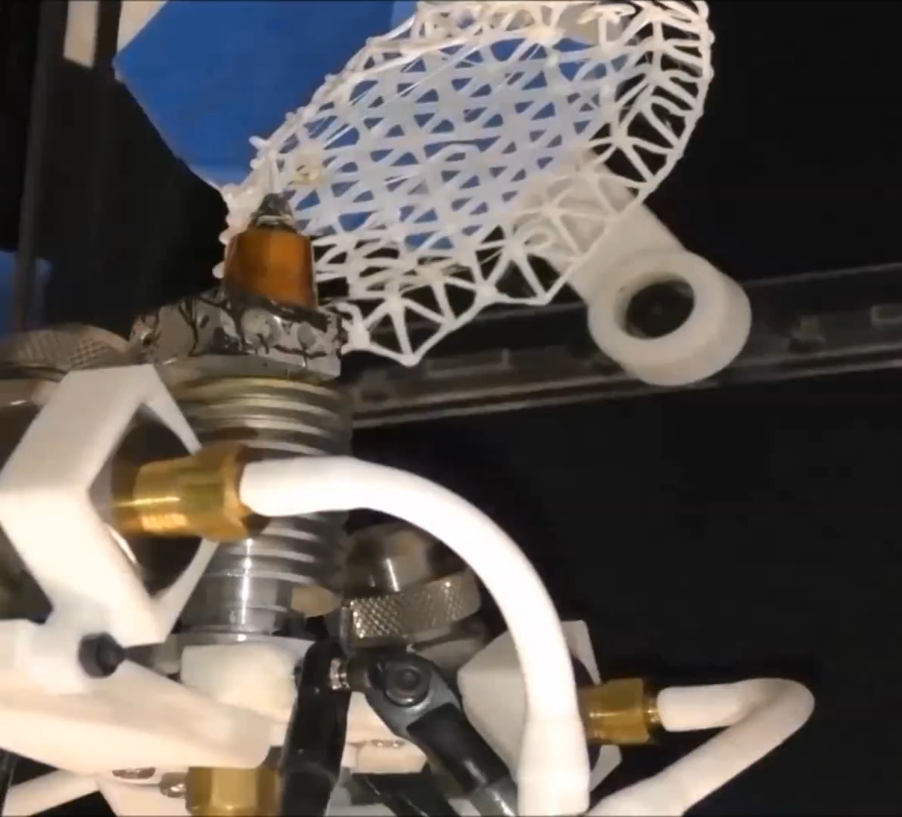
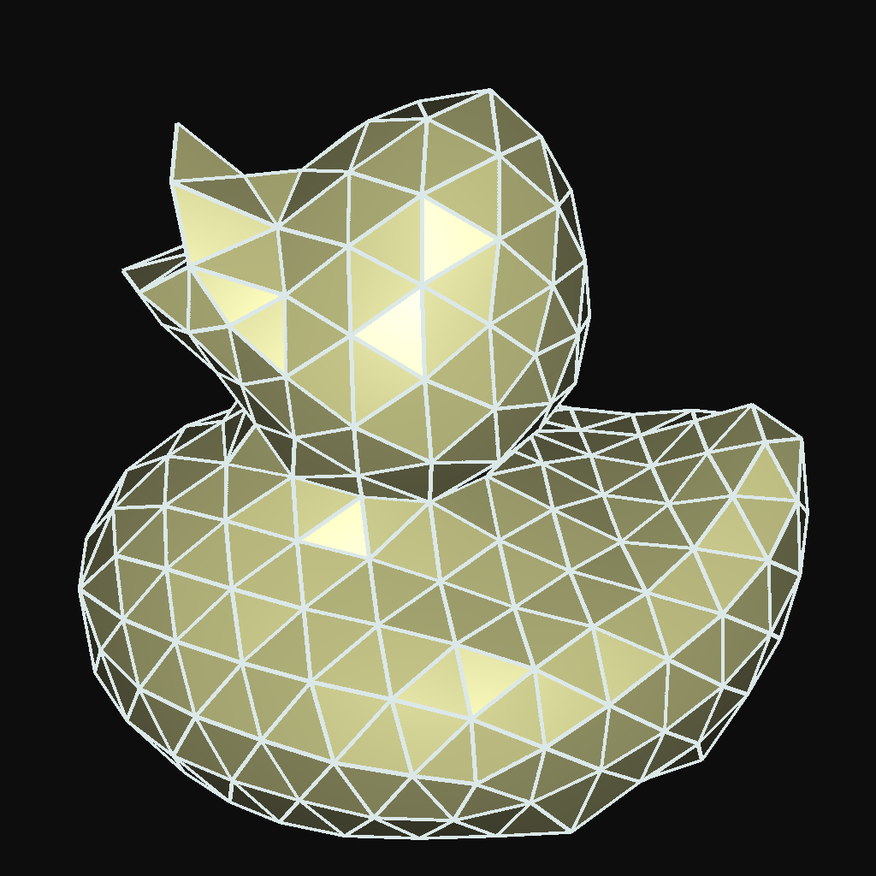
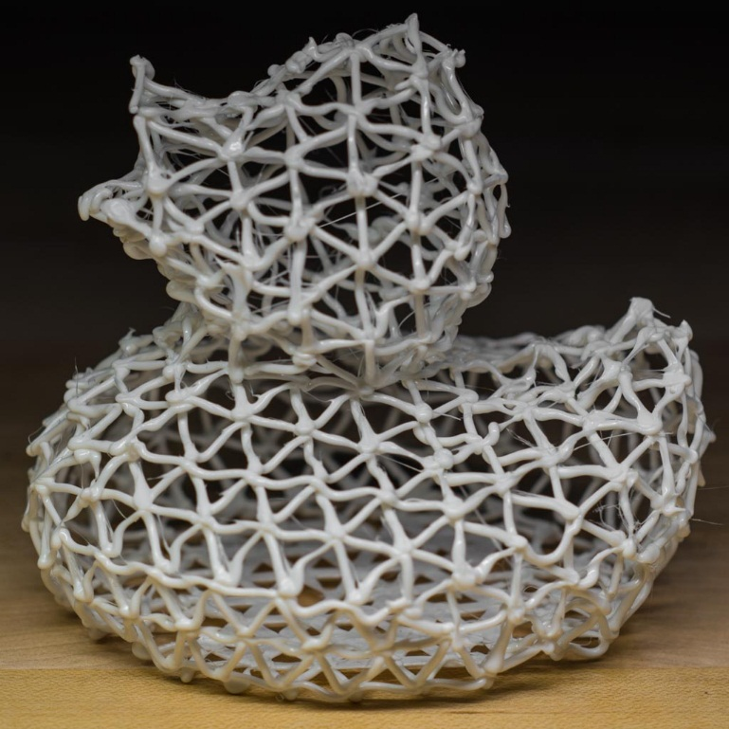
Notes:
This is how we do it with the 5DOF printer. With a right order of edges, we can keep adjusting the pose of the platform so that every edge can be printed without collision.

Slide 9
Our Goal
Schedule the printing process for an arbitrary mesh.
Given a mesh, we need to generate a sequence of edges and determine the printing orientation for each edge.
Notes:
But how to schedule the printing process is not trivial, and it’s the goal of our project to solve this problem for arbitrary meshes.
To achieve this, first we should figure out an order to print all the edges. And second, for each edge we need determine a feasible printing orientation, so that the nozzle will not collide with the parts we already printed.
For example, we can print these triangles in the WirePrint convention, but we should carefully adjust the orientations to avoid collision.

Slide 10


Constraints
Support: every edge must be attached to already printed edges.
  Easy to satisfy.
  Just need to traverse the mesh.
Collision: the planning should be collision free.
  Try to satisfy these constraints first.
Notes:
A feasible schedule must satisfy two types of constraints.
First, since an edge cannot float in the air, it must be attached to already printed edges or to the platform.
The support constraints are easy to satisfy: we just need to traverse the mesh. That means we can start from the edges on the platform, append a neighbor edge of printed ones each time and repeat until the entire mesh is printed.
The other kind of constraint is that, the nozzle should not collide with already printed parts when printing an edge.
The collision constraints are not as trivial. A naïve ordering of the edges, such as the top right example, often paints itself into corners where an edge cannot be printed without collision. So our algorithm pays special attention to make sure that the ordering can be collision free, like the bottom right example.

Slide 11
Strategy
Phase 1: put constraints on the ordering to avoid collision.
Phase 2: order the edges and optimize the tool path.
Notes:
Our strategy falls into two parts.
Since collision is the major problem, we will first use an algorithm to put some constraints on the order of edges to avoid collision.
Then we traverse the mesh while obeying those constraints, and also try to optimize the tool path.

Slide 12
Overview
Collision Avoidance
Edge Ordering
Results
Conclusion
Notes:
This is an overview of the rest of the talk. I will first talk about the two phases of our algorithm. And then show you some results before wrapping it up.
Let’s start with the collision avoidance algorithm.

Slide 13
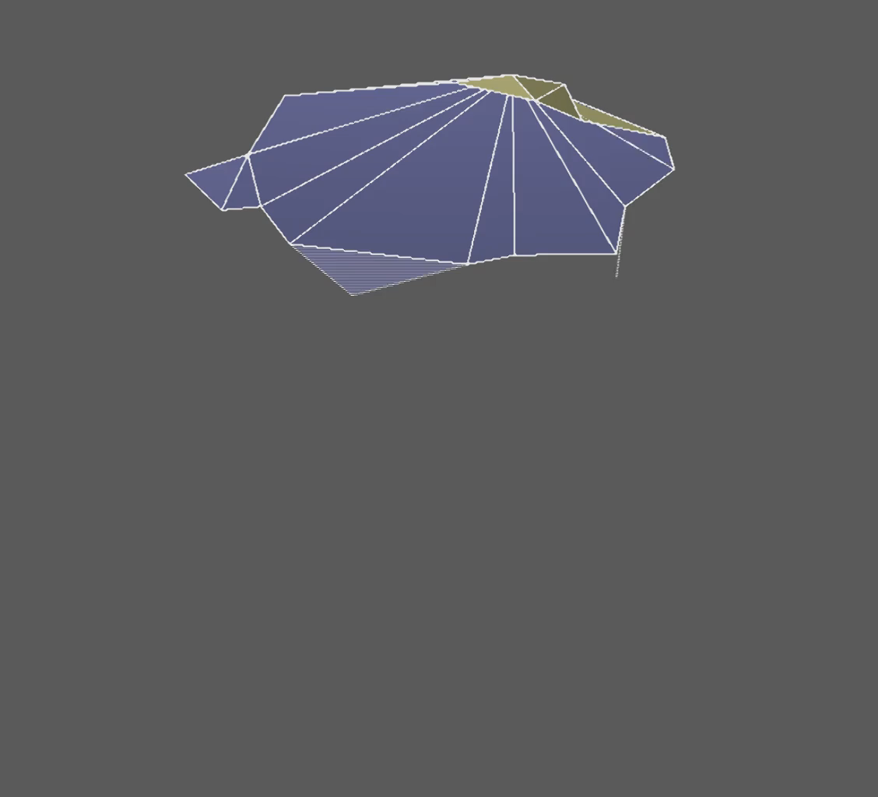
Problem
Naïve ordering gets stuck when an edge does not have any collision-free printing orientations.
Need to look ahead to avoid making edges unprintable.
Notes:
As we mentioned, we need to figure out the order to print the edges. A simple way is to sort the edges by height. However, this naïve way does not work in many cases.
For example, for this bunny mesh, the printing will get stuck at the red edges, because there are no collision-free printing orientations for them.
If we think about the ordering problem, the difficulty is that when we append a new edge in the sequence, it might make others unprintable. We can look ahead and enumerate possible orders to prevent this from happening, but this will require exponential computation.

Slide 14
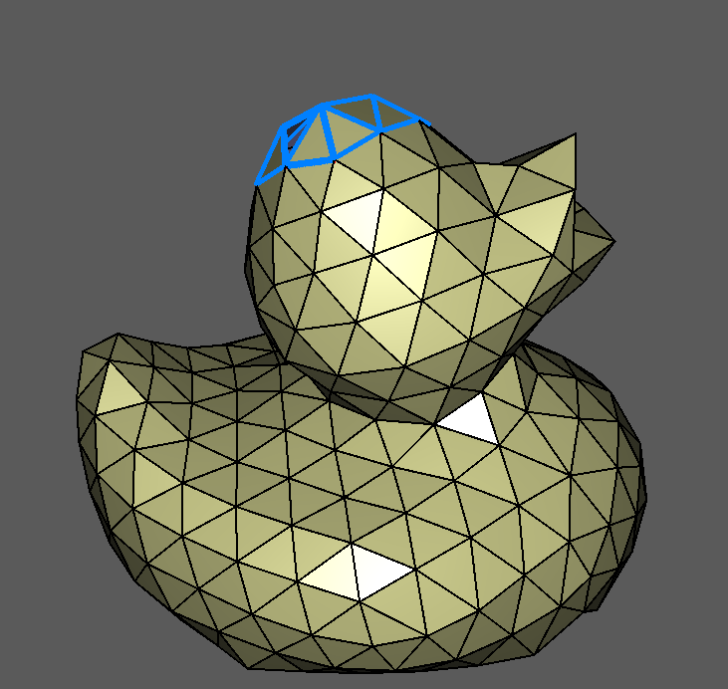
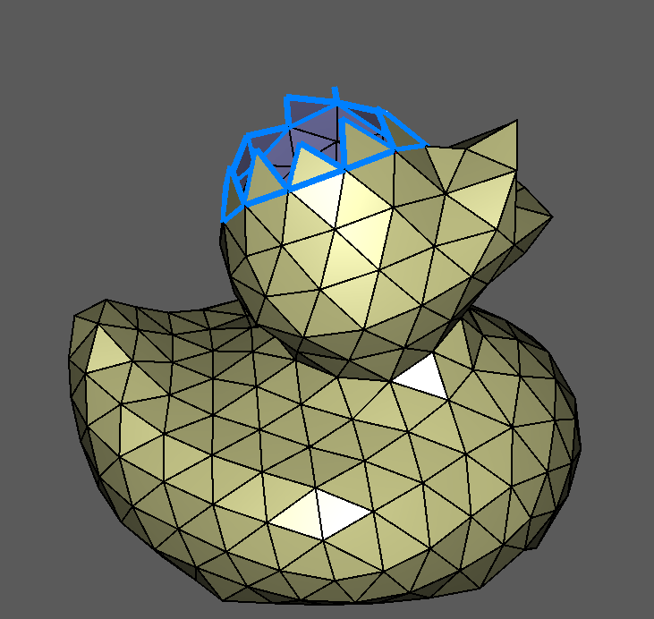
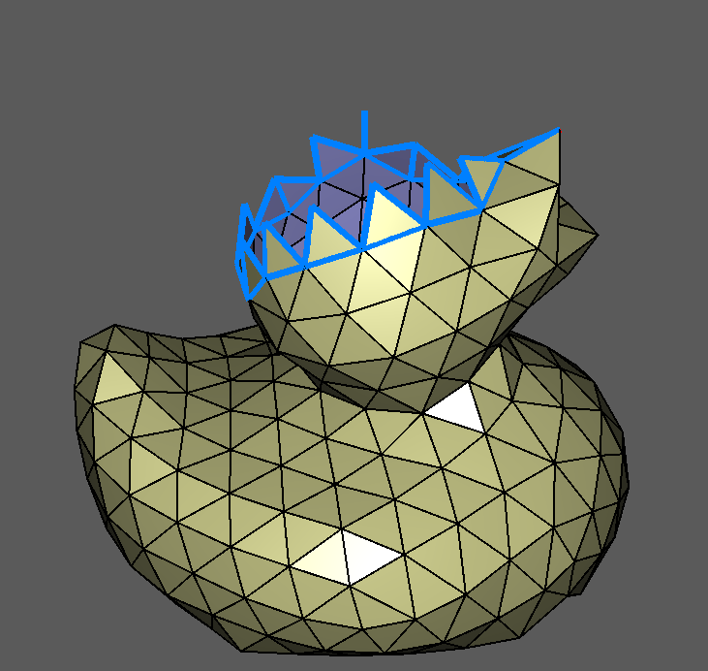
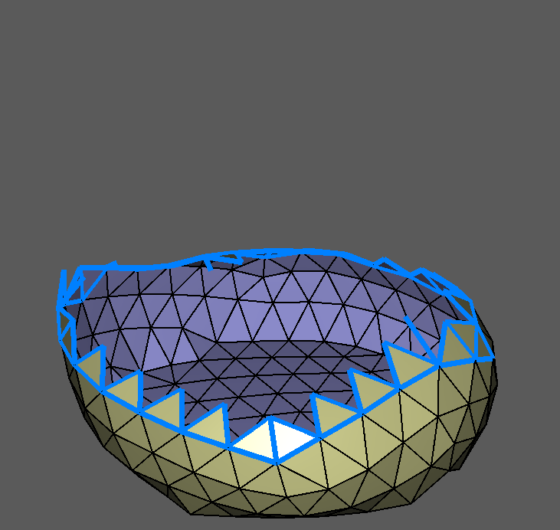
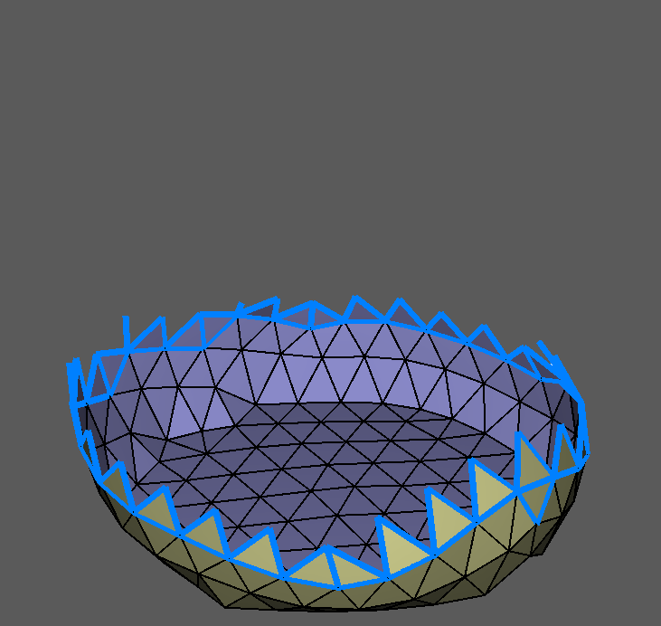
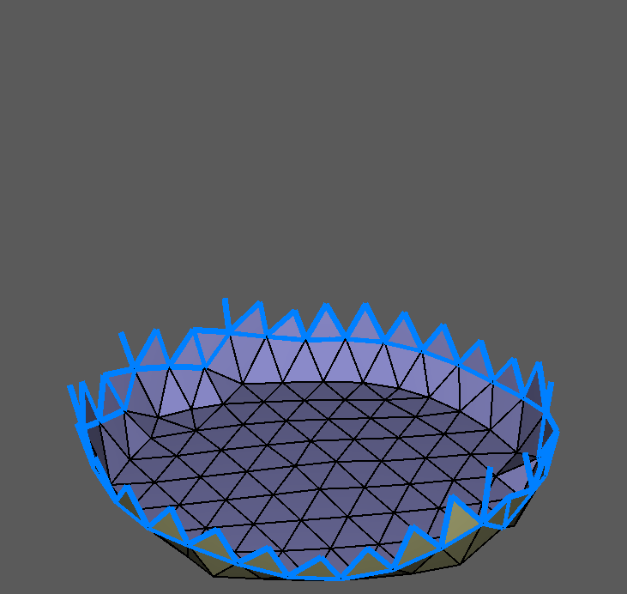
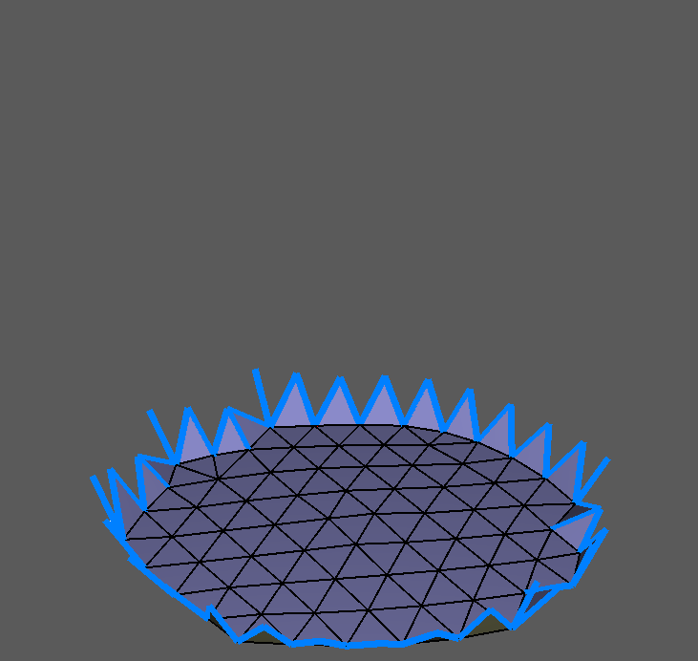
Solution
Idea:
  If a mesh is printable, there must be some edges that can be printed last.
  Print these edges last will open printability for other edges.
  We can do this repeatedly until all edges are considered.
  Then we print the edges in the reverse order of the peeling.
Notes:
Thinking in the reverse way will help for this problem: for example, if this duck is printable, there must be some edges that can be printed after all the others are printed, such as these edges on the top. If we print them last, we don’t need to worry about them when we consider the others. Then, these edges can be printed last but before the edges on the top. We can do this repeatedly until the entire mesh is considered.
This is just like peeling an onion.
Using the peeling order as a guide line, we can print the edges in roughly the reverse order. For example, these edges in the bottom should be printed first and are guaranteed to be printable, because the others have not been printed yet. Next, these edges are also guaranteed to be printable. And again, we can repeat this until the entire mesh is printed.
Now I’ll describe the algorithm in the formal way.

Slide 15
Problem Formalization
a
3
2
f
1
d
e
a
b
c
f
e
3
2
1
c
b
The nozzle collides with edge e when printing edge b in orientation 2.
d
Notes:
We formalize the problem using a directed graph. In this example of a tetrahedron, we have six edges. So we build a graph that consists of 6 nodes. Each node corresponds to a mesh edge as labeled.
Suppose we have a printer that can print edges from three different orientations. We will use the three sectors to represent the orientations. Every node in the graph has the information about whether each orientation is guaranteed to be collision free.
We use directed edges in the graph to encode the information about collision. To distinguish from the edges of the mesh, I’ll use arcs to refer to the edges in the graph.
For example, there is an arc from b to e and orientation 2 of the arc is colored orange. This means that if edge e is already printed, the nozzle will collide with it when we print edge b in orientation 2.
We can check for collision for every pair of the edges, and add corresponding arcs in the graph.

Slide 16
Problem Formalization
a
3
2
f
1
d
e
a
b
c
f
e
3
2
1
Edge b should be printed before edge e
c
b
d
Notes:
As we mentioned, the first phase of our scheme is to put some constraints on the order of the edges, such that any sequence that obeys these constraints is guaranteed to be collision-free. Directed arcs can represent such constraints: for example, the arc (b, e) can represent that we intend to print b before e.
Therefore, we use a subset of arcs to represent the constraints we intend to follow. These arcs, together with all the nodes, form a subgraph of the original graph.
For example, this subgraph has only three arcs. Which means that we should print a before d, b before e and c before f.
With these constraints, we can print the edges in alphabetical order, which is collision free.
Another compatible order is a-d-b-e-c-f. However, if we print in this order, after we print a and c, we will not be able to print b because all three orientations result in collision.
This means that this subgraph does not guarantee a collision free printing order.

Slide 17
Problem Formalization
a
3
2
f
1
d
e
a
b
c
f
e
3
2
1
b
c
d
Conflict: d before e
or e before d?
Notes:
Now the question is, what kind of subgraph is a solution to our problem? Let’s look at the original graph, it’s not a feasible solution because it’s cyclic. We cannot obey all the constraints simultaneously.

Slide 18
Problem Formalization
a
3
2
f
1
d
e
a
b
c
f
e
3
2
1
b
c
d
f may be printed before b
Notes:
This subgraph is acyclic, but it’s not a solution either. Because arc (b, d) is absent so edge d might be printed before b, in which case edge b is not printable due to collision.

Slide 19
Problem Formalization
a
3
2
f
1
d
e
a
b
c
f
e
Open
Closed
3
2
Open
3
2
3
2
3
2
1
1
1
1
b
c
d
Closed
Orientation 2 should be closed if arc (b, e) is absent in the subgraph.
Notes:
Now let me explain how we know whether a node is guaranteed to be printable without collision.
For a node, if an orientation is guaranteed to be collision-free given a set of constraints, we say such an orientation is open and we leave it blank in the figure, otherwise it’s closed and we color it orange. If at least one orientation of a node is open, we say that the node is open, otherwise it’s closed.
With this definition, it follows that if an arc is absent in a subgraph, the corresponding orientations in the arc’s tail node should be closed.
For example, when we remove arc (b, e), we should close orientation 2 of node b, because without arc (b, e), edge e is allowed to be printed before b, which will make edge b unprintable in orientation 2.
Similarly, we have to close these orientations when we remove arc (b, f), or when we remove (f, e) and (f, d).
This means that in order to get a feasible solution, some arcs must remain in the subgraph to keep every node open.

Slide 20
Problem Formalization
Feasible acyclic subgraph: the arcs in the subgraph represents the subset of ordering constraints we intend to follow.
  Acyclic: a partial order on the edges.
  Feasible: each edge has at least one orientation that is guaranteed to be collision free.
Notes:
Now we’ve figured out the two properties a subgraph must have in order to be a solution. First, it must be acyclic. Second, every node must be open. We call such subgraph a feasible acyclic subgraph.

Slide 21
Start
Open
Remove all arcs
S: the set of newly opened nodes; R: the set of closed nodes
Open
Open
n
Add back arcs in R×S
All nodes open or S is empty?
y
Open
Open
End
Open
Notes:
Now let me show you how our algorithm finds a feasible acyclic subgraph.
We start with the full graph. Then we remove all the arcs and close the orientations.
The nodes that are still open are the edges that can be printed last. We can add back the arcs pointing to them. These constraints will force the others to be printed before them. (RXS)
This action will open more nodes. We can repeat this until all nodes are open or stop when we cannot open any more. In this simple example, we don’t need more iterations. But in real data it will repeat many times.
If all nodes are open at the end, we’ve found a solution and we can print the edges in the reverse order. If not, it means the nodes that are still closed cannot be printed in any order, because there is a deadlock.

Slide 22
Overview
Collision Avoidance
Edge Ordering
Results
Conclusion
Notes:
Now we’ve finished the collision avoidance algorithm. The take-home message is that we use a directed graph to encode the information about collision, and use the peeling algorithm to get a subgraph that represents the ordering constraints to avoid collision.
Now I’ll talk about how we actually make the printing plan.

Slide 23


Ordering the Edges
Once we have the feasible acyclic subgraph, we can use any traversal of the mesh, as long as it follows the arcs in the subgraph.
Some favorable properties:
  the edges should connect back to printed parts as frequently as possible.
  long, straight moves that connect several previously printed parts are favorable.
  WirePrint and On-the-Fly Print use strategies with these properties.
Notes:
Once we have the ordering constraints, we can use any traversal order of the mesh, as long as it follows the arcs in the subgraph.
For instance, the left figure is a feasible solution to print these triangles.
But it’s not the ideal solution because the nozzle has to move around a lot. In practice we found that some properties tend to improve the quality of the prints.
For instance, the right figure shows a good example, in which the edges are printed in the WirePrint style, with a few continuous strokes.

Slide 24
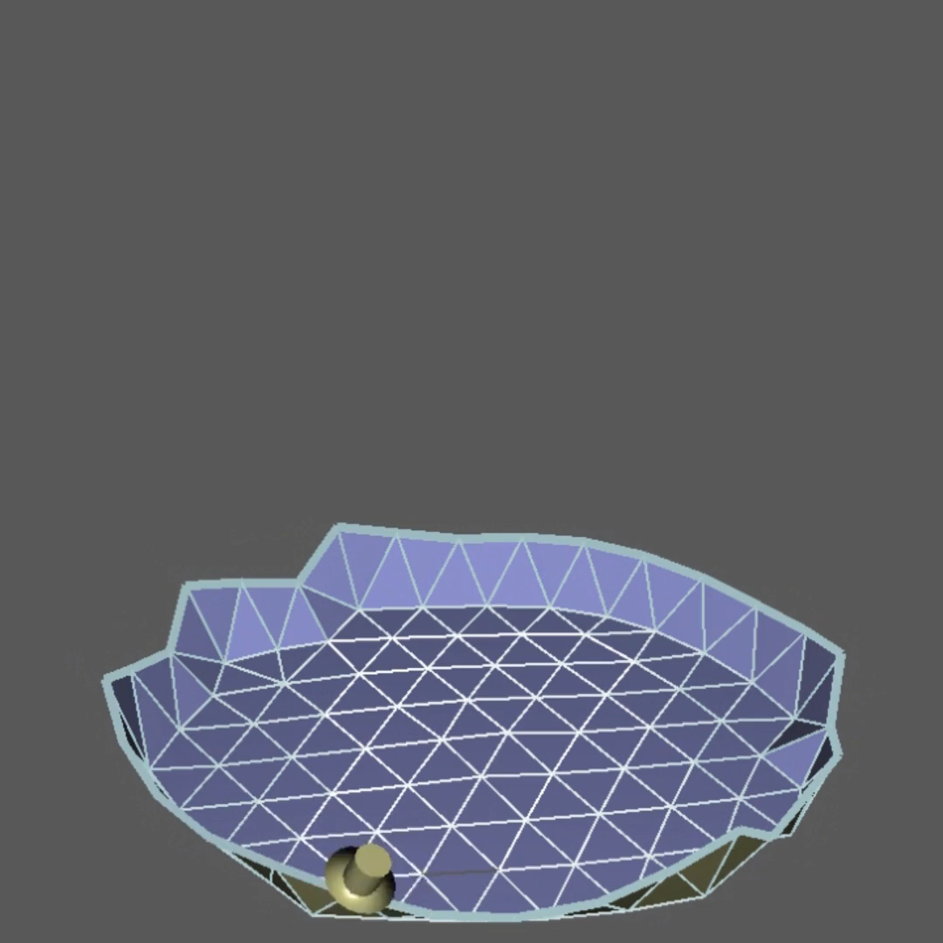
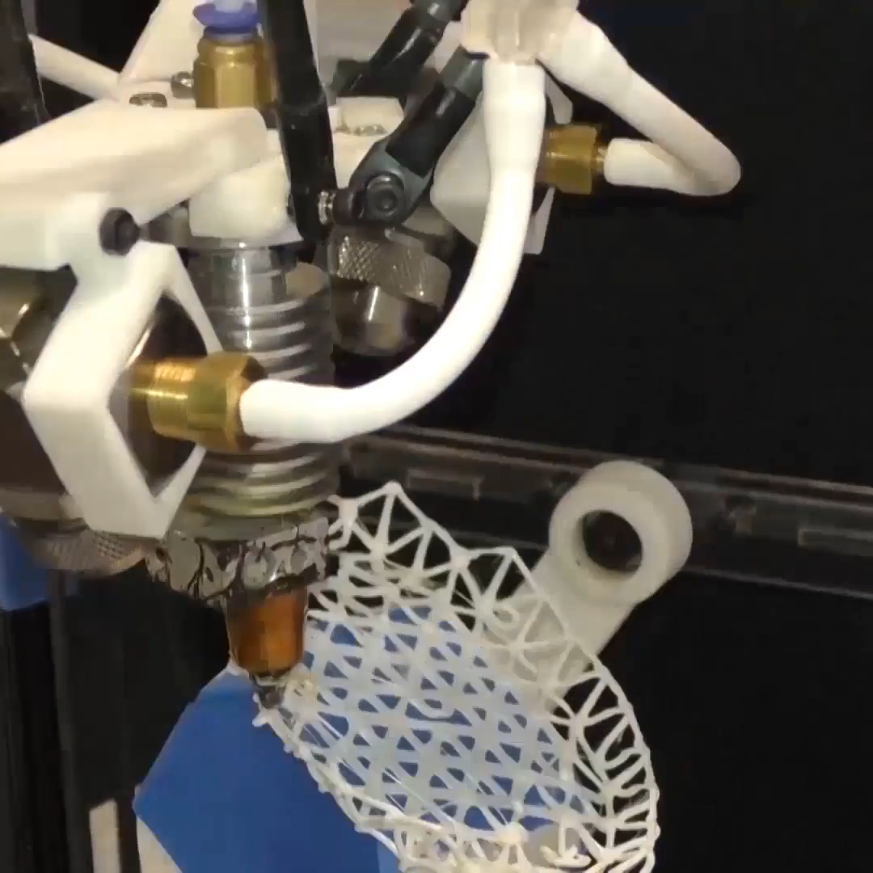
Ordering the Edges
We try to produce long continuous strips of edges, and minimize the rotation of the platform.
28X
Notes:
Therefore, we try to produce long continuous strips of edges, and minimize the rotation of the platform.
Here is an example of the ordering result, together with a time-lapse video of the printing process. Note that the edges are grouped into continuous strips and the printing orientations change smoothly within each strip.
Because of the time limit, I will leave out the details about how we optimize the tool path. You can find the details in the paper if you’re interested.

Slide 25
Overview
Collision Avoidance
Edge Ordering
Results
Conclusion
Notes:
As we just saw, the main goal of the edge ordering phase is to optimize the tool path, so as to improve the printing quality.
We’ve tried our method for a representative set of meshes. Now let me show you some more results.

Slide 26
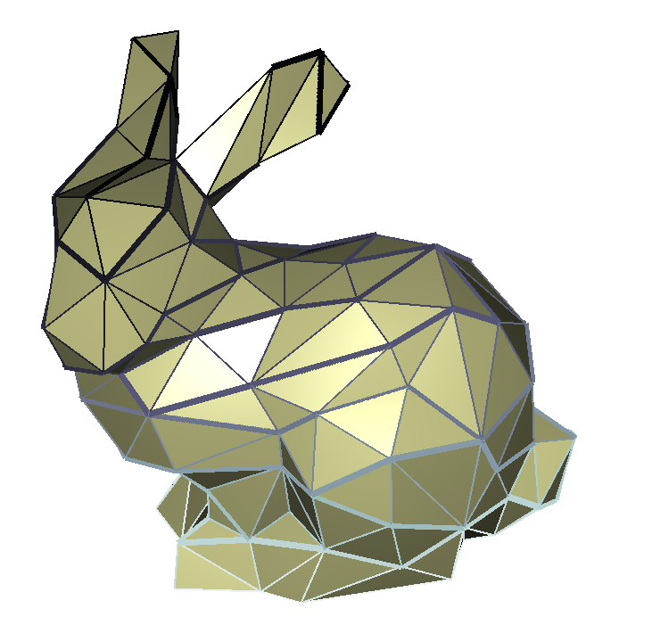
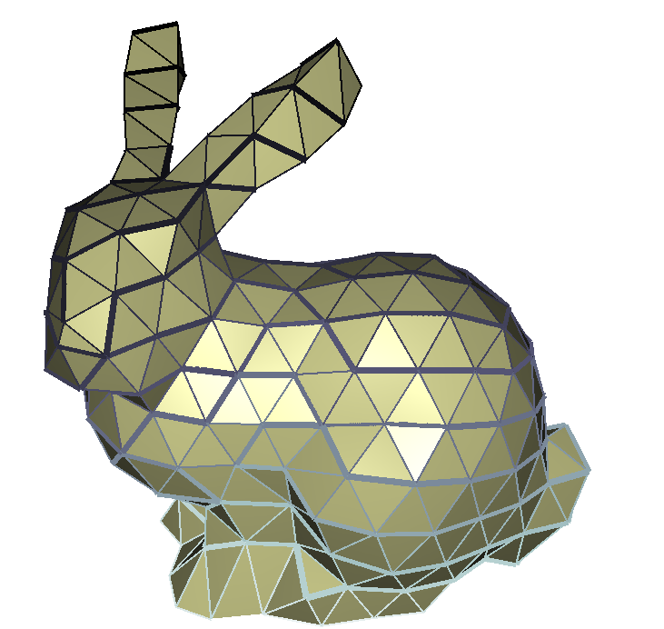
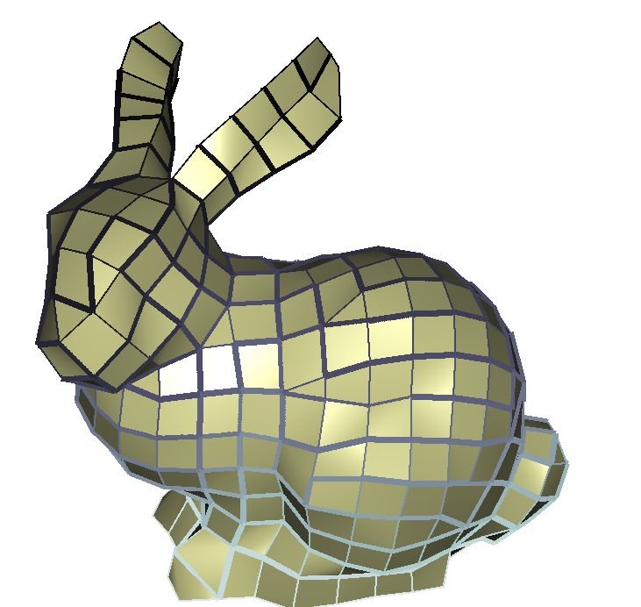
Notes:
I have already shown you the bunnies.
Here in the top row, the color indicates the order of edges, from white to black.
I want to emphasize again that these meshes, especially the quad mesh on the right, represent the features of the model much better than the results of previous works.

Slide 27
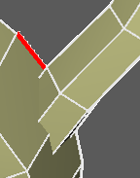
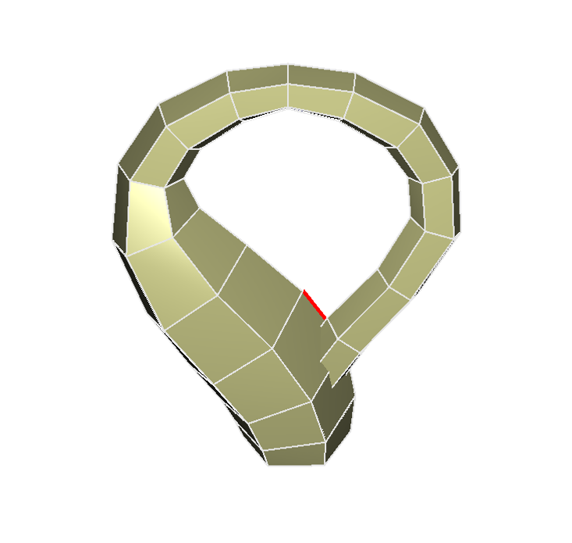
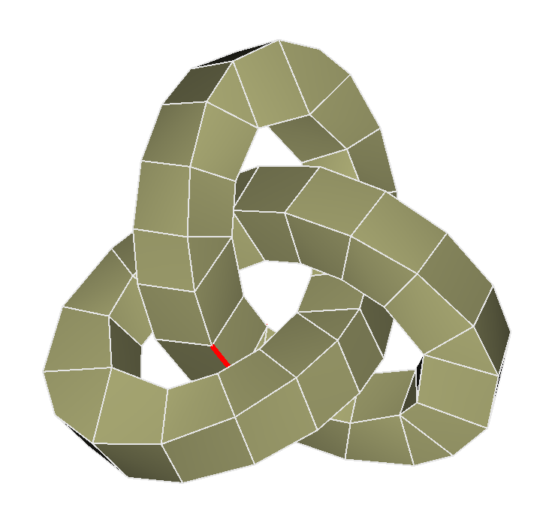
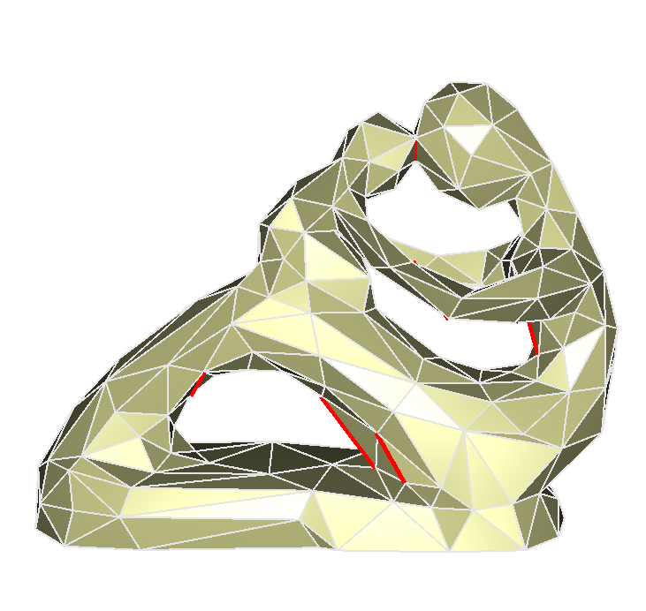
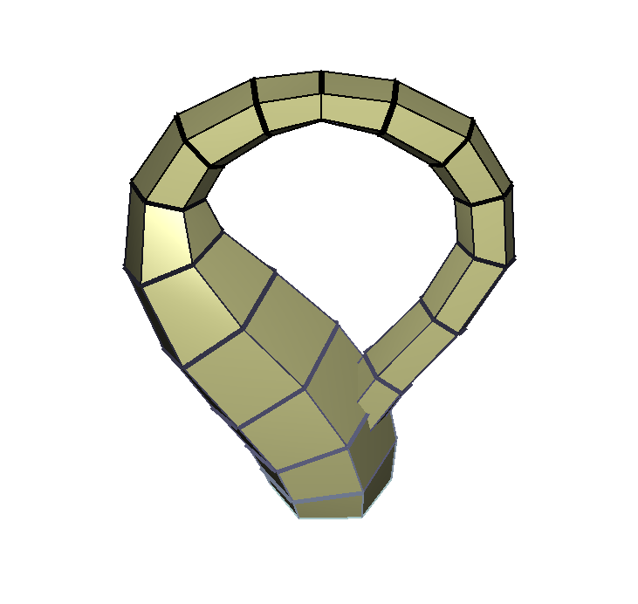
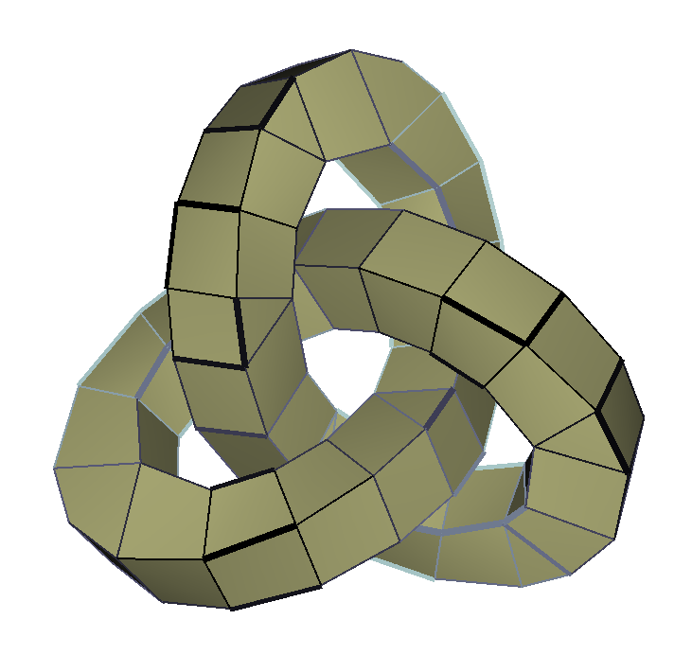
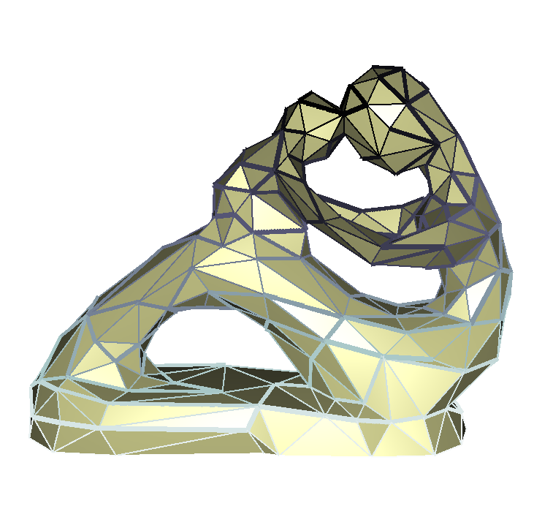
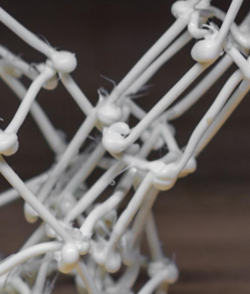
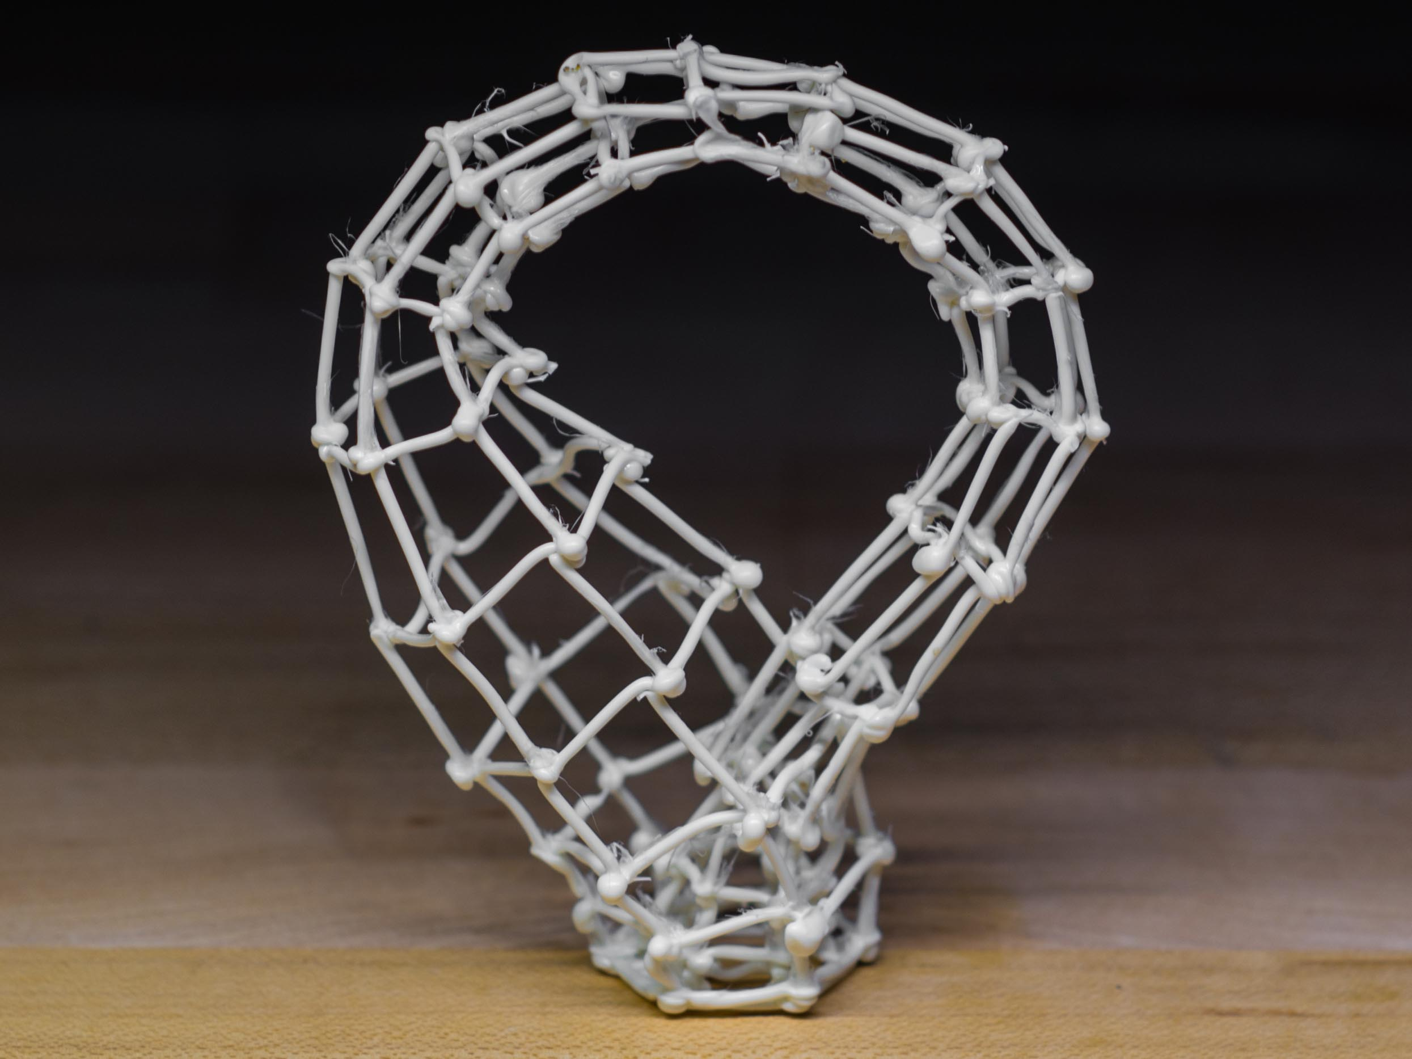
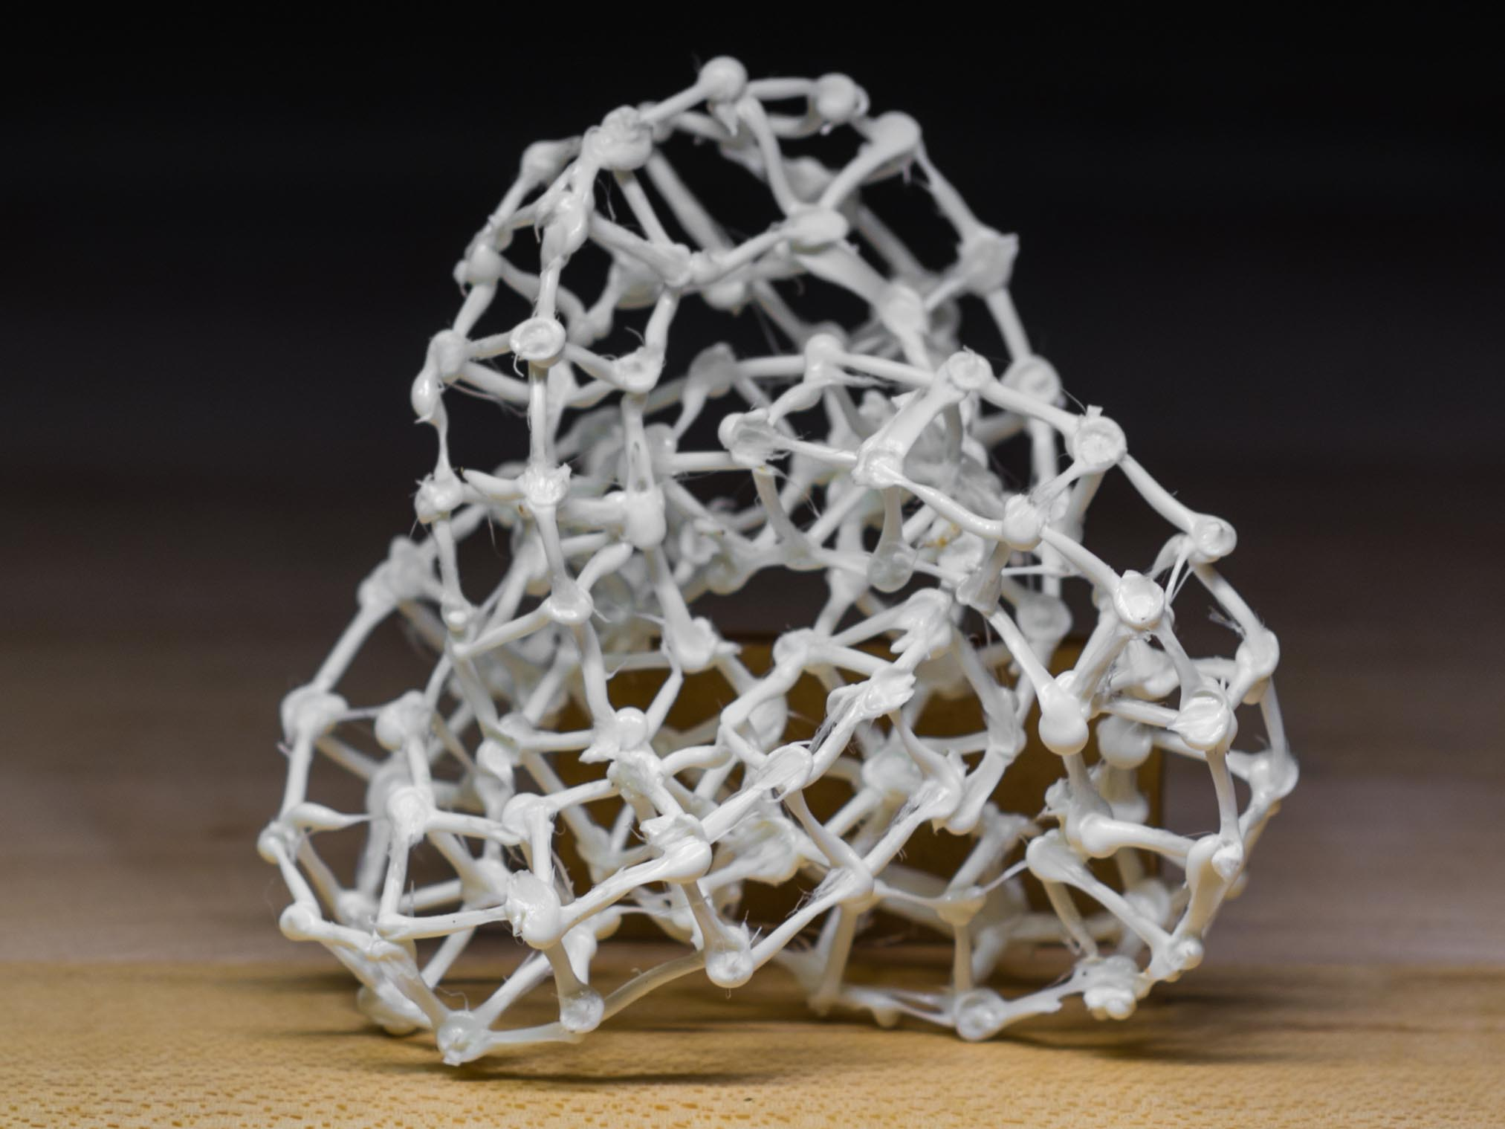
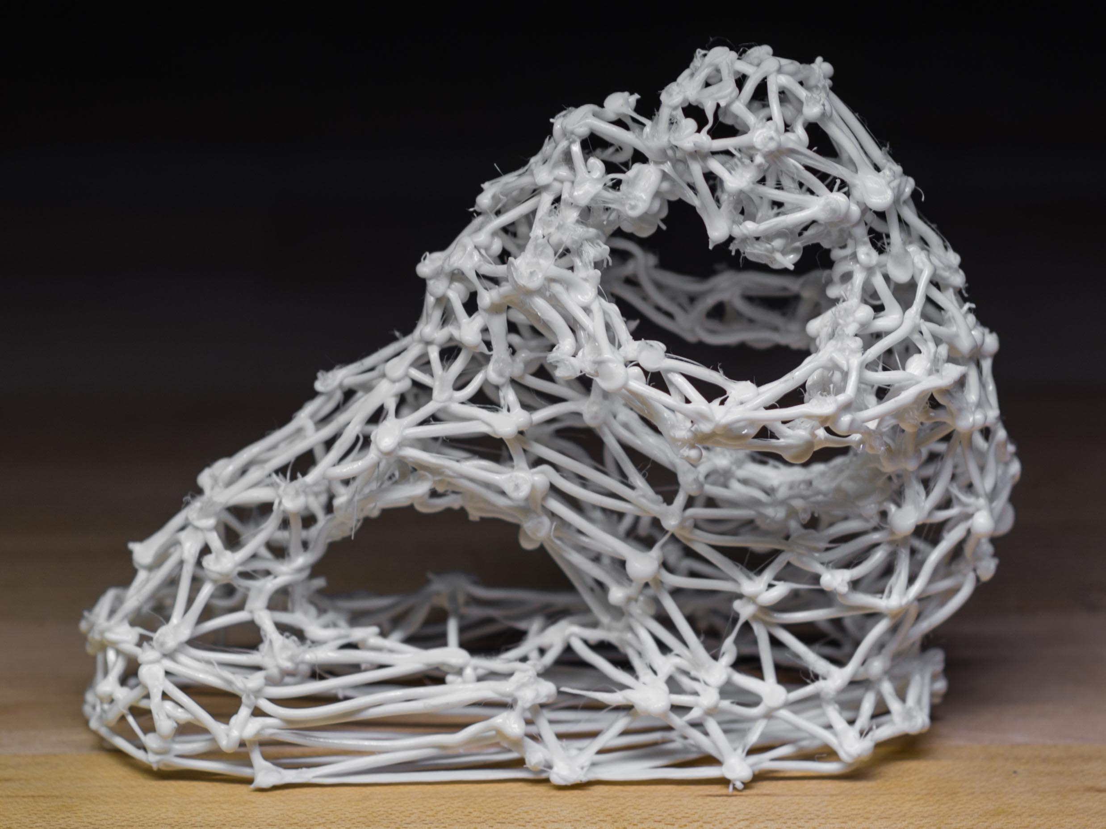
Notes:
And here are some more results: a klein bottle, a trefoil knot, and the fertility model.
These shapes are not trivial to find a collision free order. For example, the surface of klein bottle is self intersecting and it’s hard to print the edges without collision. If we print the edges in height order, these red edges in the top row cannot be printed without collision. But our method found feasible solutions to print them.

Slide 28
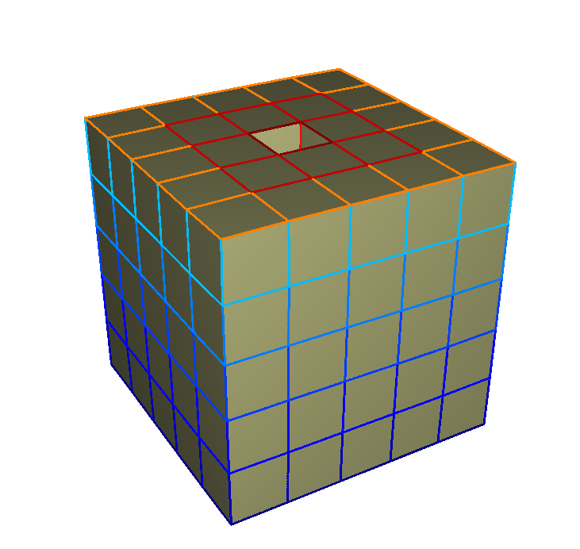
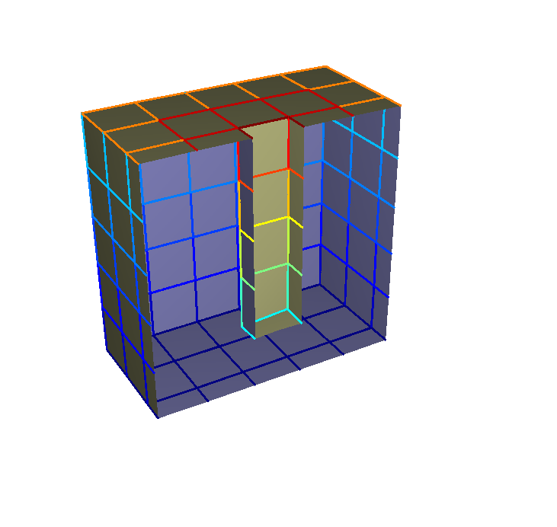
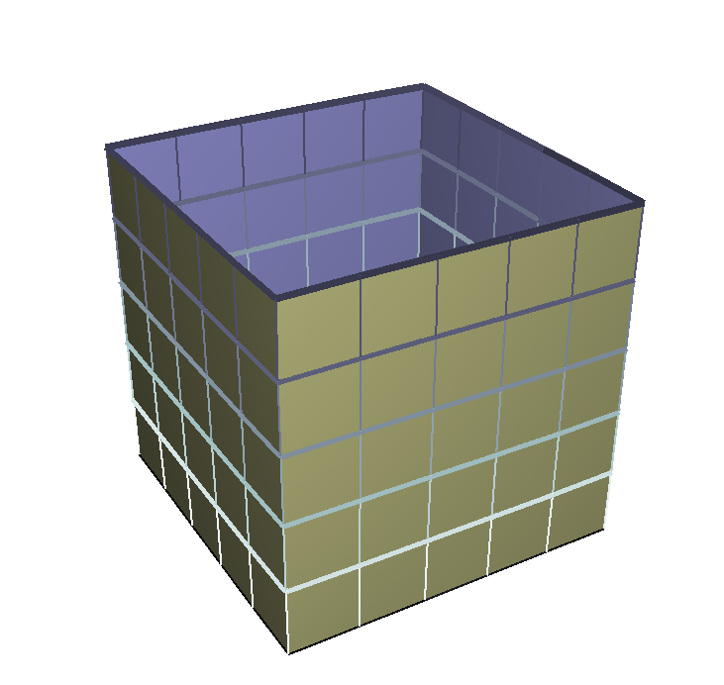
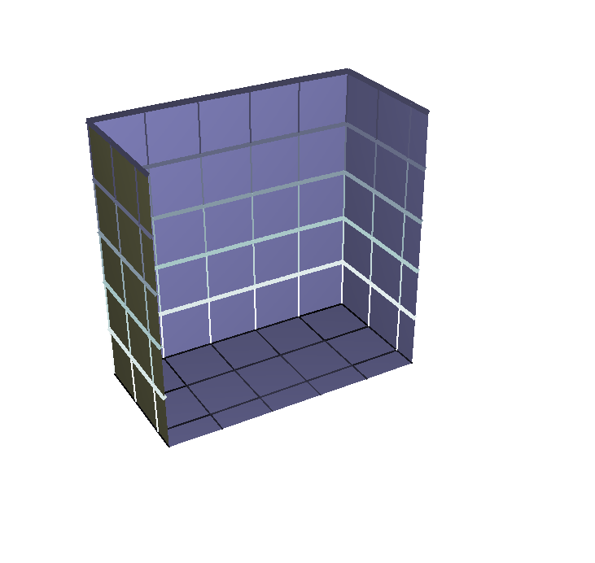
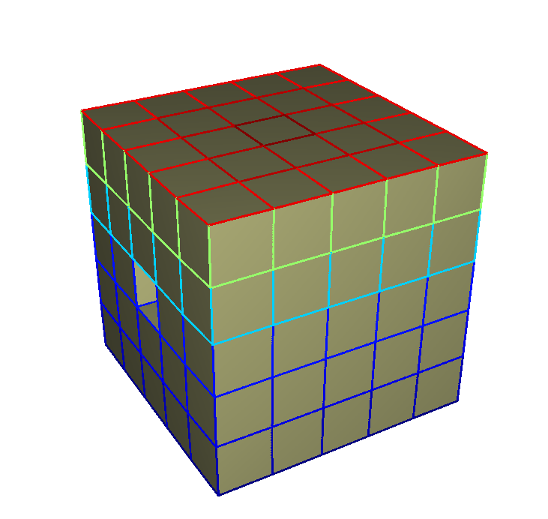



Failure Cases
The algorithm fails when the constraints are not compatible with any traversal of mesh edges.
Layer 0
Layer 16
Layer 0
Layer 21
Notes:
Although our method works for a wide range of meshes, it is not guaranteed to find a solution even if one exists.
When considered alone, either of the two phases is guaranteed to find a solution. However, when it comes together, the algorithm may fail because the constraints we get in the first phase are not compatible with any possible traversal order.
For example, the cube with a hole on the top is a typical failure case. As you an indicate from the color coding, these edges on the top are peeled first and should be printed last. And these edges in the hole should be printed before those on the top. But it’s impossible to do so because they are not supported.
But if we rotate this model by 90 degrees, we can find a feasible solution.
This is the major limitation of our approach. How to consider the two phases together and find traversal compatible constraints remains an open question.

Slide 29
Overview
Collision Avoidance
Edge Ordering
Results
Conclusion
Notes:
You’ve seen that our approach works for a set of meshes that are hard to print, as well as some failure case where the two phases are not compatible.
Now let me wrap up this talk.

Slide 30
Conclusion
An algorithm that enables a 5DOF printer to wireprint arbitrary input meshes.
  Constraints to avoid collision
  Schedule the printing
We managed to print a wide range of meshes that previous methods cannot handle.
Limitations
  Not guaranteed to find a solution
  Quadratic computational cost
Notes:
We proposed an algorithm that enables a 5DOF printer to wireprint arbitrary input meshes. Our method consists of two parts: find a set of ordering constraints to avoid collision, then order the edges and optimize the tool path.
Our method can print a wide range of meshes that previous methods cannot handle. And we are excited to see that the wireprint technology can produce all kinds of nice meshes instead of those with fixed patterns.
But our work also has some limitations.
As we mentioned, the major limitation is that it’s not guaranteed to find a solution in some cases.
Also, the computational cost is an issue if the mesh has a large number of edges, because the algorithm is quadratic.

Slide 31
Future Work
Solving the theoretical problem
  Is it NP-hard?
Computational cost
  Using smarter strategies for collision sampling
Improving the hardware
  Better cooling system
  More accuracy
  Better control
Notes:
Our work leads to a couple of possible future avenues.
The most interesting topic might be trying to solve the theoretical problem. It will be interesting to find a way to solve the problems as a whole. Or maybe this will lead to an NP-hard problem. We have no answer yet.
Another possible improvement is trying to reduce the computational cost of the algorithm. Currently the major cost lies in sampling the collision for every pair of edges. We believe this can be accelerated by using smarter structures instead of the brute-force way in our implementation.
Improving the hardware is another possible future direction. A machine with better cooling system, more accuracy and better control will certainly improve the quality of the prints.
(Going back to the original motivations of those WirePrint systems, they wanted to offer instant physical feedback in the design process. But they were limited by how they scheduled printing. Our new algorithm could enable more interactive systems, like incremental WirePrint where the user can keep editing while the model is printing, and the remaining parts are rescheduled dynamically.)
(And also, if we go back to think about the original motivations of those WirePrint systems, they all aim to offer instant physical feedbacks and interactions in the designing process. But their ability to provide such interaction was limited by their defect in scheduling. With our improvement in the scheduling algorithm, one could imagine building a system with a stronger interaction power. For example, an variation of our algorithm might be essential if we want to build an incremental WirePrint system, where the user can keep editing the model while printing and get warned how the edits will affect the printability of the model.)

Slide 32
Acknowledgement
This project is supported by
  NSF
  Autodesk
We want to thank John (Spike) Hughes for his insightful comments and suggestions.
Thank you!
Notes:
Finally, we want to thank NSF and Autodesk for their generous support for this project.
And we also want to thank Spike Hughes for his insightful comments and suggestions.
This is all for my talk. Thanks for you attention.

