Slide 1



The TypTop System
Personalized Typo-Tolerant Password Checking
R. Chatterjee, J. Woodage, Y. Pnueli, A. Chowdhury, T. Ristenpart
Notes:
Good afternoon. Thanks …. for the introduction. This is a joint work with my lovely co-authors from Cornell, Royal Holloway, and Technion.

Slide 2




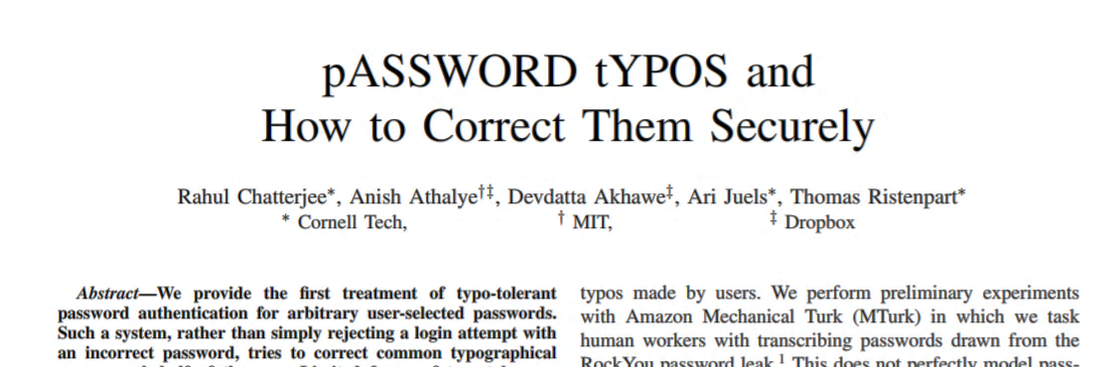
Password checking systems and typos
passw92
Salted, slow cryptographic hash
Success
?
H(passw92) = a5idoiaU7p...
small typo
?
H(Passw92) = a5idoiaU7p...
Bob
Passw92
Apply Caps lock Corrector
?
H(pASSW92) = a5idoiaU7p...
Fail
?
Apply shift Corrector
H(passw92) = a5idoiaU7p...
Oakland ’16
. . .
Top-5 correctors correct 20% of all typos
Typo-tolerant password checking
Allow registered password or typos of it
Notes:
Password checking systems traditionally works as follows: During login the submitted password is checked by applying a slow cryptographic hash function on it and comparing the output with the stored hash value, which was computed during registration. If the strict equality of the hash values passes the user is allowed login, else not.
Even if the user makes some small mistakes, such as accidentally capitalize the first character, the hash output is different and the login is rejected. This is very annoying and counter productive. Last year we published a paper introducing the idea of typo-tolerant password checking, where a user can log in with not only the registered password, but also with some small typos of it. We proposed to do so by applying some corrector functions during password checking. This specialized corrector functions designed to correct typos that are prevalent across population, and easy to correct, such as correcting caps lock errors by flipping the case of all the characters. Each of the corrections are checked in the same way the submitted password was checked, and if any of the check passes, the user is allowed to login.

Slide 3
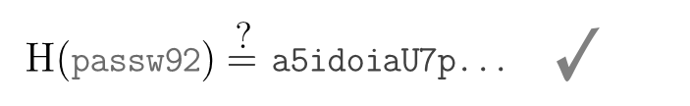

Typo-tolerance improves utility
k
passw92
Salted, slow cryptographic hash
Success
?
H(Passw92) = a5idoiaU7p...
Bob
Passw92
Apply Caps lock Corrector
?
Login will increase by 3%
H(pASSW92) = a5idoiaU7p...
Fail
?
Apply shift Corrector
H(passw92) = a5idoiaU7p...
Does not degrade security
. . .
Top-5 correctors correct 20% of all typos
Notes:
… did a measurement study with Dropbox, and found out that correcting these 5 types of typos would increase login by 3 percent, and many more will be able to login faster. For a company with hundreds of millions of users this is a significant utility improvement. We also show, somewhat surprisingly, that these carefully chosen set of correctors does not lead to any degradation in security.
However, …

Slide 4
… corrects only the tip of the iceberg
passw92
Salted, slow cryptographic hash
Limitations
Success
To correct more with correctors would be
Expensive – slow hash function
Wasteful – not all users make same mistakes
Insecure – too many corrections for each guess
?
H(Passw92) = a5idoiaU7p...
Bob
Passw92
Apply Caps lock Corrector
?
H(pASSW92) = a5idoiaU7p...
Fail
?
Apply shift Corrector
H(passw92) = a5idoiaU7p...
80% of typos are left uncorrected
. . .
Top-5 correctors correct 20% of all typos
How to correct more typos?
Notes:
… the corrector function approach only corrects the tip of the iceberg, leaving80% of the typos uncorrected. Given the benefits we have seen form correcting 20% of typos, it is not unreasonable to expect a great utility improvement can be achieved by correcting more typos.
But, correcting more typos following the prior approach will require coming up with more correctors; which has some serious drawback. First, this means more corrections need to be checked with the slow hash every time a user submits a wrong password. This will make typo-tolerance expensive for the password checker. Not all users make the same kind of errors, therefore, checking all corrections of each individual is wasteful, and this might degrade the security.
Of course building better corrector functions will require precise population wide password typo statistics which is difficult to come by.
The question on the table is … How can we correct more typos?

Slide 5
We propose: Personalized typo-tolerance
Introduce personalized typo-tolerant password checking: allow only the typos that a user makes
Design TypTop, a password checker that learns user’s frequent typos and allows login with them. Rigorously analyze TypTop’s security.
Build a prototype for rendering computer logins typo-tolerant
  https://typtop.info
Notes:
For this, we introduce the notion of personalized typo-tolerance, where the password checker corrects only the typos a user frequently make. To learn about user’s mistakes we design TypTop, a smart password checker that adapts to the user’s mistakes, and allow user to log in with a frequent subset of them.
Analytically we prove the security of TypTop under standard cryptographic assumptions. We give some precise requirements, which if met TypTop is as secure as traditional password checker. We empirically very that real world password and typos meet those requirements.
Finally, we build a prototype implementation of TypTop for Unix based computers, that will render computer logins typo-tolerant. The tool is freely available in typtop.info. Feel free to check it out.

Slide 6
Adaptive typo-tolerance
passw92
Salted, slow cryptographic hash
Success
?
H(passe92) = a5idoiaU7p...
Bob
passe92
2. How to figure out this is a legitimate typo? E.g., within edit-distance 1 from real password
Fail
Allow previously seen typos
☺
passe92
1. Do users repeat their typos?
Success
Bob
If only we could store passwords in plaintext…
Notes:
So, what did I mean by adaptive typo-tolerance?
The password checker (somehow) monitors the typing mistakes that a user makes, and in future, if the user makes the same mistake again, it will let the user in.
Obviously, there is few big questions. First, the idea of adaptive typo-tolerance is predicated upon the assumption that users repeat their typos. But, the question is do they?
And the second question is, how to know that a submitted password is a legitimate typo of the registered password, and not a garbage string, or an attacker’s input. During login the real password is not available in plaintext form, therefore doing any edit-distance type similarity matching is infeasible. This will be not be an issue if we could store the password in plaintext, but that’ll probably be not secure.... ☺

Slide 7
Do users repeat their typos?
Notes:
So, we first try to figure out whether users repeat their typos, and whether or not adaptive typo tolerance will be beneficial.

Slide 8

Simulate password typing behavior at
Asked workers
  to register a password for an imaginary email service
  and then, login by typing the password over multiple days
271 workers logged in for 8,739 times, median 30 times
35% made at least two typos in two different logins
50% more users will benefit compared to prior approach
45% of them repeat their typos
Notes:
We conducted an Amazon Mechanical Turk study, where we ask the workers to create a password for some imaginary email service, and login with that password for few days. 271 workers participated in the study who logged in for median 30 times over couple of weeks. We got almost nine thousand login attempts out of which 4.6% needed resubmissions due to typos.

Slide 9
Is it legitimate?
?
H(passe92) = a5idoiaU7p...
How to build a secure adaptive typo-tolerant password checking?
Notes:
As we saw, adaptive typo-tolerance significantly improves utility of passwords, we now proceed to build one….

Slide 10






Design of TypTop : Registration
Register
Cache
Waitlist
Aux Info
------------
------------
------------
------------
------------
------------
passw92
2
1
passw92
E(passw92,$sk$)
$$pk$$
TypTop’s state
3
$$pk$$
(E, D): password-based encryption scheme
E(passw92, $sk$):
$k←PBKDF($passw92$)$
$C←$ AEnc$(k, sk$)
return $C$
Generates a public-key key pair: $sk, pk$
Slow, secure, authenticated encryption scheme
Notes:
We call our system TypToP that works as follows. TypTop has two databases called Cache and Waitlist. I will explain their uses in next two slides. Once the user tries to register with a password, TypTop generates a pair of public and private keys. It then encrypts the secret with the password using a secure password based encryption scheme, and stores the public key in the clear. The cache waitlist and the public key together is constitute TypTop’s state.
I would like to point out the encryption scheme internally uses a slow hash to derive a key from the password, and then use that key to encrypt the message, in this case the secret key using an authenticated encryption scheme. The encryption and decryption functions are therefore as slow as traditional password hash computations.

Slide 11



Design of TypTop : Login
Cache
Waitlist
Aux Info
------------
------------
------------
------------
------------
------------
passw92
E(passw92,$sk$)
passe92
passe92
E(passw92,$sk$)
$$pk$$
$$pk$$
Fail
$$pk$$
?
D(passe92, ) $≠ ⊥$
Notes:
Now, when a user attempts to log in with a password, TypTop, will try to decrypt the entries in the cache with the submitted password, and if that decryption passes the user will be allowed to login. In this case the password is wrong, hence, the decryption will fail, and the login will be rejected. However, TypTop encrypts the typo with the public generated during registration, and stores it in the Waitlist. The public key encryption scheme is assumed to be semantically secure.

Slide 12






Design of TypTop : Login
Cache
Waitlist
Aux Info
------------
------------
------------
------------
------------
------------
passw92
E(passw92,$sk$)
passe92
passe92
E(passw92,$sk$)
$$pk$$
$$pk$$
4
E(passe92,$sk$)
Fail
$$pk$$
$$sk$$
passw92
?
1
D(passw92, ) $≠ ⊥$
Success
3
2
= passe92
$$sk$$
Typo Policy Check
Notes:
The user getting rejected in the first attempt will eventually submit the correct password, and then the decryption attempt will succeed. The decryption of a cache entry will output the secrete key generated during registration, and now, we can decrypt the old incorrect password submissions stored in the Waitlist. Once we decrypt the entries in the waitlist, we can check if they are valid typos of the registered password. Then we can encrypt the secret key under that legitimate typos and store them in the cache. And the waitlist is emptied after this. The user certainly does not notice any of these, and is given green light to login.

Slide 13

Design of TypTop : Login with a typo
Cache
Waitlist
Aux Info
------------
------------
------------
------------
------------
------------
passw92
☺
passe92
E(passw92,$sk$)
$$pk$$
E(passe92,$sk$)
Success
$$pk$$
Adaptive typo-tolerant password checking without storing the password or any typos in clear
Notes:
Now, in future if the user makes the same mistake, one of the entries in the Cache will successfully decrypt with that password and the user will be allowed to login. Observe, that we have achieved adaptive typo-tolerance, that is tolerating the legitimate typos that a user made in the past, without storing the password or the typo in clear.

Slide 14
Design of TypTop : Some more details
Cache
Waitlist
Aux Info
------------
------------
------------
passw92
------------
------------
------------
ラβτU823
------------
了йd0وا وا随
------------
τυχкলشન્ડ ش
passe92
E(passw92,$sk$)
$$pk$$
E(passe92,$sk$)
Frequency of typos, etc.
Success
#*D&aβτᶉëᶆ
Randomly permute after every cache update; benefits security
$$pk$$
Size: 5+1
Size: 10
Caching policy: PLFU
(Probabilistic Least Frequently Used)
Fill cache and waitlist with random values to hide # of entries
Check edit-distance + typo strength
Used zxcvbn strength meter
Typo Policy Check
Notes:
Few details I have glossed over. Such as, the Cache and Waitlist are of finite size. We made the size of the waitlist to 10, and the cache size as 6, storing the real password in the first location and 5 typos after that. As the cache and the waitlists are now of finite size, we need a caching policy to insert and evict entries once they are full. For waitlist we have used simple first-in-first-out policy, which is also known as least recently used. For the cache we have tried different well known caching policies. We devised a probabilistic variant of the least frequently used cache eviction strategy. This works the best for security while be very competitive for utility improvement.
We also don’t want to reveal the number of active entries in the cache or in the Waitlist. Therefore we fill the empty locations with random samples the corresponding ciphertext spaces. After each update in the cache, we randomly permute the typos. This benefits security. The registered password is always left at the first location.
For checking legitimacy of a typo, in addition to the edit-distance, we also check if the typo is too easy to guess. We used zxcvbn to measure the strength of the typo, and disallow typos that are weaker than a certain threshold. This also helped in improving the security.
Finally, we also store some auxiliary data encrypted under the public key, just like the entries in the waitlist. This data can be used and updated during each cache update.
Please refer to the paper, for other details on TypTop’s design.

Slide 15
What about Security?
Notes:
Next obvious topic after designing a password checker should be analyzing it’s security.

Slide 16
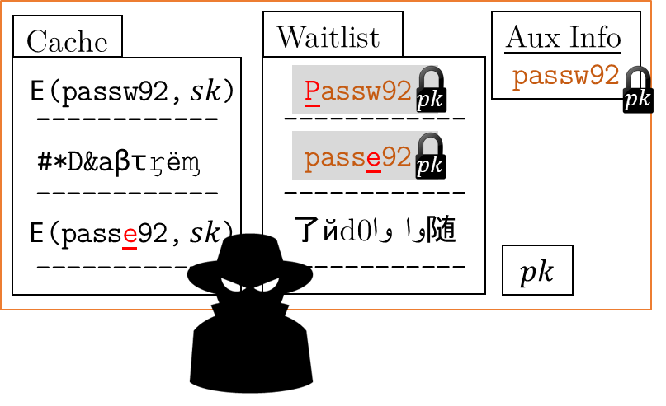
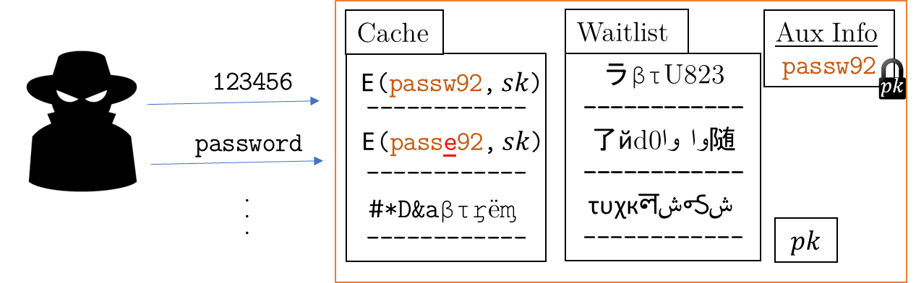
Smash and grab attack (Offline attack)
More interesting, and we detail this in the talk
Remote guessing attack (Online attack)
Analysis is similar to Oakland ’16 paper
Showed negligible security loss
Please see paper for details
Notes:
As every other password checker TypTop has two primary threats: Online attack and the offline attack.
In the online attack, also called remote guessing attack, the attacker, tries to login via the API provided by TypTop and tries to impersonate a user by guessing their password. We analyzed this attack in details, and via simulation show that the attacker gains negligible advantage over traditional password checker in guessing the user’s password. Please refer to the paper for the details.
The more interesting of the attacks is smash and grab attack, or offline attack. TypTop stores more information than a traditional password checker does, therefore, it is interesting to see if the attacker can benefit of that.

Slide 17







Smash and grab attack (Offline attack)
Attacker’s Goal
Learn the registered password
Obvious Strategy
Brute-force guess the password
just like attacking traditional password checkers
Cache
Waitlist
Aux Info
…
1234567
password
123456
------------
------------
------------
------------
------------
了йd0وا وا随
------------
passw92
E(passw92,$sk$)
Passw92
$$pk$$
$$pk$$
#*D&aβτᶉëᶆ
passe92
TypTop’s state
$$pk$$
E(passe92,$sk$)
$$pk$$
Can the attacker do better?
No!
Notes:
In this model, we assume the attacker has compromised the authentication service and stole the data TypTop stored in the persistent storage. The attacker’s ultimate goal is to learn the registered password. Obviously, the attacker can brute-force try to guess the registered password. But, can he do better than that?
The answer is no. We show via a two step argument that the best an attacker can do is to brute-force guess the real password. We first show via a cryptographic reduction, that the an attacker does not learn anything unless he guesses one of the entries in the cache.
And then, via a combinatorial argument, we prove that for certain class of password and typo distributions, the attacker gains no advantage by guessing against any of the typos active in the cache.
Let’s look at the steps one by one in more detail.

Slide 18
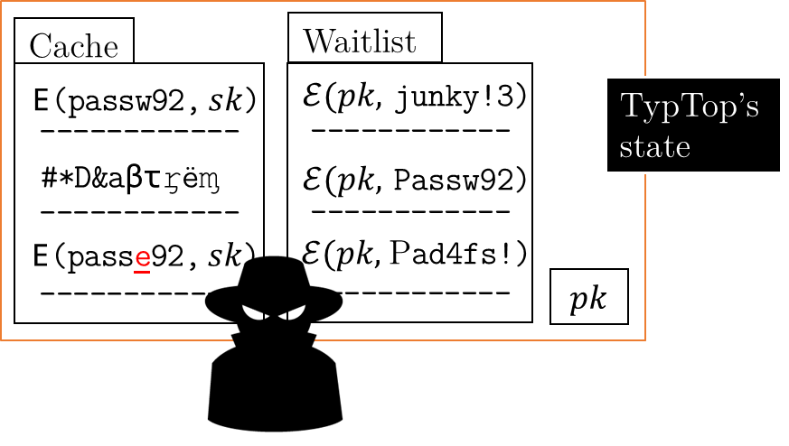
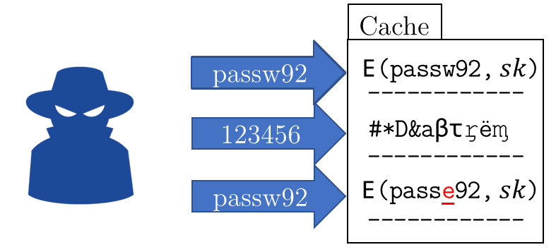
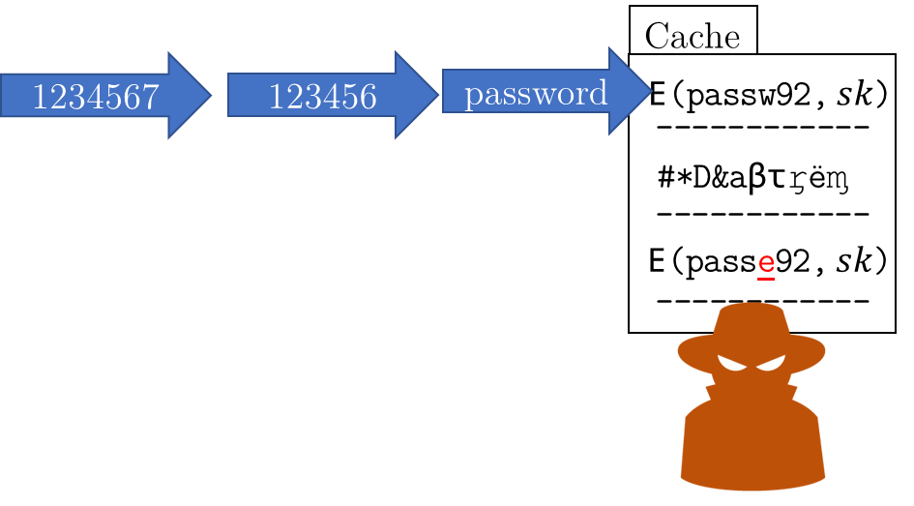
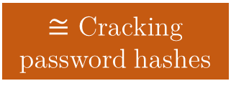
Obvious strategy is the best an attacker can do
$≅$ Cracking password hashes
Attack against TypTop’s state
Brute-force crack the cache entries
Brute-force guess the registered password
Cryptographic reduction
Combinatorial argument
Notes:
We show that the obvious strategy is the best, via an intermediary strategy where the attacker tries to guess either the registered password or a typo of it active in the cache. We show, via a cryptographic reduction, that the blue adversary in the middle obtains as much advantage as the original black adversary can. Then using a combinatorial argument we show that trying to guess a typo in the cache is futile, and better strategy is, like the orange adversary on the right, to just try to guess the registered password.
Let’s look at each of these steps one by one.

Slide 19






TypTop’s state appears random
Cache
Waitlist
Aux Info
Cache
Waitlist
Aux Info
------------
------------
------------
Ɖر&9dấḯ
------------
------------
------------
------------
------------
了йd0وا وا随
------------
passw92
------------
#έ
------------
------------
ĉṓɲṩḙċťᶒțûरें
------------
ấɖḯƥभĭṩčįɳġɾ
------------
ᵯáꞡᶇā ąⱡîɋṹẵ.
بے ترتیب اقدار
$$pk$$
E(passw92,$sk$)
Passw92
$$pk$$
$$≅$$
$$pk$$
填写随机%
#*D&aβτᶉëᶆ
passe92
$$pk$$
$@G7&值β
?
E(passe92,$sk$)
$$pk$$
$$pk$$
Assuming underlying encryption schemes are secure
$⇒$Attacker learns nothing unless he can guess an entry in the cache
Notes:
In the first part, we show that TypTop’s encrypted data appears to random to an attacker, unless he can guess the registered password or a typo of it active in the cache, and therefore without guessing a cached entry, he cannot learn anything from the stolen TypTop’s state. We formally prove this under the assumption that the underlying encryptions schemes used by TypTop is secure.
Now let’s take closer look at what I meant by guessing a password or a typo active in the cache.

Slide 20
Guessing against the cache entries
Decryption is as slow as normal password hashes
Cache
123456
------------
------------
------------
123456
password
1234567
password1
Password
qwerty
987654321
0000000
1111111
123123
123321
1234567
E(passw92,$sk$)
123456
#*D&aβτᶉëᶆ
passw92
E(passe92,$sk$)
Typo entries are randomly permuted
Decryption fails if the slot is incorrect
Can attacker ever get higher advantage by trying to decrypt a typo entry in the cache?
Notes:
Here, the attacker tries to brute-force decrypt the ciphertexts in the cache by guessing the underlying password or typo used to encrypt them. Recall, that the decryption is as slow as traditional password hashing schemes, and each entry in the cache uses independent salts. Therefore, the attacker can only decrypt one entry at a time.
So, it might seem that the attacker can get higher advantage by exploiting the liberty to choose between the real password and typos of it.
However, note that the attacker learns nothing by guessing a password or typo that is in the cache, but decrypted at a wrong slot. And, recall, that the typo cache is randomly permuted after each update and therefore all slots are equally likely for a typo. These, in conjunction with our strict typo check policy, make the attacker’s life pretty hard.

Slide 21

Guessing typo is beneficial if…
…there is a typo that is always in the cache, the attacker can break TypTop by guessing that typo against all slots.
thetypo
thetypo
thetypo
thetypo
thetypo
thetypo
That scenario is quite unnatural
Notes:
Consider a hypothetical situation, where every person makes a particular typo, and that typo is always in the cache of everyone. Then, the attacker can guess that typo against all the slots and win. In this case the attacker gets much higher advantage compared to a traditional password checker that only stores the slow hash of the real password.
This makes the point that the attacker is not bound to brute-force guess against the real password for any password or typo distributions.
However, the scenario I put forth here is, unarguably, quite unnatural. We can bound the attacker’s advantage for certain class of typo distributions, as we describe next.

Slide 22
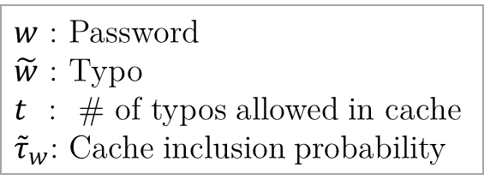
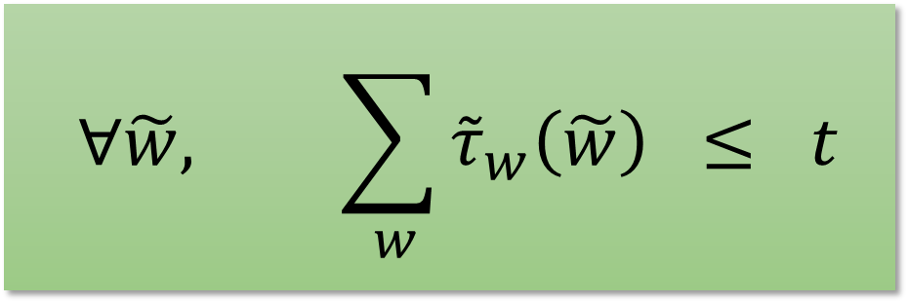
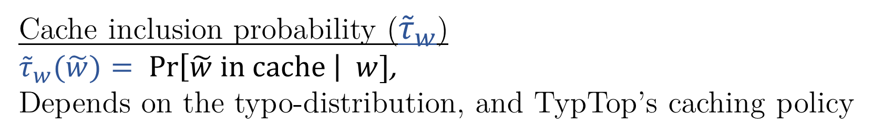
t-Sparse
t-sparse: if no typo is frequently in the cache of many passwords
  $$∀\tilde{w}, \sum_{ w}{{\tilde{τ}}_{w}\left(\tilde{w}\right)} ≤ t$$
$w$ : Password
$\tilde{w}$ : Typo
$t$ : # of typos allowed in cache
${\tilde{τ}}_{w}$: Cache inclusion probability
Cache inclusion probability (${\tilde{τ}}_{w}$)
${\tilde{τ}}_{w}(\tilde{w})= Pr\left[\tilde{w} in cache \right| w]$,
Depends on the typo-distribution, and TypTop’s caching policy

Slide 23
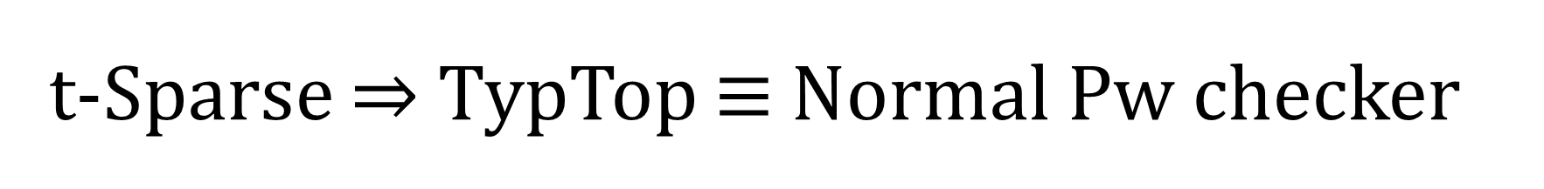
t-Sparse $⇒$ TypTop $≡$ Normal Pw checker
Theorem
𝐼𝑓 𝑡𝑦𝑝𝑜-𝑑𝑖𝑠𝑡𝑟𝑖𝑏𝑢𝑡𝑖𝑜𝑛 𝑖𝑠 𝑡-𝑠𝑝𝑎𝑟𝑠𝑒 𝑢𝑛𝑑𝑒𝑟 𝑇𝑦𝑝𝑇𝑜𝑝’𝑠 𝑐𝑎𝑐ℎ𝑖𝑛𝑔 𝑝𝑜𝑙𝑖𝑐𝑦, 𝑡ℎ𝑒𝑛 𝑏𝑒𝑠𝑡 𝑎𝑡𝑡𝑎𝑐𝑘 𝑖𝑠 𝑡𝑜 𝑏𝑟𝑢𝑡𝑒-𝑓𝑜𝑟𝑐𝑒 𝑔𝑢𝑒𝑠𝑠 𝑡ℎ𝑒 𝑟𝑒𝑔𝑖𝑠𝑡𝑒𝑟𝑒𝑑 𝑝𝑎𝑠𝑠𝑤𝑜𝑟𝑑.
Notes:
Now, we can use the t-sparsity condition to give the following theorem, that upper bound the attacker’s success probability.
If a typo distribution is t-sparse under TypTop’s caching policy, the attacker will not get any benefit for submitting guesses against th the typos stored in the cache.
That means, the guessing game against the registered password or a typo it reduces to a guessing game where the attacker only gets to guess against the real password. The later game is exactly the same as the we model for standard password checkers that stores only hashes of the real password.

Slide 24
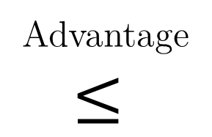




Guessing typo is sub-optimal if t-sparse
123456
1234567
password
123654!
loveyou
l3tmein
Cache
Cache
password
1234567
123456
------------
------------
------------
------------
------------
------------
E(passw92,$sk$)
E(passw92,$sk$)
Advantage
$$≤$$
Password
#*D&aβτᶉëᶆ
#*D&aβτᶉëᶆ
password
1234567
E(passe92,$sk$)
E(passe92,$sk$)
Every guess against a typo can be replaced by a guess against the real password that provides equal or more probability of success

Slide 25
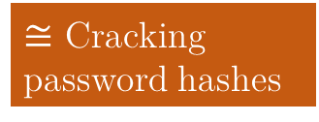
Attacking TypTop is no easier than attacking traditional password checkers
Empirically verified that real world typo-distributions are t-sparse for the configurations we considered for TypTop
Attack against TypTop’s state
Brute-force crack the cache entries
Brute-force guess the registered password
Cryptographic reduction
Combinatorial argument
$≅$ Cracking password hashes
Notes:
We empirically verify that real world typo distributions meet this requirement using passwords from RockYou leak, and instantiate TypTop with cache size 5 and caching policy as PLFU that probabilistically evicts the least frequently used typo in the cache.
Therefore, we conclude that a smash and grab attacker that steals typtop’s state cannot do better than just brute-force try to guess the registered password.

Slide 26
TypTop is secure against online and offline attacks, and it improves utility.
Let’s build one!
Notes:
As I have shown TypTop is secure and it improves utility of passwords, we go on to build one for computer login.

Slide 27

TypTop: a smart password checker for Unix
Created a password authentication module (PAM)
Renders computer logins typo-tolerant
Added a logging module
  To collect anonymous statistics about typos for our study
  Users can disable logging, and still keep using TypTop
A smart password checker that lets you make mistakes
https://typtop.info
Notes:
We built TypTop as a password authentication module for Unix based operating systems, such as Linux and MAC. This augments the traditional password checking system to make it adaptively typo-tolerant. Also, for the purpose of studying the efficacy of TypTop, we added a logging module that collects anonymous data about typing mistakes. The user can opt out of the study by disabling the logging, and continue using the system normally.
While we build TypTop for computer login, the design of TypTop is completely generic and can be instantiated for web logins too. TypTop is adaptive, and operates without any active participation from the end user.

Slide 28
TypTop pilot deployment study
Installed TypTop in 24 volunteers’ laptops
  5 on Linux platform, 19 on MAC
  for median 27 days.
  Total typos observed: 501
Prior approach
22%
TypTop
63%
TypTop provides 3x improvement over prior approach
Notes:
We installed TypTop in the computer of 24 volunteers: 5 were in Linux platforms, and 19 on MAC.
The volunteers used TypTop for median 27 days. From the collected data we found TypTop user has made 501 typos, out of which 63% were corrected by TypTop, while only 22% could be corrected using corrector functions as prescribed by prior approach. TypTop provides almost 3x improvement in typo-tolerance compared to prior approach.

Slide 29
TypTop pilot deployment study
Installed TypTop in 24 volunteers’ laptops
  5 on Linux platform, 19 on MAC
  for median 27 days.
  Total typos observed: 501
TypTop provides
3x
improvement over prior approach
Notes:
We installed TypTop in the computer of 24 volunteers: 5 were in Linux platforms, and 19 on MAC.
The volunteers used TypTop for median 27 days. From the collected data we found TypTop user has made 501 typos, out of which 63% were corrected by TypTop, while only 22% could be corrected using corrector functions as prescribed by prior approach. TypTop provides almost 3x improvement in typo-tolerance compared to prior approach.

Slide 30
TypTop in one slide
Thanks!
Designed TypTop, a secure personalized typo-tolerant password checking system, that adapts to user’s mistakes
Rigorously analyzed its security
You can try TypTop now! Visit https://typtop.info
Typo-tolerant password checking might encourage users to adopt better security practices
Notes:
So, we designed a personalized typo-tolerant password that securely observes user’s mistakes and allow login with frequent typos. We rigorously analyze it’se security and show that TypTop is secure against online and offline adversaries. Finally, build a prototype of TypTop that you can checkout out in the website typtop.info.
I strongly believe that allowing small mistakes during checking passwords might encourage users to use better security practices, and improve the overall security of passwords. For example, users might use longer passwords and lock their machines more often, if they can log in in spite of making small mistakes. Therefore I encourage the security community to explore more on typo-tolerant password checking.

