Slide 1




pASSWORD tYPOS and How to Correct Them Securely
R. Chatterjee, A. Athalye, D. Akhawe, A. Juels, T. Ristenpart
To typo is human; to tolerate, divine.
Notes:
Good morning! I am going to talk about how to allow typos in login passwords with negligible degradation security.

Slide 2
rahul
• • • • • • • • • • •
Notes:
All of us use passwords, we have to type them many times a day.
When we submit the login password ..
[[Every once in a while you will either forget to disengage the caps lock key or miss the shift key while typing your password,
and that’s it. You will be greeted with red letter “login failed” message from the server.
Though it is super annoying, it is widely believed that accepting variants of user’s password is dangerous and makes attacker’s life easy. ]]

Slide 3



Password-based authentication systems
Password459!
Salted, slow cryptographic hash
?
H(Password459!) = “a5idoiaU7p..”
Notes:
… it goes to server, where the server applies a strong cryptographic hash function on the password, and checks the output of the hash against the previously stored hash value computed on similar way on the password used at the time of registration. If the equality check passes, the user is allowed to login.

Slide 4

Password-based authentication systems
Any typo is rejected
password459!
Password459!
Salted, slow cryptographic hash
?
H(Password459!) = “a5idoiaU7p..”
?
H(password459!) = “a5idoiaU7p..”
Typo-tolerant password checking
Allow registered password or typos of it
Notes:
Otherwise not. Even a small typo, such as forgetting to capitalize the first letter in the password, will result in login failure.
This is annoying for legitimate users. Won’t it be good if the server is tolerant to some small set of typos that users frequently make while typing their passwords?
This is the motivation behind a new kind of password checking, what we call typo-tolerant password checking, where the actual password and some small variants of it is accepted.

Slide 5
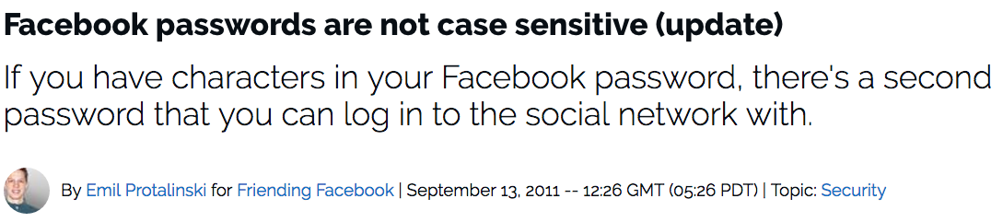
Typo-tolerant password checking in industry
Password459! pASSWORD459! password459!
Notes:
Facebook for many years accepts some variants of the password. For example, you can log into your Facebook account, with the original password that you used at the time of registration, or the password with all the cases flipped, and the password where the case of the first letter is flipped.
But they never reported, why they chose these typos to correct, how much benefit comes from tolerating these typos, nor discussed the security implication.

Slide 6
We know little about password typos
Lots of work on usability of passwords…
[Ur et al. 2012], [Shay et al. 2012, 2014], [Mazurek et al. 2013],
[Bonneau, Schechter 2014] [Keith et al. 2007, 2009],
[Bard 2007], [Jakobsson et al. 2012]
… but nothing on typo-tolerant password checking.
How can we build a typo-tolerant systems?
How much would tolerating typos help users?
Does it endanger security?
Notes:
There have been plethora of work on usability of passwords, but very few actually tried to look at the issue of typos in human chosen passwords. We only knew typos occur, but nothing about typo tolerant human chosen password checking. We did not know how to create an efficient typo-tolerant password checking system, or how much does typos hamper usability? Is it possible to allow typos without endangering the security?

Slide 7
Our work
  We measure password typos at Dropbox and show they are a huge problem for both users and service providers.
  We develop approaches to typo-tolerant checking, and show they improve utility with minimal security impact.
  “Have your cake and eat it too”
Notes:
We are the first one to explore typo-tolerant password checking. By conducting some measurement studies at Dropbox, we ascertain that typos in login password causes a huge problem for both users and web services.
we develop the notion of typo-tolerant password checking that easily extends current exact password checking system. We analyze the security of this new system via simulation with public password leaks, and conclude that we can allow typos with minimal change in security.

Slide 8
  How to do typo-tolerant
  password checking?
Notes:
So, first question is how we can allow typos in login passwords?

Slide 9
We focus on relaxed checkers
password459!
No change in password hash database
Password459!
Slow hash
?
Apply caps lock corrector
H(password459!) = “a5idoiaU7p..”
?
H(PASSWORD459!) = “a5idoiaU7p..”
Apply first case flip corrector
?
H(Password459!) = “a5idoiaU7p..”
…
…
Can we find a small but useful set of typo correctors?
Notes:
A simple and obvious approach could be to apply different correctors on the mistyped password and check each correction using the traditional hash based checking. The biggest benefit of this approach is the server does not have to make any changes in the password hash database.
But, remember the hash function used here is slow and computationally expensive. So we cannot afford to check too many corrections because that will add huge overhead on the server. This leaves us with the question can we find a small set of correctors that covers a large fraction of frequent typos.

Slide 10

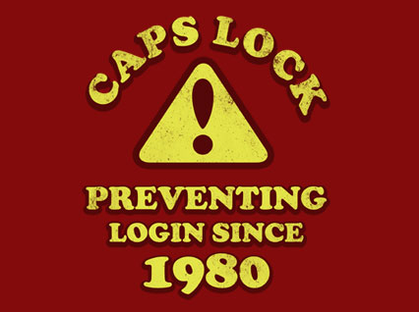

MTurk password transcription study
100,000+ passwords typed by 4,300 workers
$$Top 3$$
$$20\%$$
Notes:
To find this small effective set of typos, we performed a password transcription study in Amazon Mechanical Turk. We managed to obtain password typing data for more than 100 thousand human chosen passwords, from about than 4300 workers. By analyzing that data to find what kind of typos they make, we found 1 out of 5 errors are caused by three simple typos: First, and probably expected, error due to caps lock key. The two followed this are first letter capitalization error, and adding a extraneous character at the end of the password. We call these three typos together as Top 3 typos.
How does these three typos actually affect usability in real world?

Slide 11
Impact of top-3 typos in the real world
Instrumented production login of Dropbox to quantify typos
NOTE: We did not change authentication policy.
24 hour period:
3% of all users failed to login because one of top 3 typos
20% of users who made a typo would have saved at least 1 minute in logging into Dropbox if top 3 typos are corrected.
Allowing typos in password will add several
person-months of login time every day.
Notes:
We conducted a measurement study at Dropbox by instrumenting the production login infrastructure. We only counted how many failed logins are due to those Top 3 typos. I would like to emphasize, we DID NOT authenticate any additional users based on relaxed checking. Dropbox has hundreds of millions of users, and we instrumented all the logins.
In 24-hour period, we found that—
3% of all the users fail to login due to those Top 3 typos.
The users who could login with multiple attempt, 20% of them could have logged in 1 minute earlier should Dropbox tolerate those top3 typos.
The Bottom line is: typo tolerance will add several person-month of login time to Dropbox every day!

Slide 12
Typo-tolerance will significantly enhance usability of passwords.
Can it be secure?
Notes:
So, I hope I could convince you that typos are huge problem for legitimate users and typo tolerance will improve usability of passwords, next question is “Can we allow typos securely?”
So there are two kinds of threat for password based authentication systems.

Slide 13

Threat #1: Server compromise
password459!
No change in password hash database
Password459!
?
No change in security in case of
server compromise
H(password459!) = “a5idoiaU7p..”
?
H(PASSWORD459!) = “a5idoiaU7p..”
?
H(Password459!) = “a5idoiaU7p..”
Notes:
First, if the attacker can compromise the server and get hold of the password database. This attack also known as Smash-and-grab attack. Let me remind you, in your new typo-tolerant password checking scheme we do not change the stored password hashes. That means that the attacker learns nothing new because of allowing typos in case of server compromise.

Slide 14

Threat #2: Remote guessing attack
Web service should lock account after $q$ wrong guesses.
password
Get 3 free checks with every query.
$⇒$ $q$queries result in $3q$ free password guesses.
$⇒$ Previously, $q$queries result in no free guesses
$⇒$ Attacker’s success increases by $300\%$
?
Apply caps lock corrector
H(password) = “a5idoiaU7p..”
?
H(PASSWORD) = “a5idoiaU7p..”
Apply first case flip corrector
?
H(Password) = “a5idoiaU7p..”
?
Apply extra char. at end corrector
H(passwor) = “a5idoiaU7p..”
Notes:
Now, the second threat: The attacker can use the standard login API of the server and try to impersonate a user by guessing the user’s password. The web service can lock the user’s account after too many wrong passwords. We call this query budget or q of the attack. For example, Dropbox will lock a user account after 10 wrong password submission.
In case of typo-tolerance, if the attacker submits one guess, the server will check multiple passwords on behalf of the users. This seems to be dangerous and seems to degrade security.
To be precise, the attacker can check 4 passwords at the cost of 1 query. With q queries the attacker can check 4q passwords. Compared to the non-typo tolerant or exact checking with q guesses the attacker can check at most q passwords. This may seem to imply, that typo-tolerance will increase the attacker’s success by 300%.
No, that implication is naïve. Because, success does not only depend on the number of password that get checked, but the cumulative probabilities of those passwords. So, if human chosen passwords were distributed uniformly across all possible password strings, then this would be true, but in reality, the human chosen passwords are very skewed.

Slide 15
Passwords are not uniformly distributed!
300% improvement, only if all checked passwords are equally probable.
BUT, humans do not chose random passwords.
Good for online guesses,
maximizes success probability
Notes:
Now, the second threat: The attacker can use the standard login API of the server and try to impersonate a user by guessing the user’s password. The web service can lock the user’s account after too many wrong passwords. We call this query budget or q of the attack. For example, Dropbox will lock a user account after 10 wrong password submission.
In case of typo-tolerance, if the attacker submits one guess, the server will check multiple passwords on behalf of the users. This seems to be dangerous and seems to degrade security.
To be precise, the attacker can check 4 passwords at the cost of 1 query. With q queries the attacker can check 4q passwords. Compared to the non-typo tolerant or exact checking with q guesses the attacker can check at most q passwords. This may seem to imply, that typo-tolerance will increase the attacker’s success by 300%.
No, that implication is naïve. Because, success does not only depend on the number of password that get checked, but the cumulative probabilities of those passwords. So, if human chosen passwords were distributed uniformly across all possible password strings, then this would be true, but in reality, the human chosen passwords are very skewed.

Slide 16

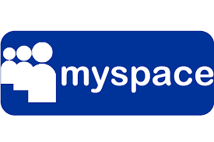
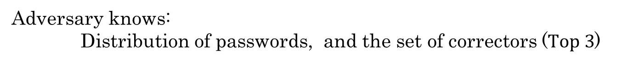

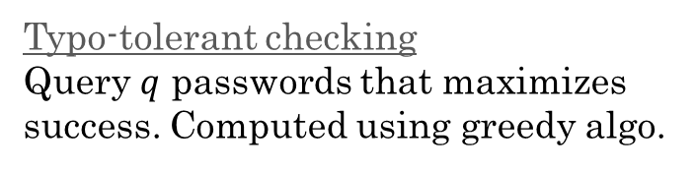
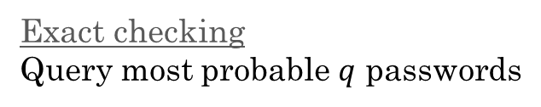
Attack simulation using password leaks
Adversary knows:
Distribution of passwords, and the set of correctors ($Top 3$)
Exact checking
Query most probable $q$ passwords
Typo-tolerant checking
Query $q$ passwords that maximizes success. Computed using greedy algo.
$$q=10$$
Notes:
To find out the actual change in security of remote guessing attack, we performed some simulation attacks using public password leaks as a proxy for real password distribution, and compare the attacker’s success probability in case of exact checking and typo-tolerant password checking with Top 3 correctors. We assume the attacker has full knowledge of the password distribution, and also it knows the algorithm behind typo-tolerance. The attacker’s goal is to log into the server by impersonating the user.
In case of exact checking, the optimal strategy of the attacker will be to submit the most probable q passwords.
In case of typo-tolerant checking, the attacker outputs q passwords that maximizes its probability of success. We used greedy algorithm to compute these guesses.
Now let’s see the output. We used two password leaks: from phpbb and myspace. The height of each column shows the maximum probability of an attacker’s success for a randomly picked user with a query budget of 10. The brown bar is for exact checking, and the blue one is with typo-tolerant checking. We can see the attacker’s success against typo-tolerant password checking, is very close to it’s success against exact checking system, and definitely the increase is not 4 times.
However, we can do better!

Slide 17
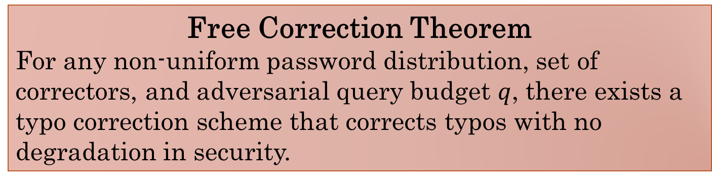
Security-sensitive typo correction
Don’t check a correction if the resulting password is too popular.
PASSWORD
Password
password
pASSWOR
Free Correction Theorem
For any non-uniform password distribution, set of correctors, and adversarial query budget $q$, there exists a typo correction scheme that corrects typos with no degradation in security.
Notes:
The server does not have to correct every mistyped password. It can selectively deny correction on some mistyped passwords if the resulting correction is too popular (read I as risky) to correct. For example, if the users submits “password 459 exclamation mark, with every letter is capitalized except the first letter”. The corrected versions are all low probable and the server can check all of them. On the other hand, if the submitted password is password with all caps except first letter, it will be corrected to two very high probable passwords such as PASSWORD with all caps, and Password with all letters are lowercase except the first one. These two are very popular and the attacker will get advantage of the typo-tolerance because of this. BUT the server can chose to filter these high probable corrections out before checking.
This intuition motivated us to come up with a theorem that states that if the password checkers has precise of the knowledge of the password distribution, it can correct typos with any number of correctors and does not change the security for any fixed query budget. We prove this theorem by construction. Please refer to the paper for detailed proof of this theorem.

Slide 18
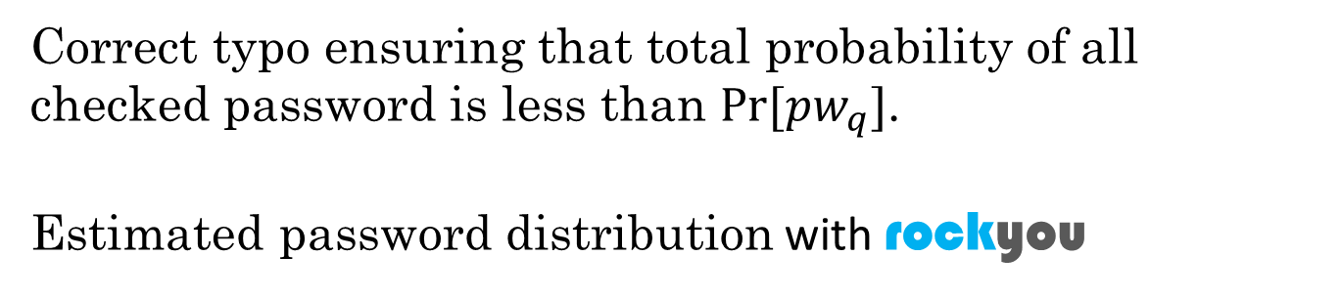

Security of checkers with filtering
Correct typo ensuring that total probability of all checked password is less than $Pr⁡[pw_{q}]$.
Estimated password distribution with rockyou
$$q=10$$
Change in success: 0.02%
Notes:
Now, to use free correction in practice the server needs precise knowledge of the password distribution, which is very hard to come by. But, it can use heuristic for that. So, we used rockyou password distribution as the heuristic, and re computed the attacker’s success against this new typo-tolerance scheme with filtering. This is the same graph as before appended with the new result—the green column, and you can see that there is at most 0.02% change in attacker success, which is essentially negligible.

Slide 19
Typo-tolerant checking can enhance users’ experience for essentially no degradation in security.
Notes:
So, the conclusion is it is possible to create typo-tolerant password checking efficiently with essentially no degradation in security.

Slide 20

pASSWORD tYPOS in one slide
Introduce typo-tolerant password checkers
  Compatible with existing password databases, easy to deploy
Study password typos empirically
  3% of users fail to login due to correctable, top-3 typos
3. Analyze security of typo-tolerant checkers
  “Free” correction theorem (In theory)
  With heuristic, works in practice too
/rchatterjee/mistypography
Thanks!
rahul@cs.cornell.edu
Notes:
To summarize, we introduce typo-tolerant password checking, that will require minimal change in current authentication system, and still be able to correct many typographical mistakes.
we conducted an in-depth analysis of password typos. We show via studies in Amazon Mechanical Turk, and Dropbox production authentication system, that few frequent typos cause significant problem for legitimate users—from preventing them to login or delaying login.
Finally, we analyzed the security of typo-tolerant password checking. First, we give a theoretical possibility result about loss less typo correction. Later, through simulation we show that we can have practical typo-tolerant password checking scheme that cost very minimal security loss.
Thank you for your attention. The code for typo-toleant password checking and analysis is up in the Github. Now, I am happy to answer if you have any questions.

