Slide 1
The Spyware Used in
Intimate Partner Violence
Rahul Chatterjee, Periwinkle Doerfler, Hadas Orgad,
Sam Havron, Jackeline Palmer, Diana Freed,
Karen Levy, Nicola Dell, Damon McCoy, Thomas Ristenpart

Slide 2
Intimate partner violence (IPV):
sexual violence, physical violence, or stalking by boyfriend, girlfriend, or spouse
1 in 4 women 1 in 10 men experienced IPV in their lifetime in US
Source: https://www.cdc.gov/, 2015
Notes:
Physical or sexual violence or stalking by an intimate partner, such as boyfriend, girlfriend, or spouse is considered as intimate partner violence or IPV. IPV is a serious public health problem that affects a large fraction of people in our society across the globe. In a study in 2015 shown 1 in 4 women and 1 in 10 men in the US experienced IPV in their lifetime. [[ add transition, technology is increasingly being used for IPV]]

Slide 3
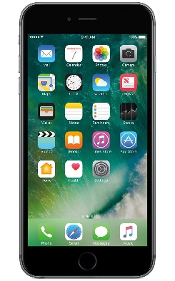
Technology is abused for IPV
Abusers exploit technologies to
send harassing texts
stalk victim online
distribute non-consensual pornography
spy on victims using spyware
Burke et al. ’11
Dimond et al. ’11
Citron ’15
Woodlock et al. ’16
Matthews et al. ’17
Freed et al. ’17, ’18
Intimate partner surveillance (IPS)
Notes:
Prior research with IPV victims and professionals who work with them have pointed out that abusers regularly exploit technologies to harass victims. One thing that came up multiple times in prior work is that abusers put spyware application on victim’s device to spy on victim. Tracking or spying on intimate partner without their knowledge or consent is what we call intimate partner surveillance or IPS, and the apps used to conduct IPS as IPS-relevant apps.
[[ add pictures of phones]]

Slide 4
IPS is both a form of violence and facilitates other forms of violence.
“An abusive partner kicked in our front door and wound up in the lobby of our building by tracking her phone . . . it was some secondary application that the abuser had put on it and knew exactly where she was… it was scary.”
– Case manager
[Freed et al. CSCW ’18]
Notes:
IPS is a form of violence in itself, or it facilitates other form of violence.
As one case manager from prior work recalls an incident where the abuser literally kicked in the front door of the case manager’s apartment and ended up in the lobby by tracking the victim via a spyware application that he installed on her phone. The abuser became violent and they had to call police.

Slide 5
Spyware threat model in IPV
has physical access
knows passwords
might own device
Abuser can install spyware
Abuser

Slide 6
We did not know …
What spyware tools are available to abusers?
How easy it is to find and (ab)use them?
Are developers of these tools complicit in IPS?
Can anti-spyware apps come to the rescue?
Notes:
… we did not know what spyware tools are available to abusers, how easy it is to find and abuse these tools, and are the developers of these tools aware that their software is being used for IPS. Are current anti-spyware useful for IPV victims to detect such IPS-relevant apps.

Slide 7
Our work: First study of the ecosystem of IPS-relevant apps
~4000 IPS-relevant apps:
Some are overt spyware
Most are dual-use
Abundant resources
(blogs, videos, forums, etc.) to help abusers with IPS
Current anti-spyware doesn’t flag IPS-relevant apps as threat
Some developers promote IPS, others condone it
Spyware ecosystem currently empowering abusers and failing victims
Notes:
We did first in depth study of the ecosystem of spyware apps available to abusers for conducting IPS.
We build a pipeline to discover apps and resources available on the web and in application stores, then created a semi-manual filtering procedure to distil out the apps that can be used for IPS. We found about 4000 apps that can be used for IPS, and a large fraction of them are dual-use, that is built for a legitimate cause, but can be repurposed to spy on intimate partner.
We show, the ecosystem of spyware empowers abusers and fails the victims. Some developers promote IPS, others condone it, and current anti-spyware apps do not flag IPS-relevant apps as a threat.

Slide 8
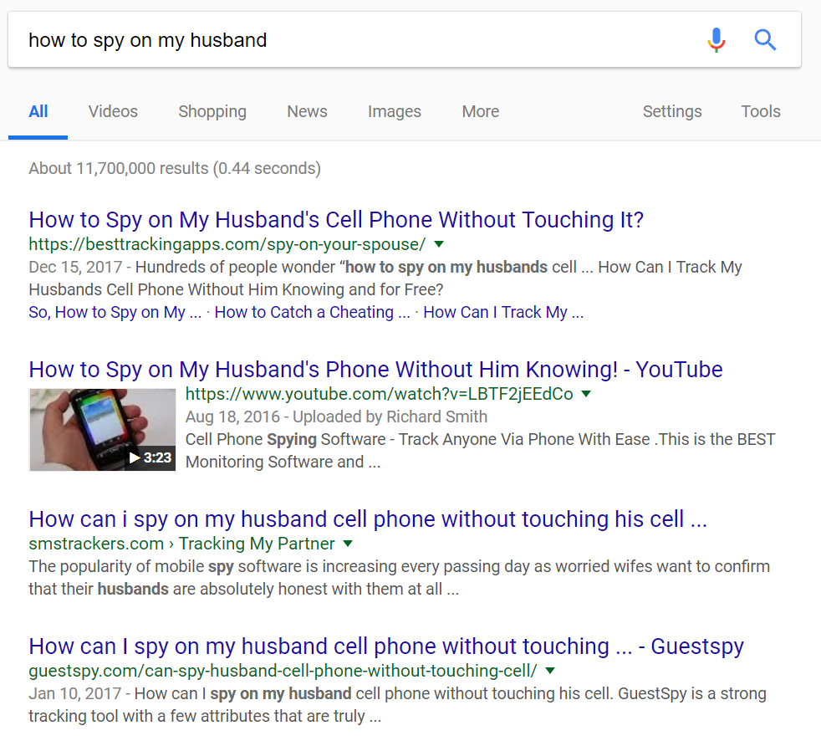
How do abusers find IPS-relevant apps?
How to spy on my husband
Blogposts comparing spy apps
Need large number of query terms that an abuser might use
Videos how-to guides
Ad funnels for spy apps
Spy app websites
Notes:
We begin our investigation with the question how do abuser find IPS apps. We hypothesize that an would-be abuser will probably start with searching on the Web via some search engine. For our study we used Google. Searching for terms like “how to spy on my husband” or “how to track my girlfriend” returns several million hits that includes,
Blogposts comparing spyware tools, video how-to guides, ad funnels that discuss about IPS and redirect traffic to some spyware app website, and spyware app websites. In addition to the search results we also observed, most modern search engines provide query recommendation educated from prior searches to help user search better. Based on this observation…

Slide 9
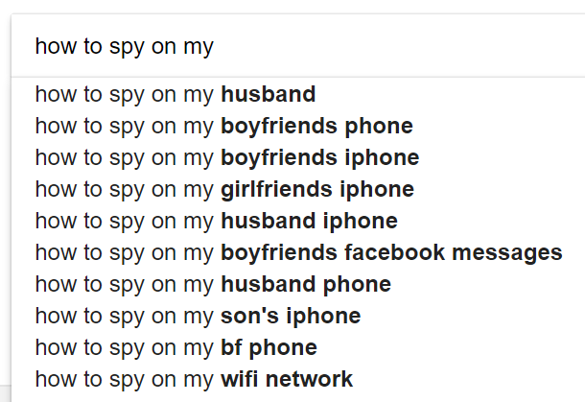
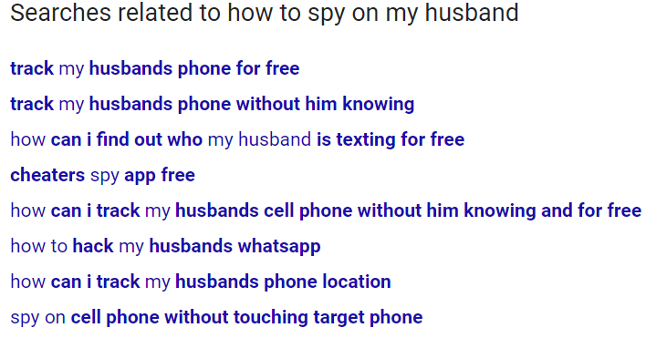
Search engines give query suggestions
Notes:
We begin our investigation with the question how do abuser find IPS apps. We hypothesize that an would-be abuser will probably start with searching on the Web via some search engine. For our study we used Google. Searching for terms like “how to spy on my husband” or “how to track my girlfriend” returns several million hits that includes,
Blogposts comparing spyware tools, video how-to guides, ad funnels that discuss about IPS and redirect traffic to some spyware app website, and spyware app websites. In addition to the search results we also observed, most modern search engines provide query recommendation educated from prior searches to help user search better. Based on this observation…

Slide 10
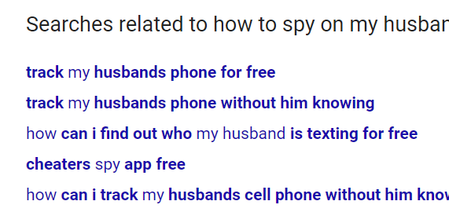
“Snowball” searching
how to spy on my girlfriend, track my girlfriend android,
how to spy on my husband
...
Regex-based filter to remove unrelated terms
Query set
Stop when no new query found or # queries more than 10,000
Notes:
… we devised a snowball search technique to find IPS resources available in the Internet. We begin with a small set of queries that seemed an would-be abuser might search for, and then search with those queries on a search engine, record the results, as well as the query recommendations. We add the query recommendations back to our query set after filtering out obviously unrelated ones. We iterate in this way, until we don’t see any new query recommendation, or we have made 10000 queries to the search engine. The 10000 limit is arbitrary but seems to be sufficient.

Slide 11
Abundant resources for conducting IPS
Crawled and (and ) using snowball searching
We found:
3,500+ IPS-relevant apps in Play Store
23 off-store spyware apps
(smaller study)
451 IPS-relevant apps in d
Notes:
We apply these snowball searching technique on Google search, Google Play store and in a smaller scale on Apple iTunes. All via the search APIs provided by these web services.
We discovered 23 spyware applications distributed outside any official application stores, around 3,500 applications in Play Store and 451 in Apple iTunes App store. In addition to actual IPS-relevant apps, we found thousands of blogposts, videos, forums discussing about how to conduct IPS.
The apps distributed outside official app stores are…

Slide 12
A typical off-store spyware app
All-Inclusive Mobile Phone Spy
Spy on all iOS and Android devices
Track SMS, Call logs, App chats, GPS etc.
No Rooting or Jailbreaking required
Invisible mode, monitor the activity remotely
Real-time + historical
Source: https://www.spyzie.com/ad/phone-spy.html
Remotely record audio, video, and alter settings
Notes:
… shockingly powerful [[and violates one or more developer policies]] in most official app market places. As one app, spyzie, succinctly describes their capabilities as following. The app can track in real time as well as preserve history of victim’s location, all app chats, all calls and SMSes. The app can even remotely record audio, video, or alter settings.
[[TODO: Change the pic]]

Slide 13
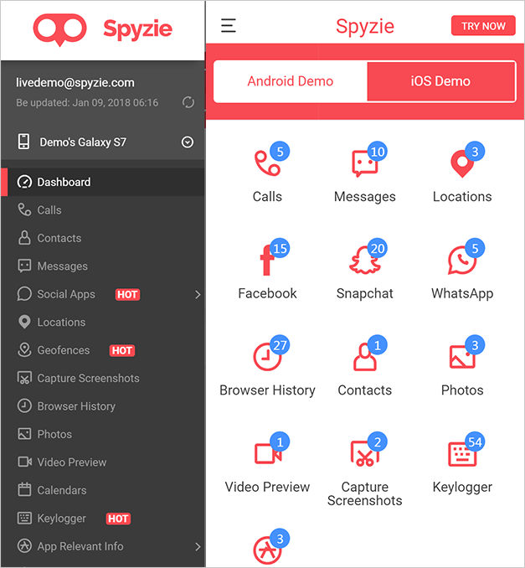
Smooth (ab)user experience with off-store spyware
How-to guides
Installing is easy
Whole process takes less than 5 min
On victim’s device:
No app icon, no notification
On abuser end:
Fancy web UI or apps
Notes:
These apps are easily found via Web search. Installation requires the abuser to turn off Play Protect regular scanning and turn on app installation from unknown sources, and there are detailed how-to guidelines available for this. All this plus installation and configuration takes less than 5 minutes. Rooting is not required to get most of the functionalities, but should the phone be rooted the app provided more invasive and reliable spying capabilities. To even further smoothline the installation and even provide more invasive spying features some spyware vendors sells mobile phones with preloaded spyware on them.
Once installed, the app has very minimalistic UI on the victim’s device, and there is no app icon in the app drawer and of course no notification when the app is exfiltrating sensitive information from the victim’s device.
On the abuser end, almost all apps provide stunning web interfaces that neatly present all the information stolen from the victim’s device, and even some comprehensive charts. These apps also provide great customer support to the abuser, as we will show shortly.
I would like to mention, we found some simple but damaging vulnerabilities in couple of web portals, that enable anyone to view photos collected from anyone’s phones.
[[ add a pic of web console. ]]

Slide 14
Abundant resources for conducting IPS
23 off-store
IPS-relevant apps
3,500+ IPS-relevant apps in a
(smaller study)
451 IPS-relevant apps in d
Notes:
There are several apps available inside official app market places that can be used for IPS.

Slide 15
Finding on-store IPS-relevant apps Apps distributed in official application stores
Snowball searching over 3 months on Play Store
Prune using ML classifier
Filter using human verifier
15,000+ apps
~4,500 apps
Found 3,500+ apps usable for IPS
Smaller study (2 weeks) on iTunes App Store:
451 IPS-relevant apps
Looks at app title, description, permissions, and genre as reported in Play Store
Notes:
For discovering on-store IPS-relevant aps in the Play Store, we build a pipeline which first snowball searches in the play store. In three months we collected more than 15000 apps via snowball searching. Not all of them are relevant for conducting IPS. So we filter the list using a supervised machine learning classifier that looks at the app title, description, and permissions as listed in the Play Store. We bias the classifier towards low false negative rate at the cost of slightly higher false positive rate, as failing to detect an IPS app can be dangerous in the IPV situation. To remove the false positives we went over the list and found 3500 apps that can be used by an abuser to spy on a victim.
We also apply this process to iTunes but for only couple of weeks, and obtained 451 apps that are relevant for IPS.

Slide 16
Taxonomy of on-store apps
Find my phone or Anti-theft
Automatic call recorder
Automatic data/SMS syncing
Phone control
Personal safety
Personal tracking
Find-my-family / friend
Couple tracking
Mutual tracking
Employee tracking
Parental control
Subordinate tracking
Notes:
All of the on-store apps have legitimate use cases, which falls into three categories. For personal tracking, such as to find the lost phone, or anti-theft, syncing SMS across devices, etc. Some apps are built for two or more people to mutually track each other, such as family tracking apps, or find my friends app, or couples to consensually track each other. The third and last category of apps are for employer to track their employees during work hours, or parents to track their children.
While, we were paranoid while flagging these apps as IPS relevant, we found several evidence in forums, app reviews, and blogs that suggest using these apps for spying on a romantic partner.

Slide 17
Seemingly innocuous apps are used for IPS
“I’m looking for an app I can install on my wife’s phone that is hidden so that I can see where she is or has been via cell towers or gps.”
Dual-use app
“[Install] Cerberus from the market.
Once installed and configured, can be set to be invisible in the app drawer.
You can also record audio and take pictures remotely with it! Be sure to silence the camera first though!”
Source: forum.xda-developers.com/showthread.php?t=1266874
Notes:
As an example, in one forum, an would-be abuser seek advice for an app that he can use to surreptitiously track his wife’s location. In response, another (ab)user recommends Cerberus which is available in the Play Store, which can be configured to be hidden in app drawer, and remotely record audio, video, and take picture. Cerberus is an antitheft app, which is being repurposed for IPS!
[[TODO: More animation]]

Slide 18
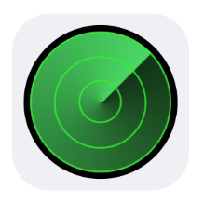
Types of IPS-relevant apps
Overt spyware apps
(typically off-store)
Dual-use apps
(typically on-store)
Notes:
The spyware mentioned in prior work are not traditional spyware that are considered in security community like nation state spyware or adware. These are unwanted applications intentionally installed on victim’s device by their abuser to track or spy on the victim. Installation might require physical access to the device, but that is very much a possible for an abuser because of intimate partner scenario.
These spyware apps includes overt spyware apps that advertise themselves to be surreptitious and useful for spying on someone.
Also another kind of apps came up in prior work, which are not built for spying on someone, but their functionalities are repurposed to spy on someone, especially an intimate partner. We call these apps “dual-use” apps. Example includes find-my-phone, find-my-friends, types apps, which came up in prior studies.
All of these apps are relevant and capable of intimate partner surveillance, and we use the term IPS-relevant apps or in short IPS apps to denote all such apps.
While prior work have provided anecdotal evidence of use of spyware in IPV,…

Slide 19
Are app developers complicit in IPS?

Slide 20
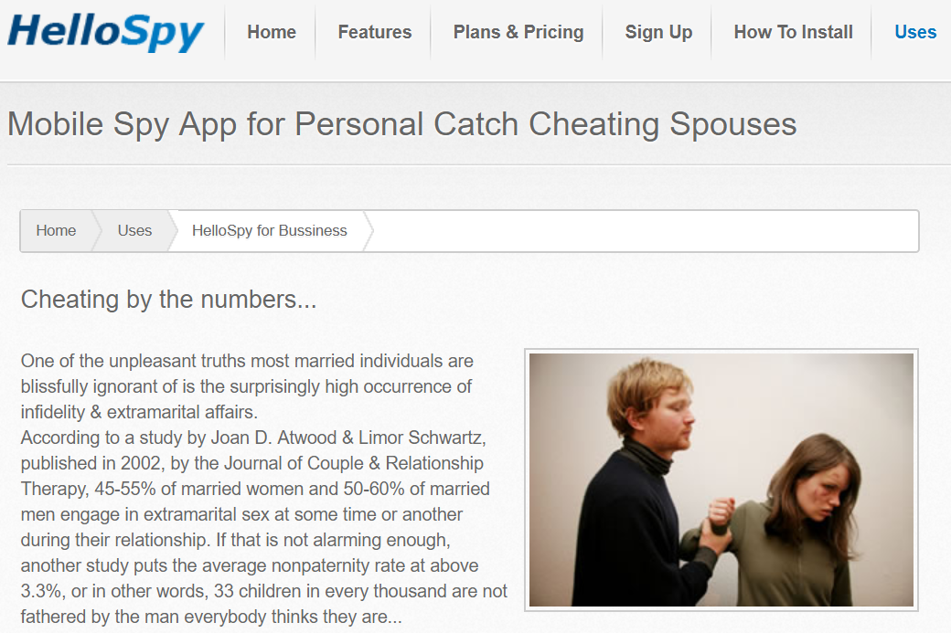
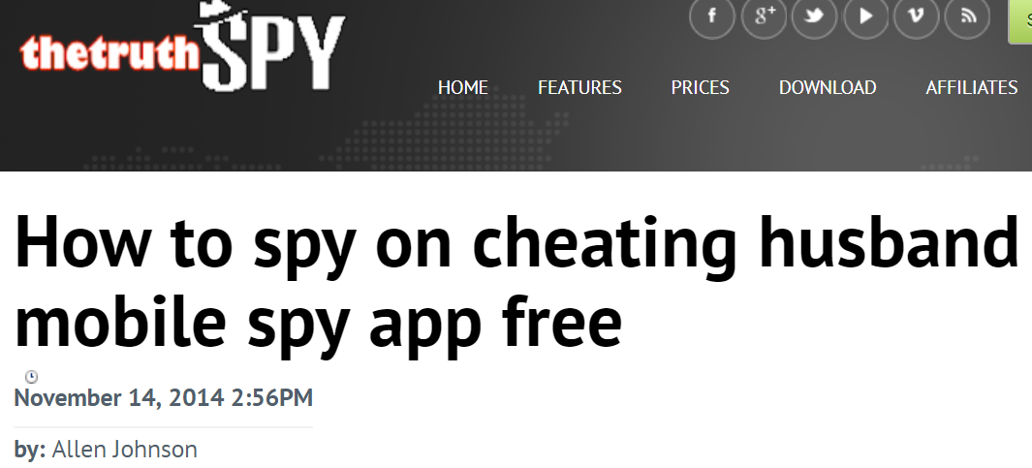
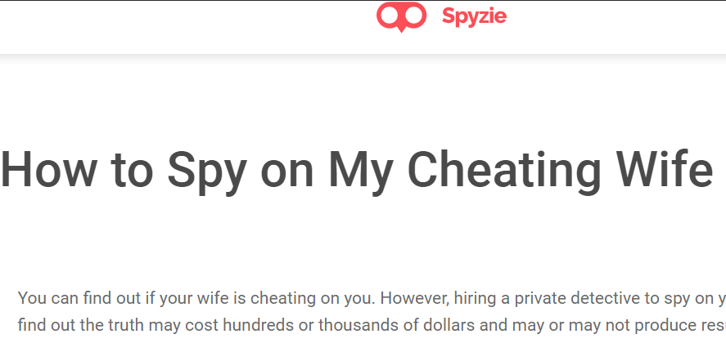
Some developers are promoting IPS
Notes:
This begs the question are the developers of these spyware and dual-use apps are tacitly complicit in IPS.
Well, some developers definitely market their app for users who want to conduct IPS, they host explicit IPS content on their app websites.

Slide 21
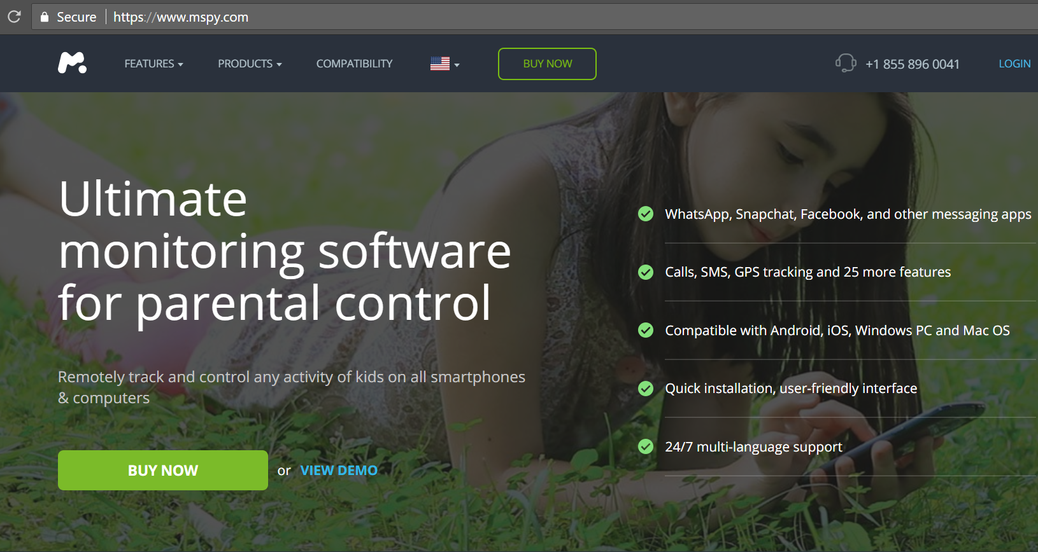
Others are condoning IPS
Suspicious redirect from IPS-content blogposts to app websites
Notes:
Others are not so clear, but we have some circumstantial evidences. Such as, there are several blogposts that we found talking about IPS and how to conduct IPS, and then exclusively link to a particular app websites, where there is no mention of IPS. These are possibly resellers of the tools, but clearly this is not possible without vendors condoning the IPS use case.

Slide 22
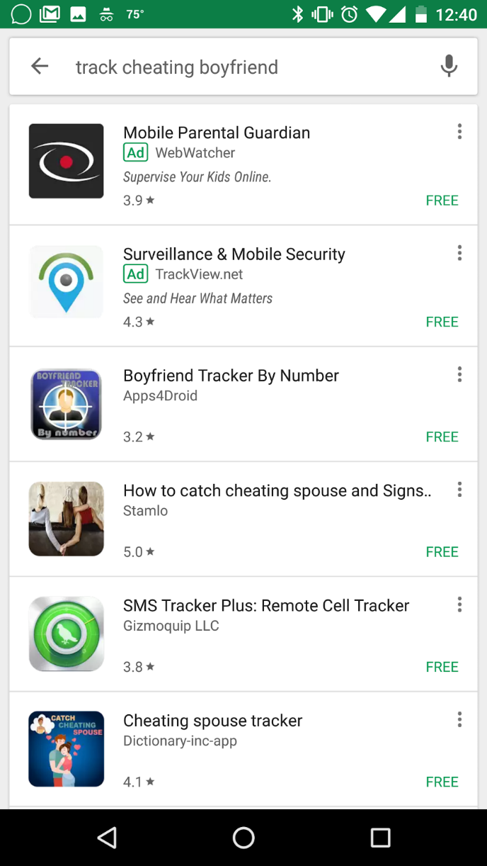
Others are condoning IPS
Suspicious redirect from IPS-content blogposts to app websites
Paid ads coming up on IPS-related search terms
Notes:
We also found several paid ads show up while we search for explicit IPS related search terms.

Slide 23
Others are condoning IPS
Suspicious redirect from IPS-content blogposts to app websites
Paid ads coming up on IPS-related search terms
Contacted customer support for 11 apps
6 on-store and 5 off-store
posing as an abuser
Jessie:
Hi, If I use this app to track my husband, will he know that I am tracking him?
WebWatcher:
For Android monitoring the app can be hidden from the home screen …
9 responses:
8 condoned IPS
1 admonished against IPS use
Notes:
Finally, we contacted 11 app customer support posing as an abuser who wants to track her husband surreptitiously. 9 responded to that query, and 8 of them condoned IPS. Only one app admonished against IPS use of their software and gave legal warning.

Slide 24
So far,
Thousands of IPS-relevant apps are available
Plenty of how-to blogs, videos, and online forums for abusers
Some developers promote IPS
Notes:
So far I have shown that thousands IPS-relevant app apps are available in the open web and in application stores. Abundant how-to guides, blogs, videos are available to help abusers conduct IPS, and some of the app developers are targeting abusers as their potential customers.
Now, remaining question: can victims use anti-spyware tools to find out whether are not they are being spied on?

Slide 25
Disclosure with Google
We communicated our findings to Google. Google has
tightened enforcement to disallow any couple tracking apps and taken action against the ones violate Play Store policies
taken action against YouTube videos that violate their policies
extended restrictions on ad-serving and Play Store search
Dual-use apps will/should remain on stores:
We need detection tools to help (potential) victims
Notes:
During the study, we have worked closely with Google. We disclosed our findings to Google, and they have taken action against apps and videos that violate their policies. They have tightened policy enforcement on Play Store to prevent all apps for tracking intimate partners. They have also extended restriction to ad-serving and Play Store search on IPS terms.

Slide 26
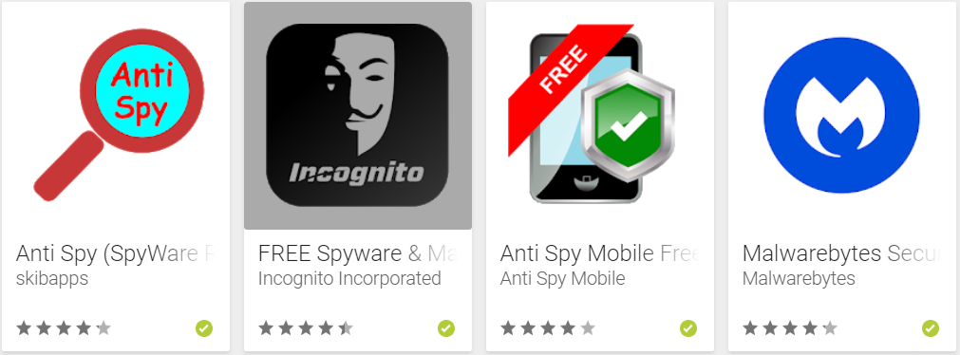
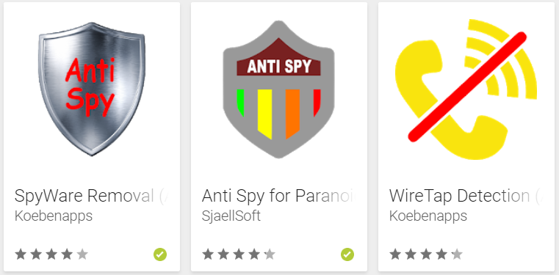
Are anti-spyware tools effective?
Snowball searched for anti-spyware apps in Play Store
Found 40 apps that claim to have anti-spyware capabilities
Methodology: Installed IPS-relevant apps in a phone along with one anti-spyware app
record the apps flagged by the anti-spyware
None of the anti-spyware apps suffice:
they do not flag dual-use apps as threat
Notes:
To measure the efficacy of existing anti-spyware tools, we searched play store, now with the view pointe of an IPV victim. We found 40 apps that claim to have anti-spyware capabilities, this include several brand name anti-spyware tools, like Avast, Norton, mccafee, and some apps from unpopular developers but with very high download counts and ratings in Play Store.
We installed a subset of IPS-relevant apps in a phone, along with these anti-spyware apps one at a time. We recored the apps flagged the anti-spyware.

Slide 27
“State-of-the-art” spyware detection remains:
Feel being spied on
or
+
Getting hot
Notes:
Therefore the best spyware detection method remains these heuristics as suggested b advocates and police: If you feel that your phone battery is draining fast, or it is getting too hot, then probably you have spyware in them and you should throw away the phone. This is very unsatisfactory for us as a security community and puts forth and call to action.

Slide 28
The Spyware Used in IPV First in-depth study of IPS app ecosystem
Abundant resources for abusers to do IPS
Some developers are complicit in IPS
Current anti-spyware doesn’t flag IPS apps
Moving forward:
Working with Google and Symantec on IPS detection
Guidelines for honest developers to prevent IPS use-case?
https://ipvtechresearch.org
Thanks!
@rhlchatterjee
rahul@cs.cornell.edu

