Slide 1
Kevlar: A Flexible Infrastructure for Wide-Area Collaborative Applications
Qi Huang (Huazhong Univ. of Sci. & Tech., Cornell),
Daniel Freedman (Cornell), Ymir Vigfusson (IBM Haifa),
Bo Peng (Cornell), Ken Birman (Cornell)
Middleware 2010, Bangalore, India

Slide 2
Wide-area Collaborative Applications
Plethora of examples
  Collaborative editing
  Remote surgery
  Massive Multiplayer Online Games (MMOG)
Normally supported by Web Services
  Standardized, extensible and interoperable
But, request patterns often closer to P2P than client-server
  Extra delay introduced by relaying messages between clients
  Relaying brings heavy load on servers in the data center
Notes:
Speaking about wide-area collaborative applications, there are plethora of examples including: collaborative document editing, remote surgery and massive player online games.
Nowadays, these applications are normally supported by Web Services, due to its highly standardization, extensibility, and interoperability.
But, unlike traditional network service, collaborative application’s request patter is often closer to p2p than C/S; imagine about a fight scenario between two players in a game, their interaction is p2p. Using WS, even these edge-side messages need to be relayed through a server. Thus extra latency and server’s load can be introduced.
///How to combine these two patterns smoothly to resolve this? While also achieving the efficiency?

Slide 3


Live Objects (LO)
LO represents an object replicated at each node
  Application LO is drag-and-drop mash-up of service LOs
  Replicas uses “Channels” to communicate among themselves
  Channel can use any choice of protocols (Web Service, P2P, …)
Mash-up of small LOs
Communication
Channel
Notes:
In a prior work, we introduced a new method for combining standard Web Services with peer-to-peer replication protocols. It is a development platform called Live Objects (or LO for short).
The word of “Live Object” actually represents a programming object replicated at each node in a distributed system. And an live object application could be built upon combining smaller service live objects. The platform supports drag-and-drop styled combination, thus even non-programmers can build complicated applications as they build web-pages today.
When running the application, all replicas of the same LO would communicate among themselves to synchronize their states. Updates are delivered through Communication channel, which is also a live object provided by the platform.
The implementation of this channel is flexible, thus any protocol could be adopted to support the application.

Slide 4
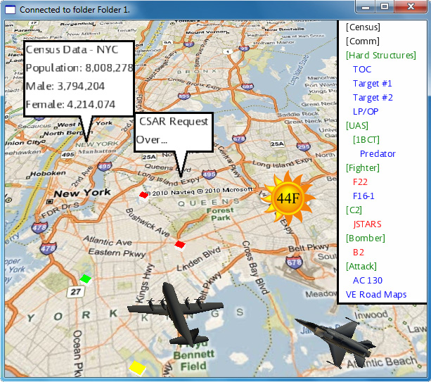
Live Objects (LO)
LO represents a replica running at each node
  Application LO is drag-and-drop mash-up of service LOs
  Replicas uses “Channels” to communicate among themselves
  Channel can use any choice of protocols (Web Service, P2P, …)
Disaster search-and-rescue
MSN Earth, Google Weather
  Retrieved from Web
  Shared through P2P
Flight Coordinates, Report
  Delivered from edge-source using P2P
Notes:
Based on the platform, we’ve built a collaborative application. It is a disaster search and rescue system to save people’s lives when hurricane or earthquake happens. We can see there are lots of different services embedded in, and various communication patterns are also applied.
For example, MSN Earth: referring to the background map, Google weather can either be retrieved from web, or updated from other clients through p2p content delivery.
There are also flight coordinates and pop-up reports generated from other source clients.

Slide 5

Scale Communication Channels
Wide-area Channel tends to have numerous receivers
Need a wide-area multicast
  Minimize redundant traffic
  Minimize average latency
  Provide high throughput
  Stay robust to node churn/failures
  Automatically adapt to the runtime environment
Can any one existing multicast achieves all goals?
Notes:
After resolving the communication pattern mismatch, the challenge of supporting wide-area collaboration would become how to scale the communication channels. If each channel has numerous receivers, we may need a wide-area multicast substrate.
An appealing multicast, should not waste bandwidth of network by generating redundant traffic; should minimize the delivery latency, yet still provide high throughput; because of the heterogeneity of wide-area network, it should be also robust and able to adapt itself to the runtime changes.

Slide 6
Review of Existing Multicast
Physical IP-multicast (IPMC)
  Disabled over WAN links
    Security concerns (DDoS attacks)
    Economic issues (how do ISPs monetize IPMC?)
  Enabled in many data centers
    Possible to fix scalability and reliability issues
Application-level multicast (ALM)
  Since, iterated unicast does not scale ⇨ Use an overlay
    Ignores the potential presence of IPMC
    Tree-overlay usually vulnerable to churn
    Mesh-overlay have high overhead and increase latency
No known solution achieves all of our goals
  Can one size fit all?

Slide 7
Introducing Kevlar’s Multicast
Quilt [DEBS’10] delivers a library:
  Patchwork multicast
  Uses centralized mechanisms
Kevlar extends Quilt:
  Re-implements components as LOs to
  support Collaborative Application
  Decentralized patch formation/maintenance
    Eliminates single point-of-failure
    Provides more privacy/security control for regional patch
Idea: What if we combine multiple multicast solutions?
Global Patch
Regional Patch
Notes:
What if we combine multiple multicast solutions.
Well, it sounds very simple, but the key point is:
“Whether we can design a cohesive and environmentally-aware system --- combining multiple independent solutions in a patchwork manner --- that provides the benefits of each, while minimizing their drawbacks?
Imagine there is multicast group, if we can identify the environment of each receivers, we can group them into different regional patches. Each patch can independently use different multicast protocol which is more efficient in this settings. Then we weave the regional patch into a patchwork, by using a global patch to forward cross patch messages.
A prior work named Quilt delivered a patchwork multicast library, using centralized mechanisms.
Kevlar extends Quilt, by re-implementing all components into live objects to support collaborative applications. More importantly, Kevlar uses a decentralized fashion to build and maintain the patchwork overlay. Thus the single-failure-point of Quilt has been eliminated. And for regional patch, there is more control over the privacy and security for its own use.

Slide 8
Talk Overview
Motivation
Kevlar Architecture
Evaluation
Conclusion
Control scenarios
Application
Environment identifier
Patch formation
Churn resilience
Kevlar
Overview
Notes:
After introducing the motivation and Kevlar’s overview, we will focus around its architecture, highlighting three points: The environment rule we use to associate multicast protocol and applied environments; the formation of patchwork overlay; and the improvements of churn resilience.
Before we conclude talk, we will also talk about evaluation.

Slide 9
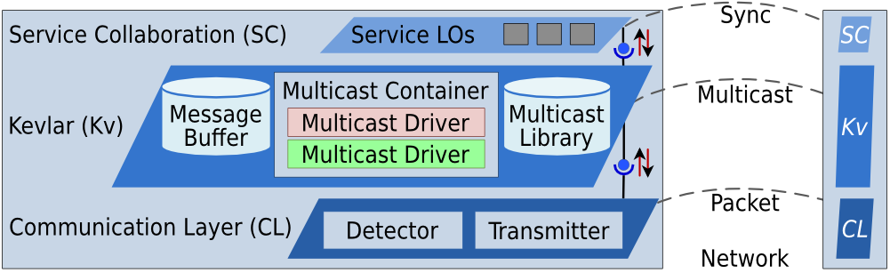
Kevlar Architecture
Kevlar Architecture
Environment identifier
Patch formation
Churn resilience
Kevlar exposes a channel endpoint to service live objects
The multicast container stores active protocol “objects”
  Physical IPMC (network-layer IP multicast)
  Coolstreaming/DONet (mesh-structured, bit-torrent style)
  OMNI Tree (latency-optimized without burdening most clients)
  And any others…
Notes:
Here is the architecture of Kevlar, consisting of three layers. The top layer is actually the mash-up of service objects, as we can see the blinking grey rectangles are services as maps, weather information
Kevlar’ multicast lies in the middle, acting as a communication channel to the service live objects. Because Kevlar needs to run various protocols, even multiple protocols for some special clients, there is library linking to all existing protocol objects in the LO platform, while the Container automatically loads active ones.
What protocol does Kevlar support?
IPMC, used when the functionality is enabled
Coolstreaming, used in the network like small ISPs, where bandwidth is more precious and latency inside is low.
OMNI Tree, not only used in stable network, but also used as the global patch because of its latency optimization.

Slide 10
Kevlar Architecture
Kevlar Architecture
Environment identifier
Patch formation
Churn resilience
Kevlar exposes a channel endpoint to service live objects
The multicast container stores active protocol “objects”
The Detector discovers environment properties
  Constructs environment identifier (EUID)
Notes:
The bottom layer has a Transmitter object dealing with the network packet delivery. Besides,
We utilized tools as NatChecker, traceroute and statistic to catch properties and construct an environment identifier, called EUID.

Slide 11
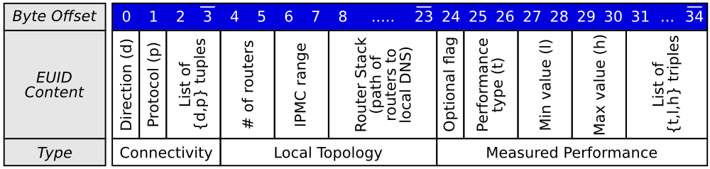
Environment identifier (EUID)
Kevlar Architecture
Environment identifier
Patch formation
Churn resilience
Associated with a NIC
  Captures Connectivity Options, Local Topology and Measured Performance
Basis of environmental rule of Multicast Protocol
  Judge the compatibility between a client and a certain patch running this protocol
Settings of
NAT,
Firewall
Network Location,
IPMC support
Latency ranges,
Bandwidth ranges,
Notes:
In Kevlar,
EUID is constructed value associated with each NIC, capturing the network properties including connectivity options, local topology and measured performance.
Also, EUID is the basis of environment rule of multicast protocol. In Kevlar, each protocol has a rule checking whether a new host is compatible with an existing multicast running this protocol. For example, the rule of IPMC needs to check whether the new host shares an IPMC enabled routing path to the running patch.

Slide 12
Decentralized patch formation
Kevlar Architecture
Environment identifier
Patch formation
Churn resilience
1
3
4
Contacts organization
  Uses anti-entropy
  gossip to gather patch
  information
Patch assignment
  Patches are ordered by the similarity of EUID value
  Locally checks the compatibility one by one
  Join the nearest compatible patch
  Create new one if none of existing patches are compatible
Difference of EUID value
2

Slide 13
Churn resilience
Kevlar Architecture
Environment identifier
Patch formation
Churn resilience
Global patch
  Regional patch uses
  Representative to
  bridge other patches
Churn happens in the global patch
  Internally fixed regional and global patch are disconnected
  Increase the number of Representatives
  Patch neighbors monitor the # of local Representatives
  Probabilistically self-promote as Representative based on the population
?
?
?
Notes:
As we mentioned earlier, to weave regional patches into a connected patchwork, representative nodes are selected from regional patch to form a global patch, running another multicast protocol inside. Current Kevlar uses OMNI Tree.
Even though existing’s multicasts can fix their own overlay (or IPMC does not need any fix) to overcome network churn, failures happen to the global patch could break its forwarding path to regional patches.
Here, look at this example,

Slide 14
Talk Overview
Motivation
Evaluation
Control Scenarios
Conclusion
Application
Kevlar
Overview
Kevlar Architecture
Notes:
Now we can talk about the evaluation.
We’ve evaluated Kevlar in a set of Control Scenarios and an Application scenario. In both cases, we separately run Kevlar, IPMC, Donet and OMNI Tree and compare their performances under the same settings.

Slide 15
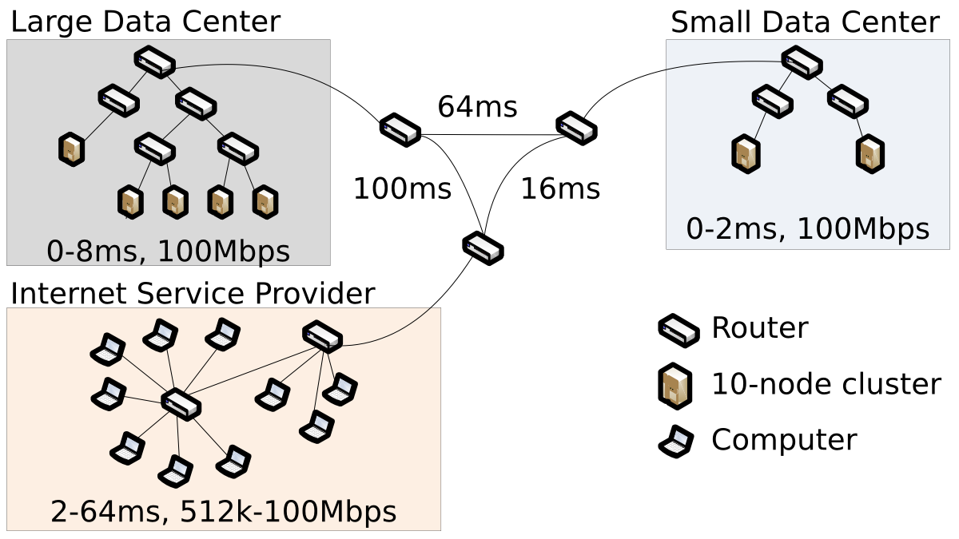
Experimental Topology
Testbed: 80 Windows XP machines on Deterlab
Typical Settings:
  IPMC is enabled within data centers
  Global IPMC is only enabled for computing the IPMC baseline
Notes:
To setup a wide-area topology which is similar to real internet, we used 80 windows machines in Deterlab and distributed them into different environments. They are a large data center, which usually hosts web content, an ISP including various types of clients and a small DC closer to ISP.
The three different networks are connected through 3 backbone routers. IPMC is enabled within data centers, and global IPMC is enabled only when checking the baseline for using IPMC across WAN.

Slide 16
Control Scenarios
Evaluating the Overlay Topology
  Tiny messages (10-byte payload), low rates (100 msgs/sec)
  Does Kevlar find low-latency paths?
  Does Kevlar use bandwidth efficiently?
Evaluating the Delivery Efficiency
  Constant stream of information
  Message sizes: 150, 1500, 15000 bytes.
  Message rates: 100, 300 Kbps, 1, 3, 10 Mbps
  How quickly are messages delivered to everyone?
Evaluating the Robustness
  Can Kevlar tolerate catastrophic node failures?
Notes:
In control scenarios we have done three types of evaluations:
By using low traffic, we try to exploit the overlay construction efficiency of kevlar against other protocols, in terms of finding low-latency paths and utilizing bandwidth.
We picked different types of constant streaming to evaluate real delivery speed of Kevlar.
The last one is robustness.

Slide 17
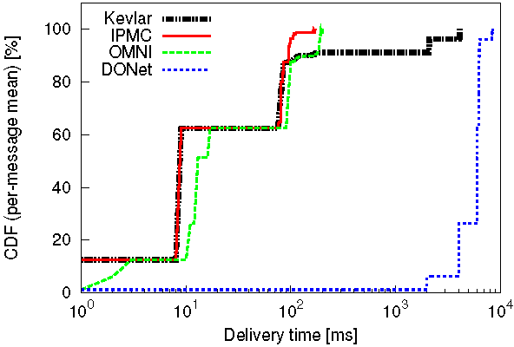
Control Scenarios
Control Scenarios
Topology
Delivery
Robustness
Does Kevlar find low-latency paths?
  Kevlar follows the ideal baseline (IPMC) except for ISP nodes
Reaches ISP
Baseline
Two Orders of magnitude
OMNI
Notes:
This graph is plotting the cumulative distribution function of average per-message delivery when running different protocols. While the Y axis shows the percentage of nodes that have received the message, the X axis is showing how much millisecond it has taken to reach the coverage. Need to note is that the X axis is in logarithmic order.
Remembering we only uses low traffic here, thus the delivery speed only depends on the latency of delivery path in the overlay.
As the red line shows, if IPMC is enabled across the WAN, it should be the fastest protocol, and here setsup a baseline for us. OMNI tree, as shown in the green line, works slower than baseline because even in Dces, it cannot utilize IPMC. But it is still faster than DONet due to its latency optimization. Donet as shown in the dashed blue line takes the longest time to deliver a single message.

Slide 18
Control Scenarios
Control Scenarios
Topology
Delivery
Robustness
Does Kevlar use bandwidth efficiently?
  An average Kevlar node forwards 1/5 of incoming traffic
  DONet balances load better for ISP than the OMNI Tree
  DONet more wasteful than OMNI across slow response
  links due to duplicate forwarding
Protocol | Forwarders [#] out of 80 nodes | Forwarding load per forwarder [%] | Forwarding load per node [%]
IPMC | 1 | 100 | 1.3
Kevlar | 12 | 135.3 | 20.3
OMNI | 20 | 400.0 | 100
DONet | 66 | 124.6 | 102.8

Slide 19
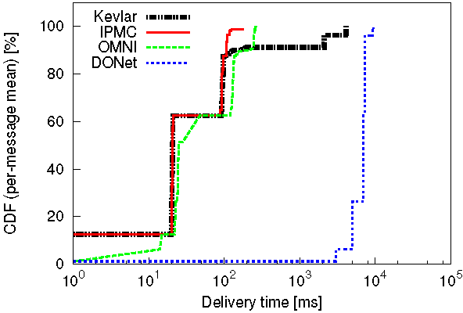
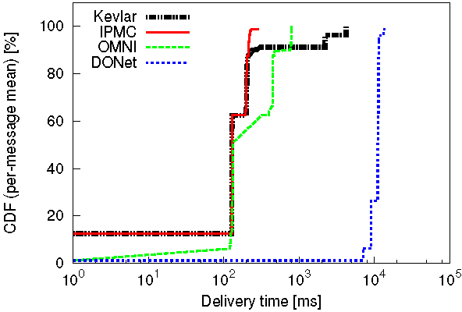
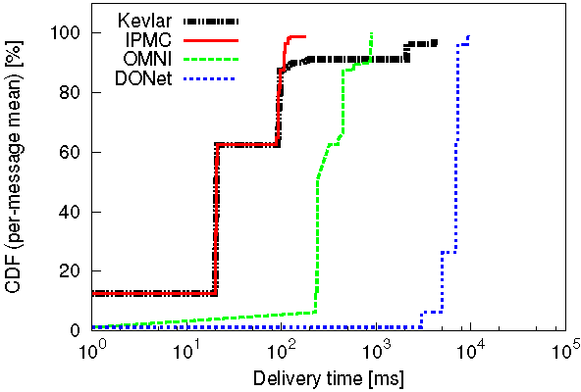
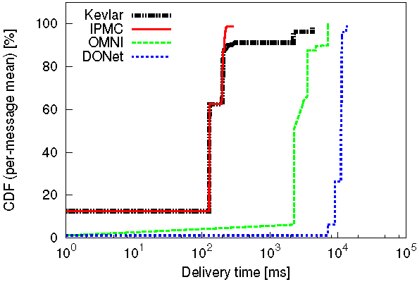
Control Scenarios
Control Scenarios
Topology
Delivery
Robustness
1500B
1Mbps
15KB
1Mbps
How quickly are messages delivered to everyone?
  Kevlar follows ideal IPMC; unaffected by bitrate unlike OMNI
1500B
10Mbps
15KB
10Mbps

Slide 20
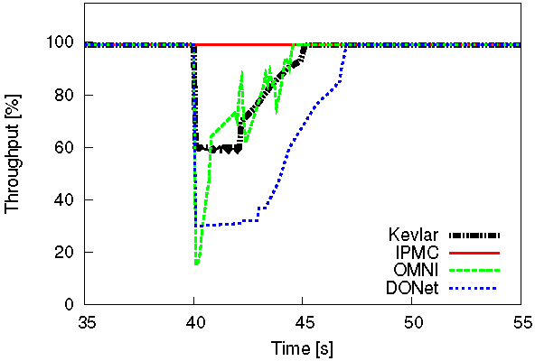
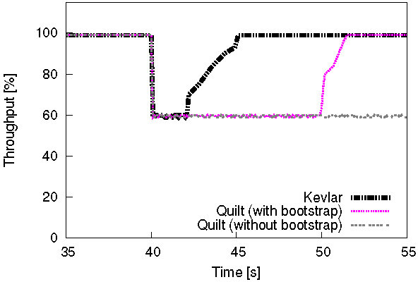
Robustness
Control Scenarios
Topology
Delivery
Robustness
50% of nodes die
50% of nodes die
  Can Kevlar tolerate catastrophic node failures?
  Kevlar recovers faster than DONet, suffers less than OMNI
  Kevlar can recover without Bootstrap server, unlike Quilt
    Kevlar uses gossip instead of the bootstrap server to form patches
Quilt, with server
DONet >7sec
Quilt, no server
OMNI < 20%
    Scenario with 1500 byte messages at 1 Mbps.

Slide 21
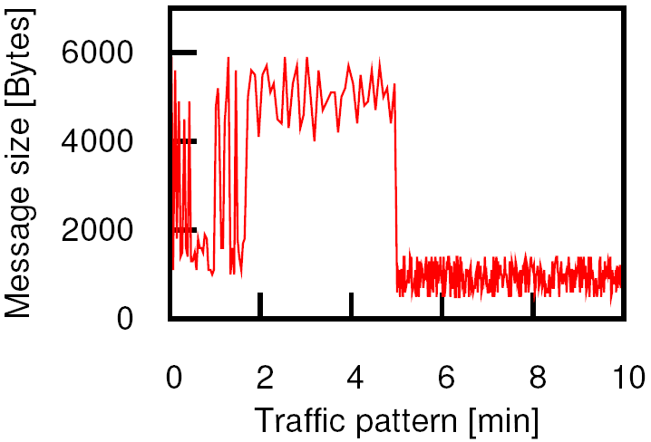
Evaluation of Custom Application atop Kevlar
Demo (from before)
  Uses services from Microsoft, Google, government, military
Evaluate the Delivery Efficiency
  User operations
  Various message sizes
  Various bitrates

Slide 22
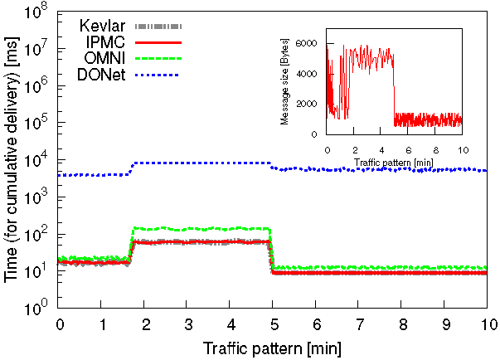
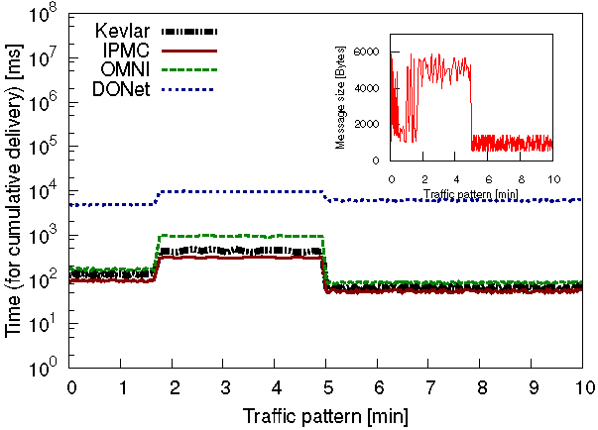
Evaluation of Custom Application atop Kevlar
50% nodes reached
90% nodes reached
Kevlar: tracks IPMC closely (up to 90% level)
OMNI: 3x higher latency than IPMC.
DONet: 50x-100x higher latency than IPMC, but less affected by bandwidth.
Notes:
Meaning of coverage, instead of using 100% of coverage

Slide 23
Conclusion
Kevlar innovates on several levels
  Flexible architecture for wide-area collaboration
  Easily extensible by the support of Live Objects
  Adaptive to diverse network environments
  Performs better than any single multicast solution
  Recovers from catastrophic failures
Kevlar is implemented, tested, and distributed
(under BSD license)
http://kevlar.cs.cornell.edu

Slide 24
Questions?
Dan Freedman and Ymir Vigfusson are on the job market!

