Slide 1





Reflection-Aware
Static Regression Test Selection
August Shi, Milica Hadzi-Tanovic,
Lingming Zhang, Darko Marinov, Owolabi Legunsen
OOPSLA 2019
Athens, Greece
October 23, 2019
CCF-1421503
CCF-1566589
CNS-1646305
CNS-1740916
CCF-1763788
CCF-1763906
Notes:
Owolabi is going to be faculty at Cornell

Slide 2





Development Cycle
Regression Testing
Too slow!
Version Control
4
Build
2
Fetch Changes
Test
CI Server
5
Pass/Fail
Commit Changes
3
1
?
6
Release/Deploy
Developers
Notes:
Software development in general happens in this cycle.
Developers are constantly changing their code, either by adding new features, optimizing existing ones, or indeed fixing bugs in the code.
Developers make changes to the code and commit those changes to version control.
Continuous integration then fetches the changes to build and test the latest code.
If the build passes, as in the code compiles and tests pass, then code can be released and deployed.
Otherwise, the developers get this feedback and must fix the code, making even more changes, to be built and tested again until the code can be deployed.
The checking of the quality of the software is here in the test part.
However, testing has two main problems:
The tests are unreliable, in the face of flaky tests, which give misleading results to developers, making them unsure if the code can be released and making them waste time if the tests actually should have passed and code should be deployed.
The tests are also slow, so waiting for the process to finish before deploying takes a long time.

Slide 3
Regression Testing is Slow!
Test suite is very large
  At Facebook, ~10⁴ tests run per change¹
Changes happen frequently
  At Google, 20+ code changes per minute²
Wasting developer time and machine time
Speed up using Regression Test Selection
¹Machalica et al., “Predictive Test Selection”, ICSE-SEIP 2019
²http://google-engtools.blogspot.com/2011/06/testing-at-speed-and-scale-of-google.html

Slide 4
Regression Test Selection (RTS)
Tests
Tests
Code Under Test
v1
T1
T2
T3
T4
…
TN
Code Under Test
v2
T1
T2
T3
T4
…
TN
Change
Many ways to do RTS

Slide 5
Static Regression Test Selection (SRTS)
Nodes are Java class files
Dependency edges are computed statically
(use edges, inheritance edges)
L
Library code
(infrequent changes)
Changed
A1
A2
A3
Developer’s code
Run
T1
T2
T3
Test code
Depends on
Notes:
<End with saving time by not running T1 and T2>

Slide 6
SRTS Pros and Cons (vs Dynamic RTS)
Dynamic RTS: Get dependencies from instrumented test runs
Pros (vs dynamic RTS)
  Can have very fast analysis (versus instrumentation)
  Does not need test runs to compute dependencies
Cons (vs dynamic RTS)
  Can over-approximate selected tests
    Prior work: end-to-end time similar to dynamic RTS¹
  Can under-approximate selected tests (miss bugs!)
Legunsen et al., “An Extensive Study of Static Regression Test Selection in Modern Software Evolution”, FSE 2016
Notes:
“Now, how does static RTS compare with dynamic RTS, which collects dependencies through instrumented test runs?”

Slide 7
Problem: Reflection makes SRTS unsafe
Reflection – programming language feature to examine/modify behavior at runtime
Reflection makes SRTS miss selecting tests!
Reflection Methods in Java:
String
Class.forName()
Class
String
ClassLoader.loadClass()
Class
String
ClassLoader.findSystemClass()
Class
byte[]
ClassLoader.defineClass()
Class

Slide 8
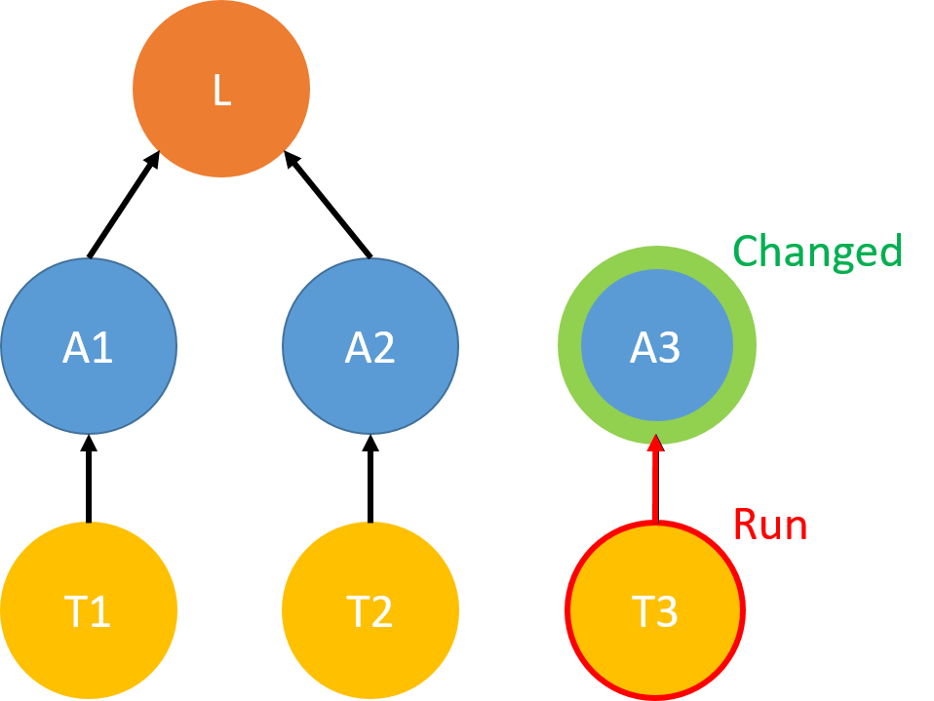
Example w/ Reflection
class L { // JSL class
public void p() {}
public void m(String s) {
Class c = Class.forName(s);
}
}
class A1 extends L {
public void m1() {
m(“A3”);
}
}
class T1 {
@Test public void t1() {
A1 a1 = new A1();
a1.m1();
}}
class A2 {
public static void m2() {
new L().p();
}
}
class T2 {
@Test public void t2() {
A2.m2();
}}
class T3 {
@Test public void t3() {
new A3();
}}
class A3 {
+ int x = 0;
}

Slide 9
Reflection-Aware SRTS
Reflection-Aware (RA) SRTS recovers edges:
  Purely static
    Naïve Analysis
    String Analysis
    Border Analysis
  Hybrid static + dynamic
    Dynamic Analysis
    Per-test Analysis
Upfront notice:
Results are unfortunately rather negative
Notes:
Reflection-awareness makes SRTS safer w.r.t. reflection (adds extra edges)

Slide 10
Naïve Analysis and String Analysis
Naïve Analysis: classes that use reflection method have edge to all other classes
String Analysis: use string analysis to approximate names of classes and add edges
Both ineffective for RTS!
  Select all tests after every change
  Due to full analysis of JSL
  See paper
Can we improve precision w/o full JSL analysis?

Slide 11
Border Analysis
Only few JSL methods lead to invoking a reflection method
Border Method – a public JSL method that may lead to invoking a reflection method
  A class that uses a border method can reach all other classes
How to determine border methods?

Slide 12
Finding Border Methods
Over-approximation
  Border methods are public JSL methods that reach reflection methods in call graph
    55,453 of 124,196 methods!
  Static Border Analysis
Under-approximation
  Border methods are the four reflection methods
    Missing indirect calls in JSL
  Four-method Border Analysis

Slide 13
Finding Border Methods (cont’d)
Dynamically determine per project
  Record border methods from instrumented test runs once per project, then reuse for later changes
  Purely static at selection time
  Dynamic Border Analysis
Stack Trace:
Border method
T1
Class.forName()
L.m()
A1.m1()
T1.t1()
Class.forName
First client method call

Slide 14
Border Analysis (Example)
Connect classes that call border method to all classes
L
A1.m1 calls
border method
L.m
Changed
A1
A2
A3
Run
Run
T1
T2
T3

Slide 15
How about using some dynamic information to do “hybrid” selection?

Slide 16
Dynamic Analysis (Example)
Find all classes used by reflection during test runs
During tests run, only reflected A3
L
Changed
A1
A2
A3
Run
Run
Run
T1
T2
T3

Slide 17
Per-test Analysis (Example)
Like Dynamic Analysis, but label edges with the individual tests
L
Edge only exists for T1
T1
Changed
A1
A2
A3
Run
Run
T1
T2
T3

Slide 18
Experimental Setup
Evaluation on 1173 revisions of 24 open-source Maven projects from GitHub
RQ1: Safety/precision of RA SRTS tests selected
RQ2: Safety/precision of RA SRTS dependencies
RQ3: RA SRTS percentage of tests selected
RQ4: RA SRTS end-to-end time
RQ5: Sizes of the graphs
See paper
Notes:
<Say that I will discuss exactly what safety/precision means later…>

Slide 19



RQ1: Safety/precision of tests selected
Compare safety/precision w.r.t. Ekstazi (state-of-the art dynamic RTS technique)
  Let $X$ be the set of tests selected by Ekstazi, and $T$ be the set of tests selected by our technique
$$X−T=\frac{|X\backslash T|}{|X∪T|}$$
$$T−X=\frac{|T\backslash X|}{|X∪T|}$$
Safety Viol. %:
Precision Viol. %:
 | X-RU | X-B_{d} | X-B_{s} | X-D | X-P
Avg | 5.8% | 3.0% | 3.0% | 3.1% | 4.9%
 | RU-X | B_{d}-X | B_{s}-X | D-X | P-X
Avg | 26.3% | 51.0% | 53.6% | 50.8% | 29.5%
B_{d} = Border Analysis (Dynamic)
B_{s} = Border Analysis (Static)
D = Dynamic Analysis
P = Per-test Analysis
Notes:
<Per-test is only a bit higher precision violation than RU>

Slide 20
Why Unsafe?
Four reasons for unsafety
  See paper
Test-order dependencies
  Specifically problem for Per-test Analysis

Slide 21
Test-Order Dependencies (Per-test)
class Server {
static Class sessClz;
static {
try {
sessClz = Class.forName(“SessImpl”);
} catch (Exception ex) {
…
}
}
}
class T1 {
@Test
public void t1()
throws Exception {
Server s = new Server();
…
}
class T2 {
@Test
public void t2()
throws Exception {
Server s = new Server();
…
}
Server
SessImpl
T1
T2
T1
T2
T2
T1
Different order,
different dependencies!

Slide 22
RQ4: End-to-end time
RU | 71.7%
B_{d} | 94.5%
B_{s} | 98.3%
D | 134.4%
P | 88.3%

Slide 23
RQ4: End-to-end time (offline)
Do not include
graph construction and instrumented run time
(all that can be “offline”)
Per-test seems reasonable
(but unsafe!)
RU | 69.1%
B_{d} | 85.8%
B_{s} | 89.1%
D | 91.2%
P | 75.8%
Notes:
<Don’t say “cheated” ☺>

Slide 24
Discussion
Results seem negative!
  RA SRTS is either impractical, or can be unsafe!
  Need RTS-specific reflection analysis
Other directions:
  Unsafe RTS is becoming used in industry, but how unsafe is it?
  Faster base RU RTS: reduce over-approximation?

Slide 25
Conclusions
Static RTS (SRTS) is unsafe due to reflection
Propose 5 reflection-aware SRTS techniques
  Three purely static, two hybrid static-dynamic
Reflection-aware SRTS is currently impractical
  End-to-end time is too high
  Fastest technique is still unsafe
Future: make RTS-specific reflection analysis
awshi2@illinois.edu

Slide 26
My Other Work
Flaky tests
Mutation
Testing
ICST 2019
ISSTA 2015
ICST 2019
ESEC/FSE 2019
ISSTA 2019
ICST 2016
ICST 2018
ISSRE 2016
ISSRE 2019
OOPSLA 2019
ASE 2016
ESEC/FSE 2015
ISSTA 2018
FSE 2016
FSE 2014
ICSE 2017
ICSE 2019
Regression
Test Selection
Test placement/
reduction
Notes:
My work broadly covers all of these parts of the testing process.
First, I work on proactively detecting and mitigating the effects of flaky tests, which are tests that can both pass and fail on the same version of the code, misleading developers.
I also work on ways to speed up the testing process, through regression test selection, or through optimizing test suites by test placement or test reduction.
Finally, I have some work on mutation testing, a commonly used technique in research for evaluating the quality of test suites.
I would be happy to discuss any of these topics with you, but today, for this presentation, I would like to focus specifically on flaky tests.

Slide 27
I will be on the job market!
August Shi
http://mir.cs.illinois.edu/awshi2
awshi2@illinois.edu

Slide 28
BACKUP

Slide 29
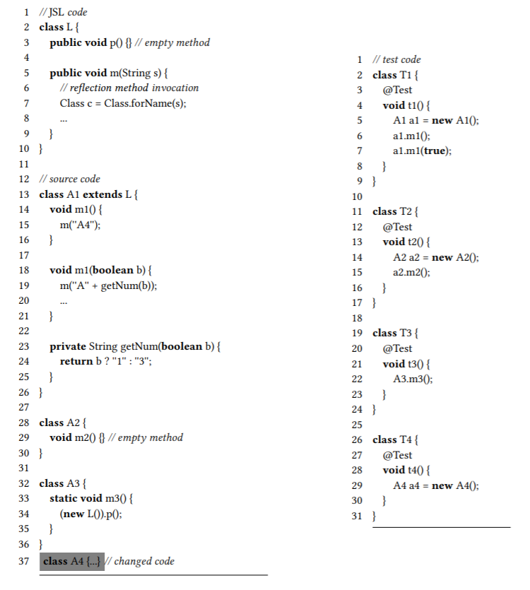
Example

Slide 30
Naïve Analysis (Example)
Classes that use reflection depend on all other classes
L
L uses Class.forName
Changed
A1
A2
A3
Run
Run
Run
T1
T2
T3

Slide 31
String Analysis (Example)
Use string analysis to approximate names of classes
Class.forName can receive “A1”, “A2”, “A3”
L
Changed
A1
A2
A3
Run
Run
Run
T1
T2
T3
Notes:
<Mention how String analysis has been used before for reflection-awareness of other static analyses>

Slide 32
Naïve and String Analysis: Ineffective
Select all tests after any change
Naïve Analysis over-approximates too much
String Analysis becomes similar to Naïve Analysis due to JSL analysis
  See paper
Can we improve precision w/o full JSL analysis?

Slide 33
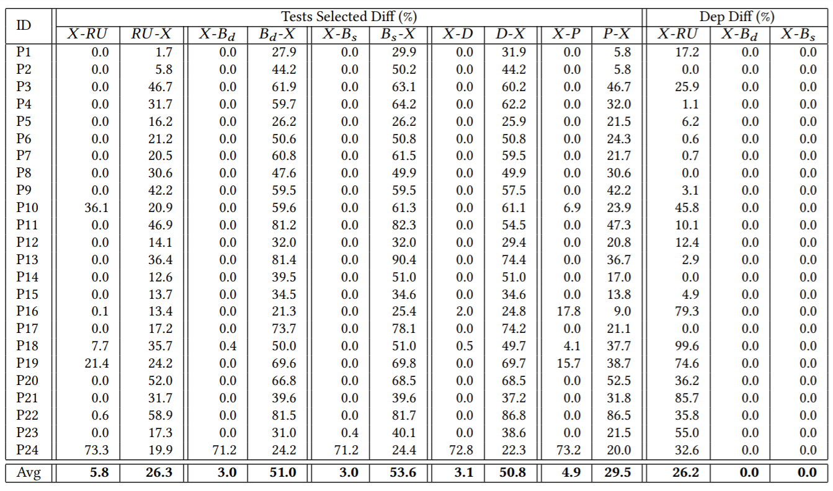
RQ1: Safety/precision of tests selected

Slide 34
Why Unsafe?
Ekstazi selects more than necessary
  Confirmed by Ekstazi developers
  RU safer than it seems
Timeouts
  Fewer tests actually run than selected
Nondeterministic generated files
  Different changes between techniques
Test-order dependencies (for Per-test Analysis)

Slide 35
RQ2: Safety/precision of dependencies
Fundamentally, tests may not be selected due to missing dependencies
What percentage of tests have missing computed dependencies (relative to Ekstazi)?
 | X-RU | X-B_{d} | X-B_{s}
Avg | 26.2% | 0.0% | 0.0%
RU SRTS can be worse than prior results suggest!

Slide 36
RQ3: Percentage of tests selected

