Slide 1

Bimanual Marking Menu For
Near Surface Interactions
François Guimbretière, Chau Nguyen
{francois, cnguyen}@cs.cornell.edu

Slide 2

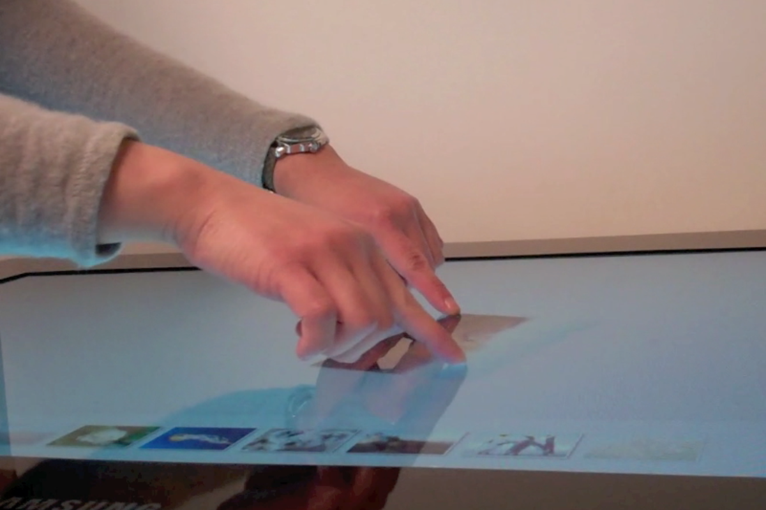
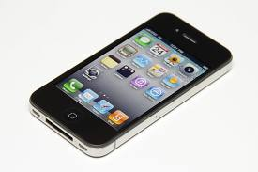
Multi-touch

Slide 3
Free Space
DepthTouch [Benko & Wilson, 2009]
Hand Menu Techniques [Bailey et al., INTERACT’11]
Vision based Hand Gesture Marking Menu [Lenman et al., NordiCHI’02]
rapMenu [Ni et al., 3DUI’08]

Slide 4
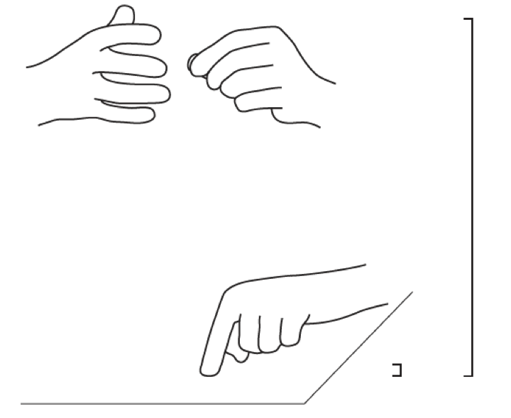
Motivations
Free Space
Surface
Hover Widgets [Grossman et al., CHI’06]

Slide 5
Notes:
Make a pause

Slide 6
Multi-finger pinch
Notes:
Make a pose

Slide 7
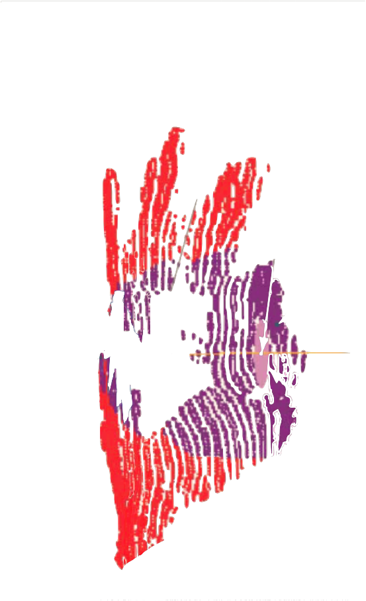
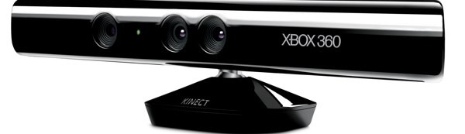
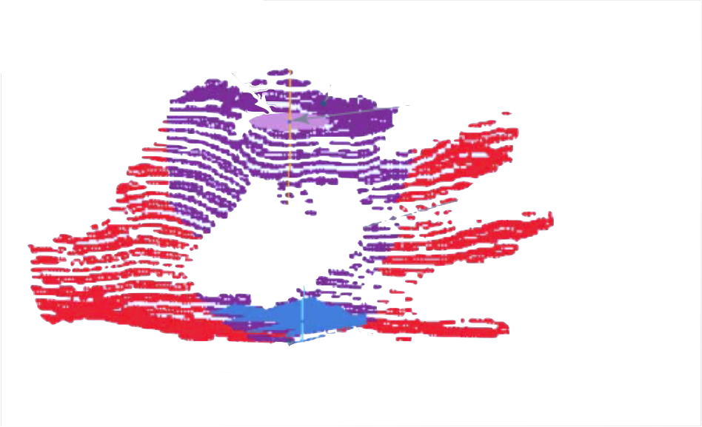
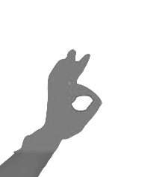
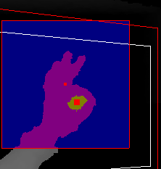
Implementations
Hand detector
Segmentation on
200 pixel wide box
Plane-fitting to
find hole’s plane
Index
93%
Re-projecting point cloud
Find palm’s plane
compute features
Multiclass
SVM
Middle
89%
Notes:
Make a pause

Slide 8
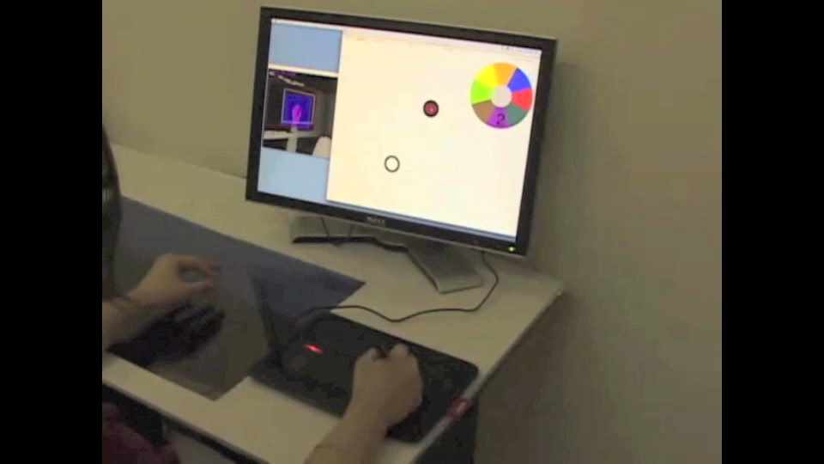
3D Bimanual Marking Menus
Notes:
Removed black at beginning

Slide 9
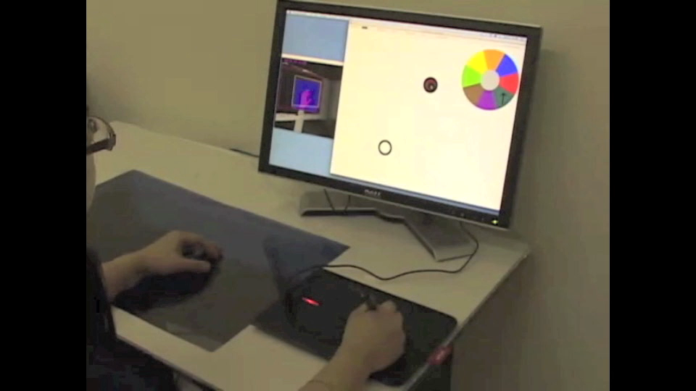
3D Bimanual Marking Menus
[Grosjean et al. ICMI’02] and [Grossman et al. CHI’08]

Slide 10
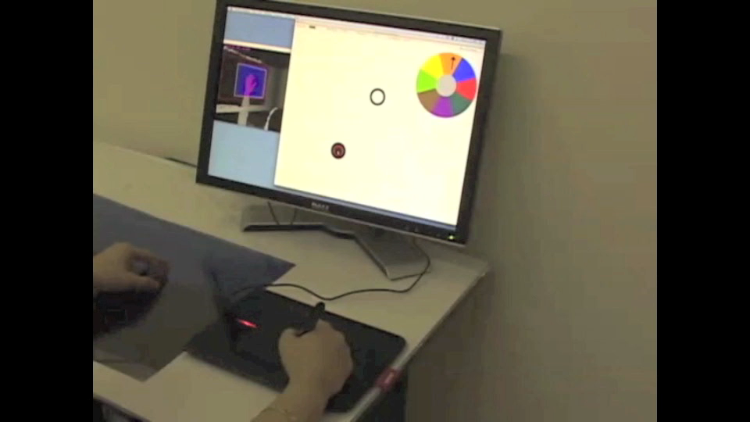
3D Bimanual Marking Menus

Slide 11
3D Bimanual Marking Menus
 | Pros | Cons
Layered | Most reliable | Layer locked early
Spherical | No early commit | Awkward downward markings
Hemi-spherical | No downward marking | Difficult to gauge upward angles
Notes:
Faster

Slide 12
Conclusions
Extra freedom to interaction design
Hand poses and hand movements in 3D space
2 different pinch types with up to 26 markings

Slide 13
Acknowledgments
This work is supported by National Science Foundation grant IIS-0936105.
We thank Shenwei Liu for providing the drawing application template and Corinna Lockenhoff for comments on earlier draft of this paper.

