Slide 1
A generic model to compose vision modules for holistic scene understanding
Adarsh Kowdle*, Congcong Li*,
Ashutosh Saxena, and Tsuhan Chen
Cornell University, Ithaca, NY, USA
*indicates equal contribution

Slide 2
Outline
Motivation
Model
Algorithm
Results and Discussions
Conclusions

Slide 3
Motivation

Slide 4
Motivation
Scene Understanding
Vision tasks are highly related.
But, how do we connect them?
Object Detection
Depth Estimation
S
E
Event Categorization
Scene Categorization
?
O
Saliency Detection
D
Geometric Layout
L
…

Slide 5
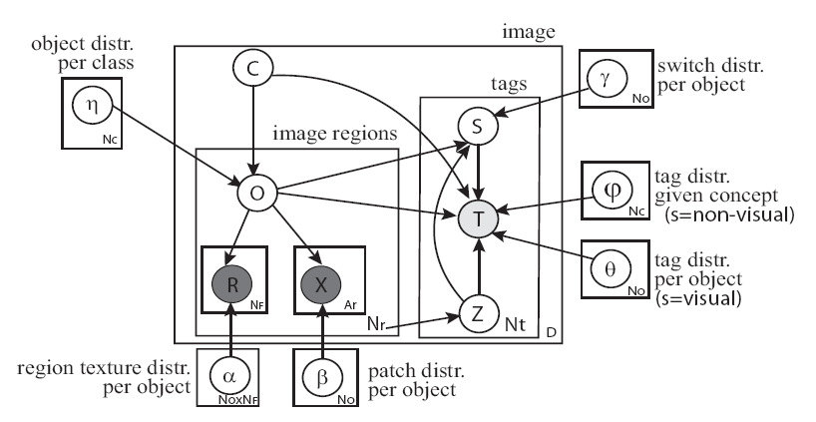
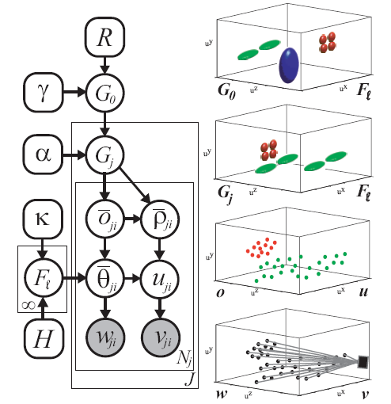
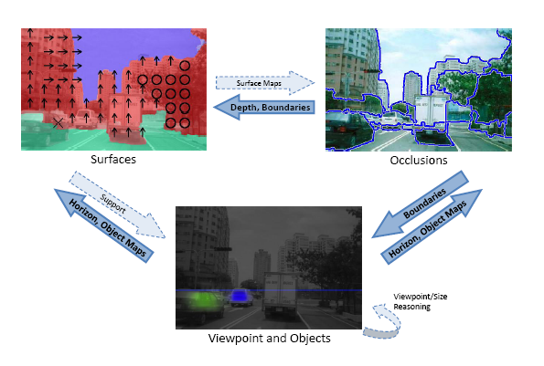
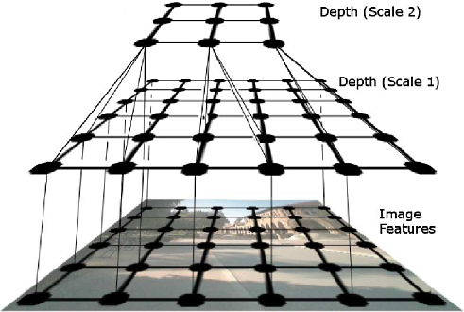
Motivation
Li et al, CVPR’09
Sudderth et al, CVPR’06
Saxena et al, IJCV’07
Hoiem et al, CVPR’08

Slide 6
Motivation
S
E
?
O
D
L
A generic model which can treat each classifier as a “black-box” and compose them to incorporate the additional information automatically

Slide 7
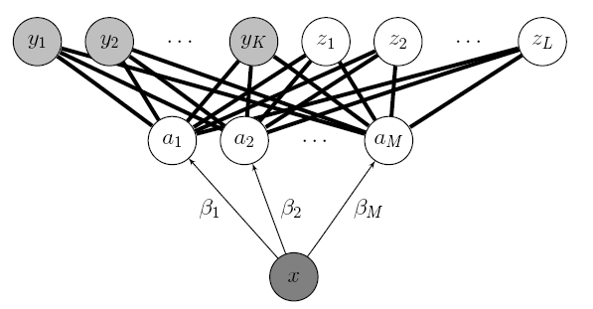
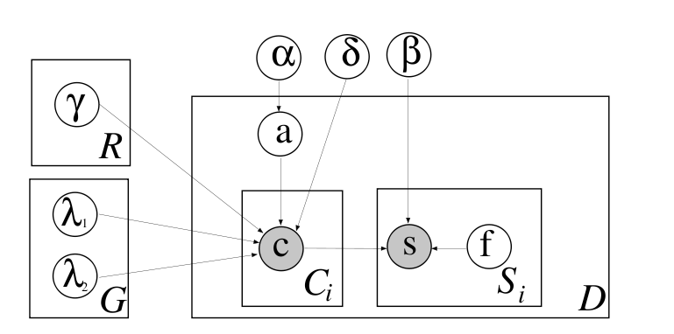
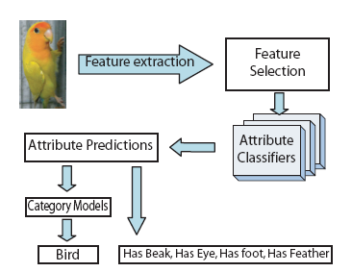
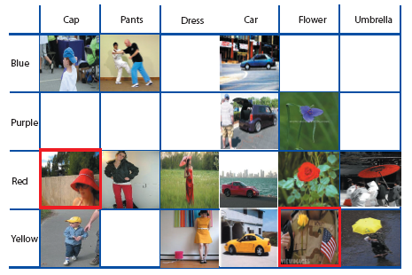
Motivation
Visual attributes
Lampert et al, CVPR’09
Ferrari et al, NIPS’07
Farhadi et al, CVPR’09
Wang et al, ICCV’09

Slide 8
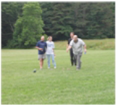
Motivation
Attributes for scene understanding?
A model which can compose the “black-box” classifiers and automatically exploit attributes for scene understanding
Bocce
“opencountry-like scene” attribute
“salient region” attribute
“depth in the middle region” attribute

Slide 9
Motivation
A model where the first layer is not trained to achieve the best independent performance, but achieve the best performance at the final output.
Cascaded classifier model (CCM)
Heitz, Gould, Saxena and Koller, NIPS’08
Features
φ_{S}(X)
φ_{D}(X)
φ_{E}(X)
φ_{Sal}(X)
First level of classifiers
Scene
Depth
Event
Saliency
?
?
?
?
Second level of classifier
Event
Feed-forward
Final output

Slide 10
Model

Slide 11
Model
Proposed generic model enables composing “black-box” classifiers
Feedback results in the first layer learning “attributes” rather than labels
Features
φ_{S}(X)
φ_{D}(X)
φ_{E}(X)
φ_{Sal}(X)
First level of classifiers
Scene
Depth
Event
Saliency
Second level of classifier
Event
Feed-forward
Feed-back
Attribute Learner
Final output

Slide 12
Algorithm

Slide 13
Algorithm
Features
φ_{S}(X^{(k)})
φ_{D}(X^{(k)})
φ_{E}(X^{(k)})
φ_{Sal}(X^{(k)})
First level of classifiers
Scene; θ_{S}
Depth; θ_{D}
Event; θ_{E}
Saliency; θ_{Sal}
T_{S}
T_{D}
T_{E}
T_{Sal}
Second level of classifier
Event; ω_{E}
Feed-forward
Feed-back
Y_{E}^{(k)}
(Output)
Optimization Goal

Slide 14
Algorithm
Features
φ_{S}(X^{(k)})
φ_{D}(X^{(k)})
φ_{E}(X^{(k)})
φ_{Sal}(X^{(k)})
First level of classifiers
Scene; θ_{S}
Depth; θ_{D}
Event; θ_{E}
Saliency; θ_{Sal}
θ_{S}
θ_{D}
θ_{E}
θ_{Sal}
T_{D}
T_{D}
T_{Sal}
T_{S}
T_{Sal}
T_{S}
T_{E}
T_{E}
Second level of classifier
Event; ω_{E}
Feed-forward
ω_{E}
Feed-back
Y_{E}^{(k)}
(Output)
Y_{E}^{(k)}
(Output)
Our Solution: Motivated from Expectation – Maximization (EM) algorithm
Parameter Learning: fix the required outputs and estimate parameters
Latent Variable Estimation: fix the model parameters and estimate latent variables (first level outputs)

Slide 15
Results and Discussion

Slide 16
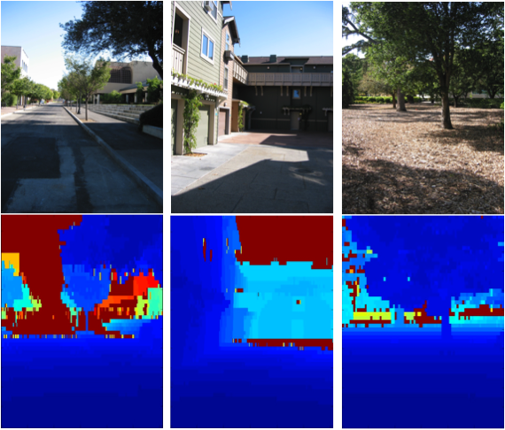
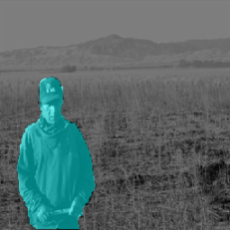
Experiments
S
D
E
Sal
S
D
E
Sal
S
E
Scene Categorization
Oliva et al, IJCV’01
Event Categorization
Li et al, ICCV’07
S
D
E
Sal
S
D
E
Sal
D
Sal
Depth Estimation - Make3D
Saxena et al, NIPS’05
Saliency Detection Achanta et al, CVPR’09

Slide 17
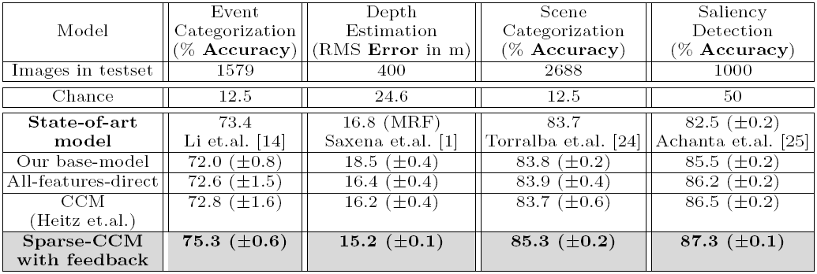
Results
Improvement on every task with the same algorithm!

Slide 18
Results: Visual improvements
Depth Estimation
Original image
Ground truth
Base – model
CCM [Heitz et. al]
Our proposed
Saliency Detection
Original image
Ground truth
Base – model
CCM [Heitz et. al]
Our proposed

Slide 19
Discussion – Attributes of the scene
Maps of weights given to depth maps for scene categorization task
S
D
E
Sal
S

Slide 20
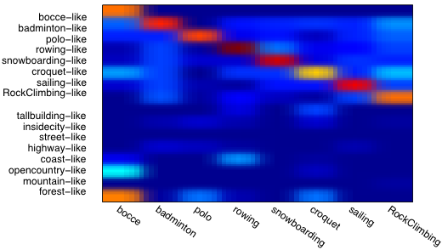
Discussion – Attributes of the scene
Weights given to event and scene attributes for event categorization
S
D
E
Sal
E

Slide 21
Conclusions

Slide 22
Conclusions
Generic model to compose multiple vision tasks to aid holistic scene understanding
“Black-box”
Feedback results in learning meaningful “attributes” instead of just the “labels”
Handles heterogeneous datasets
Improved performance for each of the tasks over state-of-art using the same learning algorithm
Joint optimization of all the tasks?
Congcong Li, Adarsh Kowdle, Ashutosh Saxena, and Tsuhan Chen, Feedback Enabled Cascaded Classification Models for Scene Understanding, NIPS 2010

Slide 23
Thank you
Questions?

Slide 25
Implementation
 | Event Categorization | Depth Estimation | Scene Categorization | Saliency Detection
Image Feature Vector | 51 – dim | 104 – dim | 512 – dim | 3 – dim
1st layer Output | 8 – dim class likelihood | Pixel level depth map | 8 – dim class likelihood | Pixel level saliency score
Layer-1 Classifier | Multi-class Logistic | Linear Regression | RBF – kernel SVM | Linear Regression
Layer-2 Classifier | Multi-class Logistic | Linear Regression | Multi-class Logistic | Linear Regression

Slide 26
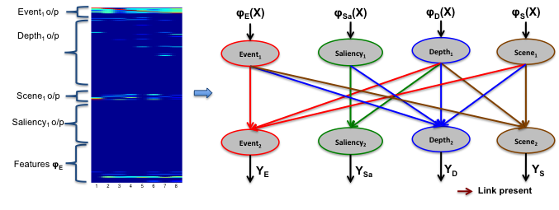
Discussion
Sparse model learnt by our model
Weights for
event categorization task

Slide 27
Discussion – Attributes of the scene
Maps of weights given to depth maps for event categorization task

Slide 28
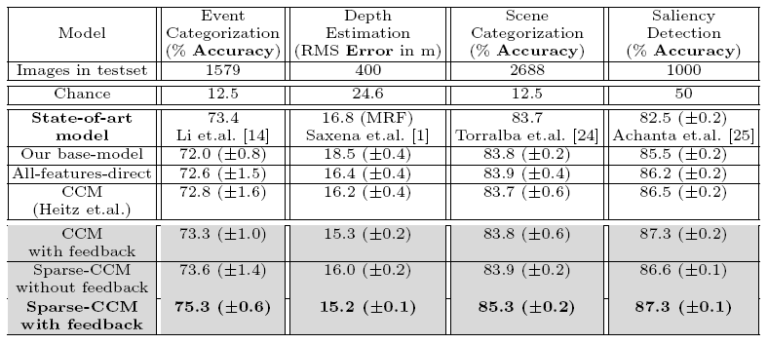
Results
Improvement on every task with the same model!

