Slide 1

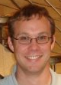

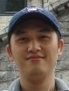

The Gossip Objects (GO) Platform
Ýmir Vigfússon
IBM Research
Haifa Labs
Ken Birman
Cornell University
Qi Huang
Cornell University
Deepak Nataraj
Cornell University

Slide 2

Gossip
Def: Exchange information with a random node once per round.
Has appealing properties:
  Bounded network traffic.
  Scalable in group size.
  Robust against failures.
  Simple to code.
Per-node scalability?
  When # of groups scales up, lose

Slide 3
The GO Platform
App
App
App
App
GO Platform
Rumor
Queue
Gossip Mechanism
Event Loop
GO Heuristic
Neighbor
Lists
Node
Network

Slide 4
Random gossip
Recipient selection:
  Pick node d uniformly at random.
Content selection:
  Pick a rumor r uniformly at random.

Slide 5
Observations
Gossip rumors usually small:
  Incremental updates.
  Few bytes hash of actual information.
Packet size below MTU irrelevant.
  Stack rumors in a message.
  But which ones?

Slide 6
Random gossip w/stacking
Recipient selection:
  Pick node d uniformly at random.
Content selection:
  Fill packet with rumors picked uniformly at random.

Slide 7
Further ingredients
Rumors can be delivered indirectly.
  Uninterested node might forward to an interested one.
  Could use longer dissemination paths.
Traffic adaptivity.
  Some groups have more to talk about than others.
  Could monitor traffic and optimize to allocate bandwidth.

Slide 8
GO Heuristic
Recipient selection:
  Pick node d biased towards higher group traffic.
Content selection:
  Compute the utility of including rumor r
    Probability of r infecting an uninfected host when it reaches the target group.
  Pick rumors to fill packet with probability proportional to utility.

Slide 9



GO Heuristic
Recipient selection:
  Pick node d biased towards higher group traffic.
Content selection:
  Compute the utility of including rumor r
    Probability of r infecting an uninfected host when it reaches the target group.
  Pick rumors to fill packet with probability proportional to utility.
Target group of r
Include r ?

Slide 10
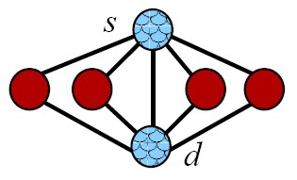
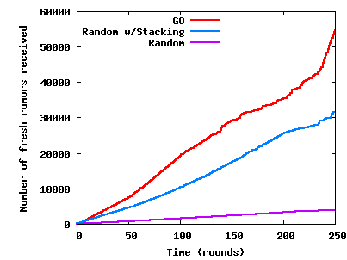
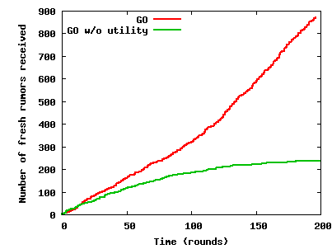
Simulation
Simulated but ‘clean’ topology shows benefit of the GO strategy.
Topology
Rumors delivered indirectly
Individual rumors delivered

Slide 11
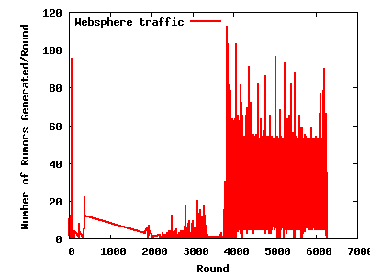
Real-world Evaluation
55 minute trace of the IBM WebSphere Virtual Enterprise (WVE) Bulletin Board layer.
  127 nodes and 1364 groups
Rumors generated per round in the trace

Slide 12
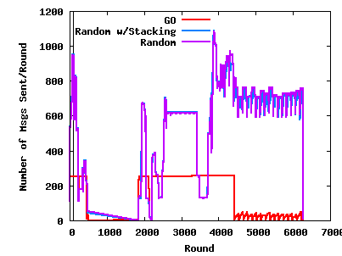
Real-world Evaluation
IBM WVE trace (127 nodes, 1364 groups)
Network traffic

Slide 13
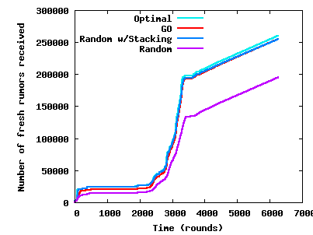
Real-world Evaluation
IBM WVE trace (127 nodes, 1364 groups)
Individual rumors delivered

Slide 14
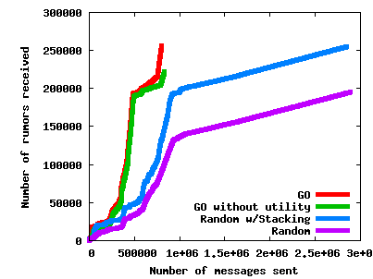
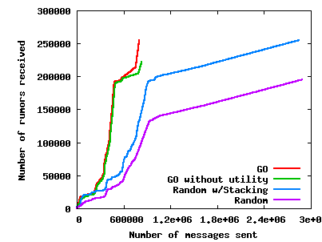
Real-world Evaluation
IBM WVE trace (127 nodes, 1364 groups)
Individual rumors delivered
vs. messages sent

Slide 15
Conclusion
GO implements novel ideas:
  Per-node gossip platform.
  Rumor stacking.
  Utility-based rumor dissemination.
  Traffic adaptivity.
GO gives per-node guarantees.
  Even when the # of groups scales up.
Experimental results are compelling.
  We plan to use GO as the transport for the Live Objects platform.

