Slide 1
Towards Decoupling Storage and Computation in Hadoop with SuperDataNodes
George Porter* <gmporter@cs.ucsd.edu>
Center for Networked Systems
U. C. San Diego
LADIS 2009 / Big Sky, MT
* Work performed at Sun Labs, Burlington, MA.
Notes:
AMDG

Slide 2
Data-intensive computing and
Hadoop is growing, gaining adoption, and used in production:
Facebook imports 25 TB/day to 1K Hadoop nodes
A key to that growth and efficiency relies on coupling compute and storage
Benefits of moving computation to data
Scheduling, locality, reduce network traffic, map parallelism
‘Grep’ type workloads especially
Notes:
Volume of data growing at a staggering rate
need to process it becomes increasingly important
Hadoop—open source, based on M/R
Growing in adoption and features (getting more mature)
Jeff Rothschild
Clear that there are lots of benefits

Slide 3
When to couple storage with computation?
Critical (yet complicated) design decision
Emerging best practices with dedicated clusters
Your datacenter design may not be based on needs of Hadoop
Adding Map/Reduce functionality to existing cluster
Small workgroups who like the programming model
Pig, Hive, Mahout…
Mixture may change over time
Non-uniform data access patterns
Desire to power down some compute functionality during periods of low utilization
Without affecting storage functionality
Notes:
2) e.g., Cloudera
3) “long tail” Design may be different than if you were building a cluster from scratch

Slide 4
Goal
Support late binding between storage and computation
Explore alternative balances between the two
Specifically the extreme point of separating all storage from the workers and consolidating it into a SuperDataNode (SDN)
Facebook observations:
Small and medium sized jobs exhibit large rack-local workers, but not node-local workers
Non-goal: Replacing traditional Hadoop deployments
Notes:
10,000 map job: 95+ rack; 90+ node
1,000 map job: 95+ rack; 75+ node
100 map job: 90+ rack; 25+ node
“Job Scheduling for Multi-User MapReduce Clusters”, Matei Zaharia Dhruba Borthakur Joydeep Sen Sarma Khaled Elmeleegy Scott Shenker Ion Stoica, April 2009.

Slide 5
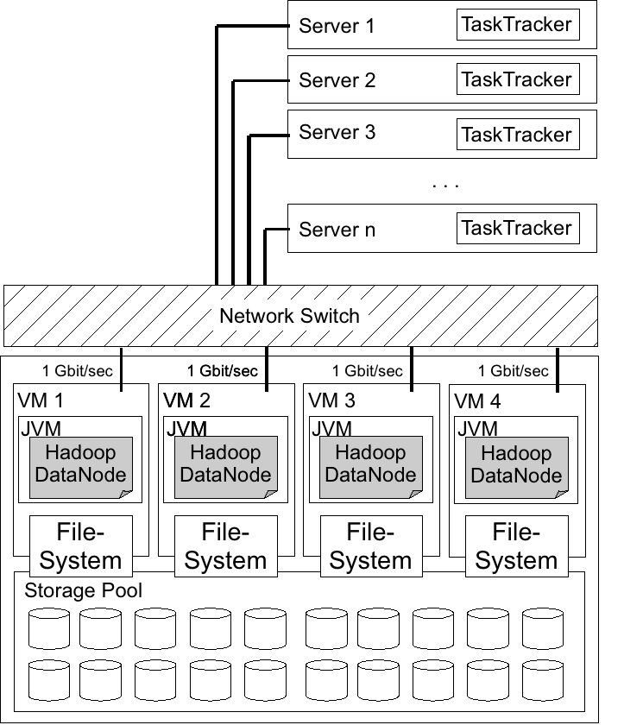
SuperDataNode Approach
Key Features
“Stateless” worker tier
Storage node with shared pool of disks under single O/S
O/S as central broker of disk requests
High bisection bandwidth to worker tier
4x1GigE; 10GigE
Artifacts of my experiments
Per net-interface VM exporting virtual storage nodes

Slide 6
Advantages
Decouple amount of storage from number of worker nodes
More intra-rack bandwidth than inter-rack bandwidth
Support for “archival” data
Subset of data with low probability of access
Increased uniformity for job scheduling and block placement
Ease of management
Workers become stateless; SDN management similar to that of a regular storage node
Replication only for node failures
Notes:
Archival: not as much cpu/bit needed
Stateless workers ideal for virtualization

Slide 7
Limitations
Scarce storage bandwidth between workers and SDN
Effective throughput with N disks in SDN (@ 100MB/sec each)
1:N ratio of bandwidth between local and remote disks
4 Gbit/sec: min(100N, 400/N) MB/sec
10 Gbit/sec: min(100N, 1000/N) MB/sec
Effect on fault-tolerance
Disk vs Node vs Link failure model
Replication
Cost
Performance depending on the workload
Notes:
2) Hadoop doesn’t differentiate b/w types of failures

Slide 8
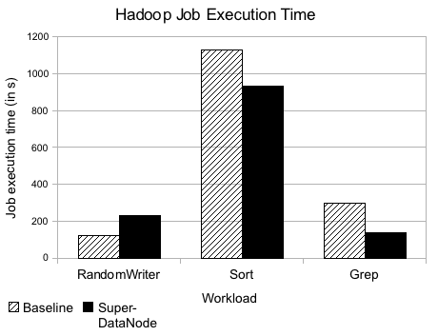
Evaluation
Baseline
10 1u servers, 2 disks each for data w/ ZFS; worker and storage node co-located
Experimental setup
10 1u servers with no data; 20 disks in SDN w/ ZFS (Thumper successor); 4 virtual datanodes in SDN
Observations
RandonWriter exhibits perfect parallelism and 100% local-only write behavior (worst case against SDN)
Notes:
1:5 ratio of local vs remote
Next slide: Why do we do better with sort and grep??

Slide 9
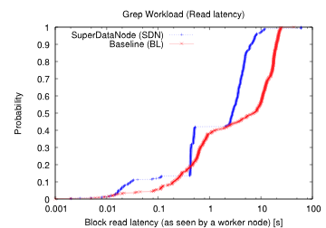
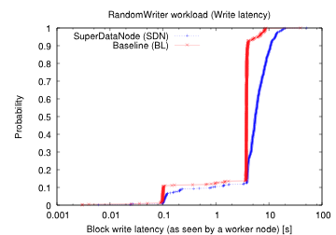
Impact of O/S on the disk pool
Isolate block read/write latency within the host only
Ignoring network, JVM, Map function, …
Instrumented HDFS data path with X-Trace events
Management of a central pool of disks based on visibility of every node using the SDN
Notes:
Grep and sort very similar

Slide 10
Related Work
Advantages of moving computation towards the data [Jim Gray, Queue, 2008]
FAWN: A Fast Array of Wimpy Nodes [SOSP09]
Archival workloads [SAM/QFS]
Deployed Hadoop installations
3800 node Terasort [Yahoo]
Counterpoint to the storage-to-I/O balance [Joseph M. Hellerstein]
As a service on EC2 [http://aws.amazon.com]

Slide 11
Conclusions
Choosing the balance of storage to computation critical
Performance, efficiency, power, job scheduling
Desire mechanism to delay this binding until runtime and decouple the two
Can support changing storage/CPU ratios, new datasets and workloads, conserve power during periods of low demand, greater management flexibility
Comparable performance for a variety of workloads

Slide 12
Discussion
Thank you
Thanks to Hsianglung Wu, Matei Zaharia, Steve Heller

