Slide 1
Storing and Accessing Live Mashup Content in the Cloud
Krzysztof Ostrowski, Ken Birman
Cornell University
{krzys|ken}@cs.cornell.edu

Slide 2
Agenda

Slide 3
Agenda
A new, versatile storage abstraction:
Checkpointed Channel (CC)
A new web application architecture:
A web of (hyperlinked) CCs

Slide 4
Introduction

Slide 5
Storing Content in the Cloud
content
edge
cloud
server in a
data center
client-server
interactions

Slide 6
Storing Content in the Cloud
content
edge
cloud
server in a
data center
client-server
interactions

Slide 7
Storing Content in the Cloud
content
edge
cloud
server in a
data center
client-server
interactions

Slide 8
Storing Content in the Cloud
content
edge
cloud
server in a
data center
client-server
interactions

Slide 9
Storing Content in the Cloud
content
edge
cloud
server in a
data center
client-server
interactions

Slide 10
Storing Content in the Cloud
content
edge
cloud
server in a
data center
client-server
interactions

Slide 11
Storing Content in the Cloud
content
edge
cloud
server in a
data center
client-server
interactions

Slide 12
Storing Content in the Cloud
content
update relayed through the server
server in a
data center
client-server
interactions

Slide 13
Storing Content in the Cloud
content
edge
cloud
server in a
data center
explicit request,
e.g. HTTP GET

Slide 14
http://liveobjects.cs.cornell.edu

Slide 15
Storing Content at the Edge
content
replica
edge
server in a
data center
peer-to-peer
interactions
content
replica
content
replica

Slide 16
Storing Content at the Edge
content
replica
edge
server in a
data center
peer-to-peer
interactions
content
replica
content
replica

Slide 17
Storing Content at the Edge
content
replica
edge
server in a
data center
peer-to-peer
interactions
content
replica
content
replica

Slide 18
Storing Content at the Edge
content
replica
edge
server in a
data center
peer-to-peer
interactions
content
replica
content
replica

Slide 19
Storing Content at the Edge
content
replica
edge
updated
server in a
data center
peer-to-peer
interactions
content
replica
content
replica

Slide 20
Storing Content at the Edge
content
replica
edge
updated
server in a
data center
multicast
peer-to-peer
interactions
content
replica
content
replica

Slide 21
Storing Content at the Edge
content
replica
edge
updated
server in a
data center
updated
updated
content
replica
content
replica

Slide 22
Storing Content at the Edge
content
replica
edge
server in a
data center
replicated state
machine
content
replica
content
replica

Slide 23
Storing Content at the Edge
content
replica
edge
server in a
data center
manage
membership
content
replica
content
replica

Slide 24
Storing Content at the Edge
edge
server in a
data center
control
data

Slide 25
Storing Content at the Edge
edge
server in a
data center
control
data

Slide 26
Cloud vs. Edge?
content
replica
content
edge
edge
cloud
server in a
data center
server in a
data center
peer-to-peer
interactions
client-server
interactions
content
replica
content
replica

Slide 27
Cloud vs. Edge?
edge
server in a
data center

Slide 28
Cloud vs. Edge?
edge
server in a
data center

Slide 29
Cloud vs. Edge?
edge
server in a
data center

Slide 30
Cloud vs. Edge?
edge
server in a
data center
no replicas left

Slide 31
Cloud vs. Edge?
content
bottleneck
edge
cloud
server in a
data center
client-server
interactions
flow of
updates

Slide 32
Cloud vs. Edge?
content
bottleneck
edge
cloud
server in a
data center
client-server
interactions
flow of
updates

Slide 33
Cloud vs. Edge?
content
bottleneck
edge
cloud
server in a
data center
client-server
interactions
flow of
updates

Slide 34
Cloud vs. Edge?
content
bottleneck
edge
cloud
server in a
data center
client-server
interactions
flow of
updates

Slide 35
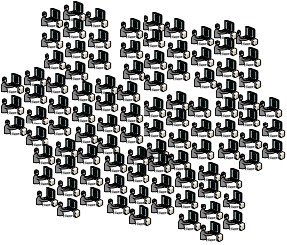

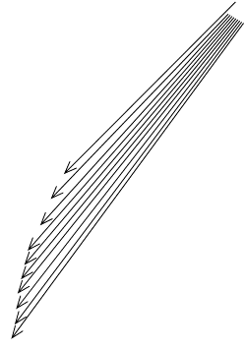
Cloud vs. Edge?
content
bottleneck
edge
cloud
server in a
data center
client-server
interactions
flow of
updates

Slide 36
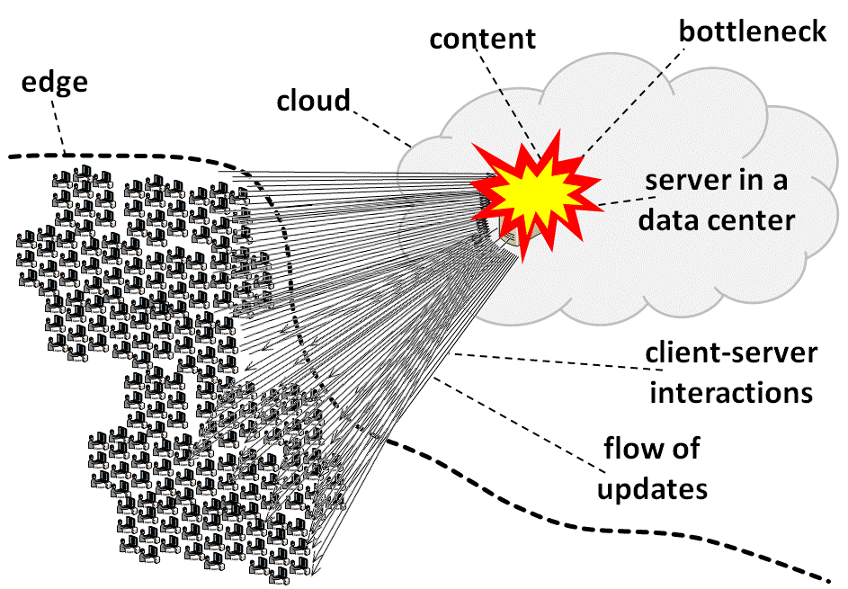
Cloud vs. Edge?
Server capacity:
SecondLife: ~40 clients/server
Second Life and the New Generation of Virtual Worlds.
S. Kumar et al. 2008. IEEE Computer, 41(9):46-53

Slide 37

Cloud vs. Edge?
Server capacity:
SecondLife: ~40 clients/server
virtual
island

Slide 38
Cloud ♥ Edge?
persistence
and
scalability
content
replica
content
edge
edge
cloud
+
server in a
data center
server in a
data center
peer-to-peer
interactions
client-server
interactions
content
replica
content
replica

Slide 39
Extending Cloud to the Edge
edge
cloud
server

Slide 40
Extending Cloud to the Edge
edge
cloud
server

Slide 41
Extending Cloud to the Edge
cloud
content
server
client-server
interactions
peer-to-peer
interactions
content

Slide 42
Extending Cloud to the Edge
cloud
content
server
distributed
protocol
(client-server,
peer-to-peer, etc.)
client-server
interactions
peer-to-peer
interactions
content

Slide 43
Extending Cloud to the Edge
edge
cloud
server

Slide 44
Edge is Larger than the Cloud
There are:
40+ times more PCs than servers (billions today, to double in five years)
2000+ client PCs per Google server
40,000+ times more client PCs purchased each year by home users than new servers purchased each year by Microsoft
=> a lot of computational power and resources at the edge that are greatly underutilized

Slide 45
Edge is Larger than the Cloud
There are:
40+ times more PCs than servers (billions today, to double in five years)
2000+ client PCs per Google server
40,000+ times more client PCs purchased each year by home users than new servers purchased each year by Microsoft
=> a lot of computational power and resources at the edge that are greatly underutilized

Slide 46
Edge is Larger than the Cloud
There are:
40+ times more PCs than servers (billions today, to double in five years)
2000+ client PCs per Google server
40,000+ times more client PCs purchased each year by home users than new servers purchased each year by Microsoft
=> a lot of computational power and resources at the edge that are greatly underutilized

Slide 47
Edge is Larger than the Cloud
There are:
40+ times more PCs than servers (billions today, to double in five years)
2000+ client PCs per Google server
40,000+ times more client PCs purchased each year by home users than new servers purchased each year by Microsoft
=> a lot of computational power and resources at the edge that are greatly underutilized

Slide 48
Edge is Larger than the Cloud
There are:
40+ times more PCs than servers (billions today, to double in five years)
2000+ client PCs per Google server
40,000+ times more client PCs purchased each year by home users than new servers purchased each year by Microsoft
=> a lot of computational power and resources at the edge that are greatly underutilized

Slide 49
New Storage Abstraction
Unify different content access models:
Centralized vs. replicated
Centralized: web service, database
Replicated: distributed P2P replication protocols
Persistent vs. temporary
Persistent: server in a data center
Temporary: collaboration session formed ad hoc
Server-side vs. client-side
Shared public vs. shared private
Public: web service or collaboration session
Private: session state, cookies, etc.
Stateful vs. stateless
Stateful: variables, files, objects, database tables
Stateless: video or notification streams

Slide 50
New Storage Abstraction
Unify different content access models:
Centralized vs. replicated
Centralized: web service, database
Replicated: distributed P2P replication protocols
Persistent vs. temporary
Persistent: server in a data center
Temporary: collaboration session formed ad hoc
Server-side vs. client-side
Shared public vs. shared private
Public: web service or collaboration session
Private: session state, cookies, etc.
Stateful vs. stateless
Stateful: variables, files, objects, database tables
Stateless: video or notification streams

Slide 51
New Storage Abstraction
Unify different content access models:
Centralized vs. replicated
Centralized: web service, database
Replicated: distributed P2P replication protocols
Persistent vs. temporary
Persistent: server in a data center
Temporary: collaboration session formed ad hoc
Server-side vs. client-side
Shared public vs. shared private
Public: web service or collaboration session
Private: session state, cookies, etc.
Stateful vs. stateless
Stateful: variables, files, objects, database tables
Stateless: video or notification streams

Slide 52
New Storage Abstraction
Unify different content access models:
Centralized vs. replicated
Centralized: web service, database
Replicated: distributed P2P replication protocols
Persistent vs. temporary
Persistent: server in a data center
Temporary: collaboration session formed ad hoc
Server-side vs. client-side
Shared public vs. shared private
Public: web service or collaboration session
Private: session state, cookies, etc.
Stateful vs. stateless
Stateful: variables, files, objects, database tables
Stateless: video or notification streams

Slide 53
New Storage Abstraction
Unify different content access models:
Centralized vs. replicated
Centralized: web service, database
Replicated: distributed P2P replication protocols
Persistent vs. temporary
Persistent: server in a data center
Temporary: collaboration session formed ad hoc
Server-side vs. client-side
Shared public vs. shared private
Public: web service or collaboration session
Private: session state, cookies, etc.
Stateful vs. stateless
Stateful: variables, files, objects, database tables
Stateless: video or notification streams

Slide 54
New Storage Abstraction
Unify different content access models:
Centralized vs. replicated
Centralized: web service, database
Replicated: distributed P2P replication protocols
Persistent vs. temporary
Persistent: server in a data center
Temporary: collaboration session formed ad hoc
Server-side vs. client-side
Shared public vs. shared private
Public: web service or collaboration session
Private: session state, cookies, etc.
Stateful vs. stateless
Stateful: variables, files, objects, database tables
Stateless: video or notification streams

Slide 55
http://liveobjects.cs.cornell.edu

Slide 56
Checkpointed Channels (CC)

Slide 57
Architecture

Slide 58
Architecture

Slide 59
Architecture

Slide 60
Architecture

Slide 61
Architecture

Slide 62
Architecture
network
messages

Slide 63
content physically resides outside the channel…
…but it could also be cached in it
the edge may “cut through” the channel

Slide 64
content physically resides outside the channel…
…but it could also be cached in it
the edge may “cut through” the channel

Slide 65
content physically resides outside the channel…
…but it could also be cached in it
the edge may “cut through” the channel

Slide 66
Interfaces
Checkpointed Communication Channel (CC)
a writable stream of checkpoints and updates

Slide 67
Interfaces
Checkpointed Communication Channel (CC)
a writable stream of checkpoints and updates

Slide 68
Interfaces
Checkpointed Communication Channel (CC)
a writable stream of checkpoints and updates

Slide 69
Interfaces
Checkpointed Communication Channel (CC)
a writable stream of checkpoints and updates

Slide 70
Interfaces
Checkpointed Communication Channel (CC)
a writable stream of checkpoints and updates

Slide 71
Interfaces
Checkpointed Communication Channel (CC)
a writable stream of checkpoints and updates

Slide 72
Dynamics (local)
Checkpointed Communication Channel (CC)
initial checkpoint
C
U
U
U
U

Slide 73
Dynamics (local)
Checkpointed Communication Channel (CC)
initial checkpoint
multiple updates
C
U
U
U
U

Slide 74
Dynamics (local)
Checkpointed Communication Channel (CC)
initial checkpoint
multiple updates
C
U
U
U
U

Slide 75
Interfaces
Checkpointed Communication Channel (CC)
a writable stream of checkpoints and updates

Slide 76
Dynamics (local)
Checkpointed Communication Channel (CC)
U
U
U
updates

Slide 77
Dynamics (local)
Checkpointed Communication Channel (CC)
U
U
U
updates

Slide 78
Interfaces
Checkpointed Communication Channel (CC)
a writable stream of checkpoints and updates

Slide 79
Interfaces
Checkpointed Communication Channel (CC)
a writable stream of checkpoints and updates

Slide 80
Interfaces
Checkpointed Communication Channel (CC)
a writable stream of checkpoints and updates

Slide 81
Dynamics (local)
Checkpointed Communication Channel (CC)
request
checkpoint
R

Slide 82
Dynamics (local)
Checkpointed Communication Channel (CC)
request
checkpoint
R

Slide 83
Dynamics (local)
Checkpointed Communication Channel (CC)
C
checkpoint

Slide 84
Dynamics (local)
Checkpointed Communication Channel (CC)
C
checkpoint

Slide 85
Dynamics (global)
Checkpointed Channel (CC)

Slide 86
Dynamics (global)
Checkpointed Channel (CC)
connect

Slide 87
Dynamics (global)
Checkpointed Channel (CC)
connect
initialize

Slide 88
Dynamics (global)
connect
initialize
need
checkpoint

Slide 89
Dynamics (global)
initialize
R
need
checkpoint

Slide 90
Dynamics (global)
request
checkpoint
need
checkpoint

Slide 91
Dynamics (global)
request
checkpoint
R

Slide 92
Dynamics (global)
initialize
request
checkpoint
need
checkpoint
R

Slide 93
Dynamics (global)
request
checkpoint
need
checkpoint
provide
checkpoint

Slide 94
Dynamics (global)
request
checkpoint
checkpoint
C
provide
checkpoint

Slide 95
Dynamics (global)
checkpoint
C
provide
checkpoint

Slide 96
Dynamics (global)
transfer
checkpoint
C

Slide 97
Dynamics (global)
transfer
checkpoint
C

Slide 98
Dynamics (global)
checkpoint
C
transfer
checkpoint

Slide 99
Dynamics (global)
deliver
checkpoint
checkpoint
C

Slide 100
Dynamics (global)
deliver
checkpoint
checkpoint
C

Slide 101
Dynamics (global)
deliver
checkpoint
consume
checkpoint
C

Slide 102
Dynamics (global)
wants to
update
consume
checkpoint
C

Slide 103
Dynamics (global)
update
wants to
update
consume
checkpoint
C
U

Slide 104
Dynamics (global)
update
wants to
update
U
request
update

Slide 105
Dynamics (global)
update
U
request
update

Slide 106
Dynamics (global)
propagate
update
U

Slide 107
Dynamics (global)
propagate
update
U
U
U

Slide 108
Dynamics (global)
update
propagate
update
U
U
U
U

Slide 109
Dynamics (global)
deliver
update
update
U
U
U
U

Slide 110
Dynamics (global)
deliver
update
U
U
U
U

Slide 111
Dynamics (global)
deliver
update
U
U
U
U

Slide 112
Dynamics (global)
consume
update
U
U
U
U

Slide 113
Semantics
+
=
C
U
C'
earlier checkpoint
or state
new
checkpoint
or state
incremental
update

Slide 114
Semantics
+
=
C
U
C'
earlier checkpoint
or state
new
checkpoint
or state
incremental
update

Slide 115
Semantics
+
=
C
U
C'
earlier checkpoint
or state
new
checkpoint
or state
incremental
update

Slide 116
Semantics
multiple updates
checkpoint
U₁
U₂
U_{n}
C_{k}

Slide 117
Semantics
U₁
U₂
U_{n}
C_{k}

Slide 118
Semantics
U₁
U₂
U_{n}
C_{k}
=
+
C_{k+1}
C_{k}
U₁

Slide 119
Semantics
U₁
U₂
U_{n}
C_{k}
=
+
C_{k+1}
C_{k+2}
C_{k+1}
U₂

Slide 120
Semantics
U₁
U₂
U_{n}
C_{k}
C_{k+1}
C_{k+2}
C_{k+n}
=
C_{k+n-1}
+
U_{n}

Slide 121
Semantics
U₁
U₂
U_{n}
C_{k}
C_{k+1}
C_{k+2}
C_{k+n}

Slide 122
Semantics
U₁
U₂
U_{n}
C_{k}
C_{k+1}
C_{k+2}
C_{k+n}

Slide 123
Semantics
U₂
U₃
C₄
U₅
C₆
C₁

Slide 124
Semantics
U₂
U₃
C₄
U₅
C₆
C₁
C₂
C₃
C₅

Slide 125
Semantics
U₂
U₃
C₄
U₅
C₆
C₁
C₂
C₃
C₅

Slide 126
Semantics
U₂
U₃
C₄
U₅
C₆
C₁
C₂
C₃
C₅

Slide 127
Semantics
“master
sequence”
C₁
C₂
C₃
C_{n}

Slide 128
Semantics
“master
sequence”
C₁
C₂
C₃
C_{n}
C₁
U₁
U₂
U_{n-1}
submitted updates

Slide 129
Semantics
“master
sequence”
C₁
C₂
C₃
C_{n}
every application observes a subset of the master sequence
C₅
C₈
C₉
C₁₅
C₁

Slide 130
Semantics
“master
sequence”
C₁
C₂
C₃
C_{n}
every application observes a subset of the master sequence
C₅
C₈
C₉
C₁₅
C₁
…and nobody lags behind

Slide 131
Types
Checkpointed Communication Channel (CC)
can be classified based on:
the type of checkpoints,
the type of updates,
(and many other factors we won’t dicuss)

Slide 132
Types
Checkpointed Communication Channel (CC)
can be classified based on:
the type of checkpoints,
the type of updates,
(and many other factors we won’t dicuss)

Slide 133
Types
XML
documents
standardized edits on XML documents
C
U
XML Channel (XC)

Slide 134
Types
XML
documents
standardized edits on XML documents
C
U
XML Channel (XC)

Slide 135
Types
XML
documents
standardized edits on XML documents
C
U
XML Channel (XC)

Slide 136
Types
XML
documents
standardized edits on XML documents
C
U
XML Channel (XC)

Slide 137
Types
Checkpointed Channel (CC)
Text Channel
Binary Channel
XML Channel (XC)
RSS Channel
XHTML Channel
XAML Channel
Reference Channel
Collection<T>

Slide 138
Types
Checkpointed Channel (CC)
Text Channel
Binary Channel
XML Channel (XC)
RSS Channel
XHTML Channel
XAML Channel
Reference Channel
Collection<T>

Slide 139
Types
Checkpointed Channel (CC)
Text Channel
Binary Channel
XML Channel (XC)
RSS Channel
XHTML Channel
XAML Channel
Reference Channel
Collection<T>

Slide 140
Types
Checkpointed Channel (CC)
Text Channel
Binary Channel
XML Channel (XC)
RSS Channel
XHTML Channel
XAML Channel
Reference Channel
Collection<T>

Slide 141
http://liveobjects.cs.cornell.edu

Slide 142
Live Distributed Objects (LO)

Slide 143
Ordinary Web Applications
display
UI components

Slide 144
Ordinary Web Applications
display
UI components

Slide 145
Ordinary Web Applications
display
UI components

Slide 146
Ordinary Web Applications
display
UI components

Slide 147
Ordinary Web Applications
display
UI components

Slide 148
Ordinary Web Applications
display
UI components

Slide 149
Ordinary Web Applications
nested
side by side

Slide 150
Ordinary Web Applications

Slide 151
Live Objects Applications
front-end to back-end
nested
side by side

Slide 152
Live Objects Applications
front-end to back-end
nested
data
pipeline
side by side

Slide 153
Live Objects Applications
front-end to back-end
nested
data
pipeline
side by side
UI component

Slide 154
Live Objects Applications
front-end to back-end
nested
data
pipeline
MPEG-2 decoder
side by side
UI component

Slide 155
Live Objects Applications
front-end to back-end
nested
data
pipeline
AES decryptor
MPEG-2 decoder
side by side
UI component

Slide 156
Live Objects Applications
front-end to back-end
nested
data
pipeline
reliable transport
AES decryptor
MPEG-2 decoder
side by side
UI component

Slide 157
Live Objects Applications
front-end to back-end
nested
data
pipeline
unreliable
transport
reliable transport
AES decryptor
MPEG-2 decoder
side by side
UI component

Slide 158
nested
front-end to back-end
<Object xsi:type="ReferenceObject" id=“…”>
<Parameter id=“…">
<Value xsi:type="ReferenceObject" id=“…">
<Parameter id=“…">
<Value xsi:type="ReferenceObject" id=“…">
<Parameter id=“…">
<Value xsi:type="ReferenceObject" id=“…">
<Parameter id=“…">
<Value xsi:type="ReferenceObject" id=“…">
…
</Value>
</Parameter>
</Value>
</Parameter>
</Value>
</Parameter>
</Value>
</Parameter>
</Object>
data
pipeline
side by side

Slide 159
nested
front-end to back-end
<Object xsi:type="ReferenceObject" id=“…”>
<Parameter id=“…">
<Value xsi:type="ReferenceObject" id=“…">
<Parameter id=“…">
<Value xsi:type="ReferenceObject" id=“…">
<Parameter id=“…">
<Value xsi:type="ReferenceObject" id=“…">
<Parameter id=“…">
<Value xsi:type="ReferenceObject" id=“…">
…
</Value>
</Parameter>
</Value>
</Parameter>
</Value>
</Parameter>
</Value>
</Parameter>
</Object>
side by side

Slide 160
nested
front-end to back-end
<Object xsi:type="ReferenceObject" id=“…”>
<Parameter id=“…">
<Value xsi:type="ReferenceObject" id=“…">
<Parameter id=“…">
<Value xsi:type="ReferenceObject" id=“…">
<Parameter id=“…">
<Value xsi:type="ReferenceObject" id=“…">
<Parameter id=“…">
<Value xsi:type="ReferenceObject" id=“…">
…
</Value>
</Parameter>
</Value>
</Parameter>
</Value>
</Parameter>
</Value>
</Parameter>
</Object>
side by side

Slide 161
nested
front-end to back-end
<Object xsi:type="ReferenceObject" id=“…”>
<Parameter id=“…">
<Value xsi:type="ReferenceObject" id=“…">
<Parameter id=“…">
<Value xsi:type="ReferenceObject" id=“…">
<Parameter id=“…">
<Value xsi:type="ReferenceObject" id=“…">
<Parameter id=“…">
<Value xsi:type="ReferenceObject" id=“…">
…
</Value>
</Parameter>
</Value>
</Parameter>
</Value>
</Parameter>
</Value>
</Parameter>
</Object>
side by side

Slide 162
nested
front-end to back-end
<Object xsi:type="ReferenceObject" id=“…”>
<Parameter id=“…">
<Value xsi:type="ReferenceObject" id=“…">
<Parameter id=“…">
<Value xsi:type="ReferenceObject" id=“…">
<Parameter id=“…">
<Value xsi:type="ReferenceObject" id=“…">
<Parameter id=“…">
<Value xsi:type="ReferenceObject" id=“…">
…
</Value>
</Parameter>
</Value>
</Parameter>
</Value>
</Parameter>
</Value>
</Parameter>
</Object>
side by side

Slide 163
nested
front-end to back-end
<Object xsi:type="ReferenceObject" id=“…”>
<Parameter id=“…">
<Value xsi:type="ReferenceObject" id=“…">
<Parameter id=“…">
<Value xsi:type="ReferenceObject" id=“…">
<Parameter id=“…">
<Value xsi:type="ReferenceObject" id=“…">
<Parameter id=“…">
<Value xsi:type="ReferenceObject" id=“…">
…
</Value>
</Parameter>
</Value>
</Parameter>
</Value>
</Parameter>
</Value>
</Parameter>
</Object>
side by side

Slide 164
Live Objects Applications
web service proxy
TCP transport
membership client
UDP
transport
recovery
protocol
hole-punching
IP multicast
reliable multicast
AES decryptor
MPEG-2 decoder
UI component

Slide 165
Live Objects Applications
web service proxy
TCP transport
membership client
UDP
transport
recovery
protocol
hole-punching
IP multicast
reliable multicast
AES decryptor
MPEG-2 decoder
UI component

Slide 166
Live Objects Applications
web service proxy
TCP transport
membership client
UDP
transport
recovery
protocol
hole-punching
IP multicast
reliable multicast
AES decryptor
MPEG-2 decoder
UI component

Slide 167
Live Objects Applications
web service proxy
TCP transport
membership client
UDP
transport
recovery
protocol
hole-punching
IP multicast
reliable multicast
AES decryptor
MPEG-2 decoder
UI component

Slide 168
Live Objects Applications
web service proxy
TCP transport
membership client
UDP
transport
recovery
protocol
hole-punching
IP multicast
reliable multicast
AES decryptor
MPEG-2 decoder
UI component

Slide 169
Live Objects Applications
data
“pipeline”

Slide 170
Live Objects Applications
data
pipeline
data
pipeline

Slide 171
Live Objects Applications
data
pipeline
data
pipeline
data
pipeline

Slide 172
Live Objects Applications
XML

Slide 173
References
channel
channel
reference
activate
XML
channel
proxy

Slide 174
References
channel
channel
reference
activate
XML
channel
proxy

Slide 175
References
channel
channel
reference
activate
XML
channel
proxy

Slide 176
References
channel
channel
reference
XML
points to
channel
proxy

Slide 177
References
channel
channel
reference
XML
XML
XML
points to
channel
proxy
channel
content

Slide 178
References
XML
XML
XML
points to
points to

Slide 179
References
XML
XML
XML
points to
points to

Slide 180
References
XML
XML
XML
XML
XML
XML
XML
XML
XML
XML
XML
XML
XML
XML
XML
XML
XML

Slide 181
Ordinary Web Applications
nested
XML markup
side by side

Slide 182
Live Objects Applications
XML
XML
XML
XML
XML
XML
XML
XML

Slide 183
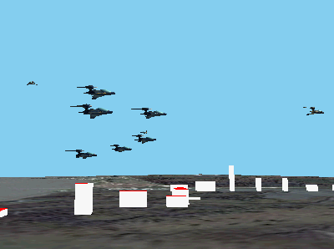
Live Objects Applications

Slide 184
Live Objects Applications
space

Slide 185
Live Objects Applications
space
XML
plane 1

Slide 186
Live Objects Applications
space
XML
XML
plane 1
plane 2

Slide 187
Live Objects Applications
space
XML
XML
XML
plane 1
plane 2
building 1

Slide 188
Live Objects Applications
space
XML
XML
XML
XML
plane 1
plane 2
building 1
map

Slide 189
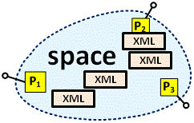
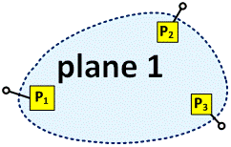
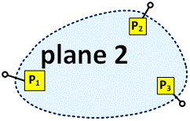
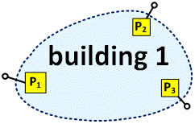
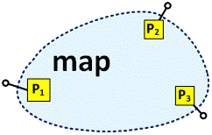
Live Objects Applications
XML
tile 1

Slide 190
Live Objects Applications
XML
XML
tile 1
tile 2

Slide 191
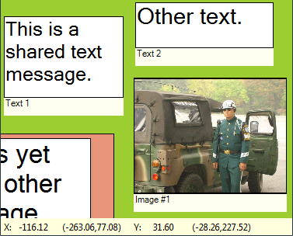
Live Objects Applications

Slide 192
Live Objects Applications
desktop

Slide 193
Live Objects Applications
desktop
XML
text 2

Slide 194
Live Objects Applications
desktop
XML
XML
text 2
image 1

Slide 195
Live Objects Applications
desktop
XML
XML
XML
text 2
image 1
desktop 2

Slide 196
Live Objects Applications
desktop
XML
XML
XML
text 2
image 1
desktop 2
XML
text 3

Slide 197
Live Objects Applications
desktop 1

Slide 198
Live Objects Applications
desktop 1
XML
desktop 2

Slide 199
Live Objects Applications
desktop 1
XML
XML
desktop 2
desktop 3

Slide 200
Live Objects Applications
desktop 1
XML
XML
XML
desktop 2
desktop 3
XML
XML
text 1

Slide 201
Live Objects Applications
desktop 1
XML
XML
XML
desktop 2
desktop 3
XML
XML
text 1

Slide 202
Conclusions

Slide 203
Conclusions
Cloud and edge technologies can work together… …but we need a new storage abstraction.
Checkpointed Channels (CCs)
Support a variety of protocols: client-server, P2P, distributed replication, append log files, etc.,
Can be used at any level of the protocol stack, at the fronted and at the backend,
Can efficiently store structured mashup content,
Can be hyperlinked into webs of CCs; these could serve as a basis for a new Web architecture.

Slide 204
Thanks

