Slide 1
Notes:
Why aren’t banks mirroring at a distance

Slide 2
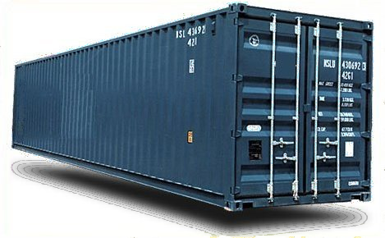

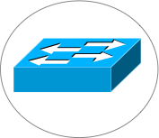

Critical Infrastructure Protection and Compliance
U.S. Department of Treasury Study
  Financial Sector vulnerable to significant data loss in disaster
  Need new technical options
Risks are real, technology available, Why is problem not solved?
Notes:
A Research and Development Agenda to Improve the Resiliency
of the Financial and Banking Sector
U.S. Department of Treasury - Office of Critical Infrastructure Protection and
Compliance Policy
Financial and Banking Information Infrastructure Committee
Financial Services Sector Coordinating Council
Design eloquent in its simplicity
Secure log promotes integrity
A hash asserts the data and order integrity of log
Byzantine quorums maintain consistency despite failure
Self-organizing via DHT technology
Narrow interface made it possible to implement and deploy system
Need to somehow summarize “Antiquity Design Summary” and “My Contributions” slides and somehow transition to SMFS and KyotoFS!
What one point should the audience take away from here?
This is also where we may discuss our research approach, or we can do it at the end

Slide 3
Bold New (Distributed Systems) World…
High performance applications coordinate over vast distances
  Systems coordinate to cache, mirror, tolerate disaster, etc.
  Enabled by cheap storage and cpus, commodity datacenters, and plentiful bandwidth
Scale is amazing, but tradeoffs are old ones
Notes:
A Research and Development Agenda to Improve the Resiliency
of the Financial and Banking Sector
U.S. Department of Treasury - Office of Critical Infrastructure Protection and
Compliance Policy
Financial and Banking Information Infrastructure Committee
Financial Services Sector Coordinating Council
Design eloquent in its simplicity
Secure log promotes integrity
A hash asserts the data and order integrity of log
Byzantine quorums maintain consistency despite failure
Self-organizing via DHT technology
Narrow interface made it possible to implement and deploy system
Need to somehow summarize “Antiquity Design Summary” and “My Contributions” slides and somehow transition to SMFS and KyotoFS!
What one point should the audience take away from here?
This is also where we may discuss our research approach, or we can do it at the end

Slide 4
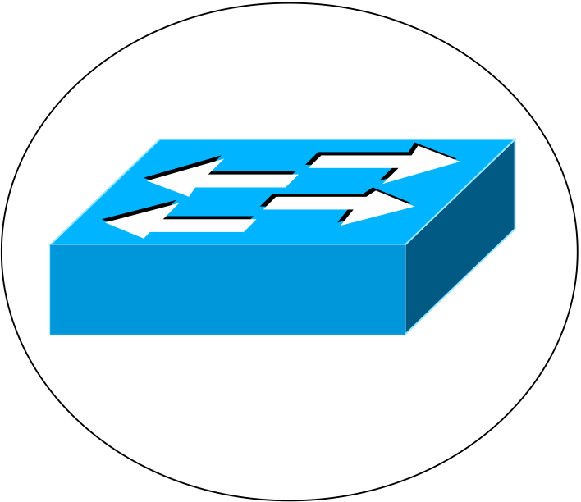

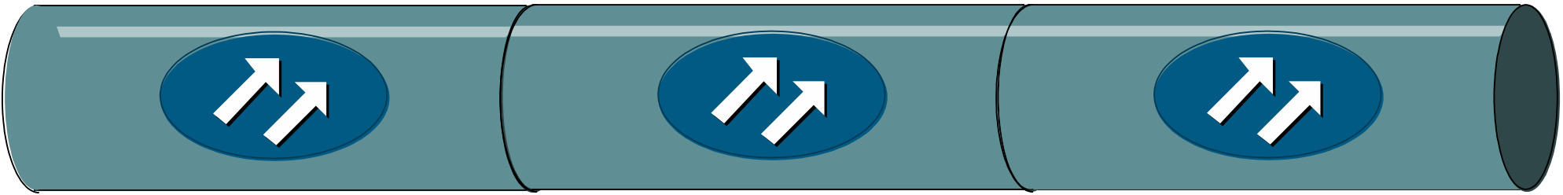
Mirroring and speed of light dilemma…
async
Conundrum:
there is no middle ground
sync
Primary site
Remote mirror
Want asynchronous performance to local data center
And want synchronous guarantee
Notes:
most enterprise use asynchronous mirroring even though a single transaction may be valued at millions of dollars
Want asynchronous performance to local data center
But if failure occurs, data may be lost
70% small firms go out of business after major data loss
And want synchronous guarantee
But many businesses cannot afford reducing client performance

Slide 5
Mirroring and speed of light dilemma…
Conundrum:
there is no middle ground
sync
Local-sync
Remote-sync
Primary site
Remote mirror
Want asynchronous performance to local data center
And want synchronous guarantee
Notes:
most enterprise use asynchronous mirroring even though a single transaction may be valued at millions of dollars
Want asynchronous performance to local data center
But if failure occurs, data may be lost
70% small firms go out of business after major data loss
And want synchronous guarantee
But many businesses cannot afford reducing client performance

Slide 6
Challenge
How can we increase reliability of local-sync protocols?
  Given many enterprises use local-sync mirroring anyways
Different levels of local-sync reliability
  Send update to mirror immediately
  Delay sending update to mirror – deduplication reduces BW

Slide 7
Talk Outline
Introduction
Enterprise Continuity
  How data loss occurs
  How we prevent it
  Smoke and mirrors file system
Evaluation
Conclusion

Slide 8
How does loss occur?
Rather, where do failures occur?
Rolling disasters
Packet
loss
Partition
Site
Failure
Power
Outage
Primary site
Remote mirror
Notes:
Want asynchronous performance to local data center
But if failure occurs, data may be lost
70% small firms go out of business after major data loss
And want synchronous guarantee
But many businesses cannot afford reducing client performance

Slide 9
Enterprise Continuity: Network-sync
Local-sync
Network-sync
Remote-sync
Primary site
Wide-area network
Remote mirror

Slide 10
Enterprise Continuity Middle Ground
Primary site
Data Packet
Repair Packet
Network-level Ack
Storage-level Ack
Remote mirror
Use network level redundancy and exposure
  reduces probability data lost due to network failure
Notes:
Optical links connect datacenters
In particular, loss rate is low
Use redundancy to reduce loss and expose redundancy to reason about reliability

Slide 11
Enterprise Continuity Middle Ground
Network-sync increases data reliability
  reduces data loss failure modes, can prevent data loss if
  At the same time primary site fail network drops packet
  And ensure data not lost in send buffers and local queues
Data loss can still occur
  Split second(s) before/after primary site fails…
  Network partitions
  Disk controller fails at mirror
  Power outage at mirror
Existing mirroring solutions can use network-sync
Notes:
Optical links connect datacenters
In particular, loss rate is low
Use redundancy to reduce loss and expose redundancy to reason about reliability

Slide 12
Smoke and Mirrors File System
A file system constructed over network-sync
  Transparently mirrors files over wide-area
  Embraces concept:
  file is in transit (in the WAN link) but with enough recovery data to ensure that loss rates are as low as for the remote disk case!
  Group mirroring consistency

Slide 13

Mirroring consistency and
Log-Structured File System
V1
R1
I1
I2
B1
B2
B3
B4
append(B1,B2)
V1
R1
I2
B4
B3
I1
B2
B1
append(V1..)
Notes:
Transition to next slide: A secure log does not solve problems/challenges, still need to replicate log
And maintain consistency amongst replicas

Slide 14
Talk Outline
Introduction
Enterprise Continuity
Evaluation
Conclusion

Slide 15
Evaluation
Demonstrate SMFS performance over Maelstrom
  In the event of disaster, how much data is lost?
  What is system and app throughput as link loss increases?
  How much are the primary and mirror sites allowed to diverge?
Emulab setup
  1 Gbps, 25ms to 100ms link connects two data centers
  Eight primary and eight mirror storage nodes
  64 testers submit 512kB appends to separate logs
    Each tester submits only one append at a time
Notes:
4 points:
Minimize loss in disaster
Tput independent of latency and loss on link
App Performance same as local-sync
There is a tradeoff: FEC reduces goodput

Slide 16
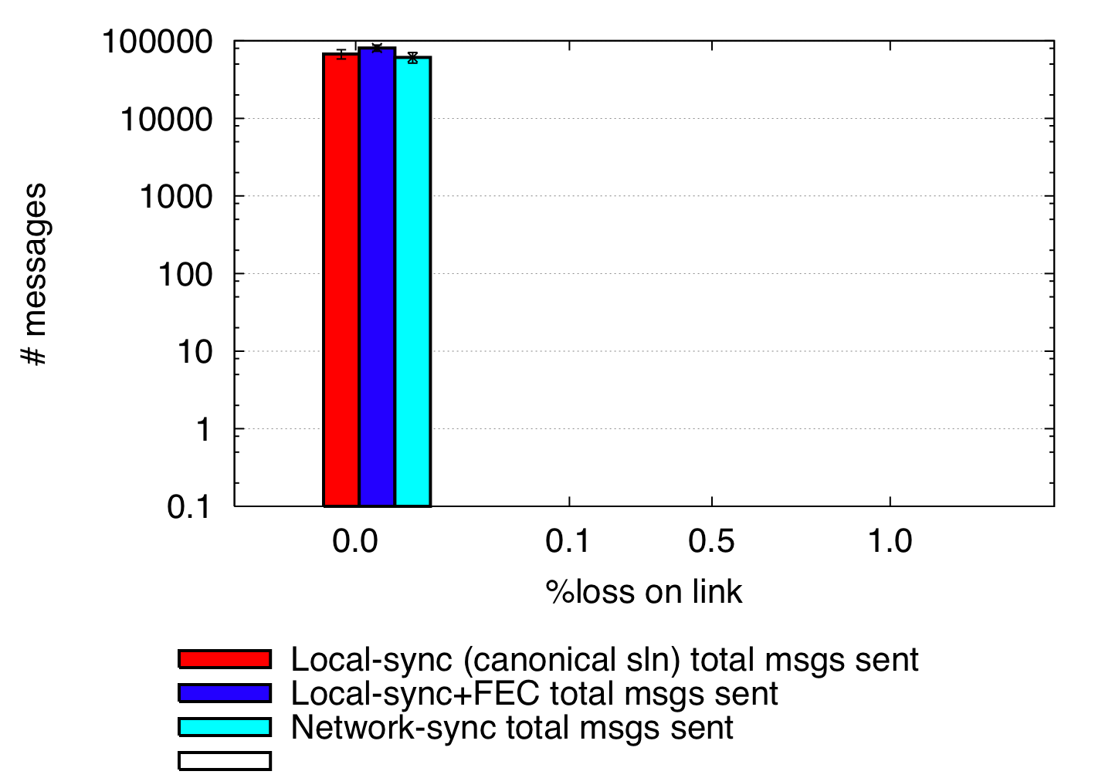
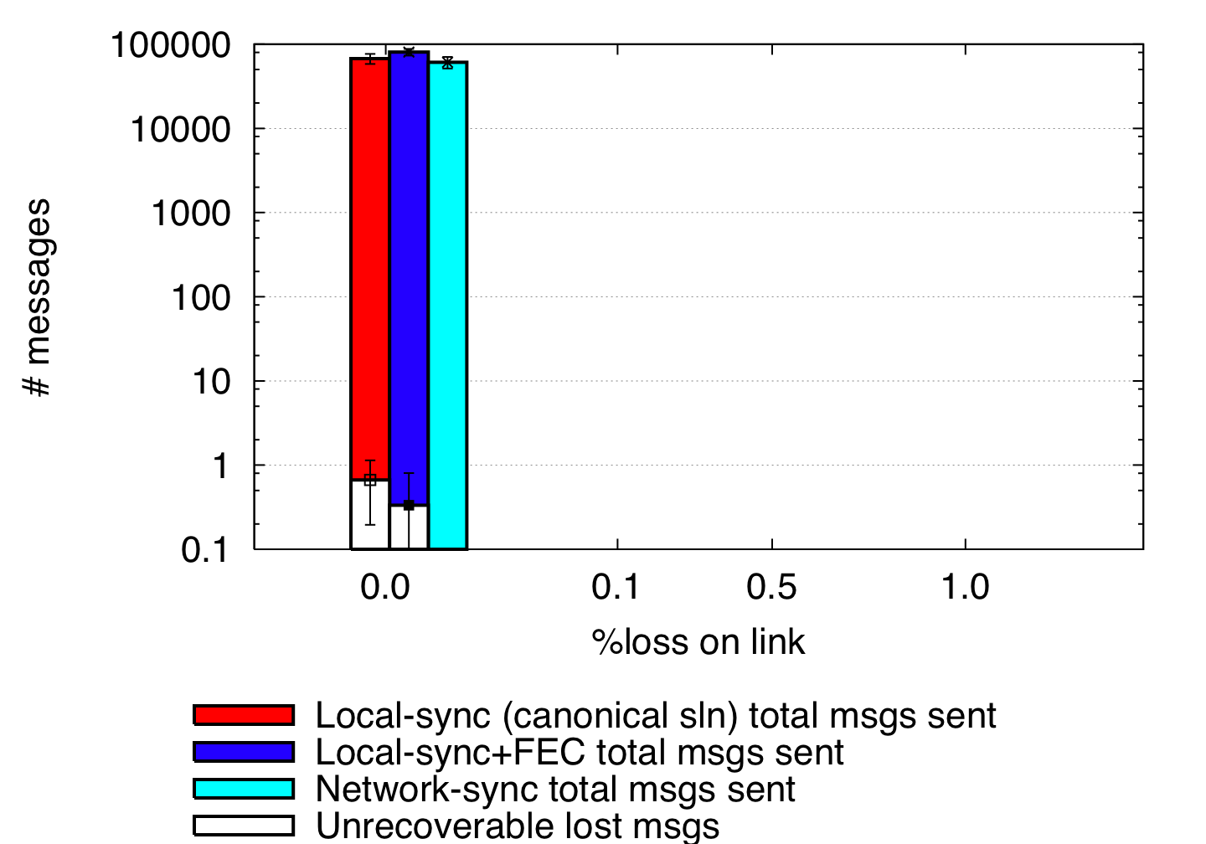
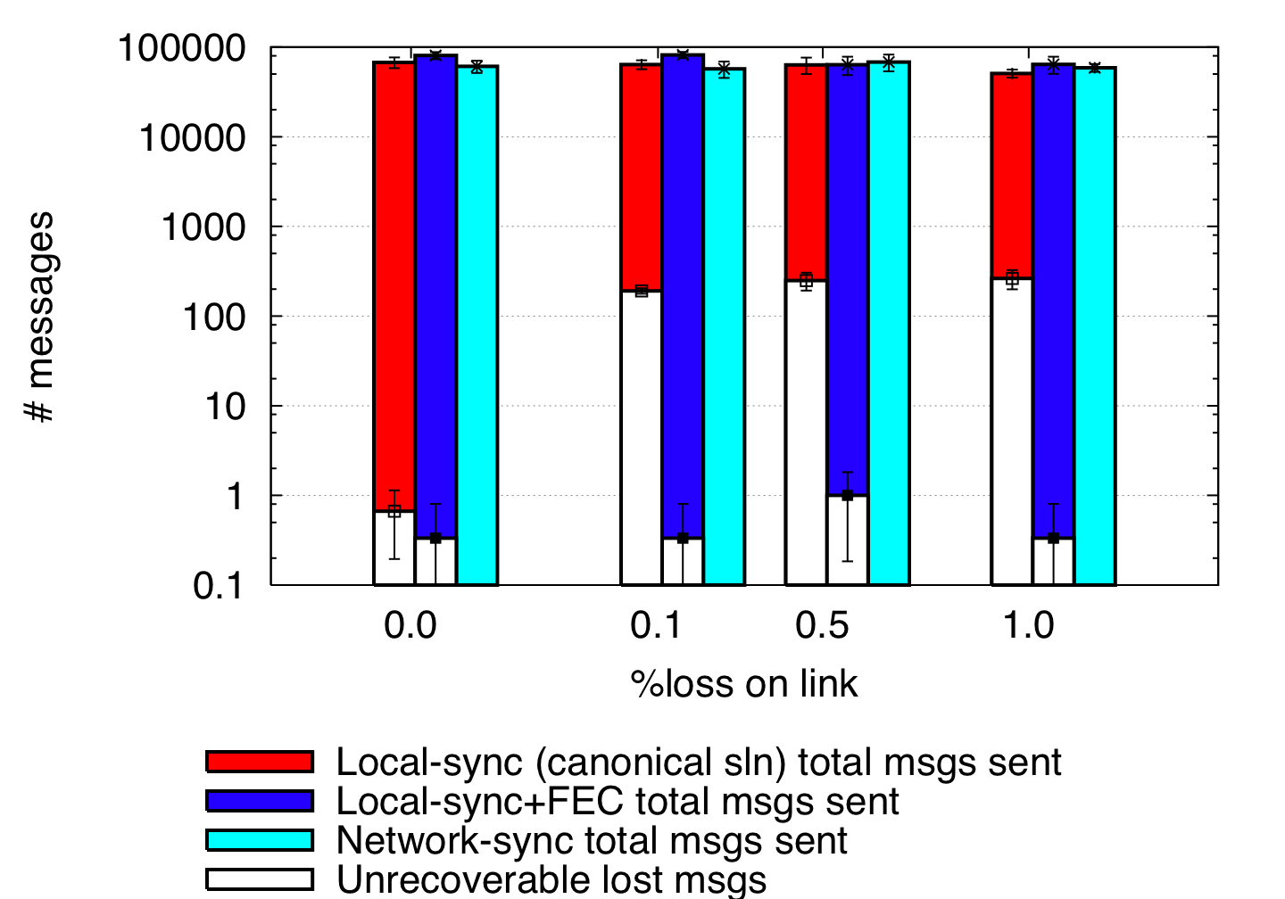
Data loss as a result of disaster
Local-
sync
Network-
sync
Remote-
sync
Primary site
Remote mirror
50 ms one-way latency
FEC(r,c) = (8,3)
Local-sync unable to recover data dropped by network
Local-sync+FEC lost data not in transit
Network-sync did not lose any data
  Represents a new tradeoff in design space

Slide 17
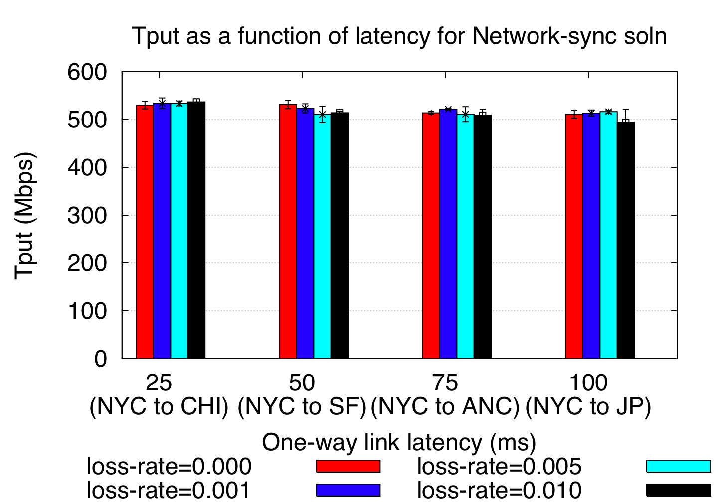
High throughput at high latencies
Notes:
Performance independent of link latency and loss

Slide 18
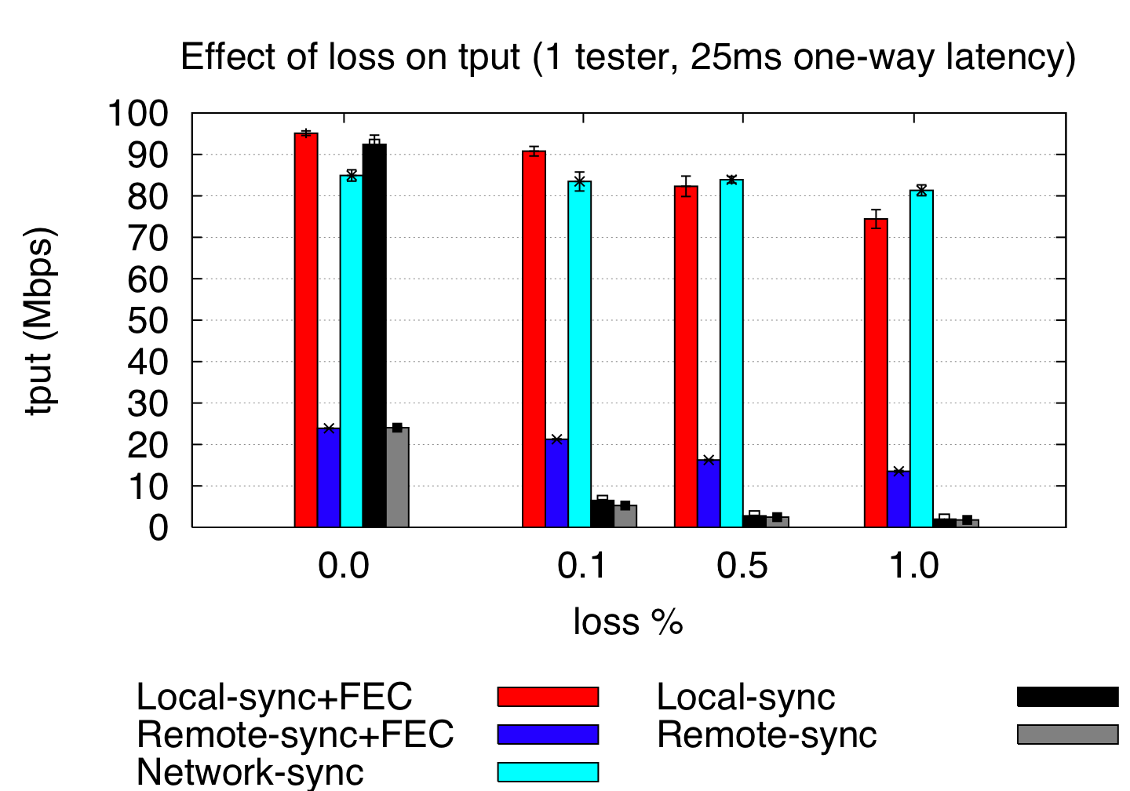
Application Throughput
App throughput measures application perceived performance
Network and Local-sync+FEC tput significantly greater than Remote-sync(+FEC)
Notes:
Network-sync performance similar to local-sync

Slide 19
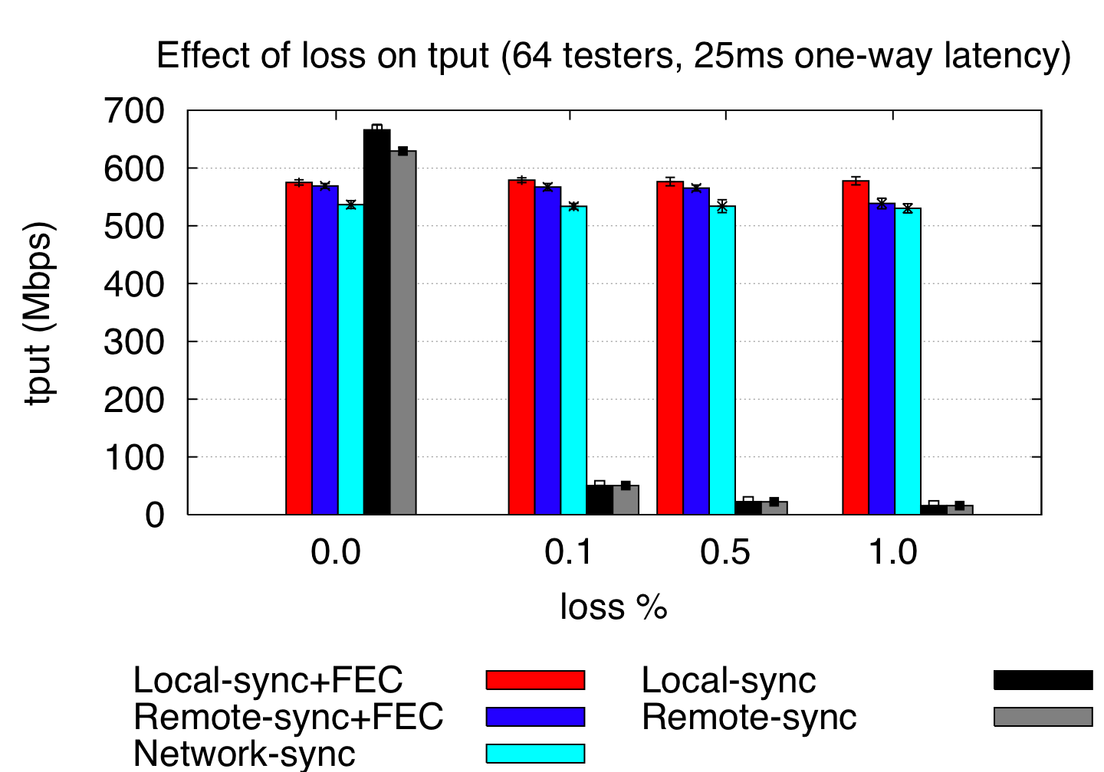
…There is a tradeoff
Notes:
Network-sync reduces goodput to protect against future loss

Slide 20
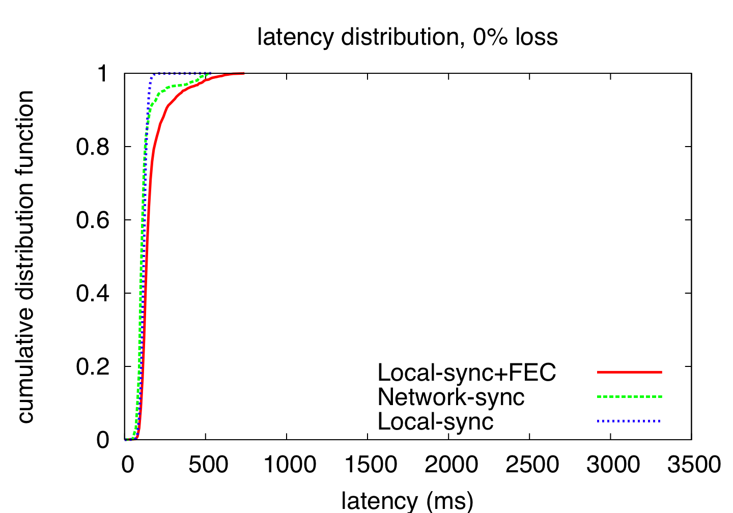
Latency Distributions
Notes:
Time between msg sent by primary server and received by remote mirror

Slide 21
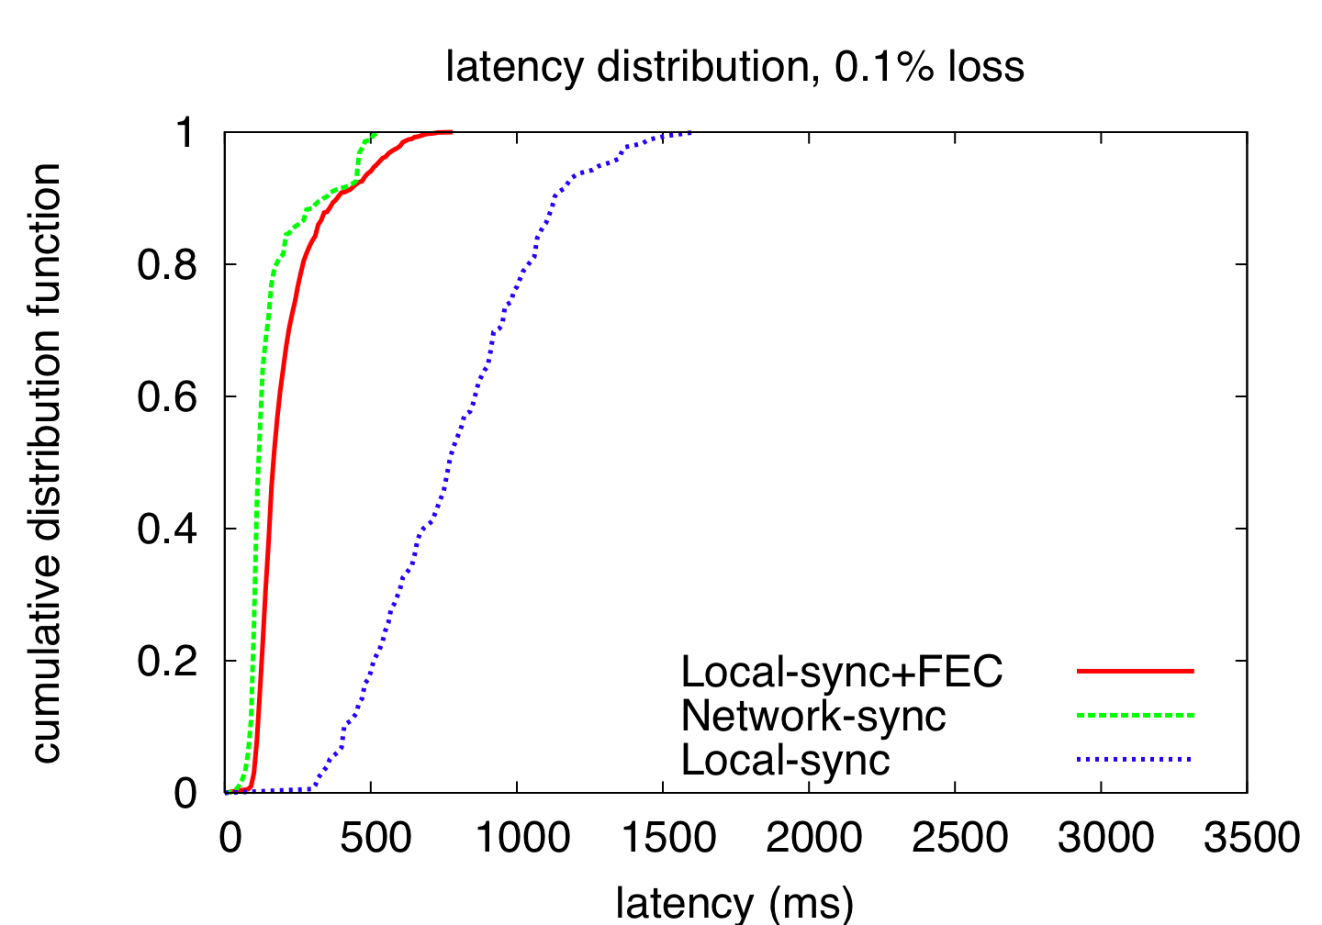
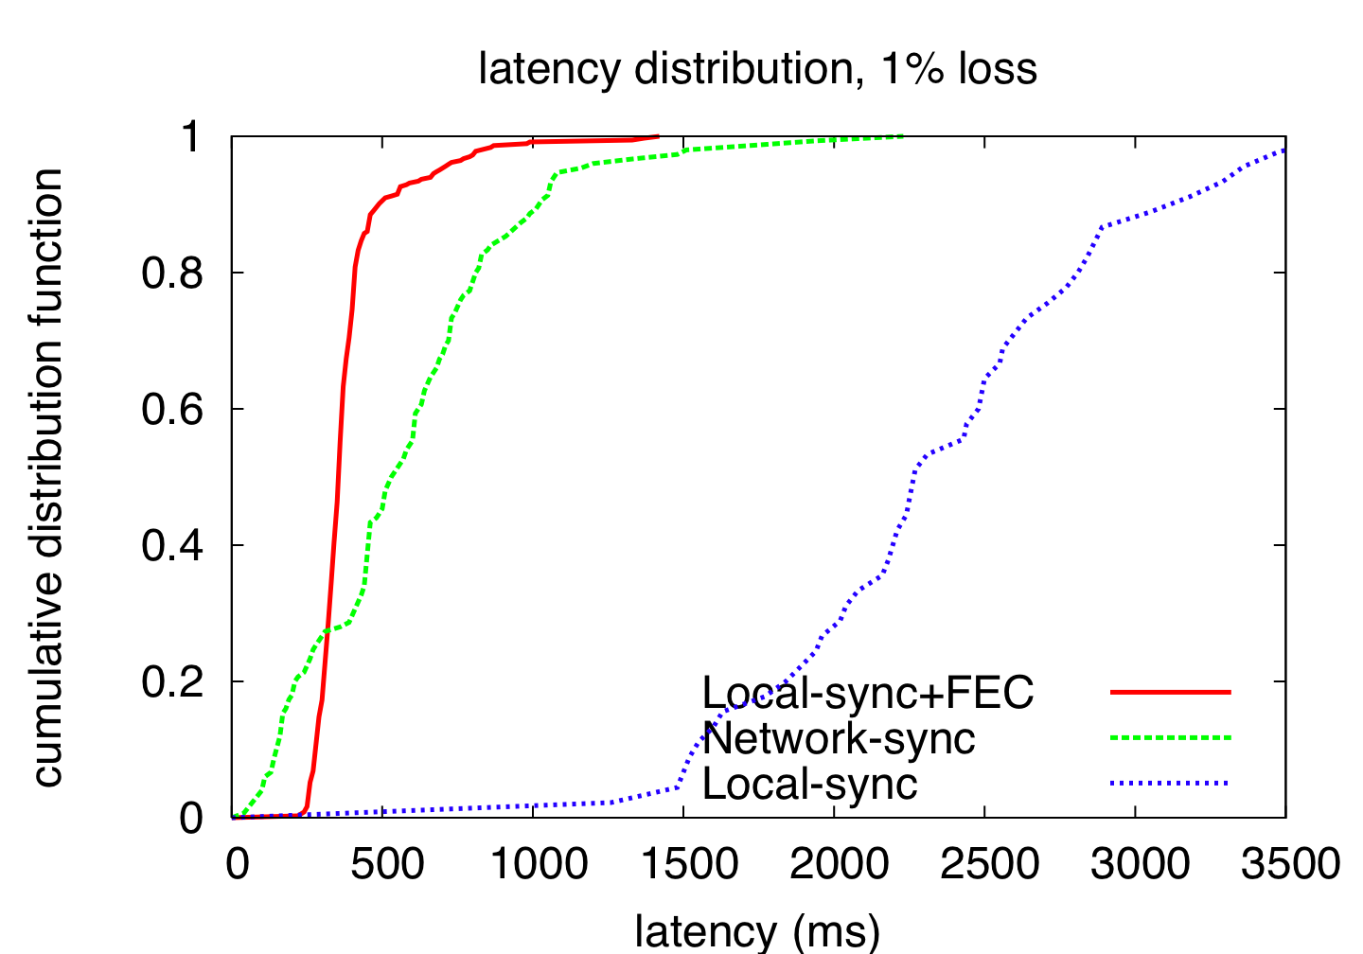
Latency Distributions
Notes:
Time between msg sent by primary server and received by remote mirror

Slide 22
Conclusion
Technology response to critical infrastructure needs
When does the filesystem return to the application?
  Fast — return after sending to mirror
  Safe — return after ACK from mirror
SMFS — return to user after sending enough FEC
Network-sync:
Lossy Network➔Lossless Network➔Disk!
Result: Fast, Safe Mirroring independent of link length!

Slide 23
Questions?

