Slide 1
Location Recognition
Given:
A query image
A database of images with known locations
Two types of approaches:
Direct matching: directly match image features to 3D points (high memory requirement)
Retrieval based: retrieve a short list of most similar images and perform image matching
We base our approach on retrieval based framework, but using a different representation

Slide 2
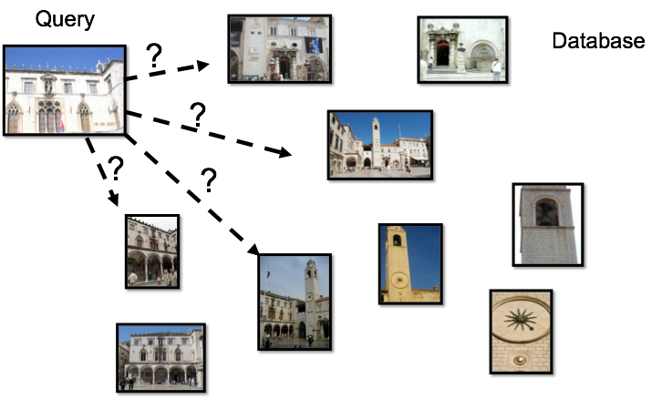
Retrieval based approach
Idea: retrieve a short list of most similar images and perform image matching
Problem: noisy ranking + expensive matching = inefficiency

Slide 3
Location Representations
Landmarks with corresponding sets of images (categories)
Latitude and longitude coordinates (geo-tags)
3D geometry (3D point clouds)
Our approach: locations are implicitly encoded in an image graph
nodes correspond to images
edges correspond to overlapping, geometrically consistent image pairs

Slide 4
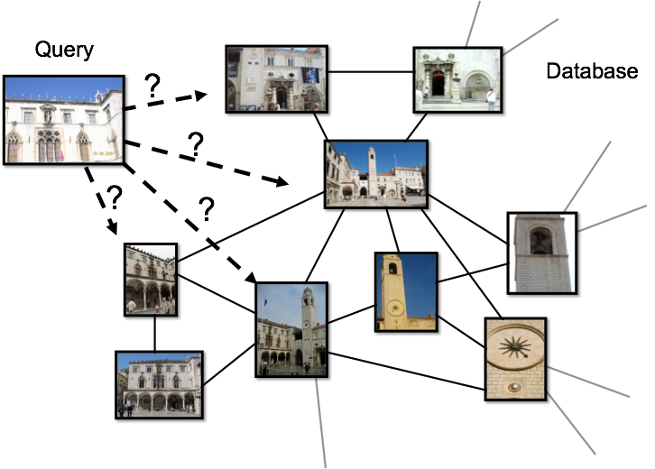
Locations in an image graph
Question: How can we learn from the image graph?
One approach is to formulate as a similarity measure learning problem

Slide 5
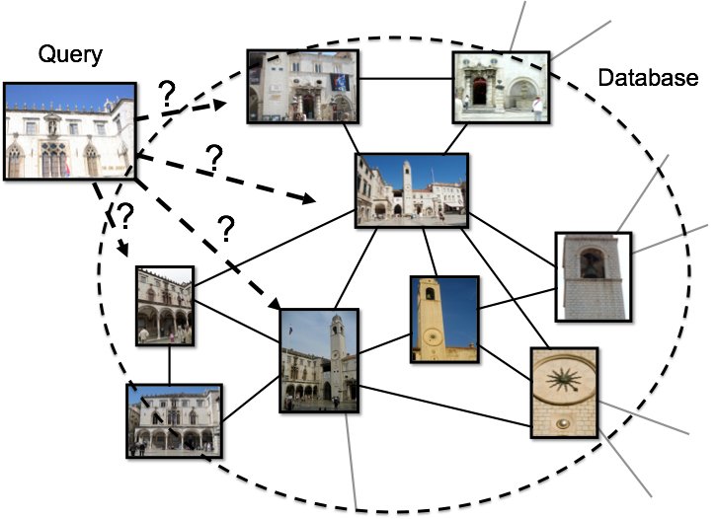
Global similarity learning
Idea: similar to learning for image matching, learn a global similarity measure using matching/non-matching image pairs
Problem: not specific enough for recognize location within a large dataset

Slide 6
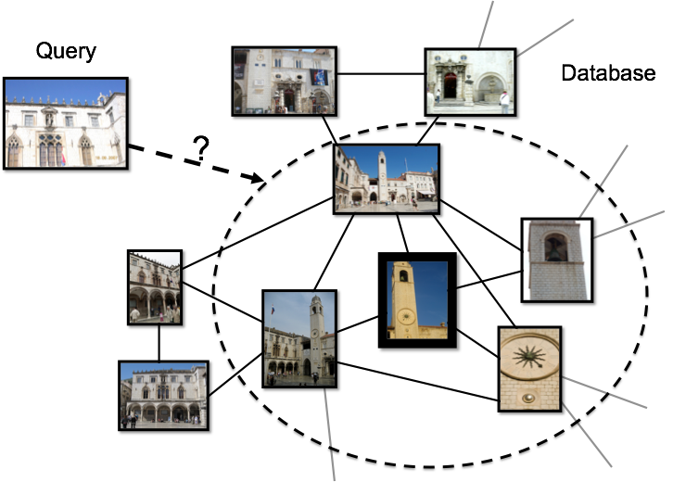
Instance similarity learning
Idea: for each individual image in the database, learn a specific similarity function

Slide 7
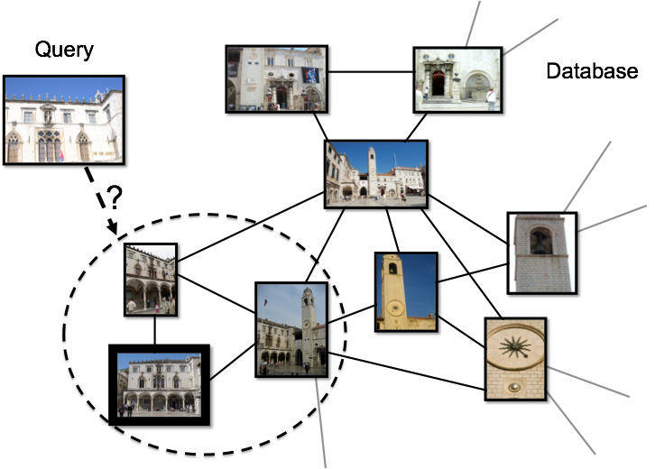
Instance similarity learning
Idea: for each individual image in the database, learn a specific similarity function

Slide 8
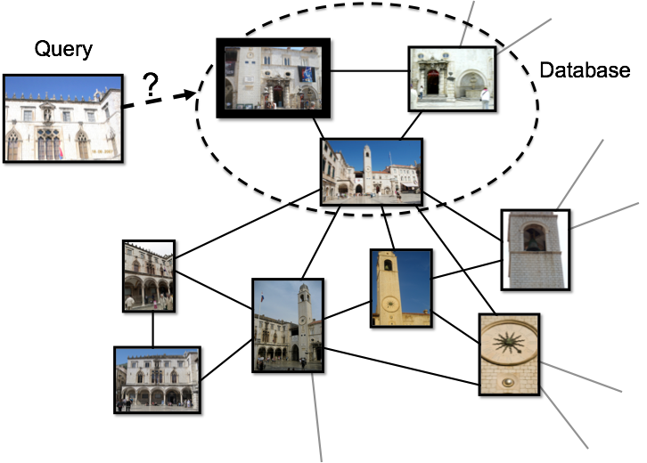
Instance similarity learning
Idea: for each individual image in the database, learn a specific similarity function

Slide 9
Instance similarity learning
Idea: for each individual image in the database, learn a specific similarity function
Problem: some images have too few training examples

Slide 10
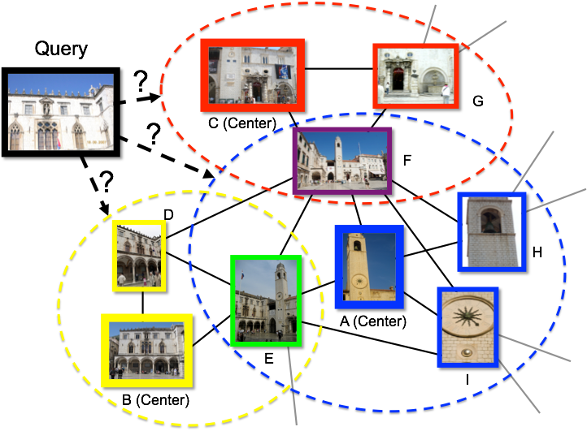
Our Approach
Idea: for each neighborhood (subgraph) in the image graph, learn a specific similarity function

Slide 11
Approach
At training time:
Obtain image matching graph
Compute a covering of the graph with a set of subgraphsLearn and calibrate an SVM-based similarity measure for each subgraph
At testing time:
Use the models in Step 3 to compute a similarity between the query image to each database image, and generate a ranked shortlist of possible image matchesPerform geometric verification with the top database images in the shortlist (image matching)

Slide 12
Approach
At training time:
Obtain image matching graph
Compute a covering of the graph with a set of subgraphsLearn and calibrate an SVM-based similarity measure for each subgraph
At testing time:
Use the models in Step 3 to compute a similarity between the query image to each database image, and generate a ranked shortlist of possible image matchesPerform geometric verification with the top database images in the shortlist (image matching)

Slide 13
Computing Subgraphs
What makes a good subgraph?contain images that are largely similarhas as many positive examples as possible
Minimum dominating set (NP-hard)
We use a greedy algorithm:
at each iteration select the image that covers the most “uncovered” images
“Covered”: is selected or has at least one neighbor that is selected
Selected images (center images) define the neighborhoods
One image could belong to multiple neighborhoods

Slide 14
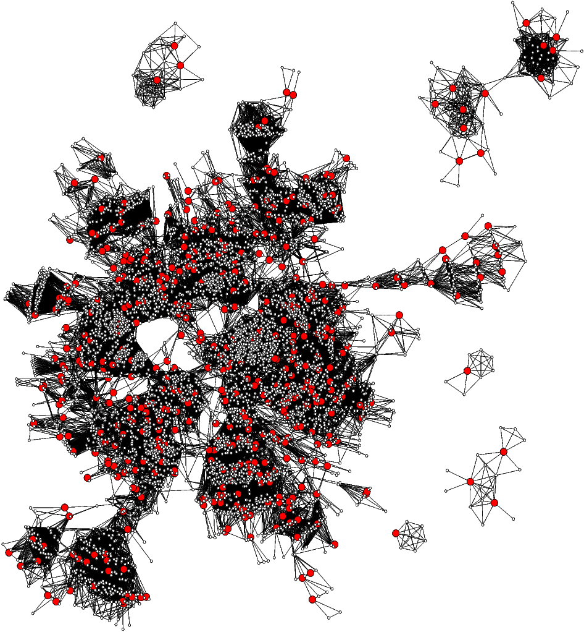
An example covering of the Dubrovnik dataset # images: 6044, # centers: 188

Slide 15
Approach
At training time:
Obtain image matching graph
Compute a covering of the graph with a set of subgraphsLearn and calibrate an SVM-based similarity measure for each subgraph
At testing time:
Use the models in Step 3 to compute a similarity between the query image to each database image, and generate a ranked shortlist of possible image matchesPerform geometric verification with the top database images in the shortlist (image matching)

Slide 16
Similarity Measure Learning
Each image is represented as BoW vector
For each subgraph, define
Positives: subgraph membersNegatives: subsample the rest
Learn an SVM classifier and calibrate to output a probability value using Platt’s method

Slide 17
Approach
At training time:
Obtain image matching graph
Compute a covering of the graph with a set of subgraphsLearn and calibrate an SVM-based similarity measure for each subgraph
At testing time:
Use the models in Step 3 to compute a similarity between the query image to each database image, and generate a ranked shortlist of possible image matchesPerform geometric verification with the top database images in the shortlist (image matching)

Slide 18
Generating a Short List
Given a query image, every subgraph has a probability score
However, a short list of most similar images from all database images is needed
A simple approach:
concatenate subgraph members according to scores
rank within each subgraph using BoW similarity
for image appearing in multiple subgraphs, only count the highest scoring subgraph

Slide 19
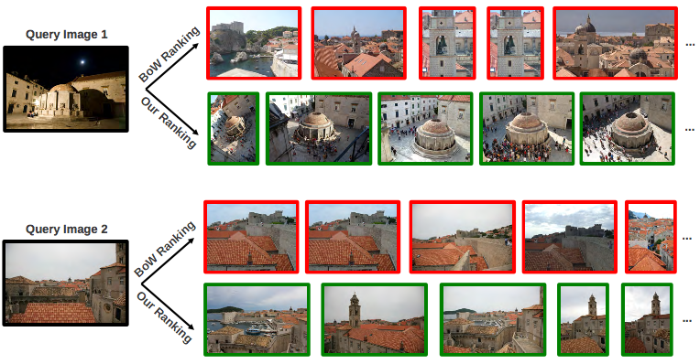
Generating a Short List
A simple approach: concatenating subgraph members according to scores

Slide 20
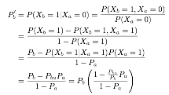
Generating a Short List
Problem: If the first subgraph/neighborhood is wrong, the result is worse than BoW ranking, which has more diversity
Idea: to encourage diversity, rank using conditional probabilities conditioned on first failure to obtain the 2nd candidate, and so on
update factor

Slide 21
Generating a Short List
Example ranking result with encouraged diversity v.s. without
Regularization using BoW ranking also helps increase diversity

Slide 22
Approach
At training time:
Obtain image matching graph
Compute a covering of the graph with a set of subgraphsLearn and calibrate an SVM-based similarity measure for each subgraph
At testing time:
Use the models in Step 3 to compute a similarity between the query image to each database image, and generate a ranked shortlist of possible image matchesPerform geometric verification with the top database images in the shortlist (image matching)

Slide 23
Experiments
Key bottleneck: quality of the shortlist
The higher the first match appears, the less computation is needed
different from retrieval, where recall is also important
Evaluate using accuracies at top k (k = 1, 2, 5, 10)
Baselines
BoW ranking
Co-ocset (BoW ranking considering co-occuring stat.)
GPS based approach
Two alternative learning formulations:
single global similarity using image pairs
instance similarity using each image as center

Slide 24
Experiments
Visual Vocabulary size: 1M
Two versions of vocabularies
specific (trained using each dataset)
generic (trained with a common unrelated dataset)
Using 3 standard benchmark datasets

Slide 25
Experiments
Unsupervised methods perform similarly
GPS based model and other learning formulations perform worse
Our approach (GBP) improves accuracies consistently
Probabilistic reranking (+RR) and BoW regularization (+BoW) improves results further
Top k accuracies and mAP are not the same objectives

Slide 26
Conclusions
Compared to BoW ranking
higher performance with little extra overhead during query time
Compared to direct matching
less memory usage and better scalability thanks to BoW framework
Graph-based recognition could be extended to other recognition tasks (e.g. object recognition)
Song Cao, Noah Snavely: Graph-Based Discriminative Learning for Location Recognition. CVPR 2013 (to appear).

