Slide 1


Estimating Dual-scale Properties of Glossy Surfaces from Step-edge Lighting
Chun-Po Wang, Noah Snavely, Steve Marschner Cornell University

Slide 2
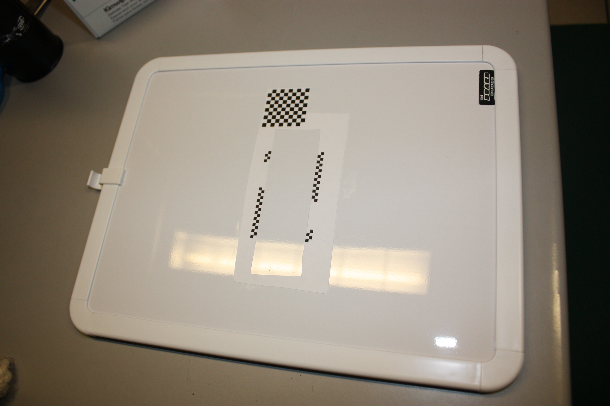
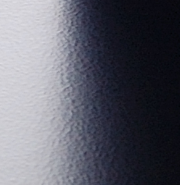
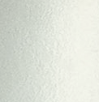
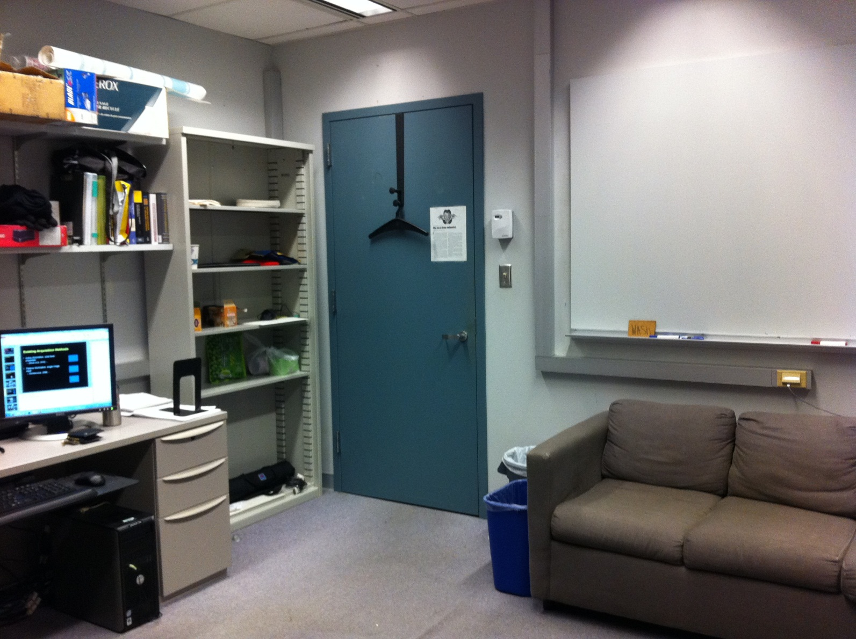
Rough Surfaces in Indoor Environment
Planar
Homogeneous
Isotropic
“Random” mesostructure
Notes:
If we want to render a indoor scene like this room, we need to know the materials of the objects.
For example, the whiteboard, the metal shelf, and the metal bookend on the table.
If we look at them, there are actually some common features that make them easier to be captured.
Like: they are locally planar, they are homogeneous and have isotropic appearance, and they have “random” like mesostructure.
In this work, we propose a simple method to capture the properties of this kind of surfaces.

Slide 3
Rough Surfaces Assumptions
Planar
Homogeneous
Isotropic BRDF
“Random” mesostructure
Notes:
These are the common properties of many indoor surfaces
They are planar or at least locally planar, they are homogeneous and have isotropic appearance, and their mesostructure is “random”.
We’ll talk about the definition of this “random” later.

Slide 4
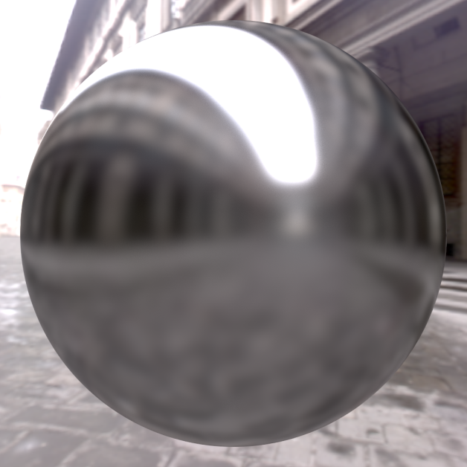
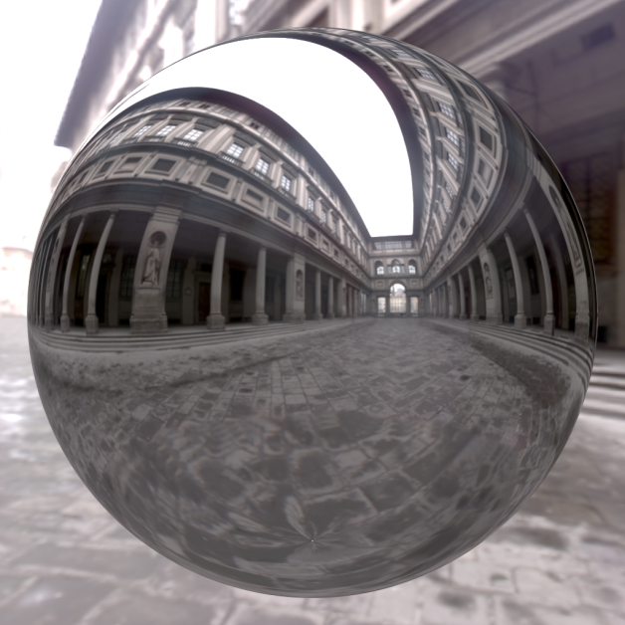

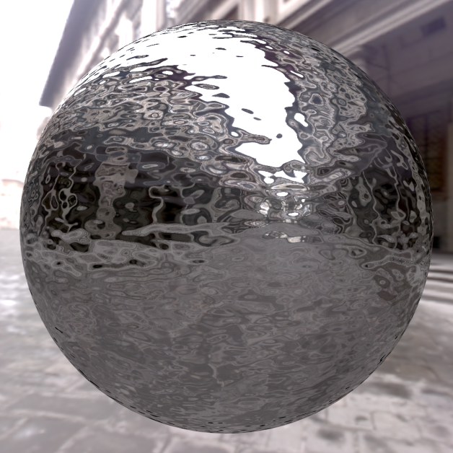
Rough Surfaces: dual-scale
Rough in microscopic scale
Mirror
Rough in both scale
(Real world surfaces)
Rough in mesostructure scale
Notes:
One key point in this work is we think the mesostructure of common material is not arbitrary; instead, we think they share the same random-like property as the micro-facets in a micro-facet BRDF. For example, consider these two spheres: you can think their surface have basically the same structure, but the bottom one its in a much larger scale. For real-world surfaces, they usually have structures in both scales, and in this work we want to estimate them separately.
You can also see the most important visual cue of the reflected image is from the high contrast edge. This gives us the idea to use high contrast step-edge lighting to find surface properties.

Slide 5
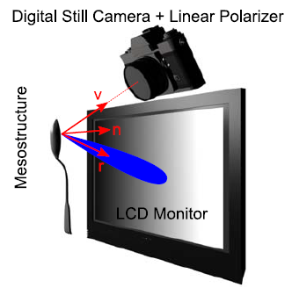
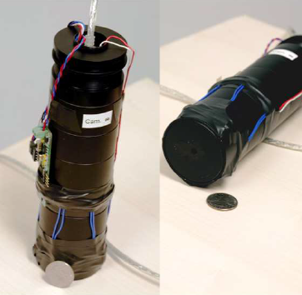
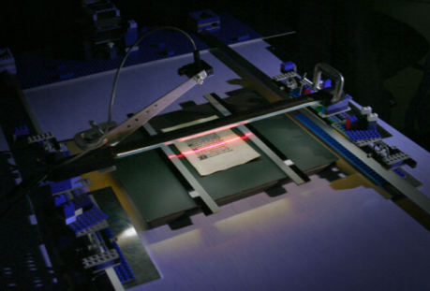
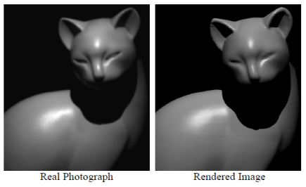
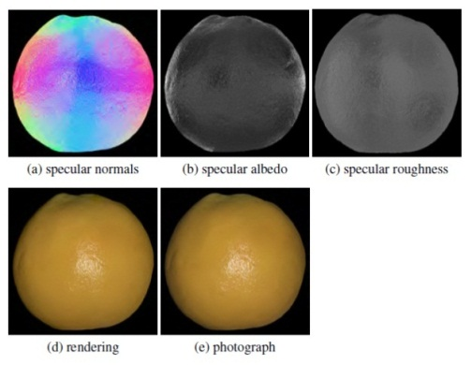
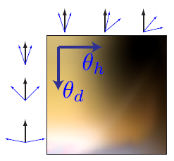
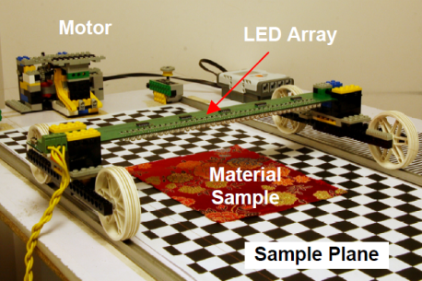
Existing Acquisition Methods
[Francken et al., 2008]
[Dong et al., 2010]
[Ramamoorthi and Hanrahan, 2001]
[Gardner et al., 2003]
Our work
More details
Less details
[Wang et al., 2008]
[Ghosh et al., 2009] [Ghosh et al., 2010]
[Romeiro et al., 2008]
Notes:
There are many existing works related to material acquisition.
If we look at a spectrum of method complexity, at one extreme, we have methods that acquires rich information of the surfaces, but requires lots of input images.
In the middle, there are techniques that utilize special illumination such as polarized or gradient illumination. These methods requires much less images, but need special illumination devices.
On another extreme, we have methods using even less or single image, but they make more assumptions like homogeneous BRDF and known geometry, or recovers less information.
Our work falls in the middle-right of the spectrum: we use simple lighting and single image, but we do the acquisition without the full knowledge of the mesostructure of the surface.

Slide 6
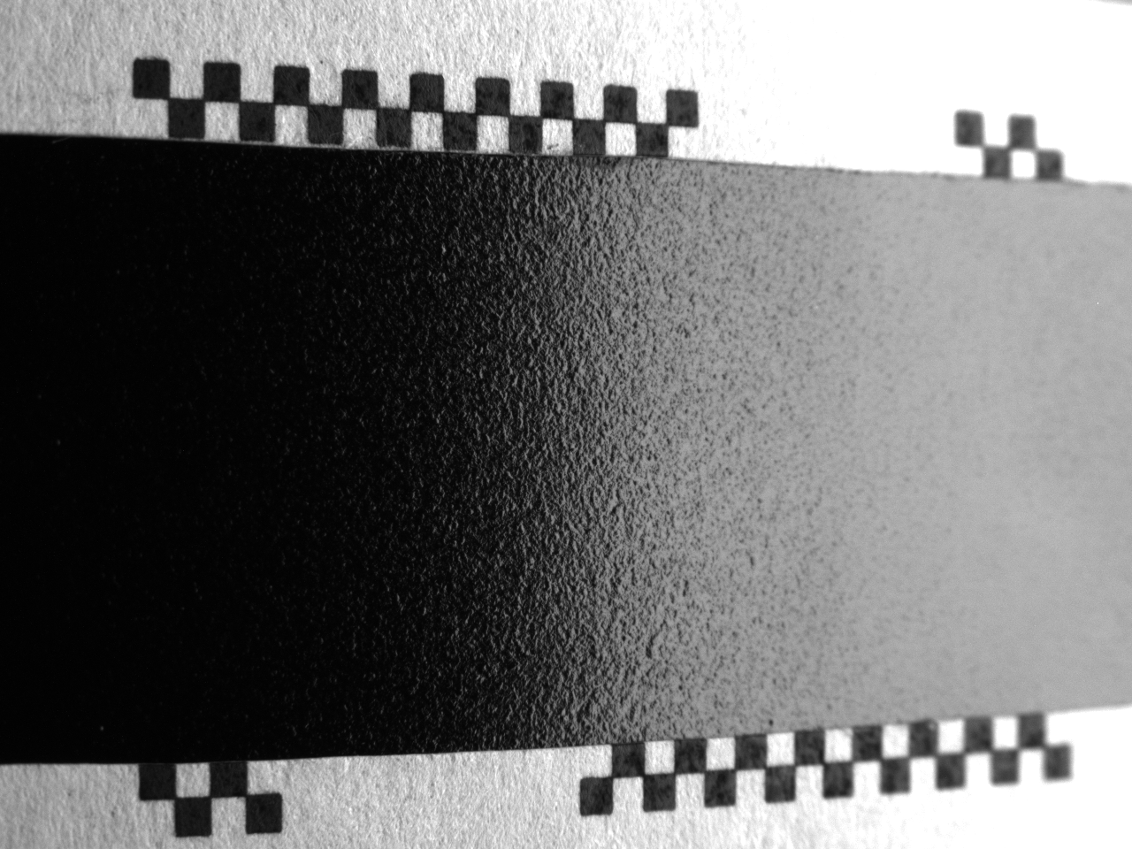
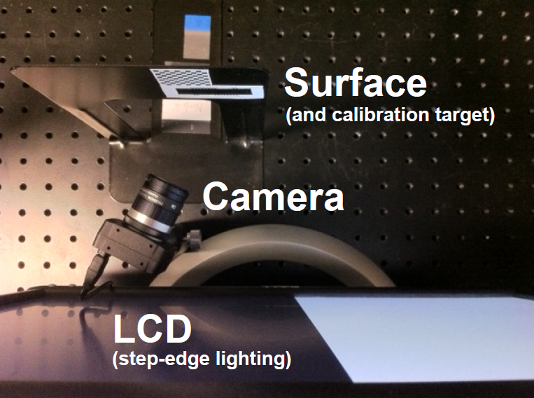
Device Setup
Surface properties
Notes:
Here shows our device setup. We use a normal LCD to illuminate the surface with step-edge lighting, which is simply a black-white pattern.
A camera is looking at the reflected image of the LCD on the surface, and this is the captured image.
In a high-level sense, we acquire the surface properties by looking at the width of the black to white transition.

Slide 7

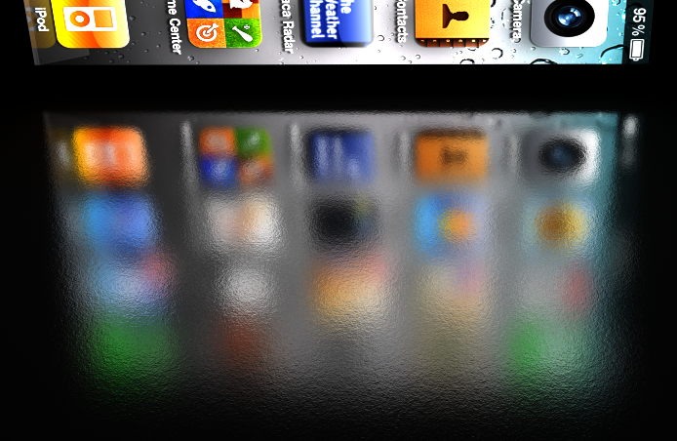
Goal
Photograph
Surface properties
Rendering
Notes:
With the acquired surface properties, we can render a surface whose appearance is similar to the real one.

Slide 8

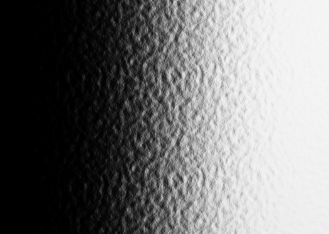


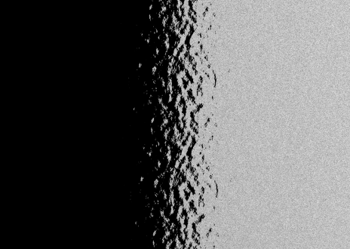
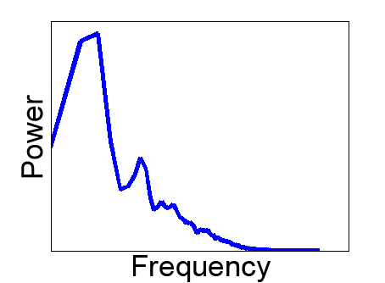
Outline
Surface appearance
Reflectance Model
Specular component
Diffuse component
Mixed structure
Micro structure
Mesostructure
σ_{M}
σ_{μ}
σ_{m}
k_{d}
Acquisition Method
k_{s}
Overall roughness
Micro roughness
Meso roughness
Texture Statistics
Diffuse/Specular albedo
Notes:
Here is the outline of my talk today
It will have 2 parts: first the reflectance model and then the acquisition method
First the reflectance model. Intuitively, the appearance of the reflected image can be roughly separated into a constant part due to the diffuse reflection, and a scrambled and blurred step-edge image that caused by the specular reflection. This specular part can then be further decompose to a smooth blurry part caused by micro-scale structure, and a scrambled part caused by the mesostructure.
Based on this decomposition, our measurement method estimates the following parameters:
The ratio between the diffuse and specular albedoes, the roughness in each level of decomposition, and finally, since the mesostructure is visible in the image, we need something to describe its texture, here we use the power spectrum of the height map of the mesostructure
In this talk, I’ll focus on these four parameters, which are directly correspondent to surface roughness

Slide 9
Part 1: Reflectance model

Slide 10

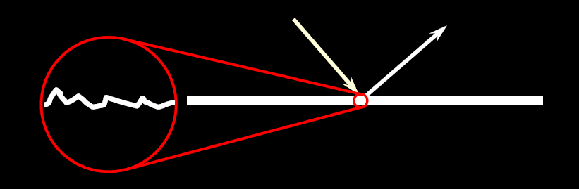
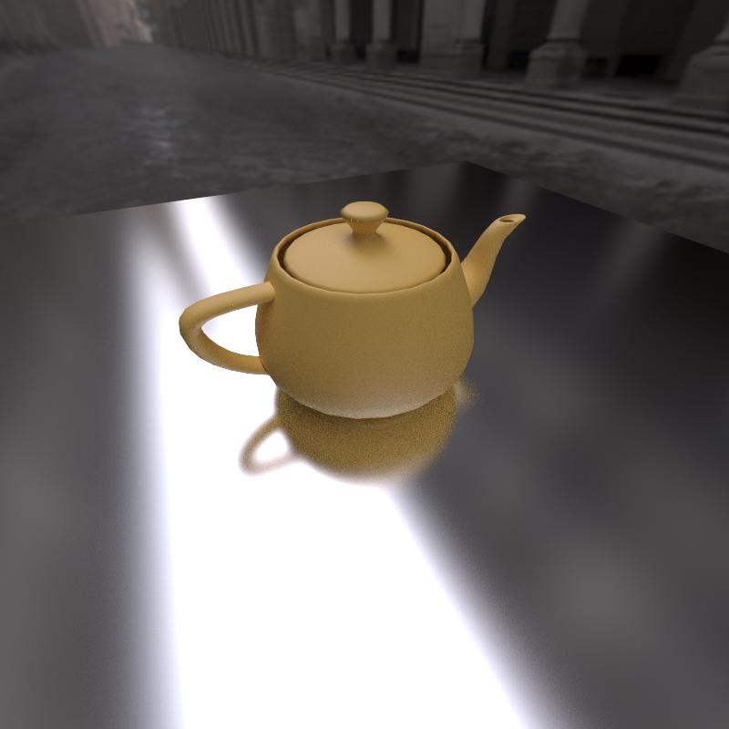
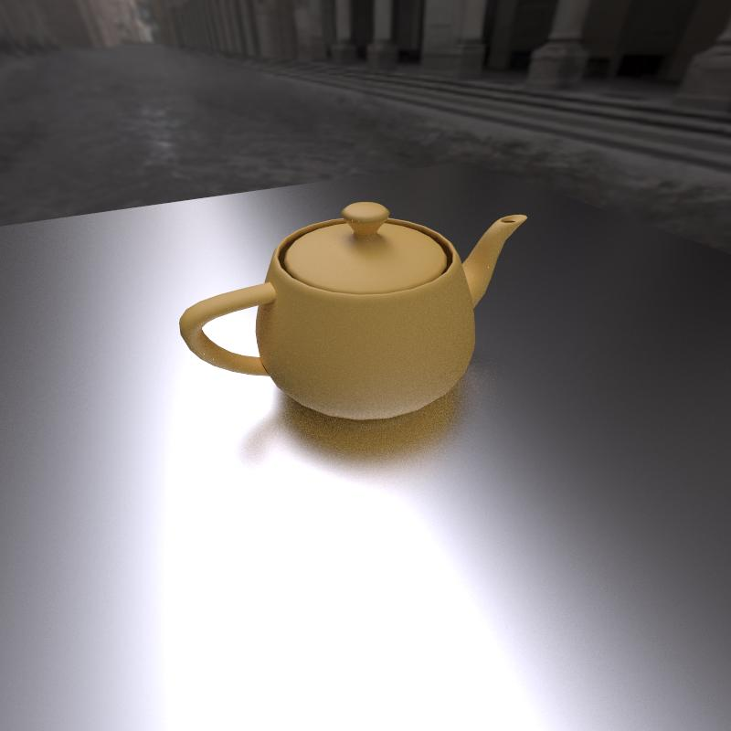
Cook-Torrance BRDF
Surface modeled by tiny mirror facets
Normal distribution function (NDF)
Geometrical Attenuation
Fresnel Reflectance
[Cook and Torrance, 1981]
Small σ
Large σ
Notes:
We use Cook-Torrance BRDF to model surface reflectance, because it’s a microfacet model and allows modeling roughness as facet normal distribution function, or NDF.
The equation shows the factors of Cook-Torrance BRDF. In this work we’re only interested in the NDF factor.
We use Gaussian distribution for NDF, so the roughness of the surface can be simply captured by the standard deviation of the Gaussian,
As the images show: smaller sigma yields a smoother surface, and larger sigma yields a rougher one.

Slide 11

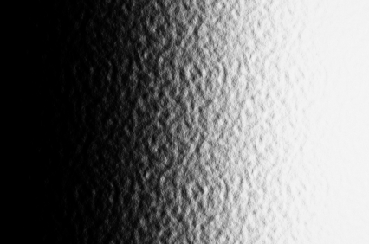
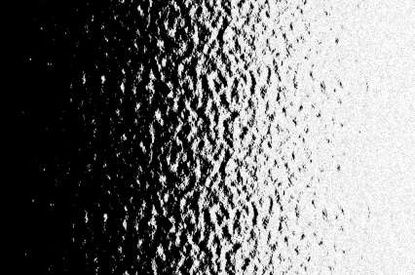
BRDF depends on scale
[Han et al., 2007]
NDF within a pixel
NDF across pixels
Surface appearance
Far distance
Microscopic
Notes:
However, when we also consider different scales of roughness, actually we need two types of NDF because micro-facet BRDF assumes facets are invisible. The first type is the NDF within a pixel; they are the NDF of tiny facets that are so small so they are no visible in the image. The second type is the NDF across pixels; they are actually the NDF of the mesostructure of the surface, where facets are visible in the image. At long distance, all facets are invisible, so we have all variance in the first NDF
When we get a lot closer to the surface to the microscopic scale, all the facets are now visible so all variance moves to the second NDF.
In real-world, we look at surface at mid-distance, so we have something in between.

Slide 12

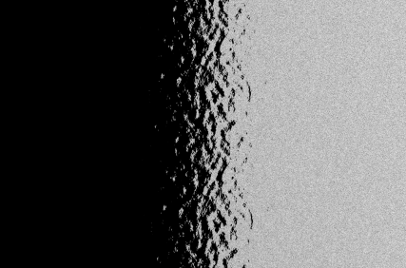
Resolvable/Unresolvable Roughness
NDF within a pixel
NDF across pixels
Surface appearance
Mid distance
Unresolvable Roughness
Resolvable Roughness
Roughness
σ_{M} (Overall)
σ_{μ} (micro)
σ_{m} (meso)
²
²
Notes:
Based on the two classes of NDF, we can decompose the appearance of the surface and define two different types of surface roughness:
Unresolvable roughness caused by invisible facets, and resolvable roughness caused by visible facets.
This decomposition gives us three different scales of roughness parameters: micro-scale roughness, meso-scale roughness, the combined effect of both of them, the overall roughness.
Note that both micro and meso-scale roughness are defiend on the Gaussian NDF, so they can be combined by a convolution. This means the overall roughness is the square-root of the square sum of both roughness

Slide 13

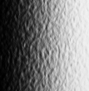


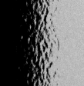

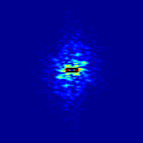
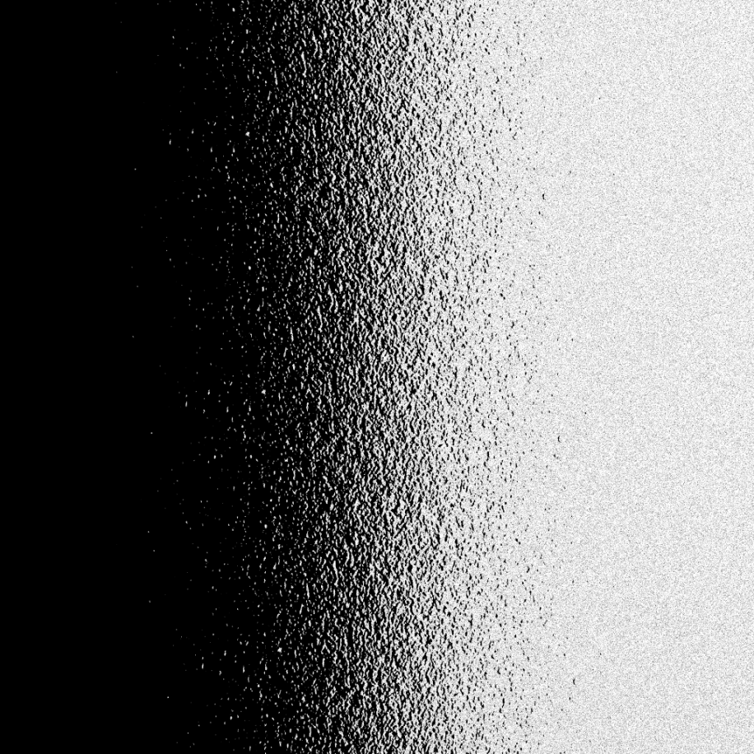
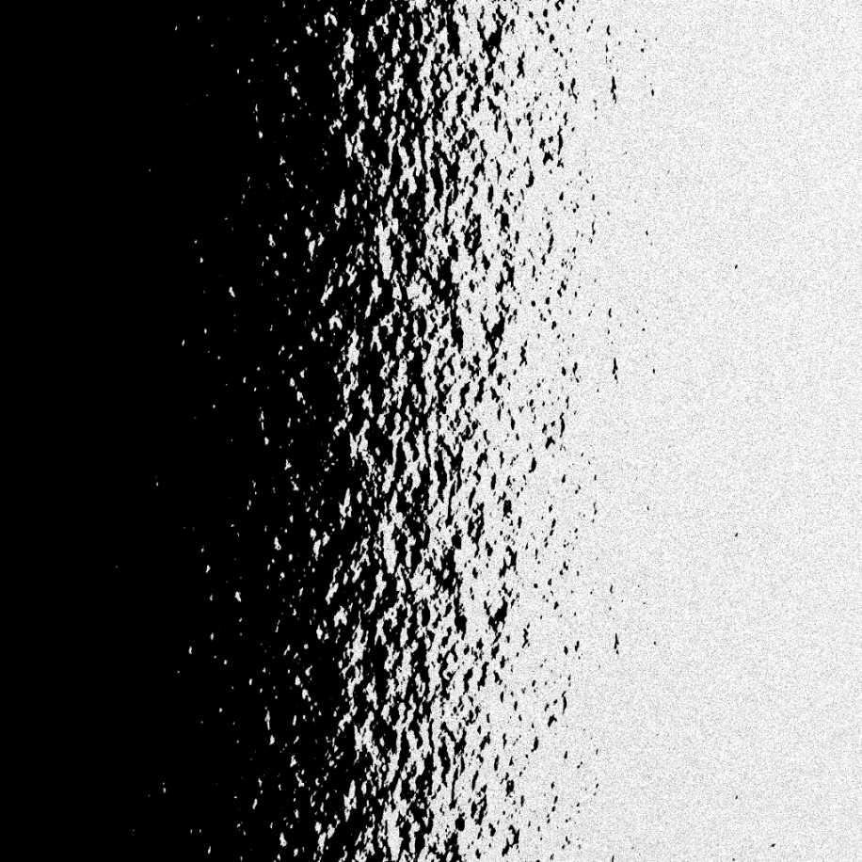
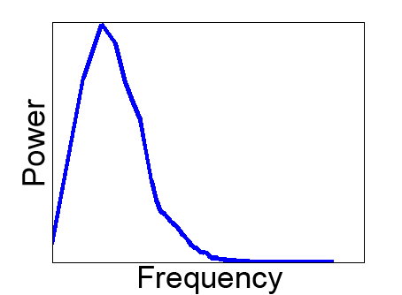
Mesostructure Representation
In meso-scale, distribution is not enough: bump shape is not defined
The same NDF with different bump shape
Notes:
However, the NDF does not tell the size and shape of the facets, and this is needed in meso-scale because facets are visible.
To illustrate, here shows two mesostructure with the same NDF, but completely different appearance
To capture the difference between them, we use the power spectrum to describe the height-map of the mesostructure.
Since we assume the surface is isotropic, the 2D power spectrum should be radially symmetric, so we can do a concentric average and represent it by a 1D slice.
We also assume the phase of the frequency domain is random so there is no need to store phase information.
And this is what we mean the mesostructure is random in the beginning of this talk.

Slide 14
Part 2: Acquisition Method
Notes:
Now we have the roughness and texture statistics to describe rough surface. Next is our acquisition method

Slide 15
Device Setup
Roughness
Texture statistics
σ_{M} (Mixed)
σ_{μ} (micro)
σ_{m} (meso)
Notes:
This is a recap of our device setup. We use this image as input to find the best surface parameters to explain the reflected image.

Slide 16


Reflection of Step-edge Lighting
Reflected image of step-light
intensity
*
X
Gauss error function (ERF)
Gaussian kernel size
Notes:
Let’s start from the simplest case: a surface with only micro-scale roughness, so the transition is smooth
If we take a horizontal slice of the image, we’ll get this intensity curve.
It turns out that this curve can be approx. by the convolution of step function and a Gaussian kernel, which is also called the Gauss Error Function.
The rougher the surface, the wider the curve becomes, and the standard deviation sigma_I of the Gauss Error function also become larger.
Assumptions: small angle (FOV, not viewing angle) => constant geometrical attenuation and foreshortening

Slide 17


Reflection of Step-edge Lighting
f_{C}: focal length
d_{L}
σ_{D}: NDF parameter
d_{C}
intensity
σ_{I}: ERF parameter
X
Notes:
We can measure the width of ERF, sigma_I, in pixels, but what we actually want is the surface NDF parameter, sigma_D
With small angle approximation, we show in the paper that their relationship follows this equation, which depends on the distance of the camera to the surface, the distance of the light to the surface, and the focal length of the lens.
Therefore, by estimating the width of the intensity curve, sigma_I, we find the surface roughness

Slide 18
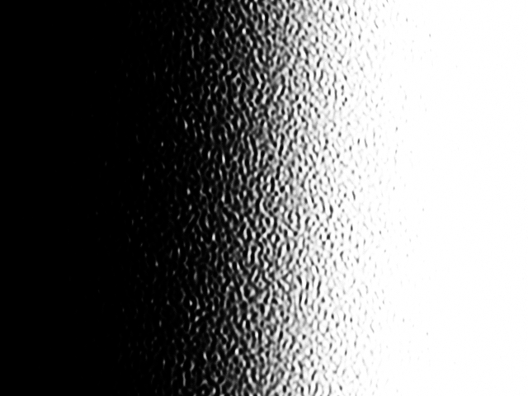
Reflection of Step-edge Lighting
Problem: our observation is the mixture of two scales of roughness
Micro-scale roughness only
Reflected image we observed
Notes:
However, the problem of this method is that our observation is not just micro-scale roughness: it’s a combination of both micro- and meso-scale roughness. Therefore we need to do more to estimate each scale of roughness

Slide 19
Overall Roughness Measurement
Found by least-square fit
σ_{I,M}
Notes:
For overall roughness the modification is very simple: just do a least-square fit of Gauss Error Function to the observed intensities

Slide 20
Effect of Mesostructure
Add meso
Add meso
Micro-roughness only
…
…
A
B
“Scrambled”
…
…
…
…
?
?
?
?
?
?
?
?
?
?
?
A
Δx
Micro + Meso
Idea: mesostructure “moves” pixels around locally
Notes:
Next, to separate meso- and micro-scale roughness from overall roughness, we need to model the effect of adding mesostructure to the surface. It turns out we can think this effect as if the mesostructure “moves” the pixels of the reflected image.
For example, consider a 1D slice of the reflected image from a surface with only micro-scale roughness. Suppose we add mesostructure to the surface, so the facet at point A now looks at the same part of the LCD as the facet at point B, then they will have the same intensity, and this can be thought as if the mesostructure moves the pixel from point B to A. As result, the image is a scrambled version of the original smooth image.

Slide 21
Micro-scale Roughness Measurement
Idea: random movement can be recovered by sorting
Micro + Meso
…
…
Sort pixels by intensities
Micro-roughness only
…
…
σ_{I,μ}
Notes:
Based on this idea, if the mesostructure is random, so it randomly moves the pixels, we can recover the original reflected image of a surface with only micro-scale roughness by sorting the pixels by intensities. In this way, the micro-scale roughness is given by the width of the transition region of the recovered image

Slide 22

Meso-scale: Roughness
Idea: amount of pixel shift meso-scale roughness
Micro-roughness only
…
…
…
…
Micro + Meso
Δx
Notes:
Now we have the micro-scale and overall roughness. In theory, we can compute the meso-scale roughness out of them; however, we found that this computation yields large error when the roughness difference between different scales is large. Therefore we propose an additional estimate for the meso-scale roughness, and adjust all three estimates to satisfy their theoretical relationship.
To estimate meso-scale roughness, we use the pixel-shift model again, but this time in the reverse way: for each pixel of the reflected image from a surface with mesostructure, we want to find its pixel shift. For example, here shows the pixel shift of the first pixel, and the second pixel, and then all of the pixels. As we show in the paper, the meso-scale roughness is given by the variance of the all the pixel shifts in the image.

Slide 23
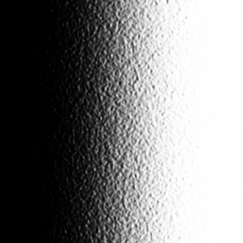

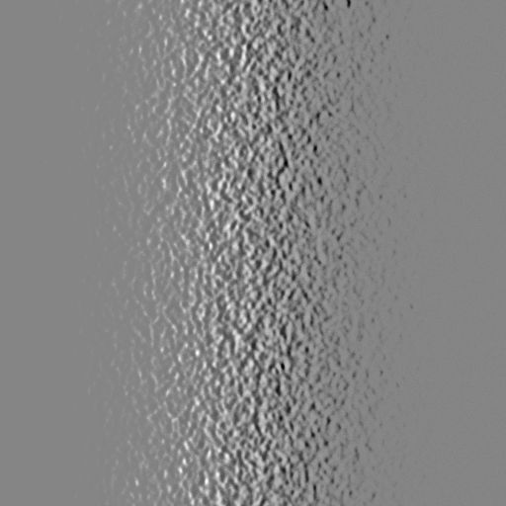
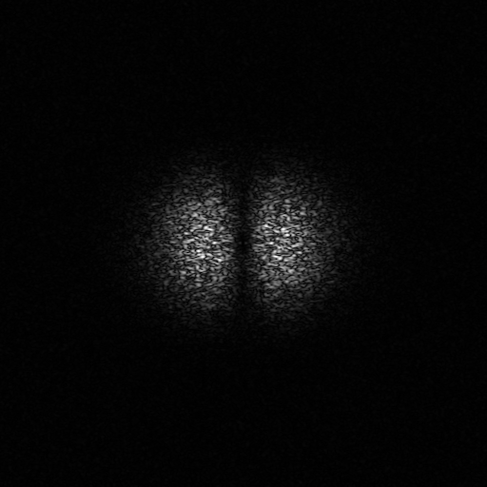
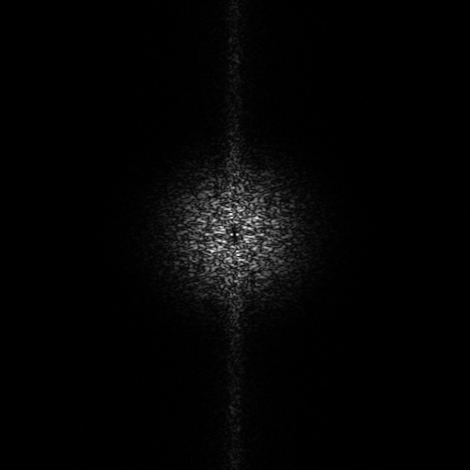
Meso-scale: Texture Statistics
Reflected Image (micro-roughness only)
Reflected Image
Concentric average of spectrum
-
=
Intensity differences
Frequency spectrum
Frequency spectrum (corrected)
Notes:
Finally is the texture statistics of the mesostructure. This can be found by subtracting the micro-scale component from the reflected image, and compute the frequency spectrum.
However, this spectrum is not the from the mesostructure itself; instead, it’s from the intensity difference of the rendered image.
In the paper, we show that the intensity difference is related to the derivatives of the height-field of the mesostructure.
So the frequency spectrum of the mesostructure itself can be obtained by using a rule for the Fourier transform of the derivative of a function.
Finally, based on the isotropic assumption, the frequency spectrum should be radially symmetric, so we do a concentric averaging to get the 1D power spectrum.

Slide 24
Results
Notes:
Now we have methods to estimate surface roughness and texture statistics. Next we will show our results.

Slide 25
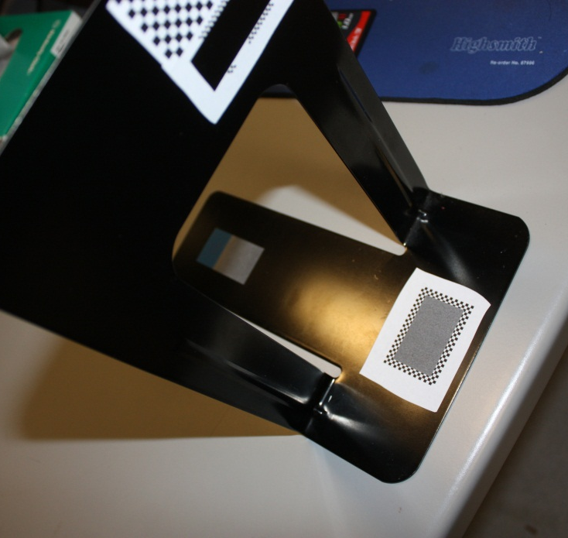
Metal bookend
Notes:
We first apply our method to a black metal bookend

Slide 26
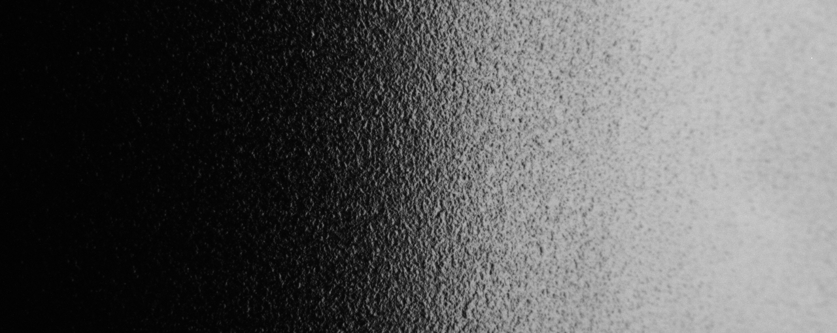
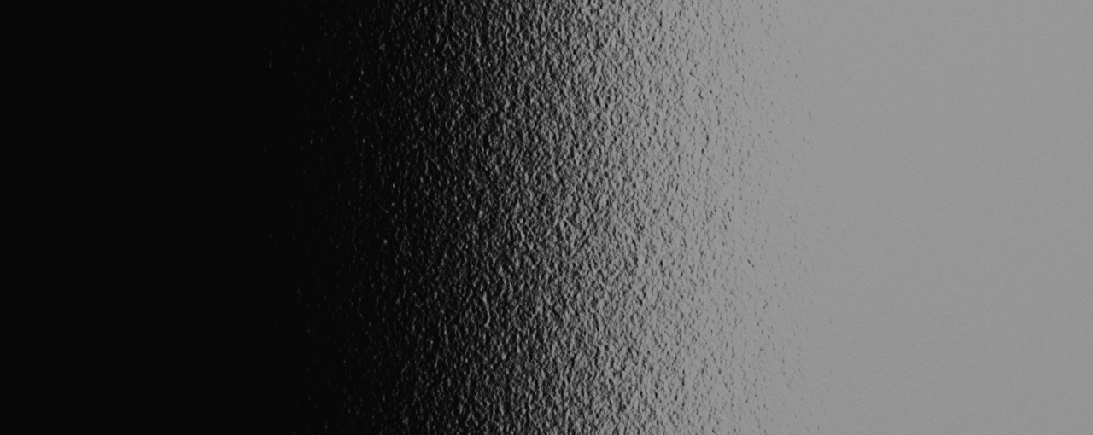
Acquired view
Acquired view (rendering)
Notes:
The top half of the image shows the real photo of the reflected image of step-edge lighting, and the bottom half is the rendering using the parameters we estimated. You can see the roughness and the properties of mesostructure is successfully captured. You might notice the intensity difference at the right of the image; this is possibly caused by the non-lambertian emission of the LCD.

Slide 27
Novel view
Novel view (rendering)
Notes:
Here shows the comparison of the real thing and the rendering from a novel view. What you see is a reflection of an iPhone screen on the surface. As you can see here, the characteristics of the surface is captured

Slide 28
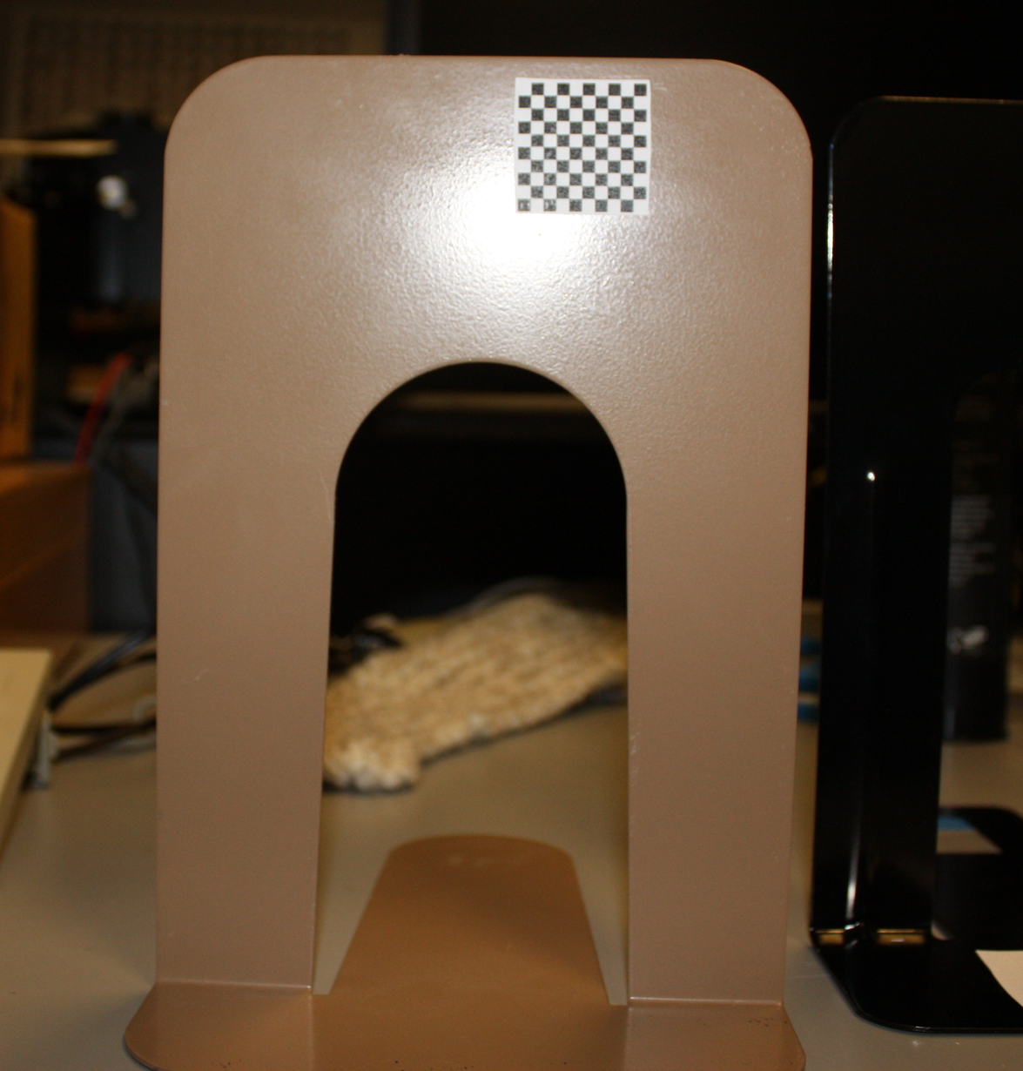
Beige bookend
Notes:
Here is another example: a beige metal bookend

Slide 29
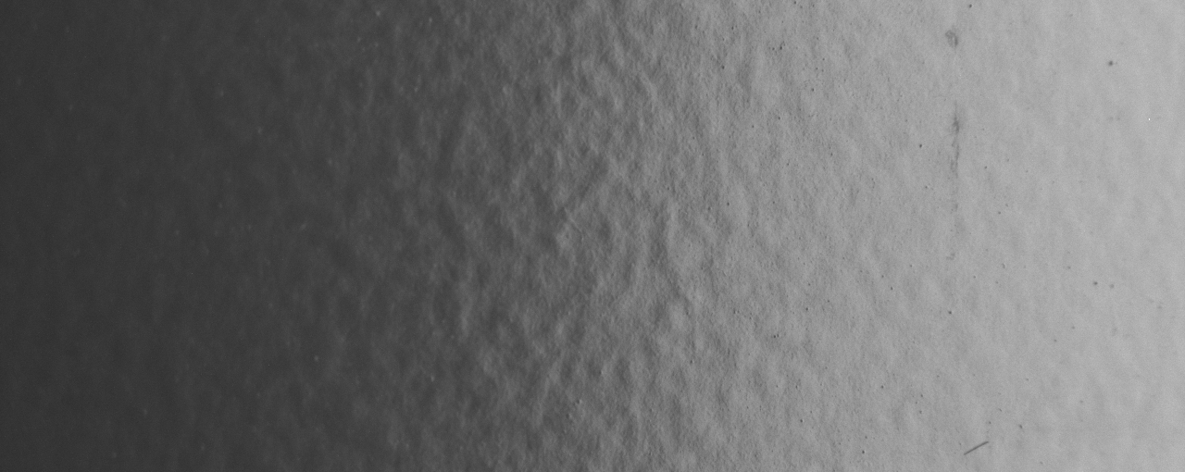

Acquired view
Acquired view (rendering)
Notes:
The image shows that this surface is much rougher than the previous bookend. And you can see even if the 1D description of texture seems weak, it can still capture this mesostructure, which is very different from the previous one.

Slide 30
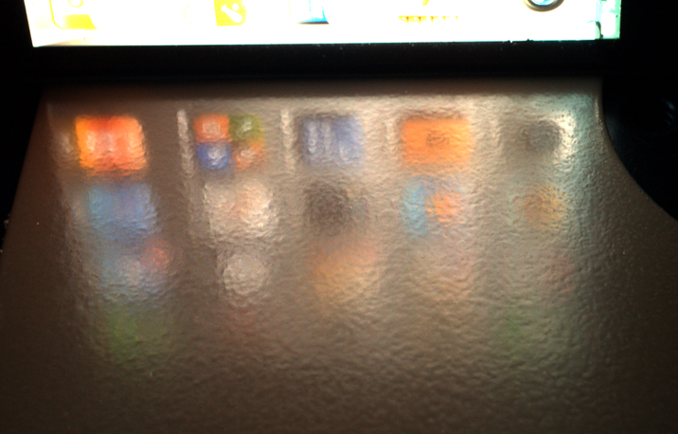
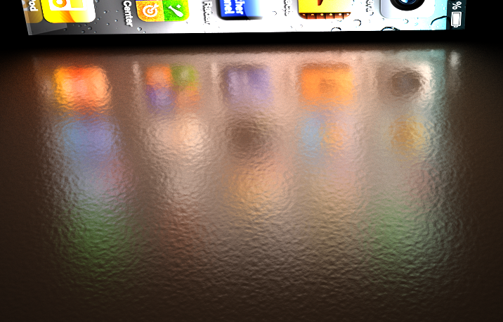
Novel view
Novel view (rendering)
Notes:
Here shows the rendering from a novel view

Slide 31
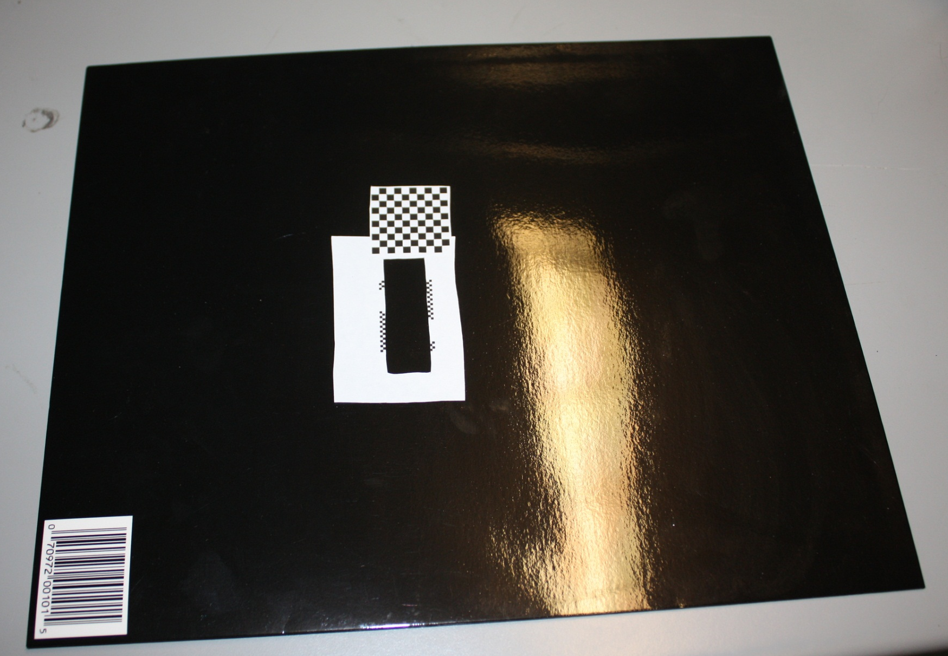
Black folder
Notes:
Next we apply our method to a more different material: a black paper folder

Slide 32
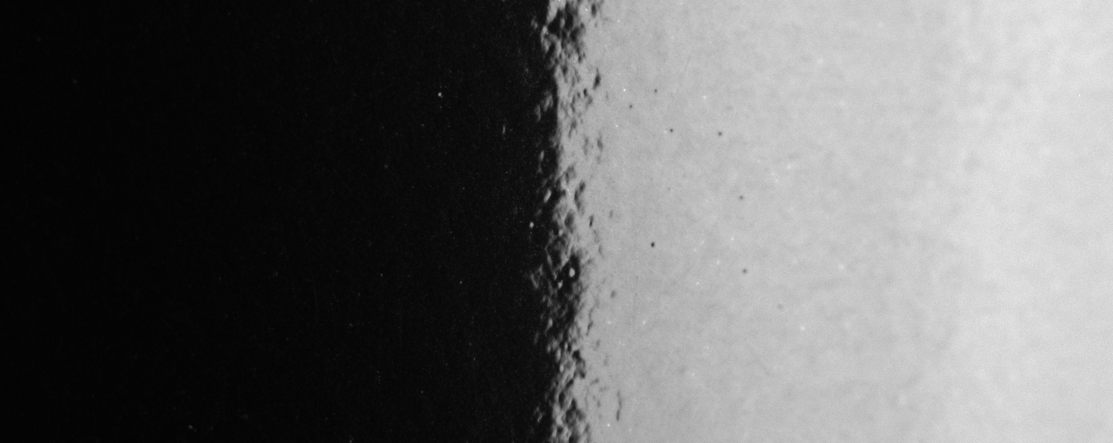

Acquired view
Acquired view (rendering)
Notes:
You can see his material is much smoother, but our method can still handle it

Slide 33
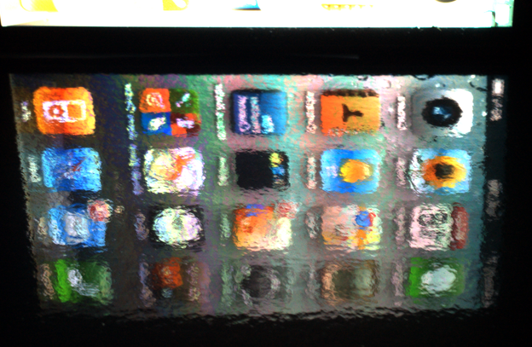
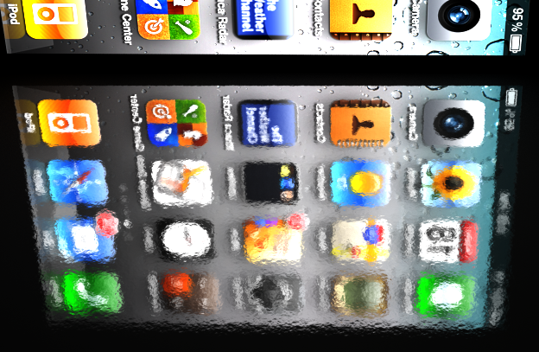
Novel view
Novel view (rendering)
Notes:
And the result from a novel view. Notice that the color moire pattern in the real photo is of course not captured in the rendering.

Slide 34
Whiteboard
Notes:
And here is the smoothest material in our dataset: a whiteboard

Slide 35
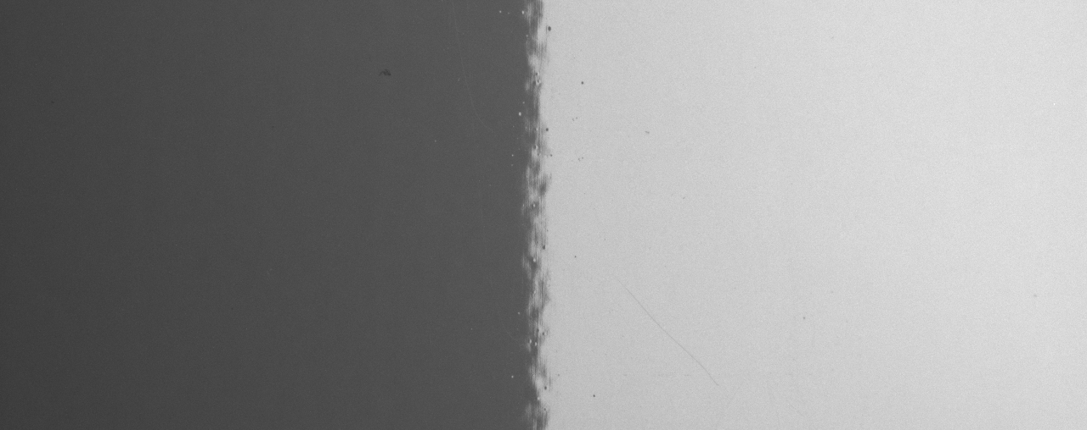

Acquired view
Acquired view (rendering)
Notes:
You might think a whiteboard is very smooth, but in close-up view it still has interesting mesostructure

Slide 36
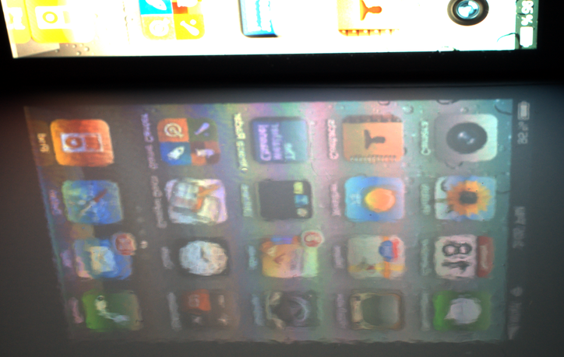

Novel view
Novel view (rendering)
Notes:
And here shows the result. Notice the high-contrast edge at the bottom of the reflection. You can see the effect of mesostructure here

Slide 37

Red folder
Notes:
Finally we show an example that our method failed. This is a red paper folder

Slide 38


Acquired view
Acquired view (rendering)
Notes:
From the acquisition view it seems that our method did well, but from the novel view you can see that

Slide 39


Anisotropic mesostructure
Novel view
Novel view (rendering)
Notes:
Our method did not capture the horizontal stripes of the real photo. This is because the stripes breaks the isotropic assumption we made. Nevertheless, our method still returns a reasonable level of roughness of the surface

Slide 40
Conclusion
Contributions
Dual-level statistical model of rough surface appearance
A lightweight material capture system
On range of glossy, bumpy surfaces
Future work
Implementation on iPad
Anisotropic surface (in micro- or meso-scale)
For arbitrary illumination: find “good” step-edges
Notes:
To conclude, we propose a dual-level statistical model for rough surfaces, and a lightweight acquisition system that applies on glossy, bumpy surfaces. For future work, we would like to implement the system on an iPad so we have a real mobile acquisition device. We also want to extend our work to handle anisotropic surfaces, and eventually, adopt arbitrary illuminations by finding “good” step-edges in the environment map.

Slide 41
Acknowledgements
Data Acquisition and Figures
Kevin Matzen
Funding
NSF grants IIS-0964027 and IIS-1011919
MIT Lincoln Labs
Intel Science and Technology Center for Visual Computing

Slide 42

Thank you

