Slide 1
Giving Professional Talks
Ken Birman

Slide 2
Professional talks
The centerpiece of any research career
  As important in industry as it is here at Cornell
  Key to getting a great job… and to keeping it!
Anyone can learn to give good talks
  But not everyone is born knowing how

Slide 3

Today’s Lunch is about your Work!
Your chance to share the amazing stuff you do.
Be yourself… Be friendly… But own it!
Don’t let anything hijack it – not the audience / clock / text on slides.
Plan the talk: your way to tell your story,
Sure, you may get questions out of order or that seem “off” topic.
… but you don’t have to answer them right away!

Slide 4
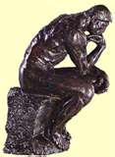
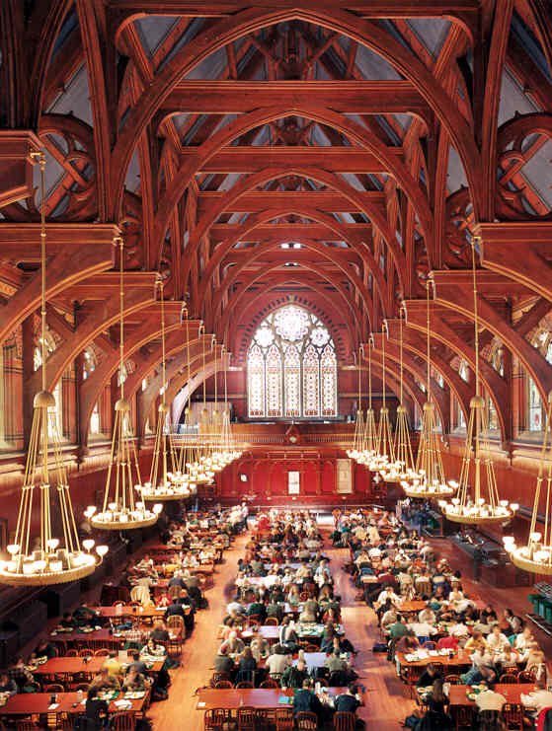
The Life of a philosopher
while(true) {
  Think();
  Eat();
  }
Oh no! Not enough forks!

Slide 5
The Life of a Researcher
while(true) {
  Think();
  Teach();
  Eat();
  }
Oh no! Not enough time!

Slide 6
But we teach in many ways…
Classroom situations
Seminars and workshops
Brainstorming sessions
Explaining an idea to colleagues at lunch

Slide 7

The Rule of Three
Almost nobody can keep more than three or four ideas in mind at the same time.
We communicate through multiple images, words, gestures, emphasis.
These can usefully be reinforcing: same message in several forms.
But if your words, images and gestures are uncoordinated… not so great.
Control how much the audience needs to remember and how you will teach it.

Slide 8
Some Aspects we’ll Consider
How to prepare a professional seminar or presentation
Dealing with timing and flow
How detailed to get?
Structuring your material
Dynamics of talking to an audience
Common pitfalls

Slide 9
Sample timelines
 | # Slides? | Warmup | State model and Problem | Core Results | Prior work, recap/summary
20 minutes, specialists | 20-25 | 2 | 5 | 5 | 5+3
20 minutes, general audience | 18 | 5 | 5 | 5 | 3+2
50 minutes, specialists | 50-65 | 5 | 10 | 25 | 5+3
50 minutes, general audience | 45 | 10 | 20 | 10 | 5+3
(not including builds and multi-slide sequences that construct one slide from several)

Slide 10
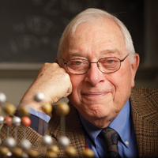
Pithy advice from Ken’s Dad
Not everything matters: Use your voice to stress the important stuff (tone, delivery pace, emphasis).
Slides aren’t papers. Be a minimalist.
A talk isn’t a paper. It is more like advertising.

Slide 11
Pithy advice from Ken’s Dad
Plan to convey one “idea” per 20 minutes
  The hard part should be limited to the central 10 minutes or so
  An idea doesn’t have to be simple, but it must be motivated and
  teachable, and needs a logical development.
  It can take a full 15 minutes to reach “voila”.
  For a talk longer than 20 minutes, think of narrative or story “arcs”

Slide 12
Underlying Insight?
In a lecture, “less is more”
There is a limited capacity for information flow.
Not using the bandwidth is a shame: your talk will seem light and dull.
But exceeding it is just as bad: the audience will disconnect.

Slide 13
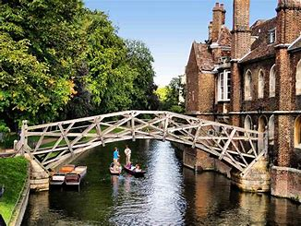
Designing a Lecture
Think about the “narrative arc”.
Ask yourself what you want your audience to understand.
Get a broad sense of your timing right from the outset.

Slide 14
Why an “arc”?
A talk tells a story, building it up over a series of slides
  Like a section in a paper, with a topic sentence
The story arc engages the audience by setting context/motivation.
Then it builds to a main contribution (the “money slides”).
Sometimes, it will need some form of summary.
An engaged audience pays attention and may even try to guess what comes next.

Slide 15
… don’t omit the “wow”
The audience expects a core insight.
  Something hard, and new to them. It’s why they came to your talk
  For a longer talk, they expect two of them
Your job: Set the stage... build suspense... lead them… blow them away.
It’s ok to get pretty technical as long as you don’t do it often.

Slide 16
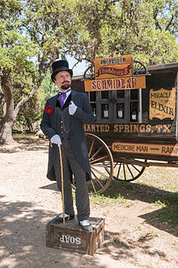
But… be honest
They wanted gold, but you’ve got bronze.
Don’t oversell the work.
“I’m excited about this result, but I need to be frank about the limitations.”

Slide 17
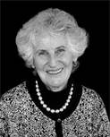
Pithy advice from Ken’s Mom
If you want people to ignore you
  Mumble. Speak rapidly (with sudden shifts of focus).
  Don’t look at the audience.
  Put way too much detail on your slides. Then read every word.
  Don’t speak to the point. Even better: lose track of your point.
  If your audience looks confused, double the speed of your delivery.
  Apologize a lot.

Slide 18
Slides
Be a minimalist
This said, slides need to look nice.

Slide 19
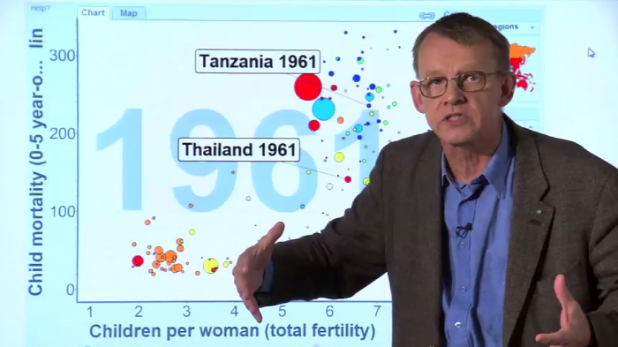
Information channel perspective
What is this speaker saying? Look at his face: Expression and emotion convey information!
What do the words and images on the slide tell us?
Hans animates his slides? Why?
You couldn’t miss his story arc even if you tried!
Hans Rosling on gapminder.org: Amazing speaker!
https://www.ted.com/talks/hans_rosling_on_global_population_growth

Slide 20
“channel fails”
Not looking at the audience, monotone delivery.
These break the connection… the audience disengages.
Disconnected stories…
If you lose the story arc, the audience will get confused.
The story arc is your thematic link… always keep it in mind.

Slide 21
Common “channel fails”
Reading your slides to the audience wastes a channel!
Useless details waste a channel.
Extra words in your sentences (remember: more is actually less!)
Going tangential… saying things only one person would care about

Slide 22
Common “channel fails”
Reading slides wastes a channel!
Useless detail.
Extra words.
Going tangential…
[Birman, K. “How to give a talk. CS BB 2018.]

Slide 23
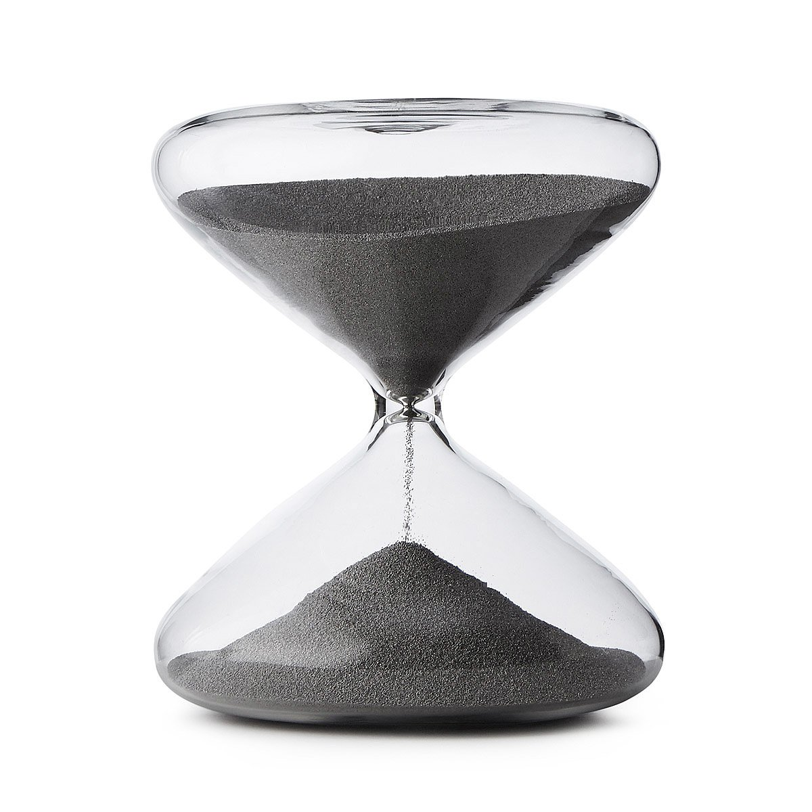
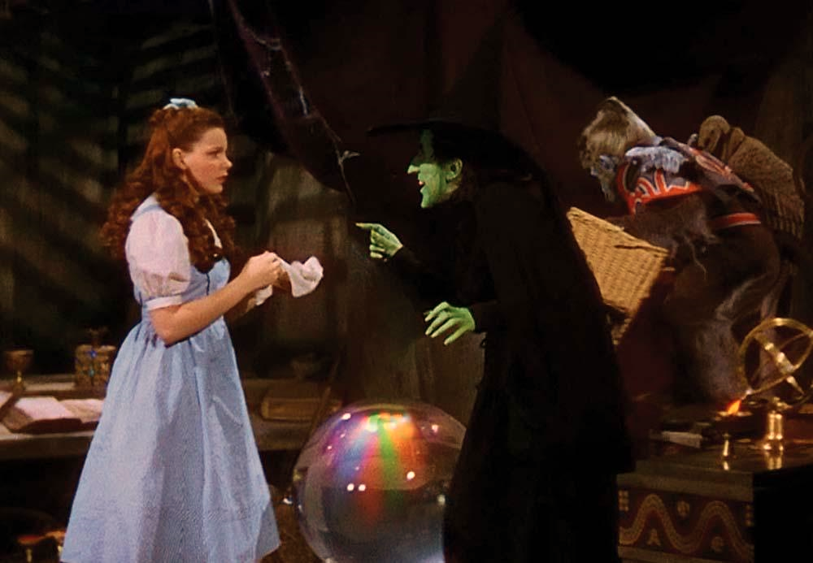
Time… friend or enemy?
You have 20 minutes, my pretty. 20 minutes... Then the microphone will be mine!
Time is hard.
… so easy to lose track!
Your talk can’t run over.
Yet time is also on your side
  You just can’t babble endlessly
  This forces you to focus
The Wizard of Oz

Slide 24

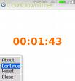

Time: Own it!
Know when you need to stop.
Find a wall clock… or put phone in timer mode
  Check it often.
  Adjust your pace to stay more or less on plan
Don’t trust a “timekeeper”
Oops, my bad. Time’s up!

Slide 25
Think of time when structuring a talk
Most talks have a “standard” structure
  The introduction and “context setting” part
  The more detailed problem statement
  The solution to the problem and validation
  Implications of your work
  Wrap-up
  If running out of time, jump to the most important remaining slide.
  Many things can be skipped
  But not that key lesson you came to teach.
}
Can loop… twice

Slide 26
Sizing up the audience
Try and find out about the audience in advance
The room is full of very smart people. Trust their intelligence.
Use wording they will understand. Watch their faces: do they get it?

Slide 27
Engage your audience
Relax. Look at the audience. Enjoy yourself.
Keep it light, but avoid comics, self-deprecating remarks, jokes about them being sleepy.
Pause for emphasis. Wait a few beats, while they think it over.

Slide 28

Overcoming fear
Relax. Talks are fun!
  Move around! You won’t look or feel so stiff
  Feel free to gesture with your hands and arms
Convey level of interest with tone of voice
  Frightened speakers often speak in a monotone

Slide 29
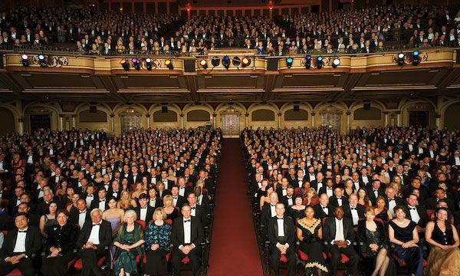
Overcoming fear
This non-threatening person is your friend!

Slide 30
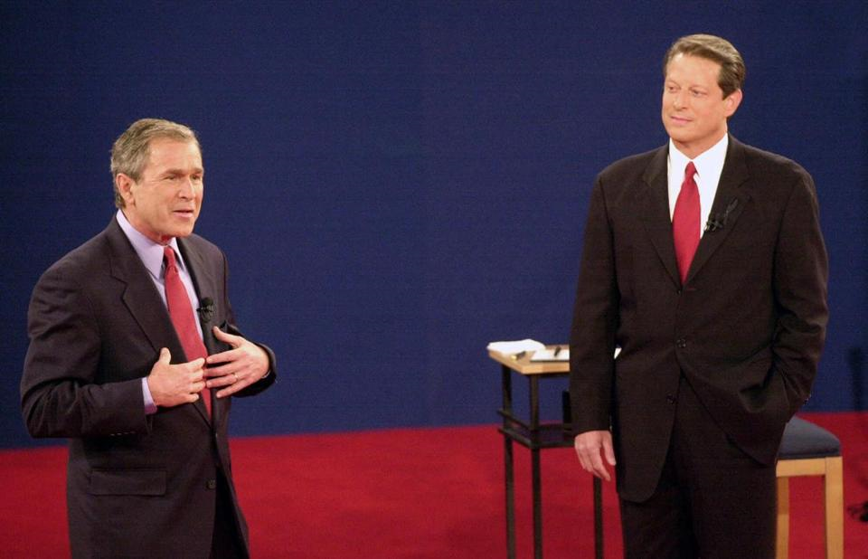
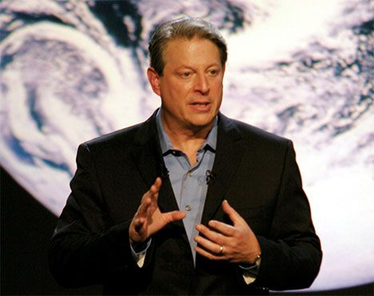
If in doubt…
Lots of us have last minute doubts
  …. Just smile confidently, and do your job
  Describe (but don’t apologize for) limitations
Body language sends a message!
  Audiences connect to confident speakers.
  If you don’t believe in yourself, who will?
  If you do believe in yourself, they will too!

Slide 31
A good Slide set Tells the story eloquently with very few words
Each slide should be
  Simple… Self-explanatory
  White space and big fonts really help a lot!
But sometimes you have no choice:
  Some slides just aren’t simple
  Use “builds” to carry your audience along step by step

Slide 32
But some slides don’t work…
With apologies to the authors…

Slide 33
Storing Content in the Cloud
content
edge
cloud
server in a
data center
client-server
interactions

Slide 34
Storing Content in the Cloud
content
edge
cloud
server in a
data center
client-server
interactions

Slide 35
Storing Content in the Cloud
content
edge
cloud
server in a
data center
client-server
interactions

Slide 36
Storing Content in the Cloud
content
edge
cloud
server in a
data center
client-server
interactions

Slide 37
Storing Content in the Cloud
content
edge
cloud
server in a
data center
client-server
interactions

Slide 38
Storing Content in the Cloud
content
edge
cloud
server in a
data center
client-server
interactions

Slide 39
Storing Content in the Cloud
content
edge
cloud
server in a
data center
client-server
interactions

Slide 40
Storing Content in the Cloud
content
update relayed through the server
server in a
data center
client-server
interactions

Slide 41
Storing Content in the Cloud
content
edge
cloud
server in a
data center
explicit request,
e.g. HTTP GET

Slide 42
http://liveobjects.cs.cornell.edu

Slide 43
Storing Content at the Edge
content
replica
edge
server in a
data center
peer-to-peer
interactions
content
replica
content
replica

Slide 44
Storing Content at the Edge
content
replica
edge
server in a
data center
peer-to-peer
interactions
content
replica
content
replica

Slide 45
Storing Content at the Edge
content
replica
edge
server in a
data center
peer-to-peer
interactions
content
replica
content
replica

Slide 46
Storing Content at the Edge
content
replica
edge
server in a
data center
peer-to-peer
interactions
content
replica
content
replica

Slide 47
Storing Content at the Edge
content
replica
edge
updated
server in a
data center
peer-to-peer
interactions
content
replica
content
replica

Slide 48
Storing Content at the Edge
content
replica
edge
updated
server in a
data center
multicast
peer-to-peer
interactions
content
replica
content
replica

Slide 49
Storing Content at the Edge
content
replica
edge
updated
server in a
data center
updated
updated
content
replica
content
replica

Slide 50
Storing Content at the Edge
content
replica
edge
server in a
data center
replicated state
machine
content
replica
content
replica

Slide 51
Storing Content at the Edge
content
replica
edge
server in a
data center
manage
membership
content
replica
content
replica

Slide 52
Storing Content at the Edge
edge
server in a
data center
control
data

Slide 53
Storing Content at the Edge
edge
server in a
data center
control
data

Slide 54
Cloud vs. Edge?
content
replica
content
edge
edge
cloud
server in a
data center
server in a
data center
peer-to-peer
interactions
client-server
interactions
content
replica
content
replica

Slide 55
Cloud vs. Edge?
edge
server in a
data center

Slide 56
Cloud vs. Edge?
edge
server in a
data center

Slide 57
Cloud vs. Edge?
edge
server in a
data center

Slide 58
Cloud vs. Edge?
edge
server in a
data center
no replicas left

Slide 59
Cloud vs. Edge?
content
bottleneck
edge
cloud
server in a
data center
client-server
interactions
flow of
updates

Slide 60
Cloud vs. Edge?
content
bottleneck
edge
cloud
server in a
data center
client-server
interactions
flow of
updates

Slide 61
Cloud vs. Edge?
content
bottleneck
edge
cloud
server in a
data center
client-server
interactions
flow of
updates

Slide 62
Cloud vs. Edge?
content
bottleneck
edge
cloud
server in a
data center
client-server
interactions
flow of
updates

Slide 63
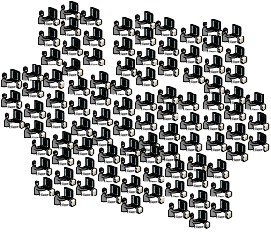

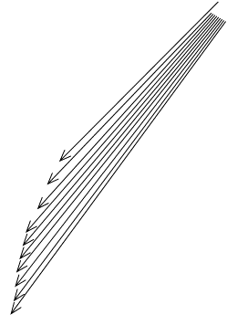
Cloud vs. Edge?
content
bottleneck
edge
cloud
server in a
data center
client-server
interactions
flow of
updates

Slide 64
DMRDDS Vision
Computational
Intelligence
Complete, accurate, tailored,
knowledge on demand
Smart Agents
JBI
Deep Extraction
Self Generating
Knowledge Bases
Advanced Reasoning
GA, DP&E, GIE
Rapid Knowledge Formation
Generic Problem
Solving Methods
Knowledge Discovery
Ontologies
Relationships
Knowledge Bases
Reasoners
TCT
KB Point Solutions
Knowledge Sharing
Intermediate Extraction
IA
Entities
Timelines
Patterns
Relationships
Knowledge
EBO
Self Organizing DB’s
A B C D
KB Foundations
X
X
y
y
X
Application specific
Problem Solvers
y
X
y
y
X
y
y
Information
X
X
X
Flat Files
Documents
Web pages
Data Tables
y
Shallow Extraction
Information Products
Knowledge Management
X
Advanced Mediation
X
Structured
Unstructured
Repositories
Relevant Data
Smart Web Search
Data
Large-Scale Object
Repositories
AFRL
DARPA
Digital Libraries
Commercial
Web Search
1997
2000
2002
2005
2008

Slide 65

DMRDDS
Relationship to the Thrust
Dynamic Planning & Execution
Examples: DPE
Next Generation & Coalition C2
C2 Decision Support
Dynamic Execution
Effects Based Operations
Reasoning about adversaries next move
Planning & Scheduling
“What-if” Enabled Planning
COA generation
Intelligent access & integration of
distributed information sources.
Focus Area DDS is
central to all three IF thrusts
Access and Structuring
Viewing
and
Querying
Information
Search
Analysis
Tools
Planning
Decision
Support
Merging
Information
Sharing
Abstraction
Global Information Enterprise
Global Awareness
Text
Analysis
Image
Analysis
Sensor
Fusion
Database
Wrapper
Simulation
Interface
Aerospace Connectivity
Information Assurance
Networking
Information Systems
Text/Speech
Images
Sensors
Data Bases
Information Exploitation
Information Fusion
Information Understanding
Knowledge-based Fusion
Situation Assessment
Threat Prediction
Discovery
Intelligence Analysis
IPB
COA Analysis
Prioritization of Intelligence Requirements
Intrusion Detection
Predict adversary behavior
Determine most likely/devastating attacks
Determine the optimal set of countermeasures
Network Configuration
Examples: GIE
Examples: SitAW

Slide 66
Recommended Quality R&D Metrics
(from Report of AFRL Research Council Quality Metrics Committee)

Slide 67
Some better Slides
(and the reasons)
Look for the principle, not the specifics of the slides

Slide 68
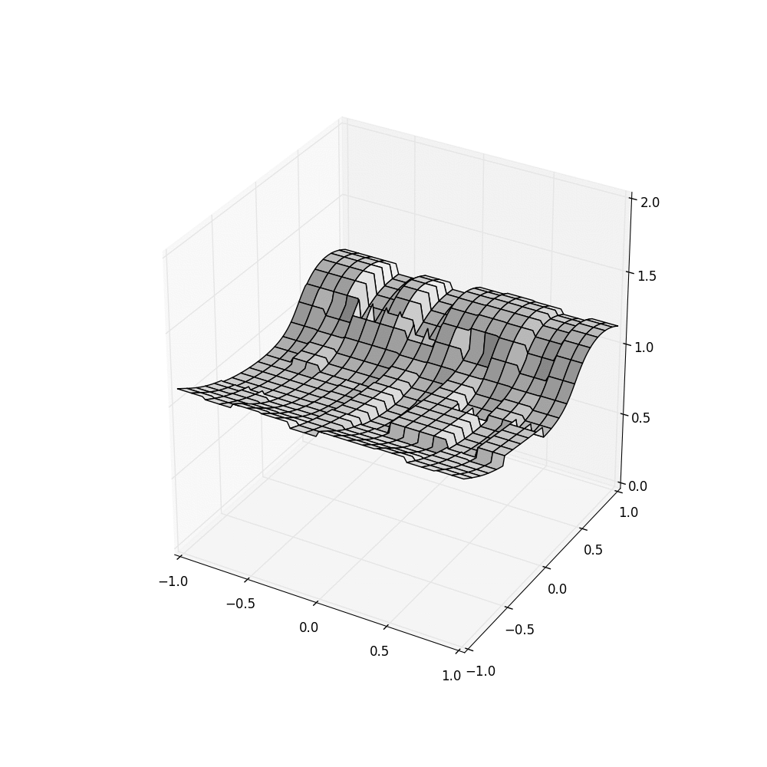
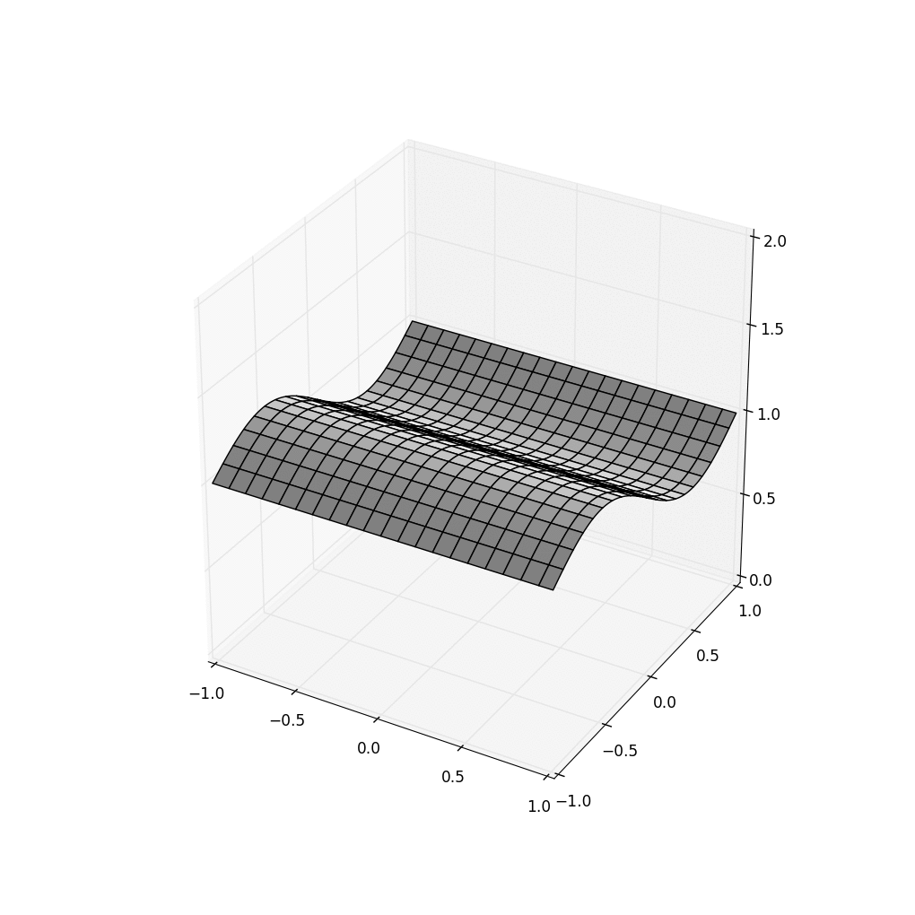

Use Animations to tell your story
HDFS FFFS+SeRver Time FFFS+Sensor TIME
This animation gives the viewer an intuition into “consistency”: HDFS lacks it.

Slide 69
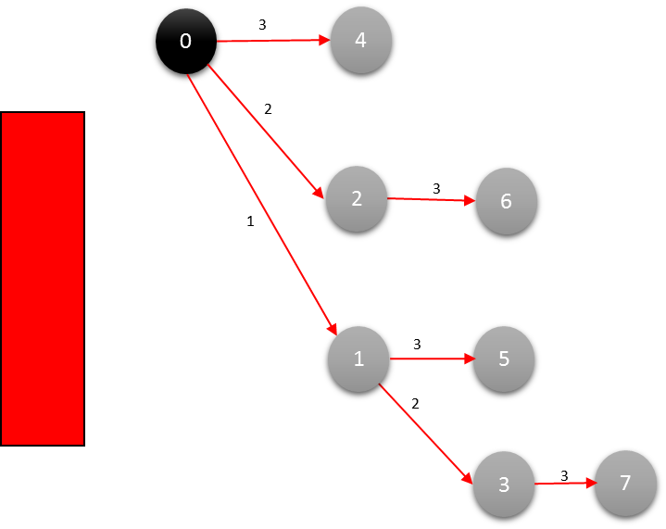
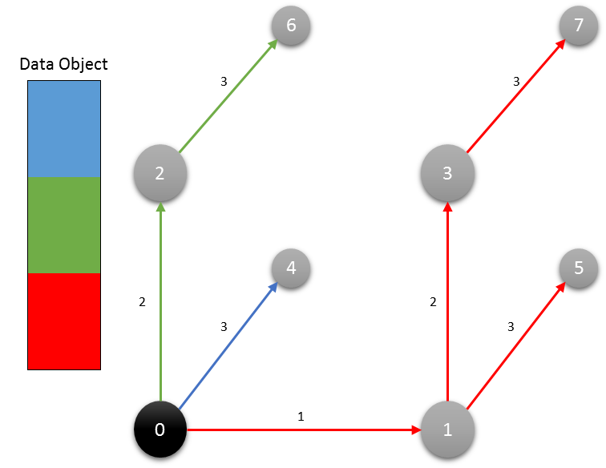
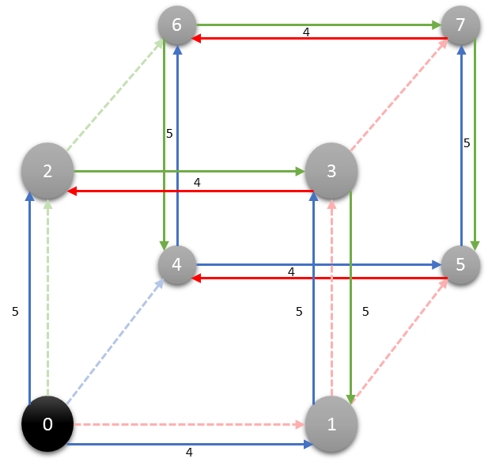
RDMC: AN RDMA Multicast
Dest
Source
Dest
Dest
Dest
Multicast
Binomial Tree
Binomial Pipeline
Final Step
This build develops intuition behind a complex algorithm.

Slide 70





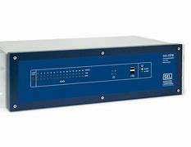

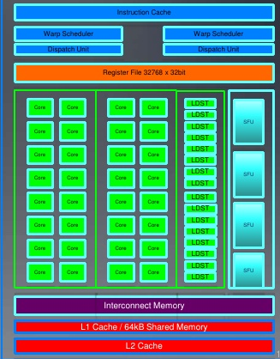
Deep dive on these costs!
First, data is saved to the file system (now we know it is a key-value object store)
Request objects one by one
Your logic
HDFS
Runtime copies data into GPU
Accelerator Layer
Objects copied over datacenter TCP network
GPU
Your code is in its own address space, maybe on a different computer

Slide 71
Traditional Approach: UsE
Caching to hide overheads
Request objects one by one
Your logic
Spark-style caching hides these costs, but
only for iterative cases like ML training
File system or
Key-Value Store
$$$
Accelerator Layer
Objects copied over datacenter TCP network
GPU
Your code is in its own address space, maybe on a different computer

Slide 72

… Cascade hosts data and code
Fast-path logic (DLL)
Key-Value Storage Layer
Accelerator Layer
GPU
Cascade runtime environment

Slide 73
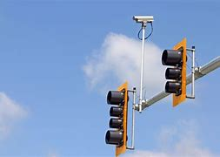
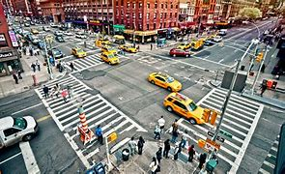
CASCADE: CUSTOMIZED SMART SERVICES
Request for classification triggers a C++ lambda in the Cascade address space
Fast-path logic (DLL)
Ideally, these are cached on GPU…
Key-Value Storage Layer
… and RDMA stores directly in GPU memory
Upload “instructions”
ML model, hyperparameters, other inputs
Image to classify
Accelerator Layer
GPU
GPU-accelerated kernel initiated from the lambda

Slide 74
When do animations and builds work?
Think of the animation or build as an element of the story.
We are using these “powerpoint tricks” as a way to communicate.
Avoid random effects… but consistent use of a nice effect can help the
audience understand your point.

Slide 75
Table, Impossible to read
Kind of technology | Why we rejected it
IP multicast, pt-to-pt TCP | Too many IPMC addrs. Too many TCP streams
Software group multicast solutions (“heavyweight”) | Protocols designed for just one group at a time; overheads soar. Instability in large deployments
Lightweight groups | Nodes get undesired traffic, data sent indirectly
Publish-subscribe bus | Unstable in large deployments, data sent indirectly
Content-filtering event notification. | Very expensive. Nodes see undesired traffic. High latency paths are common
Peer-to-peer overlays | Similar to content-filtering scenario

Slide 76
Table, with Attention emphasis
Kind of technology | Why we rejected it
IP multicast, pt-to-pt TCP | Too many IPMC addrs. Too many TCP streams
Software group multicast solutions (“heavyweight”) | Protocols designed for just one group at a time; overheads soar. Instability in large deployments
Lightweight groups | Nodes get undesired traffic, data sent indirectly
Publish-subscribe bus | Unstable in large deployments, data sent indirectly
Content-filtering event notification. | Very expensive. Nodes see undesired traffic. High latency paths are common
Peer-to-peer overlays | Similar to content-filtering scenario
Bold font, pop-ups can help too

Slide 77
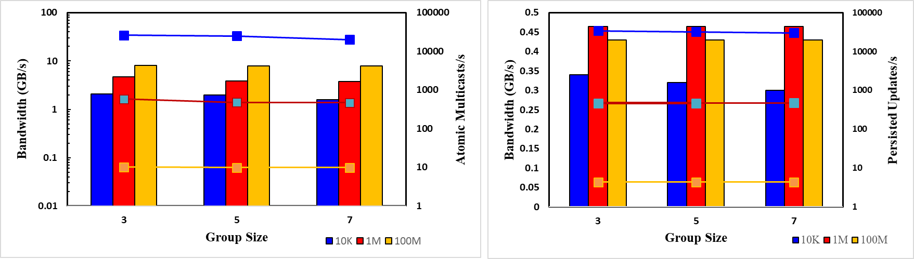
Way Faster than ANY Prior system
They can’t read these graphs!
LibPaxos atomic multicast
APUS: RDMA atomic multicast
Derecho atomic multicast
Zookeeper with in-memory files
LibPaxos Persisted to SSD
Derecho Persisted to SSD

Slide 78
Way Faster than ANY Prior system
Derecho’s atomic multicast throughput is 200x that of LibPaxos in a 5 member group.
With 1M objects,
Derecho’s replication protocol is 200x faster than LibPaxos with 100KB objects.
With 1M objects,
Derecho’s persistent replication protocol is 10x faster than LibPaxos with 100KB objects, and 50x faster than persisted LibPaxos.
With 1M objects,
Derecho’s persistent replication protocol is 10x faster than LibPaxos with 100KB objects, and 50x faster than persisted LibPaxos.
Derecho’s persistent replication throughput is 100x that of non-persisted Zookeeper,
500x faster than persisted LibPaxos.
LibPaxos atomic multicast
APUS: RDMA atomic multicast
Derecho atomic multicast
Zookeeper with in-memory files
LibPaxos Persisted to SSD
Derecho Persisted to SSD

Slide 79
Notice the pattern behind the mistakes
Getting too detailed.
  Convey style and impact… not details!
  Crowded slides, small font are just a waste of space!
  But directed focus can remedy this issue
  Old slides (or someone else’s slides)
  They never feel right… often you won’t even understand them.
Out-of-order topics. (Fuzzes the story arc)

Slide 80
Some common mistakes
Rhetorical questions (or real questions)
The audience doesn’t really want to help in this way.
Asking questions makes sense only if you have a reason.
Losing their enthusiasm.
  Key is for the audience to feel excited.
  Leave the details for offline.

Slide 81
Use jokes cautiously
Getting people to laugh with you is good
  But your job isn’t to be a comedian
  Don’t tell “real” jokes, but look for opportunities to lighten the presentation
Encouraging them to laugh at you is always bad
  “I can see that I’m putting you to sleep”
  “I know this is going to be boring”

Slide 82
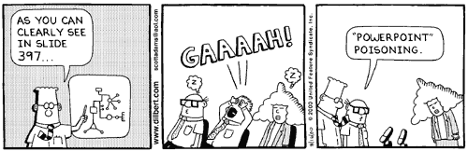
Powerpoint effects
Pick the animation effects you plan to use, then stick with them.
Try and use the same font, color scheme, animation styles throughout.
Do things for a reason.

Slide 83
Technology fails
Almost always your own fault
It is very rare that a technology problem can’t be fixed if you notice it ahead of time

Slide 84
An e xampl e… t his t alk
Often the “chair” of a session wants to run your slides on their computer
But… they might not have the identical software. Not all “open office” products interoperate. Some might just not have the fonts installed.
Agree, but always test first. Have your laptop. If their system isn’t displaying your slides properly, then say “I’ll use my laptop” in a firm tone of voice.

Slide 85
OpenOffice isn’t flawless
Deal with the laptop hookup ahead of time.
  Or while the guy before you is taking questions
Pre-test all your slides if isn’t your machine.
  Mac, Linux, PC incompatibilities are famous!
  Open office isn’t really compatible with Microsoft.
  PDF works best (but builds will be lost).
Put on the microphone pointed at your throat.
  Tap it to see if it is live.
Deal with the laptop hookup ahead of time.
  Or while the guy before you is taking questions
Pre-test all your slides if isn’t your machine.
  Mac, Linux, PC incompatibilities are famous!
  Open office isn’t really compatible with Microsoft.
  PDF works best (but builds will be lost).
Put on the microphone pointed at your throat.
  Tap it to see if it is live.

Slide 86
Technology catastrophes
Stay calm but take control. Resolve the issue.
  Time wasted will come from your slot
  Have your slide set, in original form, on a download site on the web
Fixing it may take time?
  “Look, let’s skip to the next speaker, and I’ll speak after her.”
  Don’t think, just do it. Decide instantly. Clock is running.
  Borrow someone’s laptop… download slides from web… make sure it works!

Slide 87
Some common problems
Bored looking audience
  Perhaps you are talking too fast or reading slides.
  Very likely, you are trying to give too much detail.
Recover by jumping to an interesting slide at the start of the next topic.
Never make self-deprecating remarks!

Slide 88

The angry audience
Audience is making you uncomfortable.
  Audience is actively disruptive: asking questions, interrupting, skeptical.
  (You probably forgot to mention this guy’s famous paper…)
  Some form of disruptive noise or activity.

Slide 89
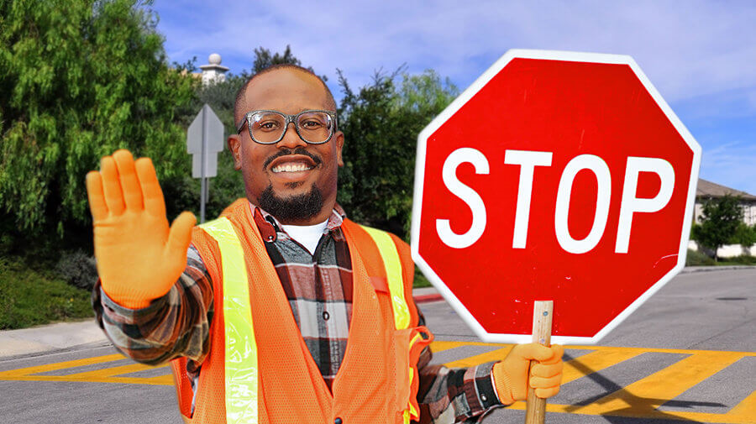
Cutting off questions
Always answer questions briefly
  Great question? Say so, but not for every question.
  Confusing question? Restate it.
Questioner gives an angry speech…
  Don’t take the bait: stay controlled and confident.
  “Thank you, Frank. Your point is interesting… let’s discuss this offline.”
Use his first name can “disarm” an aggressive audience member (but won’t make him your friend!)

Slide 90
You ran out of time…
Despite my advice, it happens!
  When the moderator says “time’s up”, smile, shrug and thank him.
  “No problem. I’ll jump to my last slide”
But now you really must finish immediately.

Slide 91
Special: Theoretical results
Show them a key theorem or two
  Sketch the proof, but don’t give the full details.
  Having explained your key result, state other theorems without proofs
Remember: even brilliant people can get lost
  Focus. What do you want them to learn?
  Teach the key points and get them excited.

Slide 92
Special: Interview talks
Not so different than other talks! But easy to fall into the “list of my papers” trap and not engage them on one or two deeper questions.
Point out which parts were your personal contribution. Find those story arcs and build your talk around them, even if some results are omitted!
At the end, summarize your innovations and future vision. Excite them!

Slide 93
What to take away?
A talk is about information channels, and constructed from story arcs.
Your goal is to build up a mental picture in their minds
Decide ahead of time on what you are trying to teach them. Keep control over your delivery by pacing yourself.

Slide 94
What to take away?
Engaging your audience is the most important thing
  Talk “with” them, not “at” them
  Decide what you want to teach today.
  Explain results in their terms. Motivate them to want to know.
The audience came to learn something
  Tell them what you will teach them…
  … point out that you are teaching them that exciting topic you promised
  At the end, summarize to remind them what they learned!

Slide 95
One final thought…
Practice really does make perfect!

