Slide 1
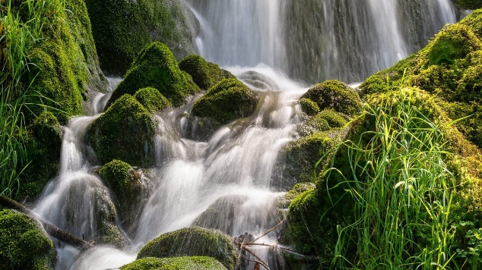
VORTEX: ARCHITECTURE FOR ACCELERATING
ML Inference and Knowledge Retrieval
Ken Birman

Slide 2
My central questions Today
How should systems people interested in time think about ML?
Can we improve the timing properties of ML systems without becoming ML experts ourselves?
What about temporal properties like causality and consistency? Do they have important roles in ML settings?

Slide 3
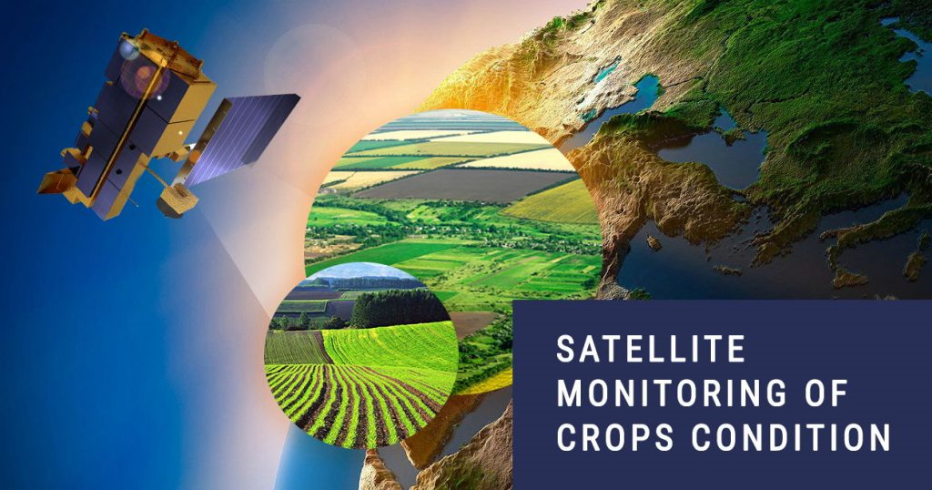
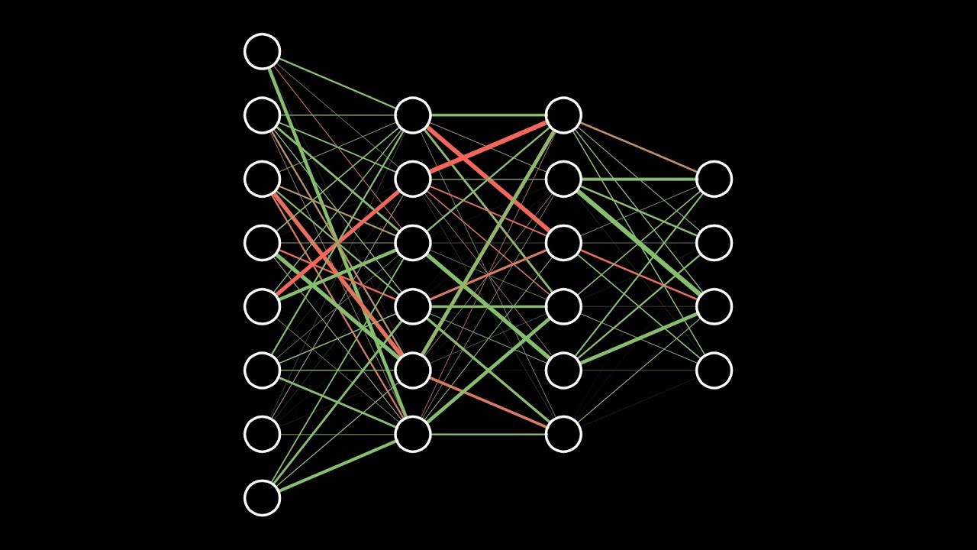
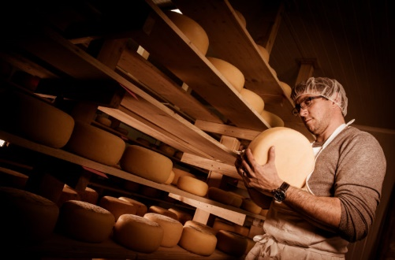
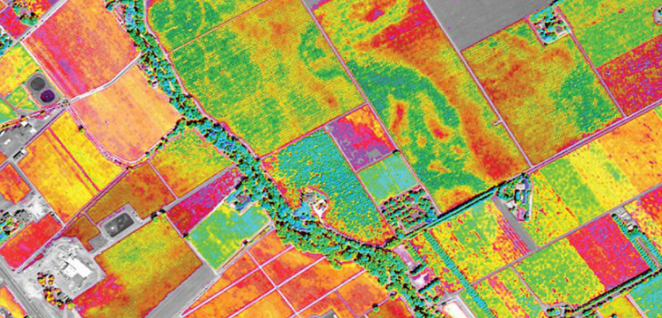
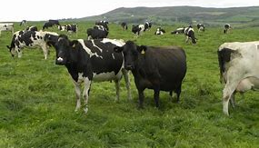
ML is being embedded into a surprising range of settings…
Data sources Cooperative ML Smart
Distributed AI Queries
How much should I budget for raw milk purchases in March for my cheese factory?”

Slide 4
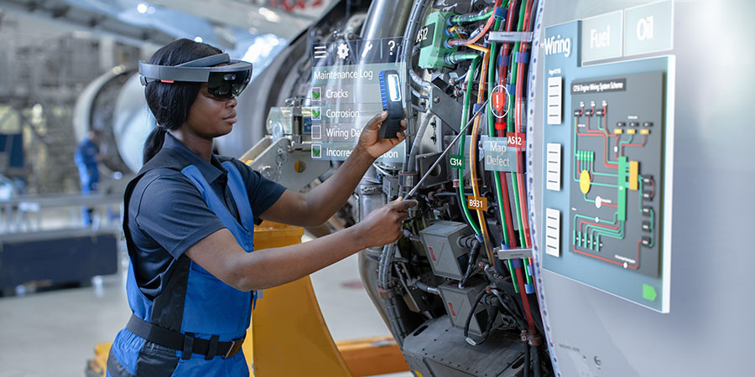
… servicing equipment

Slide 5
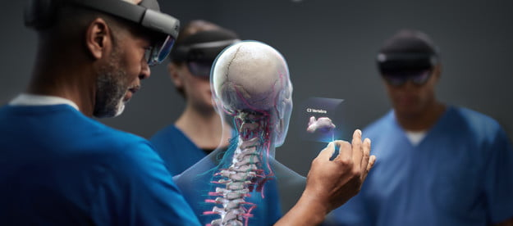
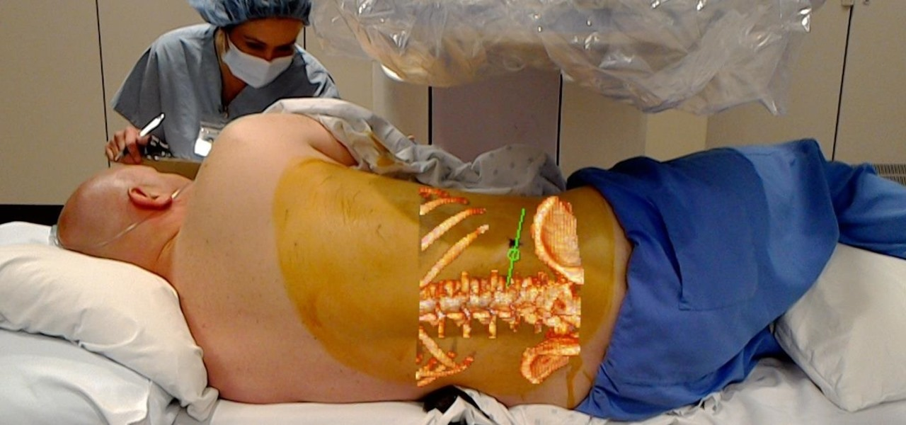
… medical AR

Slide 6

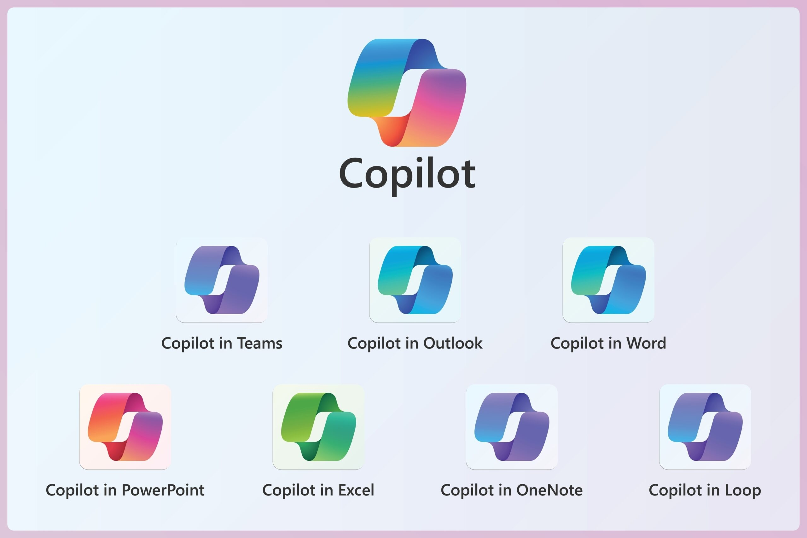
… CoPilots

Slide 7
… there can be many AI components in these pipelines
For example, updates and queries for one approach employ:
Document chunking, using a transformer
Document and query embedding, again via a transformer
Formation of point-clouds representing clusters
Approximate nearest neighbor search
Enlarged prompt formation
Actual generative response (and sanity/toxicity check)

Slide 8
Even routine forms of ML inference and Knowledge Retrieval involve pipelines
(a). Language translation pipeline
(c). Q&A dialogue pipeline
(b). Image reading pipeline
(d). 3D perception pipeline

Slide 9
How do these ML pipelines differ from standard Microservices Pipelines?
MLs tend to be built by composing components, but then are often bundled and executed as a monolithic program on a single server.
They aren’t nearly as elastic, because ML models can be huge
These are pipelines from ingress to an end-user output by the last stage. Microservices often look more like concurrent RPCs

Slide 10
How do they differ from standard ML hosting?
Although it is obvious that latency matters, many ML systems optimize only for throughput, and do not address delay.
Viewing an ML pipeline as a collection of component subsystems is a new idea (not unique to us, but most hosting systems assume the ML is a monolithic application)

Slide 11
Our idea: One platform to support these diverse AI (and ML) components
Imagine a distributed service able to host the data on which AI and ML systems depend (a diversity of objects and data types)
But rather than being rigid, extensible to create entire families of AI or ML servers, each using its own special methods/algorithms
Each of these user-defined extensions would benefit

Slide 12
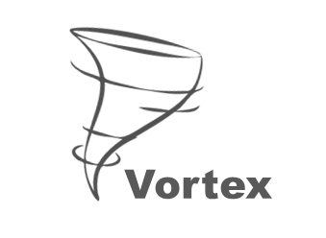
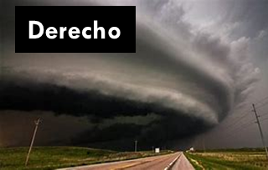
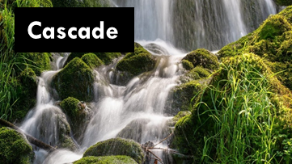

We think of this as three problems…
Vortex: A scalable vector database, our
focus today due to time constraints.
Cascade: a KV infrastructure that
combines data and compute hosting
[ArXiV 2023]
Derecho: World’s fastest atomic multicast
and Paxos, will leverage RDMA if available
[ACM TOCS 2019]
Vortex
Cascade
Derecho
Open source: https://GitHub.com/Derecho-Project

Slide 13
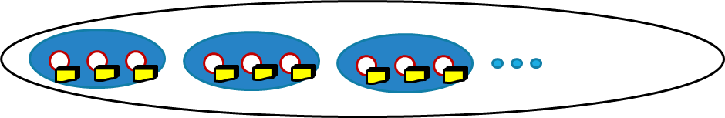
Vortex
Vortex is built on Cascade, which hosts a sharded key-value store
(KV* store). This deployment has 9 servers in shards of size 3.
It can be accessed like a
file system, or via KV
get, put operations
Cascade in turn leverages Derecho for data replication. Each member of a shard has an identical replica of the data it hosts.
Scalable sharded KV store (shards of size 3)
Scalable sharded KV store (shards of size 3)

Slide 14
Vortex
Vortex is built on Cascade, which hosts a sharded key-value store
(KV* store). This deployment has 9 servers in shards of size 3.
It can be accessed like a
file system, or via KV
get, put operations
Each member of a given shard has a complete, identical replicas
of the data it hosts. We can spread load, tolerate failures
*A KV pair is like a filename and its bytes. Not to be confused with the Q, K,V matrices arising in the transformer self-attention computation.
Scalable sharded KV store (shards of size 3)
Scalable sharded KV store (shards of size 3)

Slide 15
Extending Vortex with a UDL
User-Defined Logic (UDL)
for approximate search in
a point-cloud cluster
We extend the Vortex server
by installing an add-on “UDL”
that turns it into a “smart”
scalable service
The code in the UDL could use any popular AI coding framework or simply be in C++, Java, Python, C#, etc.
Scalable sharded KV store (shards of size 3)

Slide 16
Extending Vortex with a UDL
The UDL runs in the address space where the KV data is hosted.
User-Defined Logic (UDL)
for approximate search in
a point-cloud cluster
User-Defined Logic (UDL)
for approximate search in
a point-cloud cluster
Scalable sharded KV store (shards of size 3)

Slide 17
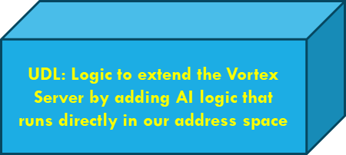
Extending Vortex with a UDL
The UDL runs in the address space where the KV data is hosted.
Scalable sharded KV store (shards of size 3)
Approximate Search in Clustered Vector Space

Slide 18
Extending Vortex with a UDL
Also, notice that we can extend the same service more than once. Here, one Vortex server is playing 3 roles.
Data is kept in separate data pools (like separate file systems)
Approximate Search in Clustered Vector Space
Enlarged prompt formation
Smart Result Aggregation

Slide 19
So each ML component…
Has its code replicated “everywhere” (on all the servers)
… but any particular server instance will actively play just some roles, controlled by the developer, and hence only some will have the ML models loaded and be active.

Slide 20
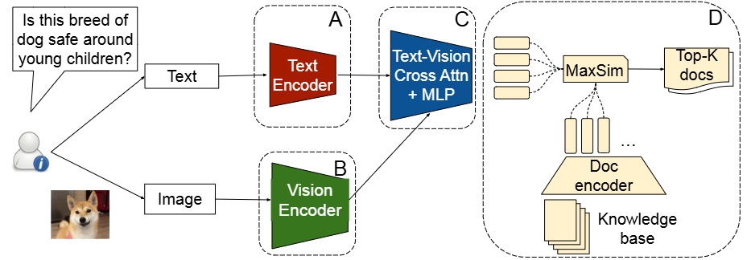
examples of ML pipeline components
PreFMLR knowledge retrieval, finds documents relevant to a query.

Slide 21
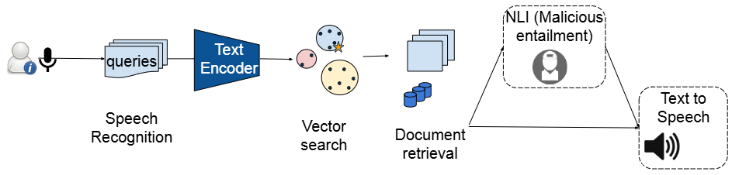
examples of ML pipeline components
SpeechSense: audio Q/A for news feeds or document collections.

Slide 22
Vortex development process
Create componentized pipeline
Turn each component into a DLL
Decide the mapping onto the server pool. Developer controls this through a Vortex configuration file. Components can now handoff tasks to one-another through Vortex trigger feature.

Slide 23
More details about Vortex

Slide 24
The Vortex layer is…
A universal runtime compatible with Linux, but offering optimized AI pipeline support coupled to KV data management. Compatible with many vector database concepts and RAG LLM approaches.
Designed to be back-compatible: Porting an AI into Vortex is easy
Insanely low latencies, high throughput, supports dynamic database updates with strong consistency guarantees.

Slide 25
User Defined AI logic: UDLs
Could be a program running in a docker container or a dynamically loaded plug-in, like a device driver.
In either case, they would use the identical programming API to talk to our platform layer
Each UDL configuration turns Vortex into a different “bespoke” AI supporting a distinct functionality on the LLM pipeline

Slide 26
The quest for ultimate performance
Why these goals? Speed translates to user satisfaction, just like for web sites
Speed also determines how many RAG LLM queries the AI can issue (and the “modes” of those queries: text, image, graphs, etc)
And speed shapes the power profile and throughput, determining the bottom line cost per query for the system owner

Slide 27
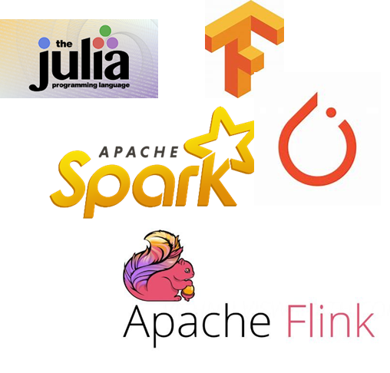
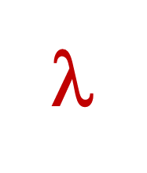
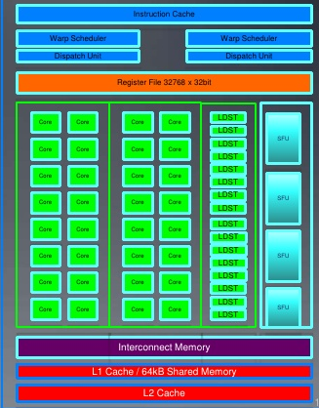
Traditional Approach
Computer, visualize nerve pathways on this patient’s right
shoulder, using red to highlight possible nerve compression points?
Request objects one by one
Your logic
File system or
Key-Value Store
Runtime copies data into GPU
Accelerator Layer
Objects copied over datacenter TCP network
GPU
The AI code probably runs on a different computer

Slide 28
Traditional Approach
Computer, visualize nerve pathways on this patient’s right
shoulder, using red to highlight possible nerve compression points?
Issues: With today’s standard platforms:
Data paths are optimized for batch processing, not real-time
Noisy, inconsistent data visible to the doctor
Hard to support AIs that mix components from different AI programming environments… most developers use Kafka, but its stage-to-stage handoffs are particularly slow, as we will see…
Request objects one by one
Your logic
File system or
Key-Value Store
Runtime copies data into GPU
Accelerator Layer
Objects copied over datacenter TCP network
GPU
The AI code probably runs on a different computer

Slide 29
Our approach
Vortex, could you visualize nerve pathways on this patient’s right
shoulder, using red to highlight possible nerve compression points?
Upload data via direct path into GPU memory
Vortex data selectively (and securely) revealed through mapped memory shared with and managed by Cascade
User logic, unmodified; runs in a standard docker container
Vortex’s Key-Value Storage Layer: Cascade
Focus on one server and on a UDL (AI extension) loaded on that same machine
Accelerator Layer
Objects/files
GPU
UDL
ML model, hyperparameters, GEMM kernels preloaded into GP
The UDL runs on the same machines where Vortex is deployed.
Here we see one, but the UDL itself is present at every Vortex server.

Slide 30
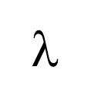
UDL-UDL “Handoffs” with 100G network
A simple cooperative ML pipeline
Vortex is close to ideal efficiency on our hardware and 100 to 10,000x faster than common options like Kafka or Apache Flink
Downstream action
Downstream action
GPU
Input event
GPU
GPU
Hyperparameters, models, cloud data
Latency: 33us
Throughput: 8GB/s
Hyperparameters, models, cloud data
Hyperparameters, models, cloud data

Slide 31
Data Consistency matters too, especially with continuous updates
RAG LLM systems increasingly support dynamic updates
Cascade’s KV layer offers update consistency guarantees based on state machine replication, resulting in a data access model called “strongly serializable snapshot isolation”.
Probably easiest to appreciate “in action”

Slide 32
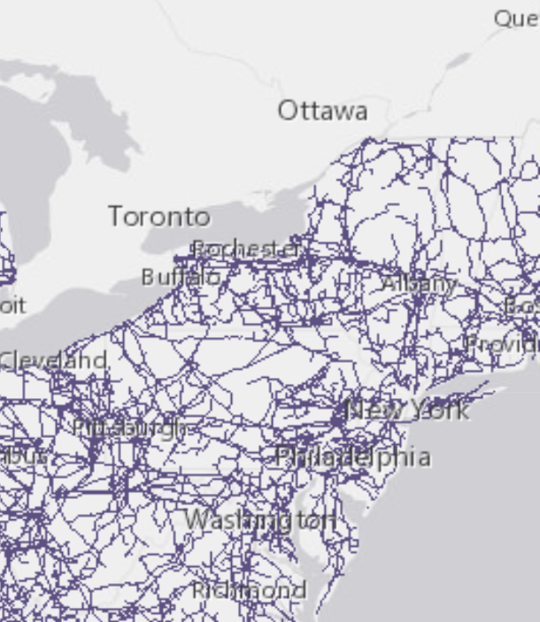
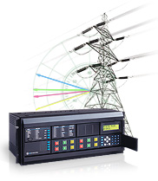
Monitoring A smart power grid
Start by deploying synchrophasors,
capturing data at 20 eps, which
forms a log containing timestamps

Slide 33
Monitoring A smart power grid
Each power bus maps to some
location. Pretend for simplicity
that they map to a simple grid

Slide 34
Monitoring A smart power grid

Slide 35
Given lots of data, we can make a movie!
Just take a series of snapshots, at synchronized times
Then render the evolution of some property (we will focus on the phase of the phasor) over time. An ML might actually react.
20fps is faster than needed. We’ll use 4fps. But our grid will be larger: 20x20, hence 400 concurrent data flows

Slide 36
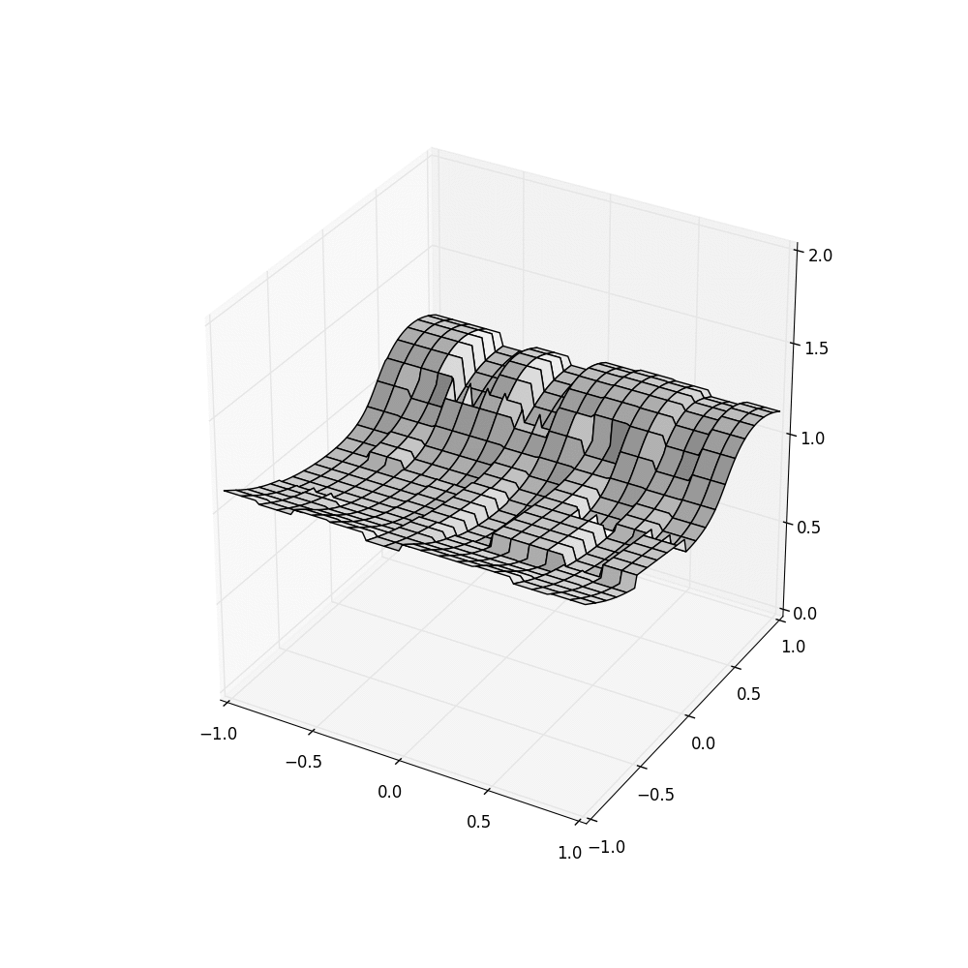
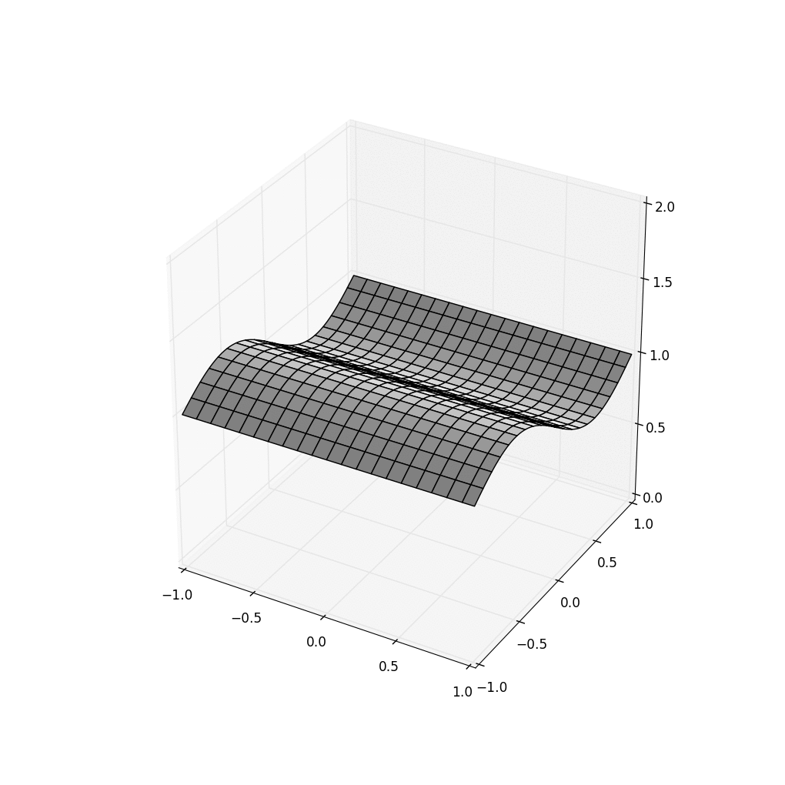

InConsistency Threatens correct behavior!
HDFS Vortex using Server clocks… and with SENSOR Clocks
Think of the self-driving cars that experience accidents… if an ML makes a mistake, is it because the ML is of low quality, or because it “saw” bad data?

Slide 37
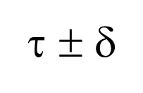
How does Vortex do it?
State machine replication plus consistent cuts
λ²
λ¹
λ⁴
λ³
Put(k’,v)
Each Vortex shard has its own Paxos-based log
Put(k,v)
Put(k’’,v)
(ε, τ)
Stable portion
Put(k,v)
λ¹
Put(k’’’,v)
λ²
λ³
time
λ⁴
Each λ is triggered by an upcall
from a “watcher” monitoring some
key (or pattern)
Unstable tail
A temporal query for time τ sees a consistent cut at τ ± δ_{clock}.
Queries to unstable data must wait, but updates are stable within 50us.

Slide 38
How does Cascade do it? State machine replication plus consistent cuts
Queries occur along a stable (durable) consistent cut
Put(k,v)
Put(k,v)
Put(k,v)
Each Cascade shard has its own Paxos-based log
Put(k,v)
Put(k,v)
Stable portion
(ε, τ)
Stable portion
Put(k,v)
λ
λ
Put(k,v)
λ
λ
time
λ
λ
time
λ
Each λ is triggered by an upcall
from a “watcher” monitoring some
key (or pattern)
λ
Unstable tail
Unstable tail
A temporal query for time τ sees a consistent cut at τ ± δ_{clock}.
Queries to unstable data must wait, but updates are stable within 50us.

Slide 39
What we just saw
Relatively “old” ideas sufficed to fix the HDFS issue that caused dynamic updates to “confuse” an AI trying to detect the wave
HDFS was inattentive to data stability, sequential order. You wouldn’t notice this except that we took snapshots in real-time.
The issue isn’t that HDFS is broken… it simply wasn’t created for use cases like the example I showed

Slide 40
Performance for real applications

Slide 41
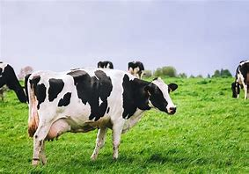
Cascade V. Apache Flink IN A cow
Body Condition Scoring Application
10x faster
Animal body condition scoring: Cascade (gray), Flink (orange). Lower is better.
Same experiment: Cascade achieves higher throughput across the board

Slide 42
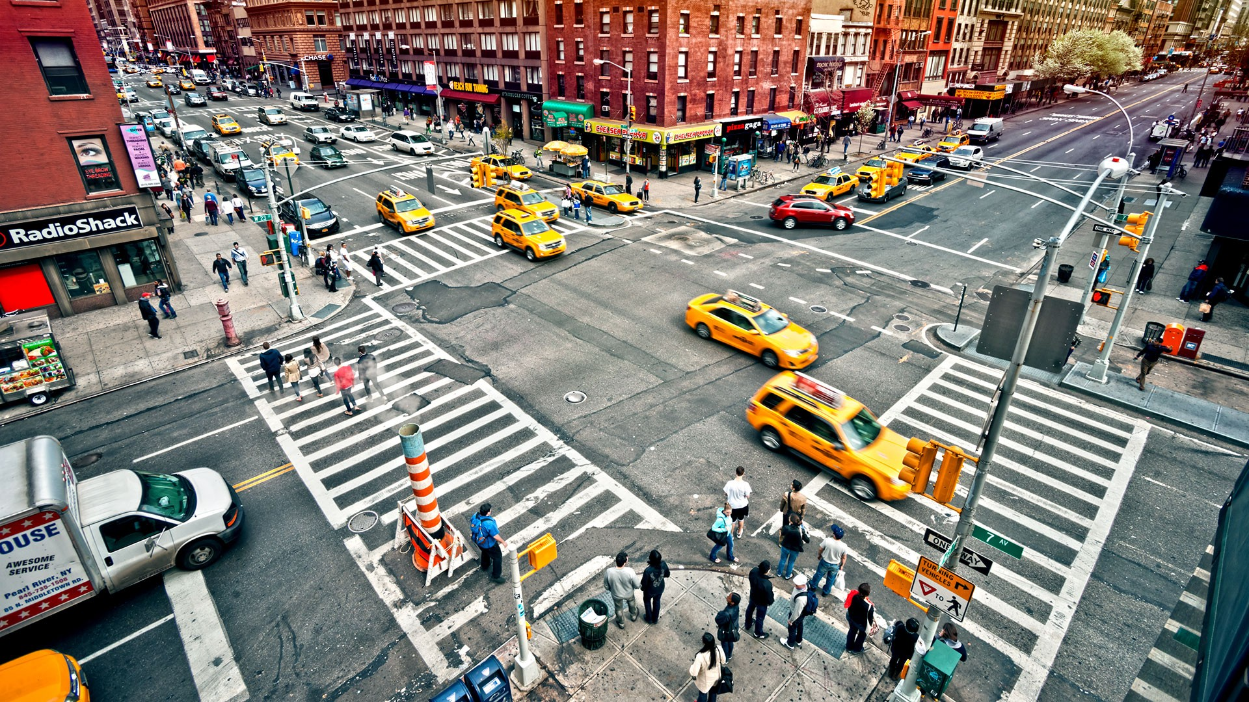
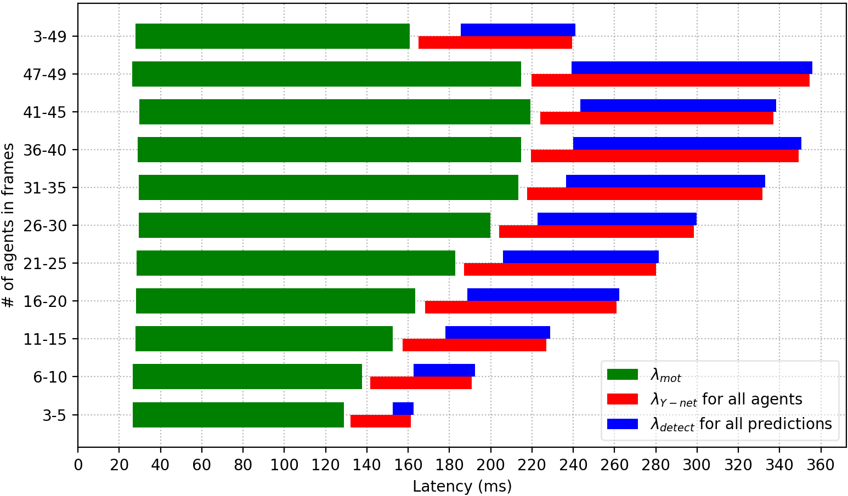
Cascade V. Azure sensIng traffic hazards
This application uses
affinity sets.
Payoff is dramatic
Azure: Seconds. Cascade: Milliseconds

Slide 43
Cross-Platform Comparisons
Smaller is better
Tighter is better
Logarithmic Y axis
Milliseconds vs. Seconds

Slide 44
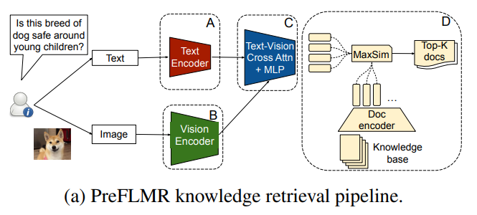
Reminder PreFLMR

Slide 45
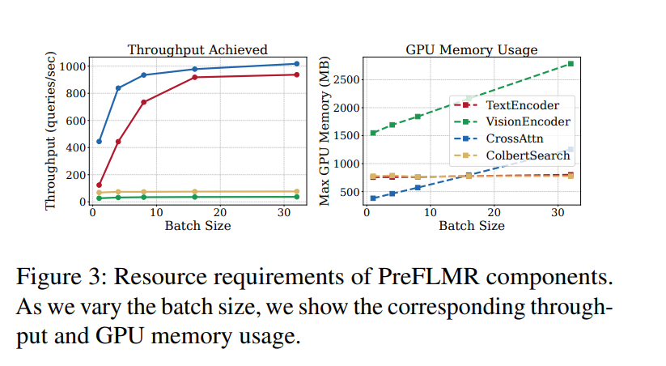
PreFLMR Microbenchmarks

Slide 46
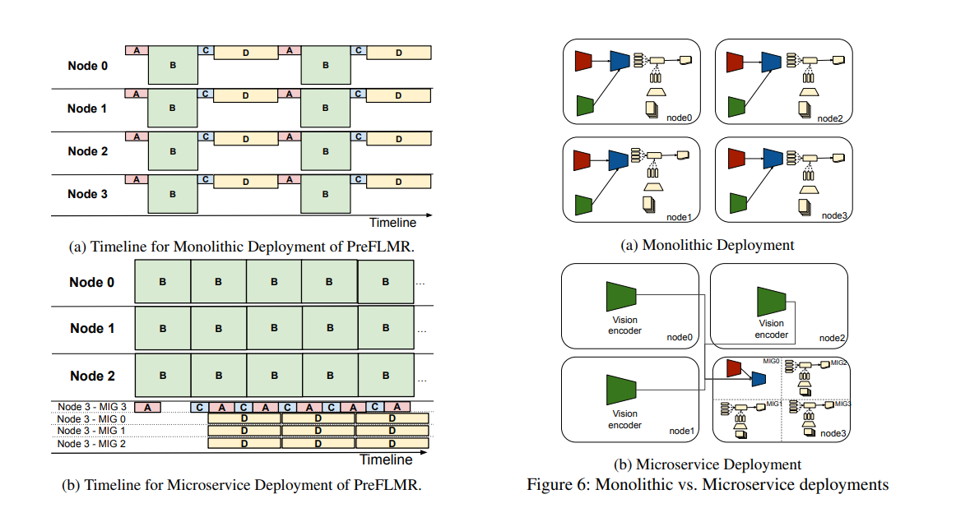
Mapping to hardware has big impact!

Slide 47
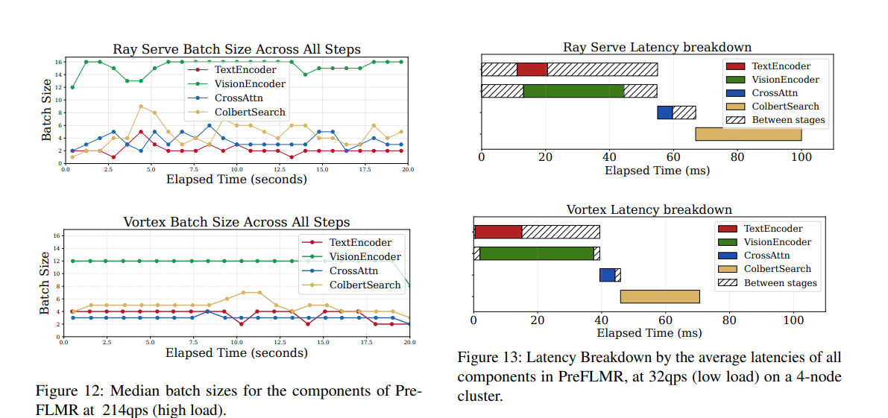
Batching also shapes latencies

Slide 48
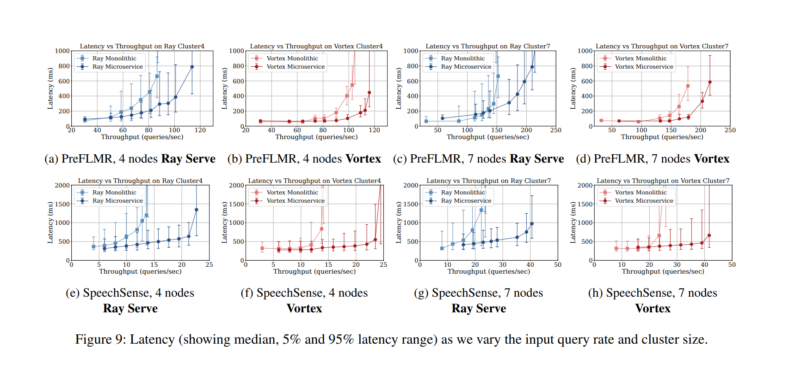
Microbenchmarks

Slide 49
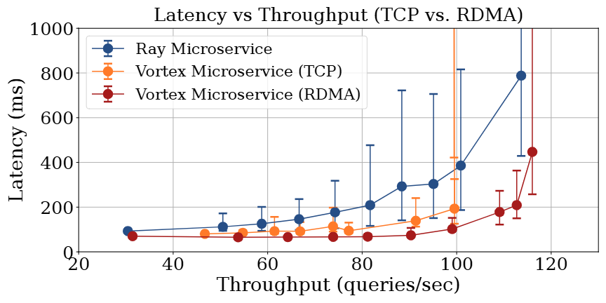
Latency versus Throughput (Preflmr)

Slide 50
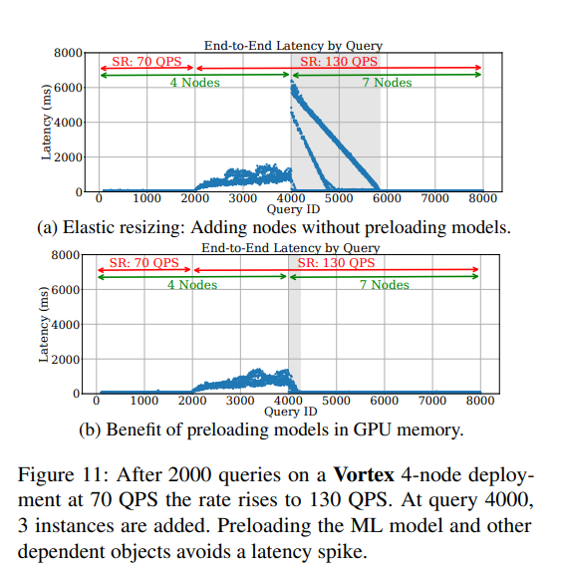
Elastic rescaling: Watch out for spikes!
When we resize the worker set for PreFLMR, preloading the ML model into GPU is critical. Without preload (left) we get a big latency spike, but with preloading (right) it can be mostly avoided.

Slide 51
Scheduling for Multitenancy workflows
(a). Language translation pipeline
(c). Q&A dialogue pipeline
(b). Image reading pipeline
(d). 3D perception pipeline

Slide 52
Multitenancy: Navigator advantage
Low-load scheduling performance
Different loads scheduling performance
Our Navigator scheduler runs the job
more fairly, and with just ½ the servers!
High-load scheduling performance

Slide 53
Summary
Cornell has created a powerful framework for time-sensitive ML tasks such as multi-modal inference and knowledge retrieval
Big performance wins against a wide range of existing options
Trends are bringing ever more ambitious ML pipelines and dataflow graphs… and multitenancy. Growing need for Vortex!
Open source: https://GitHub.com/Derecho-Project

Slide 54
Vortex team…
Alicia Yang (lead Vortex developer)
TC Yuan (AI performance design and optimization)
Weijia Song (lead Cascade developer)
Ben Ladrum, Jamal Hashim, Thiago Garrett, Ann Zhang and Yifan Wang (AI and LLM expertise, core system contributors)
… And big thanks to our funding sources, including Siemens, Cisco, Microsoft and NVIDIA.

