Slide 1
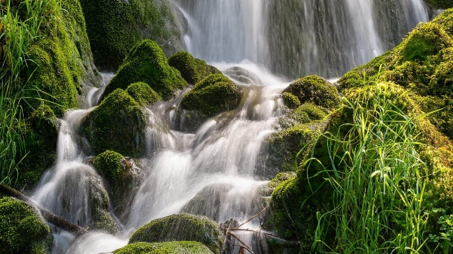
Data Consistency Challenges in AI Applications Ken Birman, Jamal Hashim, Edward Tremel, Yuting (Alicia) Yang

Slide 2
Our motivation?
AI systems are evolving to include “world models” that will need to be updated continuously. Many queries will be time-indexed.
The same AIs used in such settings will be under SLO pressure
Existing AI frameworks are consistent: They preserve FIFO ordering by design, and use storage that is generally static while in use. But inference is not distributed and dynamic updates are inevitable…

Slide 3
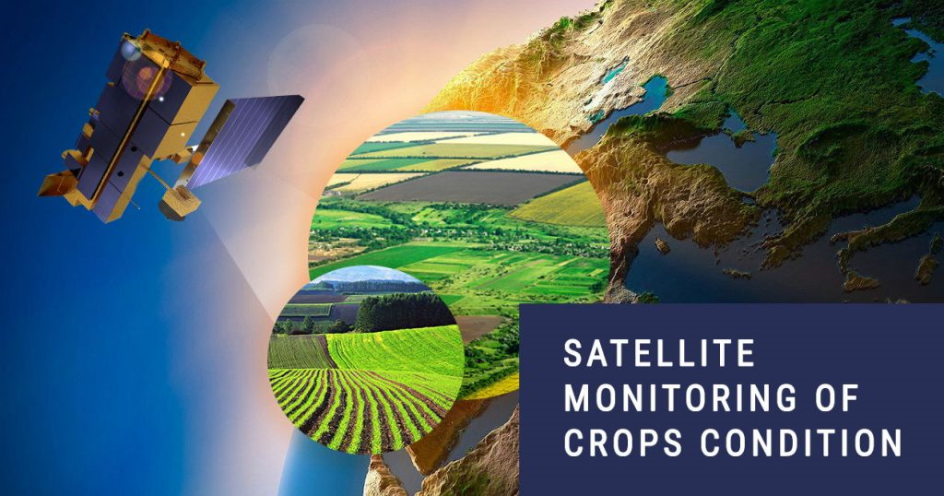
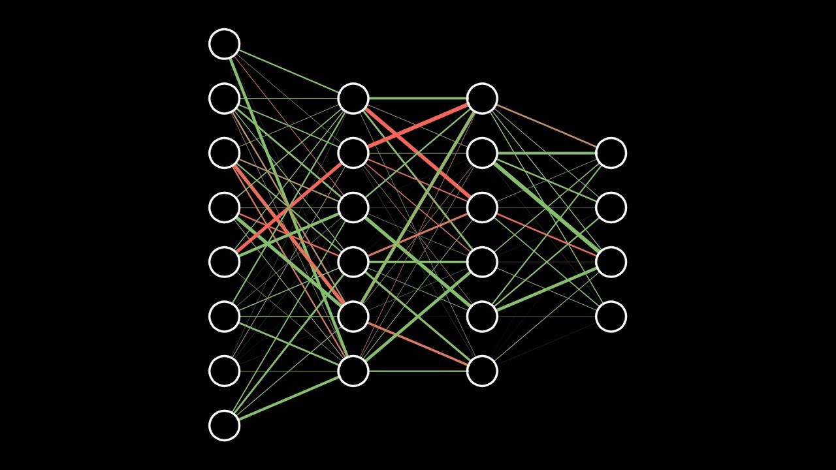
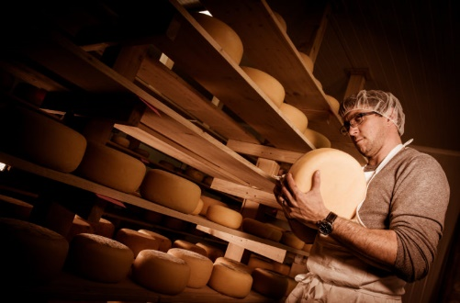
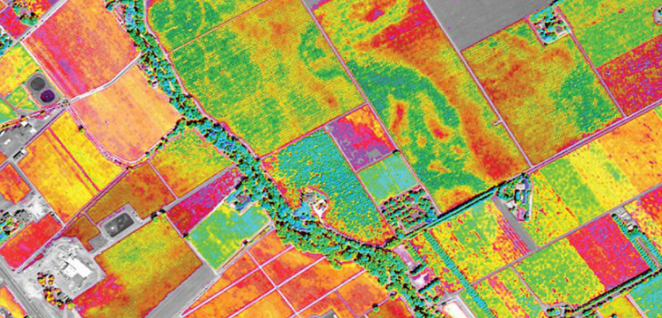
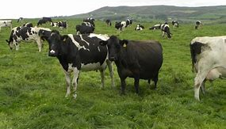
AI is being embedded into a surprising range of settings… like digital ag.
Data sources Cooperative ML Smart Distributed AI Queries
How much should I budget for raw milk purchases in March for my cheese factory?”

Slide 4
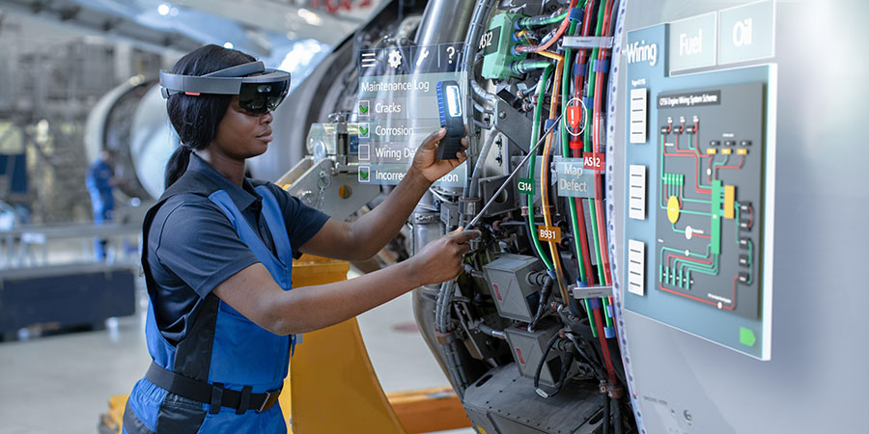
… servicing equipment

Slide 5

… medical AR
Computer, visualize nerve pathways on this patient’s right shoulder. Highlight possible nerve compression points.

Slide 6
They are becoming concurrent distributed applications with evolving state!
AI design by composition of existing models is now common
Repositories such as key-value stores and vector databases are widely used
Which poses problems: Inconsistency can easily “sneak in”!

Slide 7
Ai is inherently probabilistic. does consistency matter?
AI task explored by ISO New England, New York ISO, NYPA, other East Cost power participants (22% of the US power pool).
The real-time data is a flow of synchrophasor data. The AI tasks centered on grid state tracking and stability despite transients caused by bringing renewable power online and offline.

Slide 8
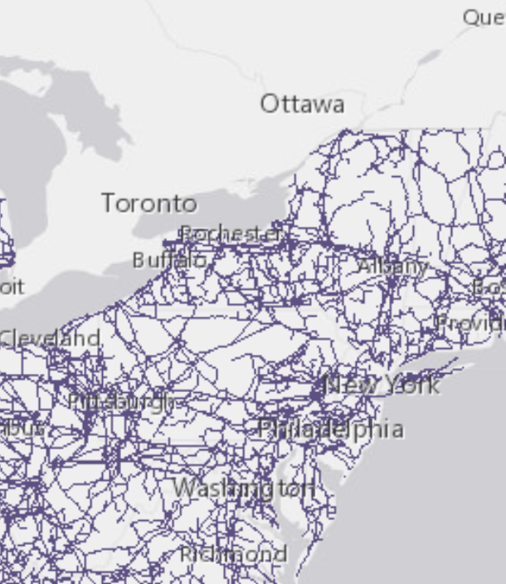
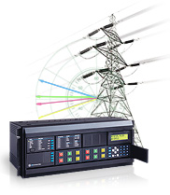
Monitoring A smart power grid
Start by deploying synchrophasors, capturing data at 20 eps, which forms a log containing timestamps

Slide 9
Monitoring A smart power grid
Each power bus maps to some location. Pretend for simplicity that they map to a simple grid

Slide 10
Monitoring A smart power grid

Slide 11
Given lots of data, we can make a movie!
Just take a series of snapshots, at synchronized times
Then render the evolution of some property (we will focus on the phase of the phasor) over time. An ML might actually react.
20fps is faster than needed. We’ll use 4fps. But our grid will be larger: 20x20, hence 400 concurrent data flows

Slide 12
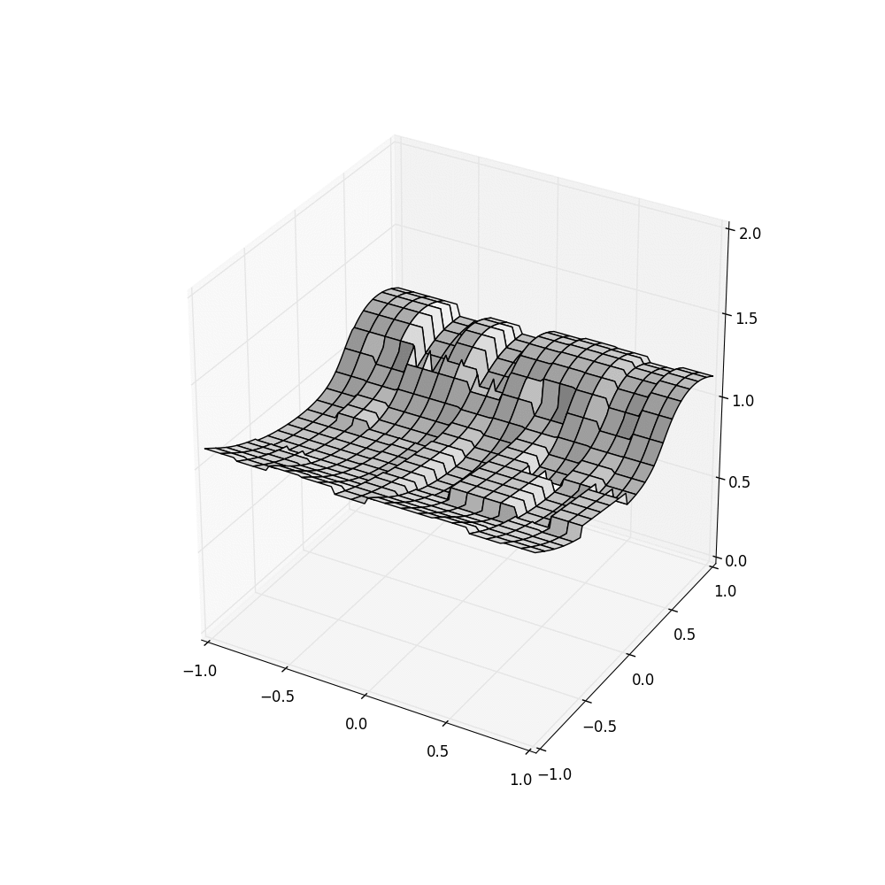
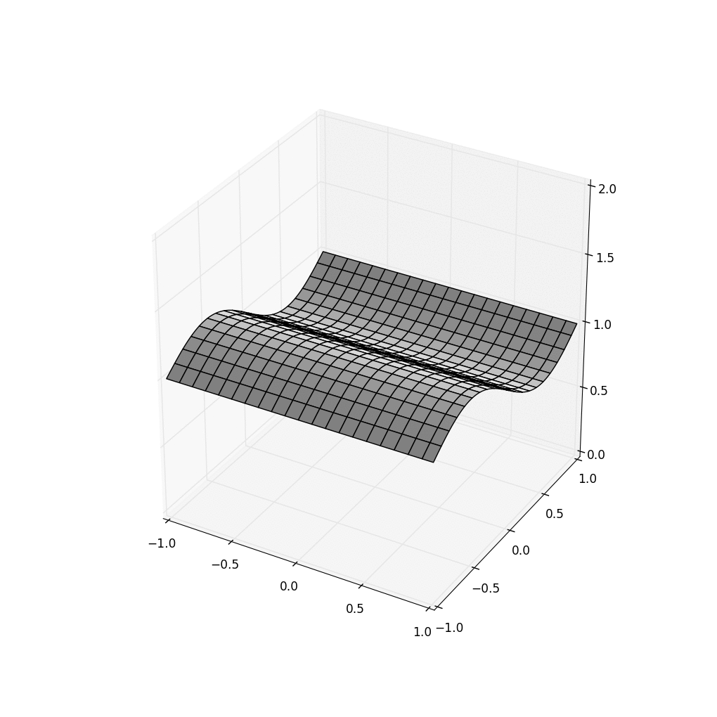

InConsistency Threatens correct behavior!
HDFS Vortex using Server clocks… and with SENSOR Clocks
Think of the self-driving cars that experience accidents… if an ML makes a mistake, is it because the ML is of low quality, or because it “saw” bad data?

Slide 13
Inconsistency in a standard AI storage service, HDFS, manifests as noise!
This noise is severe enough to compromise the goals of the AI
Vortex, used to create the two animations on the right, overcomes the issue using a mix of consistent snapshot isolation with different forms of stability sensing for logical as distinct from temporally indexed data.

Slide 14
The core issue: Ais runNing as distributed agents on a shared scalable storage layer
In the early generation of AIs, most AI models were monolithic even if they internally used multiple components. And most data was static (not updated at all, or updated “offline”)
But in the emerging more complex AIs, we see true distributed pipelines. And data flows in while the AI logic is active

Slide 15
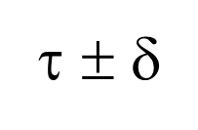
A series of triggered AI actions or queries, with dynamic data
λ²
λ¹
λ⁴
λ³
Put(k’,v)
Each Vortex shard has its own Paxos-based log
Put(k,v)
Put(k’’,v)
(ε, τ)
Stable portion
Put(k,v)
λ¹
Put(k’’’,v)
λ²
λ³
time
λ⁴
Each λ is triggered by an upcall from a “watcher” monitoring some key (or pattern)
Unstable tail
A temporal query for time τ sees a consistent cut at τ ± δ_{clock}.
Queries to unstable data must wait, but updates are stable within 50us.

Slide 16
Core Vortex model: Consistent Snapshot isolation over immutable data
In Vortex, queries occur along a stable (durable) consistent cut
Put(k,v)
Put(k,v)
Put(k,v)
Each Cascade shard has its own Paxos-based log
Put(k,v)
Put(k,v)
Stable portion
(ε, τ)
Stable portion
Put(k,v)
λ
λ
Put(k,v)
λ
λ
time
λ
λ
time
λ
Each λ is triggered by an upcall from a “watcher” monitoring some key (or pattern)
λ
Unstable tail
Unstable tail
A temporal query for time τ sees a consistent cut at τ ± δ_{clock}.
Queries to unstable data must wait, but updates are stable within 50us.

Slide 17
Two contrasting forms of stability!
With incoming real-time data, events can’t be indexed until
The update is safely logged (for us, in an in-memory log)
… and replicated, if fault-tolerance is desired
… and any other data items with the same or earlier timestamp are also logged. But this depends on network delays and internal delays as data propagates through the system

Slide 18
A further (similar) issue
Do we enforce read-what-you-wrote?
With logical consistency, we definitely need read-what-you-wrote and also preservation of FIFO ordering: crux of linearizability model, which is widely viewed as a gold standard
But for temporal indexing, we want temporal precision and reproducibility: “the state of the system at time t”

Slide 19
Two consistency “models”
Butler Lampson famously advised against unifying different ideas into one ultra-complicated, ultra-general abstraction.
If you do that, your system will often be slow
Rarely used logic will still be visible to end-users
So Vortex takes this advice and offers two models: one for time- based data and queries, and one for logical action sequences

Slide 20
Can a model like this perform well?

Slide 21
Our baselines
Standard inferencing platforms such as Ray Serve (today’s performance leader), Torch Serve (performs very poorly)
Paper has more details, I’ll show just a few examples

Slide 22
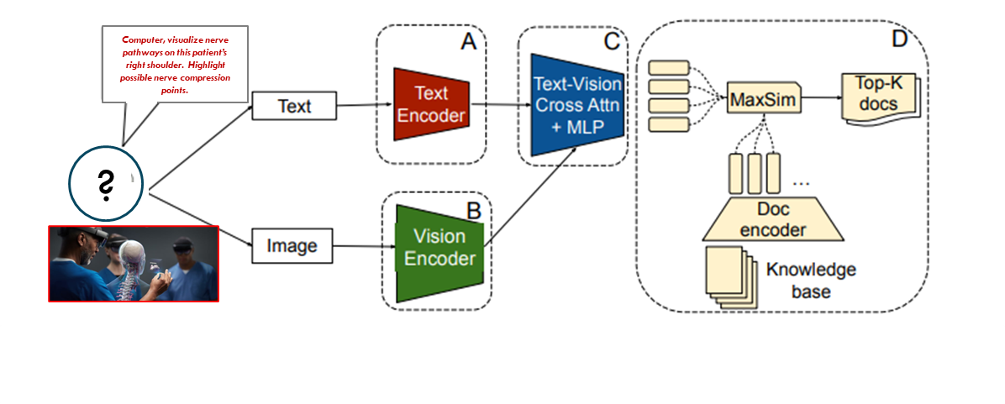
PreFLMR: pipeline for queries about images

Slide 23
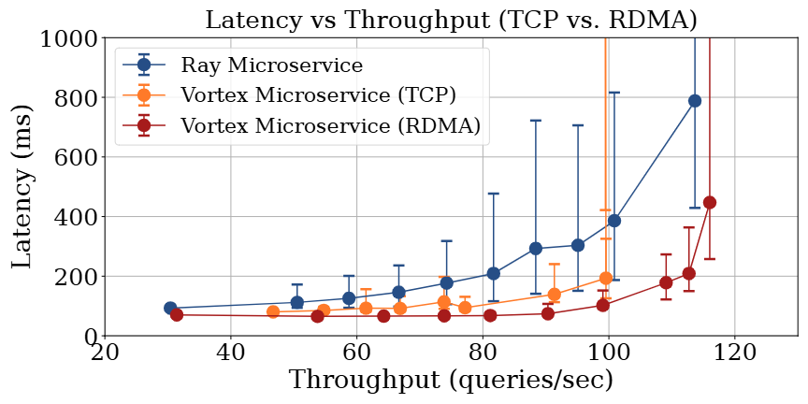
Vortex achieves higher throughput with lower latencies, enabling tighter SLOs

Slide 24
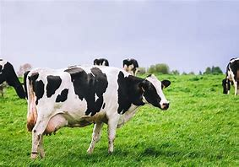
cowBody Condition Scoring
10x faster
Animal body condition scoring: Cascade (gray), Flink (orange). Lower is better.
Same experiment: Cascade achieves higher throughput across the board

Slide 25
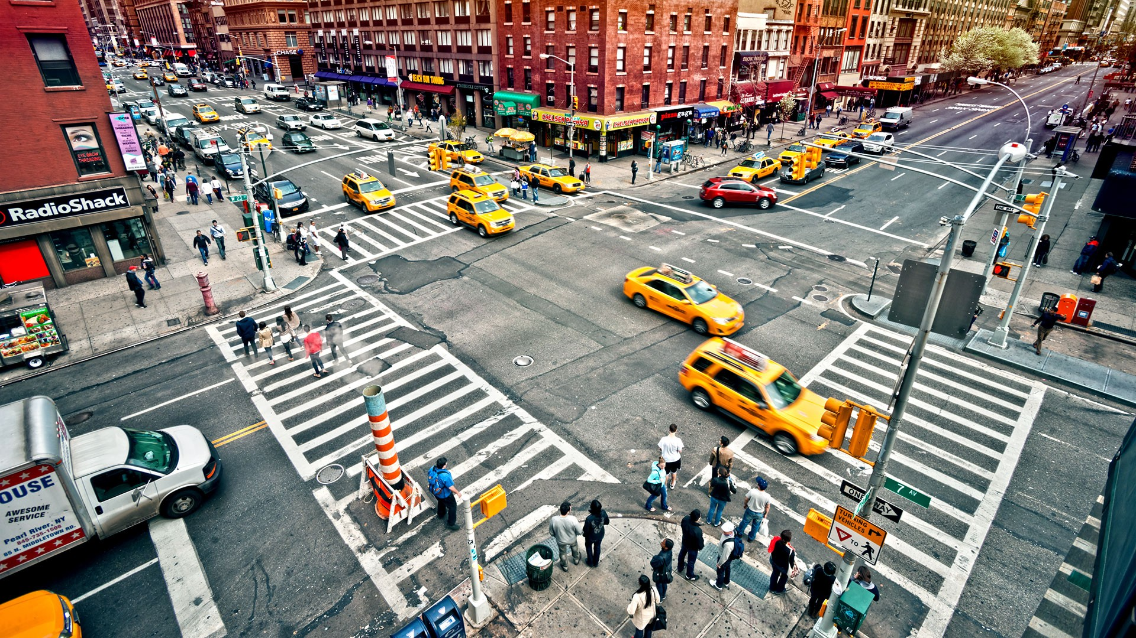

Urban traffic planner watching for issues at an intersection
ML task:
Segment each video frame, “agents” are entities moving under independent control
For each agent, run a pipeline. The red ML predicts its trajectory, emitting a stream of coordinates in order of likelihood
The blue risk detector senses dangerous proximity
Output: an alert visible to the city traffic planner
Problematic intersection
City traffic planner

Slide 26

Urban traffic planner watching for issues at an intersection
NEAR MISS!
We can flash the alert on her hololens
But it needs to be timely or the scene will have evolved too much for this to be useful
Problematic intersection
City traffic planner

Slide 27
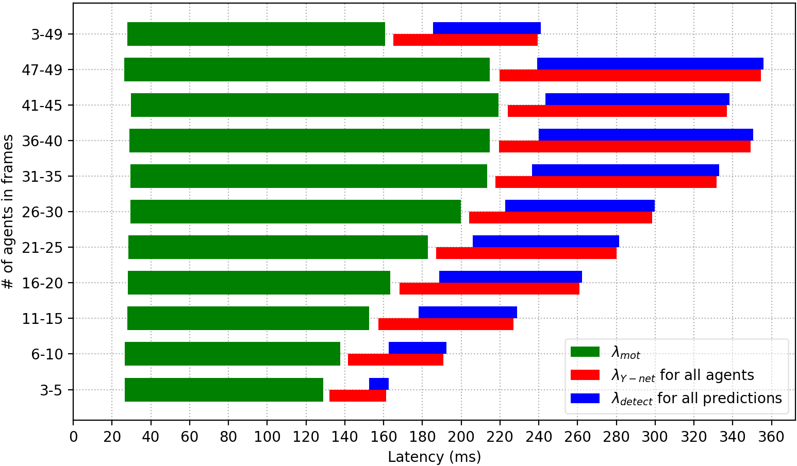
Urban traffic planner watching for issues at an intersection
NEAR MISS!
Problematic intersection
City traffic planner
Azure: Seconds. Vortex: Milliseconds

Slide 28

Summary
Cornell has created a powerful framework for time-sensitive ML tasks such as multi-modal inference and knowledge retrieval
One consistency model wasn’t enough! We offer one base model for logical properties but layer in a different one for temporal queries.
Built using Derecho, Cornell’s ultra-fast Paxos and atomic multicast library, can leverage RDMA if available
Open source: https://GitHub.com/Derecho-Project

