Slide 1

AI Systems Research in a Vibe Coding Era Ken Birman

Slide 2
Goal: High Quality Systems research in a period dominated by AI requirements
High quality research must be impactful – we shouldn’t do work that won’t live on and be influential
But the needs of AI don’t align terribly well with the aspirations and interests of the systems research community
I’ll share a representative story and then pivot to my conclusion

Slide 3
… a story about leveraging new hardware to do exciting systems research!
My story centers on leveraging RDMA to build better consensus solutions (Derecho consensus and atomic multicast library).
But when Derecho wasn’t instantly adopted by the world, we used it to create a better hosting platform for AI inference and knowledge retrieval (Vortex)

Slide 4
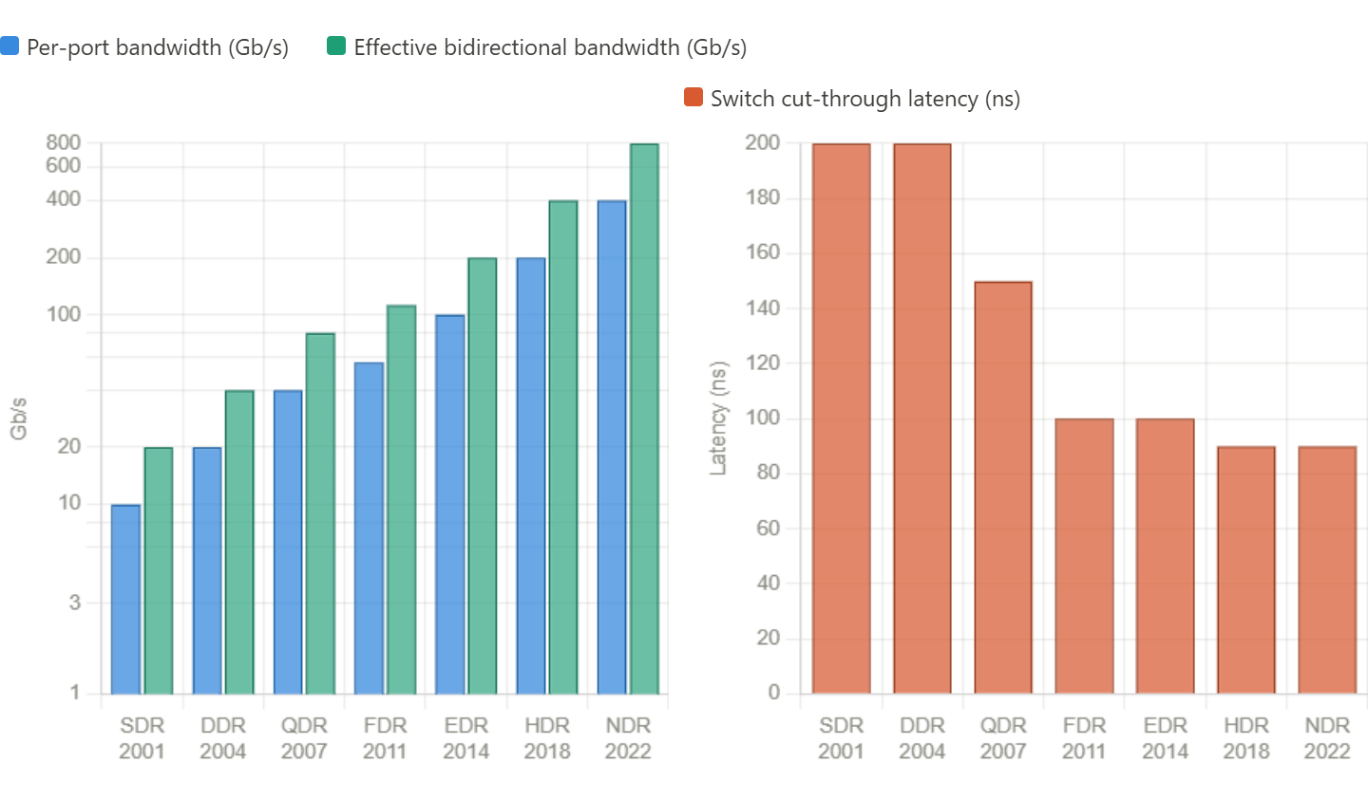
RDMA: Remote Direct Memory Access.
Steady bandwidth growth, with XDR next (800Gb/s) But 1-way latency plateau reached in 2011, now ~85ns

Slide 5
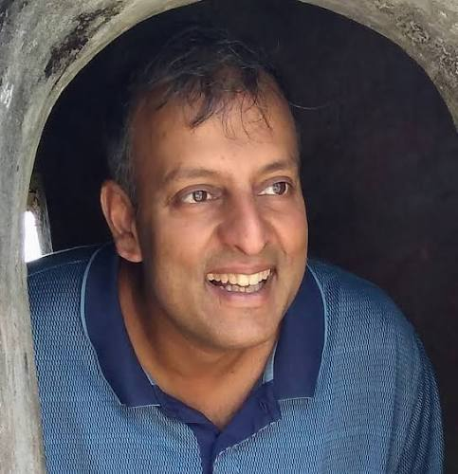
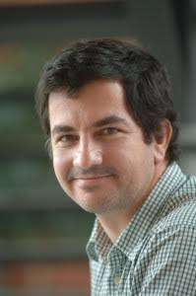
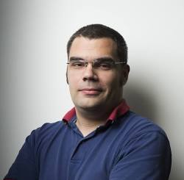
Fast Remote Memory: Castro et. al.
Used RDMA to create a fast remote memory (FaRM) in support of disaggregated, scalable KV storage.
FaRM was highly impactful and transformative for many tasks… and was central to a big step forward in Microsoft’s Bing search

Slide 6
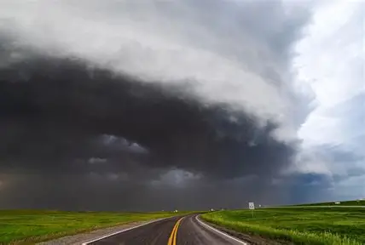
Inspired by Farm, we created The Derecho system
Don’t get in the way of a Derecho
Premise: RDMA requires a ground-up rethinking of atomic multicast, Paxos and virtual synchrony around RDMA.
Our effort wasn’t the only project, but most other projects were simply running protocols like Paxos or RaFT over RDMA. We were open to radically new architectural ideas.

Slide 7
Where we started: Consider A Simple Reliable Multicast Protocol on RDMA
P
Q
R
“Ack” “Ack”
“Here is 100B message m” “Deliver m” “Garbage collect m”

Slide 8
A Simple Reliable Protocol on 100G RDMA
P
Q
R
TIMELINE, PROCESS P
“Ack” “Ack”
“Here is 100B message m” “Deliver m” “Garbage collect m”
P
1.5us
0.75us + 100B/12.5GB/s = 0.750000008us
1.5us
1.5us
4.5us + 12 RDMA messages (limit: 75M/s)

Slide 9
A Simple Reliable Protocol on 100G RDMA
P
Q
R
TIMELINE, PROCESS P
“Ack” “Ack”
“Here is 100B message m” “Deliver m” “Garbage collect m”
Peak possible performance?
P
Time to perform one 100B reliable multicast? 4.5us + “noise”
… based on time expended, limited to 222,222/s
12 RDMA verb operations out of 75M: limited to 6.25M/s
RDMA could have transferred 56KB of data in 4.5u … we left 99.8% capacity “unused”!
0.75us + 100B/12.5GB/s = 0.750000008us
1.5us
1.5us
1.5us
4.5us + 12 RDMA messages (limit: 75M/s)

Slide 10
A few ideas
Have all the 3 members perform concurrent updates… now we might get some overlap and push our efficiency… to 0.6% ☹
Run lots of threads… maybe 10 per process. We aim for 6% efficiency (but locking and scheduling delays will cut this sharply) ☹
Batch 1000 messages at a time. ☺ But now the average message waits until 500 more have turned up. Latency soars to 2.25ms ☹

Slide 11
At Best, You get something like this…
P
Q
R
Messy and unpredictable with sudden bursts of data movement… Unlikely to perform well ☹

Slide 12
Better: Separate Data Plane and Control Plane, make them pause-free
Send continuously, as soon as new updates show up
Receivers continuously report their acks, in an all-to-all pattern. This way every process can deduce delivery/garbage collection.

Slide 13
Better: Separate Data Plane and Control Plane, make them lock-free
P
Q
R
P
Q
R

Slide 14
Better: Separate Data Plane and Control Plane, make them lock-free
P
Q
R
P
Q
R
Data plane runs steadily (Derecho’s RDMC or SMC multicast)
Control information exchanged continuously (one-sided RDMA writes via SST)

Slide 15
Now we can continuously stream data, and asynchronously discover stability
Here by “stability” I mean “the multicast is safe to deliver”
The concept encompasses reliable 1-to-many data delivery, atomic multicast and Paxos log replication.
We tackled all of this in Derecho, a virtually synchronous library for RDMA data replication

Slide 16
Derecho Needed a replication protocol for fast ASYNC Streams
It became the primary transport for our data plane
Derecho has multiple solutions; I'll show you one of them (RDMC)

Slide 17
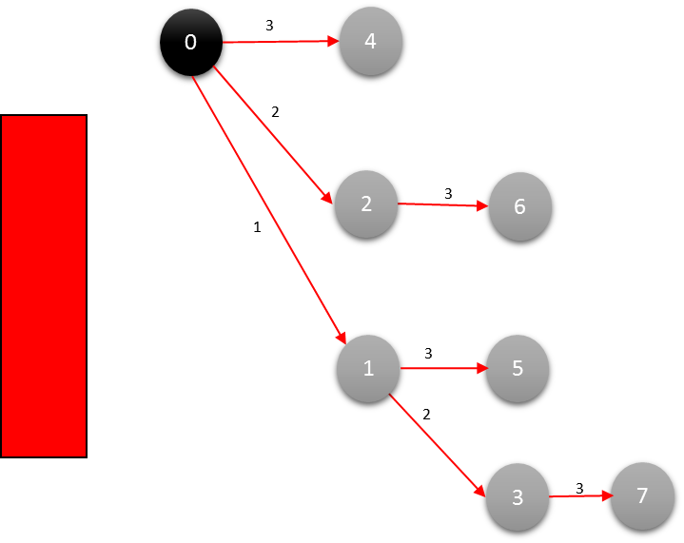
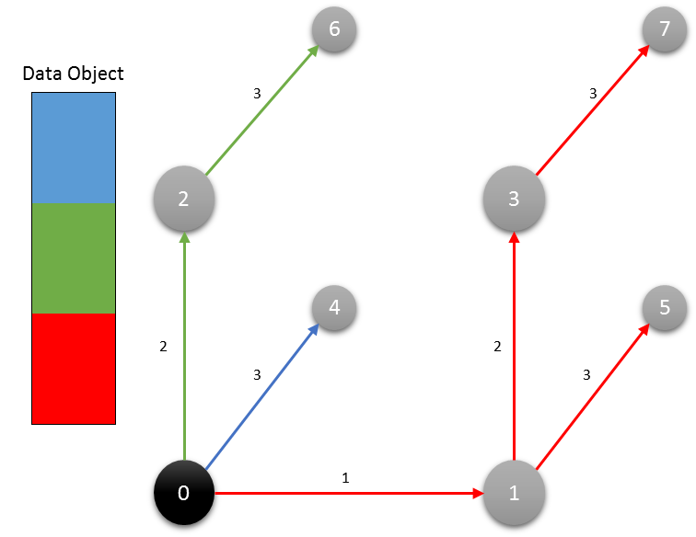
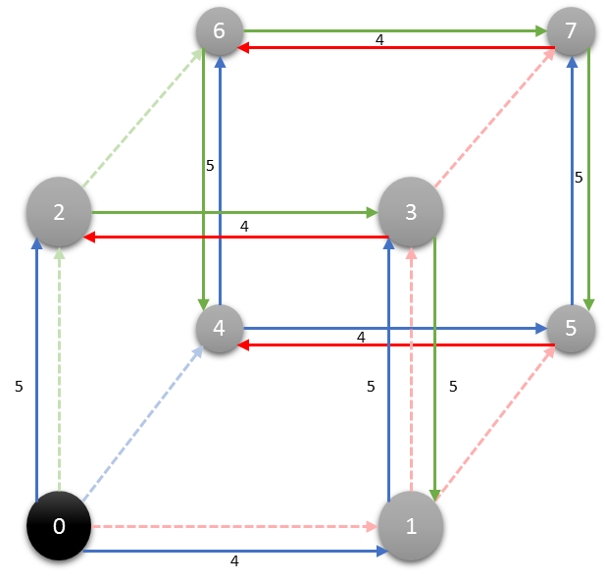
Binomial Trees on a Hypercube Overlay Network: "A Perfect" schedule!
Dest
Source
Dest
Dest
Dest
Multicast
Binomial Tree
Binomial Pipeline
Final Step
Notes:
To send large messages we don’t just send them point to point, like in Leslie’s protocol. Derecho relays them down a virtual tree it creates (left) and also breaks them into blocks, using one tree per block (middle) and wrapping the trees around a hypercube, all virtual. This yields ultra-high concurrency.

Slide 18
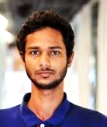

Derecho’s Data Plane = RDMC/SMC. Derecho’s Control plane = SST
Derecho group with members {A, B, C} in which C is receive-only
Sagar Jha Jonathan Behrens
A
B
C
A
B
C
A
B
C
m_{A:1}
m_{A:2}
m_{A:3}
m_{A:4}
m_{A:5}
m_{B:1}
m_{B:2}
m_{B:3}
m_{B:4}
 | Suspected |  |  | Proposal | nCommit | Acked | nReceived |  | Wedged
A | F | T | F | 4: -B | 3 | 4 | 5 | 3 | T
B | F | F | F | 3 | 3 | 3 | 4 | 4 | F
C | F | F | F | 3 | 3 | 3 | 5 | 4 | F
A B
B fails, resulting in an uncertain state
Data moved on RDMA multicast
Control is done using knowledge programming on the SST

Slide 19
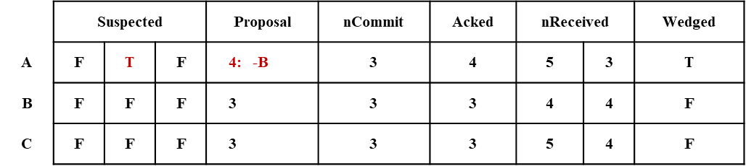
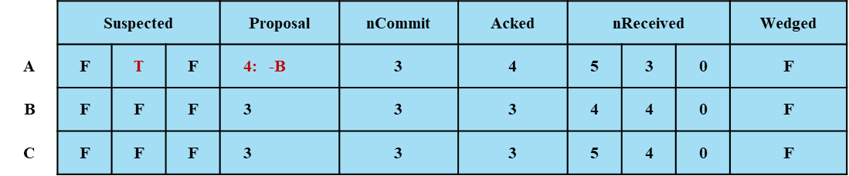
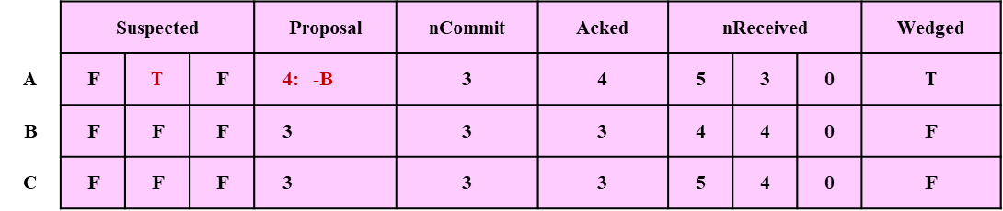
Shared State Table (SSt): Direct RDMA writes with no locking (sequential cache-line consistency)
Replicated at members
Update own row
Read-only copy of other rows
RDMA enables A to write directly to the replicas on B and C
SST on machine A
SST on machine B
SST on machine C

Slide 20
But we were far from finished!
The SST is an asynchronously updated table, FIFO consistency by sender but not totally ordered. And updates are periodic.
So we might see node B ack “22 from A”, but then “197 from A”, and need to infer that in fact this covers 22 through 197, in FIFO order (“a monotonicity” guarantee)
Led us to a model involving monotonic predicates and batched actions

Slide 21
After which…
Implementation itself: systematically zero-copy, minimal locking
Opportunistically batching needed at ten different spots
Special RDMA data paths for point-to-point data flows that later “join”, for patterns like “AllGather”

Slide 22
…Derecho was a success, yielding a new atomic multicast and the first optimal Paxos!
Bisimulates classic Paxos with Qw=N, Qr=1
… blazingly fast, orders of magnitude beyond prior options
… minimizes information passing (≈ messages) Derecho is the first solution to matches PODC ‘06 bounds from Keidar / Schraer. In fact, Derecho optimal in many senses (message efficiency, progress condition, mapping to RDMA)

Slide 23



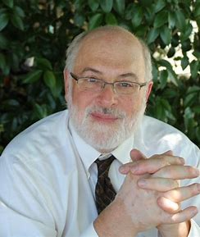

Learn more…
Sagar Jha, et. al. Derecho: Fast State Machine Replication for Cloud Services. ACM Trans. Comput. Syst. 36, 2 (May 2019), https://doi.org/10.1145/3302258
Download from https://GitHub.com/Derecho-Project

Slide 24

… But was Derecho the winner?
Not if you ask GPT or most of the other AI chat tools! ☹
They expect you to just use Zookeeper plus chained replication.
If forced to recommend a consensus algorithm, they recommend a much slower RaFT protocol, or an open library based on Paxos.

Slide 25
The harsh truth
Modern AI doesn’t need atomic multicast or consensus (for example HDFS uses Zookeeper and one replica/shard).
Multicast (like RDMC) does arise in CCL packages and used in AllReduce and MapReduce. But NVIDIA’s popular NCCL implementation, which is proprietary, doesn’t use RDMC…

Slide 26

A Puzzle
How can we do research that will have constructive impact?
To impact AI you need to work directly on the canonical components normally used in AI systems, and respect the APIs
You can build a “better hosting platform for AI inference” but that really is more of commercial than an academic path
Academic work historically needs fundamental systems insights, and elegant demonstrations that others adopt. But at the systems layer, we won’t see this from vibe-coded solutions. And vibe-coding is not going away!

Slide 27
We pushed further and further…
We used Derecho to create Vortex, a platform for hosting (serving) AI models, for very fast inference and other ML tasks.
Our focus was on zero-copy data paths, efficient pointer-based access to key-value objects. Yet API compatible!
The payoff was dramatic – I’ll show a few representative numbers

Slide 28
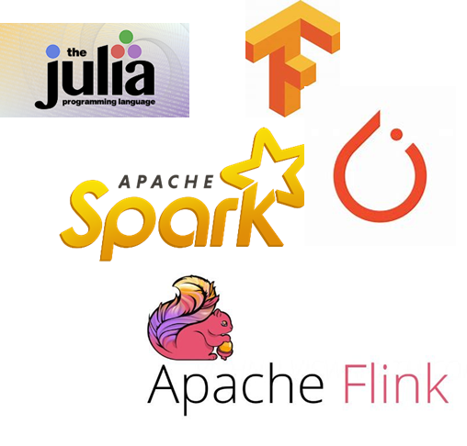

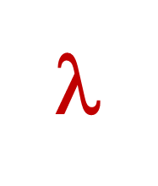
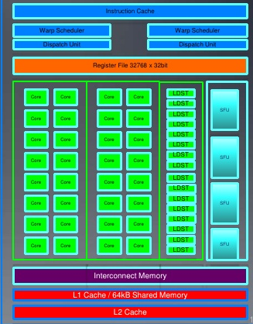
Traditional Platform
Computer, visualize nerve pathways on this patient’s right shoulder, using red to highlight possible nerve compression points?
Request objects one by one
Your logic
File system or Key-Value Store
Runtime copies data into GPU
Accelerator Layer
Objects copied over datacenter TCP network
GPU
The AI code probably runs on a different computer

Slide 29
Our approach
Vortex, could you visualize nerve pathways on this patient’s right shoulder, using red to highlight possible nerve compression points?
Upload data via direct path into GPU memory
Vortex data selectively (and securely) revealed through mapped memory shared with and managed by Vortex
User logic, unmodified; runs in a standard docker container
Vortex’s Key-Value Storage Layer: Vortex
Focus on one server and on a UDL (AI extension) loaded on that same machine
Accelerator Layer
Objects/files
GPU
UDL
ML model, hyperparameters, GEMM kernels preloaded into GP
The UDL runs on the same machines where Vortex is deployed. Here we see one, but the UDL itself is present at every Vortex server.

Slide 30
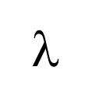
It works! Fast stage to stage handoffs
A simple cooperative ML pipeline
Vortex is close to ideal efficiency on our hardware and 100 to 10,000x faster than common options like Kafka or Apache Flink
Downstream action
Downstream action
GPU
Input event
GPU
GPU
Hyperparameters, models, cloud data
Latency: 33us
Throughput: 8GB/s
Hyperparameters, models, cloud data
Hyperparameters, models, cloud data

Slide 31
Far better than common solutions like Kafka or even KAFKA-DIRECT.
End to end latency: Vortex/Cascade versus Kafka Direct
Smaller is better
Tighter is better
Logarithmic Y axis
Milliseconds vs. Seconds

Slide 32
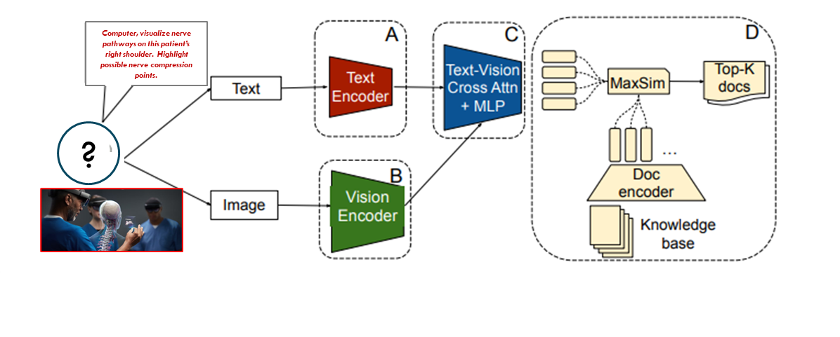
PreFLMR: pipeline for queries about images

Slide 33
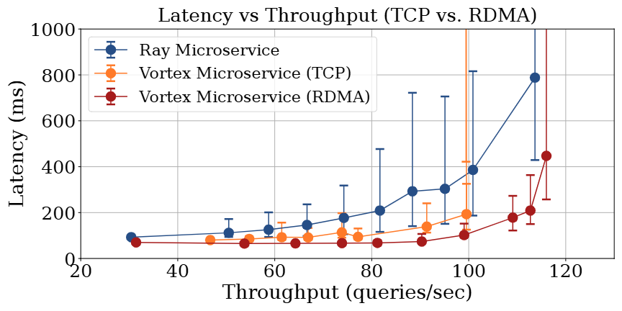
Vortex achieves higher throughput with lower latencies, enabling tighter SLOs

Slide 34
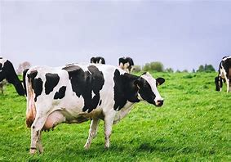
cowBody Condition Scoring
10x faster
Animal body condition scoring: Cascade (gray), Flink (orange). Lower is better.
Same experiment: Cascade achieves higher throughput across the board

Slide 35


Urban traffic planner watching for issues at an intersection
ML task:
Segment each video frame, “agents” are entities moving under independent control
For each agent, run a pipeline. The red ML predicts its trajectory, emitting a stream of coordinates in order of likelihood
The blue risk detector senses dangerous proximity
Output: an alert visible to the city traffic planner
Problematic intersection
City traffic planner

Slide 36

Urban traffic planner watching for issues at an intersection
NEAR MISS!
We can flash the alert on her hololens
But it needs to be timely or the scene will have evolved too much for this to be useful
Problematic intersection
City traffic planner

Slide 37
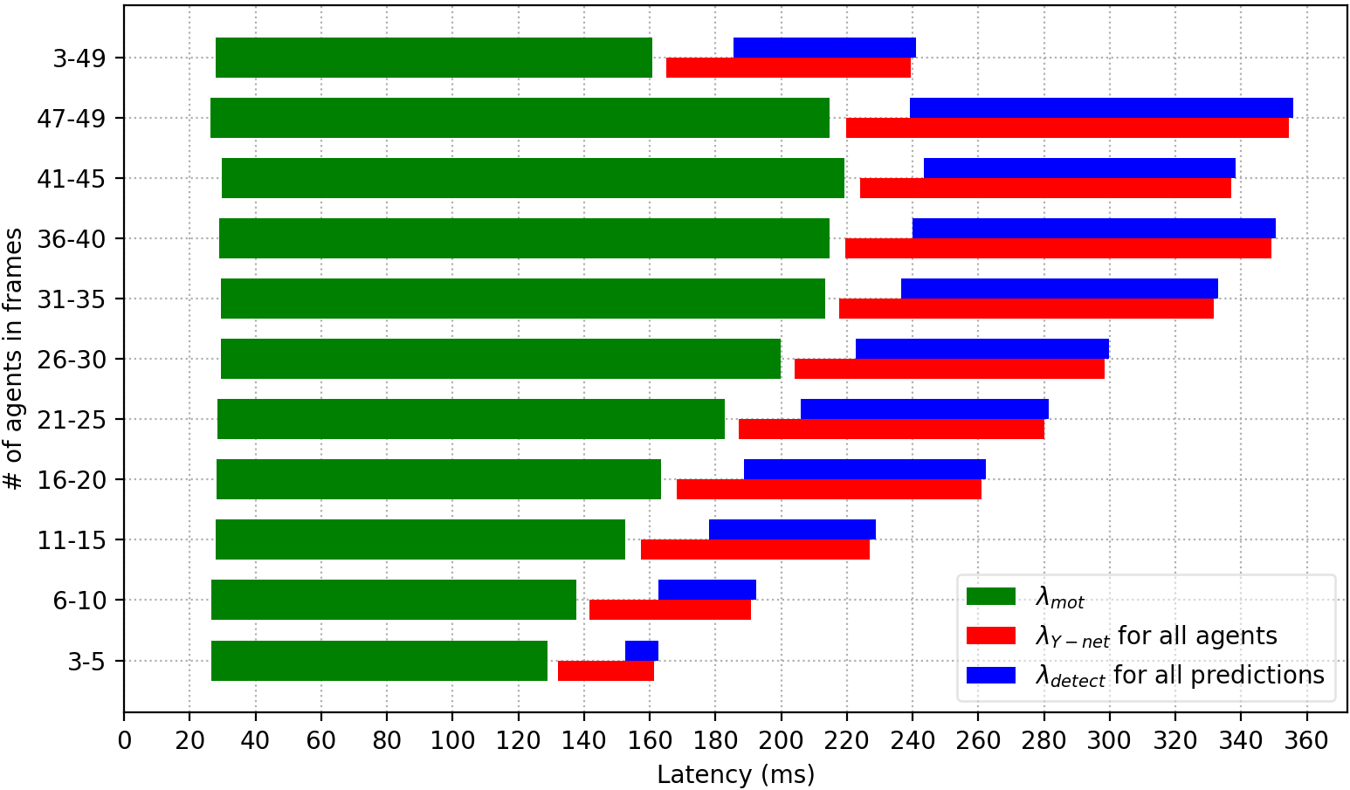
Urban traffic planner watching for issues at an intersection
NEAR MISS!
Problematic intersection
City traffic planner
Azure: Seconds. Vortex: Milliseconds

Slide 38
… yet Vortex has seen little real use
It genuinely is API back-compatible and super fast
But AI / ML deployments in “real” data centers center on standardized modularity – the key value store and file system are separate from logging servers, which are separate from Zookeeper, which is distinct from the job manager/scheduler…
Vortex disrupts too many of these expectations!

Slide 39
Bottom line?
To have impact in modern AI, you need to do research that
Respects standard styles of coding (baked into vibe copilots!)
Respects standard modularity and APIs
More or less is plug-and-play compatible
Or, maybe more promising, look at topics that aren’t really about the runtime platforms per-se, at all.

Slide 40
It isn’t just a problem with my work!
Many classic systems papers quickly were adopted into the OS technology “base” or at least “mindset”, and hence had foundational impact.
Today we are seeing an unprecedented tsunami of seemingly strong systems results that do not get adopted:
In particular, this includes a very high rate of AI systems contributions that demonstrate value yet don’t get adopted
Key insight: right at this moment, AI systems are an “easy target”: surprisingly inefficient at the lower layers, hence it is surprisingly easy to write a paper that achieves a 2x (or yes, 10x) speedup… but if the work isn’t adopted, the opportunity lives on for some future paper to tackle!

Slide 41
… many Topics could fit the constraints
A pivot back to IoT and especially, digital twins.
AI is only just starting to really engage with a rapidly evolving outside world, and will do so using these models.
Build ones that really fit as AI services, and demonstrate that AI + your service totally rocks!

Slide 42
Topics that might fit the constraints
Explore security and containment models for AI models that need to operate in settings where data is sensitive or proprietary.
A form of distributed database management combined with some form of abstract barrier. Huge potential!

Slide 43
Revisit real-time with AI in mind
Real-time systems have SLOs but with hard obligations: such and such a task “must” occur within such and such a deadline.
This was a rich area for systems research in the 1980’s but went somewhat cold later.
There must be a tremendous opportunity here, just waiting for us

Slide 44
Parting thoughts
In an AI-dominated future impactful work must pivot to respect new architectural standards and vibe-coding approaches.
Today’s, those approaches reflect 2015 models and solution preferences and have converged to use popular coding styles and models, even if other coding styles / models offer significant benefit.
There is a rich opportunity, but to advance we must respect reality!

