Slide 1

Cascade: A Platform for Intelligent edge computing Ken Birman

Slide 2
The promise of edge intelligence
Can “real world” artificial intelligence be as accurate and as fast as human intelligence?

Slide 3
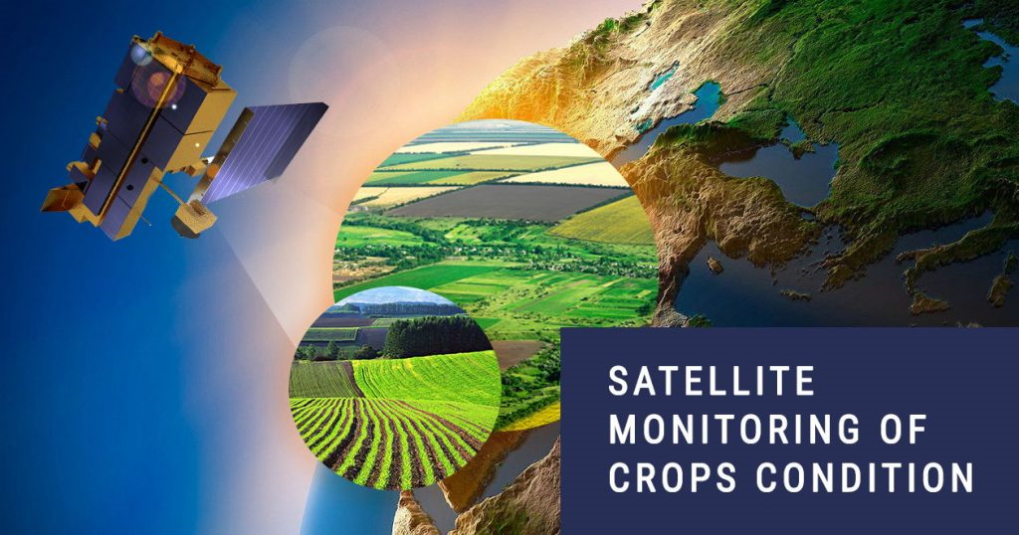
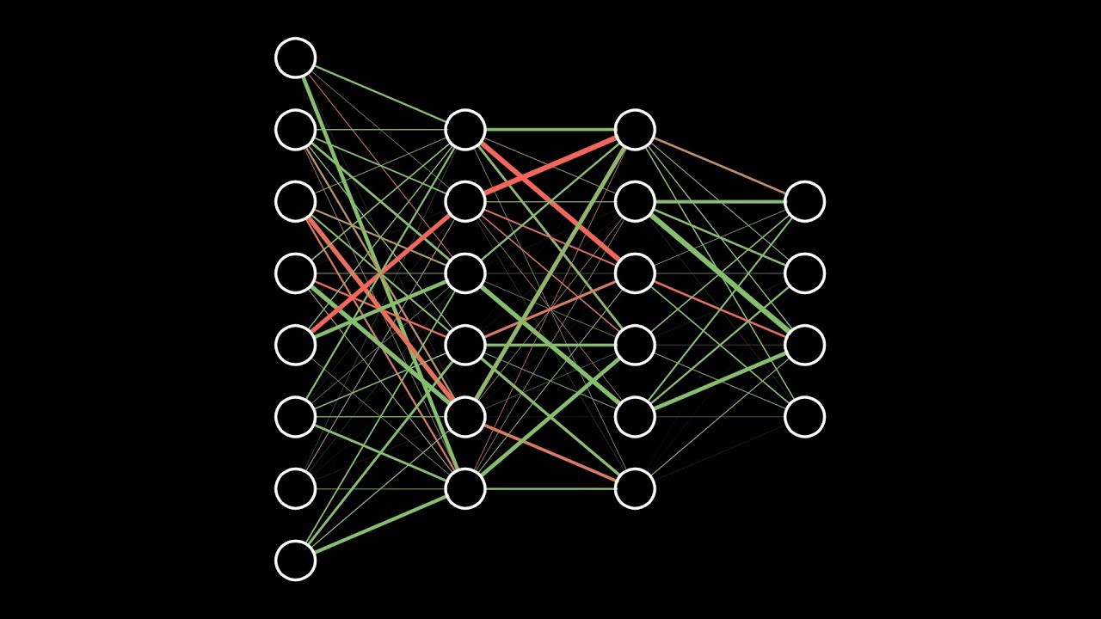
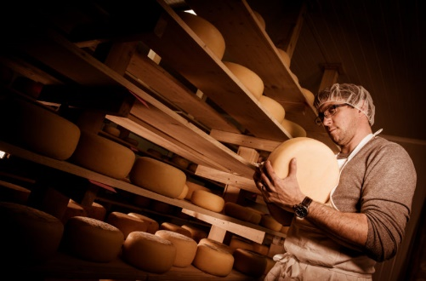
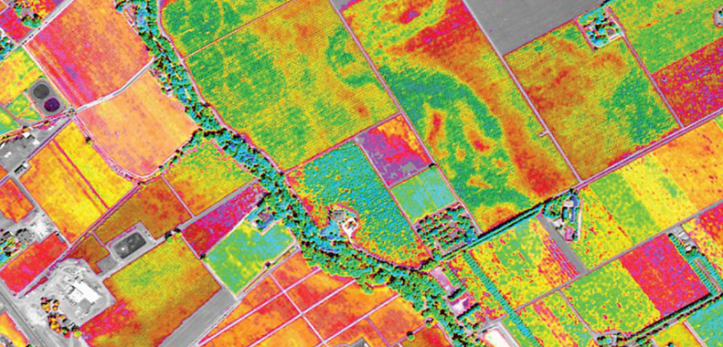
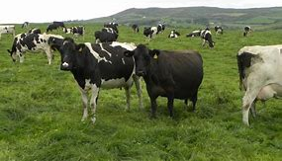
What would Real-world AI look like?
Data sources Cooperative ML Smart Distributed AI Queries
How much should I budget for raw milk purchases in March for my cheese factory?”

Slide 4
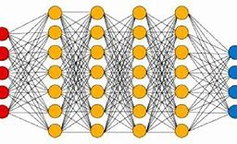
WHAT WOULD REAL-WORLD AI LOOK LIKE?
Data sources Cooperative ML Smart Distributed AI Queries
How much should I budget for raw milk purchases in March for my cheese factory?”

Slide 5
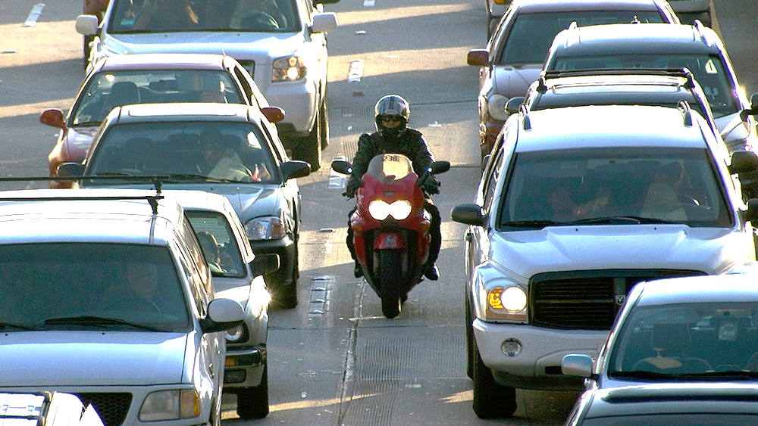
Some uses have demanding deadlines, like smart urban infrastructures
A smart intersection or roadway must send warnings within 25-30ms!

Slide 6
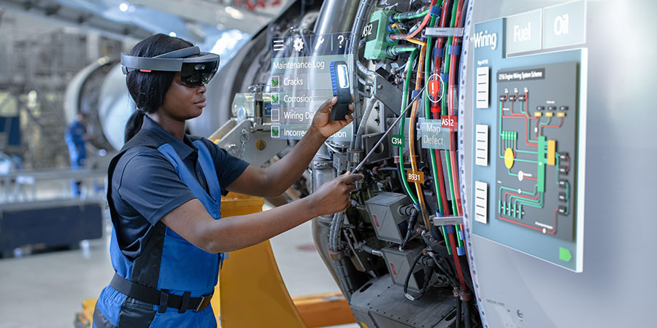
… servicing equipment

Slide 7

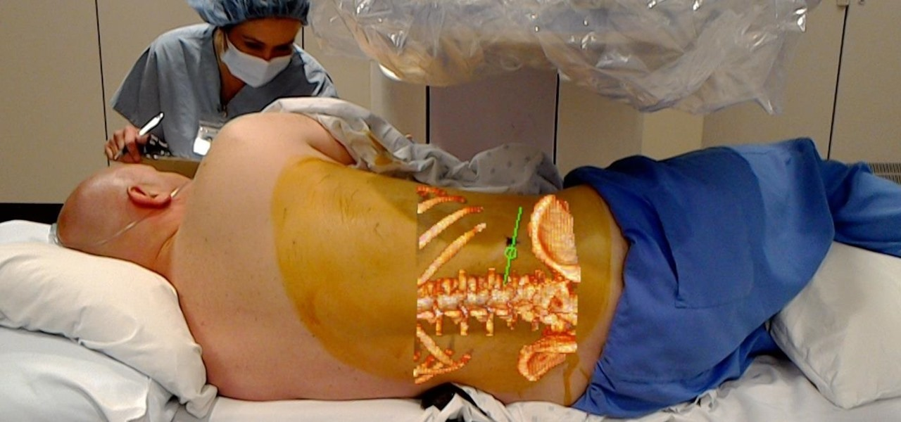
… medical AR

Slide 8
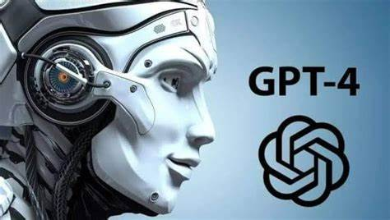
What about Generative AI?
RAG LLMs need help!
Generative AI is trained offline: today’s models learned from 2020 data.
To compensate, “RAG LLMs” are augmented with queries against vector databases
Start with documents, or chunks of documents, or data of other kinds.
Embed each object in a high-dimensional space. As a speedup option we may pre-cluster data to reduce the size of the search space
Given a query, embed it too, then search for the K “closest” documents
… and these documents are used in the LLM prompt

Slide 9
Important applications need correct input!

Slide 10
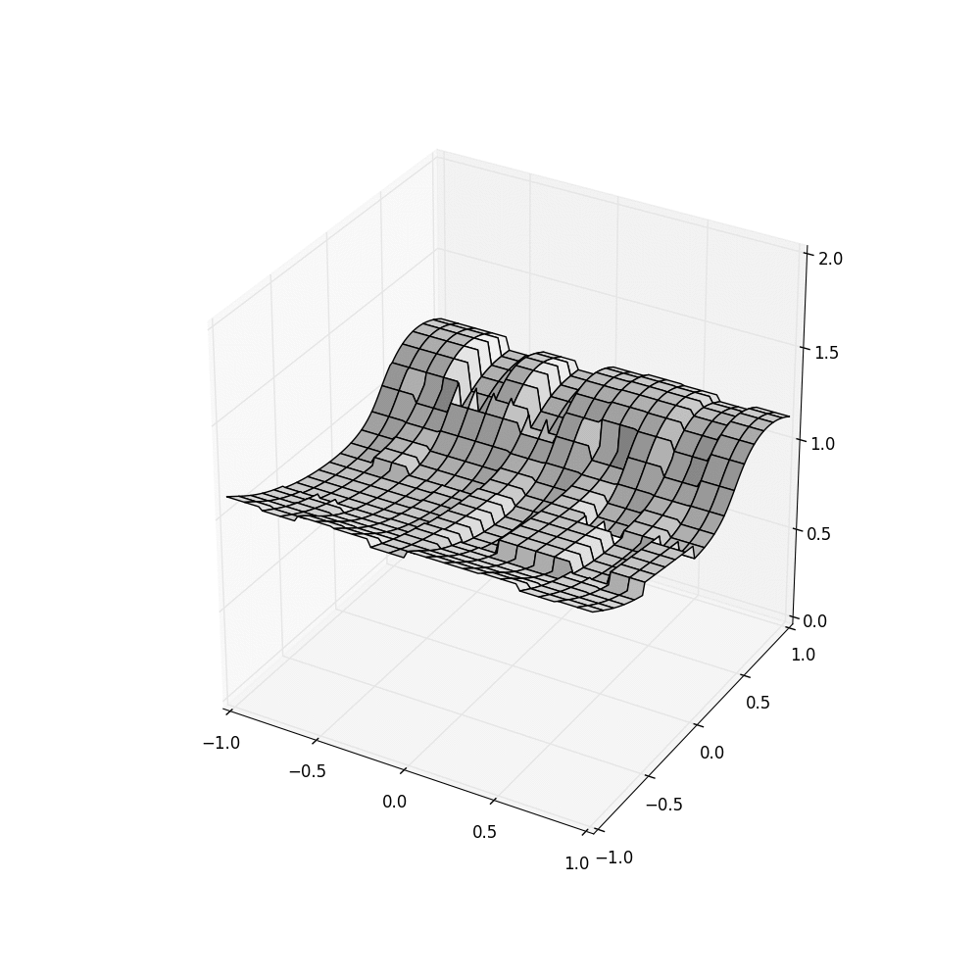
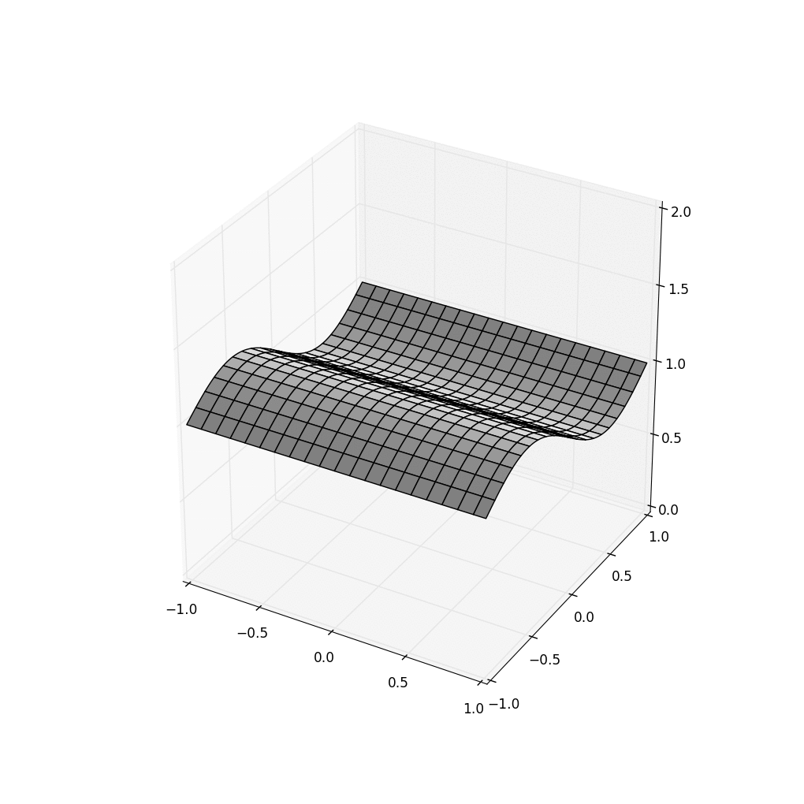

Example of a data Consistency issue (This is one solved in Cascade)
HDFS Cascade using Server clocks… and with SENSOR Clocks
Standard platforms inject noise. With Cascade, applications see the most recent updates, with no “amnesia”. Data is time-indexed for quick, accurate retrieval

Slide 11
Consistency for edge AI
In distributed systems, “consistency” covers a few properties, but adds up to the idea that the system should only be in states reached by sequentially performing actions. If data is replicated, the ordering should be identical.
Implies: no “mashups”, no “amnesia”, no “stale data”. HDFS had all of those and some other, more technical, oddities too.

Slide 12
Yet today’s Cloud lacks this property!
The cloud is biased towards a long, asynchronous update path
Data flows in… “back end” logic updates any indices or data used for web query responses. This can take minutes or hours!
Web queries see whatever the edge currently holds, which could be stale – or a mix of fresh and stale data – etc.

Slide 13
The issue is one of many!
As we push into the topic, we will uncover a series of issues
Today’s cloud has weak consistency, tends to do a lot of copying, has slow links between where sensors live and where computing can be done, and all of these are obstacles!

Slide 14
The Edge: Mile High perspective

Slide 15
Not everything needs the edge!
There are cloud cases where low latency matters
And the edge is far from the incredibly powerful cloud services we depend on for many tasks.
Leads to a “split” ML concept

Slide 16
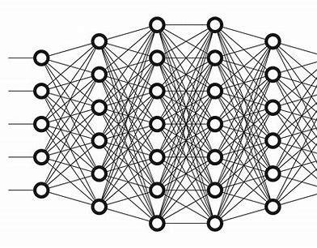

Splitting an ML
Internet
Edge Data
Cloud Data
Contextualizing Data
Snip!

Slide 17
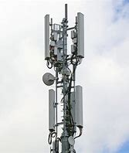

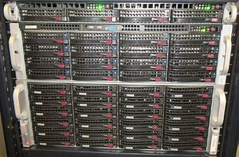

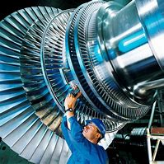
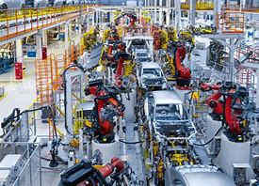
What will the edge look Like?
Cellular 5G
Fast WiFi links
Rack of standardized blade servers with RDMA and GPU accelerators

Slide 18
Must we abandon the cloud?
Imagine AWS or Azure extended with a new kind of service
… an edge service that manages an external cluster
Edge Service
IoT-enabled factory
Secure link
On-site cluster

Slide 19
Benefits of this hybrid approach
It looks like a cloud. Applications see the same environment, APIs
Yet time-sensitive code runs close to devices like cameras
Our new puzzle: what architecture should the new service use?
It will be a “platform” that runs the user’s ML code, like a specialized operating system: Same system calls, yet better behavior!

Slide 20
ML systems in a cloud
Cloud offers extensible services, pre-built by AWS / Azure. You extend them with functions: “lambdas”. They range from tiny fragments of Python to full containerized programs.
A complex ML program will be written as a set of lambdas, organized as a pipeline or a DFG and hosted by such a service.
Lambdas interact via files or pub/sub messages (Kafka). Under the covers, these are just thin APIs over key-value storage (DHT)s

Slide 21
Retrieval Augmented Generation
In this approach, the first AI in a pipeline formulates a query from the prompt.
We run the query (think of it as retrieving chunks of text)
Augment the original prompt with these results, run the second AI
… the augmented prompt contextualizes the original query

Slide 22
Puzzle: How can an edge be cloud-compatible yet also support time-sensitive programs?
This is our central challenge!
Existing ML and AI infrastructure is HUGE and very complex. We want to leverage all these preexisting, powerful solutions.
Reimplementing them just to run on the edge is unpalatable. And yet the whole point of the edge is to offer better reactivity!

Slide 23
Let’s start by fixing the HDFS issue

Slide 24
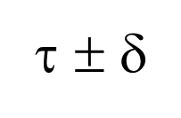
How does Cascade do so much better?
λ²
λ¹
λ⁴
λ³
Put(k’,v)
Each Cascade shard has its own Paxos-based log
Put(k,v)
Put(k’’,v)
(ε, τ)
Stable portion
Put(k,v)
λ¹
Put(k’’’,v)
λ²
λ³
time
λ⁴
Each λ is triggered by an upcall from a “watcher” monitoring some key (or pattern)
Unstable tail
A temporal query for time τ sees a consistent cut at τ ± δ_{clock}.
Queries to unstable data must wait, but updates are stable within 50us.

Slide 25
How does Cascade do it? State machine replication plus consistent cuts
Queries occur along a stable (durable) consistent cut
Put(k,v)
Put(k,v)
Put(k,v)
Each Cascade shard has its own Paxos-based log
Put(k,v)
Put(k,v)
Stable portion
(ε, τ)
Stable portion
Put(k,v)
λ
λ
Put(k,v)
λ
λ
time
λ
λ
time
λ
Each λ is triggered by an upcall from a “watcher” monitoring some key (or pattern)
λ
Unstable tail
Unstable tail
A temporal query for time τ sees a consistent cut at τ ± δ_{clock}.
Queries to unstable data must wait, but updates are stable within 50us.

Slide 26
What we just saw
Relatively “old” ideas sufficed to fix the HDFS issue
HDFS was inattentive to data stability, sequential order. You wouldn’t notice this except that we took snapshots in real-time.
The issue isn’t that HDFS is broken… it simply wasn’t created for edge use cases like the example I showed

Slide 27
Now let’s fix everything else

Slide 28

The remaining issue is speed
The adversary? Data copying and excessive locking.
memcpy

Slide 29
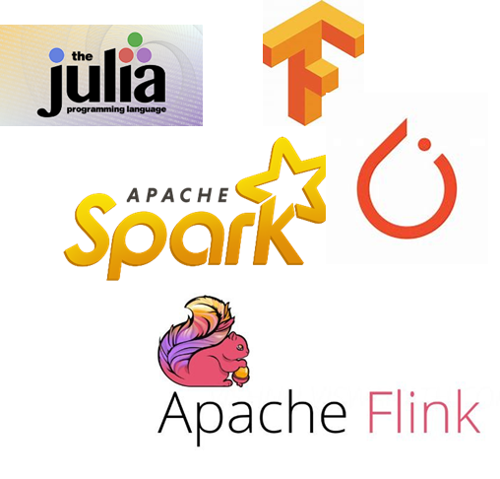
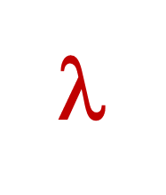
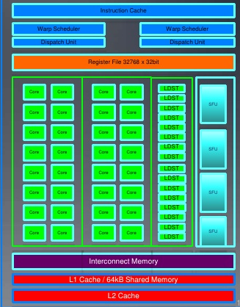
Traditional Approach
Request objects one by one
Your logic
File system or Key-Value Store
Runtime copies data into GPU
Accelerator Layer
Objects copied over datacenter TCP network
GPU
Your code is in its own address space, maybe on a different computer

Slide 30
Our approach
Direct data path into GPU memory
Cascade data selectively (and securely) revealed through mapped memory shared with and managed by Cascade
User logic, unmodified; runs in a standard docker container
Cascade Key-Value Storage Layer
Objects/files
Accelerator Layer
GPU
ML model, configuration, parameters (ideally, preloaded into GPU, then cached)

Slide 31
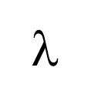
Fast-Path Performance with 100G network
A simple cooperative ML pipeline
Cascade is close to ideal efficiency on our hardware and 100 to 10,000x faster than common options like Kafka or Apache Flink
Downstream action
Downstream action
GPU
Input event
GPU
GPU
Hyperparameters, models, cloud data
Latency: 33us
Throughput: 8GB/s
Hyperparameters, models, cloud data
Hyperparameters, models, cloud data

Slide 32
This is transparent to the application!
Reminder: “Can encode tables and databases”
In effect, we are reimplementing
Storage functionality (K/V store, file system, pub/sub).
Management of memory, including GPU memory
Communication operations (RPC, multicast, asynchronous streaming)
Key idea: Map all of this to modern hardware features that Linux and ML platforms use “ineffectively” (or ignore) today

Slide 33
Deeper dive on Derecho

Slide 34
RDMA: Remote Direct Memory Access.
A form of hardware accelerator for a TCP-like protocol
Can move large objects at 100Gbps (12.5 GB).
One-way latency can be as low as 0.75us.
Competitive with the memory bus inside a modern server!
Bandwidth will continue to improve, but latency won’t drop.

Slide 35
Puzzle: Consider A Simple Reliable Barrier Protocol on RDMA
P
Q
R
“Ack” “Ack”
“Here is 100B message m” “Deliver m” “Garbage collect m”

Slide 36
A Simple Reliable Protocol on 100G RDMA
P
Q
R
TIMELINE, PROCESS P
“Ack” “Ack”
“Here is 100B message m” “Deliver m” “Garbage collect m”
P
1.5us
0.75us + 100B/12.5GB/s = 0.750000008us
1.5us
1.5us
4.5us + 12 RDMA messages (limit: 75M/s)

Slide 37
A Simple Reliable Protocol on 100G RDMA
P
Q
R
TIMELINE, PROCESS P
“Ack” “Ack”
“Here is 100B message m” “Deliver m” “Garbage collect m”
Peak possible performance?
P
Time to perform one 100B reliable multicast? 4.5us + “noise”
… based on time expended, limited to 222,222/s
12 RDMA verb operations out of 75M: limited to 6.25M/s
RDMA could have transferred 56KB of data in 4.5u … we left 99.8% capacity “unused”!
0.75us + 100B/12.5GB/s = 0.750000008us
1.5us
1.5us
1.5us
4.5us + 12 RDMA messages (limit: 75M/s)

Slide 38
A few ideas
Have all the 3 members perform concurrent updates… now we might get some overlap and push our efficiency… to 0.6% ☹
Run lots of threads… maybe 10 per process. We aim for 6% efficiency (but locking and scheduling delays will cut this sharply) ☹
Batch 1000 messages at a time. ☺ But now the average message waits until 500 more have turned up. Latency soars to 2.25ms ☹

Slide 39
At Best, You get something like this…
P
Q
R
Messy and unpredictable with sudden bursts of data movement… Unlikely to perform well ☹

Slide 40
Better: Separate Data Plane and Control Plane, make them pause-free
Send continuously, as soon as new updates show up
Receivers continuously report their acks, in an all-to-all pattern. This way every process can deduce delivery/garbage collection.

Slide 41
Better: Separate Data Plane and Control Plane, make them lock-free
P
Q
R
P
Q
R

Slide 42
Better: Separate Data Plane and Control Plane, make them lock-free
P
Q
R
P
Q
R
Data plane runs steadily (Derecho’s RDMC or SMC multicast)
Control information exchanged continuously (one-sided RDMA writes via SST)

Slide 43
Idea: start by dusting off a bit more old work (but then we need to innovate)
Use virtual synchrony to manage membership.
Consensus-based, but failures/joins are infrequent
During each membership epoch:
Deliver messages in round-robin order among “senders”.
A sender transmits null if it has no data to multicast

Slide 44
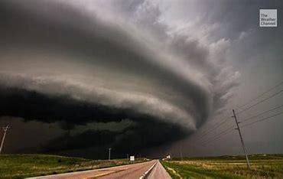
This became the Derecho project
Derecho: A powerful straight-line storm
Derecho is an open source C++ library (but callable from Java and Python and C#) for ultra fast communication and ML patterns like AllReduce
Cascade is actually built “around” Derecho.

Slide 45
SST for Monotonic Control Data

Slide 46
Derecho’s Data Plane = RDMC/SMC. Derecho’s Control plane = SST
Derecho group with members {A, B, C} in which C is receive-only
A
B
C
A
B
C
A
B
C
m_{A:1}
m_{A:2}
m_{A:3}
m_{A:4}
m_{A:5}
m_{B:1}
m_{B:2}
m_{B:3}
m_{B:4}
 | Suspected |  |  | Proposal | nCommit | Acked | nReceived |  | Wedged
A | F | T | F | 4: -B | 3 | 4 | 5 | 3 | T
B | F | F | F | 3 | 3 | 3 | 4 | 4 | F
C | F | F | F | 3 | 3 | 3 | 5 | 4 | F
A B
B fails, resulting in an uncertain state
Data moved on RDMA multicast
Control is done using knowledge programming on the SST

Slide 47
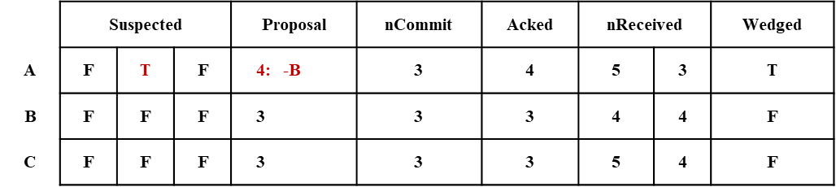
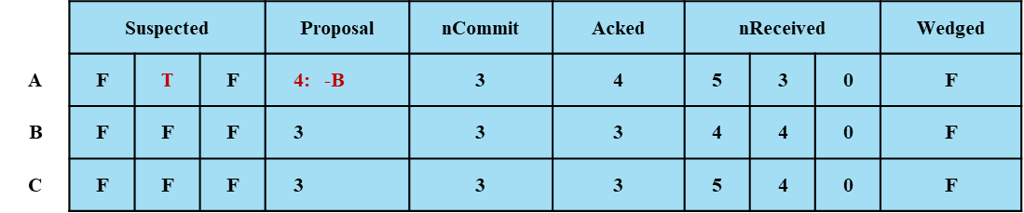
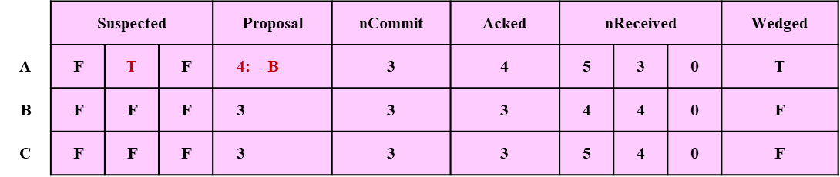
Shared State Table (SSt): Direct RDMA writes with no locking (sequential cache-line consistency)
Replicated at members
Update own row
Read-only copy of other rows
RDMA enables A to write directly to the replicas on B and C
SST on machine A
SST on machine B
SST on machine C

Slide 48
Predicates
Inside Derecho we design our logic as a loop over a series of if statements:
if(property-X-holds) { run this triggered logic }
In each participant, a single predicate thread runs this task. The predicates are expressed as logic over the SST.

Slide 49
A puzzle… and a monotonic solution
Multicasts are being streamed at high speeds
Control exchange lags and predicate thread may miss updates.
Solution: send monotonic data. If we repeatedly overwrite the receive count and it “jumps” from 4 to 27, participants can infer that they missed 5…26

Slide 50
Monotonic Predicates
Consider a “safe to deliver” predicate: P(m_{k}).
It only gets evaluated from time to time, hence perhaps it fires for m₄ and the next time it fires, we are at m₂₇
P(m_{k}) is monotonic if P(m_{k}) ⇒ P(m_{k’ < k}).
In this example, P(m₂₇) ⇒ m₁ ... m₂₇ are all safe to deliver. But m₁ ... m₄ were previously delivered. Opportunistically batch and deliver m₅ … m₂₇

Slide 51
So, what we did was…
[Data plane] 1-to-n data movement with TCP-like reliability, not atomic.
[Control plane]
a) Expresses atomic multicast and Paxos as monotonic predicates over monotonic data shared through the SST. Note: our system does full replication, not just a quorum subset. Like Q_{w}=N, Q_{R} =1
b) All participants independently and concurrently detect progress. Opportunistically batched actions “catch up” if any lag occurs.

Slide 52
…Yielding a new atomic multicast and an optimal Paxos!
Bisimulates classic Paxos with Qw=N, Qr=1
… minimizes information passing (≈ messages) Achieves bounds from Keidar/Schraer [PODC ‘06]
If a participant lags behind, opportunistic batching compensates

Slide 53
A few other aspects of Cascade

Slide 54
More ideas: Navigator Scheduler Affinity grouping
Old: Cascade hashed to place objects and used RR load balancing in a shard.
We group related objects (affinity), then move or update them as sets (this idea is work by Thiago Garrett)
New: Cascade decides where to host objects and ML tasks using a scheduler: Navigator. Effort headed by Alica Yang.
Decentralized optimization that prioritizes reduced latency via smart GPU memory management and affinity group-aware task placement.

Slide 55
Performance Microbenchmarks

Slide 56
so… does All of this work?
“In theory, theory and practice are the same. In practice, they are not.” -- Albert Einstein
Fortunately, Cascade really does work, amazingly well:
1.5x to as much as 100x speedups
Stage to stage handoffs as low as 33us
Pays off for reliable multicast but also for things like AllReduce
Even benefits complex tasks like “smart traffic intersections”

Slide 57
Derecho atomic multicast is twice as fast as the non-atomic Open MPI RDMA multicast
Derecho is stable over a wide range of scenarios
Derecho is twice as fast
Notes:
Comments: the 100MB and 1MB data series is from Jonathan’s RDMA evaluation. While the 10KB data is from Lorenzo’s spindle evaluation, which is atomic broadcast.
Please note that on the right, OpenMPI 100MB and OpenMPI

Slide 58
Derecho DDS compared to Kafka-Direct
Smaller is better
Tighter is better
Logarithmic Y axis
Milliseconds vs. Seconds

Slide 59
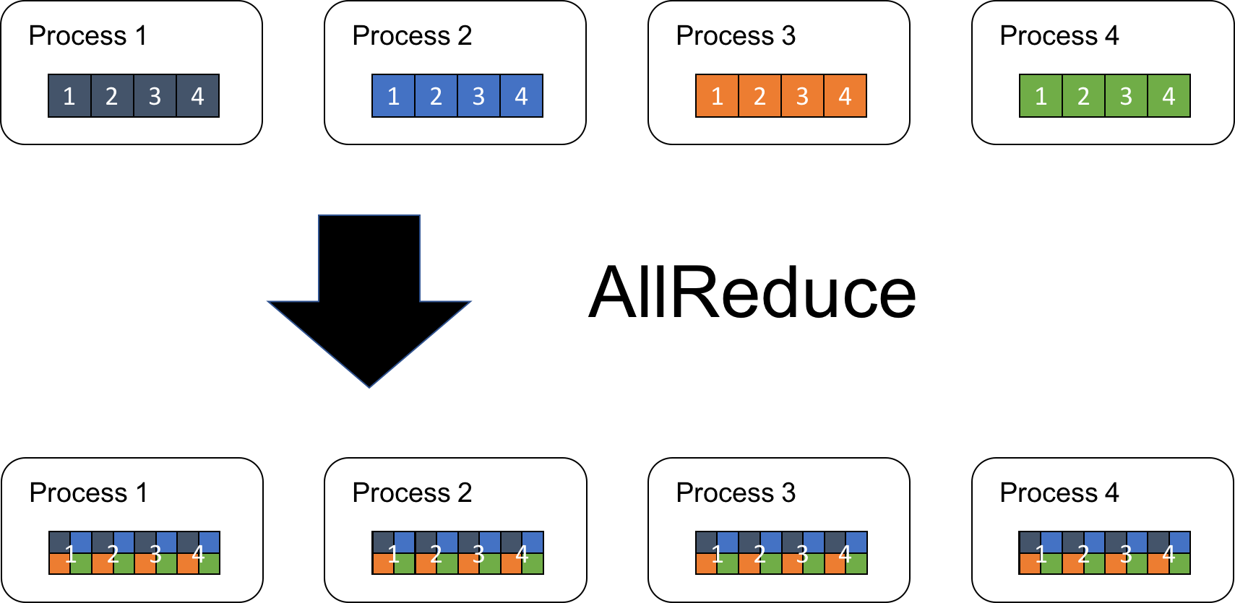
Cascade speeds up computation, too. DCCL and Experiments by Weijia Song
Notes:
We use AllReduce to show DCCL’s performance as it is one of the most important operation in distributed model training.
It allows collecting data from different processing units to combine them into a global result by a chosen operator. In turn, the result is distributed back to all processing units.

Slide 60
AlLReduce Example: 1.5x-2x speedups!
Derecho is nearly 2x faster than OMPI/UCX
Open MPI is widely viewed as the state-of-the-art for AllReduce. UCX and OB1 are two OMPI communication options.

Slide 61
Performance for real applications

Slide 62
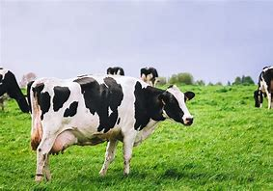
Cascade V. Apache Flink IN A cow Body Condition Scoring Application
10x faster
Animal body condition scoring: Cascade (gray), Flink (orange). Lower is better.
Same experiment: Cascade achieves higher throughput across the board

Slide 63
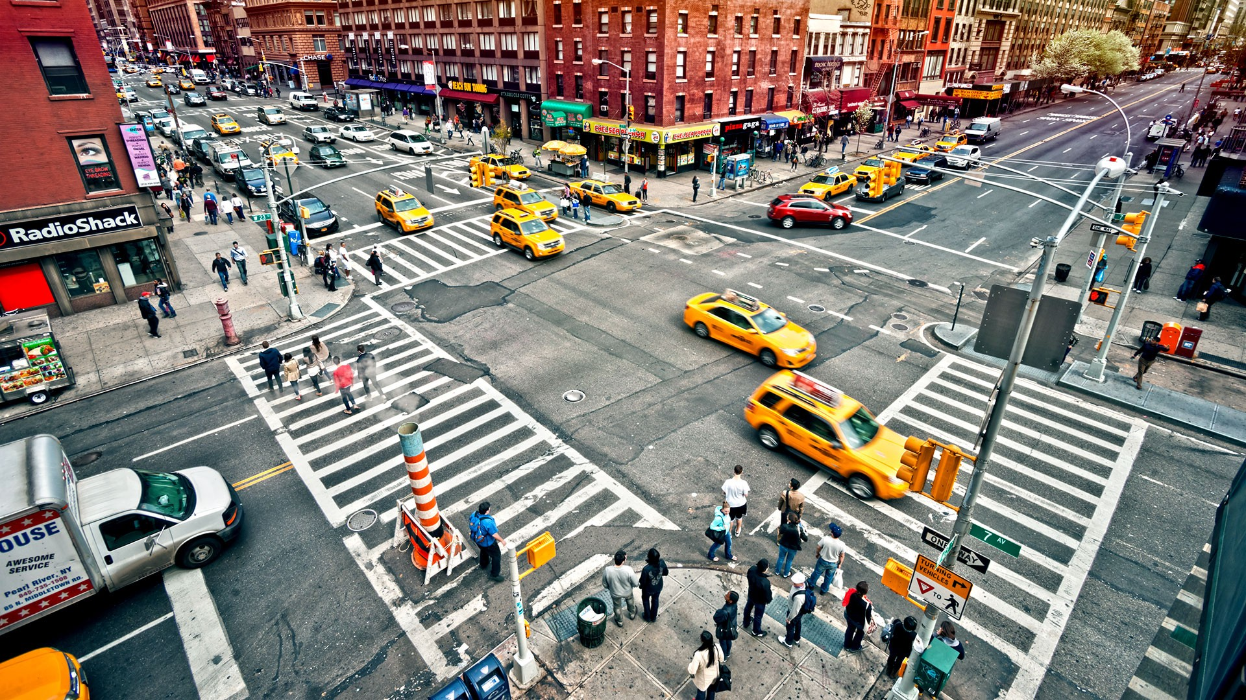
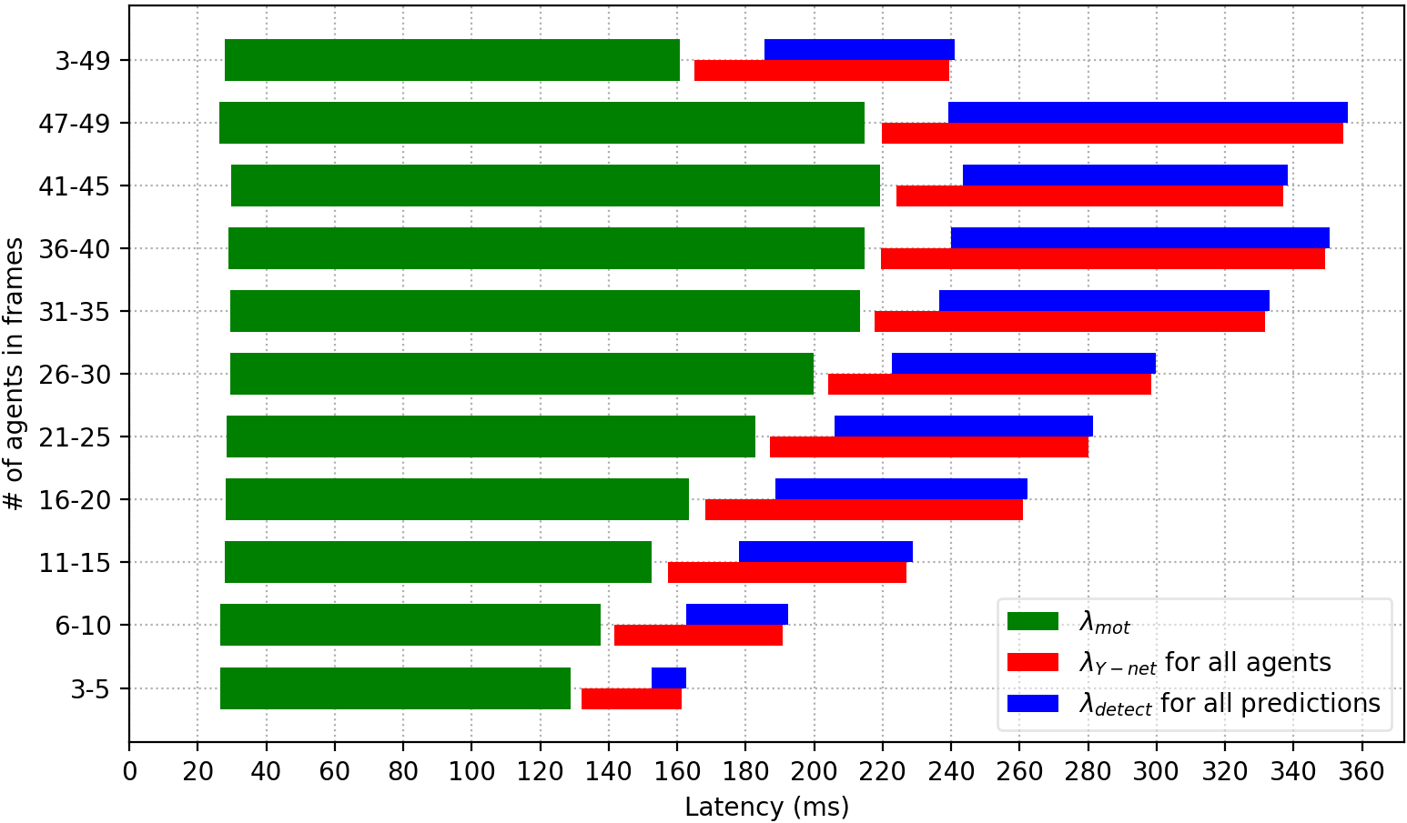
Cascade V. Azure sensIng traffic hazards
This application uses affinity sets. Payoff is dramatic
Azure: Seconds. Cascade: Milliseconds

Slide 64
Does navigator really matter?
We ported four AIs to Cascade
But this time, we won’t compare with the standard cloud. Instead we will just ask whether scheduling brings “additional speedup” beyond what Cascade already is achieving

Slide 65
Generative AI: LLM/Vision Workflows
(a). Language translation pipeline
(c). Q&A dialogue pipeline
(b). Image reading pipeline
(d). 3D perception pipeline

Slide 66
Now run these all on Cascade but vary the choice of scheduler
Low-load scheduling performance
Different loads scheduling performance
Navigator cut delays by a further 2x-6x (and runs the job with just ½ the servers!)
High-load scheduling performance

Slide 67
Wrapping up…

Slide 68
Summary: A new cloud service for edge and low-latency, high throughput uses
Huge (multiplicative!) speedups
Streaming-oriented mapping to network accelerators
Fast end-to-end path eliminates copying and (most) locking
Smart scheduling improves speed and resource efficiency
Packaged transparently: so that existing AI and ML code benefits with little or no change (and thinks it resides in a normal cloud).

Slide 69
Summary
Leverage hardware
Avoid locks, memory contention
Embed in public clouds
Dramatic improvements in AI/ML speed, consistency
Rethink protocols
Offer end to end zero copy
Hide behind standard APIs!
Our project involved work at many levels.
Some of this leveraged old ideas, but along the way we also needed to invent new protocols
Classic protocols often paused for round-trip coordination.
New ones are asynchronous, leverage monotonicity for control data, and center on monotonic knowledge-based deduction

Slide 70
Huge shout-out to the team!
Weijia Song (Overall leader for Cascade effort)
Sagar Jha (Derecho, SST)
Jonathan Behrens (Derecho, SST)
Lorenzo Rosa (Derecho DDS, Spindle, DPDK support)
Alicia Yang (Leader on Navigator, m-Navigator scheduler efforts)
Thiago Garrett (Affinity groups)
Tiancheng Yuan (our ML expert)
Yifan Wang (our GUI and low-code expert)
Roman Vitenberg, Luis Rodriguez (Navigator, m-Navigator)
… And a big crowd of amazing undergraduates, too many to fit on this slide.

Slide 71
The promise of edge intelligence
Can “real world” artificial intelligence be as accurate and as fast as human intelligence?
Real world” artificial intelligence can be as accurate and as fast as human intelligence!

