Slide 1

Interactive 3D Reconstruction
Putting the human in the loop
Adarsh Kowdle

Slide 2
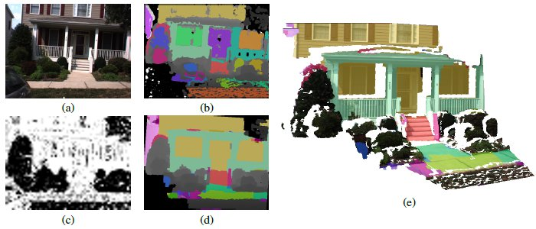
In the last class…
Automatic 3D reconstruction algorithms
Furukawa et. al. (ICCV ‘09)
Gallup et. al. (CVPR ‘10)

Slide 3
In the last class…
Automatic 3D reconstruction algorithms
Sinha et. al. (ICCV ‘09)

Slide 4
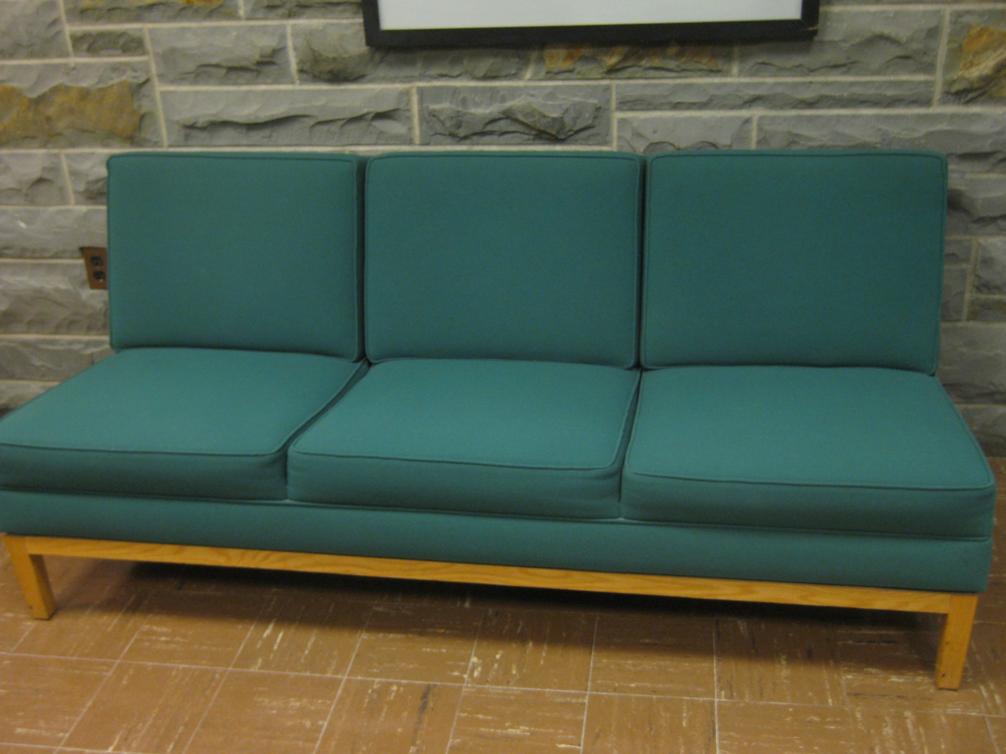
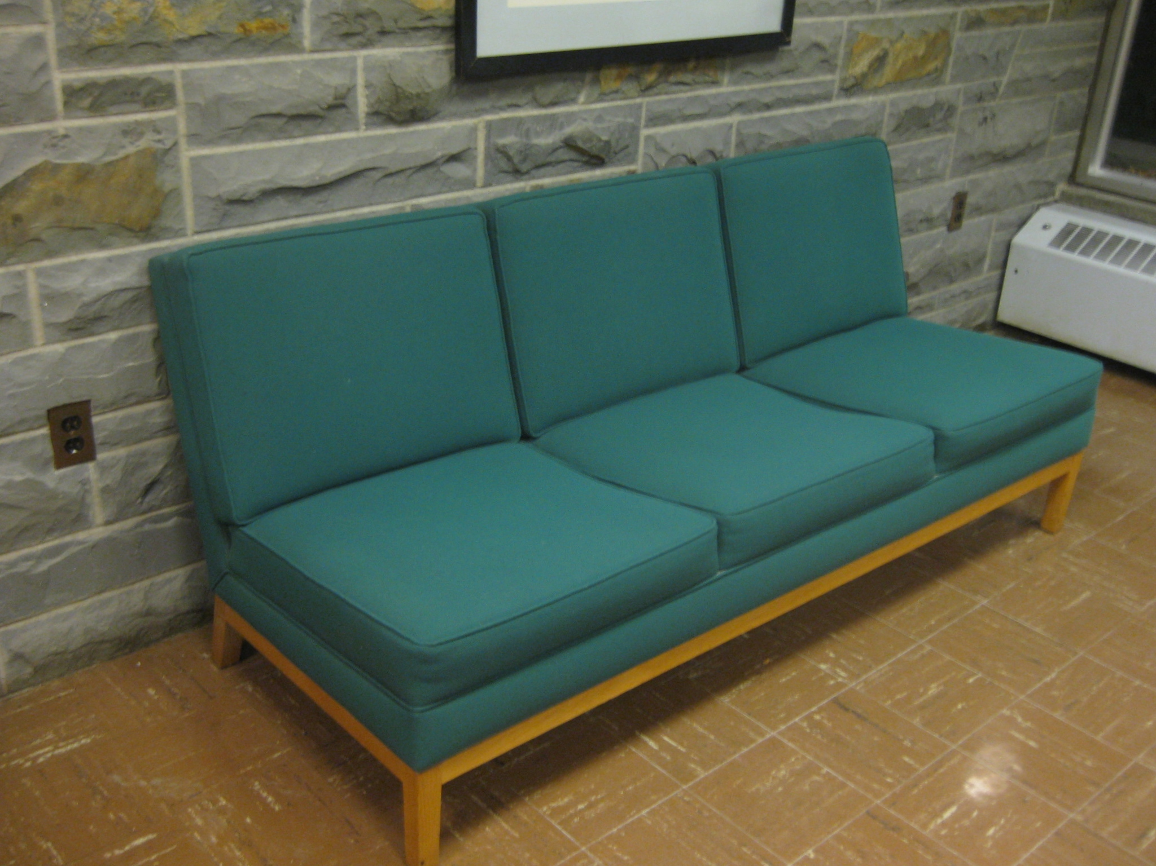
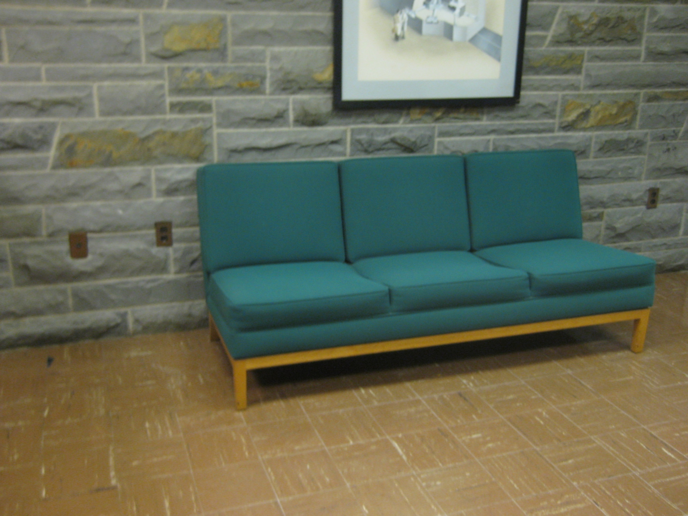
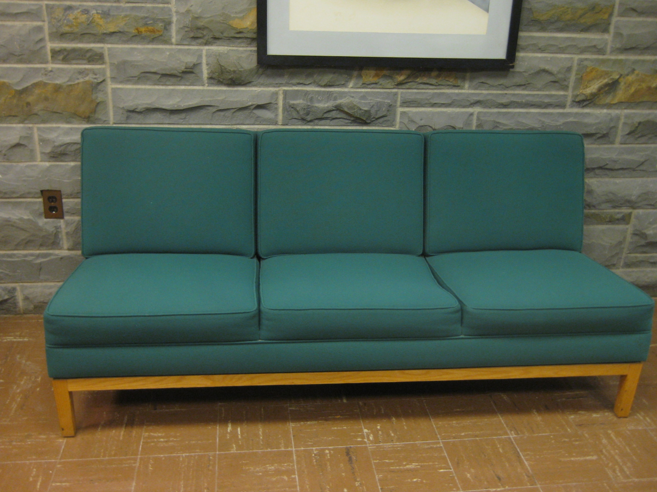
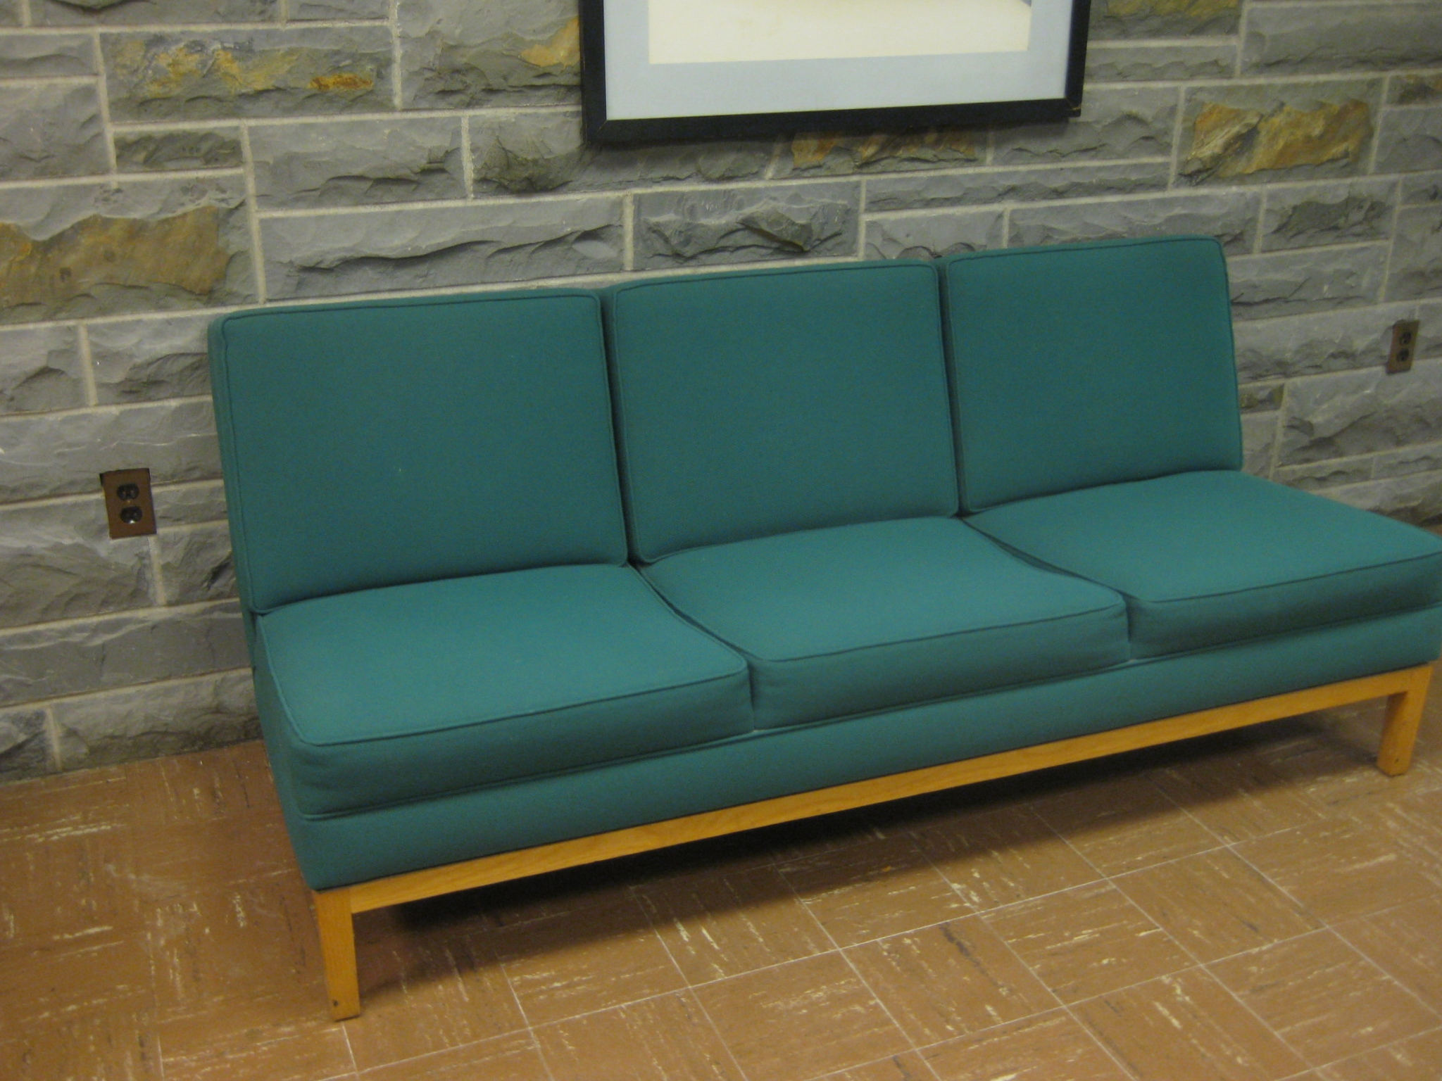
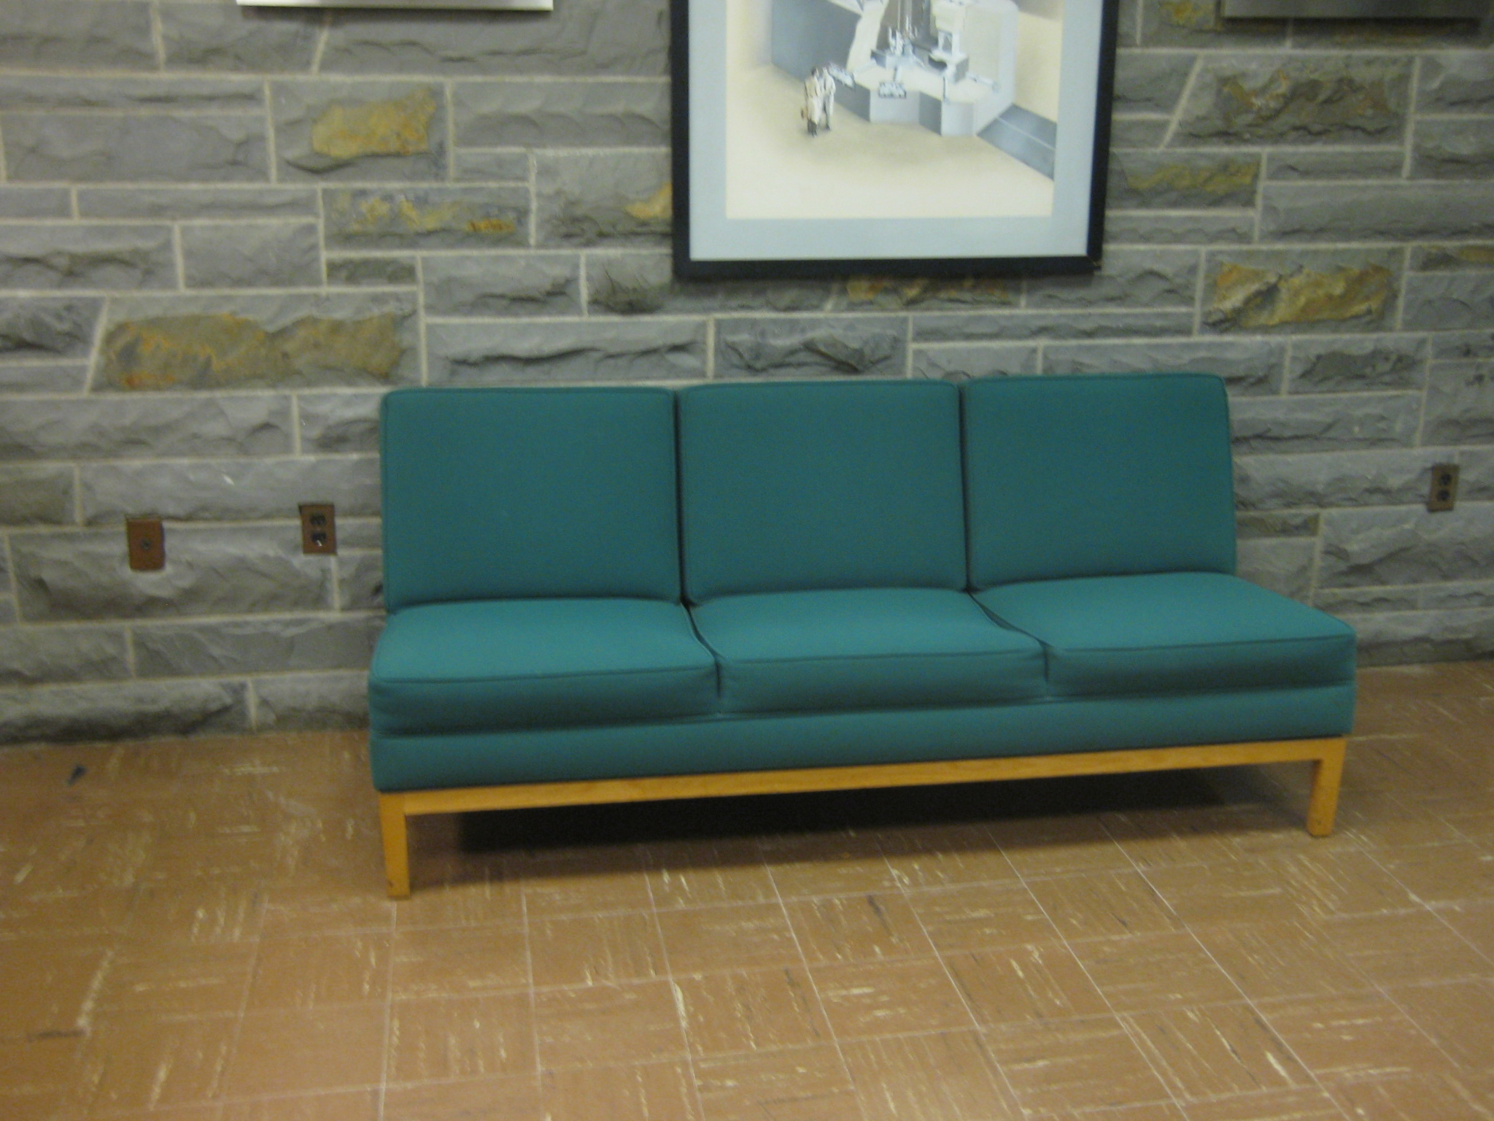
Notes:
This work is about the well known yet hard task of image based modeling. Given a set of images of a scene captured from varied viewpoints, we wish to recover the 3D structure of the scene. In case of natural scenes, structural irregularities like texture-less surfaces, specular surfaces, thin structures, complex occlusions, make this a hard problem.

Slide 5
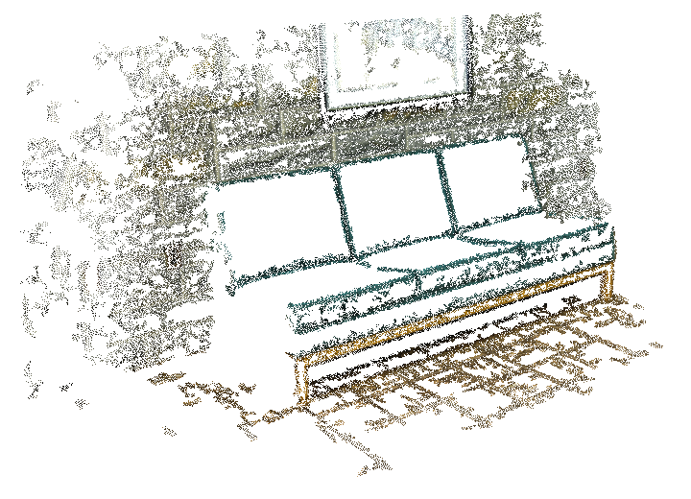

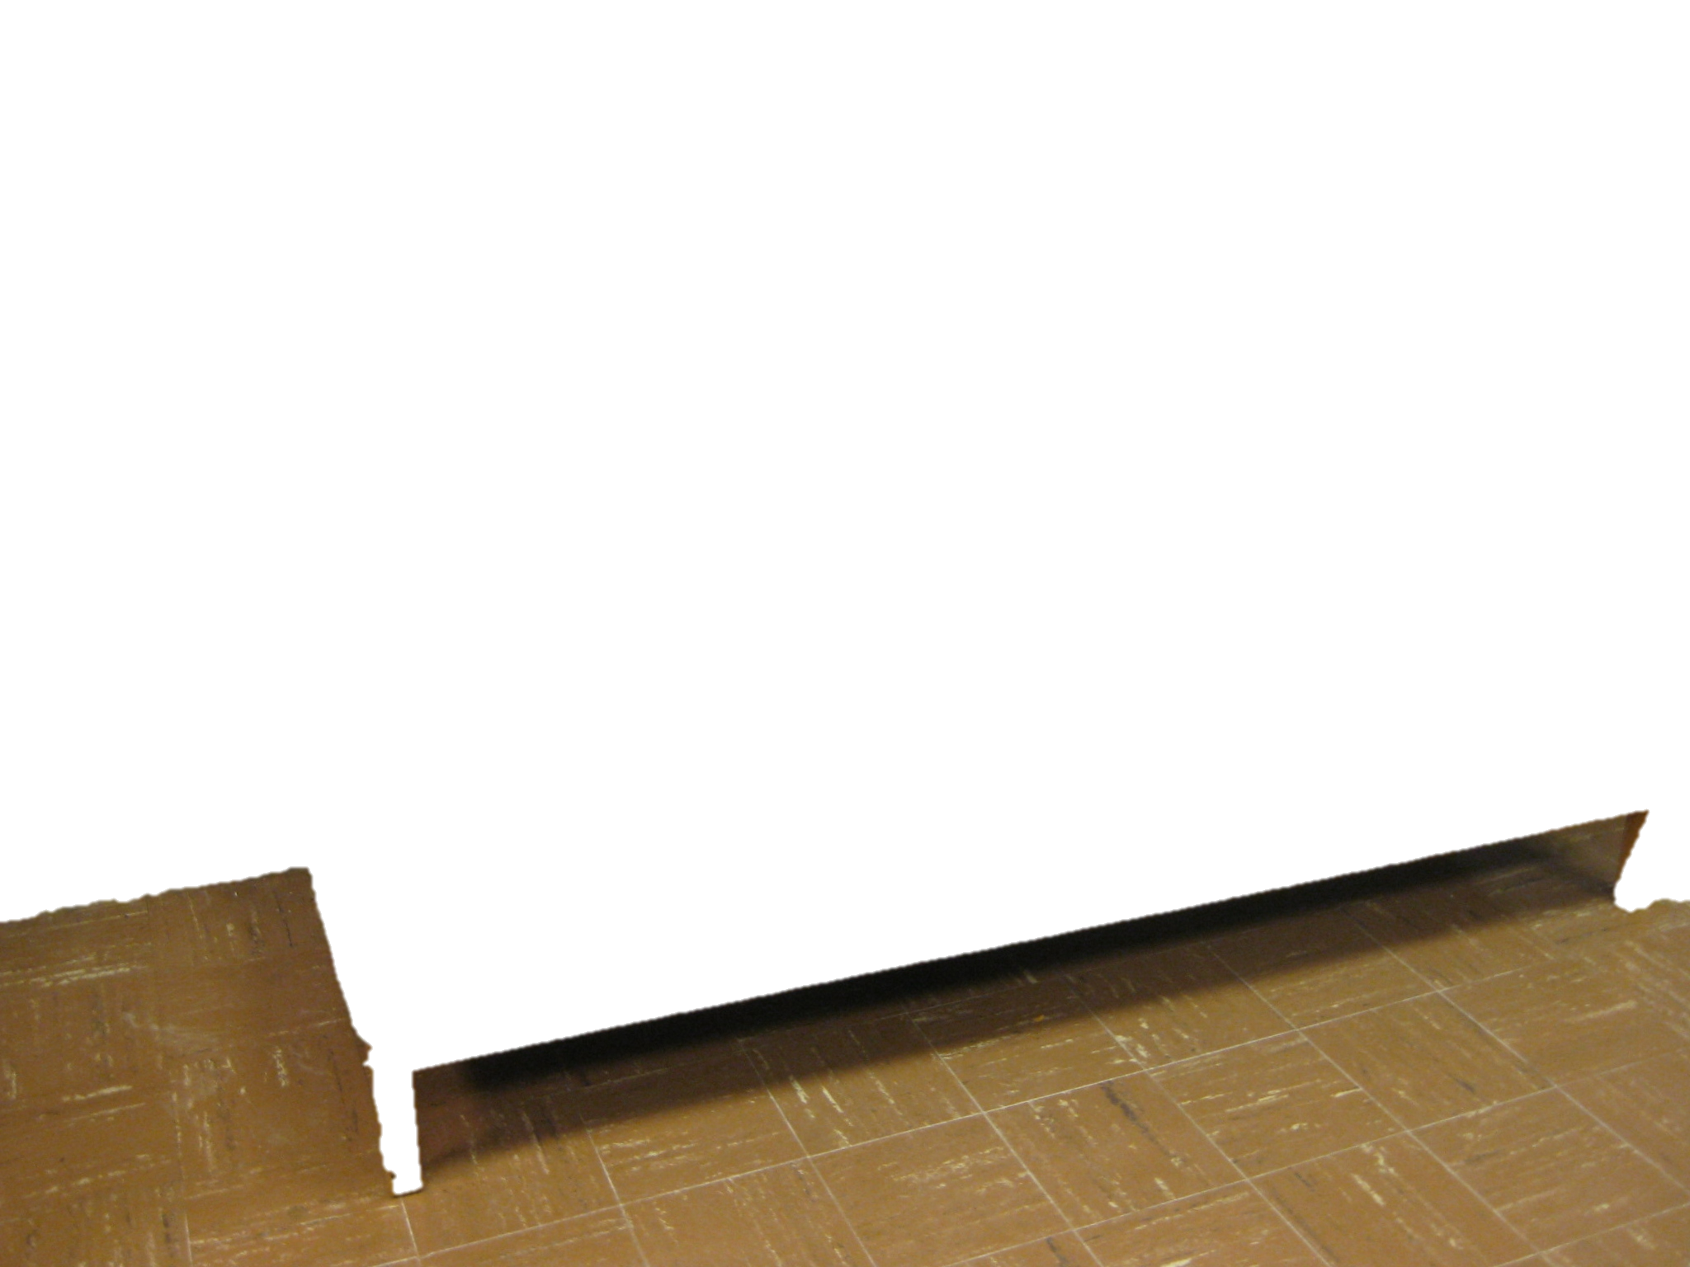
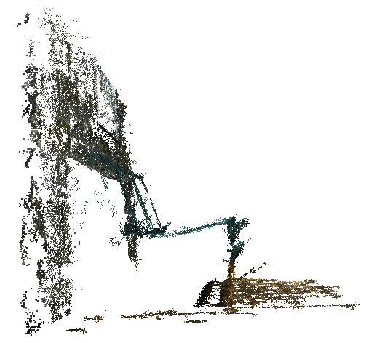
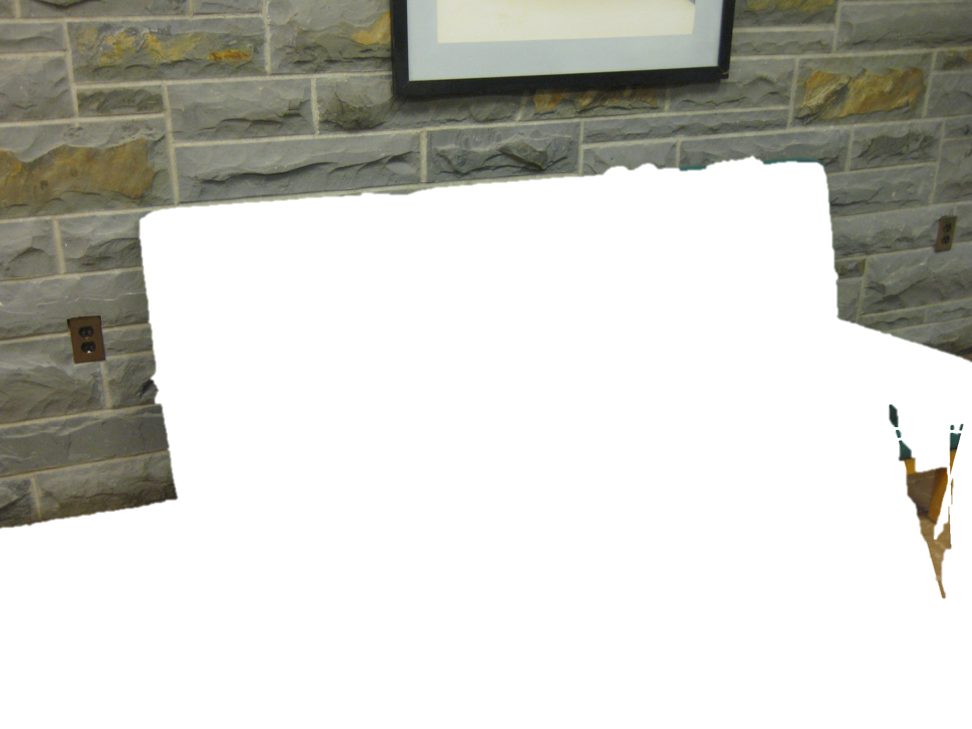
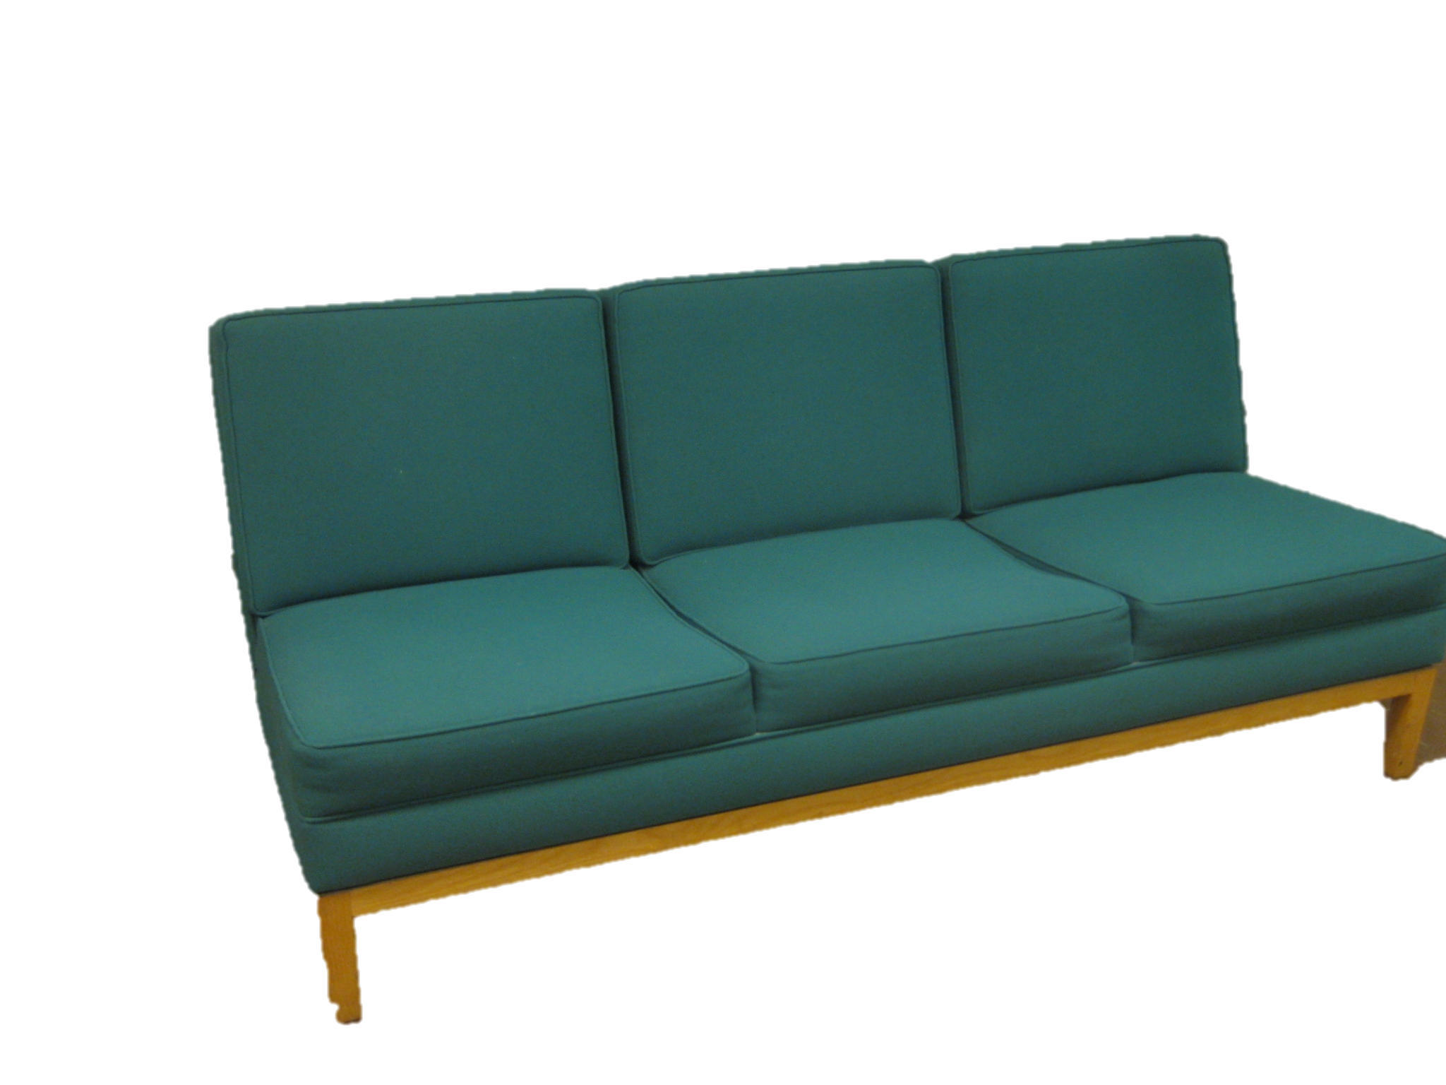
x
?
x
?
3D
PMVS - Furukawa et. al.
Notes:
For example, consider these two images of a scene.
A features such as this one of the wall can be distinctly matched to the features on the right, However, for a feature on the couch, there is an ambiguity about where the matching feature is, on the right image.
What this would mean is that, the algorithm would be able to do a good job reconstructing the wall, and the ground but the algorithm would be uncertain about regions on the couch.
But, we humans can much better discern the geometric structure underlying the pixel data we view. We understand that it a couch with a vertical back rest, flat base to sit on, at a certain height from the ground, etc. In this work we want to use this information the user has to obtain a better reconstruction.

Slide 6
Interactive 3D reconstruction
Putting the human in the loop

Slide 7
Interactive 3D reconstruction
Humans driving the show
3D reconstruction algorithm

Slide 8
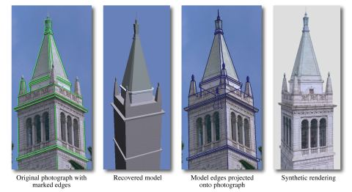
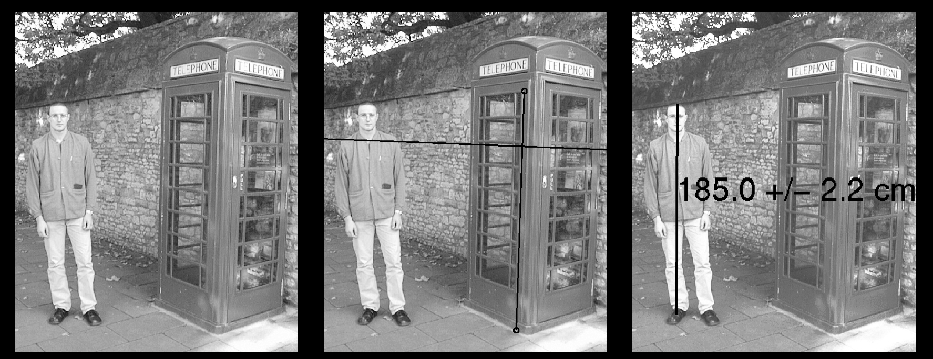
Interactive image based modeling
Facade
Debevec ‘96
  Canoma
Single-view metrology
  Criminisi ‘00
Notes:
Façade was one of the first image-based modeling system for architecture.
It produced very compelling results.
But façade used parameterized primitives and the user had to specify 2D-3D correspondences in multiple views.
This was a tedious task and so Façade required a few carefully selected photographs.
Façade inspired a commercial tool called Canoma and a host of other image based modelers.
There have been other systems – some that require only a single view. But all of these are still fairly laborious to use.

Slide 9
Interactive image based modeling
Single-view modeling
  Oh et. al.‘00

Slide 10
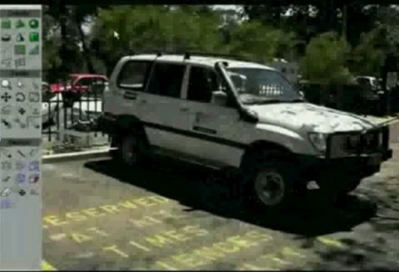
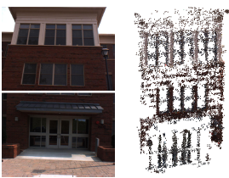
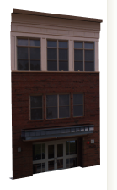
Interactive image based modeling
User Interaction + Automatic Computer Vision
VideoTrace
(Hengel et. al. ‘06, ‘07)
Image-based Façade Modeling
Muller ‘07, Xiao ‘08
Notes:
Recently, computer vision techniques were combined with user interaction in a system called VideoTrace.
Our work is similar to Videotrace but there are three main differences.
Our system uses Vanishing Points and generates better results for architecture (here is a comparison).
While Videotrace is designed for video, our user interface is more suitable for unordered photo collections.
We also create high-quality texture map composites from multiple images.

Slide 11
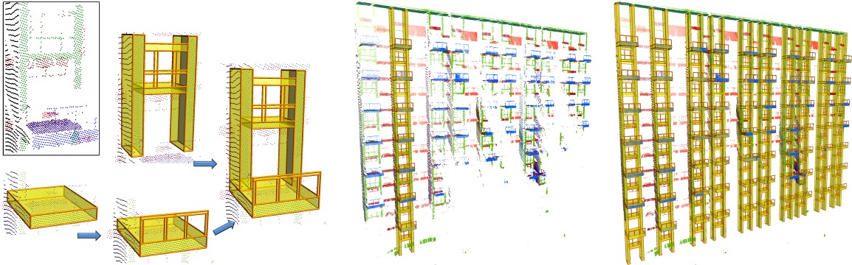
Interactive image based modeling
User Interaction + Automatic Computer Vision
SmartBoxes (Nan et. al. ‘10)
Notes:
Recently, computer vision techniques were combined with user interaction in a system called VideoTrace.
Our work is similar to Videotrace but there are three main differences.
Our system uses Vanishing Points and generates better results for architecture (here is a comparison).
While Videotrace is designed for video, our user interface is more suitable for unordered photo collections.
We also create high-quality texture map composites from multiple images.

Slide 12
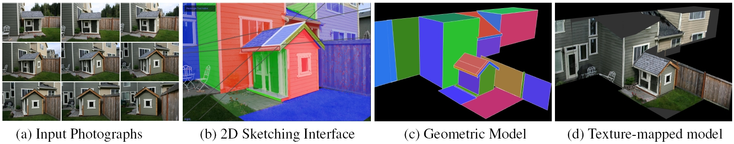
Interactive 3D architectural modeling from unordered photo collections
Sinha, Steedly, Szeliski, Agrawala, Pollefeys
SIGGRAPH ASIA 2008
Slides adapted from Sudipta Sinha’s SigAsia talk slides

Slide 13
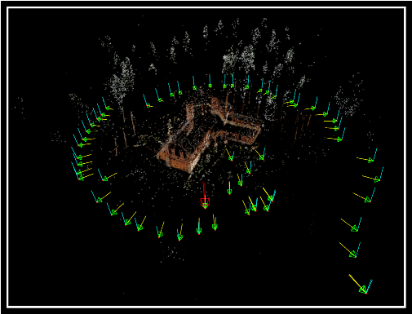
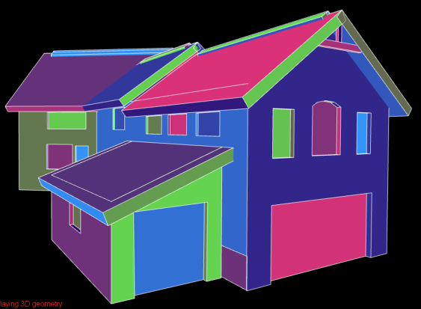
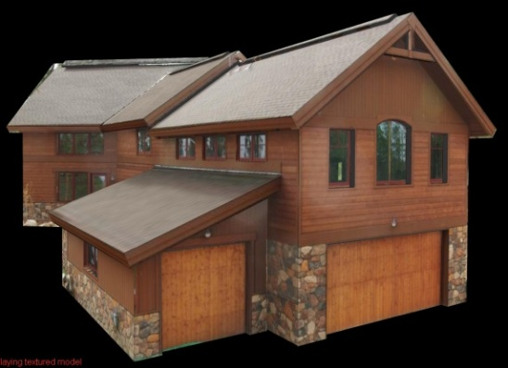
System Overview
Feature Matching + Structure from Motion
Multi-view Vanishing Point (VP) Detection
Camera pose refinement (with VP constraints)
Automatic
Computer Vision
Interactive
3D Modeling
Semi-interactive
Texture Generation
Notes:
Our system starts by computing feature matches across all images and then performing structure from motion analysis to
Recover the camera calibration and a sparse 3d point cloud.
We also extract Vanishing Points and use them in multiple places in our pipeline.
In our work we have extended single-view VP estimation techniques to the multi-view case.
We jointly optimize vanishing directions in multiple views and also refine the camera calibration parameters in a modified bundle adjustment.

Slide 14
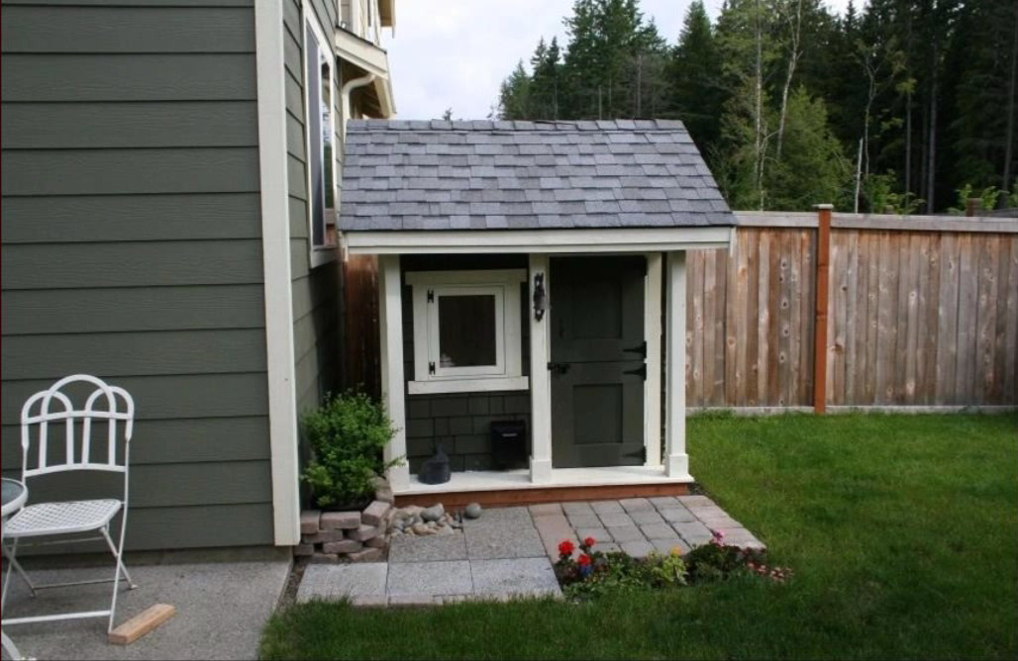
Feature Matching + Structure from Motion
Notes:
Here are the results of structure from motion. Notice that the point cloud in this case is very sparse.

Slide 15
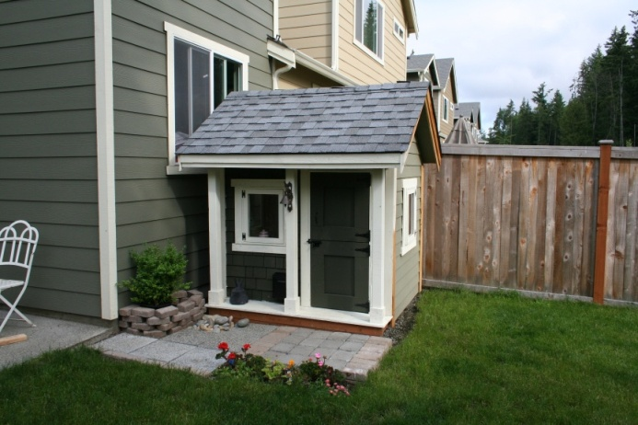
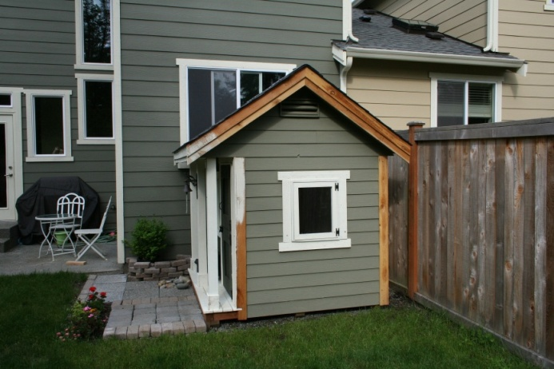
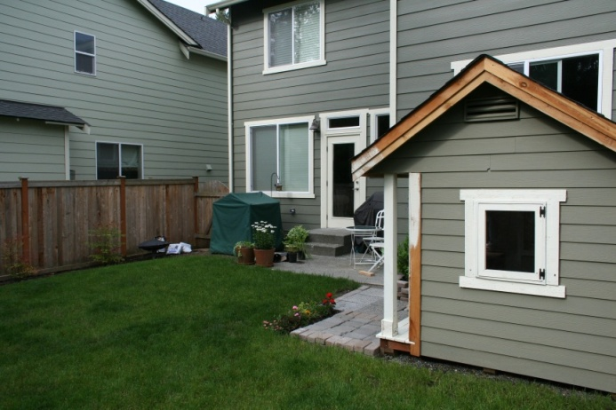
Vanishing Point (VP) Detection
Estimate VPs and cluster Vanishing Directions (VD)
Notes:
Vanishing Points are first extracted in single views using the RANSAC based robust estimation.
The corresponding Vanishing Directions are clustered
A global refinement is done to jointly optimize the Vanishing Points in all images.
The resulting VPs are consistent across all the images of our collection.

Slide 16
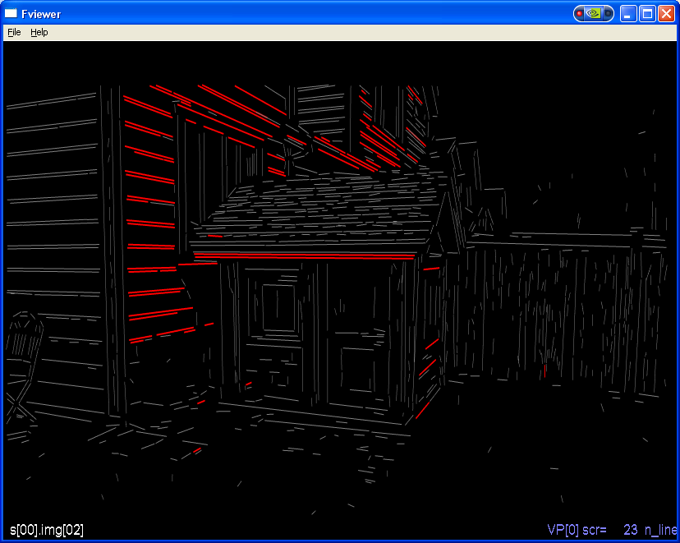
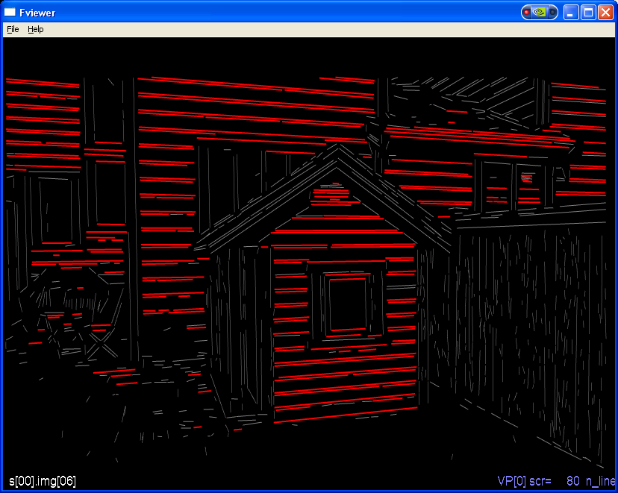
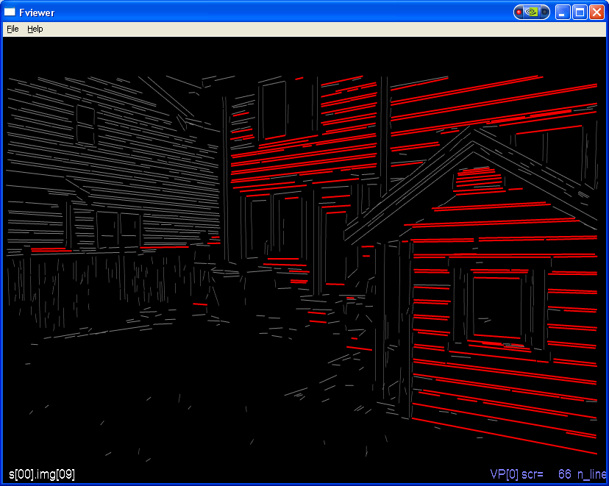
Vanishing Point (VP) Detection
Estimate VPs and cluster Vanishing Directions (VD)
Notes:
The three orthogonal VPs are shown here in red, green and blue

Slide 17
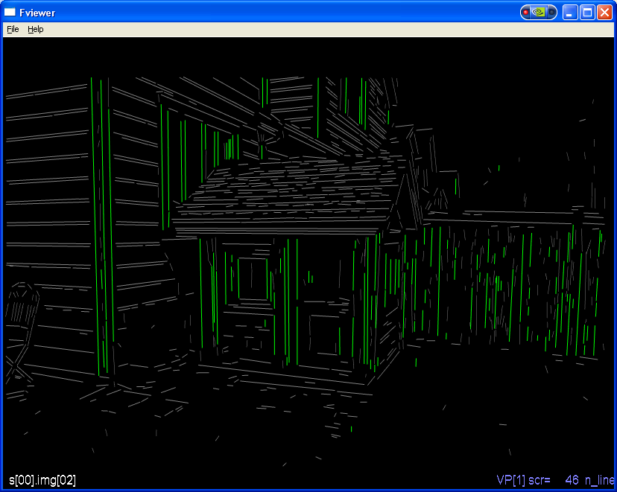
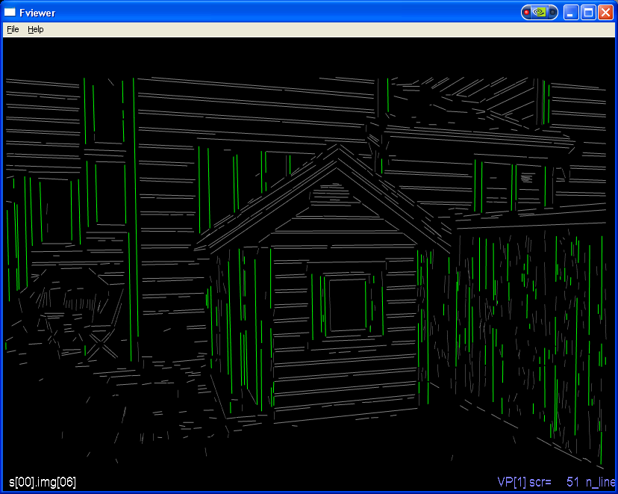
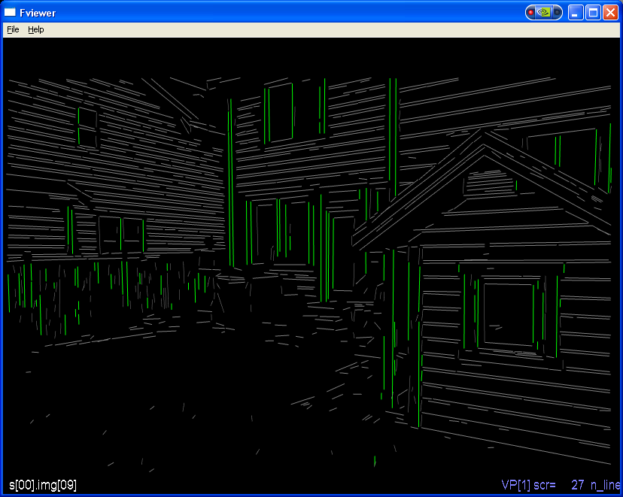
Vanishing Point (VP) Detection
Estimate VPs and cluster Vanishing Directions (VD)
Notes:
The three orthogonal VPs are shown here in red, green and blue

Slide 18
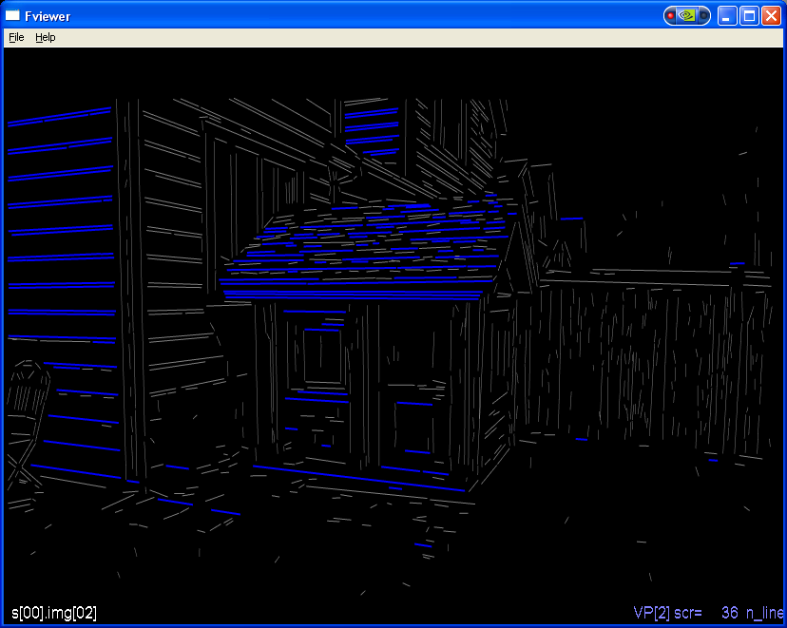
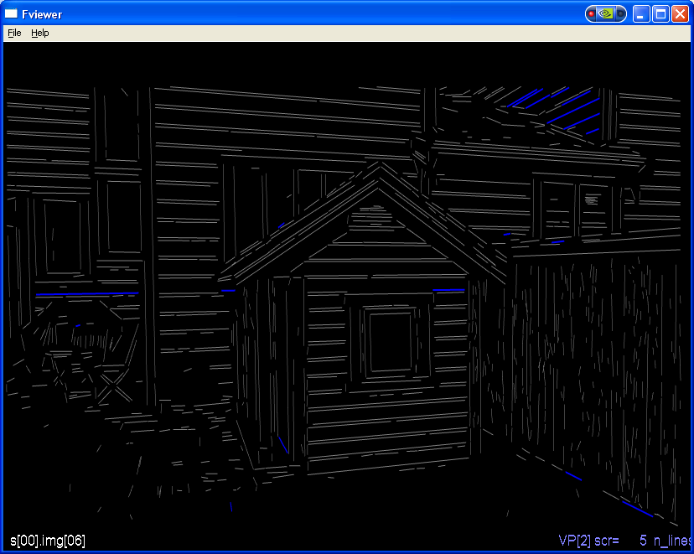
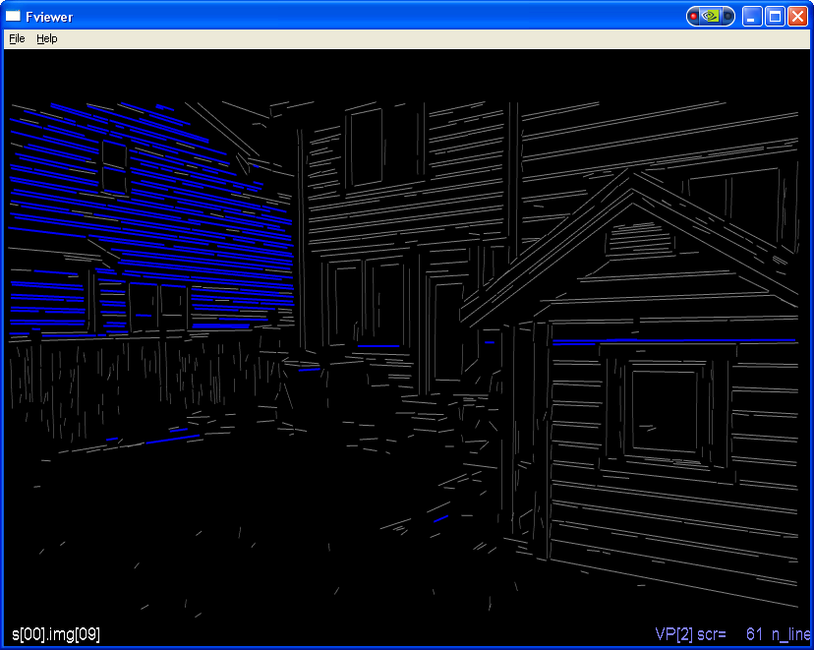
Vanishing Point (VP) Detection
Estimate VPs and cluster Vanishing Directions (VD)
Notes:
The three orthogonal VPs are shown here in red, green and blue

Slide 19
System Overview
2D sketching and robust plane estimation
3D editing with projective textures
Automatic
Computer Vision
Interactive
3D Modeling
Semi-interactive
Texture Generation
Notes:
The next step is interactive 3D modeling.
The user mainly draws the boundary of polygons in the images. The system robustly figures out the
best 3D polygon that matches what the user has drawn.
Our system also provides some 3D editing tools.
Visual feedback is produced by projecting the images on the 3d model.

Slide 20
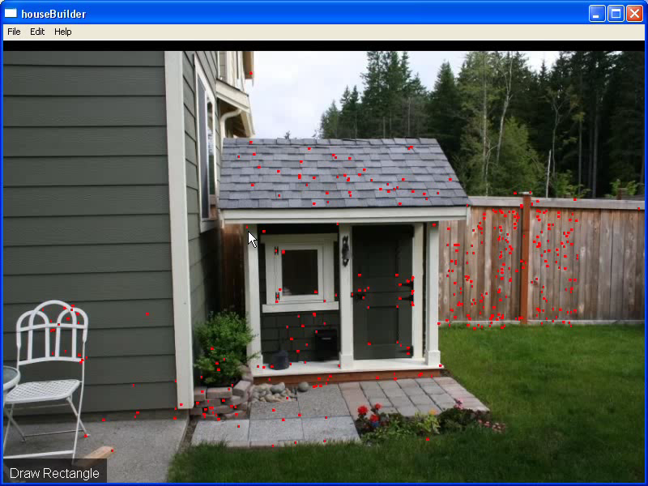
Sketch based User Interface
Notes:
This is how the user interface works. Our system allows users to reconstruct 3D polygons from a single image only.
Note how the drawn edges are being snapped to Vanishing Points or to existing edges in the 3D model.

Slide 21
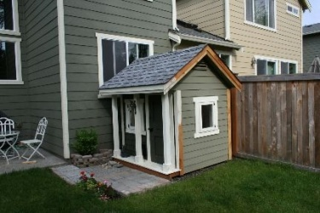
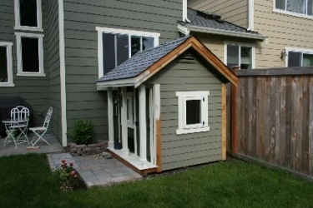
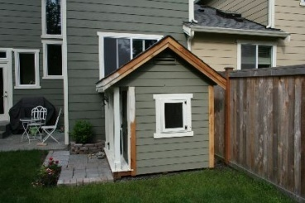
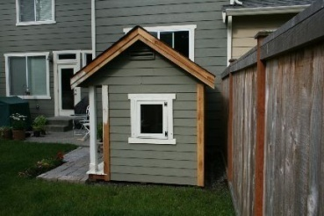
RANSAC-based Plane Estimation
Set X₁
Notes:
The user first selects an image to draw in.
The drawn polygon corresponds to a back-projected cone in 3D
The system computes a subset of the 3D points which were reconstructed from the selected view and also lies
within the back-projected cone.

Slide 22
RANSAC-based Plane Estimation
Set X₁
Notes:
We find the set of neighboring views by computing all the views from which these 3D points were reconstructed.

Slide 23
RANSAC-based Plane Estimation
Set X₂
Notes:
Finally we consider all 3D points that were reconstructed from at least a pair of neighboring cameras and also lies within the backprojected cone.
RANSAC is used to robustly fit a planar polygon – this works in real-time.

Slide 24
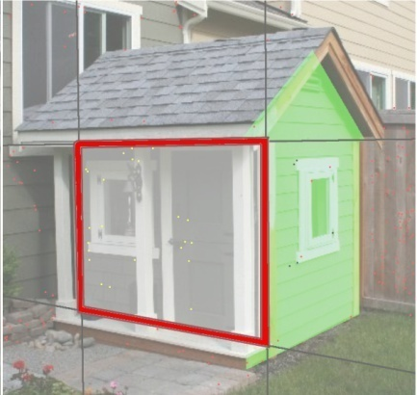
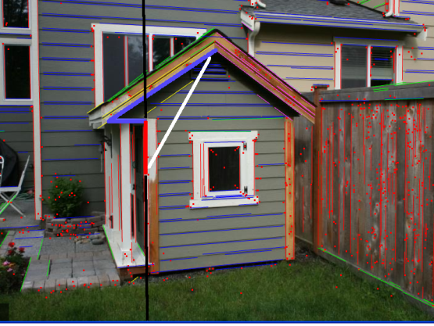
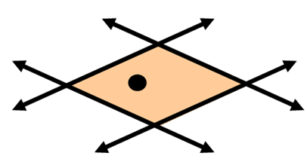
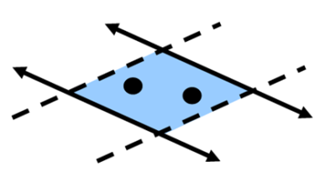
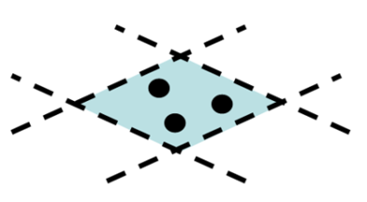
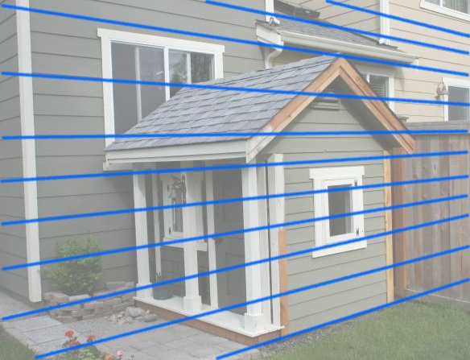
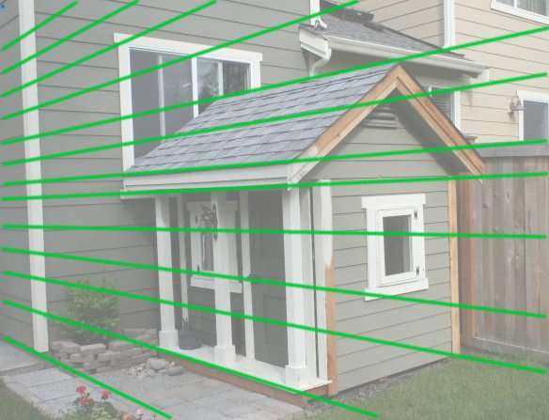
Vanishing Point Constraints
Snapping
Plane Fitting
Ambiguity
2 VP, 1 pt 1 VP, 2 pts 3 pts
Notes:
Vanishing points provide strong constraints on plane orientation.
In fact 2 such constraints fixes the plane normal.
Depending on how many vanishing point constraints are available – we compute different minimal solutions for the plane.
When using Vanishing Point based snapping – we need to handle the following ambiguity. Some lines can get associated with multiple VPs.
The system tries out all possible hypotheses and lets the plane-fit select the correct Vanishing Point

Slide 25
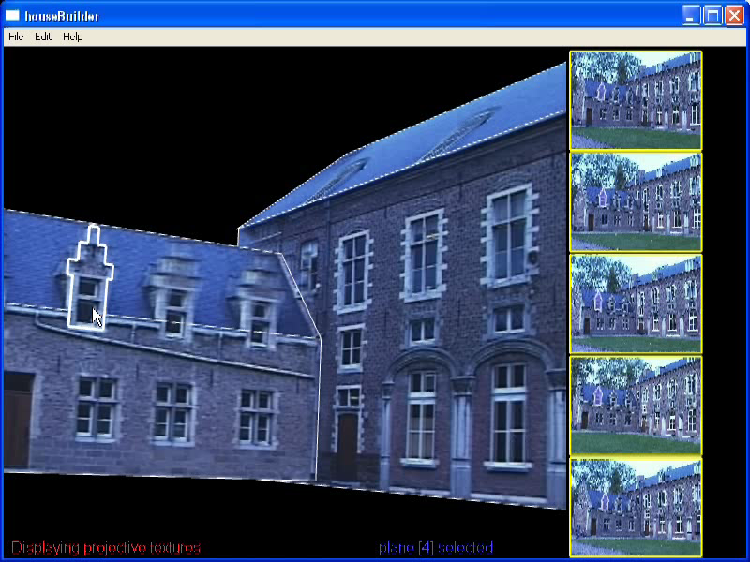
Editing 3D Geometry
Edit Polygon
Weld Planes
Extrusions
Notes:
Some planes can be created once the neighboring planes already exist in the 3D model.
This is useful for small planar facets in the 3D model.

Slide 26
System Overview
High-quality texture map composites via
Graph-cut optimization
Poisson blending
Automatic
Computer Vision
Interactive
3D Modeling
Semi-interactive
Texture Generation
Notes:
Our texture-map generation stage uses a photo-montage framework to generate better quality texture maps when compared to the
Existing techniques.

Slide 27
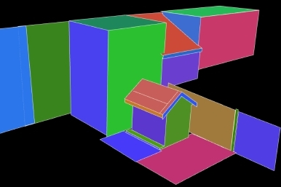

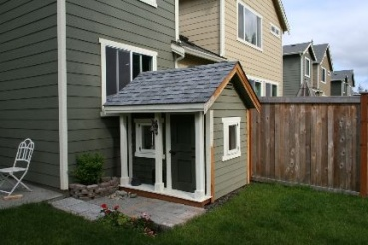
View Selection
Target Plane
Viewing Angle
2D Feature Visibility of 3D Points on Plane
Selected Source Images
Notes:
To texture a plane, multiple source images are chosen based on
The viewing angle
The 2d correspondence of the 3d points which lie on the plane.
AADD TO SLIDE

Slide 28






Texture-Map Generation
Find per pixel source images
  Estimate Visibility
  Project Images to Plane
Image stitching + Blending
Graph-cut Optimization Poisson blending
Notes:
Visibility Estimation is done for each pixel.
This is followed by image-stitching + blending.
Graph-cut Optimization is used to compute invisible seams.
Seam artifacts are further reduced by Poisson Blending.

Slide 29
MRF Optimization via Graph-Cuts
Label Image (L)
Composite
argmin E(L) = ∑ D(p, L(p)) + ∑ S(p, q, L(p), L(q))
p
p, q
Data Term
Smoothness Term
Notes:
The graph-cut solves the MRF optimization problem using the well studied alpha-expansion algorithm.
I will now describe the data and smoothness terms in our energy function.

Slide 30
Energy Minimization via Graph-Cuts
argmin E(L) = ∑ D(p, L(p)) + ∑ S(p, q, L(p), L(q))
p
p, q
Smoothness Term
Pick seams across which color and gradients are matched
without strong edge bias (Agrawala ‘04)
Data Term
Prefer a frontal view D₁ = 1 – cos² θ
Prefer photo-consistent pixels D₂ = |I_{L(p)} – μ| μ: median
User specified constraints (brush strokes)
3D point compatibility
Notes:
The interaction term is the same as used in the Photo-montage work.
However, we introduce some new data-terms relevant to our specific problem.

Slide 31




More Results
Shed - 16 images (10 minutes)
Art Gallery – 150 images (2 hrs)
Town Hall – 98 images (30 minutes)
City Scene – 102 images (2 hrs)
Notes:
Here are some more 3D models generated by our system.

Slide 32




More Results
Shed - 16 images (10 minutes)
Art Gallery – 150 images (2 hrs)
Town Hall – 98 images (30 minutes)
City Scene – 102 images (2 hrs)
Notes:
In the top-right is a 3d model of an artist gallery built from 150 images. Each painting has its own high-resolution texture-map.

Slide 33

Interactive image based modeling
VideoTrace
  Hengel et. al. ‘07
Notes:
Façade was one of the first image-based modeling system for architecture.
It produced very compelling results.
But façade used parameterized primitives and the user had to specify 2D-3D correspondences in multiple views.
This was a tedious task and so Façade required a few carefully selected photographs.
Façade inspired a commercial tool called Canoma and a host of other image based modelers.
There have been other systems – some that require only a single view. But all of these are still fairly laborious to use.

Slide 34

Interactive image based modeling
Interactive 3D modeling via co-segmentation
  Kowdle et. al. ‘10
Co-segmentation
Input images
Shape from silhouette
Rendered 3D model
Structure from motion

Slide 35


































Interactive image based modeling
Interactive 3D modeling via co-segmentation
  Kowdle et. al. ‘11

Slide 36
Interactive sketch based
3D modelers
Google Sketchup
Igarashi – User interface research
…

Slide 37
Interactive 3D reconstruction
Human driving the show
3D reconstruction algorithm

Slide 38
Interactive 3D reconstruction
Algorithm driving the show
3D reconstruction algorithm

Slide 39
Interactive 3D reconstruction
Algorithm driving the show
Automatic 3D reconstruction algorithm
Incorporate user interactions
into the algorithm
Quantify uncertainty
and select most
informative queries
Human Oracle
User interactions
  Kowdle et. al. CVPR ‘11

Slide 40







Automatic piecewise planar multi-view stereo
16 images
Sinha et. al. ICCV ‘09
Notes:
One approach

Slide 41
Notes:
This work is about the well known yet hard task of image based modeling. Given a set of images of a scene captured from varied viewpoints, we wish to recover the 3D structure of the scene.
There have been numerous works which try to recover the dense depth of the scene but, scene irregularities make this a hard task.

Slide 42




Piecewise plane labeling
Novel 3D views,
errors in black circles
Result of an automatic algorithm
(Piecewise planar multi-view stereo)
Notes:
The result from an automatic piecewise planar multiview stereo algorithm is as shown here. Given the cues in the scene, the automatic algorithm takes a shot at providing the solution.
While the algorithm does fairly well automatically, we observe the errors shown in black ellipses due to texture-less surfaces on the couch.

Slide 43


Notes:
Given the cues in the scene, the automatic algorithm tries to take its best shot at reconstructing it. Intuitively, the algorithm would have taken some uncertain decisions along the way to arrive at this solution.
Our algorithm quantifies uncertainty and automatically identifies uncertain regions, shown in cyan.
Now, there isn’t a way for the user really tell the algorithm what to do with these regions. However, the user has a good sense of the co-planarity and connectedness of the surfaces, we can thus derive support for these regions using the neighboring, confident regions. As we will see, these simple yet powerful cues can help the algorithm perform better.
The algorithm is smart enough to pick the most informative questions for the user and not throw everything at the user. The algorithm automatically identifies three most uncertain edges shown in yellow and queries the user for feedback.
Using simple scribbles the user indicates that the regions across that edge are,
Connected and co-planar regions, connected and not co-planar regions, or not connected regions. Note that the human user does not do what the machine can do but instead help where the machine fails.

Slide 44
Putting the user in the loop
Connected,
Co-planar
Not Connected
Connected,
Not Co-planar
44
Notes:
Now, the user is shown this image with the uncertain edges shown in yellow. The algorithm queries the user for some support information across the yellow edge indicated by the orange boxes. We use simple interactions in the form of scibbles to provide this information.
The user interactions we propose are more powerful than the more traditional use of scribbles in the context of segmentation.
In particular, we use three types of scribbles,
Connected and co-planar interaction: indicating that the regions across the uncertain edge are connected and are co-planar
Connected and not co-planar interaction: indicating that the regions are connected but are not-coplanar, and in particular the indicated edge is a projection of the line / edge of intersection of these planes
Not connected interaction: the last type of interaction indicating that the regions are not connected, typically indicating occlusion boundaries.

Slide 45




Piecewise plane labeling
Novel 3D views,
errors corrected in yellow circles
Algorithm guides the user towards a better reconstruction
Notes:
The algorithm incorporates these cues from the user and re-estimates the 3D structure of the scene, resulting in improved reconstructions, and closing the loop on the active learning algorithm.
Lets take a look at the algorithm in detail.

Slide 46
Summary
Image based modeling
  Errors made by the automatic algorithm can be fixed by incorporating the user intelligently into the system
Sketch based 3D modelers
  Enables users to create synthetic 3D modeling via simple sketches

Slide 47
Future directions
Moving beyond planar surfaces but the complexity low
  Planar proxies work well for image based rendering but not for obtaining a volumetric model
  Exploiting the output of say PMVS and then leveraging user input would be an interesting future direction
Image based modeling applications should try to exploit the automatic computer vision algorithms as much as possible.
  As the scene becomes more and more complicated, the effort of the user should not blow out of proportions
Interactive 3D modelers like sketchup allow users to create synthetic data and with more functionality like texturing, lighting, primitives, etc. results will continue to improve
  These are however still hard for a naïve user which has to improve
  More semantics?
  ShadowDraw

Slide 48
Thank you

Slide 50






Automatic algorithm
Result of active-learning algorithm
Notes:
In this scene the algorithm makes errors in reconstructing the textureless wall due to lack of cues.
When the user was guided by the algorithm, these errors were fixed and a much better reconstruction of the scene was obtained.

Slide 51






Automatic algorithm
Result of active-learning algorithm
Notes:
In this scene the algorithm does fairly well automatically but it makes some errors in the specular surfaces like the window and some errors on the room due to multiple plane hypotheses,
but the active learning helped guide the user to correct these errors.

Slide 52






Automatic algorithm
Result of active-learning algorithm

