Slide 1
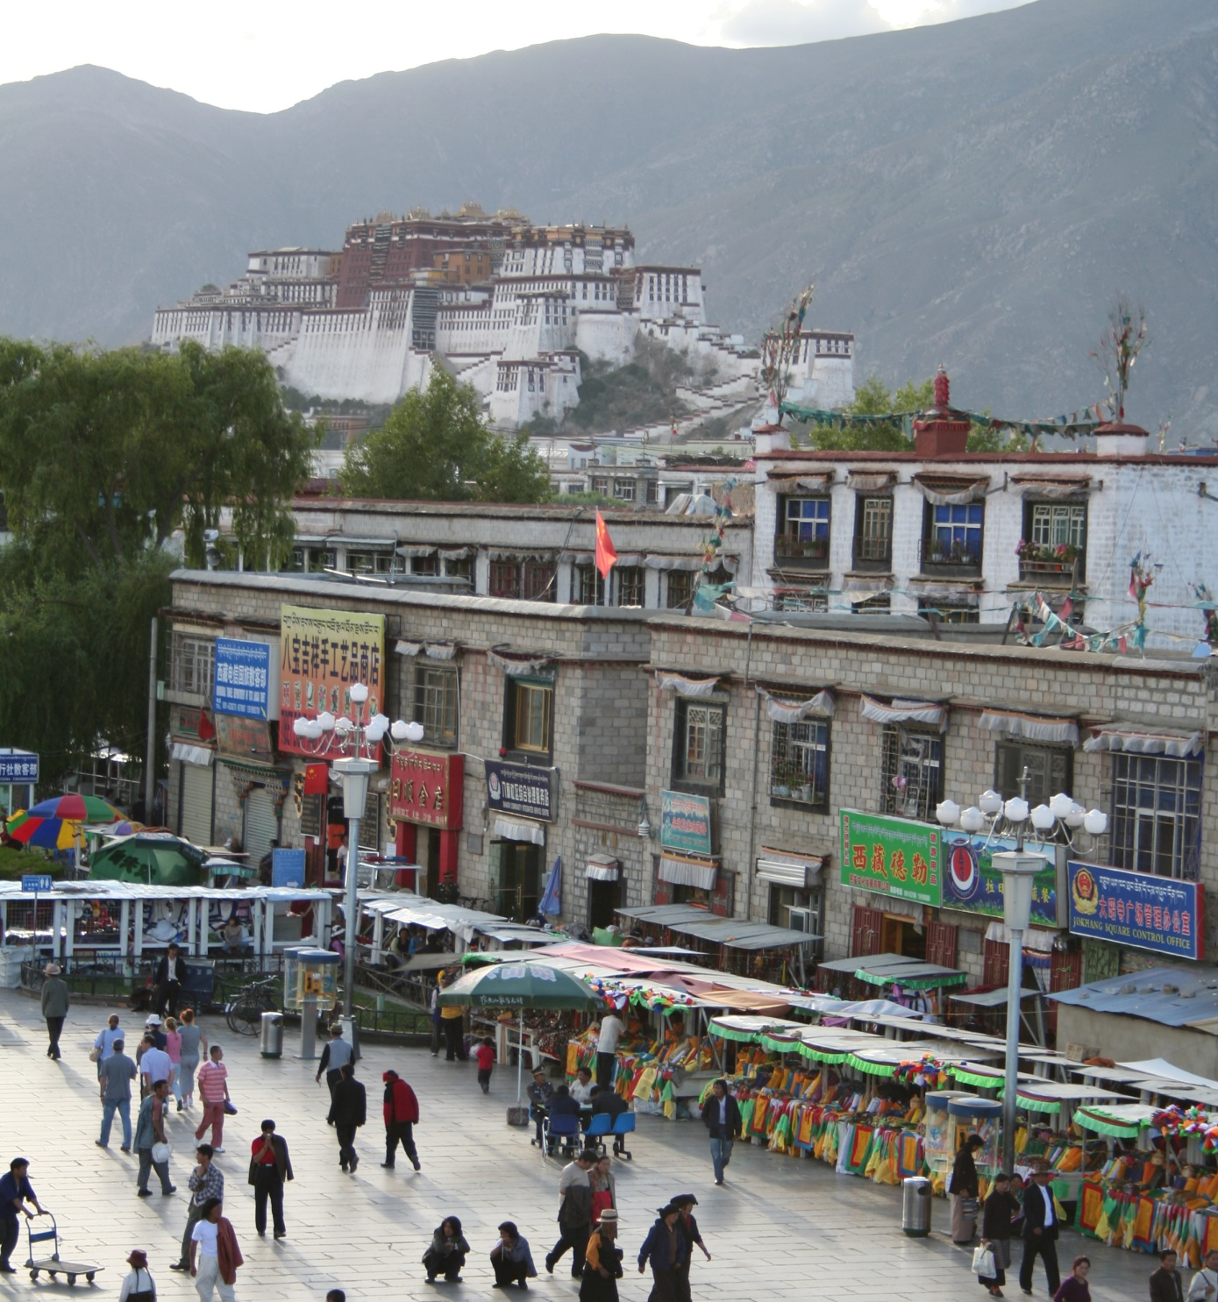
Object Detection and Recognition
CS6780: Advanced Machine Learning
mountain
tree
building
banner
street lamp
vendor
people

Slide 2

What is in this image?
Source: “80 million tiny images” by Torralba, et al.

Slide 3
What do we mean by “object recognition”?
Next 12 slides adapted from
Li, Fergus, & Torralba’s excellent short course on category and object recognition

Slide 4
Verification: is that a lamp?

Slide 5
Detection: are there people?

Slide 6
Identification: is that Potala Palace?

Slide 7
Object categorization
mountain
tree
building
banner
street lamp
vendor
people

Slide 8
Scene and context categorization
outdoor
city
…

Slide 9
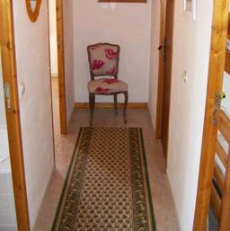

Object recognition
Is it really so hard?
Find the chair in this image
Output of normalized correlation
This is a chair

Slide 10
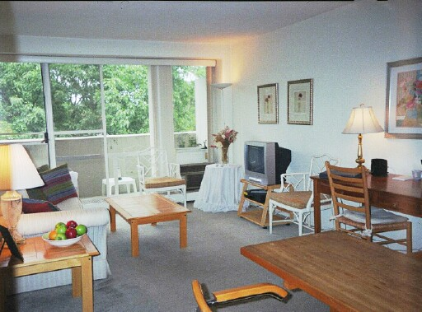
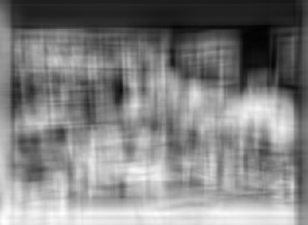
Object recognition
Is it really so hard?
Find the chair in this image
Pretty much garbage
Simple template matching is not going to make it

Slide 11
Object recognition
Is it really so hard?
Find the chair in this image
A “popular method is that of template matching, by point to point correlation of a model pattern with the image pattern. These techniques are inadequate for three-dimensional scene analysis for many reasons, such as occlusion, changes in viewing angle, and articulation of parts.” Nivatia & Binford, 1977.

Slide 12
Machine learning for object recognition
Recent techniques in detection in recognition have leveraged machine learning techniques in combination with lots of training data
  Which features to use?
  Which learning techniques?

Slide 13
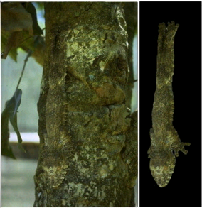
And it can get a lot harder
Brady, M. J., & Kersten, D. (2003). Bootstrapped learning of novel objects. J Vis, 3(6), 413-422

Slide 14
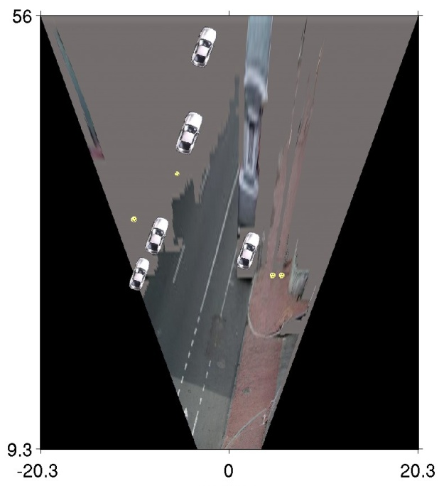
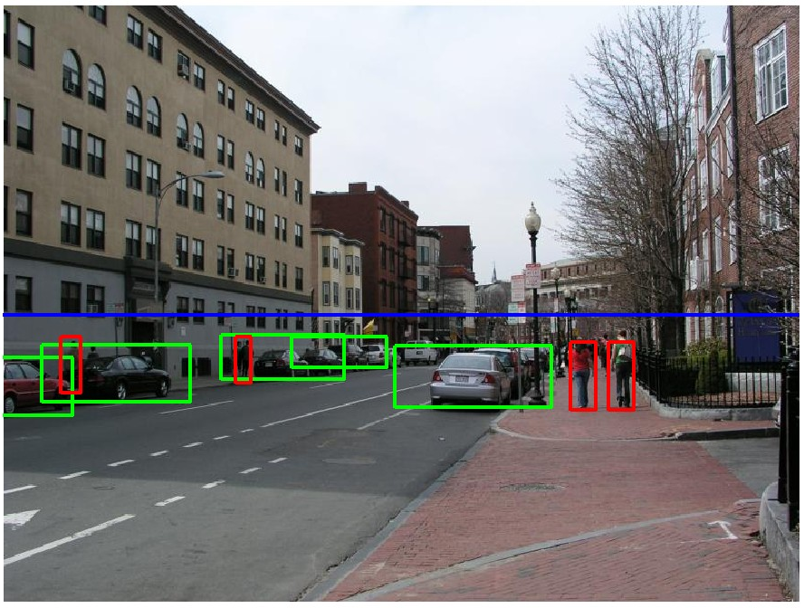
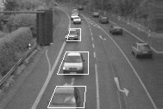
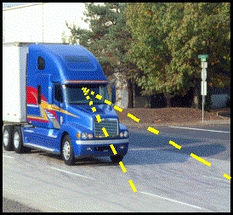
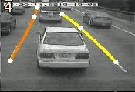
Applications: Assisted driving
Pedestrian and car detection
meters
Ped
Ped
Car
meters
Lane detection
Collision warning systems with adaptive cruise control,
Lane departure warning systems,
Rear object detection systems,

Slide 15

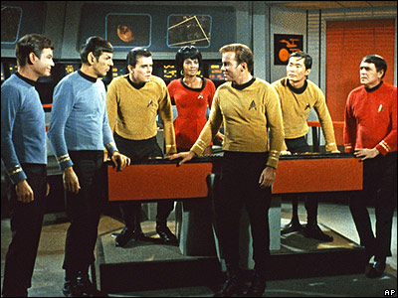
Face detection
Do these images contain faces? Where?

Slide 16


One simple method: skin detection
skin
Skin pixels have a distinctive range of colors
  Corresponds to region(s) in RGB color space
    for visualization, only R and G components are shown above
Skin classifier
  A pixel X = (R,G,B) is skin if it is in the skin region
  But how to find this region?

Slide 17

Skin detection
Learn the skin region from examples
  Manually label pixels in one or more “training images” as skin or not skin
  Plot the training data in RGB space
    skin pixels shown in orange, non-skin pixels shown in blue
    some skin pixels may be outside the region, non-skin pixels inside. Why?
Skin classifier
  Given X = (R,G,B): how to determine if it is skin or not?
Notes:
Q1: under certain lighting conditions, some surfaces have the same RGB color as skin
Q2: ask class, see what they come up with. We’ll talk about this in the next few slides

Slide 18
Skin classification techniques
Skin classifier
  Given X = (R,G,B): how to determine if it is skin or not?
  Nearest neighbor
    find labeled pixel closest to X
    choose the label for that pixel
  Data modeling
    fit a model (curve, surface, or volume) to each class
  Probabilistic data modeling
    fit a probability model to each class

Slide 19



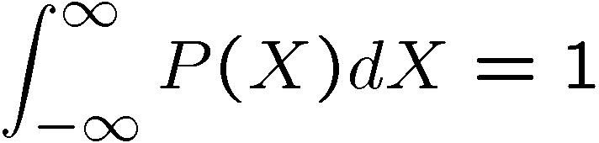
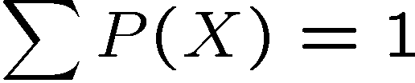
Probability
Basic probability
  or
  Conditional probability: P(X | Y)
    probability of X given that we already know Y
called a PDF
  probability distribution/density function
  a 2D PDF is a surface, 3D PDF is a volume
continuous X
discrete X

Slide 20





Probabilistic skin classification
Modeling uncertainty
  Each pixel has a probability of being skin or not skin
Skin classifier
  Given X = (R,G,B): how to determine if it is skin or not?
  Choose interpretation of highest probability
    set X to be a skin pixel if and only if
Where do we get and ?

Slide 21


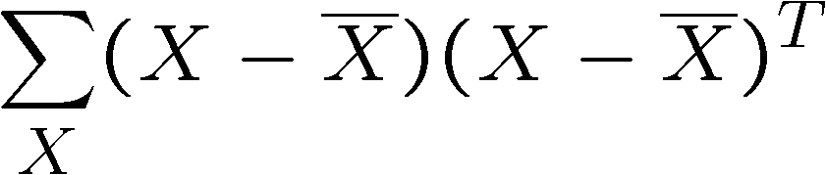
Learning conditional PDF’s
We can calculate P(R | skin) from a set of training images
  It is simply a histogram over the pixels in the training images
    each bin R_{i} contains the proportion of skin pixels with color R_{i}
This doesn’t work as well in higher-dimensional spaces.
Approach: fit parametric PDF functions
  common choice is rotated Gaussian
    center
    covariance
      orientation, size defined by eigenvecs, eigenvals

Slide 22
Learning conditional PDF’s
We can calculate P(R | skin) from a set of training images
  It is simply a histogram over the pixels in the training images
    each bin R_{i} contains the proportion of skin pixels with color R_{i}
But this isn’t quite what we want
  Why not? How to determine if a pixel is skin?
  We want P(skin | R), not P(R | skin)
  How can we get it?

Slide 23
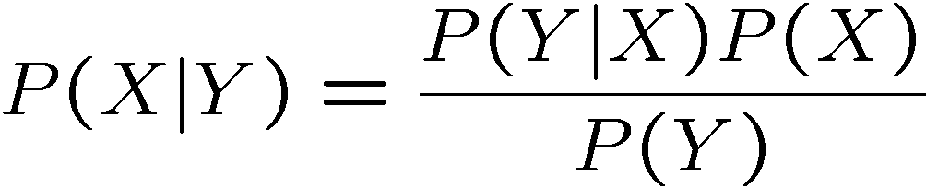
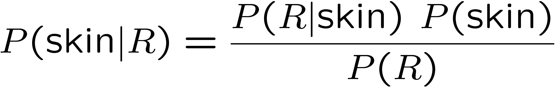
Bayes rule
In terms of our problem:
what we measure
(likelihood)
domain knowledge
(prior)
what we want
(posterior)
normalization term
The prior: P(skin)
  Could use domain knowledge
    P(skin) may be larger if we know the image contains a person
    for a portrait, P(skin) may be higher for pixels in the center
  Could learn the prior from the training set. How?
    P(skin) could be the proportion of skin pixels in training set

Slide 24


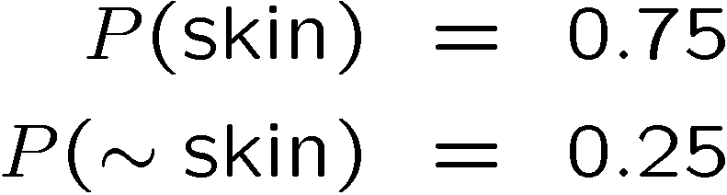

Bayesian estimation
likelihood
posterior (unnormalized)
= minimize probability of misclassification
Bayesian estimation
  Goal is to choose the label (skin or ~skin) that maximizes the posterior
    this is called Maximum A Posteriori (MAP) estimation
0.5
  Suppose the prior is uniform: P(skin) = P(~skin) =
    in this case ,
    maximizing the posterior is equivalent to maximizing the likelihood
      if and only if
    this is called Maximum Likelihood (ML) estimation

Slide 25
Skin detection results

Slide 26
General classification
This same procedure applies in more general circumstances
  More than two classes
  More than one dimension
Example: face detection
  Here, X is an image region
    dimension = # pixels
    each face can be thought
    of as a point in a high
    dimensional space
H. Schneiderman, T. Kanade. "A Statistical Method for 3D Object Detection Applied to Faces and Cars". IEEE Conference on Computer Vision and Pattern Recognition (CVPR 2000)
http://www-2.cs.cmu.edu/afs/cs.cmu.edu/user/hws/www/CVPR00.pdf
H. Schneiderman and T.Kanade

Slide 27
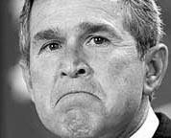
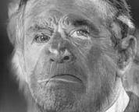
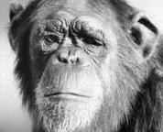
The space of faces
=
+
An image is a point in a high dimensional space
  An N x M intensity image is a point in R^{NM}
  We can define vectors in this space as we did in the 2D case

Slide 28
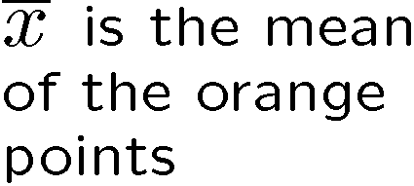




Linear subspaces
convert x into v₁, v₂ coordinates
What does the v₂ coordinate measure?
  distance to line
  use it for classification—near 0 for orange pts
What does the v₁ coordinate measure?
  position along line
  use it to specify which orange point it is
Classification can be expensive
  Must either search (e.g., nearest neighbors) or store large PDF’s
Suppose the data points are arranged as above
  Idea—fit a line, classifier measures distance to line

Slide 29
Dimensionality reduction
How to find v₁ and v₂ ?
Dimensionality reduction
  We can represent the orange points with only their v₁ coordinates
    since v₂ coordinates are all essentially 0
  This makes it much cheaper to store and compare points
  A bigger deal for higher dimensional problems

Slide 30
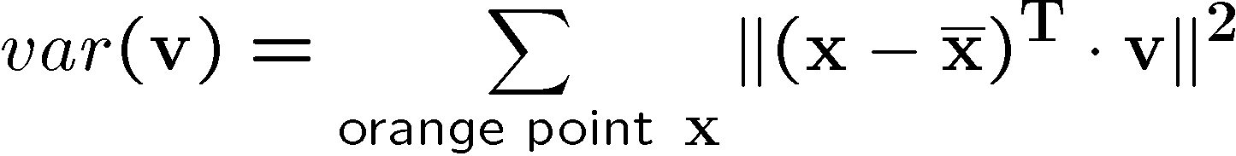


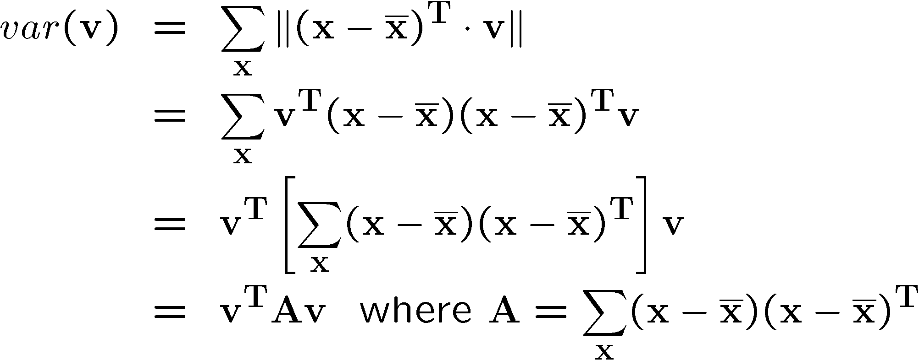
Linear subspaces
Consider the variation along direction v among all of the orange points:
What unit vector v minimizes var?
What unit vector v maximizes var?
2
Solution: v₁ is eigenvector of A with largest eigenvalue
v₂ is eigenvector of A with smallest eigenvalue

Slide 31
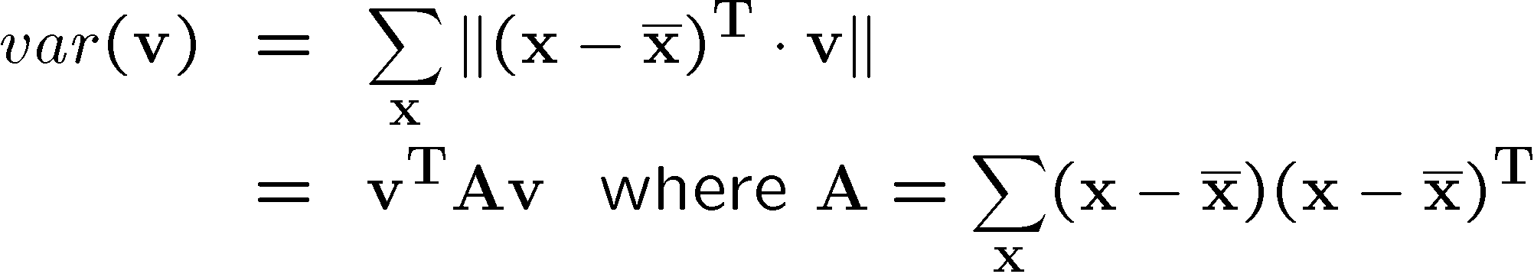
Principal component analysis
Suppose each data point is N-dimensional
  Same procedure applies:
  The eigenvectors of A define a new coordinate system
    eigenvector with largest eigenvalue captures the most variation among training vectors x
    eigenvector with smallest eigenvalue has least variation
  We can compress the data by only using the top few eigenvectors
    corresponds to choosing a “linear subspace”
      represent points on a line, plane, or “hyper-plane”
    these eigenvectors are known as the principal components

Slide 32

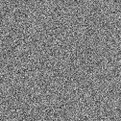
Dimensionality reduction
The set of faces is a “subspace” of the set of images
  Suppose it is K dimensional
  We can find the best subspace using PCA
  This is like fitting a “hyper-plane” to the set of faces
    spanned by vectors v₁, v₂, ..., v_{K}
    any face

Slide 33
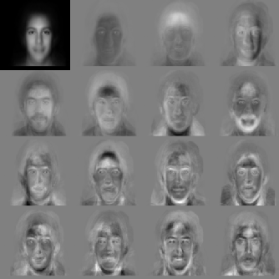


Eigenfaces
PCA extracts the eigenvectors of A
  Gives a set of vectors v₁, v₂, v₃, ...
  Each one of these vectors is a direction in face space
    what do these look like?

Slide 34




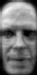










Projecting onto the eigenfaces
The eigenfaces v₁, ..., v_{K} span the space of faces
  A face is converted to eigenface coordinates by

Slide 35

Detection and recognition with eigenfaces
Algorithm
  Process the image database (set of images with labels)
    Run PCA—compute eigenfaces
    Calculate the K coefficients for each image
  Given a new image (to be recognized) x, calculate K coefficients
  Detect if x is a face
  If it is a face, who is it?
    Find closest labeled face in database
      nearest-neighbor in K-dimensional space

Slide 36
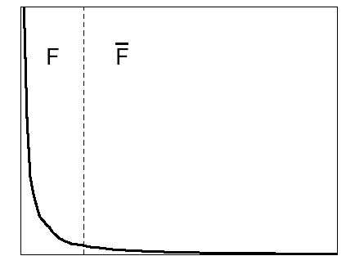

Choosing the dimension K
eigenvalues
i =
K
NM
How many eigenfaces to use?
Look at the decay of the eigenvalues
  the eigenvalue tells you the amount of variance “in the direction” of that eigenface
  ignore eigenfaces with low variance

Slide 37
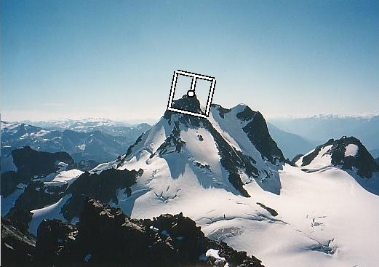




Issues: metrics
What’s the best way to compare images?
  need to define appropriate features
  depends on goal of recognition task
exact matching
complex features work well
(SIFT, MOPS, etc.)
classification/detection
simple features work well
(Viola/Jones, etc.)

Slide 38
Metrics
Lots more feature types that we haven’t mentioned
  moments, statistics
    metrics: Earth mover’s distance, ...
  edges, curves
    metrics: Hausdorff, shape context, ...
  3D: surfaces, spin images
    metrics: chamfer (ICP)
  ...

Slide 39
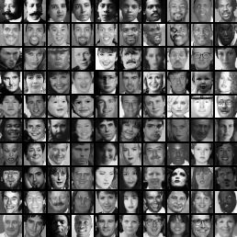
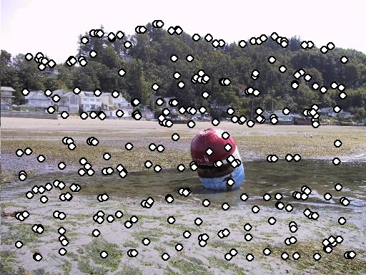
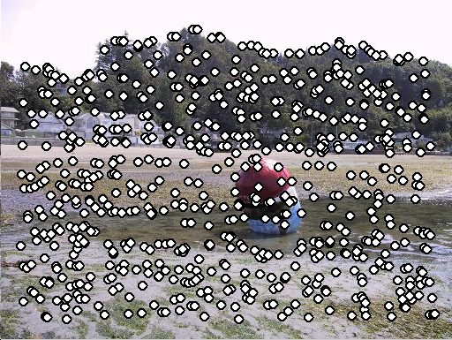
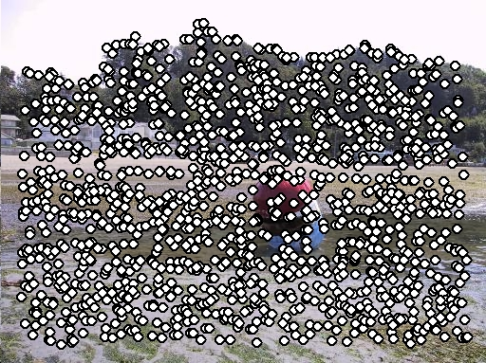
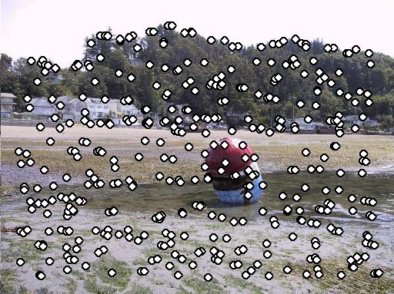
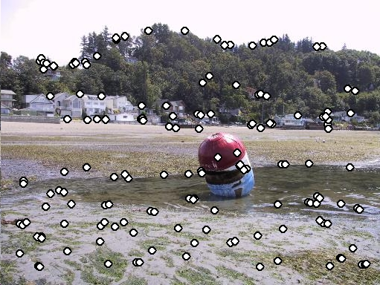
Issues: feature selection
If all you have is one image:
non-maximum suppression, etc.
If you have a training set of images:
AdaBoost, etc.

Slide 40
Issues: data modeling
Generative methods
  model the “shape” of each class
    histograms, PCA, mixtures of Gaussians
    graphical models (HMM’s, belief networks, etc.)
    ...
Discriminative methods
  model boundaries between classes
    perceptrons, neural networks
    support vector machines (SVM’s)

Slide 41
Generative vs. Discriminative
Generative Approach
model individual classes, priors
Discriminative Approach
model posterior directly
from Chris Bishop

Slide 42
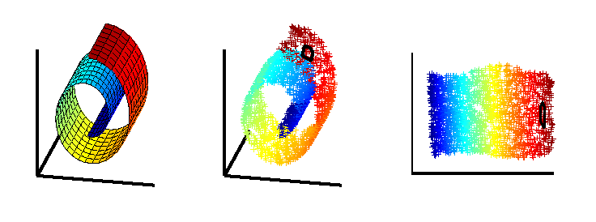
Issues: dimensionality
What if your space isn’t flat?
  PCA may not help
Nonlinear methods
LLE, MDS, etc.

Slide 43
Issues: speed
Case study: Viola Jones face detector
Exploits two key strategies:
  simple, super-efficient features
  pruning (cascaded classifiers)
Next few slides adapted Grauman & Liebe’s tutorial
  http://www.vision.ee.ethz.ch/~bleibe/teaching/tutorial-aaai08/
Also see Paul Viola’s talk (video)
  http://www.cs.washington.edu/education/courses/577/04sp/contents.html#DM

Slide 44
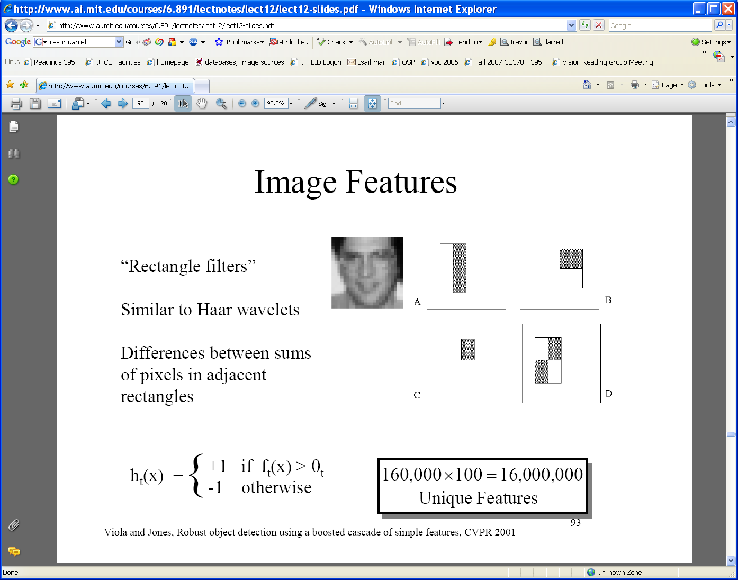
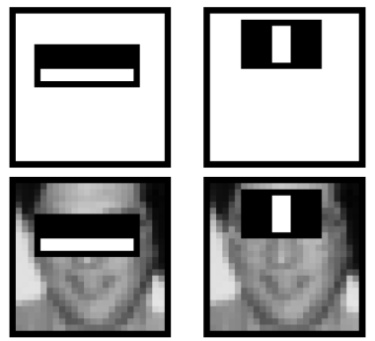
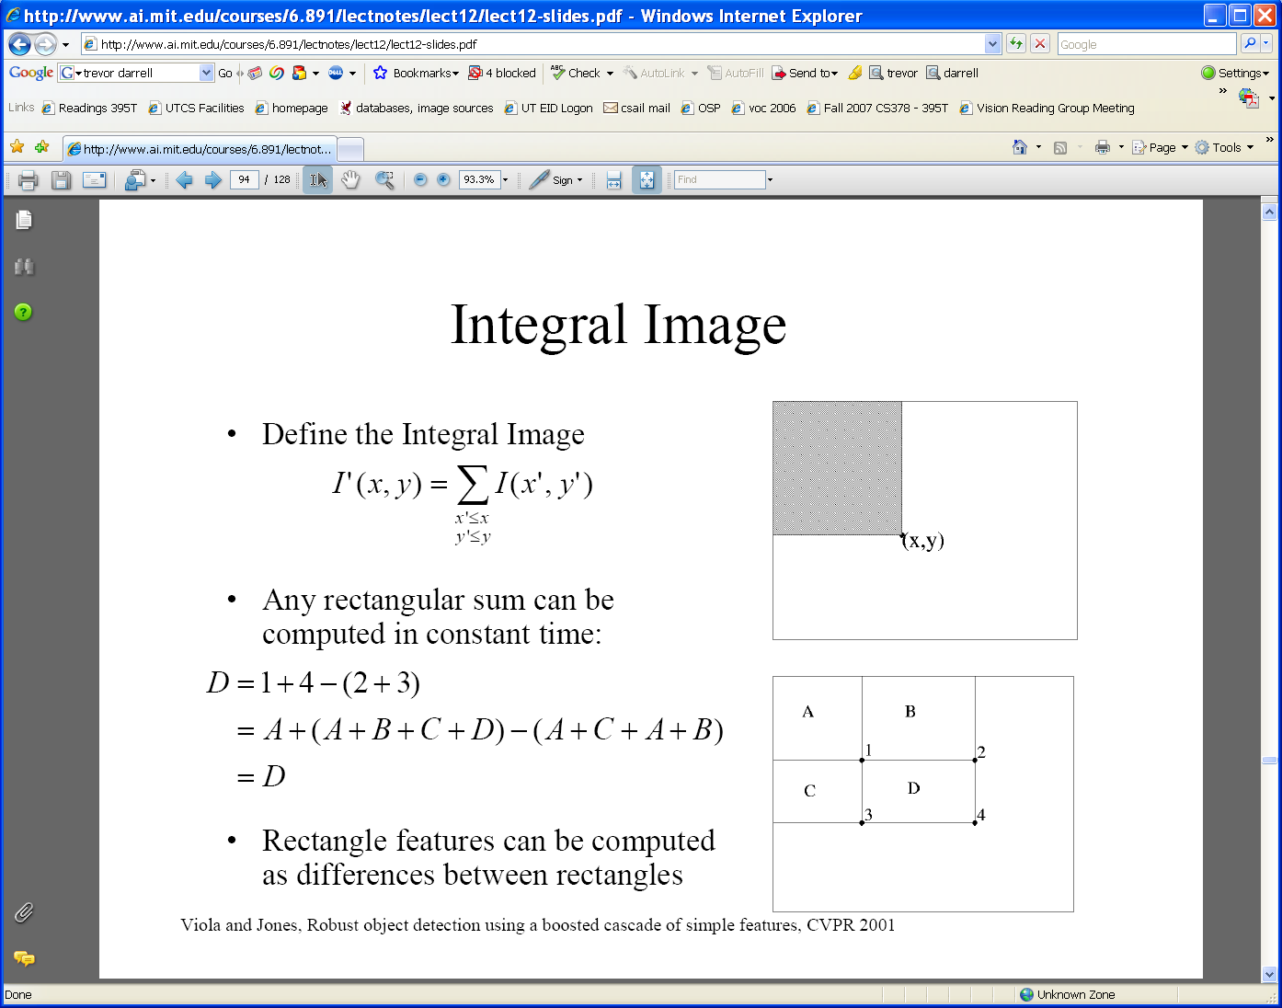
Feature extraction
“Rectangular” filters
  Feature output is difference between adjacent regions
Value at (x,y) is sum of pixels above and to the left of (x,y)
  Efficiently computable with integral image: any sum can be computed in constant time
  Avoid scaling images → scale features directly for same cost
Integral image
Viola & Jones, CVPR 2001
44
K. Grauman, B. Leibe
Notes:
44

Slide 45
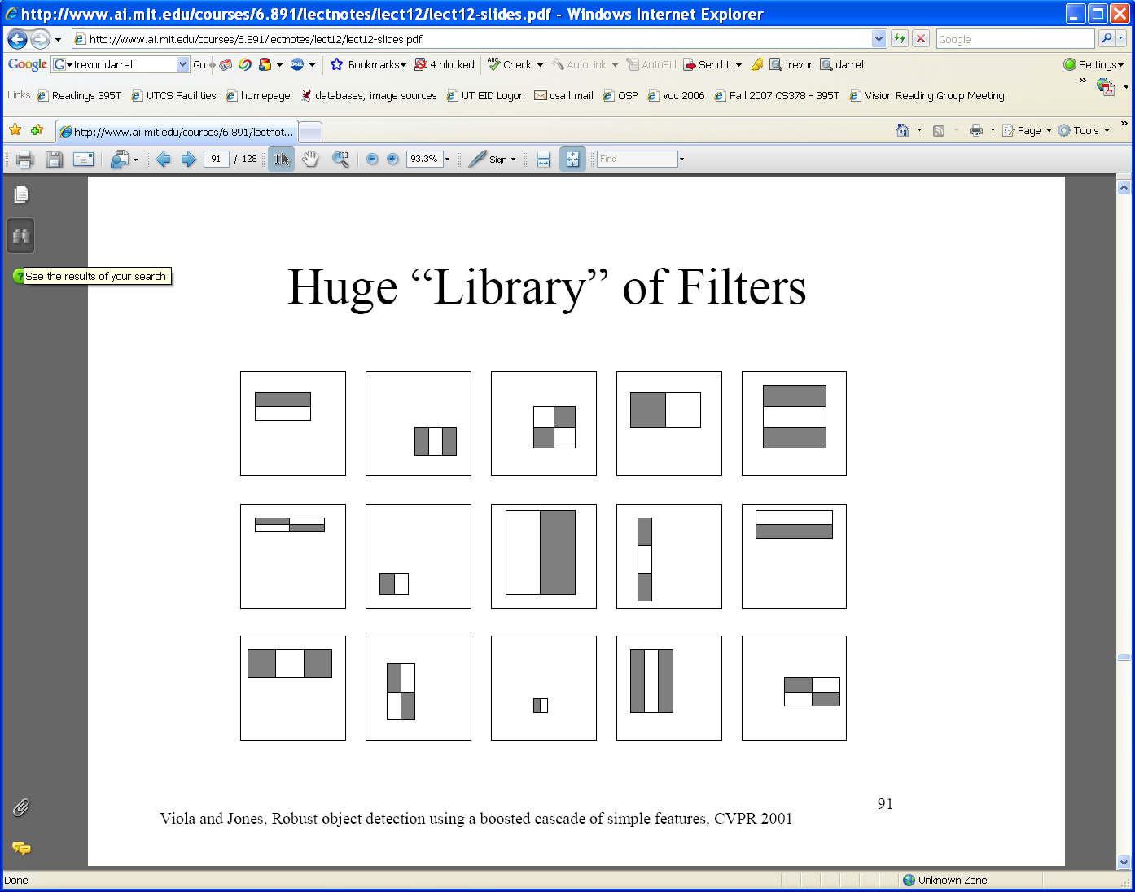
Large library of filters
  Considering all possible filter parameters: position, scale, and type:
180,000+ possible features associated with each 24 x 24 window
Use AdaBoost both to select the informative features and to form the classifier
Viola & Jones, CVPR 2001
Notes:
45

Slide 46
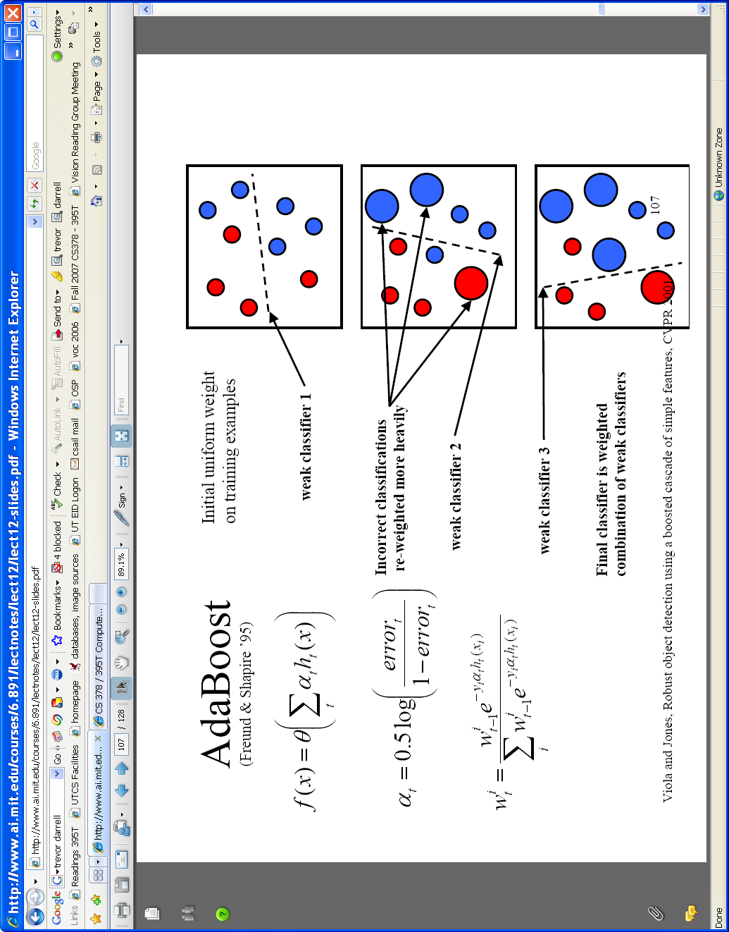

AdaBoost for feature+classifier selection
Want to select the single rectangle feature and threshold that best separates positive (faces) and negative (non-faces) training examples, in terms of weighted error.
Resulting weak classifier:
For next round, reweight the examples according to errors, choose another filter/threshold combo.
…
Outputs of a possible rectangle feature on faces and non-faces.
Viola & Jones, CVPR 2001
Notes:
46

Slide 47
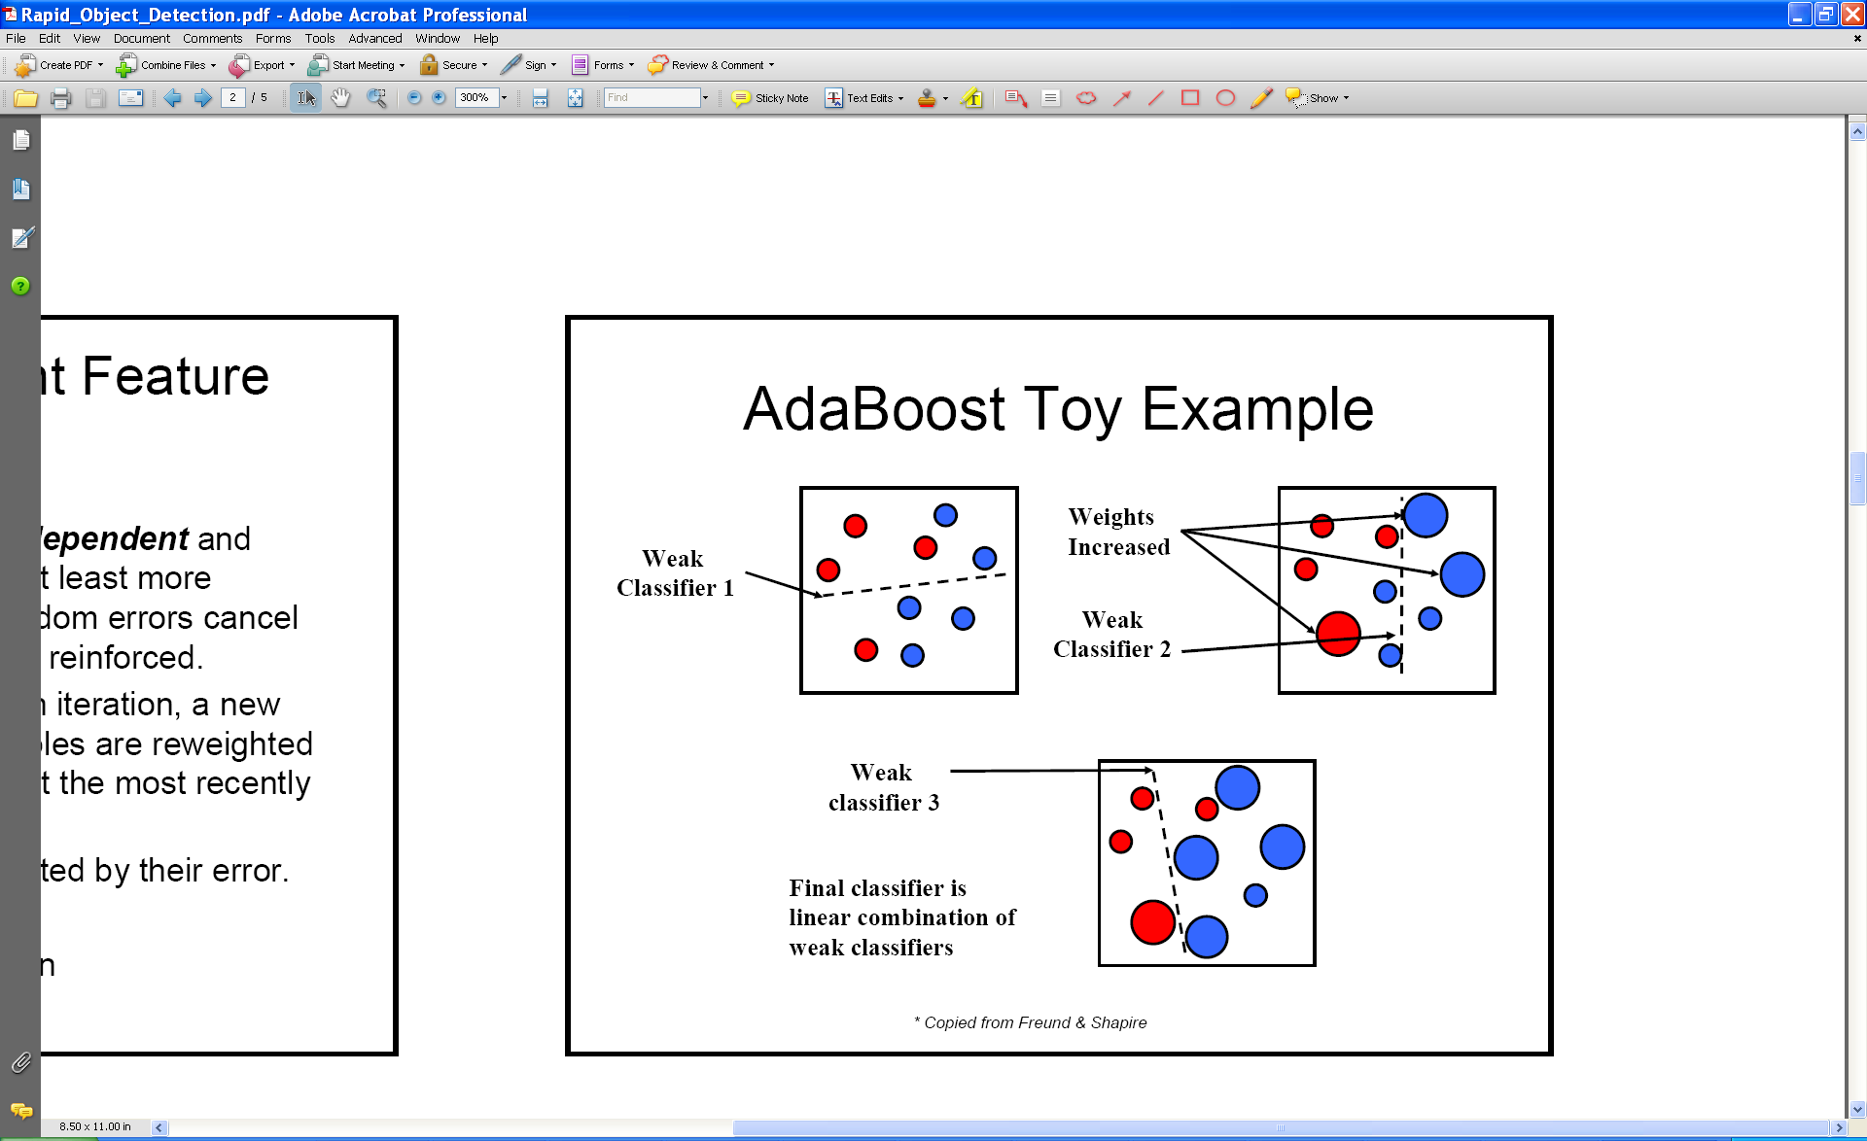
AdaBoost: Intuition
Consider a 2-d feature space with positive and negative examples.
Each weak classifier splits the training examples with at least 50% accuracy.
Examples misclassified by a previous weak learner are given more emphasis at future rounds.
Figure adapted from Freund and Schapire
47
K. Grauman, B. Leibe
Notes:
47

Slide 48
AdaBoost: Intuition
48
K. Grauman, B. Leibe
Notes:
48

Slide 49
AdaBoost: Intuition
Final classifier is combination of the weak classifiers
49
K. Grauman, B. Leibe
Notes:
49

Slide 50
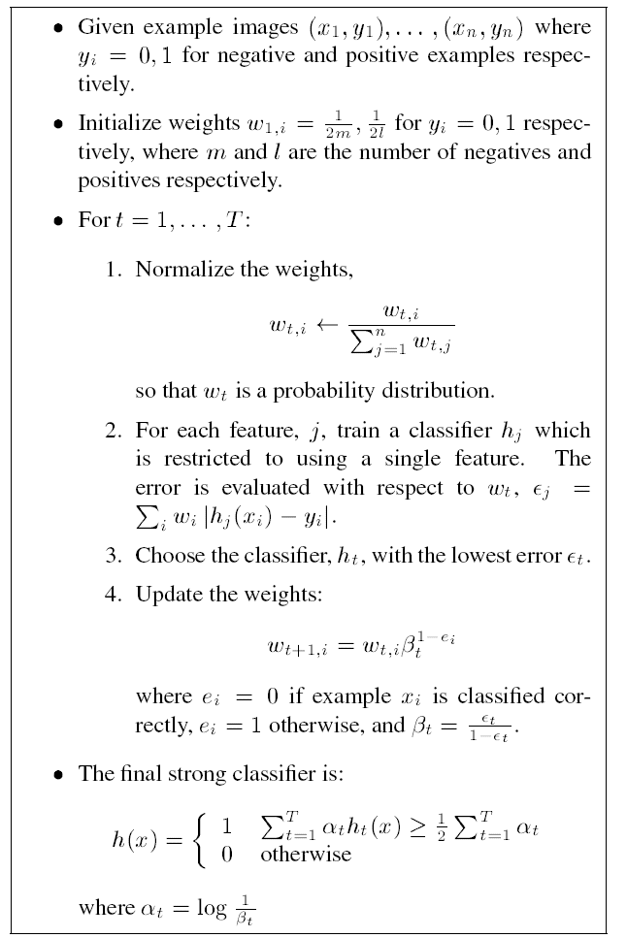
AdaBoost Algorithm
Start with uniform weights on training examples
{x₁,…x_{n}}
For T rounds
Evaluate weighted error for each feature, pick best.
Re-weight the examples:
Incorrectly classified -> more weight
Correctly classified -> less weight
Final classifier is combination of the weak ones, weighted according to error they had.
Freund & Schapire 1995
Notes:
50

Slide 51
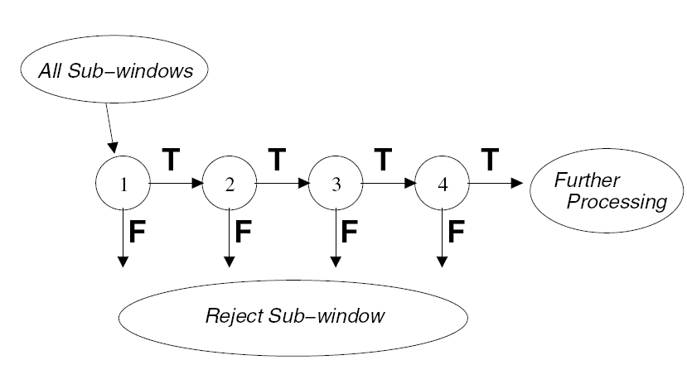
Cascading classifiers for detection
For efficiency, apply less accurate but faster classifiers first to immediately discard windows that clearly appear to be negative; e.g.,
  Filter for promising regions with an initial inexpensive classifier
  Build a chain of classifiers, choosing cheap ones with low false negative rates early in the chain
Fleuret & Geman, IJCV 2001
Rowley et al., PAMI 1998
Viola & Jones, CVPR 2001
51
K. Grauman, B. Leibe
Figure from Viola & Jones CVPR 2001
Notes:
51

Slide 52
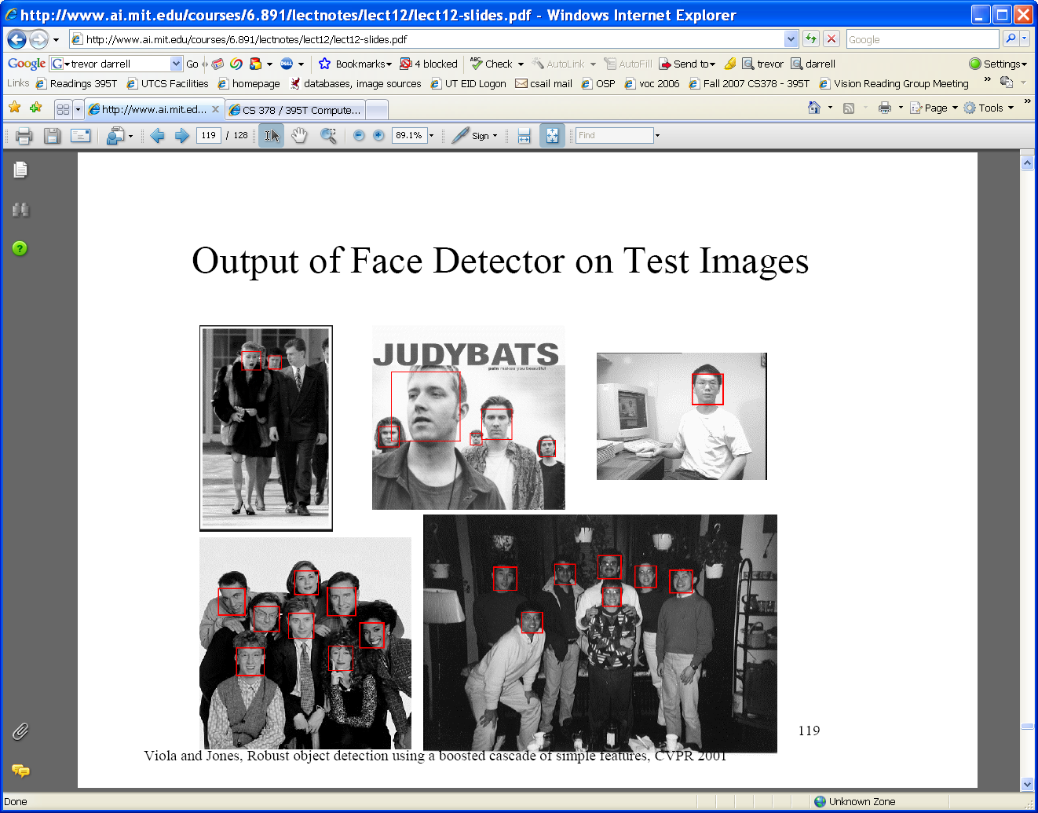





Viola-Jones Face Detector: Summary
Train cascade of classifiers with AdaBoost
Apply to each subwindow
Faces
New image
Selected features, thresholds, and weights
Non-faces
Train with 5K positives, 350M negatives
Real-time detector using 38 layer cascade
6061 features in final layer
[Implementation available in OpenCV: http://www.intel.com/technology/computing/opencv/]
52
Notes:
52

Slide 53

Viola-Jones Face Detector: Results
First two features selected
53
K. Grauman, B. Leibe
Notes:
53

Slide 54
Viola-Jones Face Detector: Results
Notes:
54

Slide 55
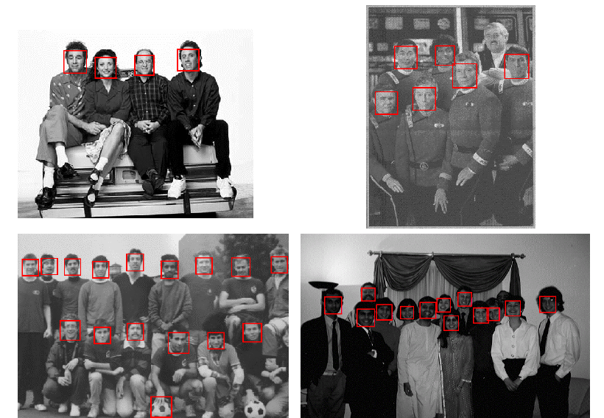
Viola-Jones Face Detector: Results
Notes:
55

Slide 56
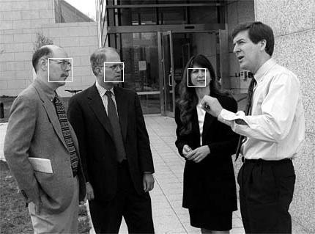
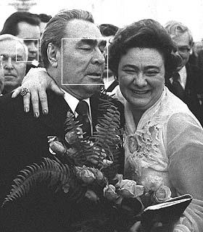
Viola-Jones Face Detector: Results

Slide 57
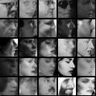
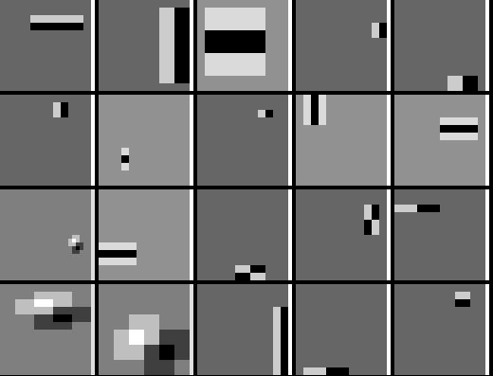
Detecting profile faces?
Detecting profile faces requires training separate detector with profile examples.

Slide 58



Viola-Jones Face Detector: Results
Paul Viola, ICCV tutorial

Slide 59
Questions?

