Slide 1
Exploring differences in two “languages”
CS/INFO 6742, lightly adapted from a section of Danescu-Niculescu-Mizil and Lee Neurips 2016 tutorial,
http://www.cs.cornell.edu/~cristian/index_files/NIPS_NLP_for_CSS_tutorial.pdf
Issues analyzed in Kleinberg (2004, Data Stream Management 2016), with a Markov model applied for temporal analysis.
Presentation/figures from slides 4 on follow Monroe, Colaresi and Quinn, Political Analysis (2008)

Slide 2
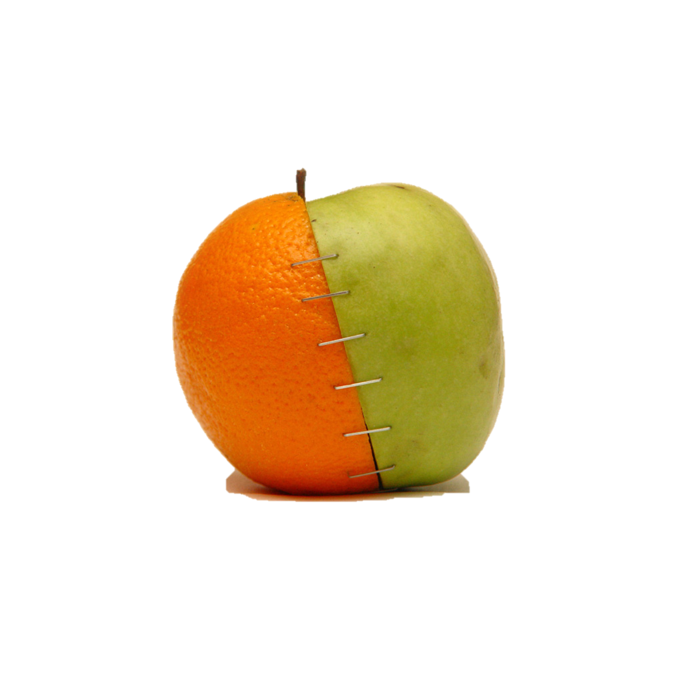
Example application: frame competition
Example: public discussion of GMOs in food
“green revolution”
“frankenfood”
http://www.ourbreathingplanet.com/control-the-world-through-genetically-modified-food/

Slide 3
Additional applications:
Differentiating the language of ….
successful vs. unsuccessful persuaders
language in one time period vs. another…
your experimental condition A vs. your experimental condition B!!
Also good for sanity-checking your data…
“…”
“…”

Slide 4
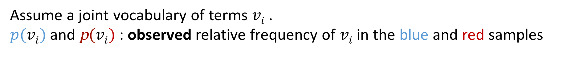
Example: 106th U.S. Senate speeches on abortion
“Frames” → words we might expect from Democrats:
… women’s rights …
… privacy ...
“Frames” → words we might expect from Republicans:
... unborn children ...
... murder ...
Assume a joint vocabulary of terms $vi$ .
$p(vi)$ and p$(vi)$ : observed relative frequency of $vi$ in the blue and red samples
Notes:
* = vocab choice can be another issue …
the 106th Congress (1999–2000), often the subject of frame analysis (Adams 1997; McCaffrey and Keys 2008; Schonhardt-Bailey 2008).3

Slide 5
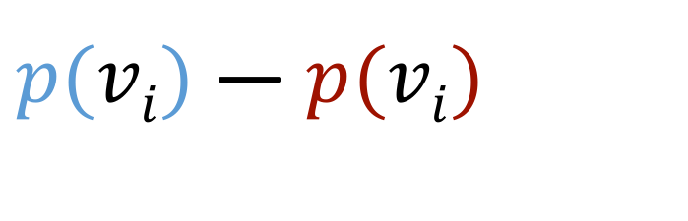
Ranking idea
✔
life
born
fact
a
ar
but
perform
it
child
mother
you
that
be
kill
not
procedur
babi
of
abort
the
✘
to
women
right
senat
their
amend
woman
her
my
and
decis
famili
doctor
make
health
for
will
friend
court
law
✔
✔
✘
✔
Top and bottom 20 words according to
✔
✔
✔
✘
$p(vi)$ — $p(vi)$
✘
✔
✔
✔
✔
✘
✘
important, but would be lost with stopword filtering
✘

Slide 6
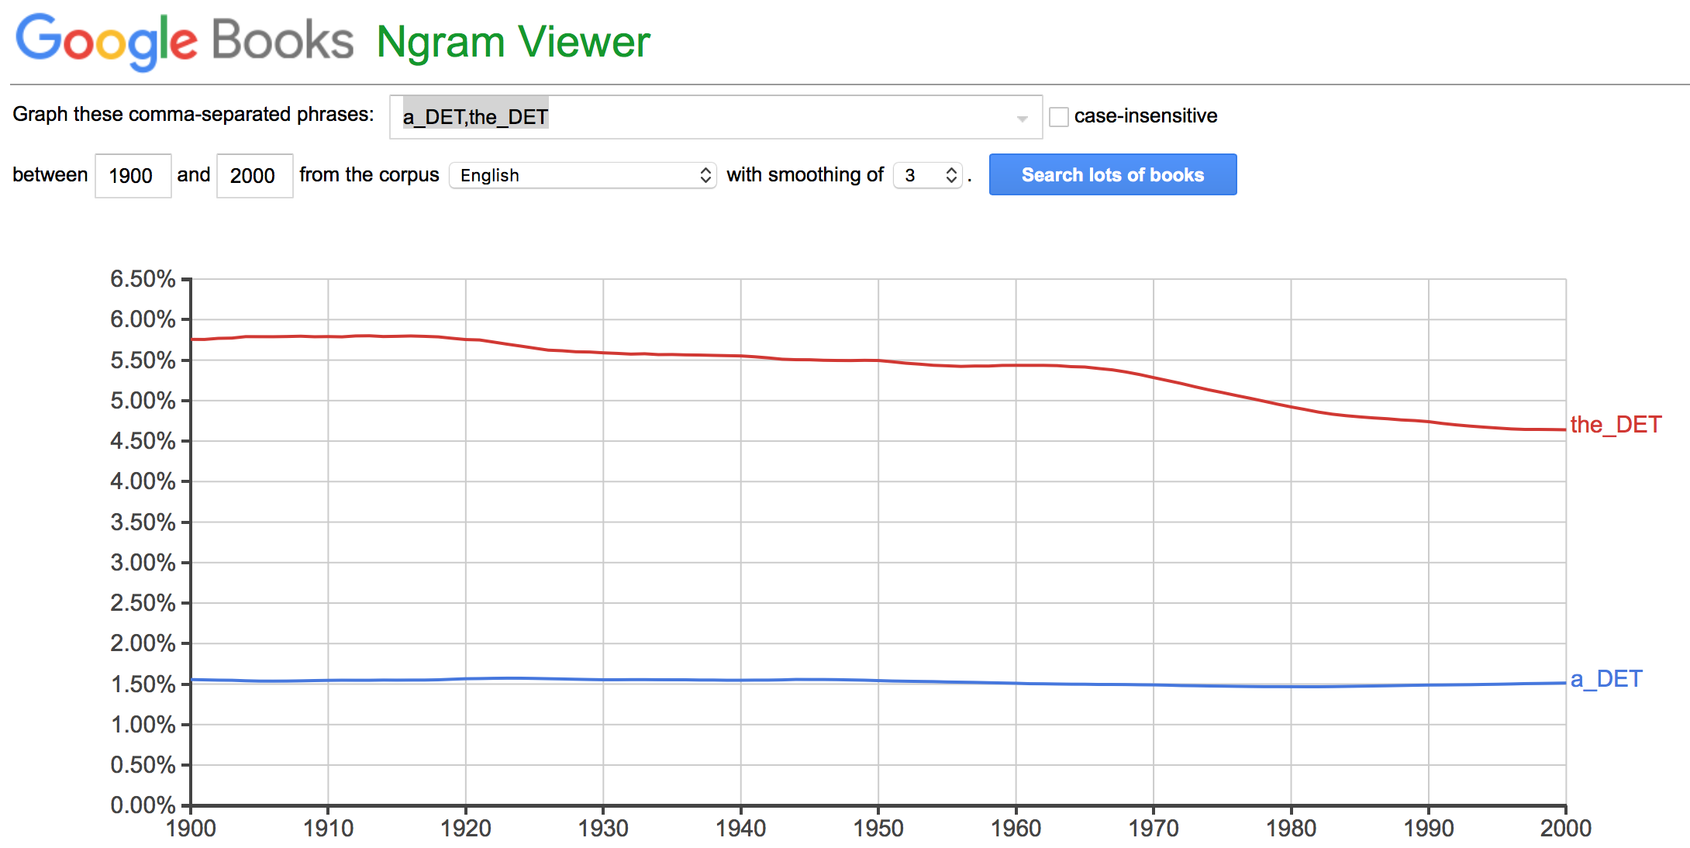
Aside: “stopword removal” not recommended
Very-frequent terms have been proving “increasingly” useful, e.g., for stylistic or psychological cues
“a” vs “the” is surprising
[for years LL assumed this was a bug, but see Language Log, Jan 3 2016:
“The case of the missing determiners”]

Slide 7
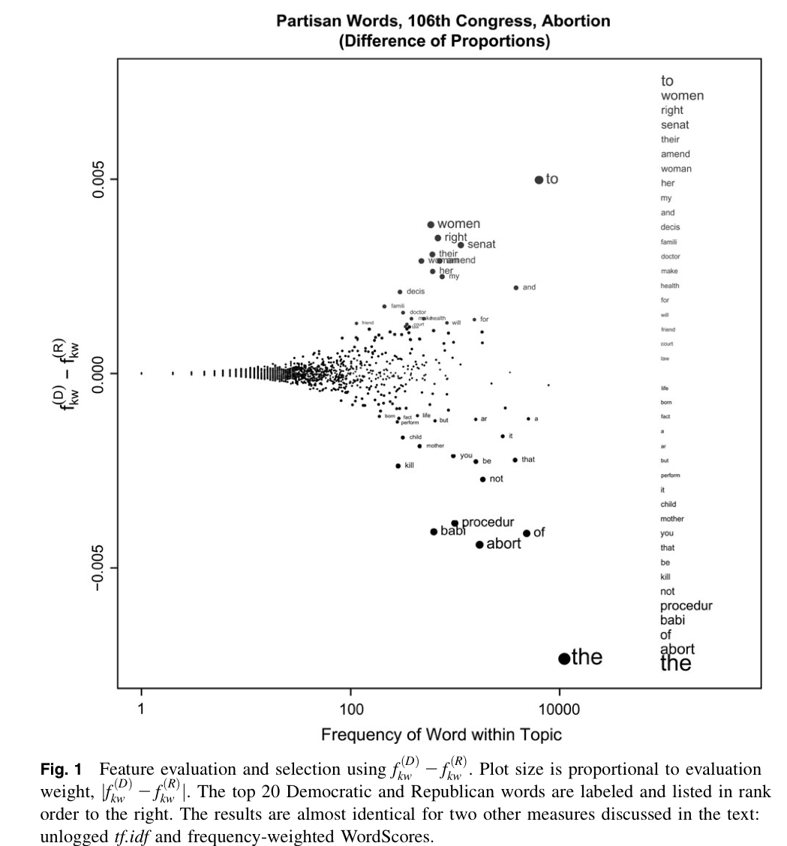
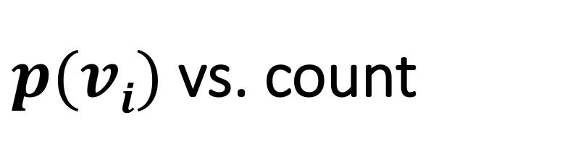
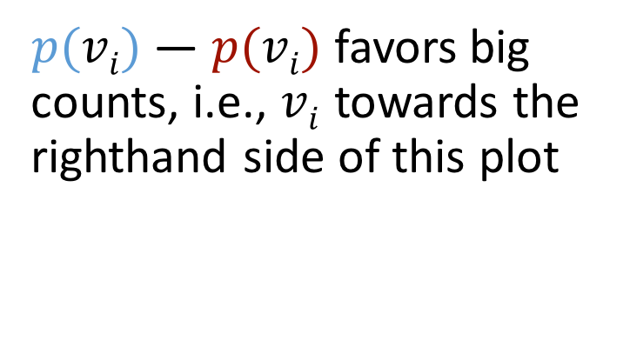
$p(vi)$vs. count
to
women
right
senat
their
amend
woman
$p(vi)$ — $p(vi)$ favors big counts, i.e., $vi$towards the righthand side of this plot
kill
not
procedur
babi
of
abort
the
(can’t have a large difference between two small differences)

Slide 8
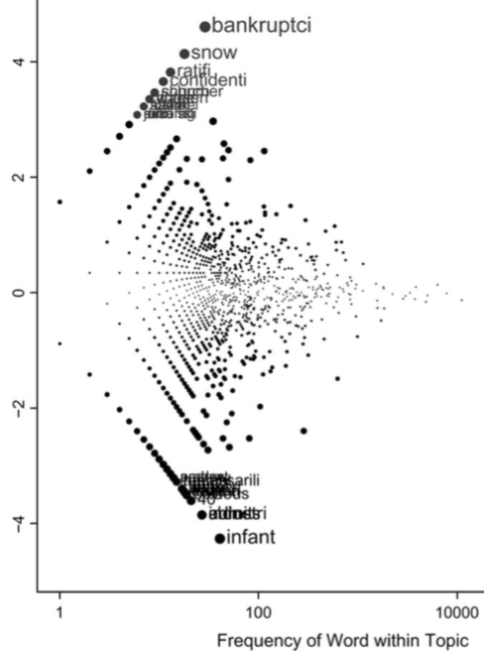
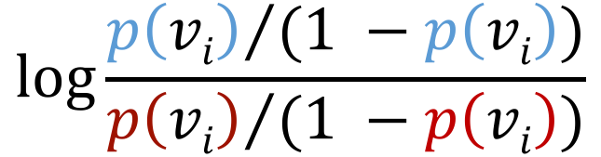
Ranking by log odds-ratio
bankruptc
snow
ratifi
confidenti
church
schumer
chosen
voter
wage
1974
attach
attornie
idaho
sadli
coverag
d
juri
mikulsi
tonight
necessarili
martin
peter
leg
harvest
frist
bright
anim
trade
taught
dayton
obvious
40
industri
chines
admit
infant
$$\log{\frac{{p\left(vi\right)}/{(1 −p\left(vi\right))}}{{p\left(vi\right)}/{(1 −p\left(vi\right))}}}$$
Notes:
log-odds ratio. Seemingly similar idea as before, look at how much the blue language “uses the word”,, vs. how much the red language uses the word but working with the odds of v_i instead of straight p(v_i). If we do the log of the ratio then we have “0” when equal
Foornote “there is abortion partisanship in these words. For example, Democrat Charles Schumer introduced an amendment to a bankruptcy reform bill designed to prevent abortion clinic protesters from avoiding fines via bankruptcy protections. We argue only that these do not have face validity as the most important words.”
A naïve-bayes style P(c|x) would also have problems with rare words, also probably overweighting them.

Slide 9
(Move to handout: model choices)

Slide 10
Aside: warning on ignoring (language) history
Should we really write P(v_{i}), with no conditioning on context?
Previous lectures: language accommodation/coordination
Church 2000: “Empirical Estimates of Adaptation: The chance of Two Noriegas is closer to p / 2 than p² “. COLING.
  “Finding a rare word like Noriega in a document is like lightning. We might not expect lightning to strike twice, but it happens all the time, especially for good keywords.“

Slide 11
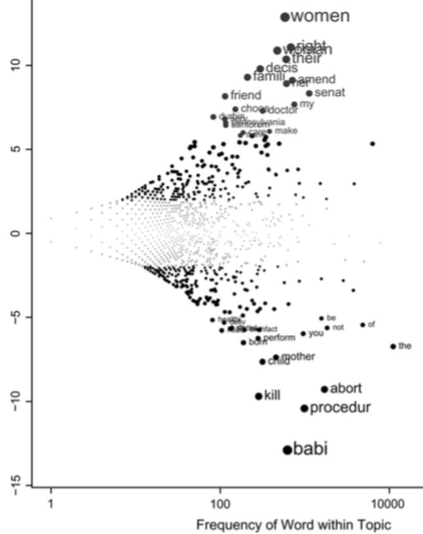
Ranking by z-score of log odds-ratio, with model of variance (uninformative prior)
women
right
woman
their
decis
famili
amend
her
senat
friend
my
choos
doctor
durbin
serv
pennsylvania
santorum
of
dr
not
partial
fact
birth
head
you
perform
born
the
mother
child
abort
kill
procedur
babi

Slide 12
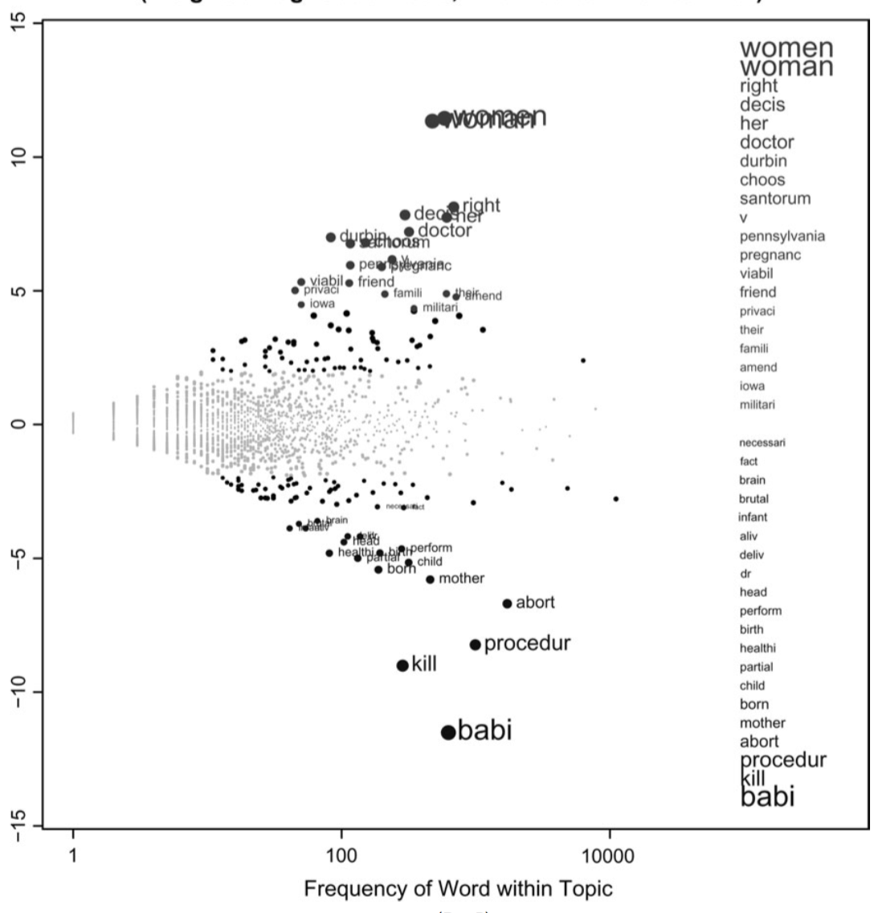
Ranking by z-score of log odds-ratio, with model of variance (informative prior)
women
woman
right
decis
her
doctor
durbin
choos
santorum
v
pennsylvania
pregnanc
viabil
friend
privaci
their
famili
aliv
deliv
dr
head
perform
head
perform
birth
healthi
partial
child
born
mother
abort
procedur
kill
babi

