Slide 1
Intelligent Machines:
From Turing to
Deep Blue to
Watson and Beyond
Bart Selman
Notes:
1
1

Slide 2
Today's Lecture
What is Artificial Intelligence (AI)?
  the components of intelligence
  historical perspective
  [in part from CS-4700 intro]
The current frontier
  recent achievements
Challenges ahead:
  what makes AI problems hard?

Slide 3
What is Intelligence?
Intelligence:
  “the capacity to learn and solve problems”
    (Webster dictionary)
  the ability to act rationally
Artificial Intelligence:
  build and understand intelligent entities
  synergy between:
    philosophy, psychology, and cognitive science
    computer science and engineering
    mathematics and physics

Slide 4
philosophy
e.g., foundational issues (can a machine think?), issues of
knowledge and believe, mutual knowledge
psychology and cognitive science
e.g., problem solving skills
computer science and engineering
e.g., complexity theory, algorithms, logic and inference,
programming languages, and system building.
mathematics and physics
e.g., statistical modeling, continuous mathematics, Markov
models, statistical physics, and complex systems.

Slide 5
What's involved in Intelligence?
A) Ability to interact with the real world
  to perceive, understand, and act
  speech recognition and understanding
  image understanding (computer vision)
B) Reasoning and Planning
  modelling the external world
  problem solving, planning, and decision making
  ability to deal with unexpected problems, uncertainties

Slide 6
C) Learning and Adaptation
We are continuously learning and adapting.
  We want systems that adapt to us!

Slide 7
Different Approaches
I Building exact models of human cognition
  view from psychology and cognitive science
II Developing methods to match or exceed human
performance in certain domains, possibly by
very different means.
  Examples:
  Deep Blue (‘97), Stanley (‘05)
  Watson (’11) , and Dr. Fill (‘11).
Our focus is on II (most recent progress).
New goal: Reach top 100 performers in the world.

Slide 8
Issue: The Hardware
The brain
  a neuron, or nerve cell, is the basic information
  processing unit (10^11 )
  many more synapses (10^14) connect the neurons
  cycle time: 10^(-3) seconds (1 millisecond)
How complex can we make computers?
  10^9 or more transistors per CPU
  Ten of thousands of cores, 10^10 bits of RAM
  cycle times: order of 10^(-9) seconds
Numbers are getting close! Hardware will surpass human brain within next 20 yrs.

Slide 9
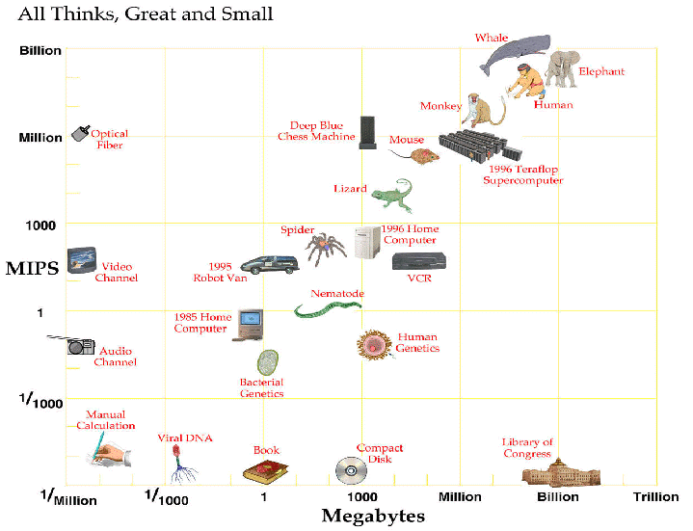
Computer vs. Brain
approx. 2025
Current:
Nvidia: tesla
personal super-
computer
1000 cores
4 teraflop

Slide 10
Conclusion
  In near future we can have computers with as many processing elements as our brain, but:
  far fewer interconnections (wires or synapses)
  much faster updates.
Fundamentally different hardware may
require fundamentally different algorithms!
  Very much an open question.
  Neural net research.

Slide 11
A Neuron

Slide 12
An Artificial Neural Network
Output Unit
Input Units

Slide 13
An artificial neural network is an abstraction (well, really, a “drastic simplification”) of a real neural network.
Start out with random connection weights on the links between units. Then train from input examples and environment, by changing network weights.
Recent breakthrough: Deep Learning
(one of the reading / discussion topics
automatic discovery of “deep” features)

Slide 14
Historical Perspective
Obtaining an understanding of the human mind is
one of the final frontiers of modern science.
Founders:
George Boole, Gottlob Frege, and Alfred Tarski
  formalizing the laws of human thought
Alan Turing, John von Neumann, and Claude Shannon
  thinking as computation
John McCarthy, Marvin Minsky,
Herbert Simon, and Allen Newell
  the start of the field of AI (1959)

Slide 15
Early success: Deep Blue
May, '97 --- Deep Blue vs. Kasparov. First match won against
world-champion. ``intelligent creative'' play.
  200 million board positions per second!
  Kasparov: “I could feel --- I could smell --- a
  new kind of intelligence across the table.”
  ... still understood 99.9 of Deep Blue's moves.
Intriguing issue: How does human cognition deal
with the search space explosion of chess?
Or how can humans compete with computers at
all?? (What does human cognition do?)
Example of reaching top 10 world performers.
Accelerating trend: Stanley (?), Watson, and Dr. Fill.

Slide 16
Deep Blue
An outgrowth of work started by early pioneers, such as,
Shannon and McCarthy.
Matches expert level performance, while doing (most likely)
something very different from the human expert.
Dominant direction in current research on intelligent
machines: we're interested in overall performance.
So far, attempts at incorporating more expert specific chess
knowledge to prune the search have failed.
What’s the problem?
[Room for a project! Can machine learn from watching millions of expert-level chess games?]

Slide 17
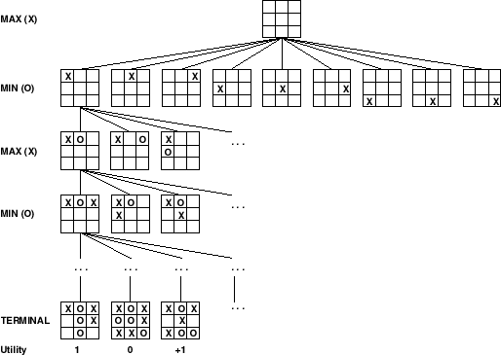
Game Tree Search: the Essence of Deep Blue
What if we can’t reach bottom?
Aside: Recent new randomized sampling search
for Go. (MoGo, 2008)

Slide 18
Combinatorics of Chess
Opening book
Endgame
  database of all 5 piece endgames exists; database of all 6 piece games being built
Middle game
  branching factor of 30 to 40
  1000^{(d/2)} positions
    1 move by each player = 1,000
    2 moves by each player = 1,000,000
    3 moves by each player = 1,000,000,000

Slide 19
Positions with Smart Pruning
Search Depth Positions
2 60
4 2,000
6 60,000
8 2,000,000
10 (<1 second DB) 60,000,000
12 2,000,000,000
14 (5 minutes DB) 60,000,000,000
16 2,000,000,000,000
Strong player: >= 10K boards
Grandmaster: >= 100K boards
How many lines of play does a grand master consider?
Around 5 to 7 (principal variations)

Slide 20

Why is it so difficult to use real expert chess knowledge?
Example: consider tic-tac-toe. ☺
What next for Black?
Suggested strategy:
1) If there is a winning move, make it.
2) If opponent can win at a square by next
move, play that move. (“block”)
3) Taking central square is better than others.
4) Taking corners is better than on edges.

Slide 21
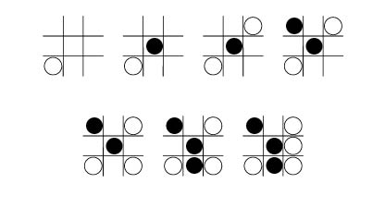
Strategy looks pretty good… right?
But:
Black’s strategy:
1) If there is a winning move, make it.
2) If opponent can win at a square by next
move, play that move. (“block”)
3) Taking central square is better than others.
4) Taking corners is better than on edges.
The problem: Interesting play involves the exceptions to the general rules!
☹

Slide 22
On Game 2
(Game 2 - Deep Blue took an early lead. Kasparov resigned, but it turned out he could have forced a draw by perpetual check.)
This was real chess. This was a game any human grandmaster would have been proud of.
Joel Benjamin
grandmaster, member Deep Blue team

Slide 23
Kasparov on Deep Blue
1996: Kasparov Beats Deep Blue
“I could feel --- I could smell --- a new kind of intelligence across the table.”
1997: Deep Blue Beats Kasparov
“Deep Blue hasn't proven anything.”

Slide 24
Formal Complexity of Chess
How hard is chess (formal complexity)?
  Problem: standard complexity theory tells us nothing about finite games!
  Generalizing chess to NxN board: optimal play is PSPACE-hard
  What is the smallest Boolean circuit that plays optimally on a standard 8x8 board?
  Fisher: the smallest circuit for a particular 128 bit function would require more gates than there are atoms in the universe.

Slide 25
Game Tree Search
How to search a game tree was independently invented by Shannon (1950) and Turing (1951).
Technique: MiniMax search.
Evaluation function combines material & position.
  Pruning "bad" nodes: doesn't work in practice (why not??)
  Extend "unstable" nodes (e.g. after captures): works well in practice

Slide 26
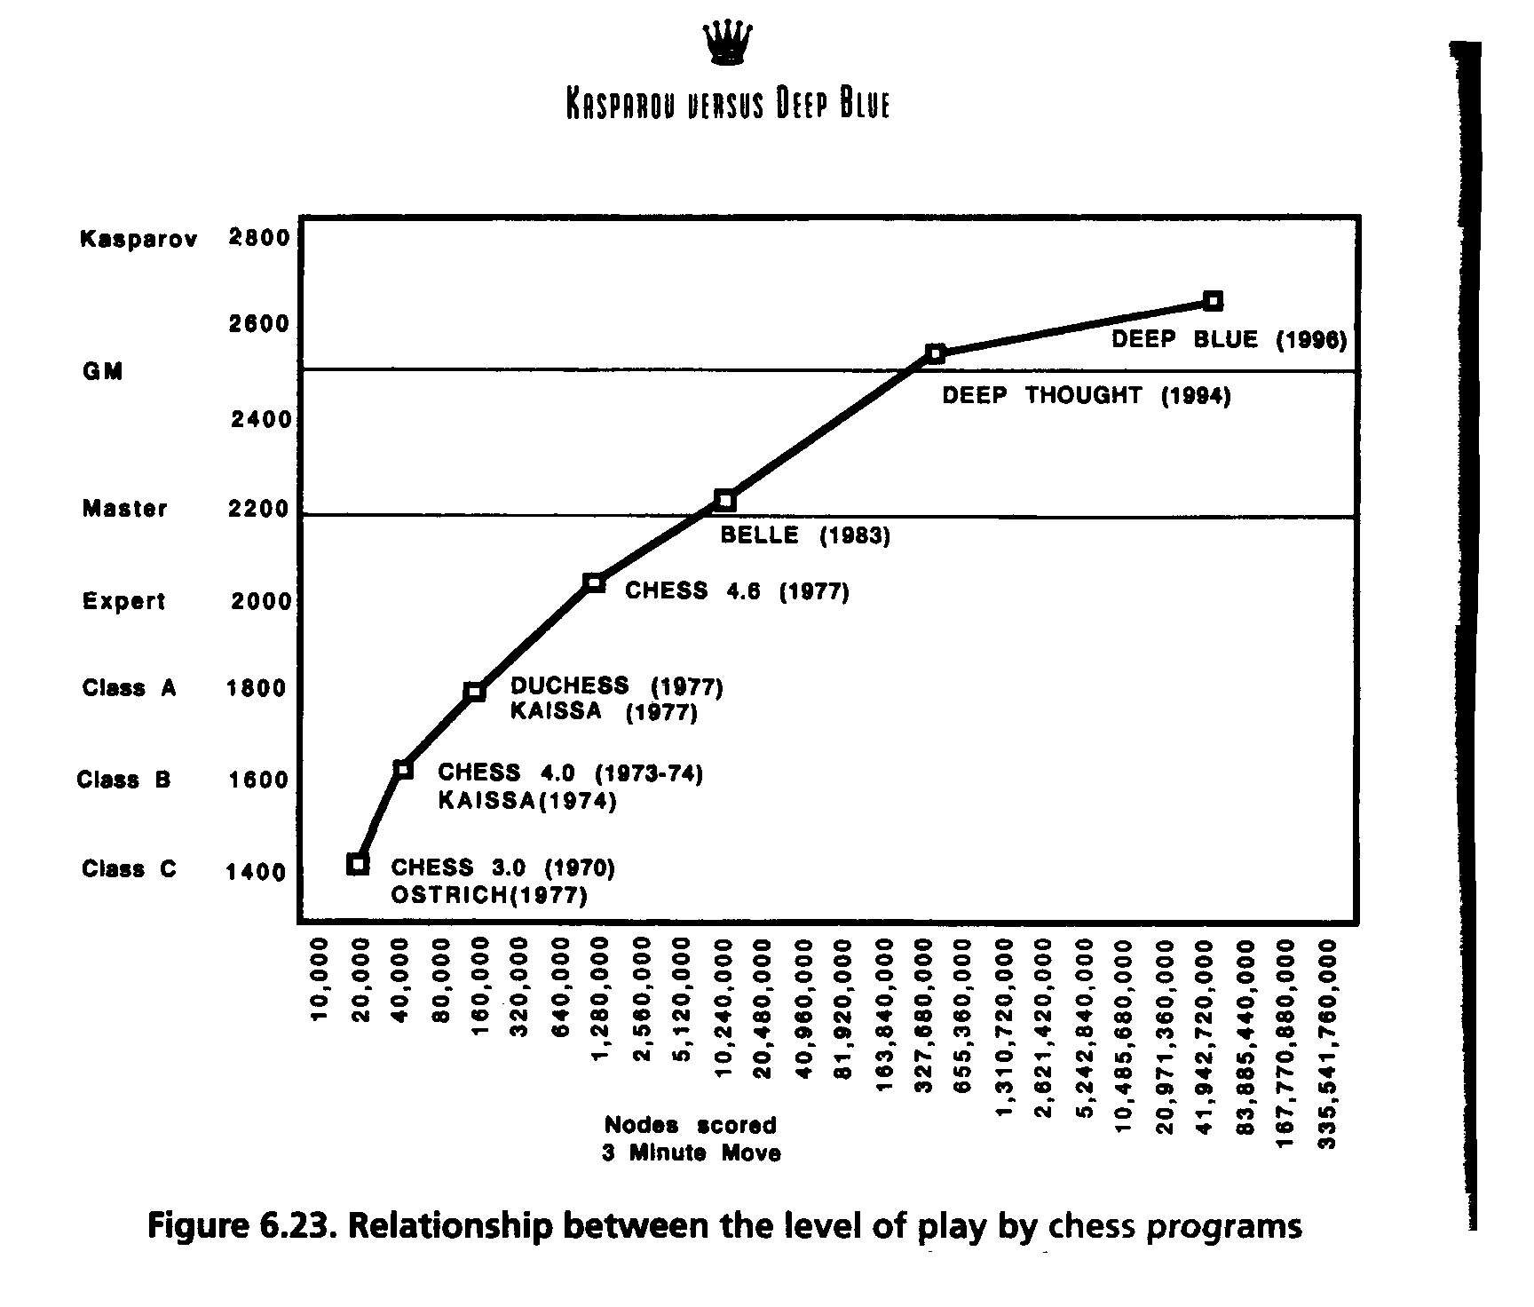

Slide 27
A Note on Minimax
Minimax “obviously” correct – but is it?? The
deeper we search, the better one plays… Right?
  Nau (1982) discovered pathological game trees
Games where
  evaluation function grows more accurate as it nears the leaves
  but performance is worse the deeper you search!

Slide 28
Clustering
Monte Carlo simulations showed clustering is important
  if winning or losing terminal leaves tend to be clustered, pathologies do not occur
  in chess: a position is “strong” or “weak”, rarely completely ambiguous!
But still no completely satisfactory theoretical understanding of why minimax works so well!

Slide 29
History of Search Innovations
Shannon, Turing Minimax search 1950
Kotok/McCarthy Alpha-beta pruning 1966
MacHack Transposition tables 1967
Chess 3.0+ Iterative-deepening 1975
Belle Special hardware 1978
Cray Blitz Parallel search 1983
Hitech Parallel evaluation 1985
Deep Blue ALL OF THE ABOVE 1997

Slide 30
Evaluation Functions
Primary way knowledge of chess is encoded
  material
  position
    doubled pawns
    how constrained position is
Must execute quickly - constant time
  parallel evaluation: allows more complex functions
    tactics: patterns to recognitize weak positions
    arbitrarily complicated domain knowledge

Slide 31
Learning better evaluation functions
  Deep Blue learns by tuning weights in its board evaluation function
        f(p) = w₁f₁(p) + w₂f₂(p) + ... + w_{n}f_{n}(p)
  Tune weights to find best least-squares fit with respect to moves actually choosen by grandmasters in 1000+ games.
  The key difference between 1996 and 1997 match!
  Note that Kasparov also trained on
  “computer chess” play.
  Open question: Do we even need search?

Slide 32
Transposition Tables
Introduced by Greenblat's Mac Hack (1966)
Basic idea: cacheing
  once a board is evaluated, save in a hash table, avoid re-evaluating.
  called “transposition” tables, because different orderings (transpositions) of the same set of moves can lead to the same board.

Slide 33
Transposition Tables as Learning
Is a form of root learning (memorization).
  positions generalize sequences of moves
  learning on-the-fly
  don't repeat blunders: can't beat the computer twice in a row using same moves!
Deep Blue --- huge transposition tables (100,000,000+), must be carefully managed.

Slide 34
Special-Purpose and Parallel Hardware
Belle (Thompson 1978)
Cray Blitz (1993)
Hitech (1985)
Deep Blue (1987-1996)
  Parallel evaluation: allows more complicated evaluation functions
  Hardest part: coordinating parallel search
  Deep Blue never quite plays the same game, because of “noise” in its hardware!

Slide 35
Deep Blue
Hardware
  32 general processors
  220 VSLI chess chips
Overall: 200,000,000 positions per second
  5 minutes = depth 14
Selective extensions - search deeper at unstable positions
  down to depth 25 !

Slide 36
Evolution of Deep Blue
From 1987 to 1996
  faster chess processors
  port to IBM base machine from Sun
    Deep Blue’s non-Chess hardware is actually quite slow, in integer performance!
  bigger opening and endgame books
  1996 differed little from 1997 - fixed bugs and tuned evaluation function!
    After its loss in 1996, people underestimated its strength!

Slide 38
Tactics into Strategy
As Deep Blue goes deeper and deeper into a position, it displays elements of strategic understanding. Somewhere out there mere tactics translate into strategy. This is the closet thing I've ever seen to computer intelligence. It's a very weird form of intelligence, but you can feel it. It feels like thinking.
  Frederick Friedel (grandmaster), Newsday, May 9, 1997

Slide 39
One criticism of chess --- it’s complete
Information game, in a very well-defined
world…
Not hard to extend!
Kriegspiel

Slide 40
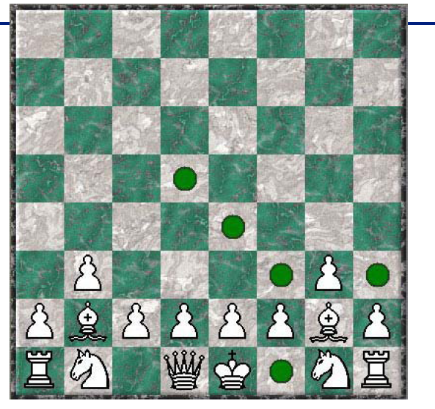
Let’s make things a bit more challenging…
Kriegspiel --- you can’t see your opponent!
Incomplete /
uncertain information
inherent in
the game.
Use probabilistic
reasoning techniques, e.g.,
Graphical models, or Markov Logic.

Slide 41
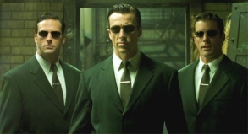
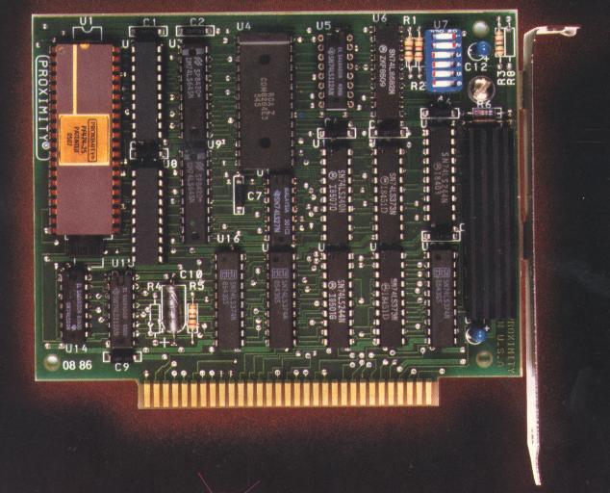
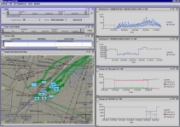
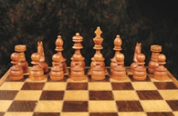
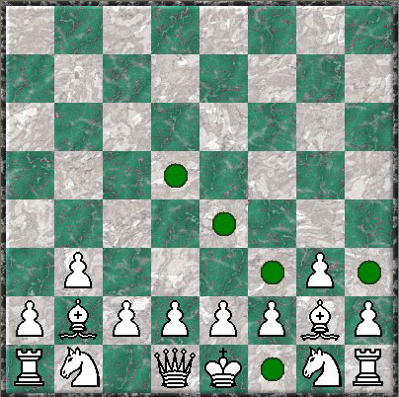
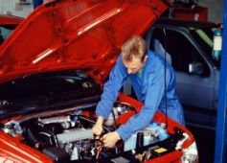

Automated reasoning --- the path
1M
5M
Multi-agent systems
combining:
reasoning,
uncertainty &
learning
10^{301,020}
Complexity
0.5M
1M
VLSI
Verification
10^{150,500}
Case complexity
Exponential
100K
450K
Military Logistics
10⁶⁰²⁰
20K
100K
Chess (20 steps deep) & Kriegspiel (!)
No. of atoms
On earth
10³⁰¹⁰
10⁴⁷
10K
50K
Deep space mission control
Seconds until heat death of sun
10³⁰
100
200
Car repair diagnosis
Protein folding
Calculation (petaflop-year)
100
10K
20K
100K
1M
Variables
$25M Darpa research program --- 2004-2009
Rules (Constraints)

Slide 42
AI Examples, cont.
(Nov., '96) a “creative” proof by computer
  60 year open problem.
  Robbins' problem in finite algebra.
Qualitative difference from previous results.
  E.g. compare with computer proof of four
  color theorem.
http://www.mcs.anl.gov/home/mccune/ar/robbins
Does technique generalize?
  Our own expert: Prof. Constable.

Slide 43
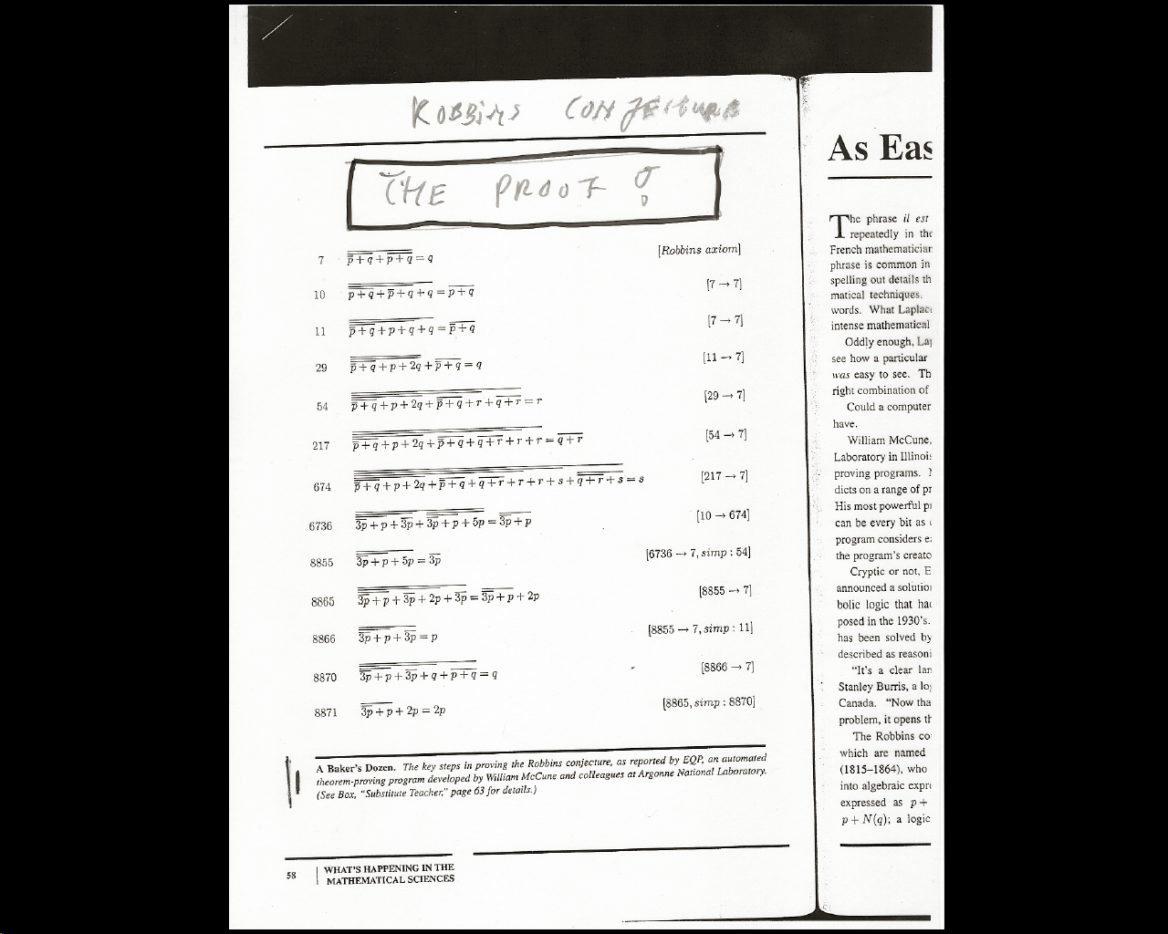

Slide 44
NASA: Autonomous Intelligent Systems.
Engine control next generation spacecrafts.
Automatic planning and execution model.
Fast real-time, on-line performance.
Compiled into 2,000 variable logical reasoning problem.
Contrast: current approach customized software with
ground control team. (E.g., Mars mission 50 million.)

Slide 45
Machine Learning
In ’95, TD-Gammon.
World-champion level play by Neural Network
that learned from scratch by playing millions and
millions of games against itself! (about 4 months
of training.)
Has changed human play.
Key open question: Why does this NOT work
for, e.g., chess??

Slide 46
Challenges ahead
Note that the examples we discussed so far all
involve quite specific tasks.
The systems lack a level of generality and
adaptability. They can't easily (if at all)
switch context.
Current work on “intelligent agents”
--- integrates various functions (planning, reasoning, learning etc.) in one module
--- goal: to build more flexible / general systems.

Slide 47
A Key Issue
The knowledge-acquisition bottleneck
Lack of general commonsense knowledge.
CYC project (Doug Lenat et al.).
Attempt to encode millions of facts.
New: Wolfram’s Alpha knowledge engine
Google’s knowledge graph
Reasoning, planning, learning can compensate
to some extent for lack of background knowledge
by deriving information from first principles.
But, presumably, there is a limit to how
far one can take this. (open question)

Slide 48
Current key direction in knowledge based systems:
Combine logical (“strict”) inference with
probabilistic / Bayesian (“soft”) reasoning.
E.g. Markov Logic (Domingos 2008)
Probabilistic knowledge can be acquired via
learning from (noisy/incomplete) data. Great for
handling ambiguities!
Logical relations represent hard constraints.
E.g., when reasoning about bibliographic reference
data, and “author” has to be a “person” and cannot
be a location.

Slide 49
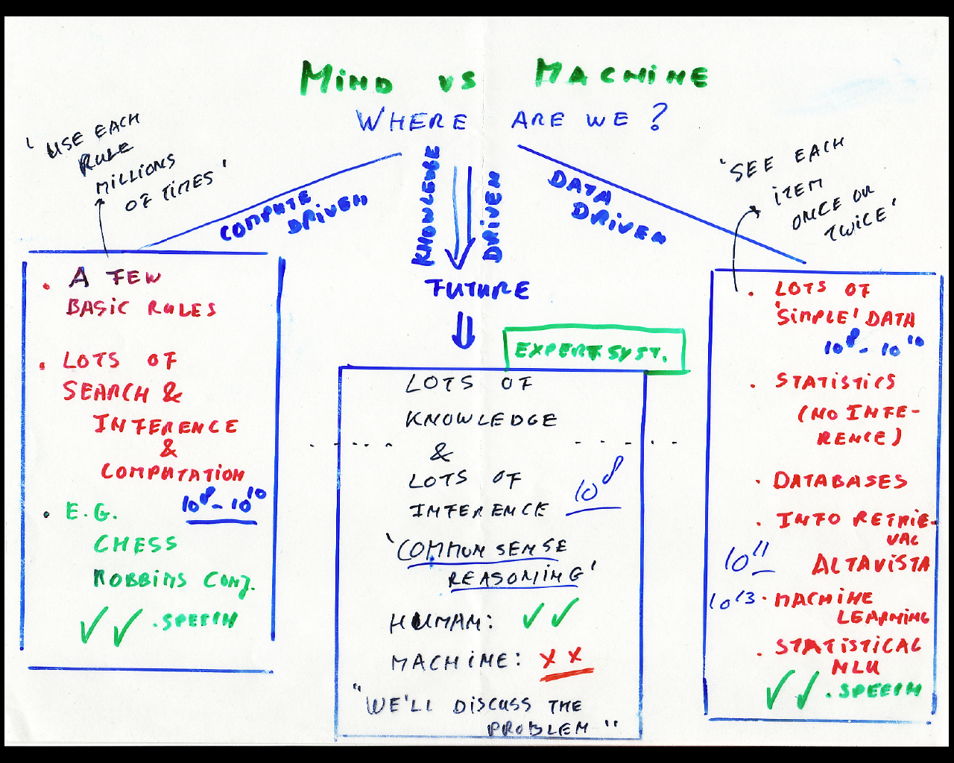
☺
☺
☹ But recent progress!

Slide 50
Knowledge or Data?
Last 5 yrs: New direction.
Combine a few general principles / rules (i.e.
knowledge) with training on a large expert
data set to tune hundreds of model parameters.
Obtain world-expert performance.
Examples:
--- IBM’s Watson / Jeopardy
--- Dr. Fill / NYT crosswords
--- Iamus / Classical music composition
Performance: Top 50 or better in the world!
Is this the key to human expert intelligence?
Discussion / readings topic.

Slide 51
END INTRO

