Slide 1
CS6700 Advanced AI Bart Selman
Notes:
1
1

Slide 2
Admin
Project oriented course
Projects --- research style or implementation
style with experimental component.
1 or 2 students
70% grade
Readings: Class presentation and discussion 20%
(group of 2 or 3 is assigned 1 or 2 papers)
Participation --- 10%
Weekly lecture on Wedn. at 3:35pm

Slide 3
Projects
Very open-ended
Go for BIG ideas! (No such thing as “failure.”)
E.g.
Can you evolve a language from scratch?
Can you learn from “reading”? (E.g. game play from text on discussion boards)
Mechanical Turk --- Human-computing hybrids
Mine info from twitter feeds
Boost game play via “mimicry”

Slide 4
Topics list
AI --- general intro
Knowledge-based approaches
--- inference
--- problem hardness
--- connections to statistical physics
Statistical and probabilistic inference
--- connections to graphical models / Bayes nets
--- Markov Logic
Multi-agent systems
--- combinatorial auctions
--- multi-agent reasoning
Planning
But, also, to get you thinking about future challenges /
directions for AI.

Slide 5
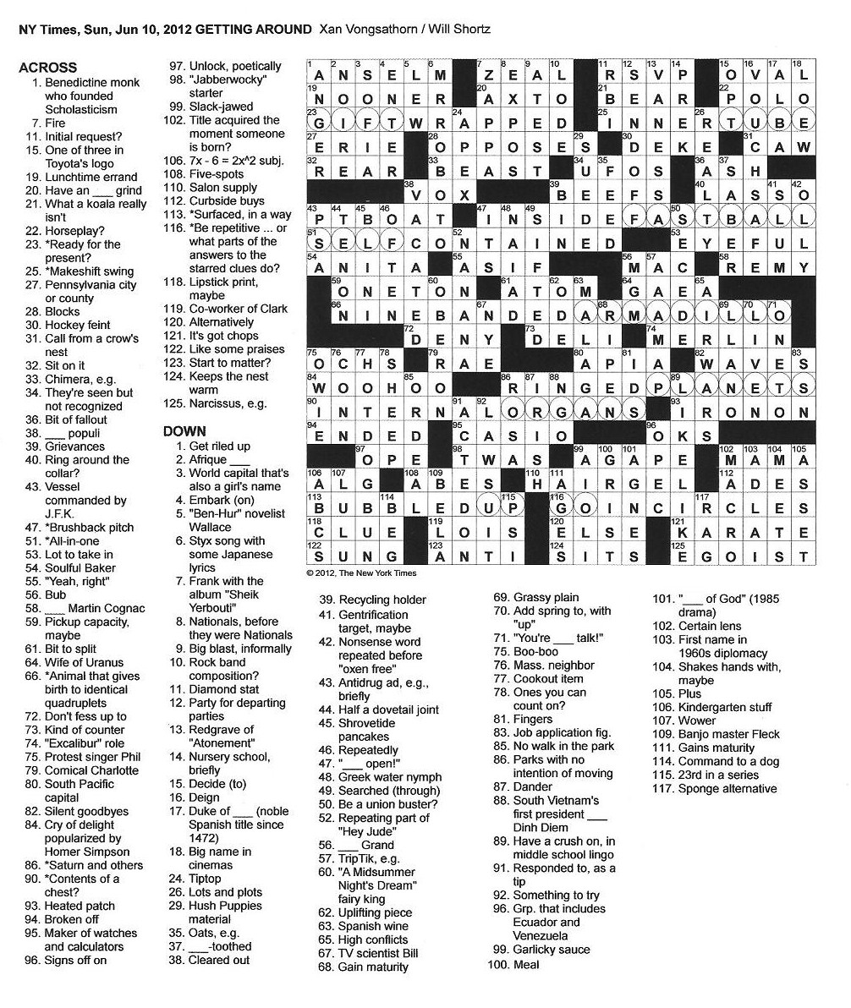
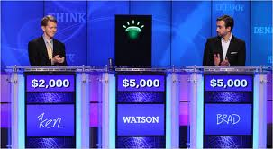
In Class Discussion Papers
Examples topics:
AI: Science or Engineering?
IBM’s Watson (world-level Jeopardy)
Dr. Fill (world-level NYT crossword solver)
Iamus (world-level classical music composition)
Deep Learning (automatic structure discovery)

Slide 6
AI Knowledge- Data- Inference Triangle
Knowledge
Intensive
NLU
Common Sense
Computer Vision
20+ yr GAP!
Google’s Knowl. Graph
Iamus
Watson
Verification
Machine Learning
Google Transl.
Dr. Fill
Robbin’s Conj.
Siri
4-color thm.
Deep Blue
Google Search (IR)
Inference/Search
Intensive
Semantic Web
Data
Intensive

Slide 7
Knowledge or Data?
Last 5 yrs: New direction.
Combine a few general principles / rules (i.e.
knowledge) with training (ML) on a large expert
data set to tune hundreds of model parameters.
Obtain world-expert performance using inference.
Examples:
--- IBM’s Watson / Jeopardy
--- Dr. Fill / NYT crosswords
--- Iamus / Classical music composition
Performance: Top 50 or better in the world!
Is this the key to human expert intelligence?
Discussion / readings topic.

