Slide 1
Learning perception independent of goals: self-supervised learning
An embodied agent can’t depend on labels
Reinforcement learning goals are inevitably tied to particular goals / tasks
Need another way to build good feature representation.

Slide 2
Pretext task
Labels are unavailable
Idea: create your own labels from data
“Pretext” task
Hope: Solving the task leads to good feature representations

Slide 3
Pretext tasks
Transform input, task network with predicting transformation
1 | 3
4 | 2
30º

Slide 4

Pretext tasks
Remove data, then task network with predicting it

Slide 5
Pretext tasks
Use representation to cluster dataset
Clustering
Use pseudo-labels to produce representation

Slide 6
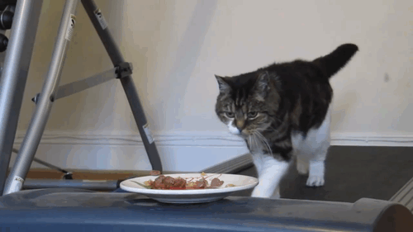
Pretext tasks
Use some source with additional data
E.g. videos

Slide 7
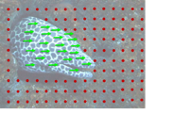
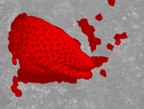
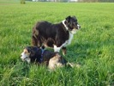
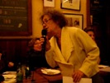
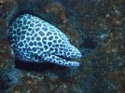
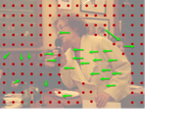
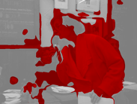
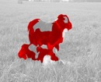
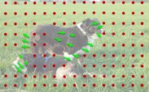
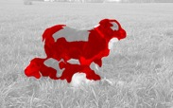

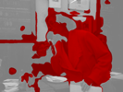
1. Collect videos
2. Segment using motion
3. Train ConvNet
Pathak, Deepak, et al. "Learning Features by Watching Objects Move." CVPR. Vol. 1. No. 2. 2017.
Notes:
This led to a fairly straightforward approach to learning representations in an unsupervised manner: we collected a large number of uncurated videos, we used motion grouping to segment out the foreground in each frame, and then we trained a ConvNet to predict this foreground segmentation

Slide 8
What do humans do?
Elizabeth Spielke. Principles of Object Perception. In Cognitive Science, 1990.
Notes:
There is evidence from human psychology that this is a really important cue. For example, if you show really young infants this static display on the left, then they cannot distinguish between the two options on the right. In other words, they are unable to decide if the two halves of the rod form a single unified object, or whether they are indeed two rods.

Slide 9
What do humans do?
Elizabeth Spielke. Principles of Object Perception. In Cognitive Science, 1990.
Notes:
However, if you show infants this moving display

Slide 10
What do humans do?
Elizabeth Spielke. Principles of Object Perception. In Cognitive Science, 1990.
Notes:
Then they do perceive the rod as connected. This suggests that very young infants are unable to perceive any sort of depth ordering in the static image, but when objects move, they actually use the fact that things that move together form part of a single object.

Slide 11
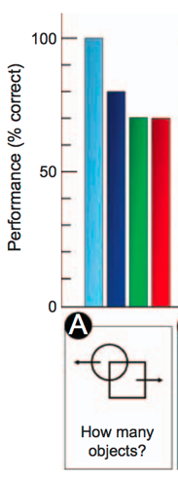
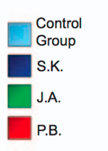
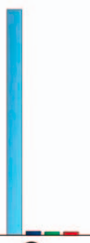
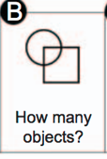
What do humans do?
Patients recovering from blindness
Ostrovsky et al. Visual Parsing After Recovery From Blindness. In Psychological Science, 2009.
Notes:
A similar effect was found in adults and older children who had recently recovered from blindness. In particular, they had trouble grouping correctly overlapping, static shapes, but they had no trouble when the objects moved.
What’s more, their ability to recognize objects was also correlated with if the object moved, that is, if it was a motile object. All of this suggests that motion-based grouping appears early on, and basically bootstraps the other forms of grouping, and even recognition.

Slide 12
The kitten carousel
Both kittens see same visual input
Active kitten learns well, passive kitten does not. Why?
  Knowledge of motion?
  Actively choosing action?
  Paid more attention?
Held, R. and Hein A. (1963). Movement-produced stimulation in the development of visually guided behavior. Jouranal of Comparative and Physiological Psychology
56(5): 872-876.
Walk, Richard D., Jane D. Shepherd, and David R. Miller. "Attention and the depth perception of kittens." Bulletin of the Psychonomic Society 26.3 (1988): 248-251.

Slide 13
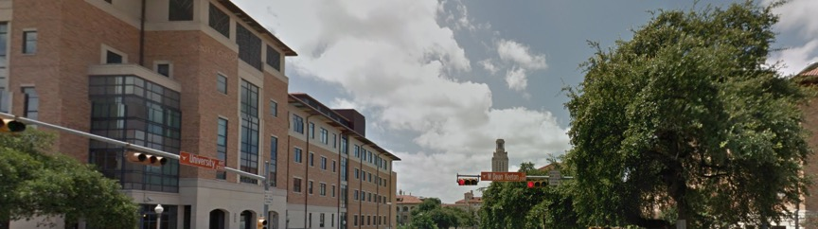
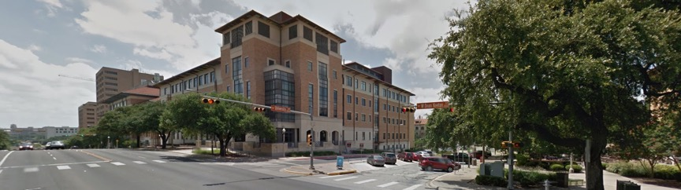
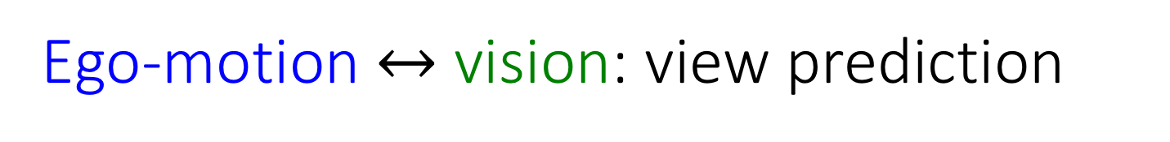
Ego-motion $↔$ vision: view prediction
After moving:
Slide credit: Dinesh Jayaraman

Slide 14
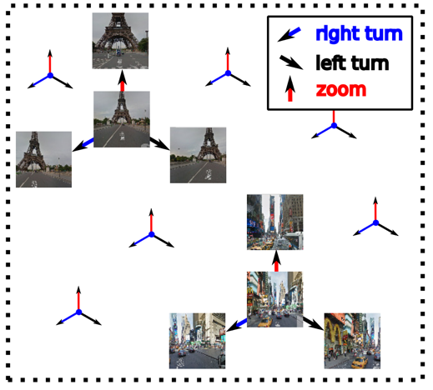

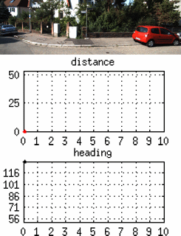








Approach idea: Ego-motion equivariance
Training data
Unlabeled video +
motor signals
Equivariant embedding organized by ego-motions
left turn
right turn
forward
Learn
Pairs of frames related by similar ego-motion should be related by same feature transformation
motor signal
time $→$
Slide credit: Dinesh Jayaraman

Slide 15
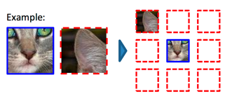
Self supervision by reconstructing hidden data
Doersch et al, ICCV 2015
Zhang et al, ECCV 2016
Pathak et al, CVPR 2016

Slide 16
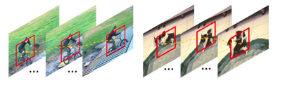
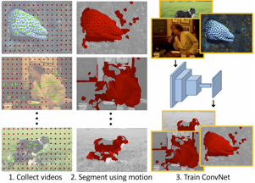
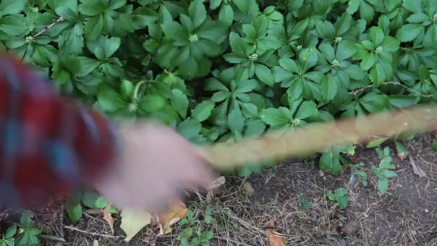
Self supervision by using external information
Wang et al, ICCV 2015
Pathak et al, CVPR 2017
Agrawal et al, ICCV 2015.
Jayaraman and Grauman, ICCV 2015.
Owens et al, CVPR 2016

Slide 17
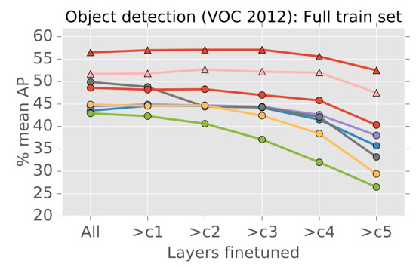
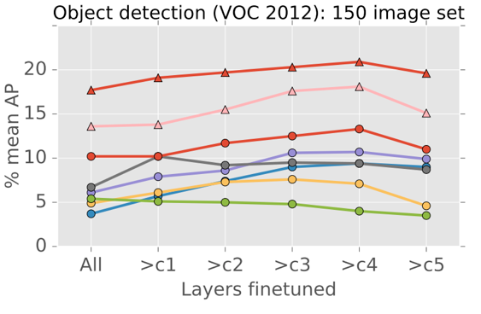
The unreasonable effectiveness of ImageNet

Slide 18
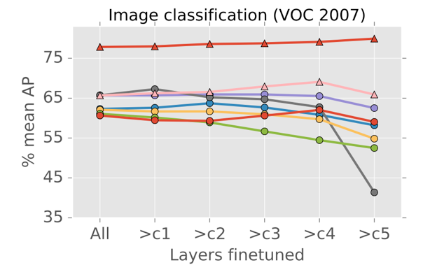
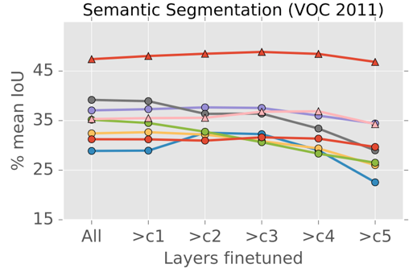
The unreasonable effectiveness of ImageNet

Slide 19
Why is ImageNet so good?
Classification?
Curated images?
Many diverse classes?
Related to target tasks?

Slide 20
Lessons from human cognition
Babies experience of the world is profoundly multi-modal
Babies develop incrementally, and they are not smart at the start.
Babies live in a physical world, full of rich regularities that organize perception, action, and ultimately thought.
Babies explore – they move and act in highly variable and playful ways that are not goal-oriented and are seemingly random.
Babies act and learn in a social world in which more mature partners guide learning and add supporting structures to that learning
Babies learn a language, a shared communicative system that is symbolic.
Smith, Linda, and Michael Gasser. "The development of embodied cognition: Six lessons from babies." Artificial life 11.1-2 (2005): 13-29.

Slide 21
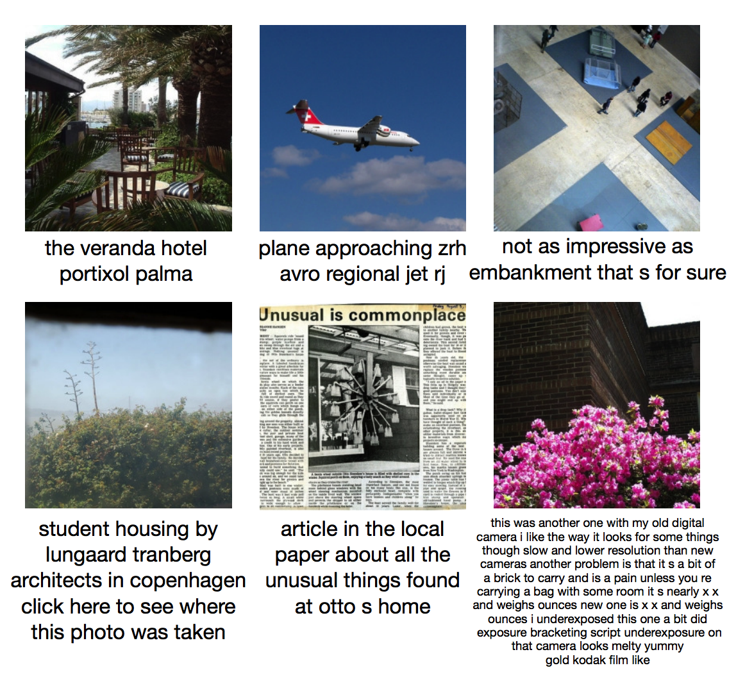
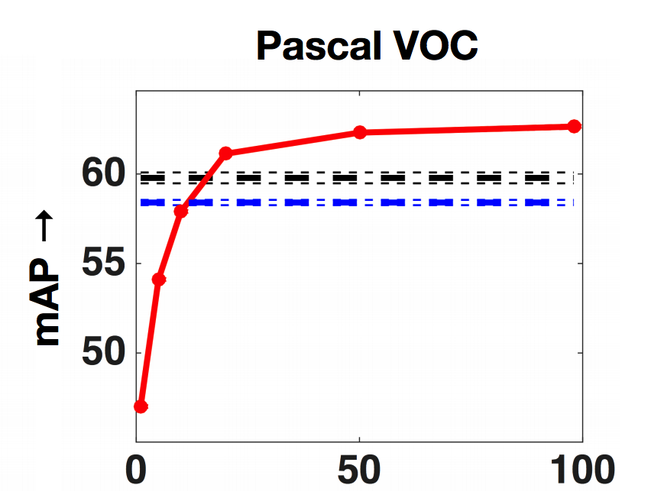
Weak supervision
A. Joulin*, L.J.P. van der Maaten*, A. Jabri, and N. Vasilache (*both authors contributed equally). Learning Visual Features from Large Weakly Supervised Data. In ECCV, 2016.

Slide 22
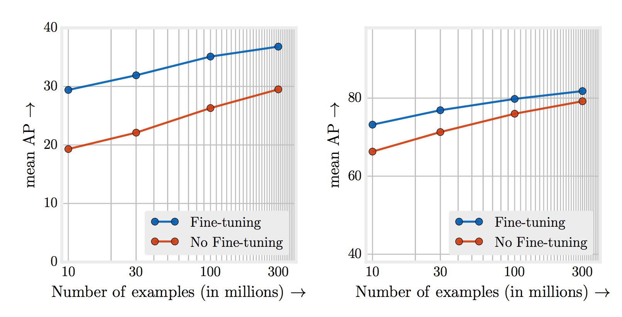
Beating supervised learning with tons and tons of data
Revisiting Unreasonable Effectiveness of Data in Deep Learning Era. Chen Sun, Abhinav Srivastava, Saurabh Singh, Abhinav Gupta. In ICCV, 2017.

Slide 23
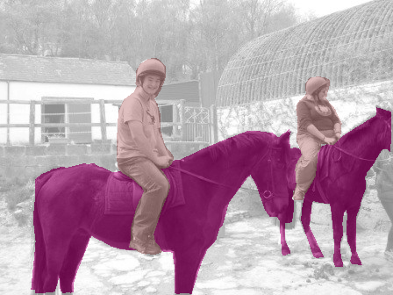
Two phases of supervision
Base task (ImageNet)
New task
Representation learning
Finetuning
New
Model
Evaluation
Model
Notes:
So here’s the problem setup. We’ll first get to train our model on a large labeled dataset containing a set of “base” classes. Then we’ll get to see some “novel classes”, which have only a few training examples. Our task is to update our model so that it can now distinguish among all the classes in the combined set.

Slide 24
Different forms of reduced supervision
Weakly supervised
  Use less rich annotation / noisy annotation
Semi supervised
  Use a few labeled images and a bank of unlabeled images
Few-shot
  Use a few labeled images
Zero-shot
  Use no labeled images but side-information

Slide 25
Weak supervision for detection
Can we learn object detection / semantic segmentation with only image level labels?
Idea: image label = “cat” => somewhere in the image there is a cat

Slide 26
Multiple instance learning

Slide 27
Multiple instance learning
Bag is negative if all instances are negative
Bag is positive if one or more instances are positive

Slide 28
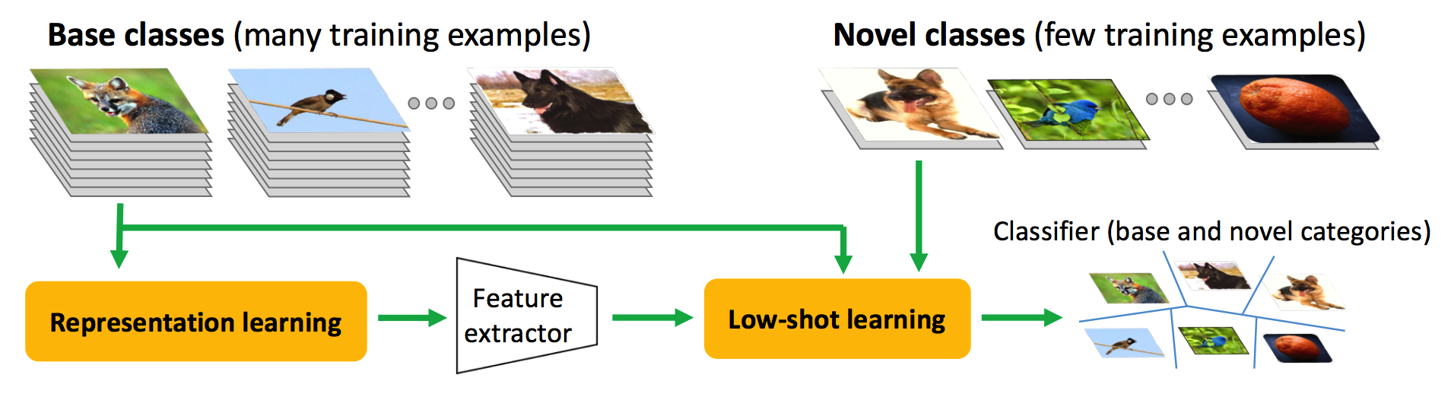
Few-shot learning

Slide 29
The challenge: Intra-class variation

Slide 30
“Train set”
“Test set”
Philippine Tarsier
Mouse lemur
Beaver
Philippine Tarsier

Slide 31
Key cue: shared modes of variation

Slide 32
How do humans do this?
Bird, grey color, long beak, long legs, black markings on head,…
More invariant representations
Inductive biases during learning

Slide 33
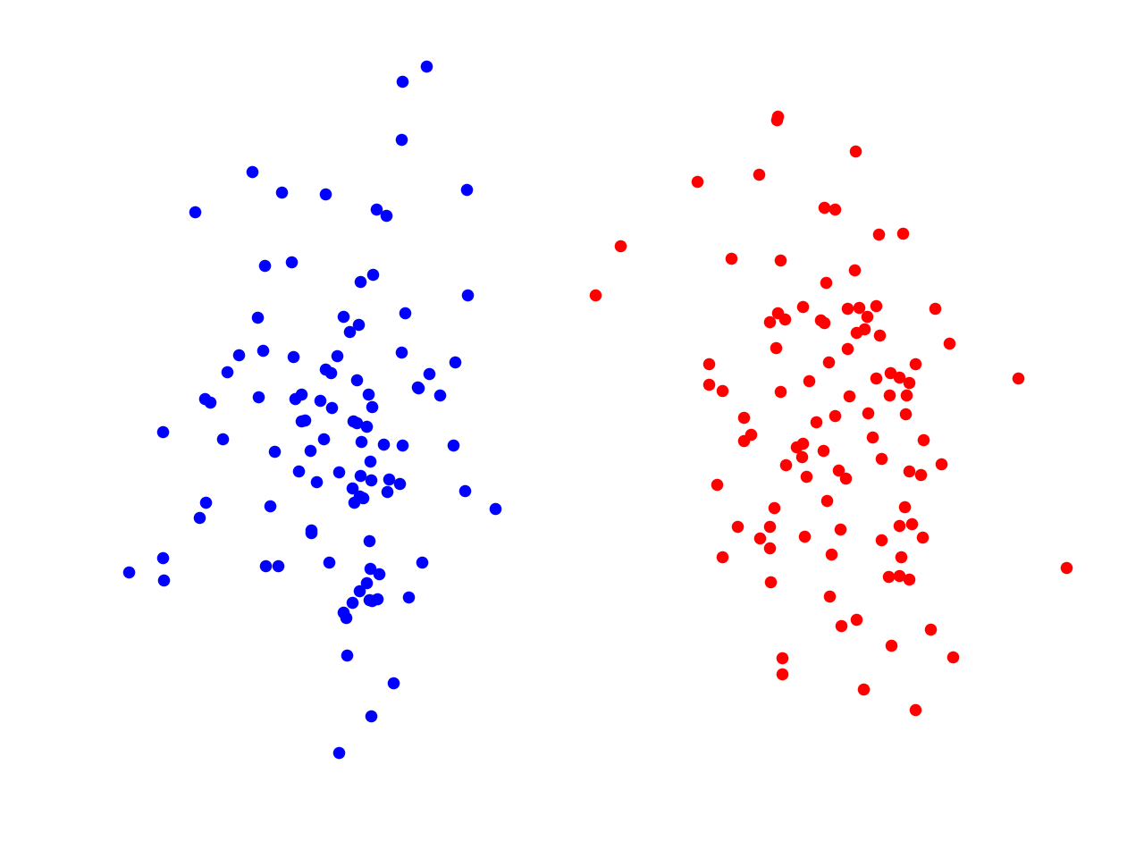
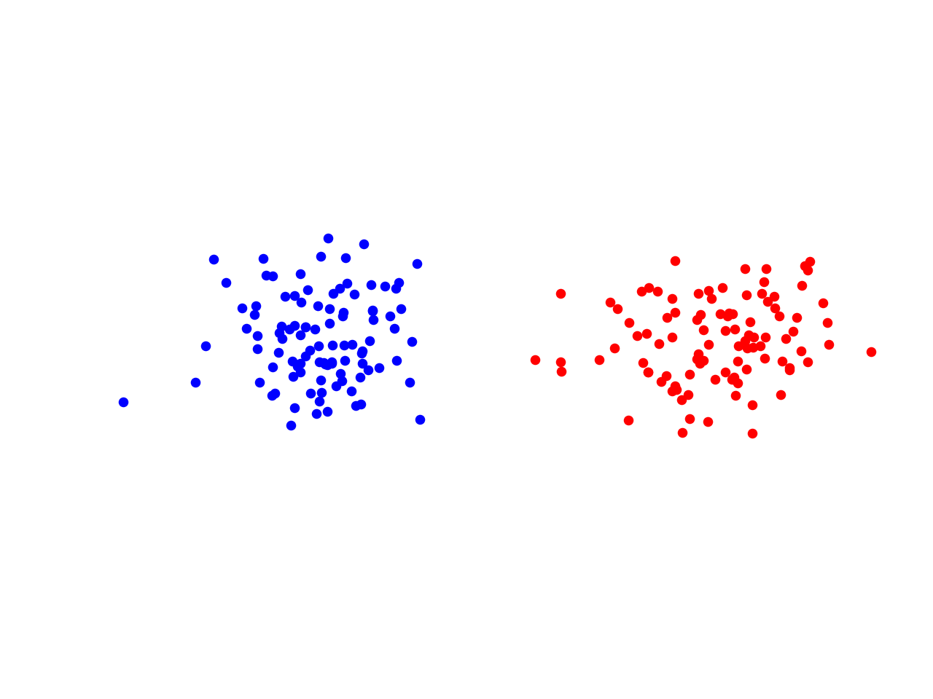
Better representations: metric learning
True class boundary

Slide 34
Better representations: metric learning
“One-shot” class boundary

Slide 35
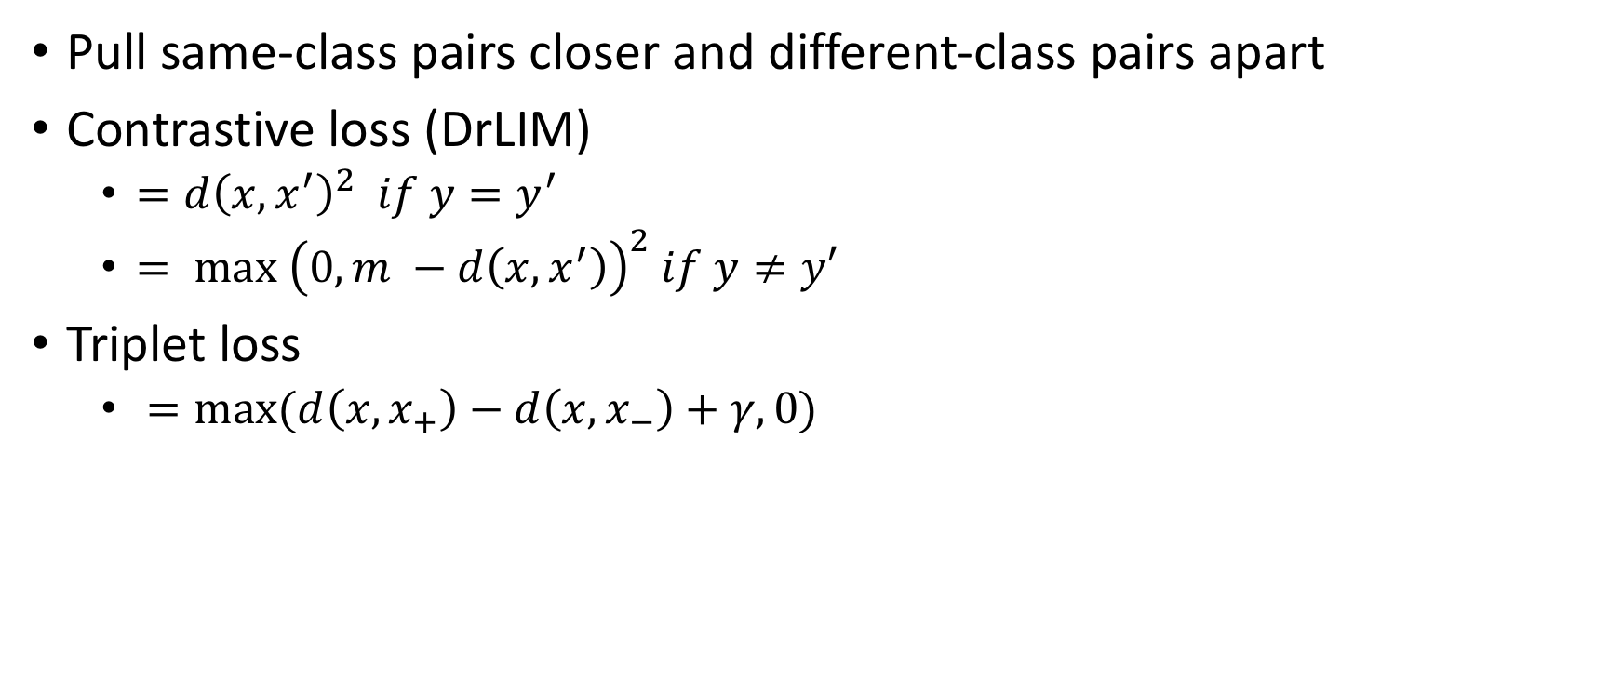
Metric learning
Pull same-class pairs closer and different-class pairs apart
Contrastive loss (DrLIM)
  $=d{\left(x,x^{′}\right)}^{2} if y=y^{′}$
  $= max {\left(0, m −d\left(x,x^{′}\right)\right)}^{2} if y≠y′$
Triplet loss
  $=max(d\left(x,x_{+}\right)−d\left(x,x_{−}\right)+γ,0)$
Dimensionality reduction by learning an invariant mapping. Raia Hadsell, Sumit Chopra, Yann LeCun.
Computer Vision and Pattern Recognition (CVPR), 2006

Slide 36
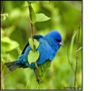
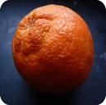
Meta-learning
Given:
Produce:
Idea: Make this a learnable function!
Small training set
(few training examples)

Slide 37


Meta-learning
$$\hat{p}$$
h

Slide 38
Meta-learning
$$\hat{p}$$
h
w

Slide 39

Meta-learning: training
$$\hat{p}$$
L
h
w
D
Image
Label

Slide 40
An army of meta-learners
Vinyals, Oriol, et al. "Matching networks for one shot learning." NIPS. 2016.
Ravi, Sachin, and Hugo Larochelle. "Optimization as a model for few-shot learning." ICLR, 2017.
Snell, Jake, Kevin Swersky, and Richard Zemel. "Prototypical networks for few-shot learning." NIPS. 2017.
Finn, Chelsea, Pieter Abbeel, and Sergey Levine. "Model-agnostic meta-learning for fast adaptation of deep networks." ICML. 2017.

Slide 41
Meta-learning: Prototypical Networks

