Slide 1
Embodied cognition

Slide 2
Recognition today
Large dataset of isolated, labeled images
Where do the images come from?
What do we do with the labels?
{(
, 1),
(
, 1),
(
, 0) , … }

Slide 3
Embodied agents
Agents that perceive and act in the world
Input images come from the physical world
“Recognition” is used to act

Slide 4
Embodied cognition
Perception now depends on action: state of agent or state of the world
  No more collections of isolated images
Feedback to agent comes through consequences of actions
  No well-defined labels
Three problems:
  Learning to act to achieve goals, with perception in the loop
  Self-supervised learning: learning perception from action
  Active perception: learning to act for perception

Slide 5
Learning to act to achieve goals

Slide 6
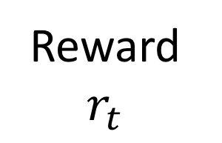
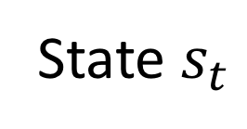
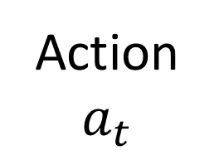
Markov decision processes
Agent acting in an environment
Environment has states that are known to agent
Agent takes actions
Action + random stuff leads to a state transition
Environment gives agent reward
Agent’s goal: maximize return = total reward over time
Agent’s policy: mapping from states to actions
Agent
Action $a_{t}$
State $s_{t}$
Reward $r_{t}$
Environment

Slide 7
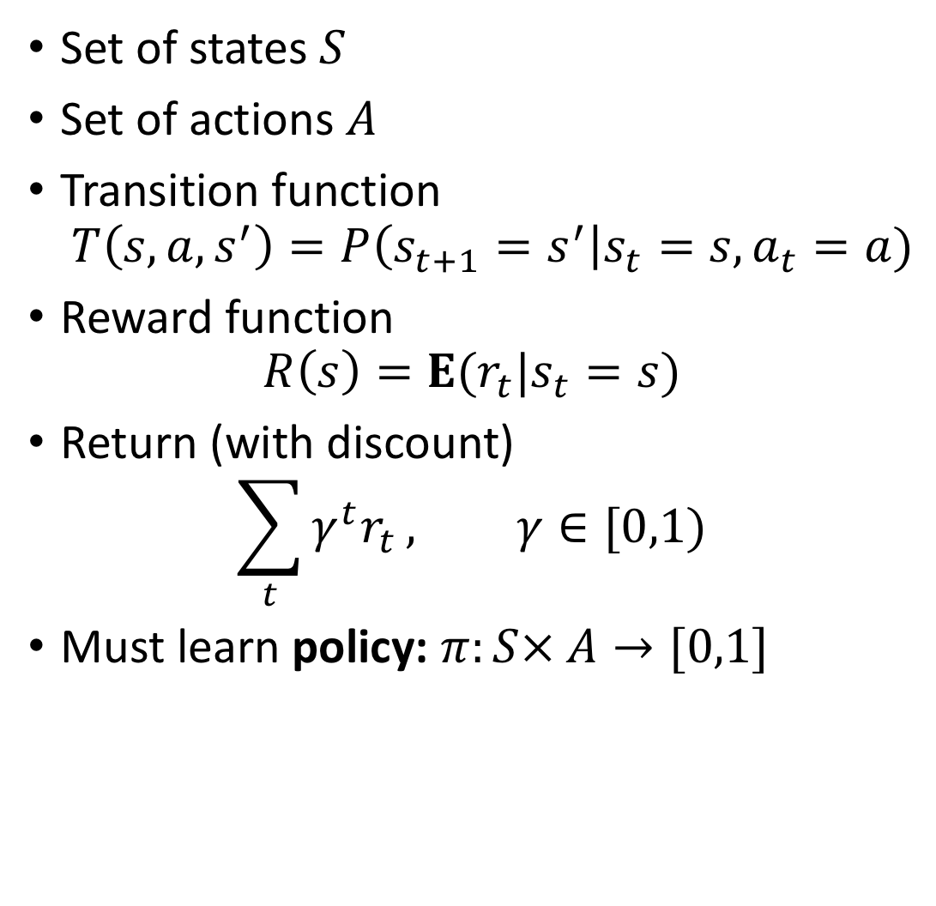
Markov decision processes
Set of states $S$
Set of actions $A$
Transition function
$T\left(s,a,s^{′}\right)=P\left(s_{t+1}=s^{′}\right|s_{t}=s, a_{t}=a)$
Reward function
$R\left(s\right)=E(r_{t}|s_{t}=s)$
Return (with discount)
$\sum_{t}{γ^{t}r_{t}}, γ∈[0,1)$
Must learn policy: $π:S× A→[0,1]$
Agent
Action $a_{t}$
State $s_{t}$
Reward $r_{t}$
Environment

Slide 8
Why is this hard?
Stochasticity
  T and R are non-deterministic
Unknown dynamics
  T and R are unknown: don’t know which action will lead to which state
Partial feedback
  Only get to see consequences of action taken
Long term consequences
  Actions can influence rewards several time steps later

Slide 9
Example: self-driving cars
Stochasticity
  Pressing gas pedal does not always cause acceleration
  Weather
Unknown dynamics
  Do not know where roads lead
  Do not know what other cars might do
Long term consequences
  E.g., may only realize later that took a wrong turn earlier

Slide 10
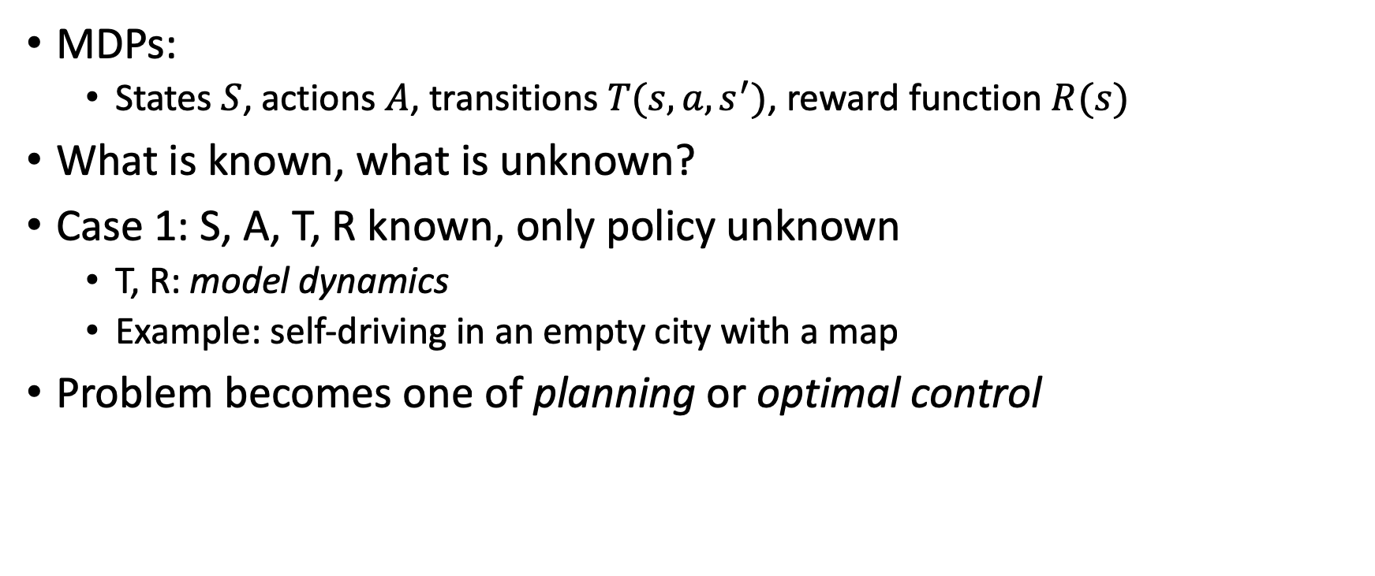
Model-based control
MDPs:
  States $S$, actions $A$, transitions $T(s,a,s^{′})$, reward function $R(s)$
What is known, what is unknown?
Case 1: S, A, T, R known, only policy unknown
  T, R: model dynamics
  Example: self-driving in an empty city with a map
Problem becomes one of planning or optimal control

Slide 11
Model-based control
If states are discrete
  Algorithms from AI : search
If states are continuous
  Algorithms from control theory : optimization
Why is this hard?
  Large space of states, most not good
  Stochasticity, e.g., wheels might slip
What to do when we don’t know model dynamics?
  Learn dynamics! (System identification in control theory)
  Reinforcement learning

Slide 12
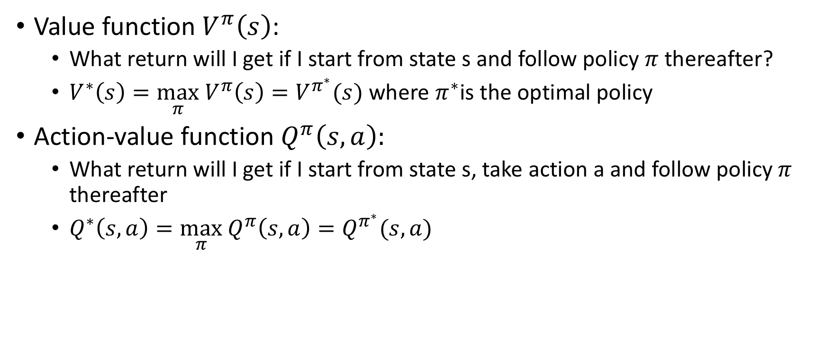
Markov decision processes
Value function $V^{π}\left(s\right)$:
  What return will I get if I start from state s and follow policy $π$ thereafter?
  $V^{∗}\left(s\right)=\max_{π} V^{π}\left(s\right)=V^{π^{∗}}(s)$ where $π^{∗}$is the optimal policy
Action-value function $Q^{π}\left(s,a\right):$
  What return will I get if I start from state s, take action a and follow policy $π$ thereafter
  $Q^{∗}\left(s,a\right)=\max_{π} Q^{π}\left(s,a\right)=Q^{π^{∗}}(s,a)$

Slide 13
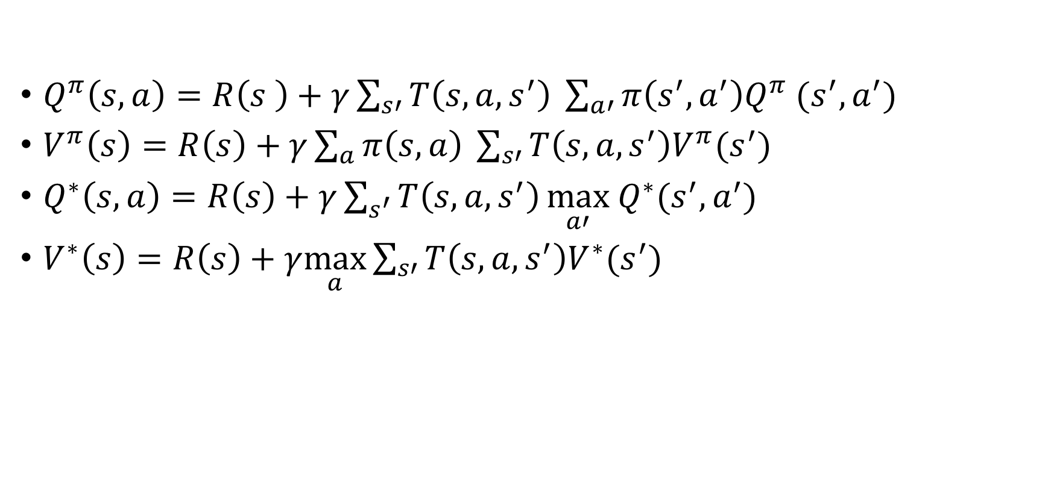
Bellman equations
$Q^{π}\left(s,a\right)=R\left(s \right)+γ\sum_{s′}{T\left(s,a,s^{′}\right)} \sum_{a′}{π\left(s^{′},a^{′}\right)Q^{π} (s^{′}, a^{′})}$
$V^{π}\left(s\right)=R\left(s\right)+γ\sum_{a}{π\left(s,a\right) }\sum_{s′}{T\left(s,a,s^{′}\right)V^{π}(s^{′})}$
$Q^{∗}\left(s,a\right)=R\left(s\right)+γ\sum_{s^{′}}{T\left(s,a,s^{′}\right)}\max_{a′} Q^{∗}(s^{′},a^{′})$
$V^{∗}\left(s\right)=R\left(s\right)+γ\max_{a}\sum_{s′}{T\left(s,a,s^{′}\right)V^{∗}(s^{′})}$

Slide 14
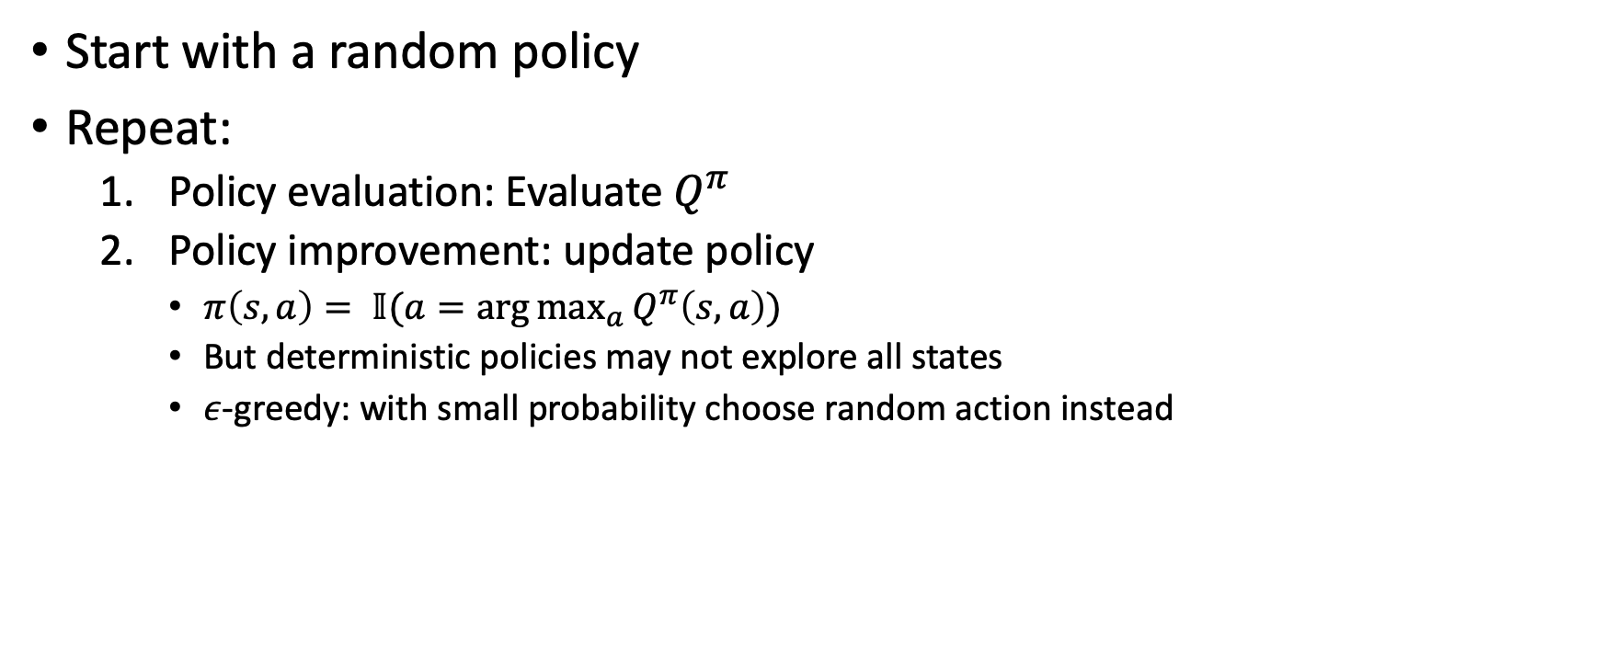
Basic RL algorithms I: Policy iteration
Start with a random policy
Repeat:
  Policy evaluation: Evaluate $Q^{π}$
  Policy improvement: update policy
    $π\left(s,a\right)= 𝕀(a=\arg{\max_{a}{Q^{π}\left(s,a\right)}})$
    But deterministic policies may not explore all states
    $ε$-greedy: with small probability choose random action instead

Slide 15
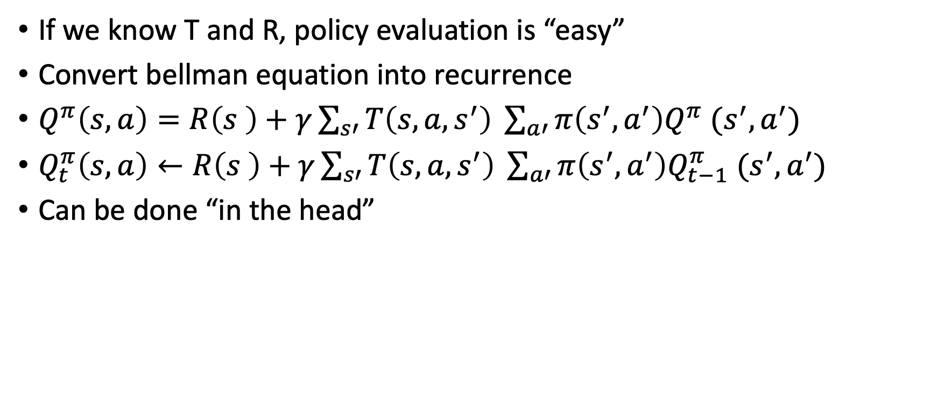
Policy evaluation: (Q-) value iteration
If we know T and R, policy evaluation is “easy”
Convert bellman equation into recurrence
$Q^{π}\left(s,a\right)=R\left(s \right)+γ\sum_{s′}{T\left(s,a,s^{′}\right)} \sum_{a′}{π\left(s^{′},a^{′}\right)Q^{π} (s^{′}, a^{′})}$
$Q_{t}^{π}\left(s,a\right)←R\left(s \right)+γ\sum_{s′}{T\left(s,a,s^{′}\right)} \sum_{a′}{π\left(s^{′},a^{′}\right)Q_{t−1}^{π} (s^{′}, a^{′})}$
Can be done “in the head”

Slide 16
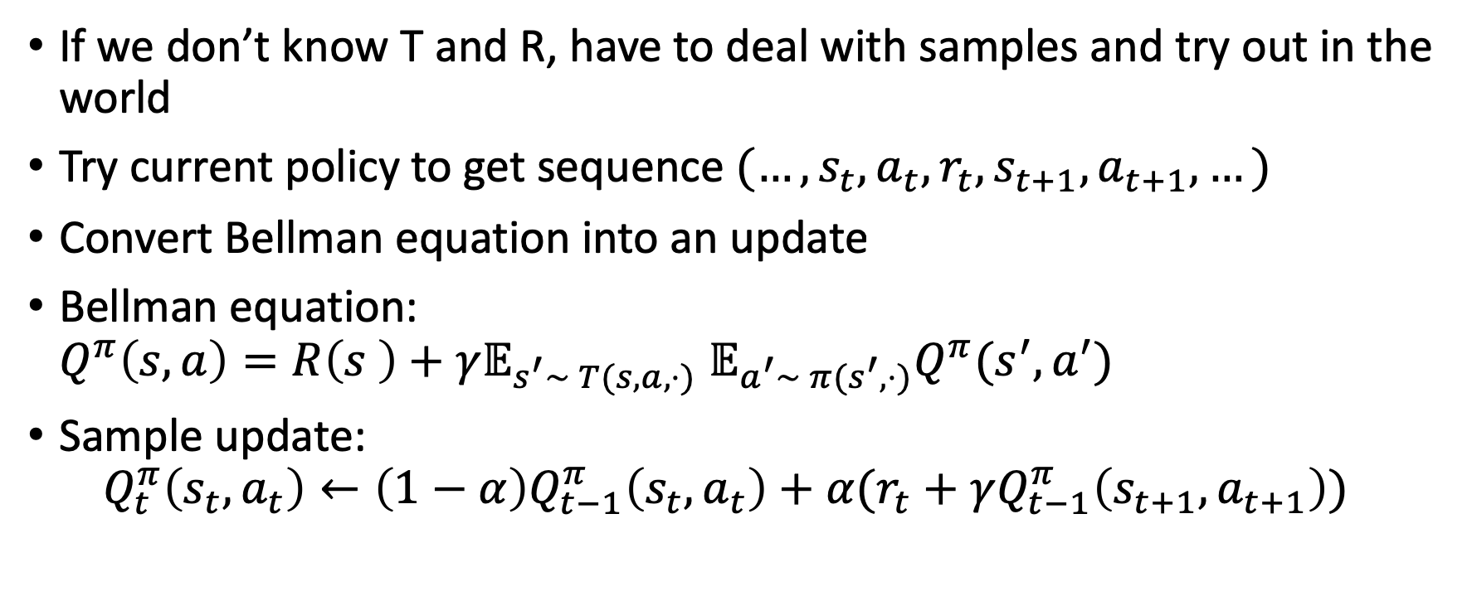
Policy evaluation: sarsa
If we don’t know T and R, have to deal with samples and try out in the world
Try current policy to get sequence $(…,s_{t}, a_{t}, r_{t}, s_{t+1}, a_{t+1}, …)$
Convert Bellman equation into an update
Bellman equation:
$Q^{π}\left(s,a\right)=R\left(s \right)+γ𝔼_{s^{′}\sim T(s, a,⋅)}$ $𝔼_{a^{′}\sim π(s^{′}, ⋅)}Q^{π}(s^{′}, a^{′})$
Sample update:
$Q_{t}^{π}\left(s_{t}, a_{t}\right)←\left(1−α\right)Q_{t−1}^{π}\left(s_{t},a_{t}\right)+α(r_{t}+γQ_{t−1}^{π}\left(s_{t+1}, a_{t+1}\right))$

Slide 17
Basic RL algorithms II: Q-learning
Policy iteration can be slow
Can update policy without waiting for full evaluation
Alternative: learn Q* directly
Act using some random policy, but use observations to find Q*

Slide 18
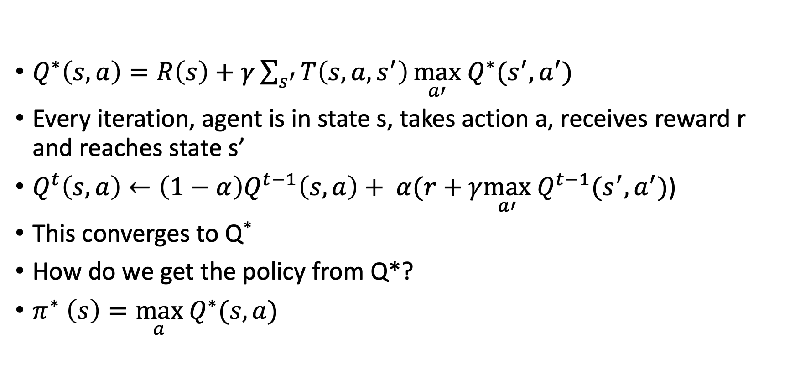
Q-learning
$Q^{∗}\left(s,a\right)=R\left(s\right)+γ\sum_{s^{′}}{T\left(s,a,s^{′}\right)}\max_{a′} Q^{∗}(s^{′},a^{′})$
Every iteration, agent is in state s, takes action a, receives reward r and reaches state s’
$Q^{t}\left(s,a\right)←\left(1−α\right)Q^{t−1}\left(s,a\right)+ α(r+γ\max_{a′} Q^{t−1}(s^{′},a^{′})$)
This converges to Q*
How do we get the policy from Q*?
$π^{∗} \left(s\right)=\max_{a} Q^{∗}(s,a)$

Slide 19
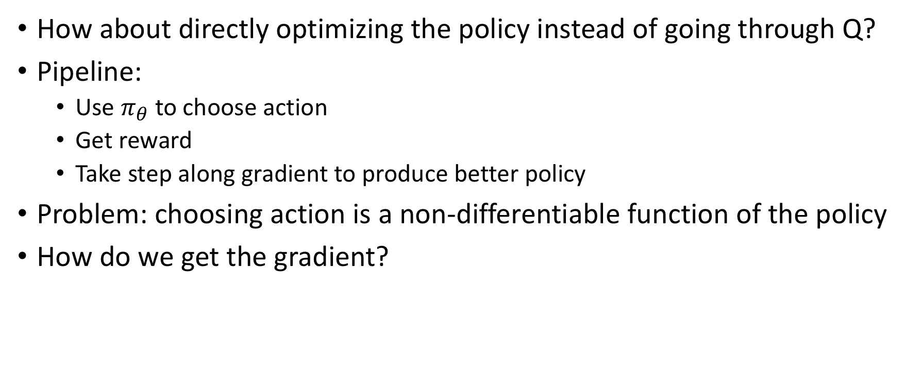
Basic RL algorithms III: Policy gradient
How about directly optimizing the policy instead of going through Q?
Pipeline:
  Use $π_{θ}$ to choose action
  Get reward
  Take step along gradient to produce better policy
Problem: choosing action is a non-differentiable function of the policy
How do we get the gradient?

Slide 20
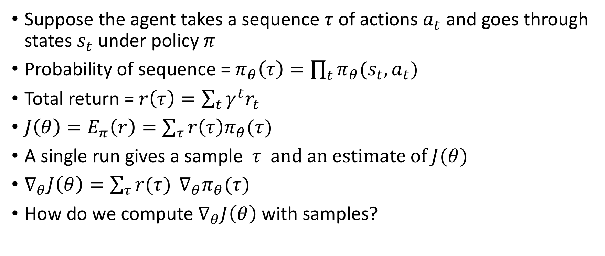
REINFORCE
Suppose the agent takes a sequence $τ$of actions $a_{t}$ and goes through states $s_{t}$ under policy $π$
Probability of sequence = $π_{θ}\left(τ\right)=\prod_{t}{π_{θ}(s_{t},a_{t})}$
Total return = $r\left(τ\right)=\sum_{t}{γ^{t}r_{t}}$
$J\left(θ\right)=E_{π}\left(r\right)=\sum_{τ}{r\left(τ\right)π_{θ}(τ)}$
A single run gives a sample $τ \text{and} \text{an} \text{estimate} \text{of} J(θ)$
$∇_{θ}J\left(θ\right)=\sum_{τ}{r(τ)} ∇_{θ}π_{θ}(τ)$
How do we compute $∇_{θ}J\left(θ\right)$ with samples?

Slide 21
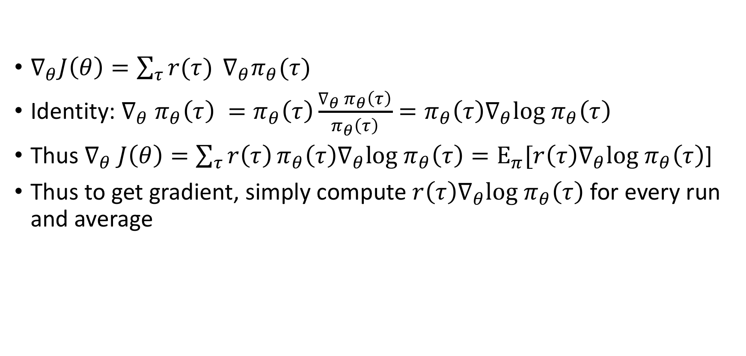
REINFORCE
$∇_{θ}J\left(θ\right)=\sum_{τ}{r(τ)} ∇_{θ}π_{θ}(τ)$
Identity: $∇_{θ} π_{θ}\left(τ\right) =π_{θ}\left(τ\right)\frac{∇_{θ} π_{θ}\left(τ\right)}{π_{θ}\left(τ\right)}=π_{θ}\left(τ\right)∇_{θ}log π_{θ}\left(τ\right)$
Thus $∇_{θ} J\left(θ\right)=\sum_{τ}{r\left(τ\right)}π_{θ}\left(τ\right)∇_{θ}log π_{θ}\left(τ\right)=E_{π}[r\left(τ\right)∇_{θ}log π_{θ}\left(τ\right)$]
Thus to get gradient, simply compute $r\left(τ\right)∇_{θ}log π_{θ}\left(τ\right)$ for every run and average

Slide 22
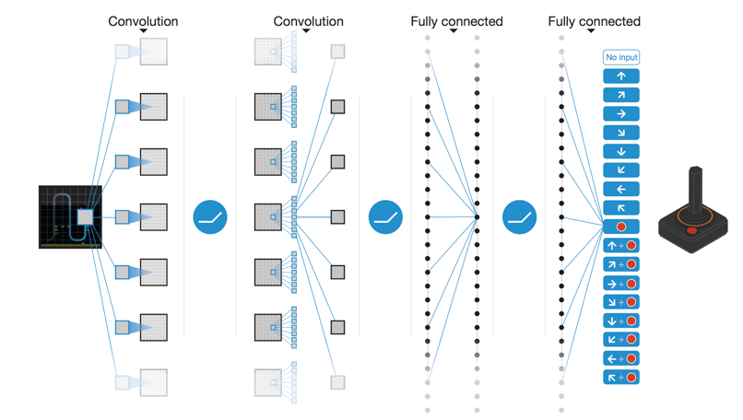
Learning to play Atari games
Mnih, Volodymyr, et al. "Human-level control through deep reinforcement learning." Nature518.7540 (2015): 529-533.

Slide 23
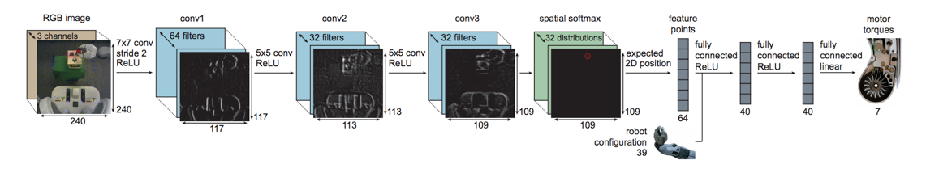
Learning to do robotic tasks
End-to-End Training of Deep Visuomotor Policies. S. Levine, C. Finn, T. Darrell, P. Abbeel. In JMLR, 2016

Slide 24
Reinforcement learning and generalization
RL learns a policy
Policies are specific to goals
Reinforcement learning = learning to play a particular game
Separate model for each game
  “Close this bottle”
  “Peel this banana”
General model?

Slide 25
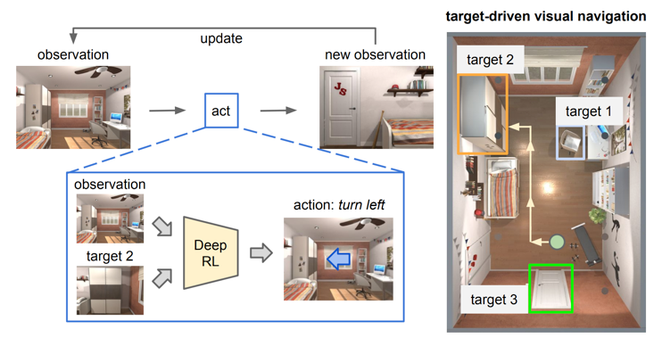
Conditioning on input and target
Target-driven Visual Navigation in Indoor Scenes using Deep Reinforcement Learning. Y. Zhu, R. Mottaghi, E. Kolve, J. J. Lim, A. Gupta, L. Fei-fei, A. Farhadi. In ICRA, 2017

Slide 26
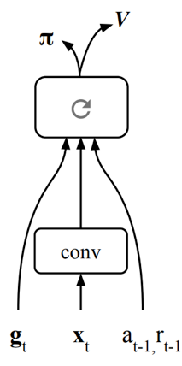
Partial observations
Assumption: image conveys the entire state
True for Atari, not true for real worls
Simple idea: let neural network maintain state internally
Mirowski, Piotr, et al. "Learning to Navigate in Cities Without a Map." arXiv preprint arXiv:1804.00168 (2018).

Slide 27
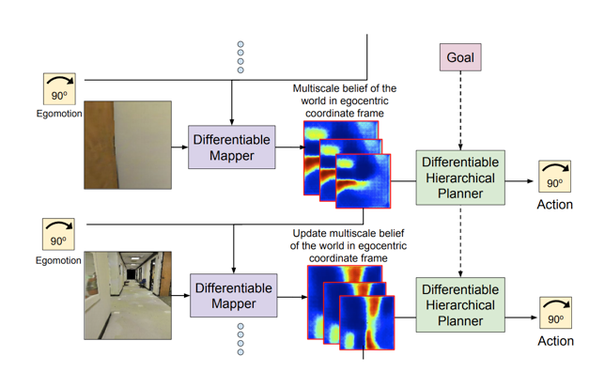
Incorporating domain knowledge
Should we rely on learning entirely?
E.g. for navigation, maintain a map of the environment and of agent’s state within it
Classical solution: SLAM (Simultaneous localization and mapping)
Gupta, Saurabh, et al. "Cognitive mapping and planning for visual navigation." arXiv preprint arXiv:1702.03920 3 (2017).

Slide 28
Reflex agents
Reflex agents
  Map states to actions
  Are feedforward
  Cannot explore / back-track unless state records history
  Have to be trained on each environment

Slide 29
Planning
If we can predict consequences of actions, we can plan

Slide 30
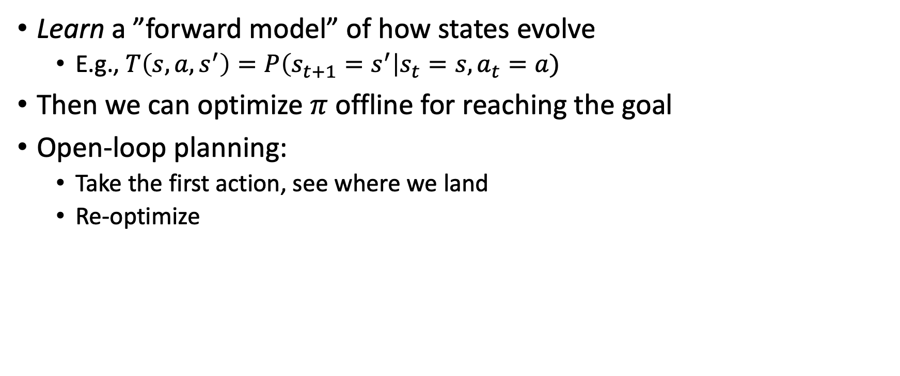
Model-based RL
Learn a ”forward model” of how states evolve
  E.g., $T\left(s,a,s^{′}\right)=P\left(s_{t+1}=s^{′}\right|s_{t}=s, a_{t}=a)$
Then we can optimize $π$ offline for reaching the goal
Open-loop planning:
  Take the first action, see where we land
  Re-optimize

Slide 31
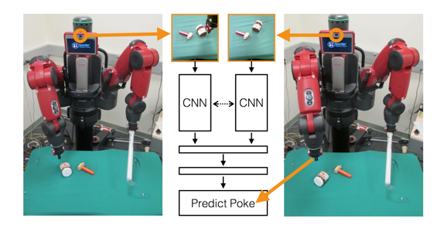
Inverse model
Predicting image pixels is hard
Can also have inverse model: given s and s’, what action takes me from s to s’?
Use inverse model to find an initial action, perform action, then re-evaluate.
Agrawal, Pulkit, et al. "Learning to poke by poking: Experiential learning of intuitive physics." Advances in Neural Information Processing Systems. 2016.

