Slide 1
Recognition on videos

Slide 2
Video classification
Significantly harder to collect data
1 video = hundreds of frames
UCF 101 : 13k videos from 101 actions
HMDB: 7k videos from 51 actions

Slide 3
UCF 101
Recognition of 101 human actions from videos in the wild, Khurram Soomro, Amir Roshan Zamir and Mubarak Shah,
In arXiv preprint arXiv:1212.0402, November, 2012

Slide 4
HMDB 51
H. Kuehne, H. Jhuang, E. Garrote, T. Poggio, and T. Serre. HMDB: A Large Video Database for Human Motion Recognition. ICCV, 2011.

Slide 5
Is a video just a collection of images?

Slide 6
Is a video just a collection of images?

Slide 7
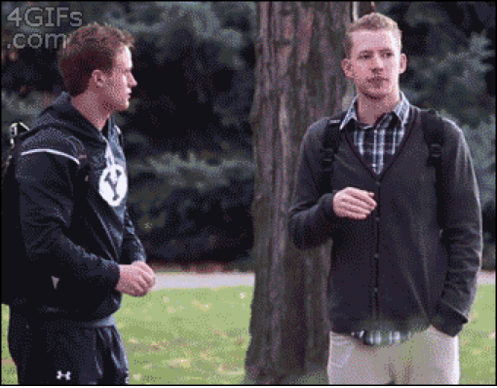
Is a video just a collection of images?

Slide 8
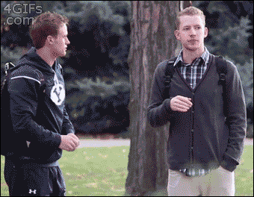
Is a video just a collection of images?

Slide 9
Is a video just a collection of images?
Mostly a question of classes involved
Actions involving object interactions can be identified from single image
  e.g., riding horse, playing tennis, pitching ball
Actions that occur in particular scenes can be identified from single images
  e.g., diving, swimming, rock-climbing

Slide 10
Video recognition with convolutional networks

Slide 11
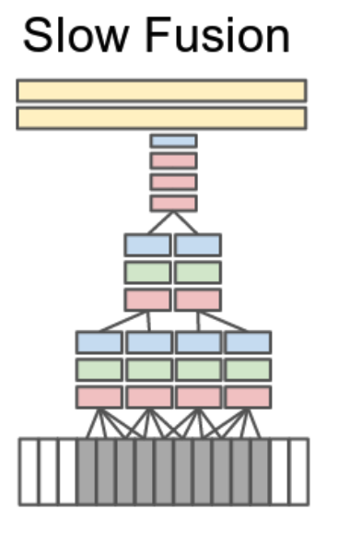
Extending convolutional networks to 3D

Slide 12
Extending convolutional networks to 3D
Method | Accuracy
Best non-deep approach | 85.9%
Temporal convolution | 65.4%

Slide 13
The challenge of applying convnets to videos
Each video = multiple images: memory constraints
Cost of convolution increases with dimension: time constraints

Slide 14
Convnets and Videos
Can’t use pretraining
Can’t train with long videos
3D convolution too expensive

Slide 15
A step back: frame-based convnets
Idea: train single-frame classifier
  Can use pretraining
  Can sample frames from videos
  Cheap
Average scores over frames
Method | Accuracy (UCF 101)
Best classical approach | 85.9%
Temporal convolution | 65.4%
Avg-of-frame-scores | 72.8%

Slide 16
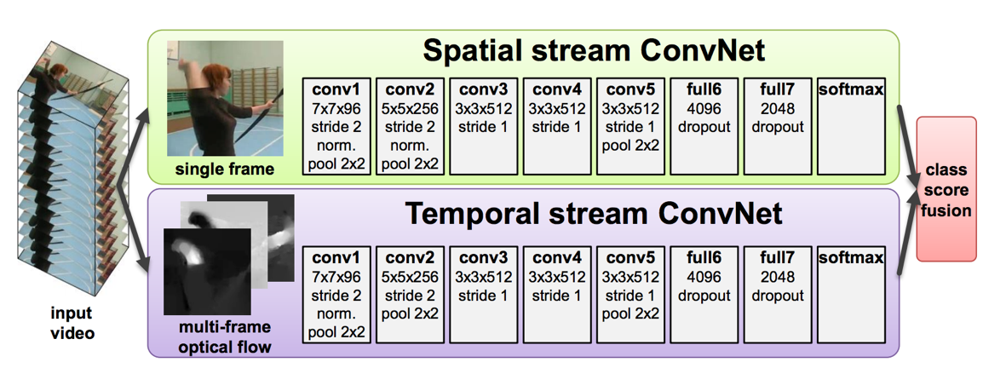
Bringing back motion
How do we take motion into account?
Key idea: use optical flow
Add flow as additional channel?
  Can’t use pretraining!
Idea: Use two-stream architecture

Slide 17
Bringing back motion
Method | Accuracy (UCF 101)
Best dense trajectories + bag-of-words | 85.9%
Temporal convolution | 65.4%
Avg-of-frame-scores (color) | 72.8%
Avg-of-frame-scores (flow) | 81.2%
Avg-of-frame-scores (both) | 86.2%
Two-Stream Convolutional Networks for Action Recognition in Videos. Karen Simonyan and Andrew Zisserman. In NIPS, 2014.

Slide 18
Beyond frame averaging
Do better than averaging frames?
  without increasing cost!
Idea: video is sequence of frames
Convnet converts each frame into feature vector
Sequence of feature vectors → class scores?

Slide 19
Detour: Sequence modeling

Slide 20
Sequence modeling
Internal state h
Observations x
See observations over time
Update state
h₁
h₂
h₃
f
f
f
x₁
x₂
x₃
Recurrent Neural Networks (RNNs)

Slide 21
Problem: vanishing/exploding gradients

Slide 22
“Long Short-term Memory”
Instead of repeated applications of arbitrary function f
Have repeated application of something that does not decay or scale up
  Addition!

Slide 23
(Not) LSTM - 1

Slide 24
(Not) LSTM - 2

Slide 25
(Not) LSTM - 3

Slide 26
(Not) LSTM - 3
Long Short-Term Memory. Sepp Hochreiter and Jurgen Schmidhuber. In Neural Computation

Slide 27
Using LSTMs for frame accumulation
Method | Accuracy (UCF 101)
Simple average | 78.9%
LSTM | 82.3%
Long-term Recurrent Convolutional Networks. J. Donahue, L. A. Hendricks, S. Guadarrama, M. Rohrbach, S. Venugopalan, K. Saenko, T. Darrell. In CVPR, 2015.

Slide 28
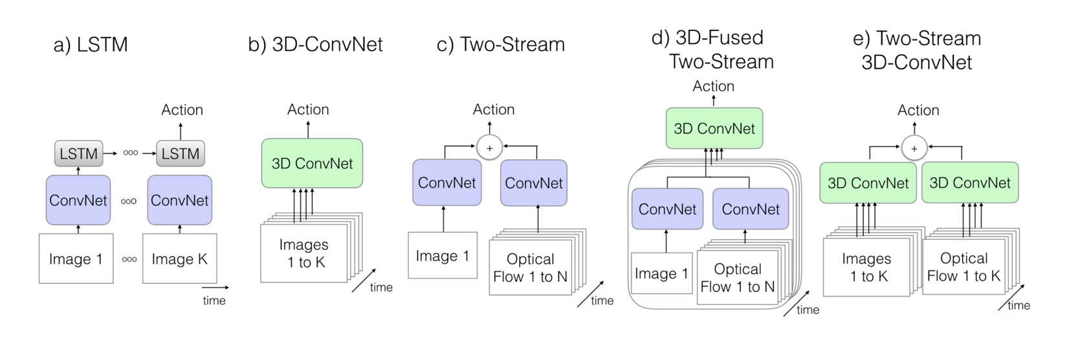
Revisiting video classification architectures
Quo Vadis, Action Recognition? A New Model and the Kinetics Dataset. J. Carreira and A. Zisserman. In CVPR, 2017.

Slide 29
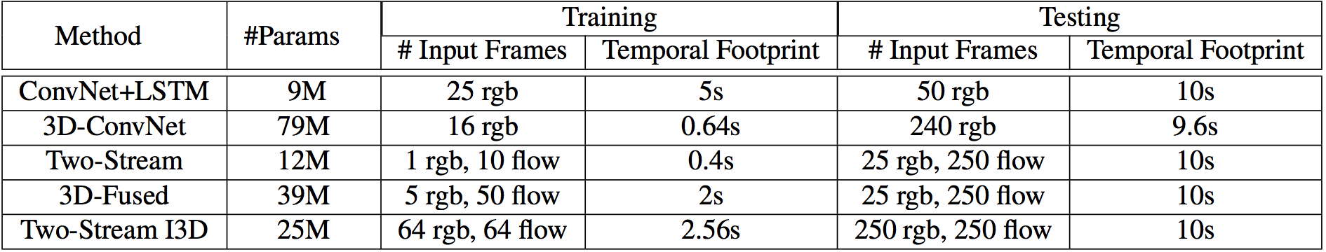
Revisiting video classification architectures

Slide 30
Pre-training 3D convolutional networks

Slide 31
Pre-training 3D convolutional networks

Slide 32
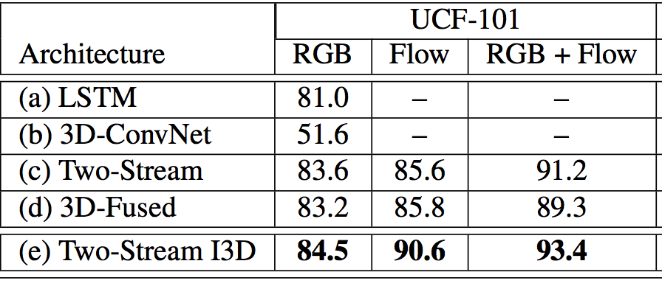
Revisiting video classification architectures

Slide 33
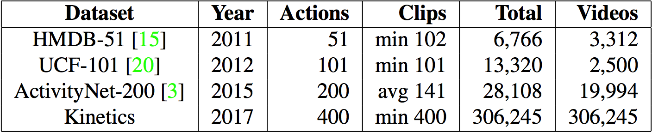
Towards better video datasets
The Kinetics Human Action Video Dataset. Kay, Will et al. Arxiv 2017.

Slide 34
Other video problems
Action “detection / localization” in time
Temporally consistent object detection / semantic segmentation
Tracking

Slide 35
Vision and Language

Slide 36
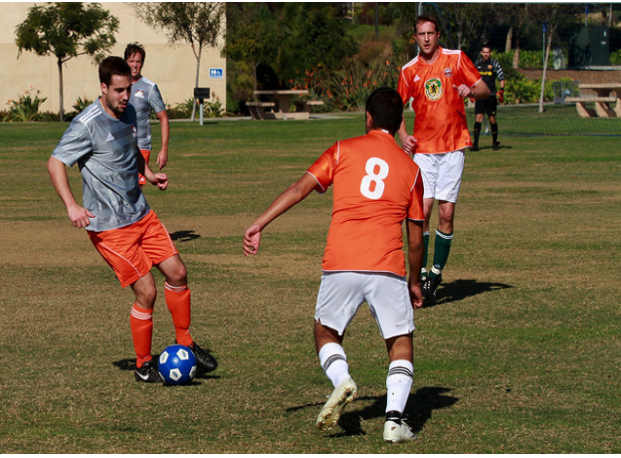
Image captioning - The task
A group of young men playing soccer.

Slide 37
Image captioning - why?
Alt-text for visually impaired
Test for true understanding?

Slide 38
Image captioning - evaluation
Given computer-generated caption and human caption, compute match
BLEU from machine translation community
Computes (modified) n-gram precision
Reference: A group of people playing soccer
Candidate: People playing baseball.
BLEU: 1/3

Slide 39
Image captioning
Long-term Recurrent Convolutional Networks. J. Donahue, L. A. Hendricks, S. Guadarrama, M. Rohrbach, S. Venugopalan, K. Saenko, T. Darrell. In CVPR, 2015.
Deep Visual-Semantic Alignments for Generating Image Descriptions. Andrej Karpathy and Li Fei-Fei. In CVPR, 2015
Show and tell: A neural image caption generator
Oriol Vinyals, Alexander Toshev, Samy Bengio, Dumitru Erhan. In CVPR, 2015.

Slide 40
Generating sequences with LSTMs
…
x₁
x₂
x₃

Slide 41
Generating sequences with LSTMs
y₁
y₂
y₃
…
x₁
x₂
x₃

Slide 42
Generating sequences with LSTMs
A
group
of
p₁
p₂
p₃
…
x
x
x

Slide 43
Evaluation Metrics
Slide credit: Larry Zitnick

Slide 44
Evaluation Metrics
Human captions
Slide credit: Larry Zitnick

Slide 45
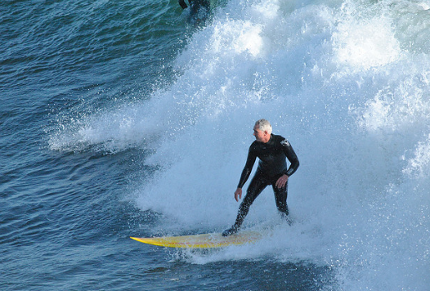
A man riding a wave on a surfboard in the water.
Slide credit: Larry Zitnick

Slide 46
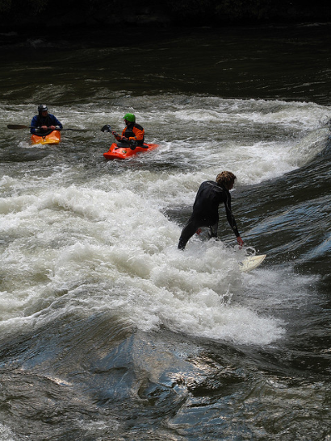
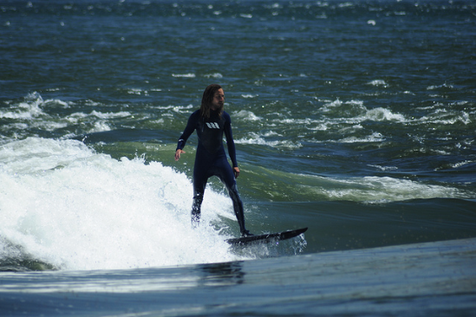
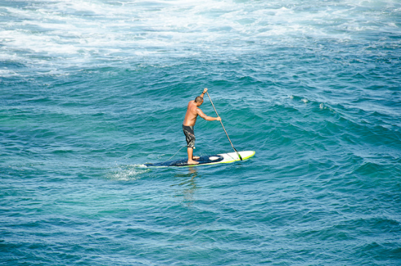
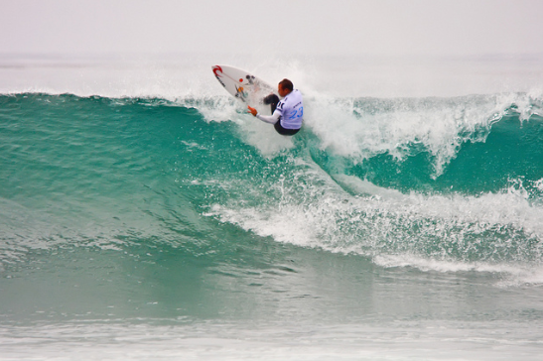
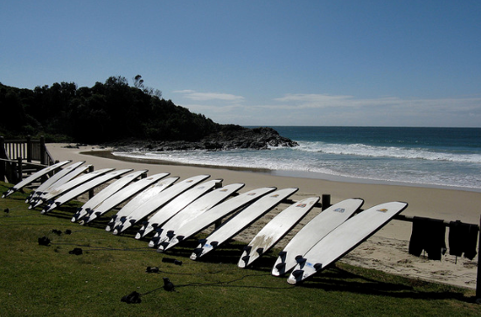
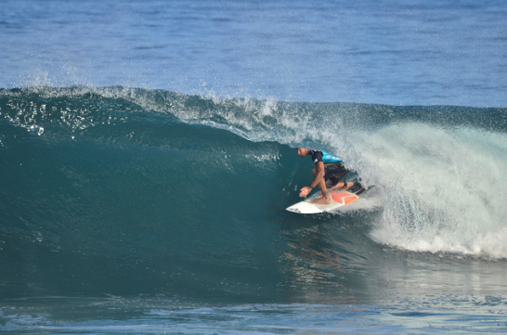
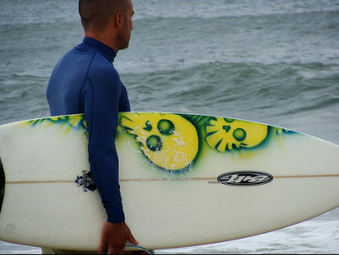
A man riding a wave on a surfboard in the water.
“surfboard”
Slide credit: Larry Zitnick

Slide 47
The post-captioning world
Captioning is hard to evaluate!
  Frame task so that it is easy to evaluate objectively
Datasets are biased!
  Control dataset bias

Slide 48
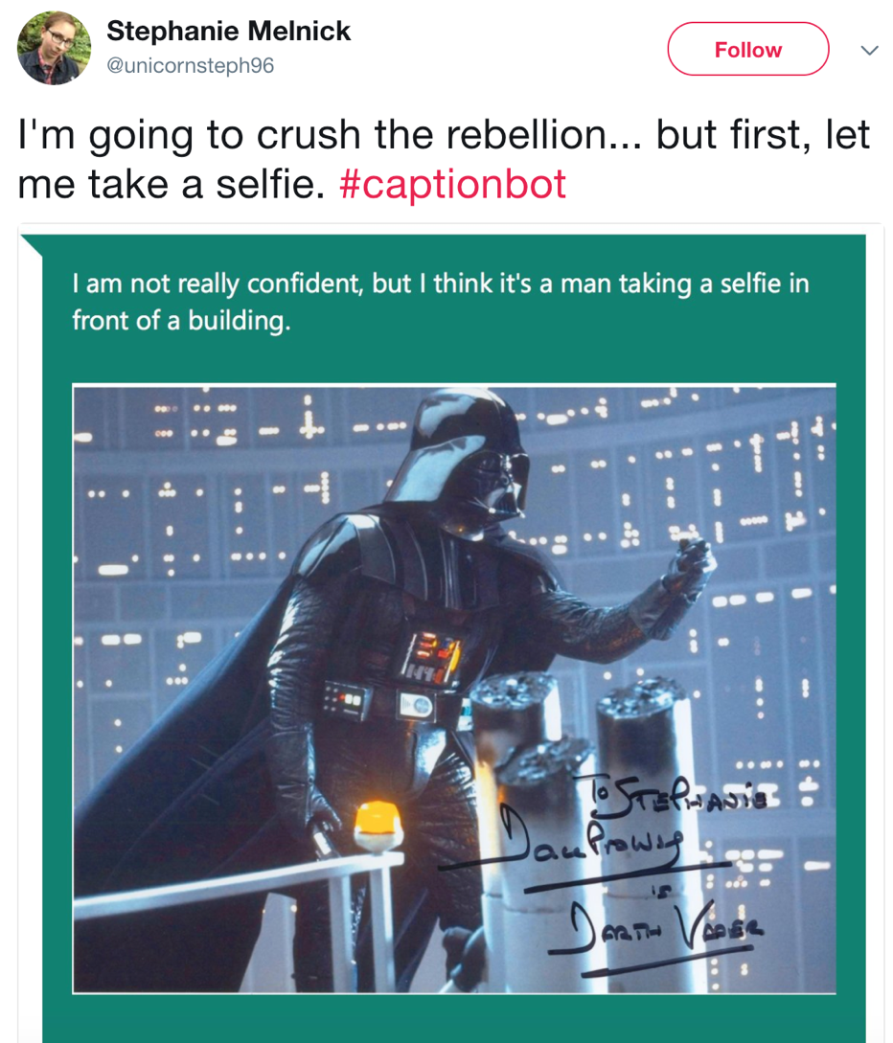

Slide 49
Reasoning
Want vision systems to reason about what is going on
  Identify objects and scenes
  Identify relationships between objects
  Understand physics of the world
  Understand social interactions, intent etc.
  Incorporate knowledge: common sense, pop culture, …

Slide 50
Visual Question Answering
Direct motivation: assistive technology
Indirect motivation: sandbox for reasoning
VQA: Visual Question Answering. Aishwarya Agrawal, Jiasen Lu, Stanislaw Antol, Margaret Mitchell, C. Lawrence Zitnick, Dhruv Batra, Devi Parikh. In ICCV, 2015.

Slide 51
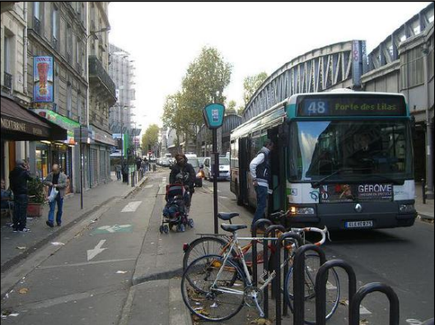
Visual Question Answering
“We have built a smart robot. It understands a lot about images. It can recognize and name all the objects, it knows where the objects are, it can recognize the scene (e.g., kitchen, beach), people’s expressions and poses, and properties of objects (e.g., color of objects, their texture). Your task is to stump this smart robot! Ask a question about this scene that this smart robot probably can not answer, but any human can easily answer while looking at the scene in the image.”

Slide 52
Methods for VQA
Answer
Standard recognition CNN
How
many
bikes
are
there
?

Slide 53
Methods for VQA
Answer
Standard recognition CNN
…
How
many
bikes
are
there
?
Z. Yang, X. He, J. Gao, L. Deng, and A. Smola. Stacked attention networks for image question answering. In CVPR, 2016

Slide 54
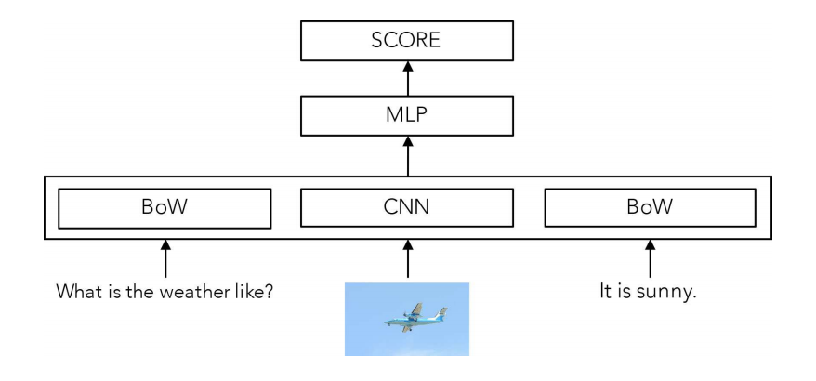
The Unreasonable Effectiveness of Baselines
A. Jabri, A. Joulin, L. van der Maaten. Revisiting visual question answering baselines. In ECCV, 2016.

Slide 55
Compositional reasoning
What is the color of the kitten to the left of the blue kitten?

Slide 56
Compositional reasoning
What is the color of the kitten to the left of the blue kitten?
Detect kittens
And
Look left
Detect blueness
Get color

Slide 57
Compositional reasoning
Triangle detector
Look left
Look left
Blue detector
Triangle detector
And
Get color
Get color
Red

Slide 58
Compositional reasoning
What is the color of the kitten to the left of the blue kitten?
Kitten detector
Look left
Blue detector
And
Get color

Slide 59
Compositional reasoning
What is the color of the kitten to the left of the blue kitten?
Kitten detector
Look left
Kitten detector
Blue detector
And
Look left
Get color
And
Blue detector
Get color

Slide 60
Compositional reasoning
How do we learn a mapping from language to trees?
  Problem: semantic parsing
  Option 1: Syntactic parsing
  Option 2: Use supervision
Neural module networks.Jacob Andreas, Marcus Rohrbach, Trevor Darrell and Dan Klein.CVPR 2016
Learning to compose neural networks for question answering.Jacob Andreas, Marcus Rohrbach, Trevor Darrell and Dan Klein.NAACL 2016
Learning to reason: End-to-end module networks for visual question answering.Ronghang Hu, Jacob Andreas, Marcus Rohrbach, Trevor Darrell and Kate Saenko.ICCV 2017
Inferring and Executing Programs for Visual Reasoning
Justin Johnson, Bharath Hariharan, Laurens van der Maaten, Judy Hoffman, Li Fei-Fei, C. Lawrence Zitnick, Ross Girshick. ICCV, 2017

Slide 61
Compositional reasoning

Slide 62
The problem with VQA
Dataset biases allow cheating
  Only-question Bag-of-Words: 53.7% (vs ~65% for state-of-the-art)
Require common sense to answer
  “What is the moustache made of?”
Hard to diagnose error
  Is the problem understanding the question?
  Or understanding the image?

Slide 63
Clever Hans

Slide 64
Current state of vision and language
Still an active area of research
Much better datasets but…
Non-compositional models still win out
The search for a better task continues

