Slide 1
Training and optimization

Slide 2
Stochastic gradient descent
Gradient on single example = unbiased sample of true gradient
Idea: at each iteration sample single example x^{(t)}
Con: variance in estimate of gradient → slow convergence, jumping near optimum
step size

Slide 3
Minibatch stochastic gradient descent
Compute gradient on a small batch of examples
Same mean (=true gradient), but variance inversely proportional to minibatch size

Slide 4
Momentum
Average multiple gradient steps
Use exponential averaging

Slide 5
Weight decay
Add -aw^{(t)} to the gradient
Prevents w^{(t)} from growing to infinity
Equivalent to L2 regularization of weights

Slide 6
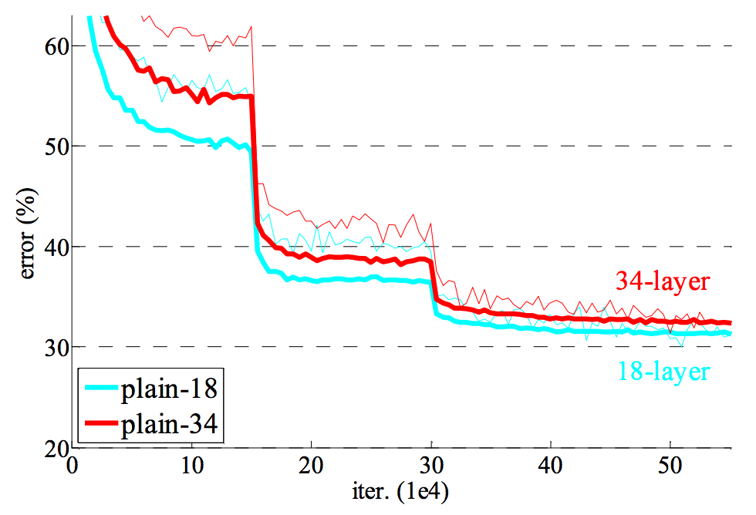
Learning rate decay
Large step size / learning rate
  Faster convergence initially
  Bouncing around at the end because of noisy gradients
Learning rate must be decreased over time
Usually done in steps

Slide 7
Convolutional network training
Initialize network
Sample minibatch of images
Forward pass to compute loss
Backpropagate loss to compute gradient
Combine gradient with momentum and weight decay
Take step according to current learning rate

Slide 8
Beyond sequences: computation graphs
Multi-layer perceptrons and first convolutional networks were sequences of functions
In general, can have arbitrary DAGs of functions
g
k
u
x
f
l
y
h
w

Slide 9
Computation graphs
Each node implements two methods
  A “forward”
    Computes output given input
  A “backward”
    Computes derivative of z w.r.t input, given derivative of z w.r.t output

Slide 10
Computation graphs
a
f_{i}
b
d
c

Slide 11
Computation graphs
f_{i}

Slide 12
Exploring convnet architectures

Slide 13
Deeper is better
7 layers
16 layers

Slide 14
Deeper is better
Alexnet
VGG16

Slide 15
The VGG pattern
Every convolution is 3x3, padded by 1
Every convolution followed by ReLU
ConvNet is divided into “stages”
  Layers within a stage: no subsampling
  Subsampling by 2 at the end of each stage
Layers within stage have same number of channels
Every subsampling → double the number of channels

Slide 16
Challenges in training: exploding / vanishing gradients
Vanishing / exploding gradients
  If each term is (much) greater than 1 → explosion of gradients
  If each term is (much) less than 1 → vanishing gradients

Slide 17
Challenges in training: dependence on init

Slide 18
Solutions
Careful init
Batch normalization
Residual connections

Slide 19
Careful initialization
Key idea: want variance to remain approx. constant
  Variance increases in backward pass => exploding gradient
  Variance decreases in backward pass => vanishing gradient
“MSRA initialization”
  weights = Gaussian with 0 mean and variance = 2/(k*k*d)
Delving Deep into Rectifiers: Surpassing Human-Level Performance on ImageNet Classification. K. He, X. Zhang, S. Ren, J. Sun

Slide 20
Batch normalization
Key idea: normalize so that each layer output has zero mean and unit variance
  Compute mean and variance for each channel
  Aggregate over batch
  Subtract mean, divide by std
Need to reconcile train and test
  No ”batches” during test
  After training, compute means and variances on train set and store
Batch Normalization: Accelerating Deep Network Training by Reducing Internal Covariate Shift. S. Ioffe, C. Szegedy. In ICML, 2015.

Slide 21
Residual connections
In general, gradients tend to vanish
Key idea: allow gradients to flow unimpeded

Slide 22
Residual connections
In general, gradients tend to vanish
Key idea: allow gradients to flow unimpeded

Slide 23
Residual connections
Assumes all z_{i} have the same size
True within a stage
Across stages?
  Doubling of feature channels
  Subsampling
Increase channels by 1x1 convolution
Decrease spatial resolution by subsampling

Slide 24
A residual block
Instead of single layers, have residual connections over block
Conv
BN
ReLU
Conv
BN

Slide 25
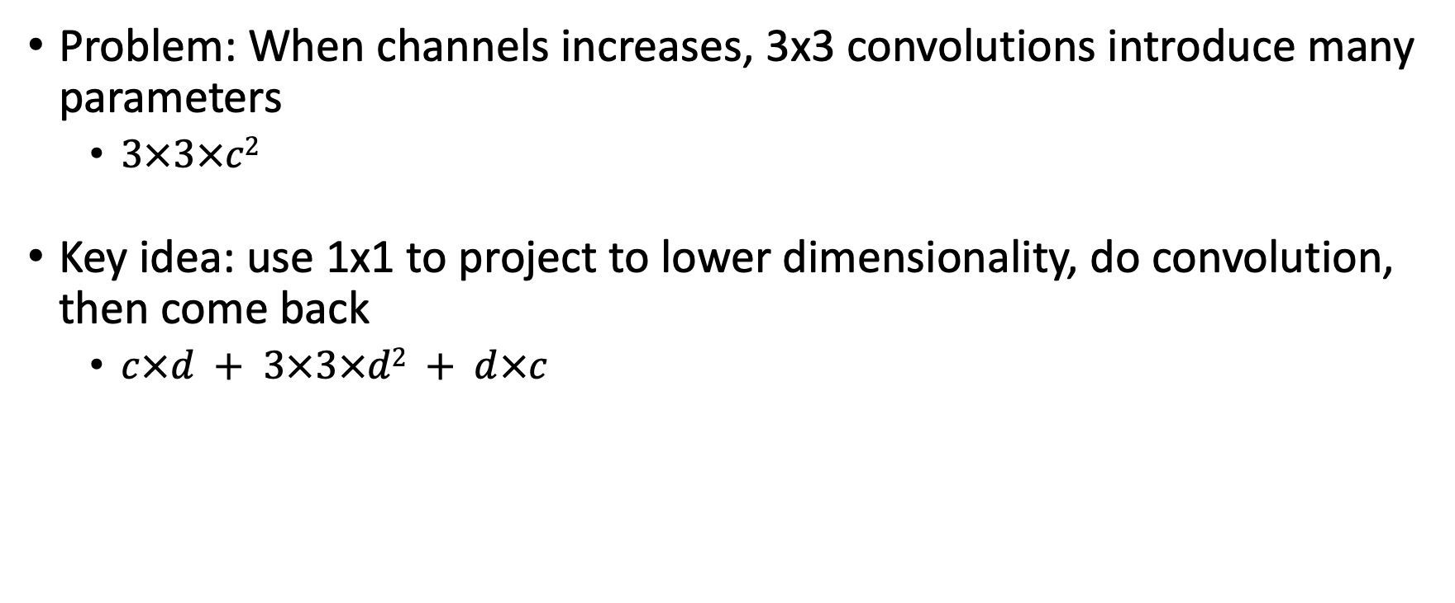
Bottleneck blocks
Problem: When channels increases, 3x3 convolutions introduce many parameters
  $3×3×c2$
Key idea: use 1x1 to project to lower dimensionality, do convolution, then come back
  $c×d + 3×3×d2 + d×c$

Slide 26
The ResNet pattern
Decrease resolution substantially in first layer
  Reduces memory consumption due to intermediate outputs
Divide into stages
  maintain resolution, channels in each stage
  halve resolution, double channels between stages
Divide each stage into residual blocks
At the end, compute average value of each channel to feed linear classifier

Slide 27
Putting it all together - Residual networks

Slide 28
Computational complexity

Slide 29
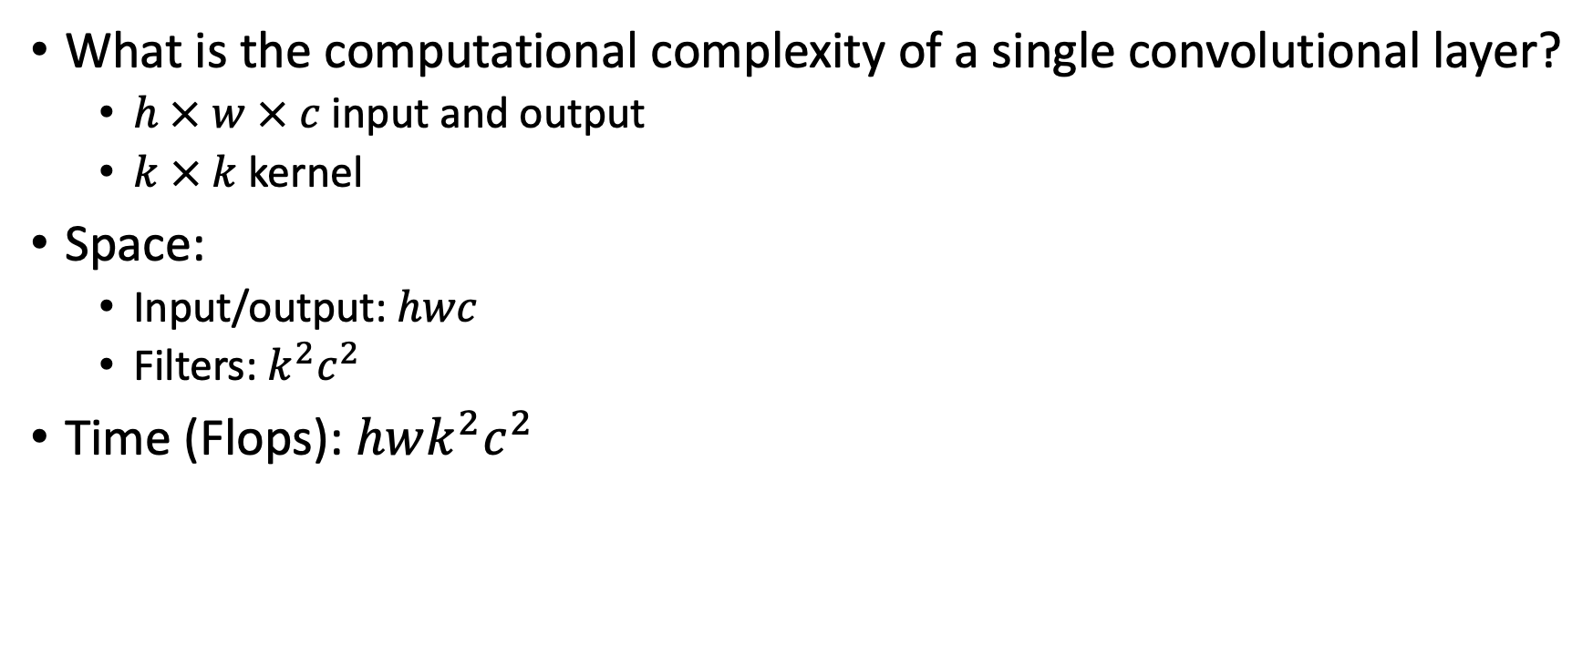
Analyzing computational complexity
What is the computational complexity of a single convolutional layer?
  $h × w × c$input and output
  $k × k$kernel
Space:
  Input/output: $hwc$
  Filters: $k^{2}c^{2}$
Time (Flops): $hwk^{2}c^{2}$

Slide 30
Reducing computational complexity
…while maintaining accuracy?
Multiple ways:
  Make architecture a priori cheaper
  Make weights and operations cheaper
  Make inference adaptive

Slide 31
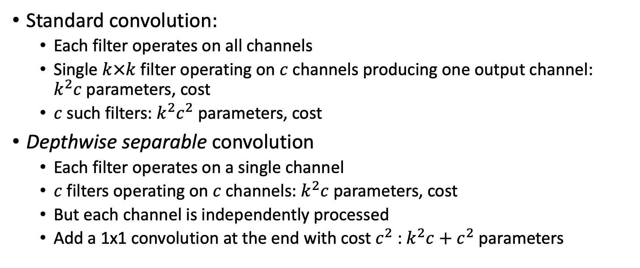
Cheaper convolutional blocks
Standard convolution:
  Each filter operates on all channels
  Single $k×k$filter operating on $c$ channels producing one output channel: $k^{2}c$parameters, cost
  $c$ such filters: $k^{2}c^{2}$parameters, cost
Depthwise separable convolution
  Each filter operates on a single channel
  $c$ filters operating on $c$ channels: $k^{2}c$ parameters, cost
  But each channel is independently processed
  Add a 1x1 convolution at the end with cost $c^{2}$ : $k^{2}c+c^{2}$ parameters

Slide 32
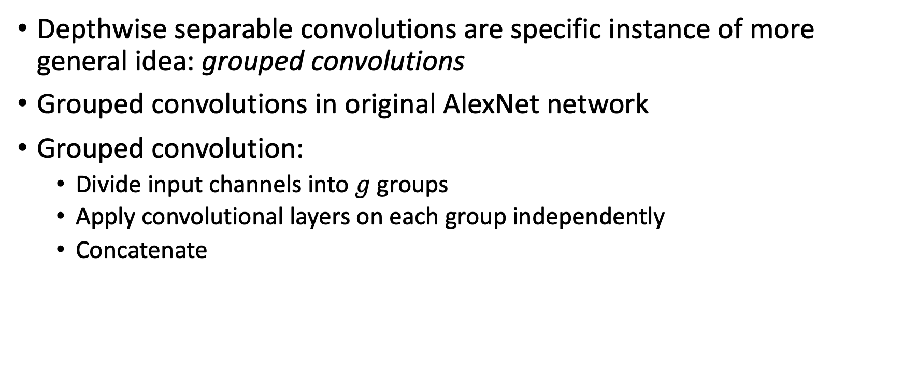
Cheaper convolutional blocks
Depthwise separable convolutions are specific instance of more general idea: grouped convolutions
Grouped convolutions in original AlexNet network
Grouped convolution:
  Divide input channels into $g$ groups
  Apply convolutional layers on each group independently
  Concatenate

Slide 33
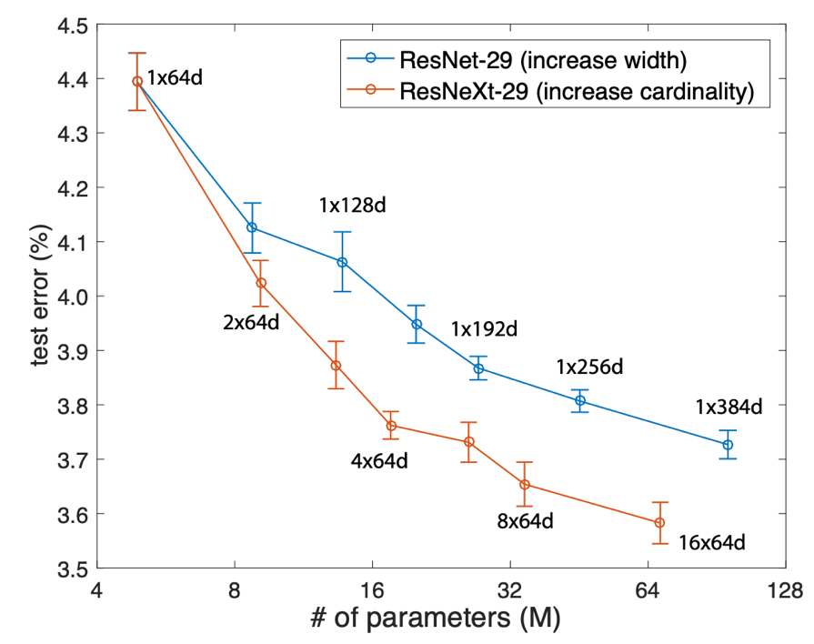
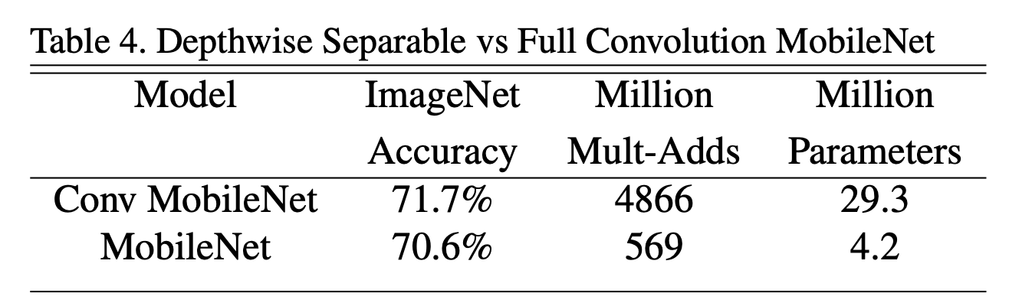
Grouped and depth-wise convolutions
Xie, Saining, et al. "Aggregated residual transformations for deep neural networks." Proceedings of the IEEE conference on computer vision and pattern recognition. 2017.
Howard, Andrew G., et al. "Mobilenets: Efficient convolutional neural networks for mobile vision applications." arXiv preprint arXiv:1704.04861 (2017).

Slide 34
Other architectural changes
Biggest memory consumption: large feature maps
Expensive feature maps
VGG 19
Image

Slide 35
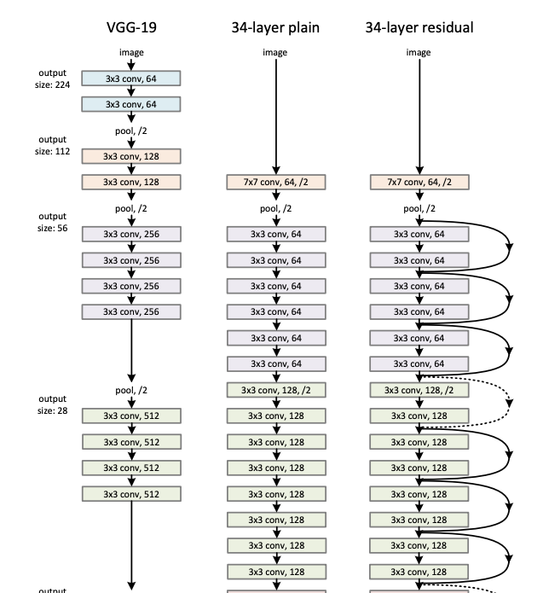
Other architectural changes
Biggest memory consumption: large feature maps
Simple solution: reduce resolution early

Slide 36
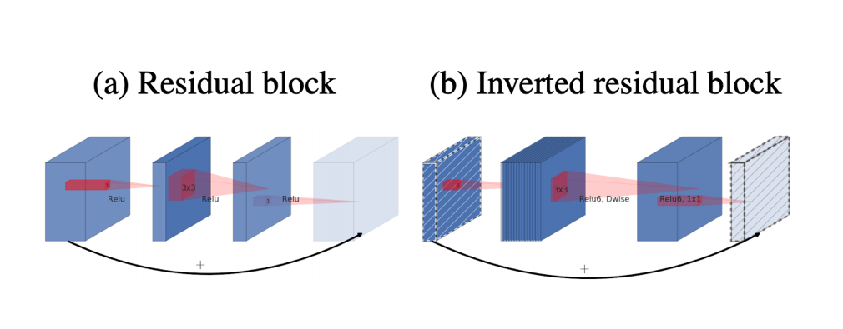
Other architectural changes
Biggest memory consumption: large feature maps
Simple solution (ResNet):
  Reduce resolution drastically (/4) early
More sophisticated changes: Inverted residuals (MobileNet v2)
Sandler, Mark, et al. "Mobilenetv2: Inverted residuals and linear bottlenecks." Proceedings of the IEEE Conference on Computer Vision and Pattern Recognition. 2018.
Dispose of these

Slide 37
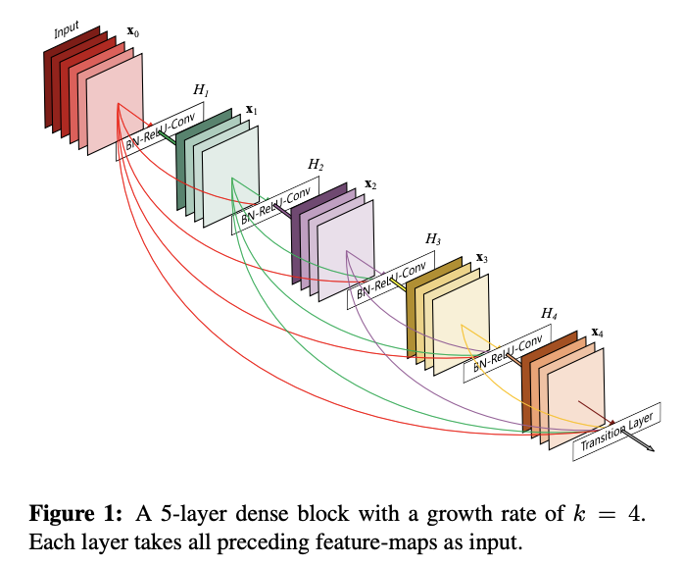
Other kinds of connections
DenseNets
  Replace addition of residuals with concatenation
  Alternative to solving vanishing gradient problem
  Should increase number of parameters, but decreases them
  Better re-use of features

Slide 38
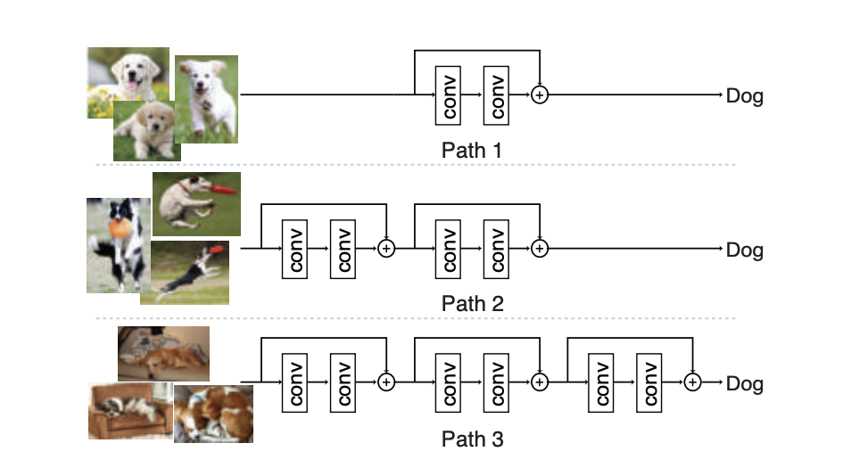
Adaptive inference
Some examples are harder than others
Should be able to use different amounts of computation for different examples
Version 1: skip some residuals
Veit, Andreas, and Serge Belongie. "Convolutional networks with adaptive inference graphs." Proceedings of the European Conference on Computer Vision (ECCV). 2018.
Wu, Zuxuan, et al. "Blockdrop: Dynamic inference paths in residual networks." Proceedings of the IEEE Conference on Computer Vision and Pattern Recognition. 2018.

Slide 39
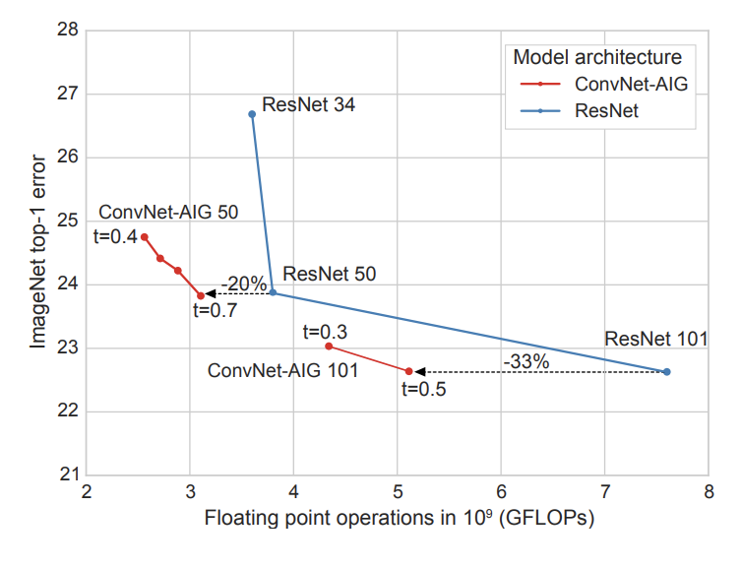
Adaptive inference
Some examples are harder than others
Should be able to use different amounts of computation for different examples
Version 1: skip some residuals
Veit, Andreas, and Serge Belongie. "Convolutional networks with adaptive inference graphs." Proceedings of the European Conference on Computer Vision (ECCV). 2018.
Wu, Zuxuan, et al. "Blockdrop: Dynamic inference paths in residual networks." Proceedings of the IEEE Conference on Computer Vision and Pattern Recognition. 2018.

Slide 40
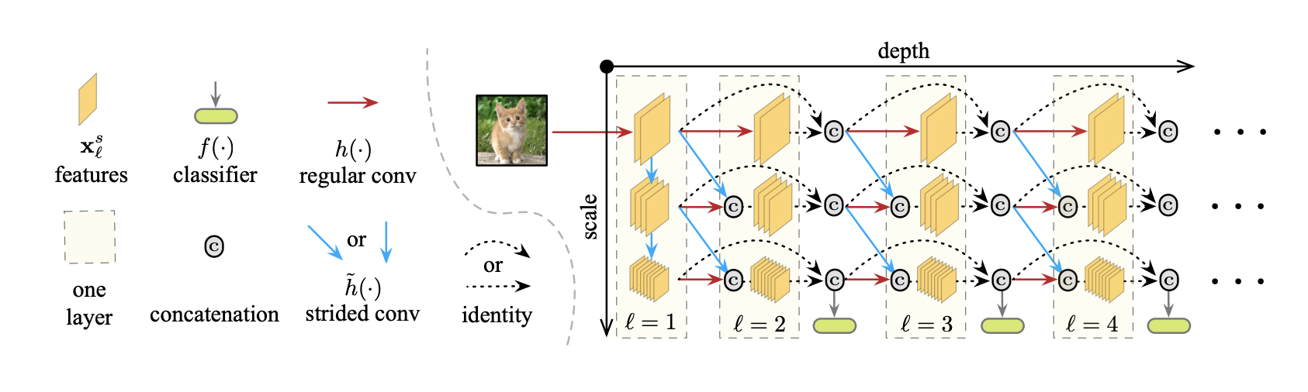
Adaptive inference
Some examples are harder than others
Should be able to use different amounts of computation for different examples
Version 2: reduce resolution at different rates
Huang, Gao, et al. "Multi-scale dense networks for resource efficient image classification." ICLR 2018

Slide 41
Compressing model weights
All of model storage: filters
Flops also scale with non-zero entries in filters (in principle)
Compress filters
  Sparsify them
  Represent them with fewer bits

Slide 42
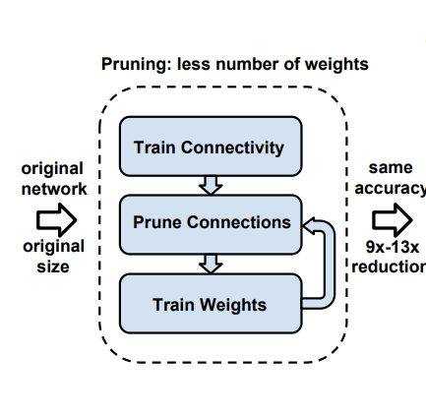
Pruning network connections
Simple approach: prune weights that are below a threshold
Retrain rest of the weights
Repeat
Han, Song, Huizi Mao, and William J. Dally. "Deep compression: Compressing deep neural networks with pruning, trained quantization and huffman coding." ICLR, 2016

Slide 43
Pruning network connections
Simple approach: prune weights that are below a threshold
Retrain rest of the weights
Repeat
Sophisticated alternative
  Train with regularizer that penalizes expensive connections
  Prune
  If model within budget, expand and retrain
Gordon, Ariel, et al. "Morphnet: Fast & simple resource-constrained structure learning of deep networks." Proceedings of the IEEE Conference on Computer Vision and Pattern Recognition. 2018.

Slide 44
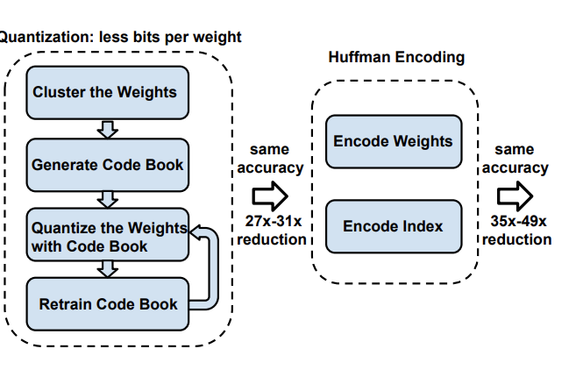
Filter quantization
Two questions:
  How do we quantize?
  Quantization → discrete values. How do we optimize?
Example 1: cluster
  Weights → indices into dictionary
  Update dictionary elements as parameters.
Han, Song, Huizi Mao, and William J. Dally. "Deep compression: Compressing deep neural networks with pruning, trained quantization and huffman coding." ICLR, 2016

Slide 45
Filter quantization
Two questions:
  How do we quantize?
  Quantization → discrete values. How do we optimize?
Example 2: binarize/ternarize
  Weights → binary/ternary, + real-valued scale
  Parameter updates happen in real space
Zhu, Chenzhuo, et al. "Trained ternary quantization." ICLR, 2017.
Rastegari, Mohammad, et al. "Xnor-net: Imagenet classification using binary convolutional neural networks." European Conference on Computer Vision. Springer, Cham, 2016.

