Slide 1
Multilayer perceptrons
Key idea: build complex functions by composing simple functions
f(x) = Wx
g(x) = max(x,0)
f(x) = Wx
g(x) = max(x,0)
f(x) = Wx

Slide 2
Multilayer perceptrons
Key idea: build complex functions by composing simple functions
Caveat: simple functions must include non-linearities
W(U(Vx)) = (WUV)x

Slide 3
Reducing capacity
256
65K
256

Slide 4
Reducing capacity
W
65K
65K
65K

Slide 5
Idea 1: local connectivity
Inputs and outputs are feature maps
Pixels only related to nearby pixels

Slide 6
Idea 2: Translation invariance
Pixels only related to nearby pixels

Slide 7
Local connectivity + translation invariance = convolution
5.4 | 0.1 | 3.6
1.8 | 2.3 | 4.5
1.1 | 3.4 | 7.2

Slide 8
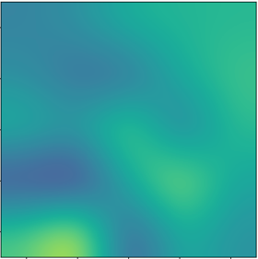
Local connectivity + translation invariance = convolution
5.4 | 0.1 | 3.6
1.8 | 2.3 | 4.5
1.1 | 3.4 | 7.2

Slide 9
Local connectivity + translation invariance = convolution
Feature map
5.4 | 0.1 | 3.6
1.8 | 2.3 | 4.5
1.1 | 3.4 | 7.2

Slide 10
Convolution as a primitive
c
c
c’
c’
Convolution
h
h
w
w

Slide 11
Invariance to distortions

Slide 12
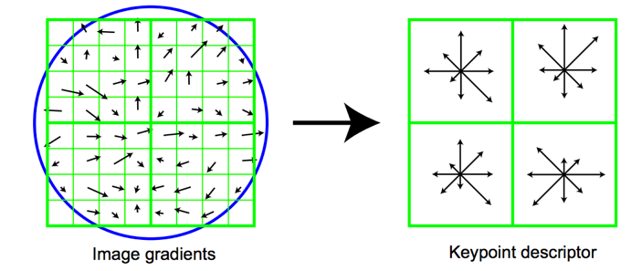
Invariance to distortions

Slide 13
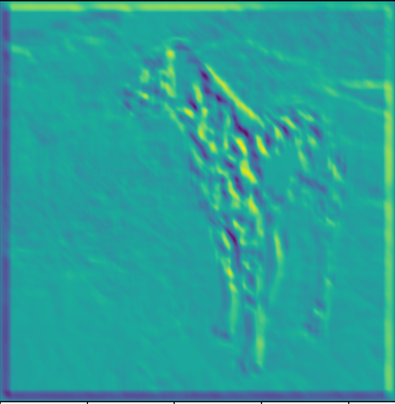
Invariance to distortions: Pooling
…

Slide 14
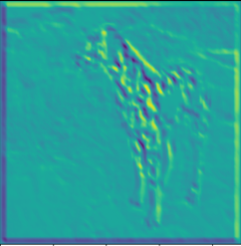
Invariance to distortions: Subsampling

Slide 15
Convolution subsampling convolution

Slide 16
Convolution subsampling convolution
Convolution in earlier steps detects more local patterns less resilient to distortion
Convolution in later steps detects more global patterns more resilient to distortion
Subsampling allows capture of larger, more invariant patterns

Slide 17
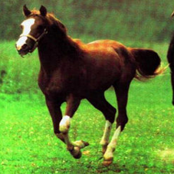
Convolutional networks
Horse

Slide 18
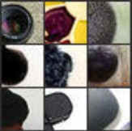
Convolutional networks
Horse
Visualizations from : M. Zeiler and R. Fergus. Visualizing and Understanding Convolutional Networks. In ECCV 2014.
Notes:
In contrast, if you look at the earlier layers, this particular unit here really likes a dark blob at a very precise location and scale in its field of view. If this unit fired, you will know exactly where the dark blob was. Unfortunately, this unit doesn’t care about the actual semantics of the dark blob: you will have no idea what the dark blob actually is.

Slide 19
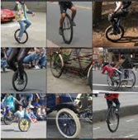
Convolutional networks
Horse
Visualizations from : M. Zeiler and R. Fergus. Visualizing and Understanding Convolutional Networks. In ECCV 2014.
Notes:
If you look at what one of these higher layers is detecting, here I am showing the input image patches that are highly scored by one of the units. This particular layer really likes bicycle wheels, so if this unit fires, you know that there is a bicycle wheel in the image. Unfortunately, you don’t know where the bicycle wheel is, because this unit doesn’t care where the bicycle wheel appears, or at what orientation or what scale.

Slide 20
Vagaries of optimization
Non-convex
  Local optima
  Sensitivity to initialization
Vanishing / exploding gradients
  If each term is (much) greater than 1 → explosion of gradients
  If each term is (much) less than 1 → vanishing gradients

Slide 21
Vanishing and exploding gradients

Slide 22
Sigmoids cause vanishing gradients
Gradient close to 0

Slide 23
Convolution subsampling convolution
conv + non-linearity
conv + non-linearity
subsample

Slide 24
Rectified Linear Unit (ReLU)
max (x,0)
Also called half-wave rectification (signal processing)

Slide 25
Image Classification

Slide 26
ImageNet
1000 categories
~1000 instances per category
Olga Russakovsky*, Jia Deng*, Hao Su, Jonathan Krause, Sanjeev Satheesh, Sean Ma, Zhiheng Huang, Andrej Karpathy, Aditya Khosla, Michael Bernstein, Alexander C. Berg and Li Fei-Fei. (* = equal contribution) ImageNet Large Scale Visual Recognition Challenge. International Journal of Computer Vision, 2015.

Slide 27
Convolutional Networks

Slide 28
Transfer learning

Slide 29
Transfer learning with convolutional networks
Horse
Trained feature extractor $φ$

Slide 30
Transfer learning with convolutional networks
Dataset | Non-Convnet Method | Non-Convnet perf | Pretrained convnet + classifier | Improvement
Caltech 101 | MKL | 84.3 | 87.7 | +3.4
VOC 2007 | SIFT+FK | 61.7 | 79.7 | +18
CUB 200 | SIFT+FK | 18.8 | 61.0 | +42.2
Aircraft | SIFT+FK | 61.0 | 45.0 | -16
Cars | SIFT+FK | 59.2 | 36.5 | -22.7

Slide 31
Why transfer learning?
Availability of training data
Computational cost
Ability to pre-compute feature vectors and use for multiple tasks
Con: NO end-to-end learning

Slide 32
Finetuning
Horse

Slide 33
Finetuning
Bakery
Initialize with pre-trained, then train with low learning rate

Slide 34
Finetuning
Dataset | Non-Convnet Method | Non-Convnet perf | Pretrained convnet + classifier | Finetuned convnet | Improvement
Caltech 101 | MKL | 84.3 | 87.7 | 88.4 | +4.1
VOC 2007 | SIFT+FK | 61.7 | 79.7 | 82.4 | +20.7
CUB 200 | SIFT+FK | 18.8 | 61.0 | 70.4 | +51.6
Aircraft | SIFT+FK | 61.0 | 45.0 | 74.1 | +13.1
Cars | SIFT+FK | 59.2 | 36.5 | 79.8 | +20.6

