Slide 1
Intro to ML

Slide 2
Image classification
Given an image, produce a label
Label can be:
  0/1 or yes/no: Binary classification
  one-of-k: Multiclass classification
  0/1 for each of k concepts: Multilabel classification

Slide 3
MNIST
2D
10 classes
6000 examples per class
1990’s

Slide 4
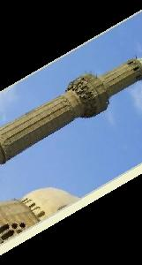
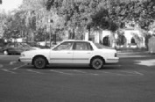
Caltech 101
101 classes
10 classes
30 examples per class
Strong category-specific biases
Clean images
MNIST
1990’s
2004

Slide 5
PASCAL VOC
20 classes
~500 examples per class
Clutter, occlusion, natural scenes
MNIST
Caltech 101
1990’s
2004
2007-2012

Slide 6
ImageNet
1000 classes
~1000 examples per class
Mix of cluttered and clean images
MNIST
Caltech 101
PASCAL VOC
1990’s
2004
2007-2013
2013-2017

Slide 7
Why is recognition hard?
Pose/articulation
Scale
Clutter/
occlusion
Lighting

Slide 8
Learning
Key idea: teach computer visual concepts by providing examples
Training Set

Slide 9
Example
Binary classifier “Dog” or ”not Dog”
Labels: {0, 1}
Training set
{(
, 1),
(
, 1),
(
, 0) , … }

Slide 10
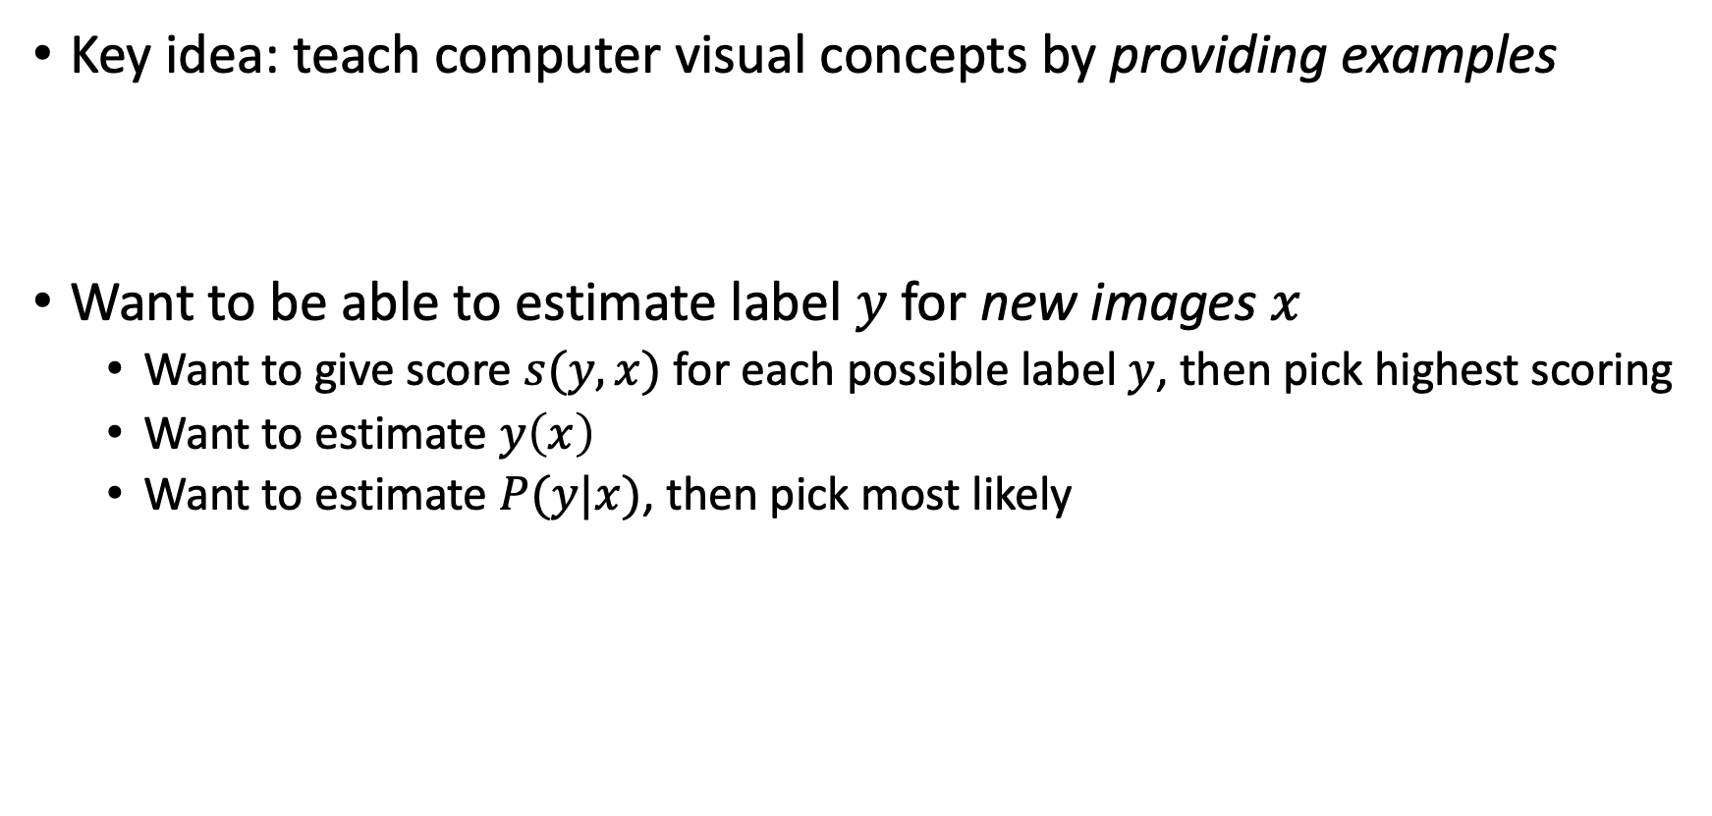
Learning
Key idea: teach computer visual concepts by providing examples
Want to be able to estimate label $y$for new images $x$
  Want to give score $s(y,x)$ for each possible label $y$, then pick highest scoring
  Want to estimate $y\left(x\right)$
  Want to estimate $P(y|x)$, then pick most likely

Slide 11
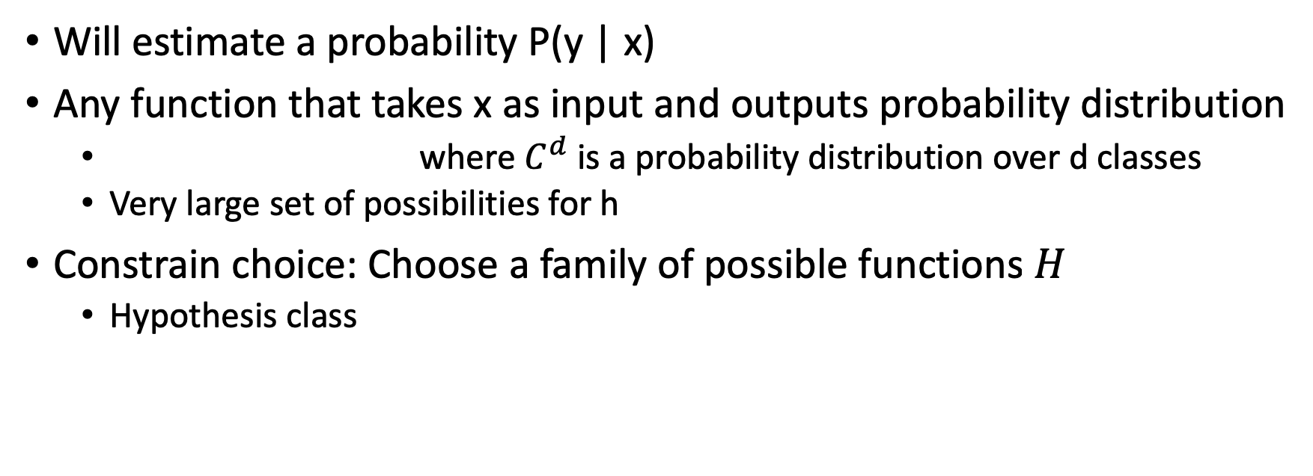
Choosing a model class
Will estimate a probability P(y | x)
Any function that takes x as input and outputs probability distribution
  where $C^{d}$ is a probability distribution over d classes
  Very large set of possibilities for h
Constrain choice: Choose a family of possible functions $H$
  Hypothesis class

Slide 12
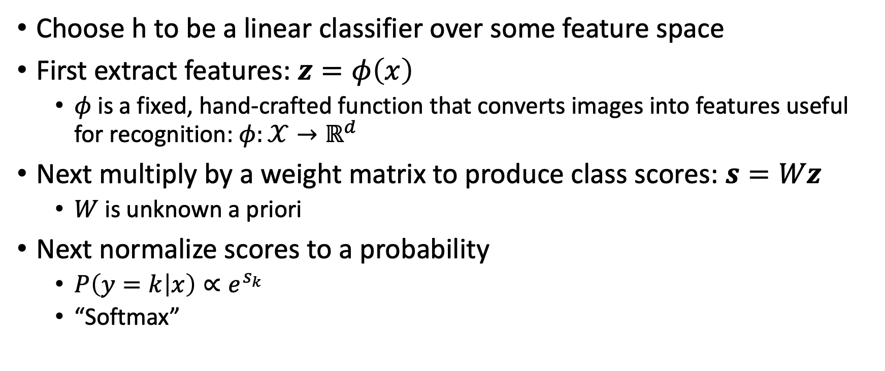
Hypothesis class I: Classical models
Choose h to be a linear classifier over some feature space
First extract features: $z=φ\left(x\right)$
  $φ$ is a fixed, hand-crafted function that converts images into features useful for recognition: $φ:𝒳→ℝ^{d}$
Next multiply by a weight matrix to produce class scores: $s=Wz$
  $W$ is unknown a priori
Next normalize scores to a probability
  $P\left(y=k | x\right)∝e^{s_{k}}$
  “Softmax”

Slide 13
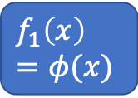

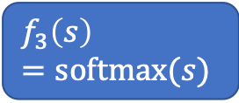
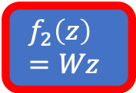
Hypothesis class I: Classical models
$h\left(x;W\right)= softmax(Wφ\left(x\right))$
For different settings of W, get different hypotheses
Hypothesis class $H=\left\{h\left(⋅;W\right);W∈ℝ^{|𝒴| × d}\right\}$
W are parameters: index hypotheses in hypothesis class
$$f_{1}\left(x\right)=φ(x)$$
$$f_{2}\left(z\right)=Wz$$
$$f_{3}\left(s\right)=softmax(s)$$

Slide 14
Choice of feature extractor?
SIFT, HOG, GIST, BOW….
The rest of the pipeline is very simple: linear function + softmax
So heavy lifting must be done by feature extractor
But how do we design feature extractor?

Slide 15
SIFT
SIFT itself a series of simple, fixed steps
Make some of them parametric?
Compute gradients
Compute magnitude and orientation
Quantize and bin
Histogram

Slide 16

Hypothesis class 2: Multilayer perceptrons
Key idea: build complex functions by composing many simple functions
f(x) = Wx
g(x) = max(x,0)
f(x) = Wx
g(x) = max(x,0)
f(x) = Wx
$$f_{3}\left(s\right)=softmax(s)$$

Slide 17
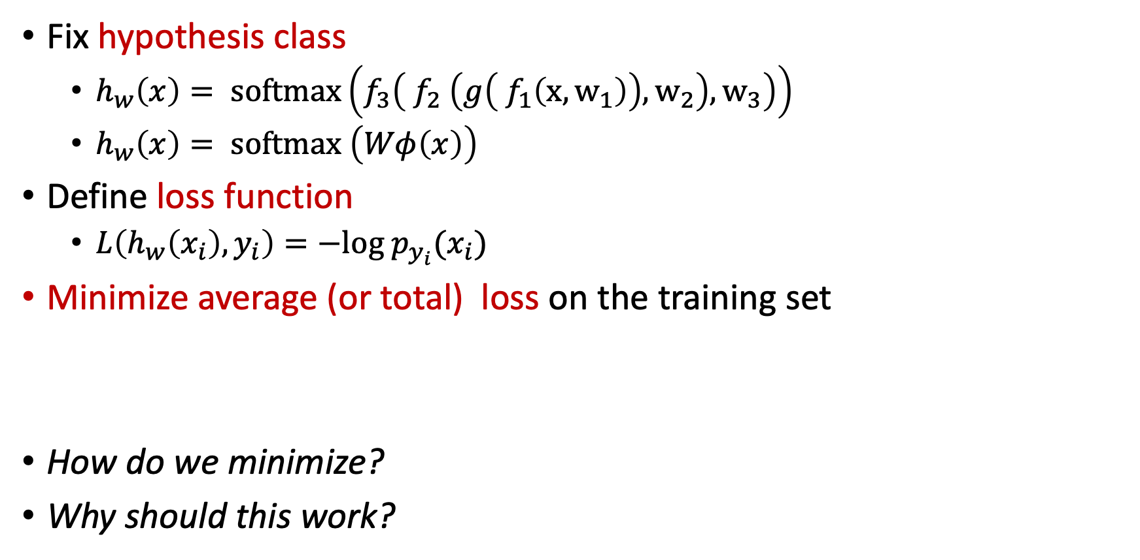
General recipe
Fix hypothesis class
  $h_{w}\left(x\right)= softmax\left(f_{3}\left( f_{2} \left(g\left( f_{1}\left(x,w_{1}\right)\right),w_{2}\right),w_{3}\right)\right)$
  $h_{w}\left(x\right)= softmax \left(Wφ\left(x\right)\right)$
Define loss function
  $L\left(h_{w}\left(x_{i}\right),y_{i}\right)=−log p_{y_{i}}(x_{i})$
Minimize average (or total) loss on the training set
How do we minimize?
Why should this work?

Slide 18
Training: Choosing the best hypothesis
Need to minimize an objective function.
In general, optimization problem.
If L is differentiable and h is differentiable: can do gradient descent

Slide 19
Training = Optimization
Simple solution: gradient descent

Slide 20
Stochastic gradient descent
Objective function
Gradient
Gradient = average of per example gradients
Stochastic gradient descent using single examples
Stochastic gradient descent using minibatch

Slide 21
Stochastic gradient descent
Randomly sample small subset of examples
Compute gradient on small subset
  Unbiased estimate of true gradient
Take step along estimated gradient

Slide 22
Computing derivatives
How do we compute gradient?
Composition of functions: use chain rule

Slide 23
The gradient of convnets
z₁
z₂
z₃
z₄
z₅ = z
f₁
f₂
f₃
f₄
f₅
x
w₁
w₂
w₃
w₄
w₅
Backpropagation

Slide 24
Risk
Given:
  Distribution
  A hypothesis
  Loss function L
We are interested in Expected Risk:
Given training set S, and a particular hypothesis h, Empirical Risk:

Slide 25
Risk
By central limit theorem,
Variance proportional to 1/n
For randomly chosen h, empirical risk is an unbiased estimator of expected risk

Slide 26
Risk
Empirical risk unbiased estimate of expected risk
Want to minimize expected risk
Idea: Minimize empirical risk instead
This is the Empirical Risk Minimization Principle

Slide 27
Generalization
Training error
Generalization error

Slide 28
Overfitting
We are minimizing training error
Empirical risk of chosen hypothesis no longer unbiased estimate:
  We chose hypothesis based on S
  Might have chosen h for which S is a special case
Overfitting:
  Minimize training error, but generalization error increases

Slide 29
Controlling generalization error
Variance of empirical risk inversely proportional to size of S
  Choose very large S!
Larger the hypothesis class H, Higher the chance of hitting bad hypotheses with low training error and high generalization error
  Choose small H!
For many models, can bound generalization error using some property of parameters
  Regularize during optimization!
  Eg. L2 regularization

Slide 30
Controlling generalization error
How do we know we are overfitting?
  Use a held-out “validation set”
  To be an unbiased sample, must be completely unseen

Slide 31
Putting it all together
Want model with least expected risk = expected loss
But expected risk hard to evaluate
Empirical Risk Minimization: minimize empirical risk in training set
Might end up picking special case: overfitting
Avoid overfitting by:
  Constructing large training sets
  Reducing size of model class
  Regularization

Slide 32
Putting it all together
Collect training set and validation set
Pick hypothesis class
Pick loss function
Minimize empirical risk (+ regularization)
Measure performance on held-out validation set
Profit!

Slide 33
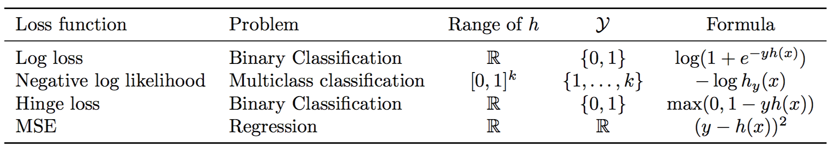
Loss functions and hypothesis classes

Slide 34
Discussion

