Slide 1
Correspondence

Slide 2
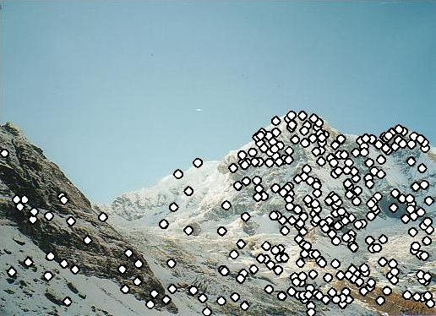
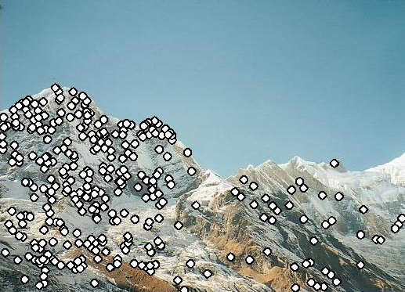
Matching feature points
We know how to detect good points
Next question: How to match them?
Two interrelated questions:
How do we describe each feature point?
How do we match descriptions?
?

Slide 3
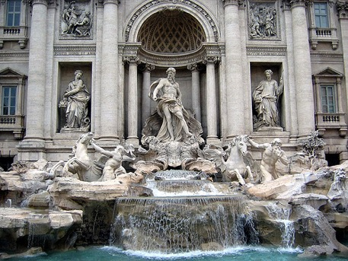
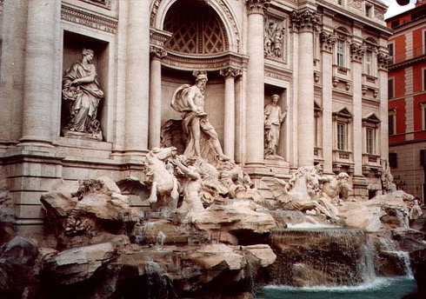




Feature descriptor
$$x_{1}$$
$$x_{2}$$
$$y_{1}$$
$$y_{2}$$

Slide 4
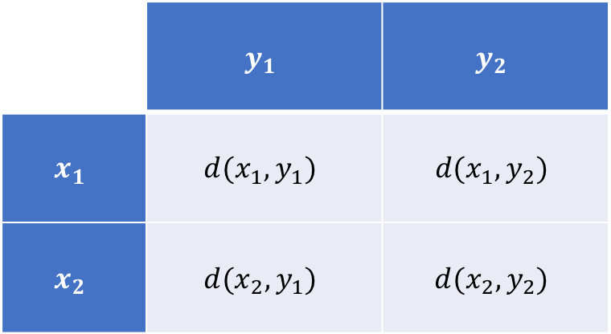
Feature matching
Measure the distance between (or similarity between) every pair of descriptors
 | $$y_{1}$$ | $$y_{2}$$
$$x_{1}$$ | $$d(x_{1},y_{1})$$ | $$d(x_{1},y_{2})$$
$$x_{2}$$ | $$d(x_{2},y_{1})$$ | $$d(x_{2},y_{2})$$

Slide 5
Invariance vs. discriminability
Invariance:
  Distance between descriptors should be small even if image is transformed
Discriminability:
  Descriptor should be highly unique for each point (far away from other points in the image)

Slide 6

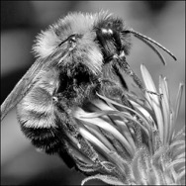
Image transformations
Geometric
  Rotation
  Scale
Photometric
  Intensity change

Slide 7
Invariance
Most feature descriptors are designed to be invariant to
  Translation, 2D rotation, scale
They can usually also handle
  Limited 3D rotations (SIFT works up to about 60 degrees)
  Limited affine transformations (some are fully affine invariant)
  Limited illumination/contrast changes

Slide 8
How to achieve invariance
Design an invariant feature descriptor
  Simplest descriptor: a single 0
    What’s this invariant to?
    Is this discriminative?
  Next simplest descriptor: a single pixel
    What’s this invariant to?
    Is this discriminative?

Slide 9
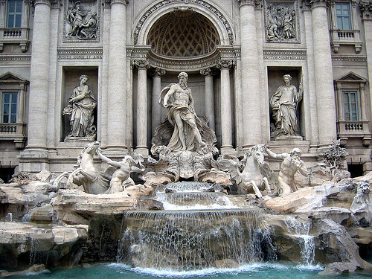

The aperture problem

Slide 10
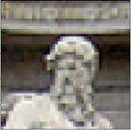
The aperture problem
Use a whole patch instead of a pixel?

Slide 11
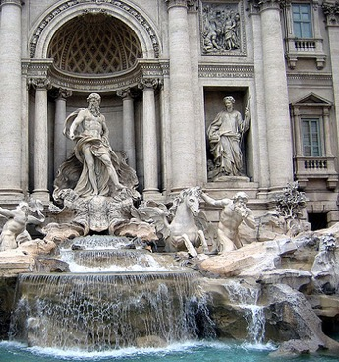
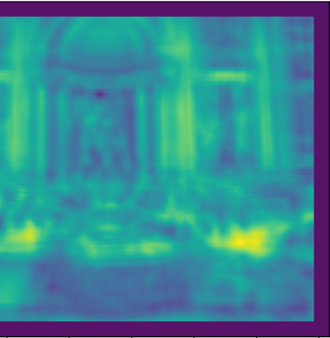
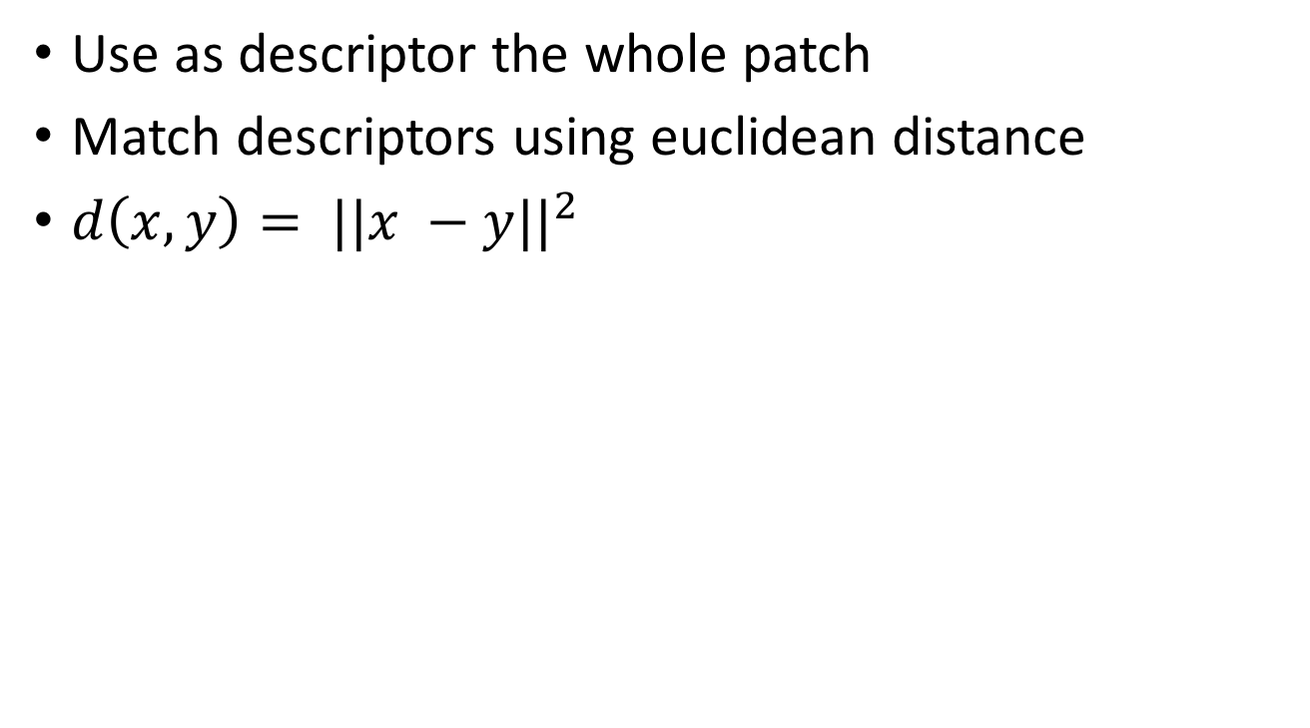
SSD
Use as descriptor the whole patch
Match descriptors using euclidean distance
$d\left(x,y\right)= ||x −y||^{2}$

Slide 12
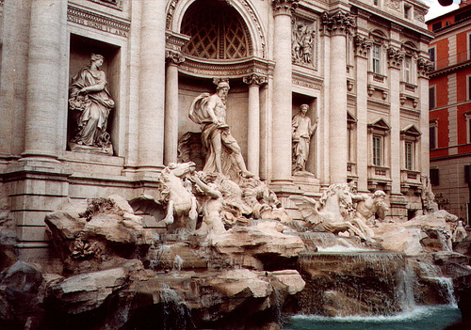
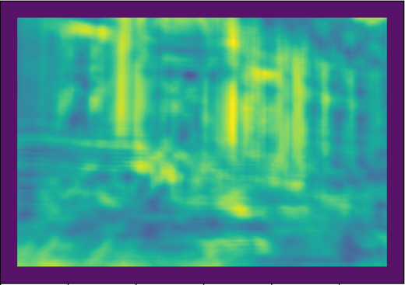
SSD

Slide 13
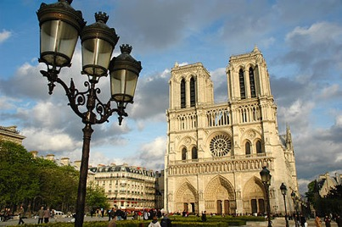
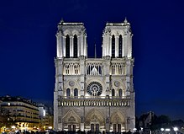
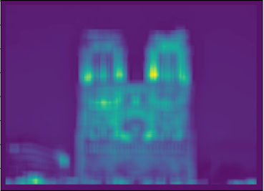

SSD

Slide 14
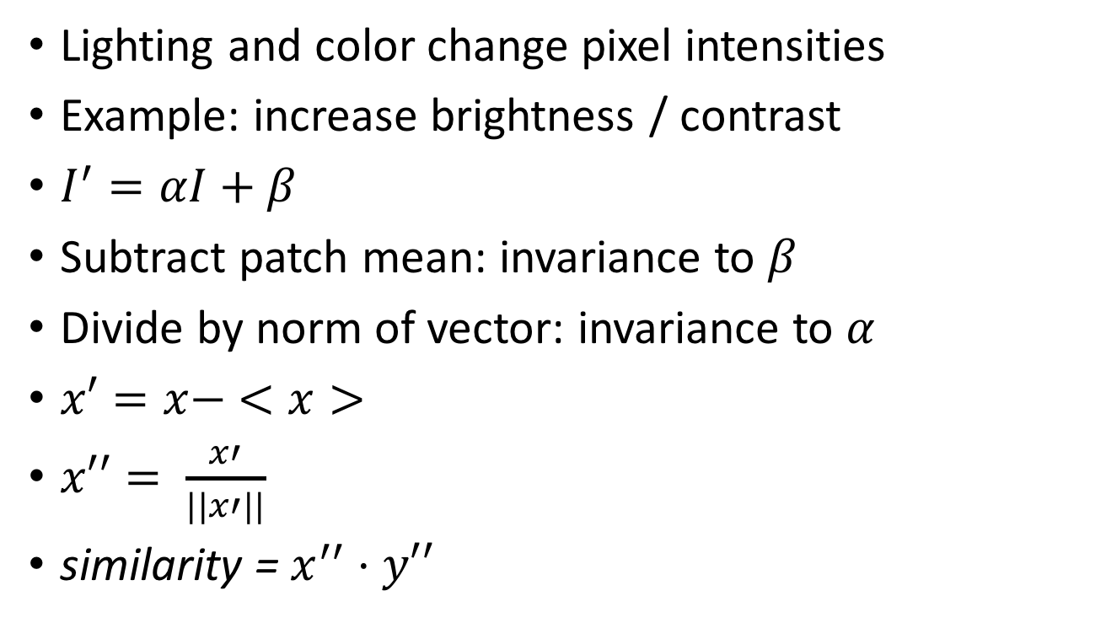
NCC - Normalized Cross Correlation
Lighting and color change pixel intensities
Example: increase brightness / contrast
$I^{′}=αI+β$
Subtract patch mean: invariance to $β$
Divide by norm of vector: invariance to $α$
$x′=x− <x>$
$x′′= \frac{x′}{||x′||}$
similarity = $x^{′′}⋅y′′$

Slide 15
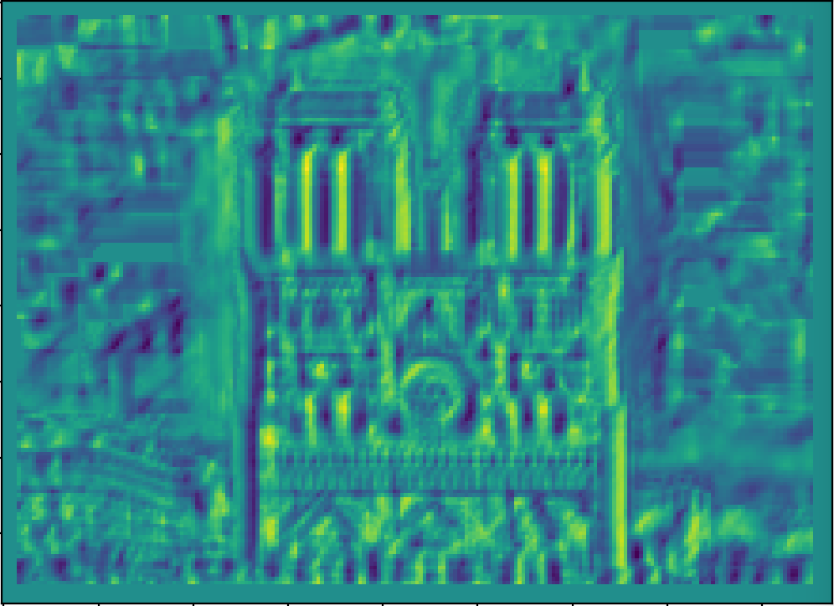
NCC - Normalized cross correlation

Slide 16
Basic correspondence
Image patch as descriptor, NCC as similarity
Invariant to?
  Photometric transformations?
  Translation?
  Rotation?

Slide 17
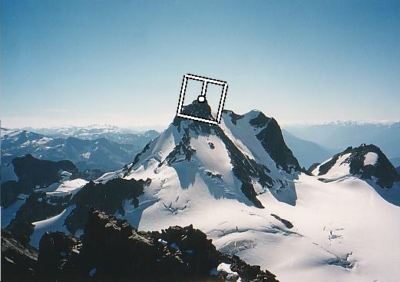
Rotation invariance for feature descriptors
Find dominant orientation of the image patch
  This is given by x_{max}, the eigenvector of M corresponding to λ_{max} (the larger eigenvalue)
  Rotate the patch according to this angle
Figure by Matthew Brown

Slide 18
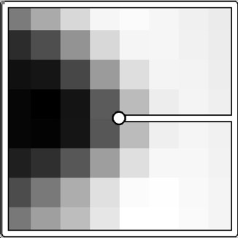
Multiscale Oriented PatcheS descriptor
Take 40x40 square window around detected feature
  Scale to 1/5 size (using prefiltering)
  Rotate to horizontal
  Sample 8x8 square window centered at feature
  Intensity normalize the window by subtracting the mean, dividing by the standard deviation in the window
40 pixels
8 pixels
Adapted from slide by Matthew Brown

Slide 19
Detections at multiple scales

Slide 20
Invariance of MOPS
Intensity
Scale
Rotation

Slide 21
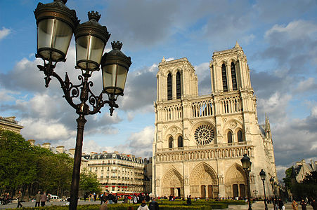
Color and Lighting

Slide 22
Out-of-plane rotation
Out-of-plane rotation

Slide 23
Discussion

Slide 24
Better representation than color: Edges
Normal discontinuity
Depth Discontinuity
Albedo Edge
Shadow

Slide 25
Towards a better feature descriptor
Match pattern of edges
  Edge orientation – clue to shape
Be resilient to small deformations
  Deformations might move pixels around, but slightly
  Deformations might change edge orientations, but slightly

Slide 26
Invariance to deformation by quantization
37
42
Between 30 and 45

Slide 27
Invariance to deformation by quantization

Slide 28
Spatial invariance by histograms
2 blue balls, one red box
2
1
balls
boxes

Slide 29
Rotation Invariance by Orientation Normalization
[Lowe, SIFT, 1999]
Compute orientation histogram
Select dominant orientation
Normalize: rotate to fixed orientation
0
2
π

Slide 30
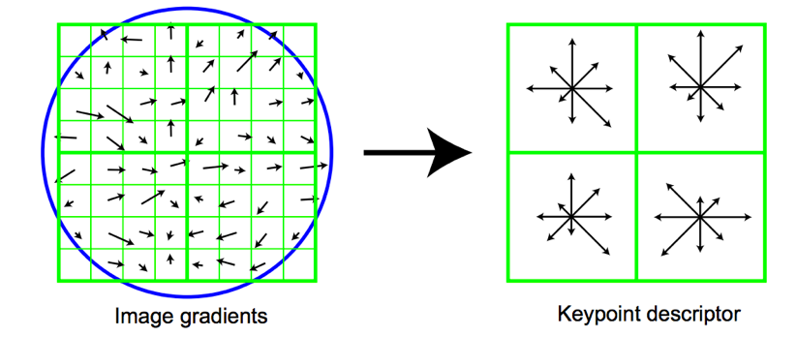
The SIFT descriptor
Compute edge magnitudes + orientations
Quantize orientations (invariance to def)
Divide into spatial cells
Compute orientation histogram in each cell (spatial invariance)
Distinctive Image Features from Scale-Invariant Keypoints. Lowe. In IJCV 2004

Slide 31
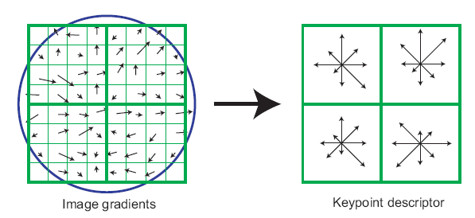
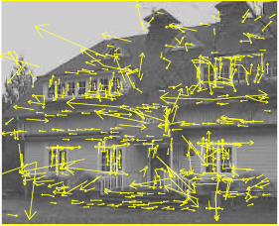
The SIFT descriptor
SIFT – Lowe IJCV 2004
Notes:
Do scale-space invariant feature detection using DoG.

Slide 32
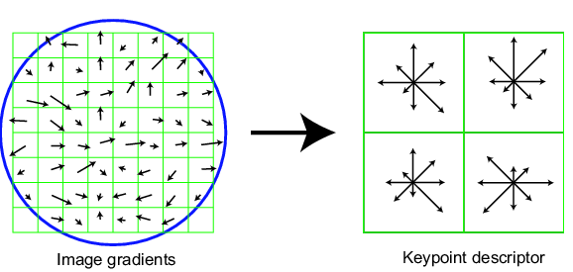
Scale Invariant Feature Transform
Basic idea:
  DoG for scale-space feature detection
  Take 16x16 square window around detected feature
    Compute gradient orientation for each pixel
    Throw out weak edges (threshold gradient magnitude)
    Create histogram of surviving edge orientations
0
2π
angle histogram
Adapted from slide by David Lowe

Slide 33
SIFT descriptor
Create histogram
  Divide the 16x16 window into a 4x4 grid of cells (2x2 case shown below)
  Compute an orientation histogram for each cell
  16 cells * 8 orientations = 128 dimensional descriptor
Adapted from slide by David Lowe

Slide 34
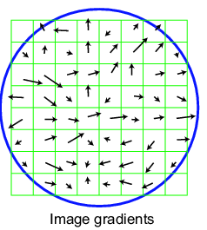
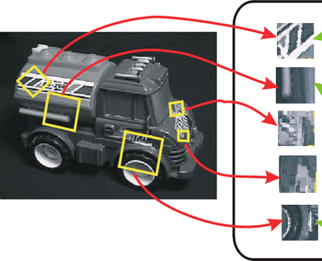
SIFT vector formation
Computed on rotated and scaled version of window according to computed orientation & scale
  resample the window
Based on gradients weighted by a Gaussian

Slide 35
Ensure smoothness
Trilinear interpolation
  a given gradient contributes to 8 bins:
  4 in space times 2 in orientation

Slide 36
Reduce effect of illumination
128-dim vector normalized to 1
Threshold gradient magnitudes to avoid excessive influence of high gradients
  after normalization, clamp gradients >0.2
  renormalize

Slide 37
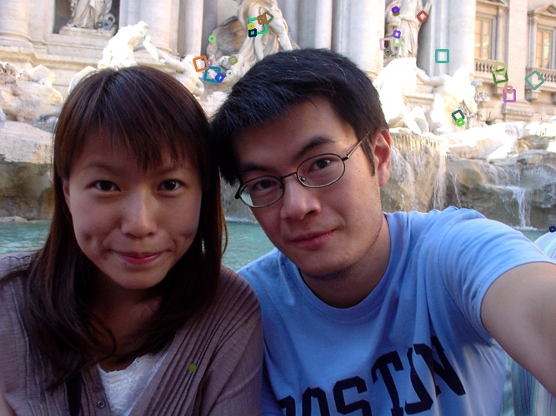
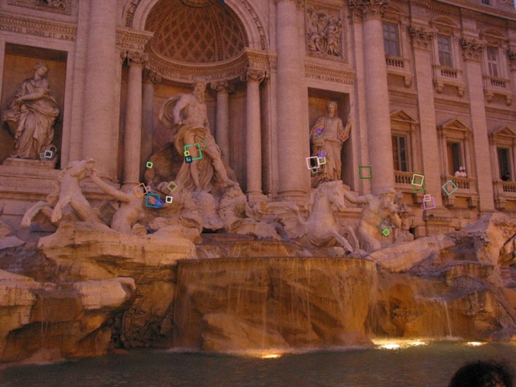
Properties of SIFT
Extraordinarily robust matching technique
  Can handle changes in viewpoint
    Up to about 60 degree out of plane rotation
  Can handle significant changes in illumination
    Sometimes even day vs. night (below)
  Fast and efficient—can run in real time
  Lots of code available: http://people.csail.mit.edu/albert/ladypack/wiki/index.php/Known_implementations_of_SIFT

Slide 38
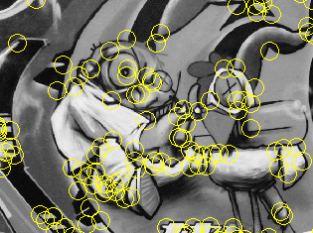
Summary
Keypoint detection: repeatable and distinctive
  Corners, blobs, stable regions
  Harris, DoG
Descriptors: robust and selective
  spatial histograms of orientation
  SIFT and variants are typically good for stitching and recognition
  But, need not stick to one

Slide 39
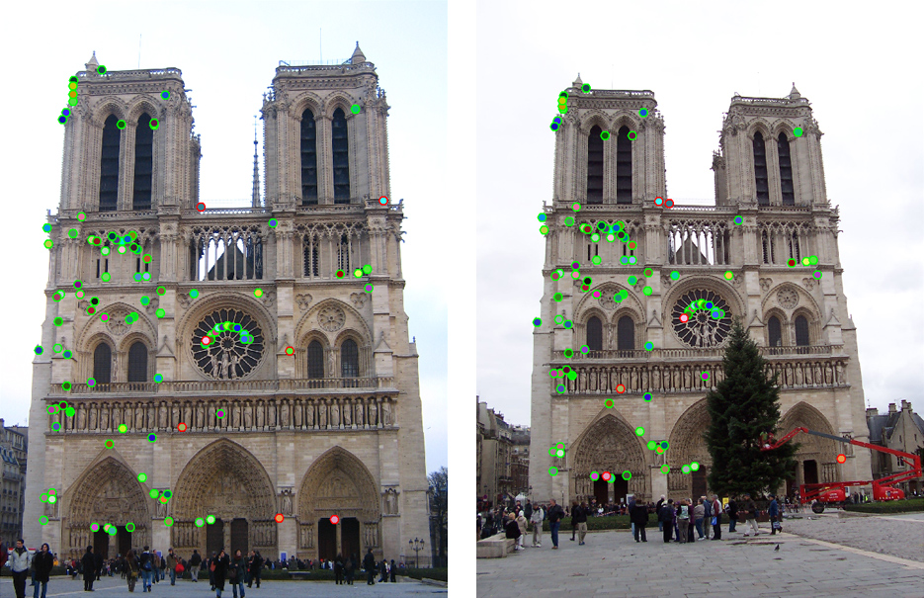
Which features match?

Slide 40
Feature matching
Given a feature in I₁, how to find the best match in I₂?
  Define distance function that compares two descriptors
  Test all the features in I₂, find the one with min distance

Slide 41
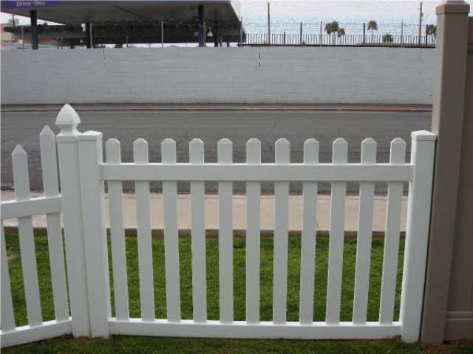
Feature distance
How to define the difference between two features f₁, f₂?
  Simple approach: L₂ distance, ||f₁ - f₂ ||
  can give good scores to ambiguous (incorrect) matches
f₁
f₂
I₁
I₂

Slide 42
Feature distance
How to define the difference between two features f₁, f₂?
  Better approach: ratio distance = ||f₁ - f₂ || / || f₁ - f₂’ ||
    f₂ is best SSD match to f₁ in I₂
    f₂’ is 2nd best SSD match to f₁ in I₂
    gives large values for ambiguous matches
f₁
f₂'
f₂
I₁
I₂

Slide 43
Dense correspondence

Slide 44
Dense correspondence
Goal: Assign disparity value to each pixel
Problem: most pixels will be ambiguous
Solution: propagate from unambiguous to ambiguous pixels
Basic idea: nearby pixels likely to have same disparity (smoothness)

Slide 45
Dense correspondence
Goal:
  Assign disparity value to each pixel
Basic idea:
  Disparity image should be smooth
Energy minimization
  min E(d), where d is disparity image
  E(d) = E_{data}(d) + E_{smoothness}(d)
E_{data}(d) : scores based on NCC (for example)
E_{smoothness}(d) =

Slide 46
Markov Random Fields
Probabilistic model
Undirected graphical model
Undirected graph with nodes and edges
Unary potential on nodes = data term
Binary potential on edges = smoothness term

Slide 47
Optimizing MRFs
NP-Hard
Approximate solutions
  Message passing
  Graph cut-based solutions

Slide 48
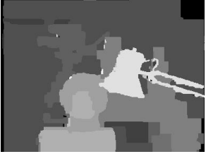
Dense correspondence with MRFs

Slide 49
Dense correspondence
Goal: Assign disparity value to each pixel
Problem: most pixels will be ambiguous
Solution: propagate from unambiguous to ambiguous pixels
Basic idea: nearby pixels likely to have same disparity (smoothness)

Slide 50
Dense correspondence
Obtain disparity through optimization
Based on e.g NCC distance
(d(i,j) – d(k,l))²

Slide 51
Detour: Graphical models
Probabilistic models with graphs
Nodes are variables
Edges determine dependency structure
independent of given all
It is 8 am
Alarm rings
I wake up
Naughty roommate
Roommate sets up prank

Slide 52
Markov Random Fields (MRFs)
Probabilistic model
Represented by graph
Each node is random variable
Edges represent dependence structure
  independent of given all

Slide 53
Markov Random Fields (MRFs)
Hammersley-clifford theorem
Unary potential
Binary potential

Slide 54
Dense correspondence as MRFs
Obtain disparity through optimization
Random variable: disparity
Find most likely disparity
Based on e.g NCC distance
(d(i,j) – d(k,l))²

Slide 55
Aligning depth boundaries to image boundaries
Some pairs more likely to have same disparity
w(i,j) (d(i,j) – d(k,l))²
w(i,j) = 0 for edges
Conditional Random Field (CRF)

Slide 56
Other applications of MRFs / CRFs
Semantic Image Segmentation with Deep Convolutional Nets and Fully Connected CRFs.
Liang-Chieh Chen*, George Papandreou*, Iasonas Kokkinos, Kevin Murphy, and Alan L. Yuille. In ICLR, 2015

Slide 57
Optimizing MRFs
NP-Hard
Approximate solutions
  Message passing
  Mean field-based inference
  Graph cut-based solutions
A comparative study of energy minimization methods for markov random fields with smoothness-based priors. Szeliski, R., Zabih, R., Scharstein, D., Veksler, O., Kolmogorov, V., Agarwala, A., Tappen, M. and Rother, C. In TPAMI, 2008.

Slide 58
Dense correspondence with MRFs

