Slide 1
Reconstruction

Slide 2
Perspective projection in rectified cameras
For rectified cameras, correspondence problem is easier
Only requires searching along a particular row.

Slide 3
Epipolar constraint
Reduces 2D search problem to search along a particular line: epipolar line

Slide 4
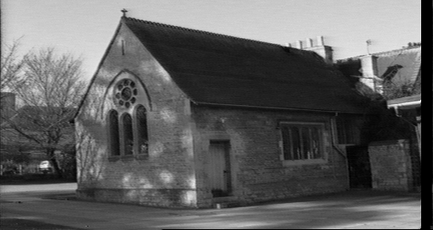
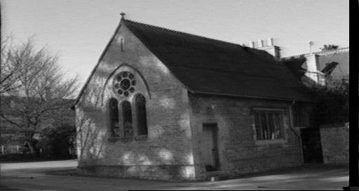
Epipolar constraint
True in general!
Given pixel (x,y) in one image, corresponding pixel in the other image must lie on a line
Line function of (x,y) and parameters of camera
These lines are called epipolar line

Slide 5
Epipolar geometry

Slide 6
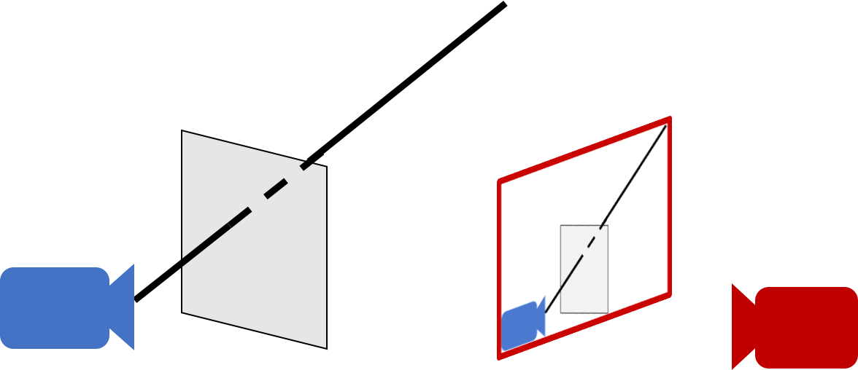
Epipolar geometry - why?
For a single camera, pixel in image plane must correspond to point somewhere along a ray

Slide 7
Epipolar geometry
When viewed in second image, this ray looks like a line: epipolar line
The epipolar line must pass through image of the first camera in the second image - epipole
Epipole
Epipolar line

Slide 8
Epipolar geometry
  Given an image point in one view, where is the corresponding point in the other view?
?
epipolar line
C
C
/
epipole
baseline
  A point in one view “generates” an epipolar line in the other view
  The corresponding point lies on this line

Slide 9
Epipolar line
Epipolar constraint
  Reduces correspondence problem to 1D search along an epipolar line

Slide 10
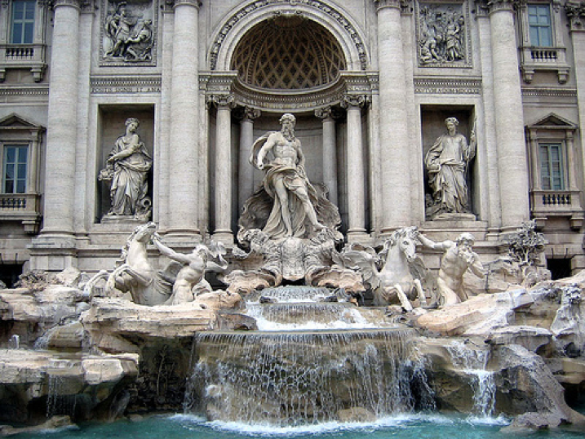
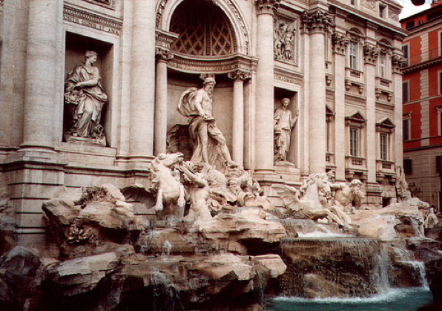
Epipolar lines

Slide 11
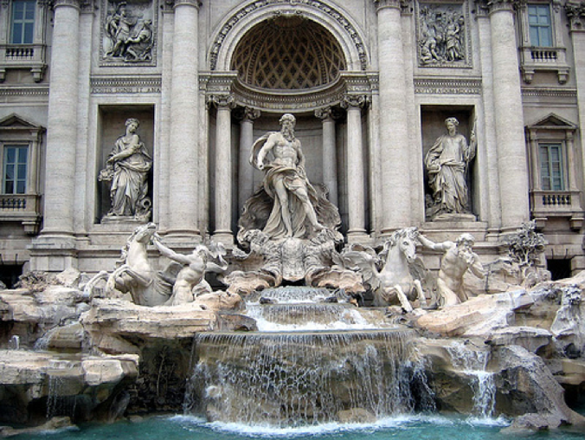
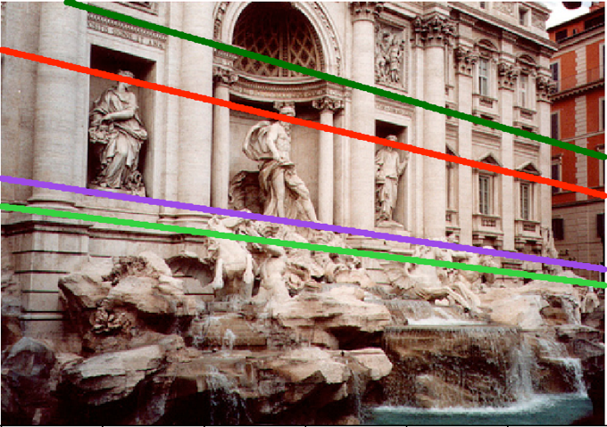
Epipolar lines

Slide 12

Epipolar lines
Epipole

Slide 13
Epipolar geometry continued
Epipolar geometry is a consequence of the coplanarity of the camera centres and scene point
X
x
x
/
C
C
/
The camera centres, corresponding points and scene point lie in a single plane, known as the epipolar plane

Slide 14
Nomenclature
X
l/
right epipolar line
left epipolar line
x
/
x
e
e
/
C
C
/
The epipolar line l/ is the image of the ray through x
The epipole e is the point of intersection of the line joining the camera centres with the image plane
  this line is the baseline for a stereo rig, and
  the translation vector for a moving camera
The epipole is the image of the centre of the other camera: e = PC/ , e/ = P/C

Slide 15
The epipolar pencil
X
e
/
e
baseline
As the position of the 3D point X varies, the epipolar planes “rotate” about the baseline. This family of planes is known as an epipolar pencil (a pencil is a one parameter family).
All epipolar lines intersect at the epipole.

Slide 16
The epipolar pencil
X
e
/
e
baseline
As the position of the 3D point X varies, the epipolar planes “rotate” about the baseline. This family of planes is known as an epipolar pencil (a pencil is a one parameter family).
All epipolar lines intersect at the epipole.

Slide 17
Epipolar geometry - the math
Assume intrinsic parameters K are identity
Assume world coordinate system is centered at 1st camera pinhole with Z along viewing direction

Slide 18
Epipolar geometry - the math
Assume intrinsic parameters K are identity
Assume world coordinate system is centered at 1st camera pinhole with Z along viewing direction

Slide 19
Epipolar geometry - the math
Assume intrinsic parameters K are identity
Assume world coordinate system is centered at 1st camera pinhole with Z along viewing direction

Slide 20
Epipolar geometry - the math
Assume intrinsic parameters K are identity
Assume world coordinate system is centered at 1st camera pinhole with Z along viewing direction

Slide 21
Epipolar geometry - the math
Assume intrinsic parameters K are identity
Assume world coordinate system is centered at 1st camera pinhole with Z along viewing direction

Slide 22
Epipolar geometry - the math
0
0

Slide 23
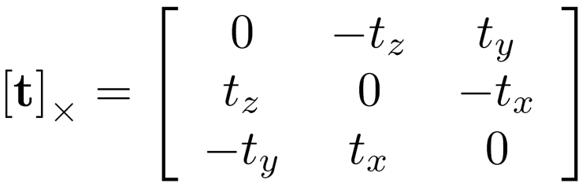
Epipolar geometry - the math
Can we write this as matrix vector operations?
Cross product can be written as a matrix

Slide 24
Epipolar geometry - the math
Can we write this as matrix vector operations?
Dot product can be written as a vector-vector times

Slide 25
Epipolar geometry - the math
Can we write this as matrix vector operations?
Dot product can be written as a vector-vector times

Slide 26
Epipolar geometry - the math

Slide 27
Epipolar geometry - the math
Homogenous coordinates of point in image 2
Homogenous coordinates of point in image 1
Essential matrix

Slide 28
Epipolar constraint and epipolar lines
Consider a known, fixed pixel in the first image
What constraint does this place on the corresponding pixel?
where
What kind of equation is this?

Slide 29
Epipolar constraint and epipolar lines
Consider a known, fixed pixel in the first image
where
Line!

Slide 30
Epipolar constraint: putting it all together
If p is a pixel in first image and q is the corresponding pixel in the second image, then:
q^{T}Ep = 0
E = [t]_{X}R
For fixed p, q must satisfy:
q^{T}l = 0, where l = Ep
For fixed q, p must satisfy:
l^{T}p = 0 where l^{T} = q^{T}E, or l = E^{t}q
These are epipolar lines!
Epipolar line in 2nd image
Epipolar line in 1st image

Slide 31
Essential matrix and epipoles
E = [t]_{X}R
Ep is an epipolar line in 2nd image
All epipolar lines in second image pass through c₂
c₂ is epipole in 2nd image

Slide 32
Essential matrix and epipoles
E = [t]_{X}R
E^{T}q is an epipolar line in 1st image
All epipolar lines in first image pass through c₁
c₁ is the epipole in 1st image

Slide 33
Epipolar geometry - the math
We assumed that intrinsic parameters K are identity
What if they are not?

Slide 34
Fundamental matrix

Slide 35
Fundamental matrix

Slide 36
Fundamental matrix

Slide 37
Fundamental matrix

Slide 38
Fundamental matrix
Fundamental matrix

Slide 39
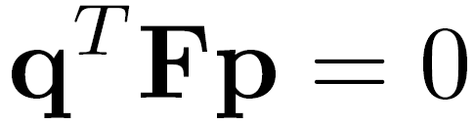

Fundamental matrix result

Slide 40


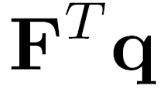



Properties of the Fundamental Matrix
is the epipolar line associated with
is the epipolar line associated with
T
0
Notes:
5 parameters

Slide 41
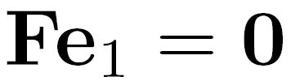
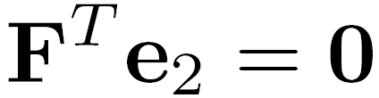
Properties of the Fundamental Matrix
is the epipolar line associated with
is the epipolar line associated with
and
All epipolar lines contain epipole
T
0
Notes:
5 parameters

Slide 42

Properties of the Fundamental Matrix
is the epipolar line associated with
is the epipolar line associated with
and
is rank 2
T
0
Notes:
Prove that F is rank 2. F

Slide 43
Why is F rank 2?
F is a 3 x 3 matrix
But there is a vector c₁ and c₂ such that Fc₁ = 0 and F^{T}c₂ = 0

Slide 44


Estimating F
If we don’t know K₁, K₂, R, or t, can we estimate F for two images?
Yes, given enough correspondences

Slide 45
Estimating F – 8-point algorithm
The fundamental matrix F is defined by
for any pair of matches x and x’ in two images.
Let x=(u,v,1)^{T} and x’=(u’,v’,1)^{T},
each match gives a linear equation

Slide 46
8-point algorithm
In reality, instead of solving , we seek f to minimize , least eigenvector of .

Slide 47
8-point algorithm – Problem?
F should have rank 2
To enforce that F is of rank 2, F is replaced by F’ that minimizes subject to the rank constraint.
This is achieved by SVD. Let , where
, let
then is the solution.
Notes:
The problem is that the resulting often is ill-conditioned. In theory, should have one singular value equal to zero and the rest are non-zero. In practice, however, some of the non-zero singular values can become small relative to the larger ones. If more than eight corresponding points are used to construct , where the coordinates are only approximately correct, there may not be a well-defined singular value which can be identified as approximately zero. Consequently, the solution of the homogeneous linear system of equations may not be sufficiently accurate to be useful.

Slide 48
Recovering camera parameters from F / E
Can we recover R and t between the cameras from F?
No: K₁ and K₂ are in principle arbitrary matrices
What if we knew K₁ and K₂ to be identity?

Slide 49
Recovering camera parameters from E
t is a solution to E^{T}x = 0
Can’t distinguish between t and ct for constant scalar c
How do we recover R?

Slide 50
Recovering camera parameters from E
We know E and t
Consider taking SVD of E and [t]_{X}

Slide 51
Recovering camera parameters from E
t is a solution to E^{T}x = 0
Can’t distinguish between t and ct for constant scalar c

Slide 52
8-point algorithm
Pros: it is linear, easy to implement and fast
Cons: susceptible to noise
Degenerate: if points are on same plane
Normalized 8-point algorithm: Hartley
  Position origin at centroid of image points
  Rescale coordinates so that center to farthest point is sqrt (2)

Slide 53
Dealing with noise
Triangulation relies on correspondences
What if correspondences are incorrect?
Fitting: find the parameters of a model that best fit the data
Other examples:
  least squares linear regression

Slide 54
Least squares: linear regression
(y_{i}, x_{i})
y = mx + b

Slide 55
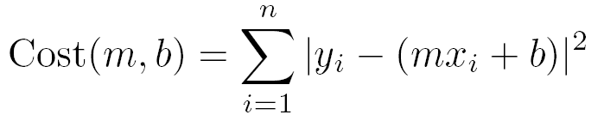
Linear regression
residual error

Slide 56
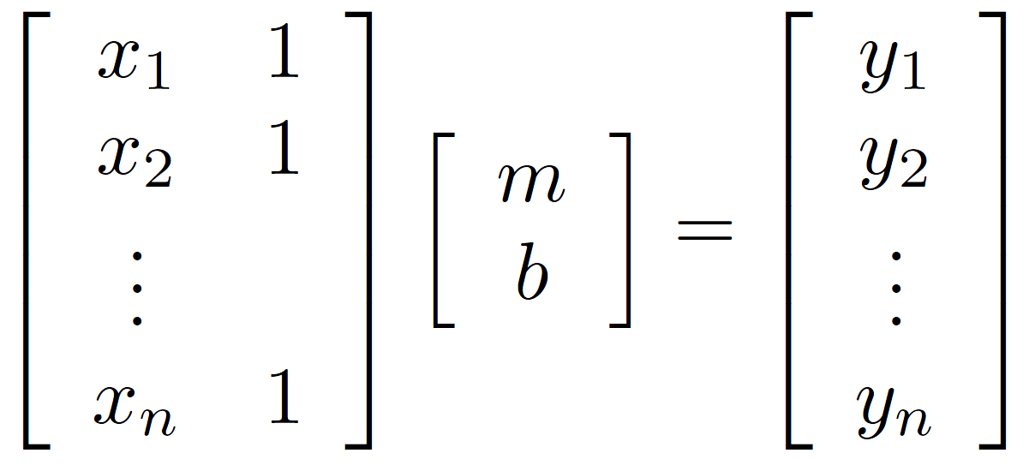
Linear regression

Slide 57
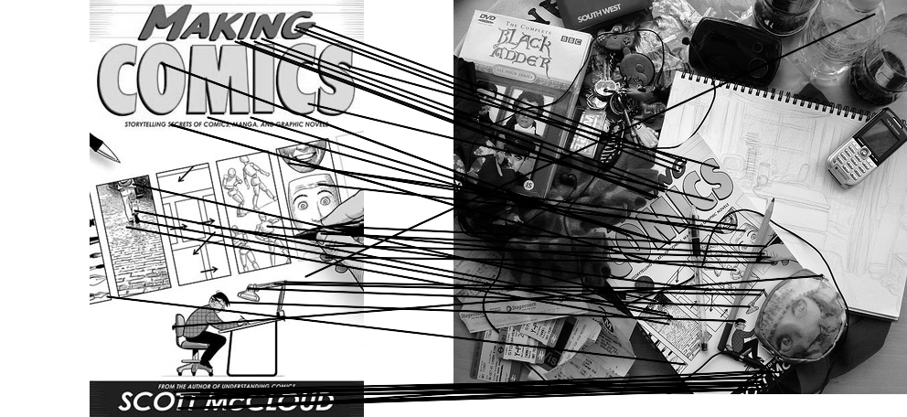
Outliers
outliers
inliers

Slide 58
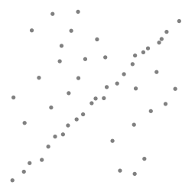
Robustness
Problem: Fit a line to these datapoints
Least squares fit

Slide 59
Idea
Given a hypothesized line
Count the number of points that “agree” with the line
  “Agree” = within a small distance of the line
  I.e., the inliers to that line
For all possible lines, select the one with the largest number of inliers

Slide 60
Counting inliers

Slide 61
Counting inliers
Inliers: 3

Slide 62
Counting inliers
Inliers: 20

Slide 63
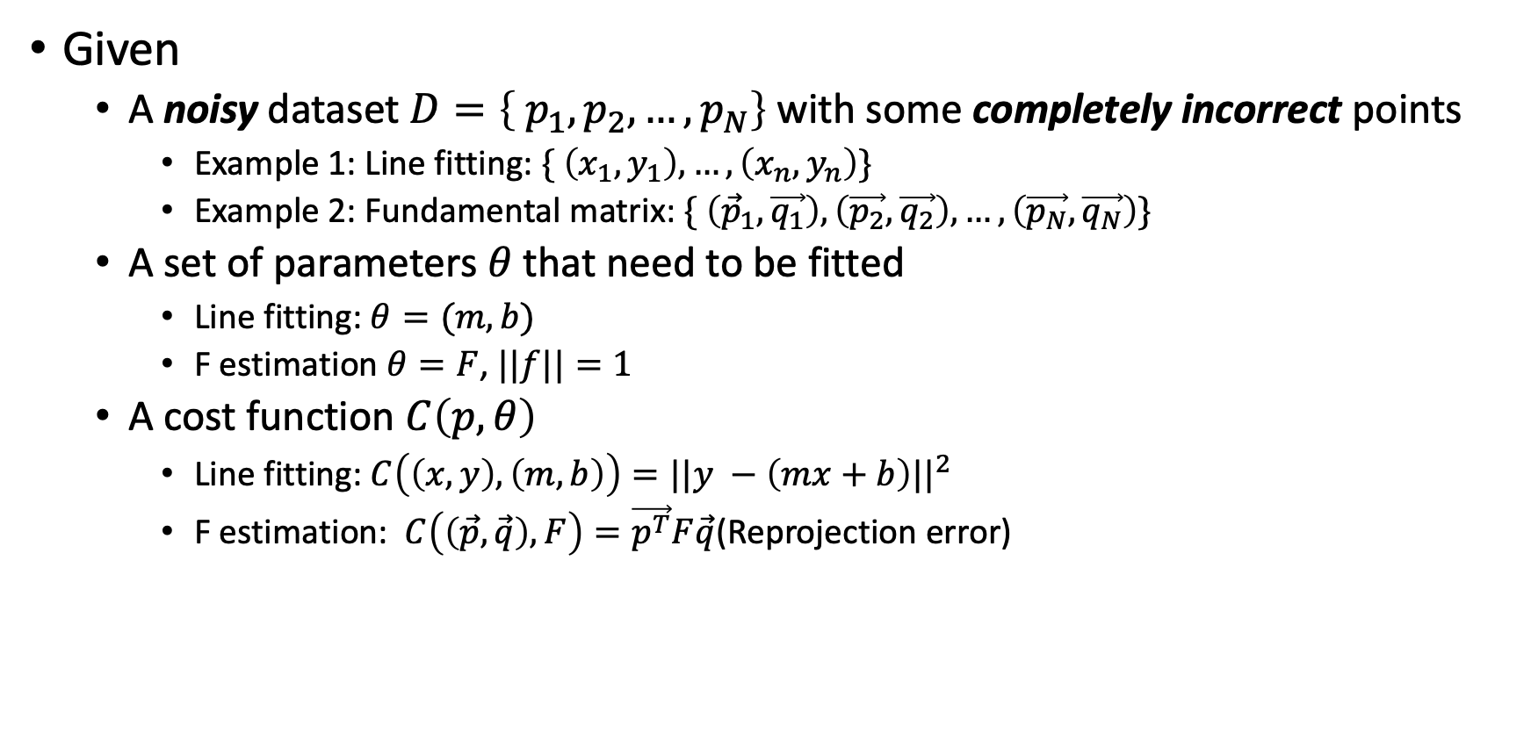
More general problem setup
Given
  A noisy dataset $D=\left\{ p_{1},p_{2}, …,p_{N}\right\}$ with some completely incorrect points
    Example 1: Line fitting: $\{ \left(x_{1},y_{1}\right), …, \left(x_{n}, y_{n}\right)\}$
    Example 2: Fundamental matrix: $\{ \left({\vec{p}}_{1}, \vec{q_{1}}\right), \left(\vec{p_{2}}, \vec{q_{2}}\right), …, \left(\vec{p_{N}}, \vec{q_{N}}\right)\}$
  A set of parameters $θ$ that need to be fitted
    Line fitting: $θ=(m, b)$
    F estimation $θ=F$, $||f||=1$
  A cost function $C\left(p, θ\right)$
    Line fitting: $C\left(\left(x,y\right), \left(m,b\right)\right)=||y −\left(mx+b\right)||^{2}$
    F estimation: $C\left(\left(\vec{p},\vec{q}\right), F\right)=\vec{p^{T}}F\vec{q}$(Reprojection error)

Slide 64
How do we find the best hypotheses?
Unlike least-squares, no simple closed-form solution
Hypothesize-and-test
  Try out many hypotheses, keep the best one
  Which hypotheses?
  How do we decide which is best?

Slide 65
Which hypotheses?
Sample hypotheses randomly?
  Might sample useless hypotheses that doesn’t fit any data
Idea: sample data and fit hypotheses (assuming no noise)
  Usually need a minimum number k of points to fit hypotheses
  Randomly sample exactly k

Slide 66
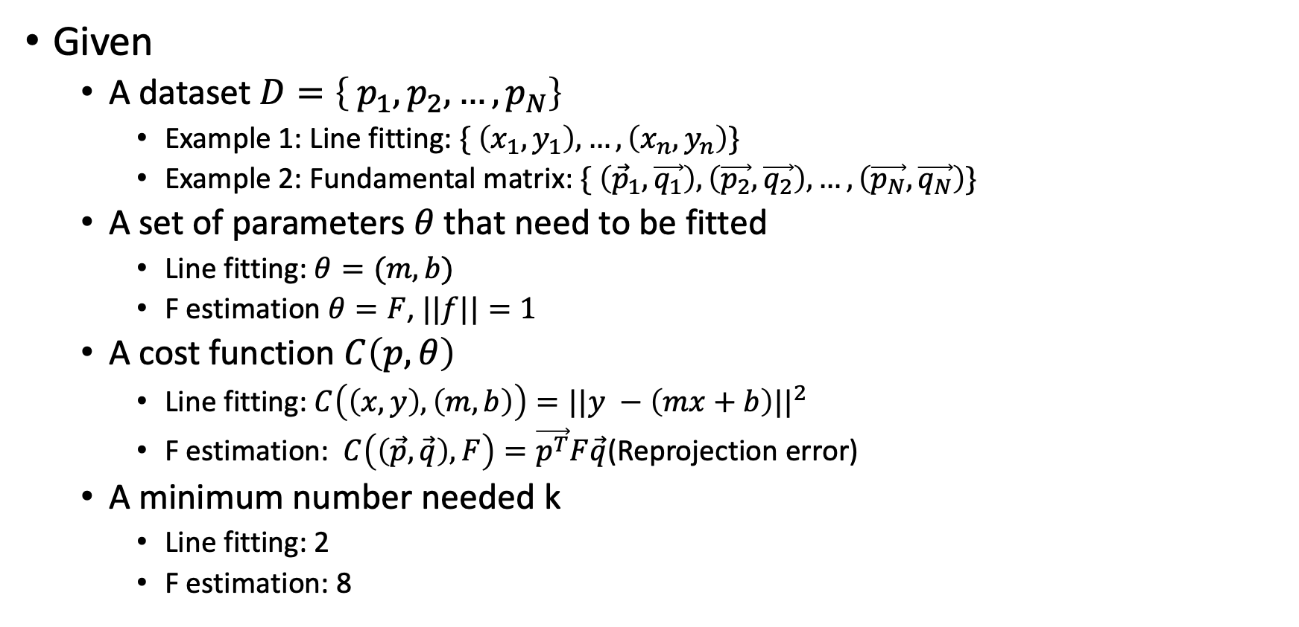
Problem setup (again)
Given
  A dataset $D=\left\{ p_{1},p_{2}, …,p_{N}\right\}$
    Example 1: Line fitting: $\{ \left(x_{1},y_{1}\right), …, \left(x_{n}, y_{n}\right)\}$
    Example 2: Fundamental matrix: $\{ \left({\vec{p}}_{1}, \vec{q_{1}}\right), \left(\vec{p_{2}}, \vec{q_{2}}\right), …, \left(\vec{p_{N}}, \vec{q_{N}}\right)\}$
  A set of parameters $θ$ that need to be fitted
    Line fitting: $θ=(m, b)$
    F estimation $θ=F$, $||f||=1$
  A cost function $C\left(p, θ\right)$
    Line fitting: $C\left(\left(x,y\right), \left(m,b\right)\right)=||y −\left(mx+b\right)||^{2}$
    F estimation: $C\left(\left(\vec{p},\vec{q}\right), F\right)=\vec{p^{T}}F\vec{q}$(Reprojection error)
  A minimum number needed k
    Line fitting: 2
    F estimation: 8

Slide 67
How do we decide which is best?
“Happy families are all alike; every unhappy family is unhappy in its own way.” – Leo Tolstoy, Anna Karenina
Good hypothesis: lots of data points will agree (lots of inliers)
Bad hypothesis: very little agreement (few inliers)
Assumption:
  Noise is either <50%
  Or noisy points don’t all agree

Slide 68
RANSAC (RAndom SAmple Consensus)
Repeat:
  Sample minimum number of points k to fit hypothesis
  Fit hypothesis
  Count number of inliers in entire dataset
Return hypothesis with most number of inliers

Slide 69
RANSAC (Random Sample Consensus)
Line fitting example
Algorithm:
Sample (randomly) the number of points required to fit the model (#=2)
Solve for model parameters using samples
Score by the fraction of inliers within a preset threshold of the model
Repeat 1-3 until the best model is found with high confidence
Illustration by Savarese
Notes:
Let me give you an intuition of what is going on. Suppose we have the standard line fitting problem in presence of outliers.
We can formulate this problem as follows: want to find the best partition of points in inlier set and outlier set such that…
The objective consists of adjusting the parameters of a model function so as to best fit a data set.
"best" is defined by a function f that needs to be minimized.
Such that the best parameter of fitting the line give rise to a residual error lower that delta
as when the sum, S, of squared residuals

Slide 70
RANSAC
Line fitting example
Algorithm:
Sample (randomly) the number of points required to fit the model (#=2)
Solve for model parameters using samples
Score by the fraction of inliers within a preset threshold of the model
Repeat 1-3 until the best model is found with high confidence
Notes:
Let me give you an intuition of what is going on. Suppose we have the standard line fitting problem in presence of outliers.
We can formulate this problem as follows: want to find the best partition of points in inlier set and outlier set such that…
The objective consists of adjusting the parameters of a model function so as to best fit a data set.
"best" is defined by a function f that needs to be minimized.
Such that the best parameter of fitting the line give rise to a residual error lower that delta
as when the sum, S, of squared residuals

Slide 71
RANSAC
Line fitting example
Algorithm:
Sample (randomly) the number of points required to fit the model (#=2)
Solve for model parameters using samples
Score by the fraction of inliers within a preset threshold of the model
Repeat 1-3 until the best model is found with high confidence
Notes:
Let me give you an intuition of what is going on. Suppose we have the standard line fitting problem in presence of outliers.
We can formulate this problem as follows: want to find the best partition of points in inlier set and outlier set such that…
The objective consists of adjusting the parameters of a model function so as to best fit a data set.
"best" is defined by a function f that needs to be minimized.
Such that the best parameter of fitting the line give rise to a residual error lower that delta
as when the sum, S, of squared residuals

Slide 72
RANSAC
Algorithm:
Sample (randomly) the number of points required to fit the model (#=2)
Solve for model parameters using samples
Score by the fraction of inliers within a preset threshold of the model
Repeat 1-3 until the best model is found with high confidence
Notes:
Let me give you an intuition of what is going on. Suppose we have the standard line fitting problem in presence of outliers.
We can formulate this problem as follows: want to find the best partition of points in inlier set and outlier set such that…
The objective consists of adjusting the parameters of a model function so as to best fit a data set.
"best" is defined by a function f that needs to be minimized.
Such that the best parameter of fitting the line give rise to a residual error lower that delta
as when the sum, S, of squared residuals

Slide 73
RANSAC
Inlier threshold related to the amount of noise we expect in inliers
  Often model noise as Gaussian with some standard deviation (e.g., 3 pixels)
Number of rounds related to the percentage of outliers we expect, and the probability of success we’d like to guarantee
  Suppose there are 20% outliers, and we want to find the correct answer with 99% probability
  How many rounds do we need?

Slide 74
RANSAC pros and cons
Pros
  Simple and general
  Applicable to many different problems
  Often works well in practice
Cons
  Parameters to tune
  Sometimes too many iterations are required
  Can fail for extremely low inlier ratios

Slide 75
RANSAC
An example of a “voting”-based fitting scheme
Each hypothesis gets voted on by each data point, best hypothesis wins
There are many other types of voting schemes
  E.g., Hough transforms…

