Slide 1
Reconstruction

Slide 2
Reconstruction
The forward process:
  Given
    3D shapes
    Their locations+orientations
    Their material+paint
    Light directions+intensity
    The Camera parameters
  Produce the image
Reconstruction: Reverse this process
Next two/three classes: reconstructing geometry

Slide 3
Final perspective projection
Camera extrinsics: where your camera is relative to the world. Changes if you move the camera
Camera intrinsics: how your camera handles pixel. Changes if you change your camera

Slide 4
Final perspective projection
Camera parameters

Slide 5
Camera calibration
Goal: find the parameters of the camera
Why?
  Tells you where the camera is relative to the world/particular objects
  Equivalently, tells you where objects are relative to the camera
  Can allow you to ”render” new objects into the scene

Slide 6
Camera calibration
Need to estimate P
How many parameters does P have?
  Size of P : 3 x 4
  But:
  P can only be known upto a scale
  3*4 - 1 = 11 parameters

Slide 7
Camera calibration
Suppose we know that (X,Y,Z) in the world projects to (x,y) in the image.
How many equations does this provide?
Need to convert equivalence into equality.

Slide 8
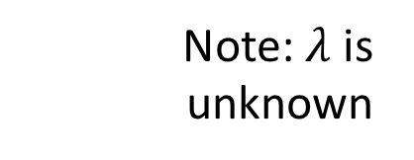
Camera calibration
Suppose we know that (X,Y,Z) in the world projects to (x,y) in the image.
How many equations does this provide?
Note: $λ$ is unknown

Slide 9
Camera calibration
Suppose we know that (X,Y,Z) in the world projects to (x,y) in the image.
How many equations does this provide?

Slide 10
Camera calibration
Suppose we know that (X,Y,Z) in the world projects to (x,y) in the image.
How many equations does this provide?

Slide 11
Camera calibration
Suppose we know that (X,Y,Z) in the world projects to (x,y) in the image.
How many equations does this provide?
2 equations!
Are the equations linear in the parameters?
How many equations do we need?

Slide 12
Camera calibration
In matrix vector form: Ap = 0
6 points give 12 equations, 12 variables to solve for
But can only solve upto scale

Slide 13

Camera calibration
In matrix vector form: Ap = 0
We want non-trivial solutions
If p is a solution, $α$p is a solution too
Let’s just search for a solution with unit norm
s.t

Slide 14
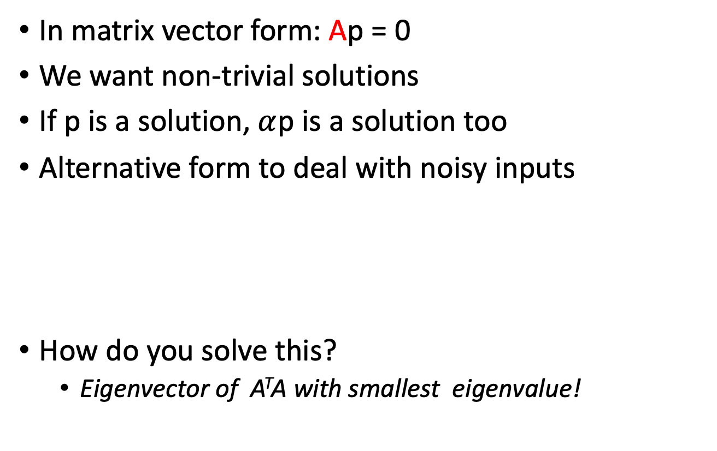
Camera calibration
In matrix vector form: Ap = 0
We want non-trivial solutions
If p is a solution, $α$p is a solution too
Alternative form to deal with noisy inputs
How do you solve this?
  Eigenvector of A^{T}A with smallest eigenvalue!
s.t

Slide 15
Camera calibration
We need 6 world points for which we know image locations
Would any 6 points work?
  What if all 6 points are the same?
Need at least 6 non-coplanar points!

Slide 16
Camera calibration
How do we get K, R and t from P?
Need to make some assumptions about K
What if K is upper triangular?
Added skew if image x and y axes are not perpendicular

Slide 17
Camera calibration
How do we get K, R and t from P?
Need to make some assumptions about K
What if K is upper triangular?
P = K [ R t]
First 3 x 3 matrix of P is KR
“RQ” decomposition: decomposes an n x n matrix into product of upper triangular and rotation matrix

Slide 18
Camera calibration
How do we get K, R and t from P?
Need to make some assumptions about K
What if K is upper triangular?
P = K [ R t]
First 3 x 3 matrix of P is KR
“RQ” decomposition: decomposes an n x n matrix into product of upper triangular and rotation matrix
t = K⁻¹P[:,2] ← last column of P

Slide 19
Camera calibration and pose estimation
Where camera is relative to car equivalent to where car is relative to camera

Slide 20
Reconstructing world points given camera
Can we recover this from just a single equation?

Slide 21
Ambiguity
A pixel corresponds to an entire ray
  2 linear equations in 3D space
Need additional constraints!

Slide 22
Triangulation
A pixel corresponds to an entire ray
  2 linear equations in 3D space
If we have corresponding pixel from another view, can intersect rays!
  4 equations

Slide 23
Binocular stereo
Single
If we know where cameras are, we can shoot rays from corresponding pixels and intersect

Slide 24
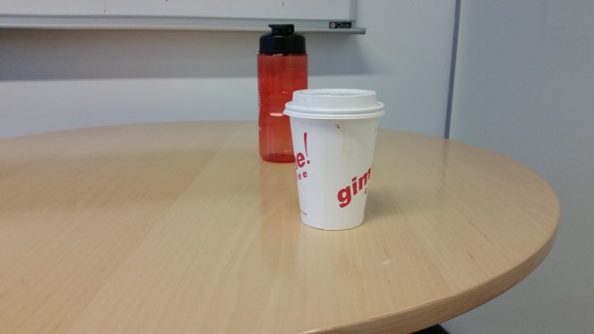
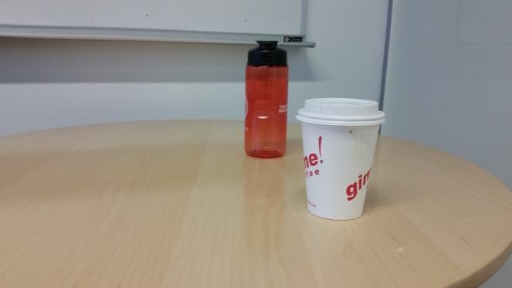
Triangulation
Suppose we have two cameras
  Calibrated: parameters known
And a pair of corresponding pixels
Find 3D location of point!

Slide 25
Triangulation
Suppose we have two cameras
  Calibrated: parameters known
And a pair of corresponding pixels
Find 3D location of point!
(x₁,y₁)
(x₂,y₂)

Slide 26
Triangulation

Slide 27
Triangulation

Slide 28
Triangulation
1 image gives 2 equations
Need 2 images!
Solve linear equations to get 3D point location

Slide 29
Linear vs non-linear optimization

Slide 30
Linear vs non-linear optimization
Reprojection error

Slide 31
Linear vs non-linear optimization
Reprojection error
Reprojection error is the squared error between the true image coordinates of a point and the projected coordinates of hypothesized 3D point
Actual error we care about
Minimize total sum of reprojection error across all images
Non-linear optimization

Slide 32
Binocular stereo
Given two calibrated cameras
  Find pairs of corresponding pixels
  Use corresponding image locations to set up equations on world coordinates
  Solve!

Slide 33
Binocular stereo
General case: cameras can be arbitrary locations and orientations

Slide 34
Binocular stereo
Special case: cameras are parallel to each other and translated along X axis
X axis
Z axis

Slide 35
Stereo with rectified cameras
Special case: cameras are parallel to each other and translated along X axis
X axis
Z axis

Slide 36
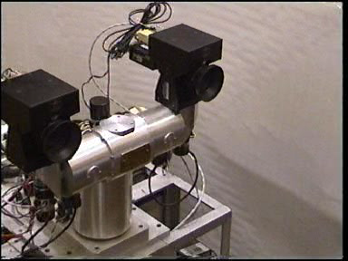
Stereo head
Kinect / depth cameras

Slide 37
Stereo with “rectified cameras”

Slide 38
Perspective projection in rectified cameras
Without loss of generality, assume origin is at pinhole of 1st camera

Slide 39
Perspective projection in rectified cameras
Without loss of generality, assume origin is at pinhole of 1st camera

Slide 40
Perspective projection in rectified cameras
Without loss of generality, assume origin is at pinhole of 1st camera

Slide 41
Perspective projection in rectified cameras
Without loss of generality, assume origin is at pinhole of 1st camera

Slide 42
Perspective projection in rectified cameras
Without loss of generality, assume origin is at pinhole of 1st camera

Slide 43
Perspective projection in rectified cameras
Without loss of generality, assume origin is at pinhole of 1st camera

Slide 44
Perspective projection in rectified cameras
Without loss of generality, assume origin is at pinhole of 1st camera

Slide 45
Perspective projection in rectified cameras
Without loss of generality, assume origin is at pinhole of 1st camera
X coordinate differs by t_{x}/Z
Y coordinate is the same!

Slide 46
Perspective projection in rectified cameras
X coordinate differs by t_{x}/Z
That is, difference in X coordinate is inversely proportional to depth
Difference in X coordinate is called disparity
Translation between cameras (tx) is called baseline
disparity = baseline / depth

Slide 47
The disparity image
For pixel (x,y) in one image, only need to know disparity to get correspondence
Create an image with color at (x,y) = disparity
right image
disparity
left image

Slide 48
Perspective projection in rectified cameras
For rectified cameras, correspondence problem is easier
Only requires searching along a particular row.

Slide 49
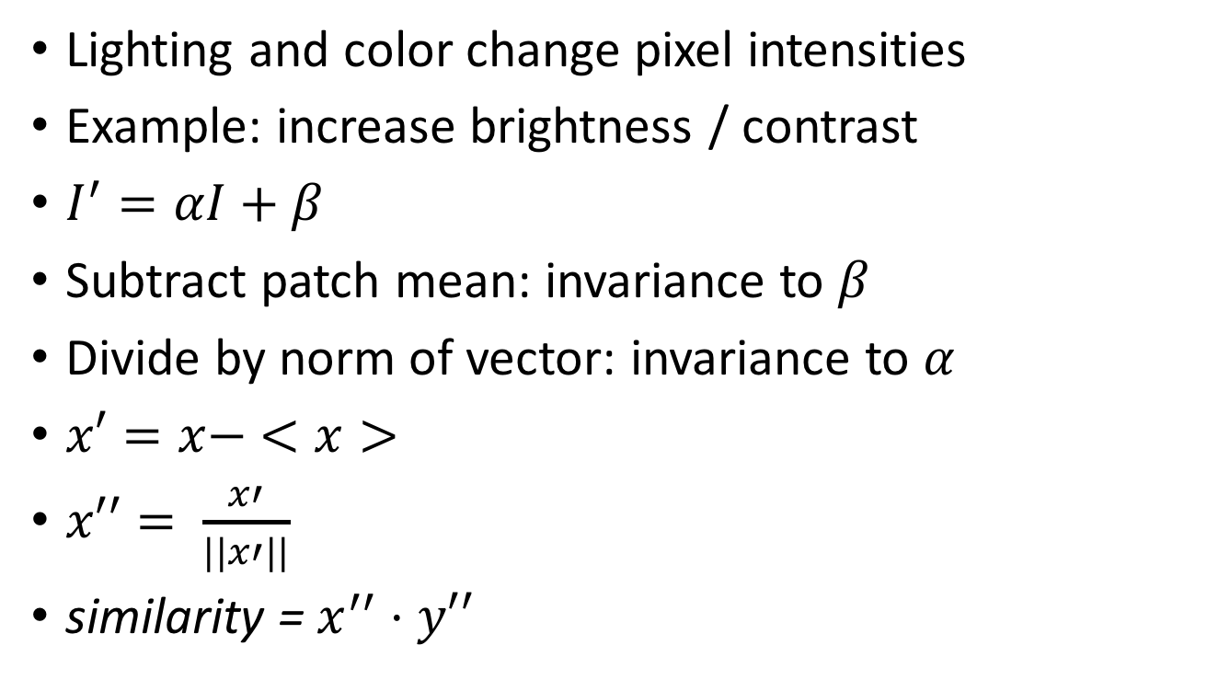
NCC - Normalized Cross Correlation
Lighting and color change pixel intensities
Example: increase brightness / contrast
$I^{′}=αI+β$
Subtract patch mean: invariance to $β$
Divide by norm of vector: invariance to $α$
$x′=x− <x>$
$x′′= \frac{x′}{||x′||}$
similarity = $x^{′′}⋅y′′$

Slide 50
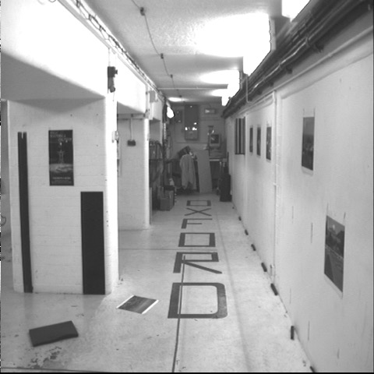
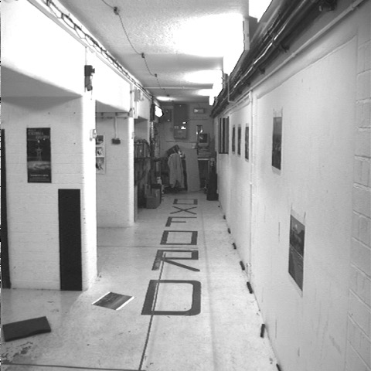


Cross-correlation of neighborhood
translate so that mean is zero

Slide 51

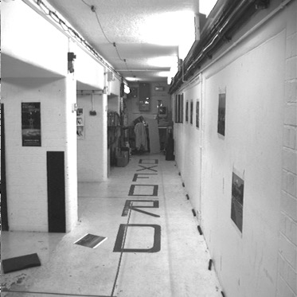
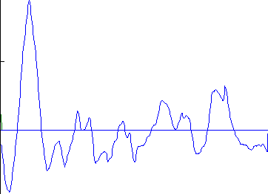
left image band
right image band
1
0.5
cross correlation
0
x

Slide 52
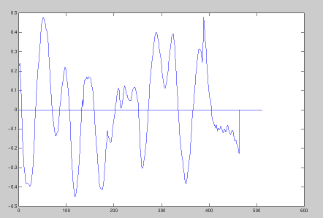
target region
left image band
right image band
1
0.5
cross correlation
0
x

Slide 53
The NCC cost volume
Consider M x N image
Suppose there are D possible disparities.
For every pixel, D possible scores
Can be written as an M x N x D array
To get disparity, take max along 3rd axis

Slide 54
Computing the NCC volume
For every pixel (x, y)
  For every disparity d
    Get normalized patch from image 1 at (x, y)
    Get normalized patch from image 2 at (x + d, y)
    Compute NCC

Slide 55
Computing the NCC volume
For every disparity d
  For every pixel (x, y)
    Get normalized patch from image 1 at (x, y)
    Get normalized patch from image 2 at (x + d, y)
    Compute NCC
Assume all pixels lie at same disparity d (i.e., lie on same plane) and compute cost for each
Plane sweep stereo

Slide 56
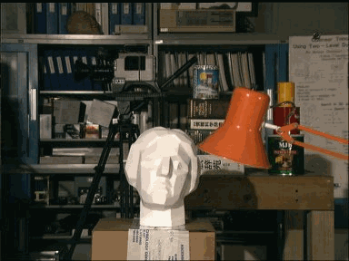
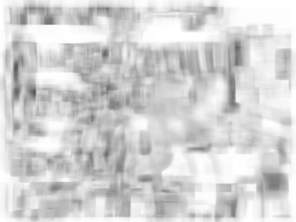
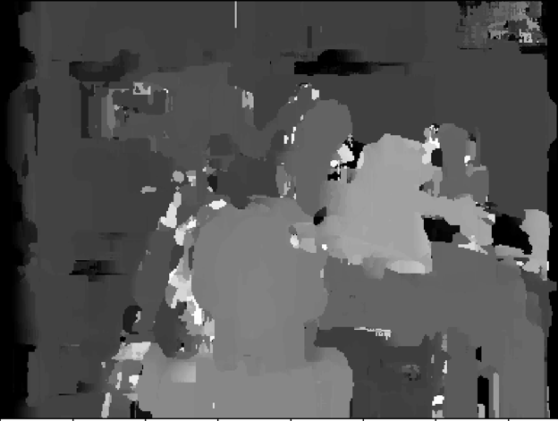

Slide 57
Rectifying cameras
Given two images from two cameras with known relationship, can we rectify them?

Slide 58
Rectifying cameras
Can we rotate / translate cameras?
  Do we need to know the 3D structure of the world to do this?

Slide 59
Rotating cameras
Assume K is identity
Assume coordinate system at camera pinhole

Slide 60
Rotating cameras
Assume K is identity
Assume coordinate system at camera pinhole

Slide 61
Rotating cameras
What happens if the camera is rotated?

Slide 62
Rotating cameras
What happens if the camera is rotated?
No need to know the 3D structure
Rotation matrix
Homogenous coordinates of mapped pixel
Homogenous coordinates of original pixel

Slide 63
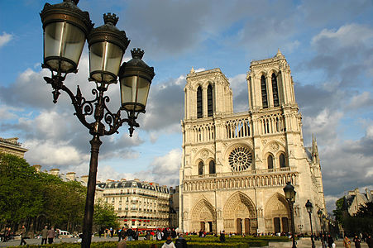
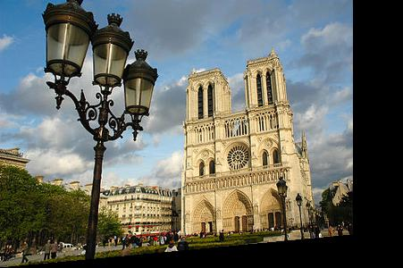
Rotating cameras

Slide 64
Rectifying cameras

Slide 65
Rectifying cameras

Slide 66
Rectifying cameras

Slide 67
Rectifying cameras

Slide 68
Perspective projection in rectified cameras
For rectified cameras, correspondence problem is easier
Only requires searching along a particular row.

Slide 69
Perspective projection in rectified cameras
What about non-rectified cameras?
Is there an equivalent?
For rectified cameras, correspondence problem is easier
Only requires searching along a particular row.

Slide 70
A similar special case
Fixating camera system
Eyes fixate on object
Angle at which they merge proportional to inverse depth
b
Z
a

