Slide 1
Image processing

Slide 2
Today
Consequences of image formation
Some basic primitives needed for computer vision problems
Edge detection
Image resizing
Convolution as a basic operation
Image pyramids as a basic structure

Slide 3
Recap
Geometry:
Color (Lambertian assumptipn):

Slide 4
Consequences of image formation
Nearby objects appear larger
Parallel lines and planes converge
Information lost: distance from camera
Pixel color depends on light intensity, light direction and surface normal and paint on object
So objects in images
can appear in many different sizes and many positions
can have very different color

Slide 5
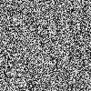
Consequence 1: nearby pixels are similar

Slide 6
Consequence 1: nearby pixels are similar
Why?
Nearby pixels in pinhole camera lead to nearby rays
Nearby rays mostly fall on the same object
Objects have mostly smooth surfaces and mostly uniform color
Lighting is mostly uniform

Slide 7
Consequence 1: nearby pixels are similar
Nearby pixels that are not similar tend to have different depth, surface normal, paint or lighting
Idea: Abrupt changes in color can delineate objects, be a clue to shape, or be distinctive marks
Depth discontinuities
Changes in albedo
Normal discontinuities

Slide 8
Key primitive: edge detection

Slide 9
Consequence 2: Farther away objects appear smaller

Slide 10
Key primitive: Image resizing
May need to match objects/patches across different scales.

Slide 11
Some primitives
Edge detection: identifying where pixels change color
Cue to object boundary
Cue to shape
More resilient to lighting than pixel color
Image resizing: downsizing or upscaling images
Allows searching over scales
Basic operation: convolution

Slide 12
Convolution

Slide 13
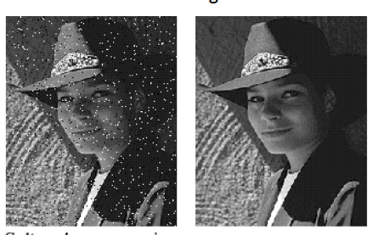
Image denoising

Slide 14
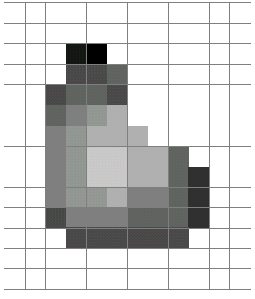
What is an image?
A grid (matrix) of intensity values: 1 color or 3 colors
255 | 255 | 255 | 255 | 255 | 255 | 255 | 255 | 255 | 255 | 255 | 255
255 | 255 | 255 | 255 | 255 | 255 | 255 | 255 | 255 | 255 | 255 | 255
255 | 255 | 255 | 20 | 0 | 255 | 255 | 255 | 255 | 255 | 255 | 255
255 | 255 | 255 | 75 | 75 | 75 | 255 | 255 | 255 | 255 | 255 | 255
255 | 255 | 75 | 95 | 95 | 75 | 255 | 255 | 255 | 255 | 255 | 255
255 | 255 | 96 | 127 | 145 | 175 | 255 | 255 | 255 | 255 | 255 | 255
255 | 255 | 127 | 145 | 175 | 175 | 175 | 255 | 255 | 255 | 255 | 255
255 | 255 | 127 | 145 | 200 | 200 | 175 | 175 | 95 | 255 | 255 | 255
255 | 255 | 127 | 145 | 200 | 200 | 175 | 175 | 95 | 47 | 255 | 255
255 | 255 | 127 | 145 | 145 | 175 | 127 | 127 | 95 | 47 | 255 | 255
255 | 255 | 74 | 127 | 127 | 127 | 95 | 95 | 95 | 47 | 255 | 255
255 | 255 | 255 | 74 | 74 | 74 | 74 | 74 | 74 | 255 | 255 | 255
255 | 255 | 255 | 255 | 255 | 255 | 255 | 255 | 255 | 255 | 255 | 255
255 | 255 | 255 | 255 | 255 | 255 | 255 | 255 | 255 | 255 | 255 | 255
=

Slide 15
Mean filtering: replace pixel by mean of neighborhood
0 | 0 | 0 | 0 | 0 | 0 | 0 | 0 | 0 | 0
0 | 0 | 0 | 10 | 10 | 10 | 0 | 0 | 0 | 0
0 | 0 | 10 | 20 | 20 | 20 | 10 | 40 | 0 | 0
0 | 10 | 20 | 30 | 0 | 20 | 10 | 0 | 0 | 0
0 | 10 | 0 | 30 | 40 | 30 | 20 | 10 | 0 | 0
0 | 10 | 20 | 30 | 40 | 30 | 20 | 10 | 0 | 0
0 | 10 | 20 | 10 | 40 | 30 | 20 | 10 | 0 | 0
0 | 10 | 20 | 30 | 30 | 20 | 10 | 0 | 0 | 0
0 | 0 | 10 | 20 | 20 | 0 | 10 | 0 | 20 | 0
0 | 0 | 0 | 10 | 10 | 10 | 0 | 0 | 0 | 0
(0 + 0 + 0 + 10 + 40 + 0 + 10 + 0 + 0)/9 = 6.66

Slide 16
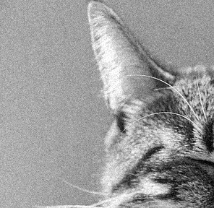
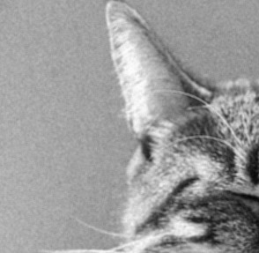
Noise reduction using mean filtering

Slide 17
A more general version
0 | 10 | 5 | 7 | 0
5 | 11 | 6 | 8 | 3
9 | 22 | 4 | 5 | 1
2 | 9 | 14 | 6 | 7
3 | 10 | 15 | 12 | 9
 |  | 7
Local image data
Kernel size = 2k+1

Slide 18
Convolution and cross-correlation
Cross correlation
Convolution

Slide 19

Convolution
Adapted from F. Durand

Slide 20
Properties: Linearity

Slide 21
Properties: Linearity

Slide 22
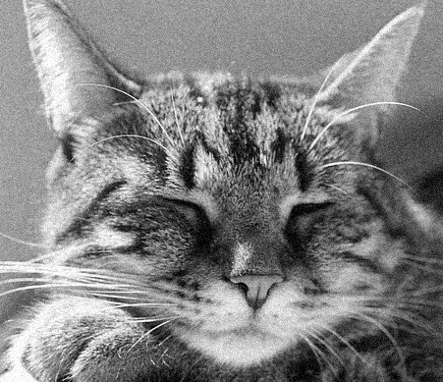
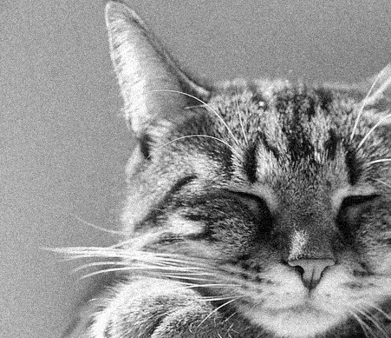
Properties: Shift invariance
f
f’

Slide 23
Shift invariance

Slide 24
Shift invariance
Shift, then convolve = convolve, then shift
Convolution does not depend on where the pixel is
f
f’

Slide 25


Why is convolution important?
Shift invariance is a crucial property

Slide 26
Why is convolution important?
We like linearity
Linear functions behave predictably when input changes
Lots of theory just easier with linear functions
All linear shift-invariant systems can be expressed as a convolution
Basic primitive in computer vision

Slide 27
Image resizing

Slide 28
Why is resizing hard?
E.g, consider reducing size by a factor of 2
Simple solution: subsampling
Example: subsampling by a factor of 2

Slide 29
Why is resizing hard?
Dropping pixels causes problems

Slide 31
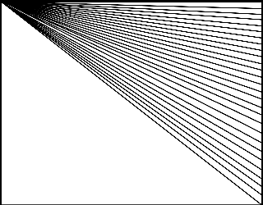

Slide 32

Aliasing in time

Slide 33
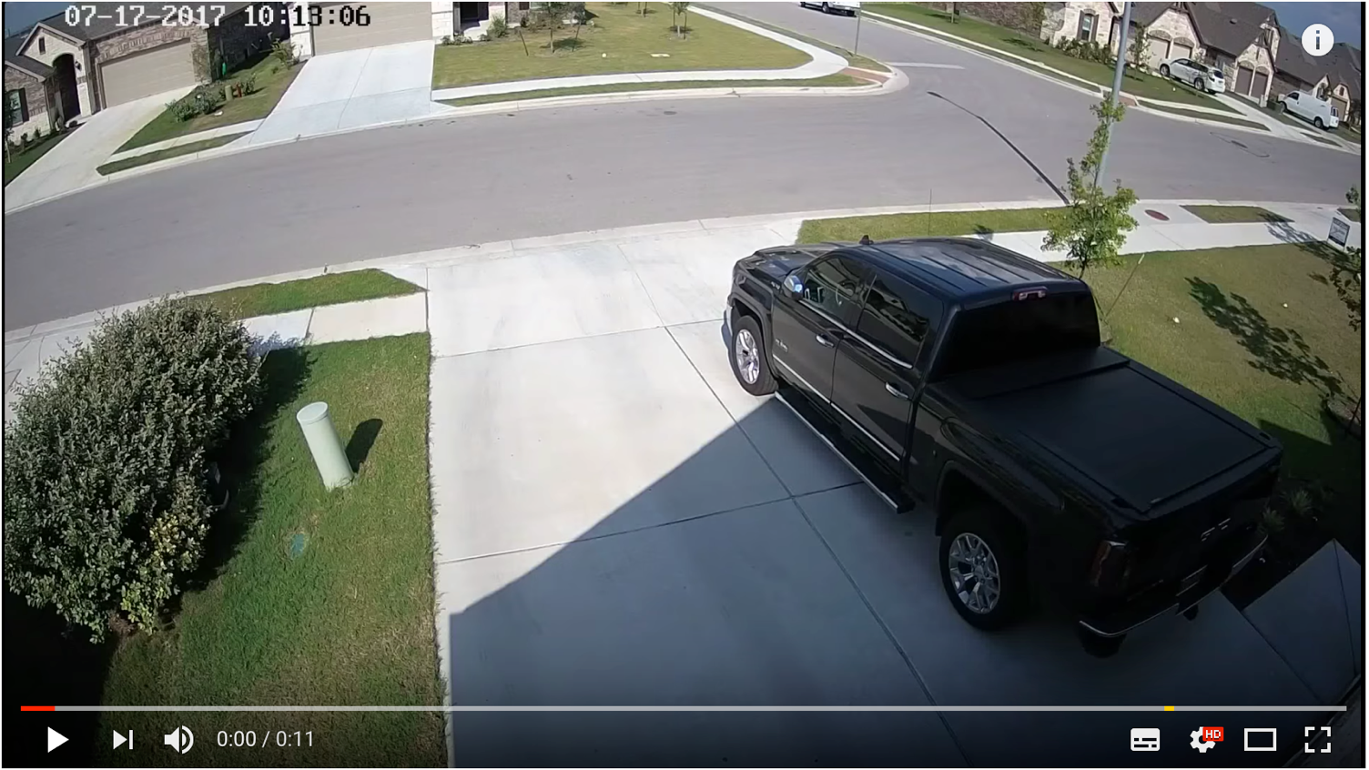
Aliasing in time

Slide 34
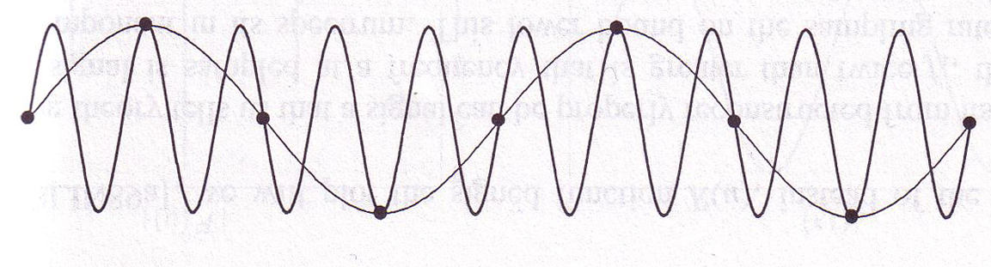
Why does aliasing happen?
We ”miss” things between samples
High frequency signals might appear as low frequency signals
Called “aliasing”
© Kavita Bala, Computer Science, Cornell University

Slide 35
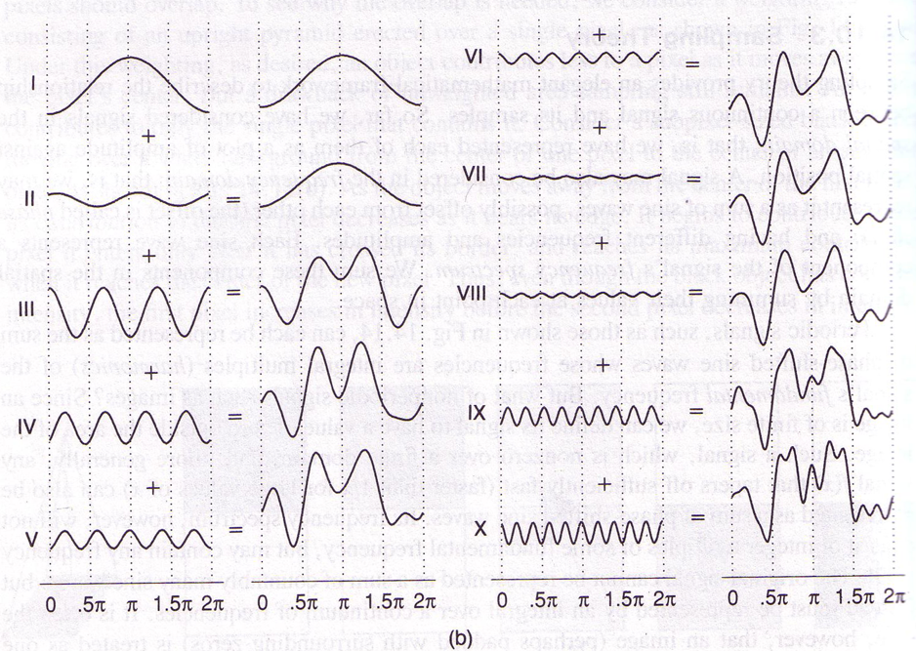
What about the general case?
Every signal (doesn’t matter what it is)
Sum of sine/cosine waves
Fourier transform

Slide 36
Fourier transform
Represent each signal as a linear combination of sines and cosines
Equivalent to a change of basis
Fourier transform = representation of signal in Fourier basis

Slide 37
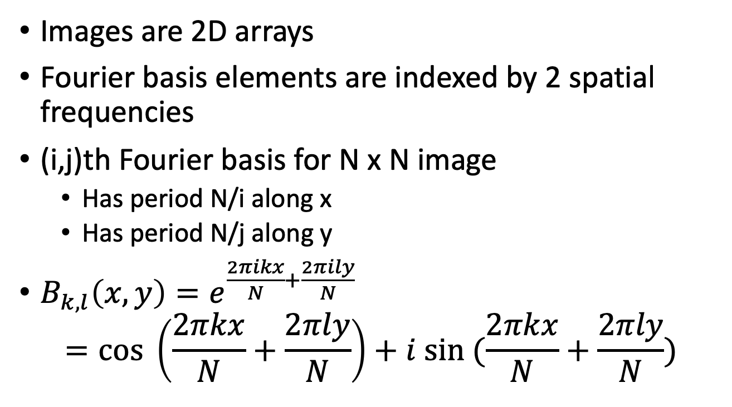
Fourier transform for images
Images are 2D arrays
Fourier basis elements are indexed by 2 spatial frequencies
(i,j)th Fourier basis for N x N image
Has period N/i along x
Has period N/j along y
$B_{k,l}\left(x,y\right)=e^{\frac{2πikx}{N}+\frac{2πily}{N}}$ $=cos \left(\frac{2πkx}{N}+\frac{2πly}{N}\right)+i sin (\frac{2πkx}{N}+\frac{2πly}{N})$

Slide 38
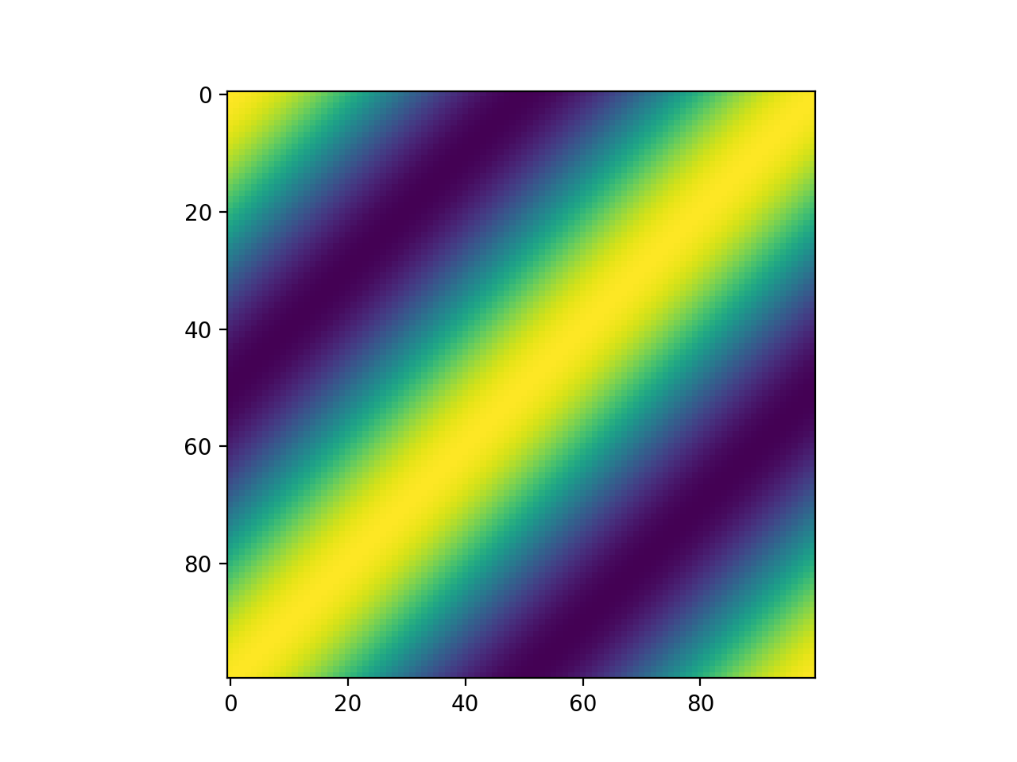
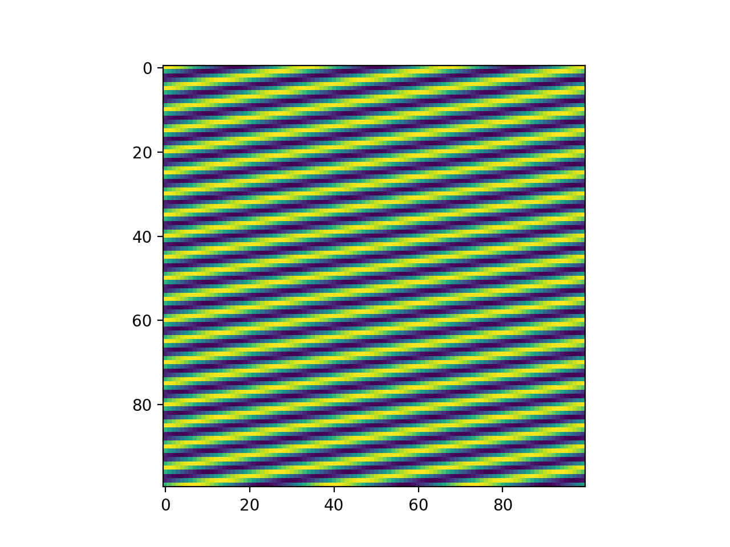
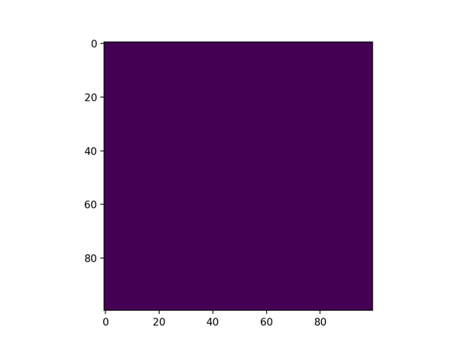
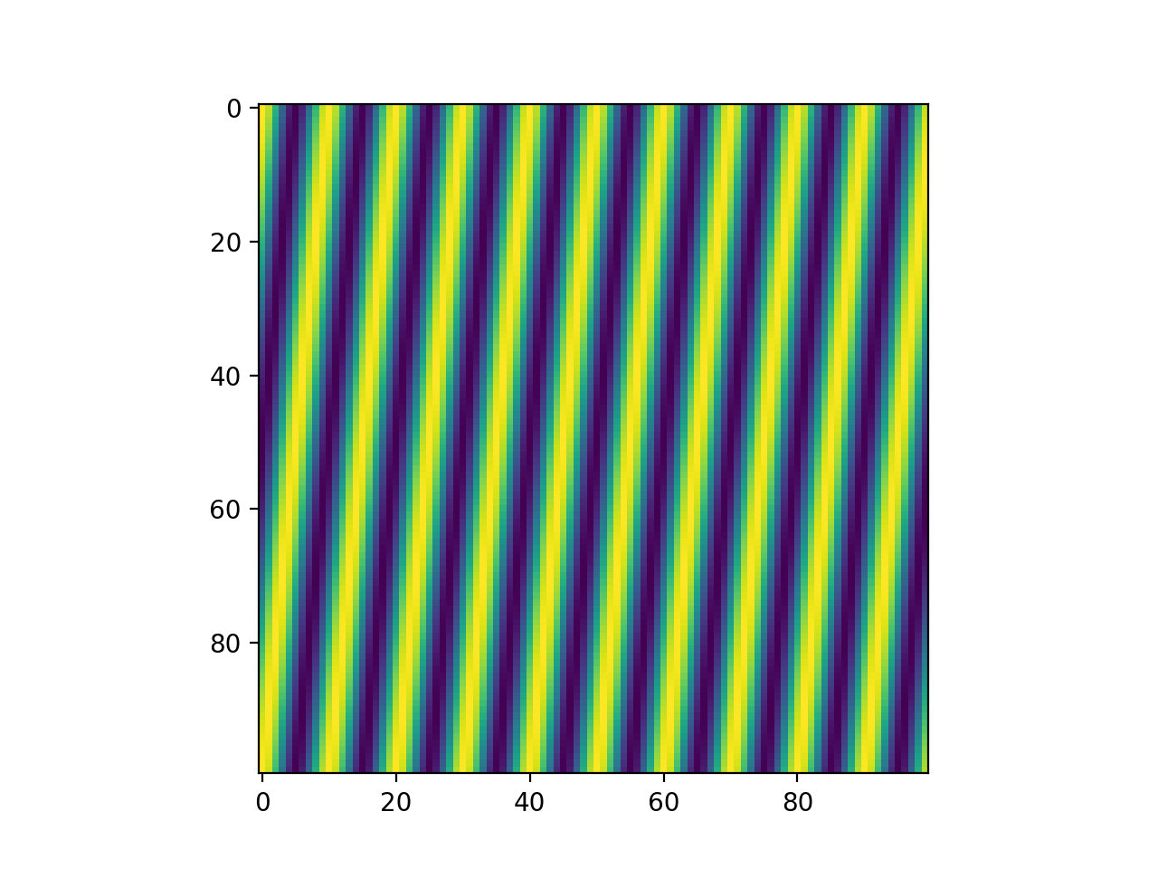




Visualizing the Fourier basis for images
$$B_{1,1}$$
$$B_{3,20}$$
$$B_{0,0}$$
$$B_{10,1}$$

Slide 39
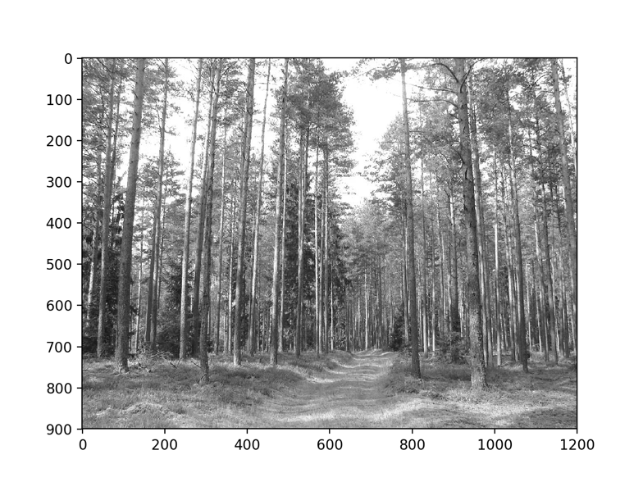
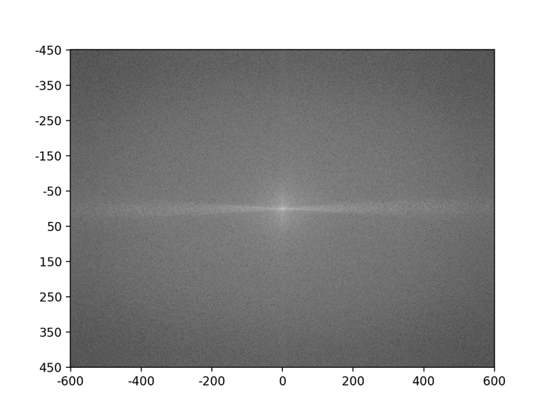
Visualizing the Fourier transform
Given NxN image, there are NxN basis elements
Fourier coefficients can be represented as an NxN image
High frequency in X

Slide 40
Aliasing

Slide 41
Aliasing
Image = linear combination of high frequency and low frequency components
Subsampling: high frequency components alias as low frequency
First smooth the image to remove high frequency components
How should we smooth?
Mean filtering?

Slide 42
Convolution and Fourier transforms
Image: Spatial domain
Fourier Transform: Frequency domain
Amplitudes are called spectrum
For any transformations we do in spatial domain, there are corresponding transformations we can do in the frequency domain
And vice-versa
Spatial Domain

Slide 43
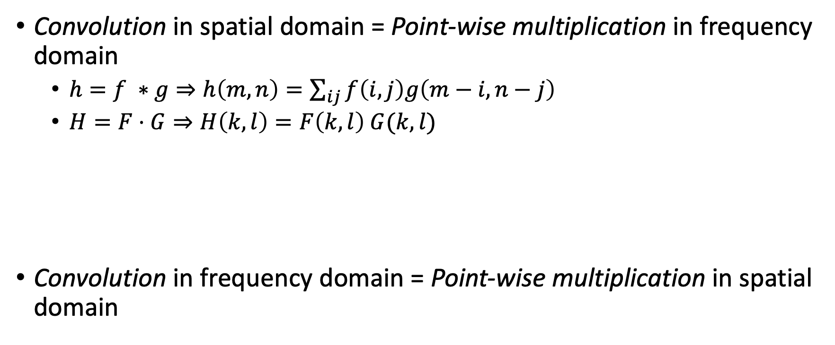
Convolution and Fourier transforms
Convolution in spatial domain = Point-wise multiplication in frequency domain
$h=f ∗g⇒h\left(m, n\right)=\sum_{ij}{f\left(i,j\right)g\left(m−i,n−j\right)}$
$H=F⋅G⇒H\left(k,l\right)=F\left(k,l\right) G(k,l)$
Convolution in frequency domain = Point-wise multiplication in spatial domain

Slide 44

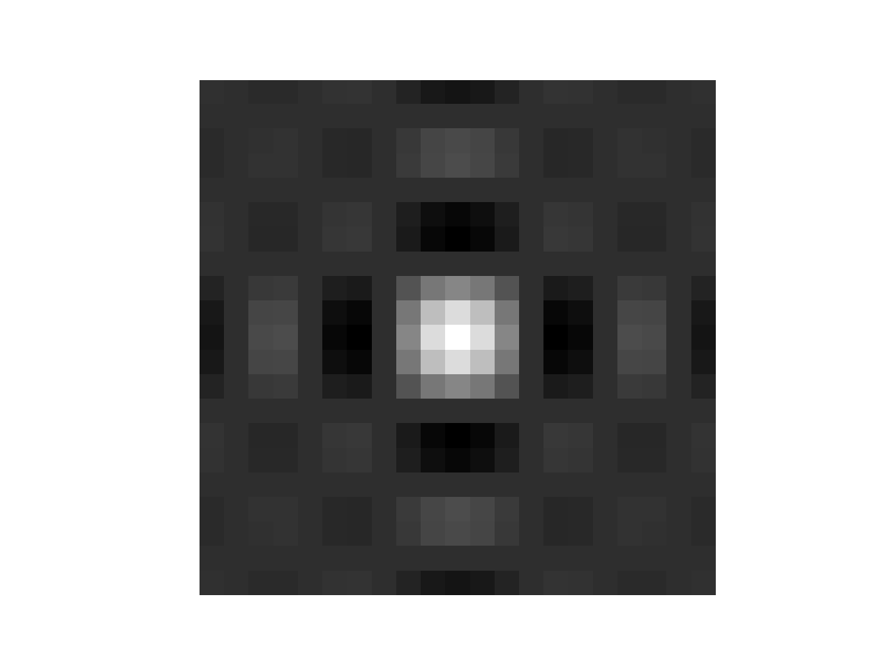
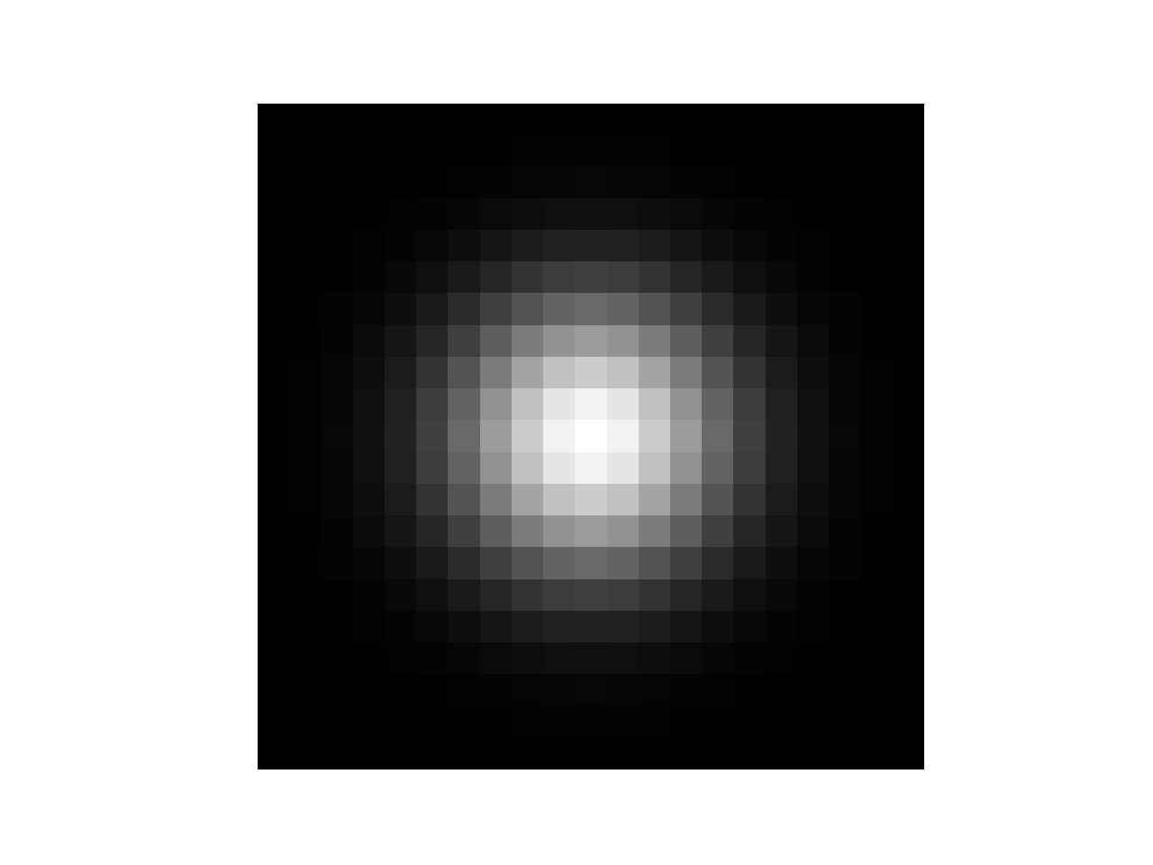
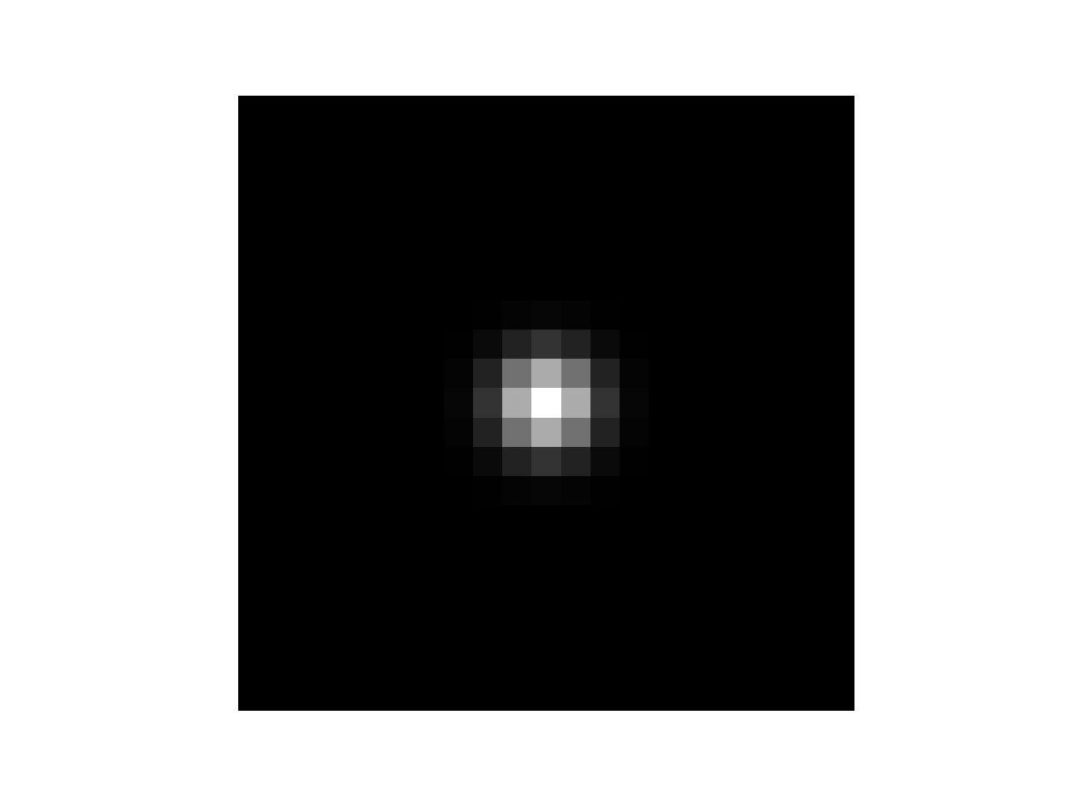
Smoothing and Fourier transforms
Mean filter = convolving with a “box” filter
Fourier transform
Filter
Box/mean filter
Gaussian filter

Slide 45

Subsampling before and after smoothing
Before
After

Slide 46
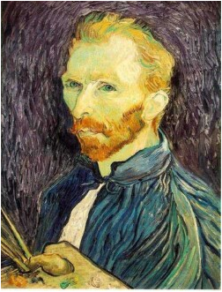
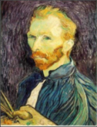






Gaussian pre-filtering
Solution: filter the image, then subsample
F₀
F₁
F₂
…
blur
subsample
blur
subsample
F₀ H
F₁ H
*
*

Slide 47
{
Gaussian pyramid
F₀
F₁
F₂
…
blur
subsample
blur
subsample
F₀ H
F₁ H
*
*

Slide 48
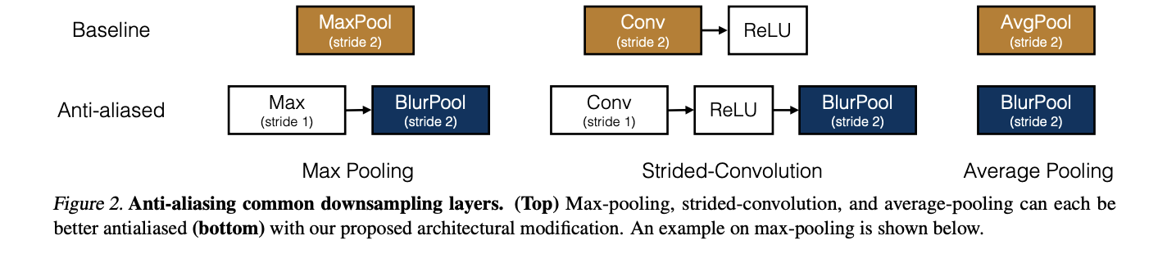
Anti-aliasing circa 2019
R. Zhang. Making convolutional networks shift-invariant again. In ICML, 2019.

Slide 49
Edge detection

Slide 50
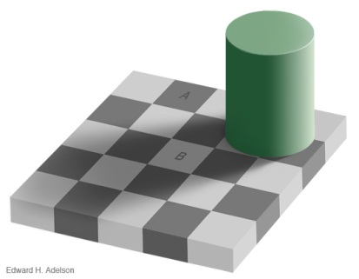
Edges
Edges are curves in the image, across which the brightness changes “a lot”
Corners/Junctions
Notes:
Reflctance edges
Shadow edges
Depth edges
Normal edges

Slide 51
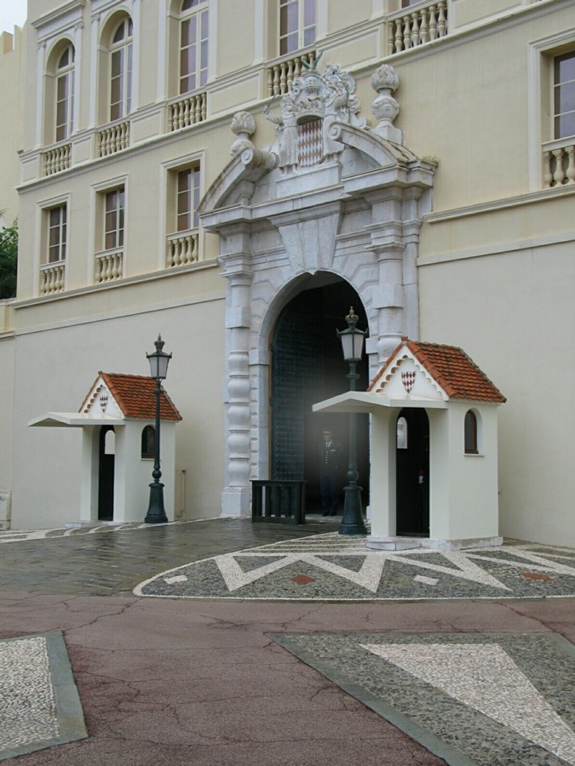
Closeup of edges
Source: D. Hoiem

Slide 52

Closeup of edges
Source: D. Hoiem

Slide 53

Closeup of edges
Source: D. Hoiem

Slide 54

Closeup of edges
Source: D. Hoiem

Slide 55

Characterizing edges
An edge is a place of rapid change in the image intensity function
intensity function (along horizontal scanline)
image
first derivative
edges correspond to extrema of derivative
Source: L. Lazebnik

Slide 56
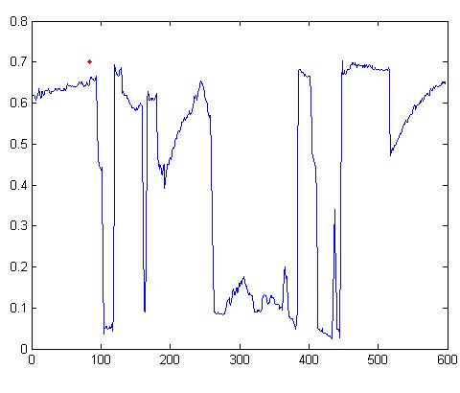

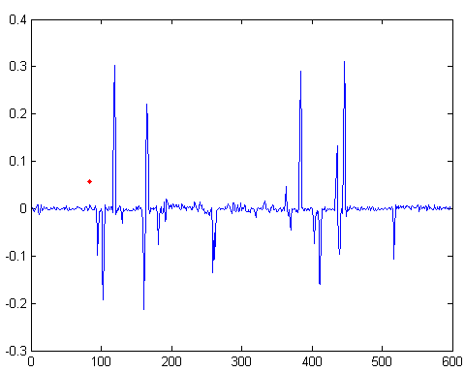
Intensity profile
Source: D. Hoiem

Slide 57
Derivatives and convolution
Differentiation is linear
Differentiation is shift-invariant
Derivative of shifted signal is shifted derivative
Hence, differentiation can be represented as convolution!

Slide 58
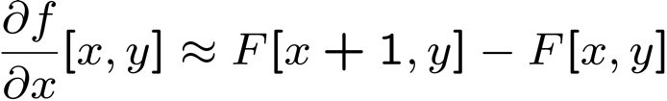




Image derivatives
How can we differentiate a digital image F[x,y]?
Option 1: reconstruct a continuous image, f, then compute the derivative
Option 2: take discrete derivative (finite difference)
How would you implement this as a linear filter?
1 | -1
 | -1
 | 1
:
:
Source: S. Seitz
Notes:
give definition of partial derivative: lim h->0 [f(x+h,y) – f(x,y)]/h

Slide 59
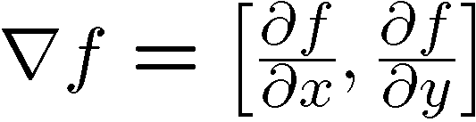
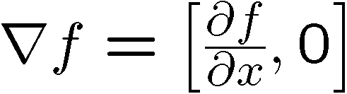
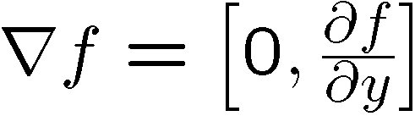
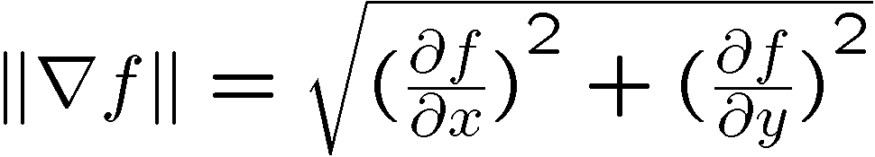
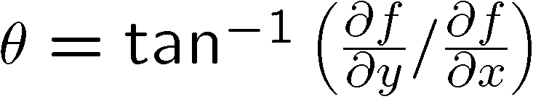
Image gradient
The gradient of an image:
The gradient points in the direction of most rapid increase in intensity
The edge strength is given by the gradient magnitude:
The gradient direction is given by:
how does this relate to the direction of the edge?
Source: Steve Seitz
Notes:
give definition of partial derivative: lim h->0 [f(x+h,y) – f(x,y)]/h
Gradient direction perpendicular to edge direction

Slide 60
Image gradient
Source: L. Lazebnik
Notes:
Top right: gradient magnitude
x, y

Slide 61
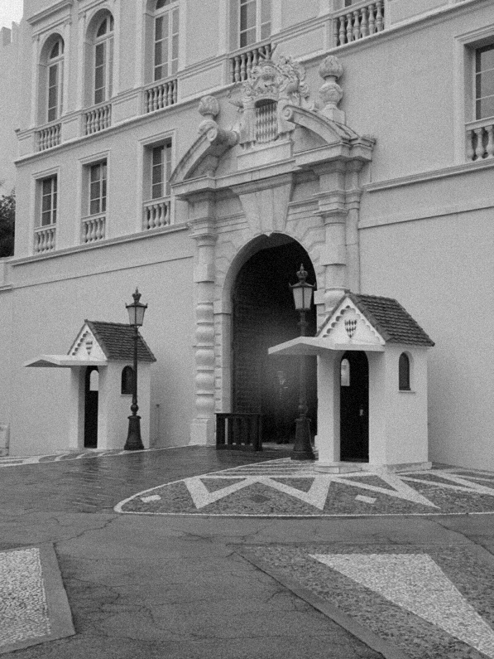
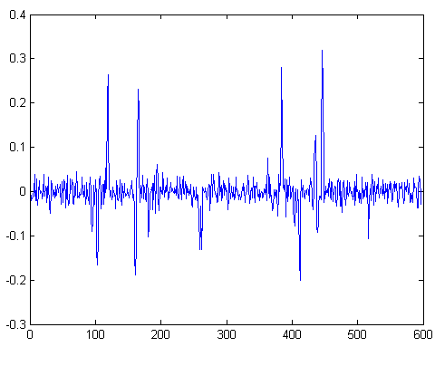
With a little Gaussian noise
Gradient
Source: D. Hoiem

Slide 62


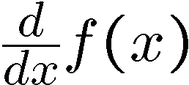
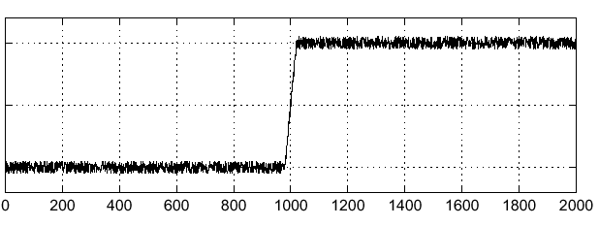
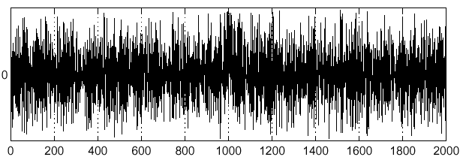
Effects of noise
Noisy input image
Where is the edge?
Source: S. Seitz
Notes:
How to fix?

Slide 63
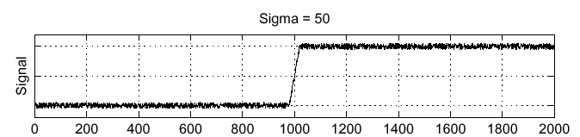
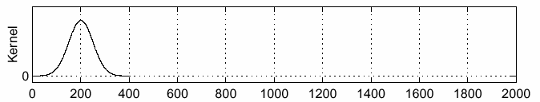
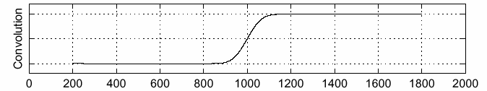
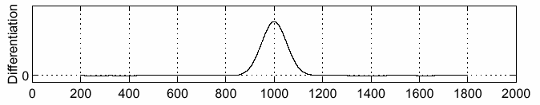
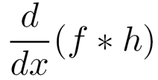
Solution: smooth first
f
h
f * h
To find edges, look for peaks in
Source: S. Seitz

Slide 64
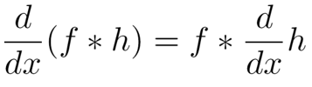
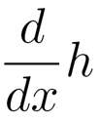
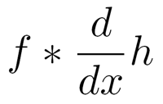
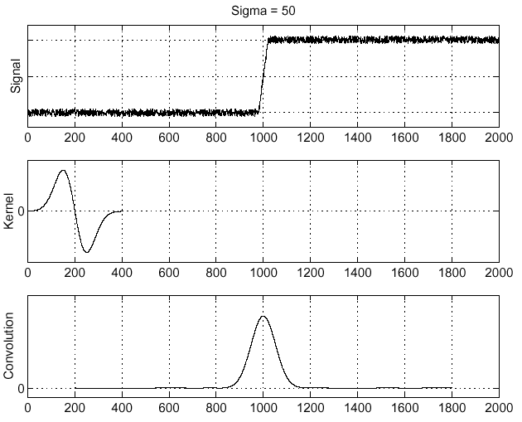
Associative property of convolution
Differentiation is a convolution
Convolution is associative:
This saves us one operation:
f
Source: S. Seitz

Slide 65
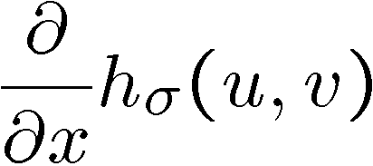



2D edge detection filters
derivative of Gaussian (x)
Gaussian
Notes:
How many 2nd derivative filters are there? There are four 2nd partial derivative filters.
In practice, it’s handy to define a single 2nd derivative filter—the Laplacian

Slide 66


Derivative of Gaussian filter
x-direction
y-direction

