Slide 1
Visual Question Answering

Slide 2
Visual Question Answering
Direct motivation: assistive technology
Indirect motivation: sandbox for reasoning
VQA: Visual Question Answering. Aishwarya Agrawal, Jiasen Lu, Stanislaw Antol, Margaret Mitchell, C. Lawrence Zitnick, Dhruv Batra, Devi Parikh. In ICCV, 2015.

Slide 3
Compositional reasoning
What is the color of the kitten to the left of the blue kitten?

Slide 4
Compositional reasoning
What is the color of the kitten to the left of the blue kitten?
Detect kittens
And
Look left
Detect blueness
Get color

Slide 5
Compositional reasoning
Triangle detector
Look left
Look left
Blue detector
Triangle detector
And
Get color
Get color
Red

Slide 6
Compositional reasoning
What is the color of the kitten to the left of the blue kitten?
Kitten detector
Look left
Blue detector
And
Get color

Slide 7
Compositional reasoning
What is the color of the kitten to the left of the blue kitten?
Kitten detector
Look left
Kitten detector
Blue detector
And
Look left
Get color
And
Blue detector
Get color

Slide 8
Compositional reasoning
How do we learn a mapping from language to trees?
  Problem: semantic parsing
  Option 1: Syntactic parsing
  Option 2: Use supervision
Neural module networks.Jacob Andreas, Marcus Rohrbach, Trevor Darrell and Dan Klein.CVPR 2016
Learning to compose neural networks for question answering.Jacob Andreas, Marcus Rohrbach, Trevor Darrell and Dan Klein.NAACL 2016
Learning to reason: End-to-end module networks for visual question answering.Ronghang Hu, Jacob Andreas, Marcus Rohrbach, Trevor Darrell and Kate Saenko.ICCV 2017
Inferring and Executing Programs for Visual Reasoning
Justin Johnson, Bharath Hariharan, Laurens van der Maaten, Judy Hoffman, Li Fei-Fei, C. Lawrence Zitnick, Ross Girshick. ICCV, 2017

Slide 9
Compositional reasoning

Slide 10
Embodied cognition

Slide 11
Recognition today
Large dataset of isolated, labeled images
Where do the images come from?
What do we do with the labels?
{(
, 1),
(
, 1),
(
, 0) , … }

Slide 12
Embodied agents
Agents that perceive and act in the world
Input images come from the physical world
“Recognition” is used to act

Slide 13
Embodied cognition
Perception now depends on action: state of agent or state of the world
  No more collections of isolated images
Feedback to agent comes through consequences of actions
  No well-defined labels
Three problems:
  Learning to act to achieve goals, with perception in the loop
  Self-supervised learning: learning perception from action
  Active perception: learning to act for perception

Slide 14
Reinforcement learning primer

Slide 15
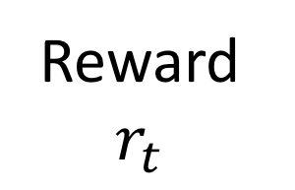

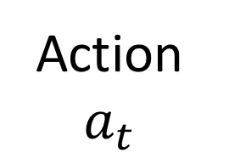
Markov decision processes
Agent acting in an environment
Environment has states that are known to agent
Agent takes actions
Action + random stuff leads to a state transition
Environment gives agent reward
Agent’s goal: maximize return = total reward over time
Agent’s policy: mapping from states to actions
Agent
Action $a_{t}$
State $s_{t}$
Reward $r_{t}$
Environment

Slide 16
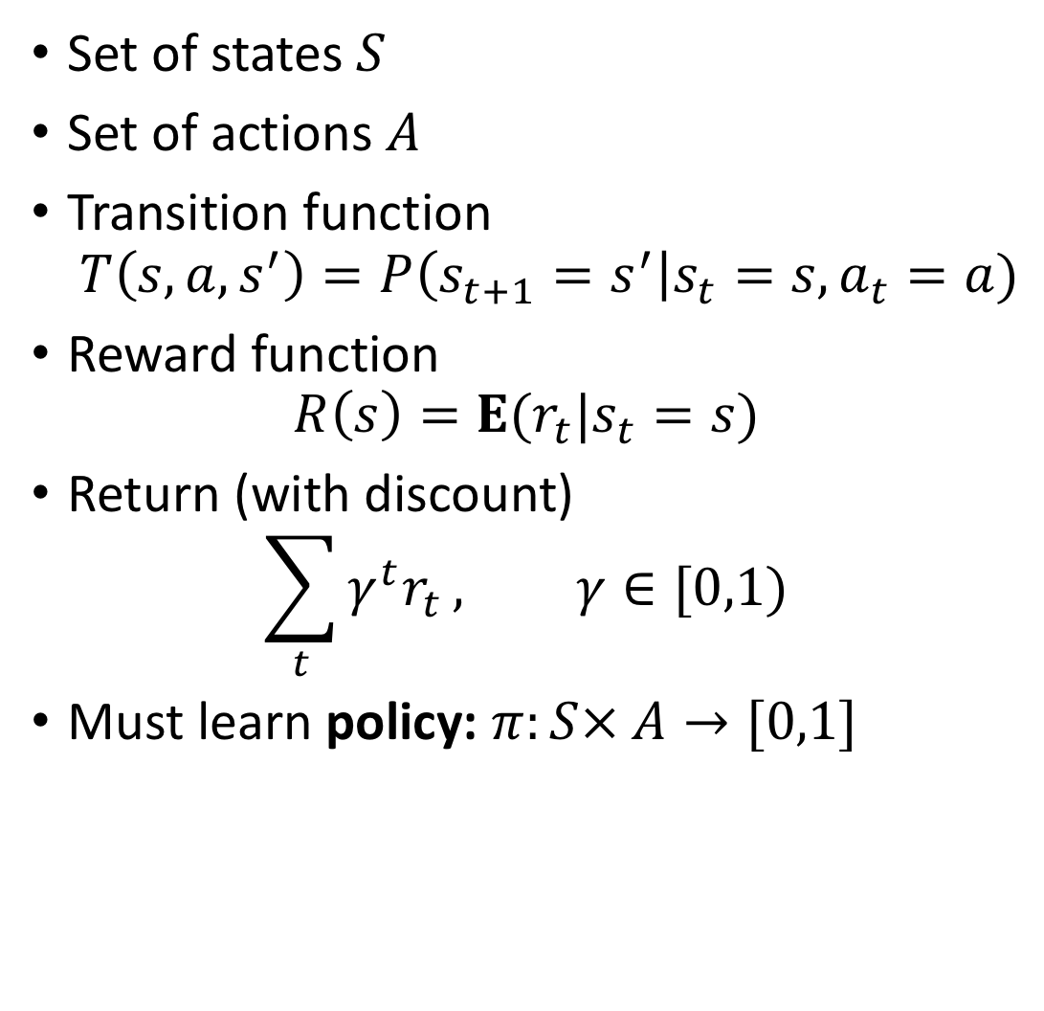
Markov decision processes
Set of states $S$
Set of actions $A$
Transition function
$T\left(s,a,s^{′}\right)=P\left(s_{t+1}=s^{′}\right|s_{t}=s, a_{t}=a)$
Reward function
$R\left(s\right)=E(r_{t}|s_{t}=s)$
Return (with discount)
$\sum_{t}{γ^{t}r_{t}}, γ∈[0,1)$
Must learn policy: $π:S× A→[0,1]$
Agent
Action $a_{t}$
State $s_{t}$
Reward $r_{t}$
Environment

Slide 17
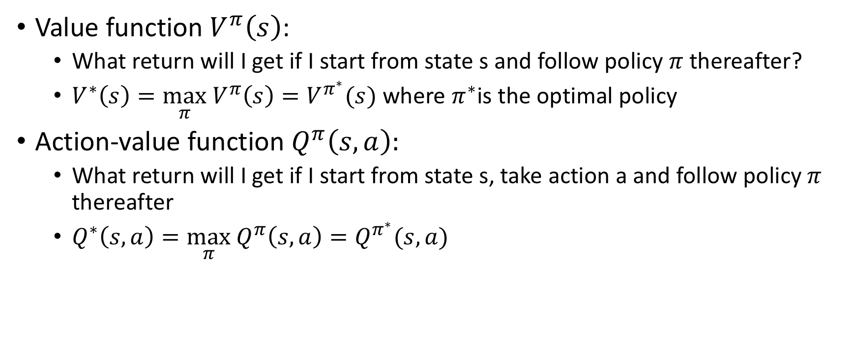
Markov decision processes
Value function $V^{π}\left(s\right)$:
  What return will I get if I start from state s and follow policy $π$ thereafter?
  $V^{∗}\left(s\right)=\max_{π} V^{π}\left(s\right)=V^{π^{∗}}(s)$ where $π^{∗}$is the optimal policy
Action-value function $Q^{π}\left(s,a\right):$
  What return will I get if I start from state s, take action a and follow policy $π$ thereafter
  $Q^{∗}\left(s,a\right)=\max_{π} Q^{π}\left(s,a\right)=Q^{π^{∗}}(s,a)$

Slide 18
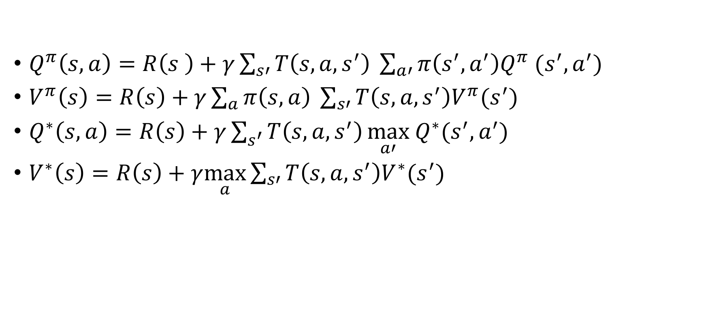
Bellman equations
$Q^{π}\left(s,a\right)=R\left(s \right)+γ\sum_{s′}{T\left(s,a,s^{′}\right)} \sum_{a′}{π\left(s^{′},a^{′}\right)Q^{π} (s^{′}, a^{′})}$
$V^{π}\left(s\right)=R\left(s\right)+γ\sum_{a}{π\left(s,a\right) }\sum_{s′}{T\left(s,a,s^{′}\right)V^{π}(s^{′})}$
$Q^{∗}\left(s,a\right)=R\left(s\right)+γ\sum_{s^{′}}{T\left(s,a,s^{′}\right)}\max_{a′} Q^{∗}(s^{′},a^{′})$
$V^{∗}\left(s\right)=R\left(s\right)+γ\max_{a}\sum_{s′}{T\left(s,a,s^{′}\right)V^{∗}(s^{′})}$

Slide 19
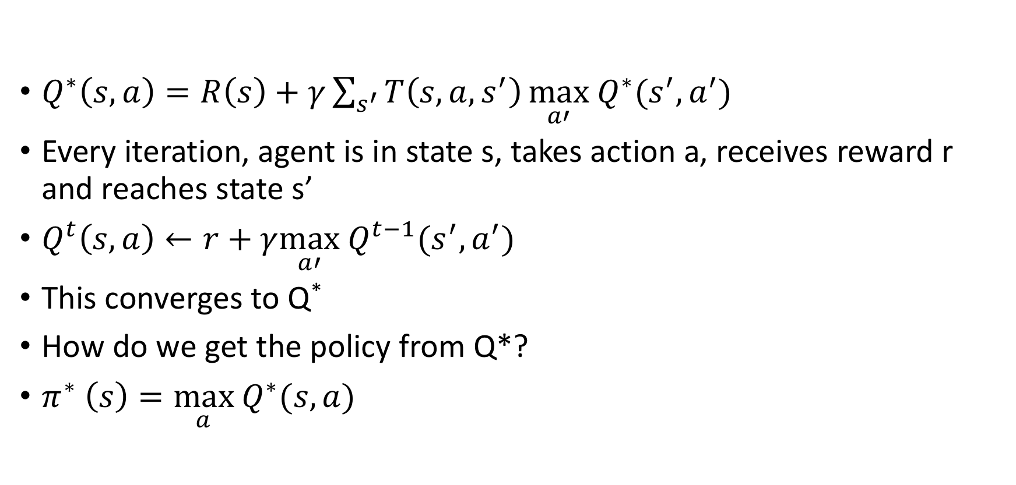
Q-learning
$Q^{∗}\left(s,a\right)=R\left(s\right)+γ\sum_{s^{′}}{T\left(s,a,s^{′}\right)}\max_{a′} Q^{∗}(s^{′},a^{′})$
Every iteration, agent is in state s, takes action a, receives reward r and reaches state s’
$Q^{t}\left(s,a\right)←r+γ\max_{a′} Q^{t−1}(s^{′},a^{′})$
This converges to Q*
How do we get the policy from Q*?
$π^{∗} \left(s\right)=\max_{a} Q^{∗}(s,a)$

Slide 20
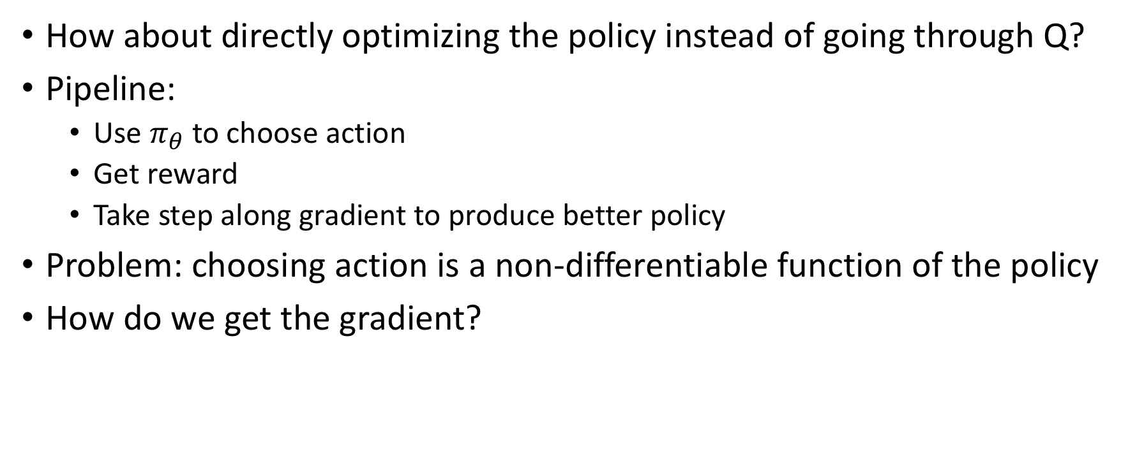
Policy gradient
How about directly optimizing the policy instead of going through Q?
Pipeline:
  Use $π_{θ}$ to choose action
  Get reward
  Take step along gradient to produce better policy
Problem: choosing action is a non-differentiable function of the policy
How do we get the gradient?

Slide 21
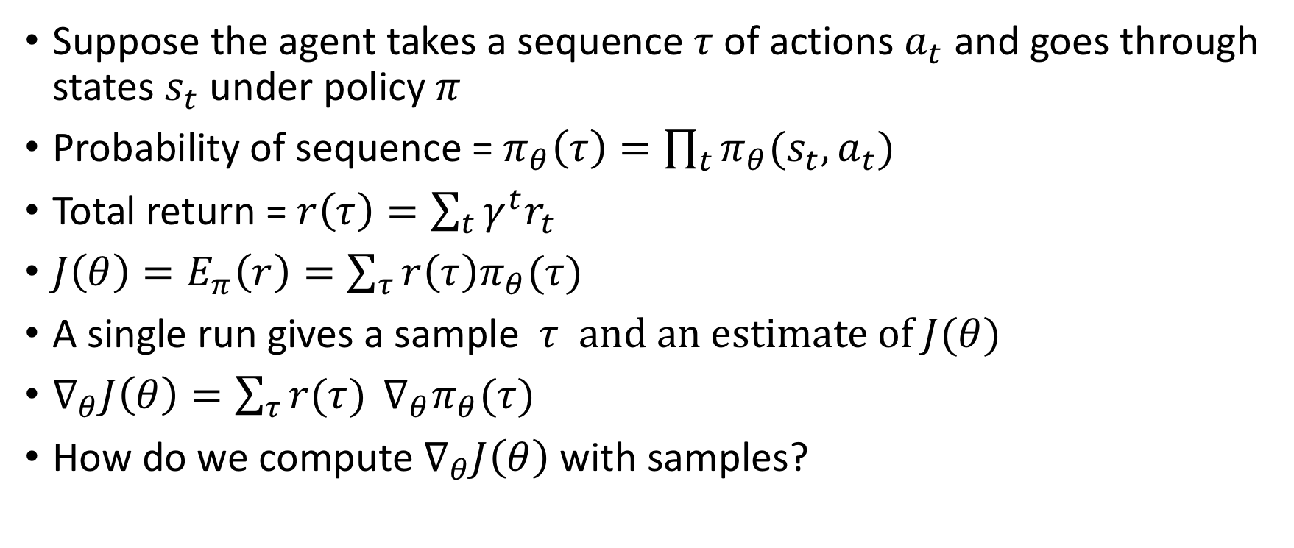
REINFORCE
Suppose the agent takes a sequence $τ$of actions $a_{t}$ and goes through states $s_{t}$ under policy $π$
Probability of sequence = $π_{θ}\left(τ\right)=\prod_{t}{π_{θ}(s_{t},a_{t})}$
Total return = $r\left(τ\right)=\sum_{t}{γ^{t}r_{t}}$
$J\left(θ\right)=E_{π}\left(r\right)=\sum_{τ}{r\left(τ\right)π_{θ}(τ)}$
A single run gives a sample $τ \text{and} \text{an} \text{estimate} \text{of} J(θ)$
$∇_{θ}J\left(θ\right)=\sum_{τ}{r(τ)} ∇_{θ}π_{θ}(τ)$
How do we compute $∇_{θ}J\left(θ\right)$ with samples?

Slide 22
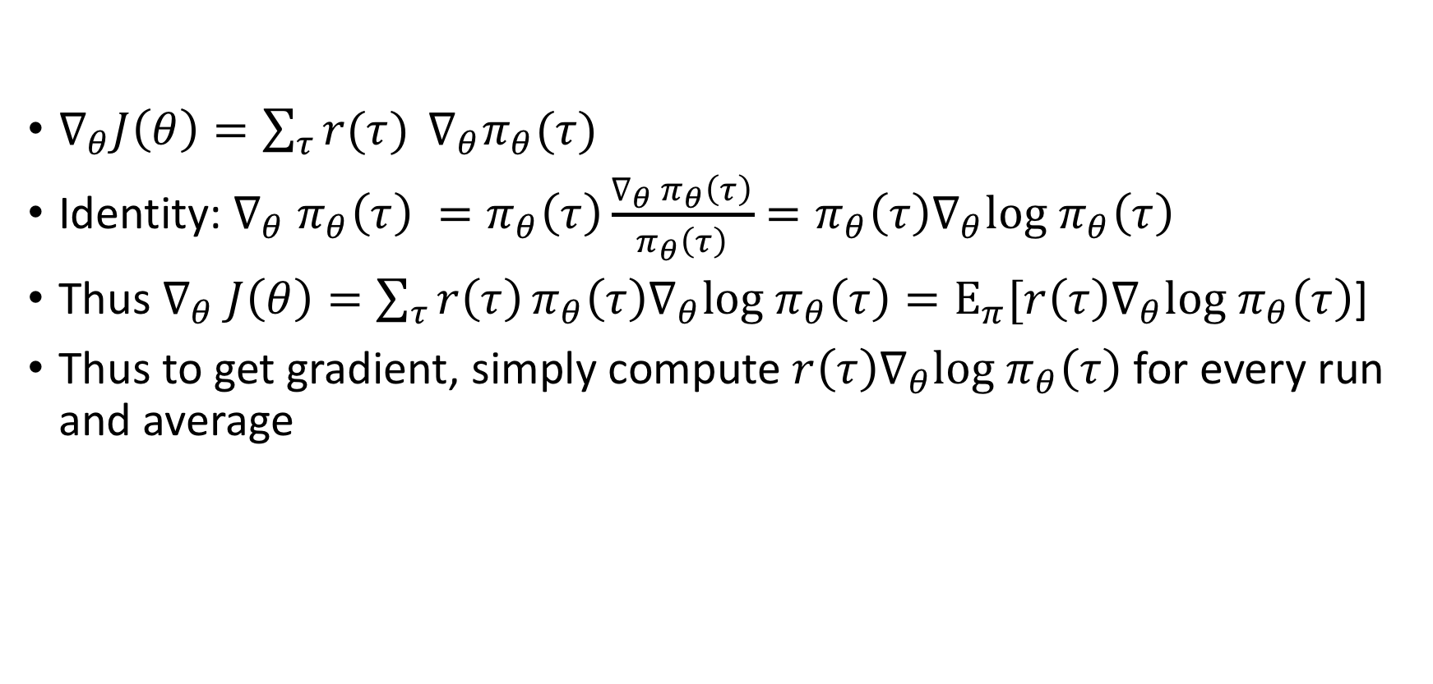
REINFORCE
$∇_{θ}J\left(θ\right)=\sum_{τ}{r(τ)} ∇_{θ}π_{θ}(τ)$
Identity: $∇_{θ} π_{θ}\left(τ\right) =π_{θ}\left(τ\right)\frac{∇_{θ} π_{θ}\left(τ\right)}{π_{θ}\left(τ\right)}=π_{θ}\left(τ\right)∇_{θ}log π_{θ}\left(τ\right)$
Thus $∇_{θ} J\left(θ\right)=\sum_{τ}{r\left(τ\right)}π_{θ}\left(τ\right)∇_{θ}log π_{θ}\left(τ\right)=E_{π}[r\left(τ\right)∇_{θ}log π_{θ}\left(τ\right)$]
Thus to get gradient, simply compute $r\left(τ\right)∇_{θ}log π_{θ}\left(τ\right)$ for every run and average

Slide 23
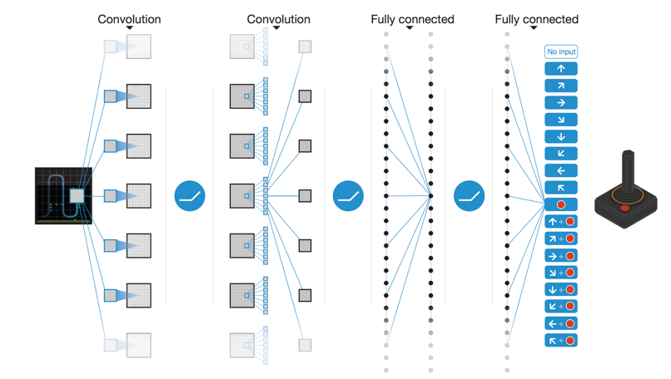
Learning to play Atari games
Mnih, Volodymyr, et al. "Human-level control through deep reinforcement learning." Nature518.7540 (2015): 529-533.

Slide 24
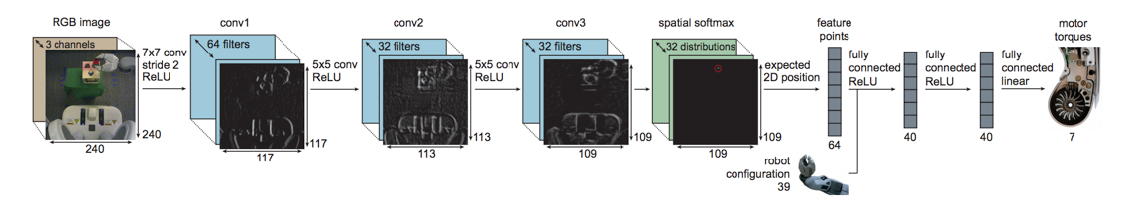
Learning to do robotic tasks
End-to-End Training of Deep Visuomotor Policies. S. Levine, C. Finn, T. Darrell, P. Abbeel. In JMLR, 2016

Slide 25
Reinforcement learning and generalization
RL learns a policy
Policies are specific to goals
Reinforcement learning = learning to play a particular game
Separate model for each game
  “Close this bottle”
  “Peel this banana”
General model?

Slide 26
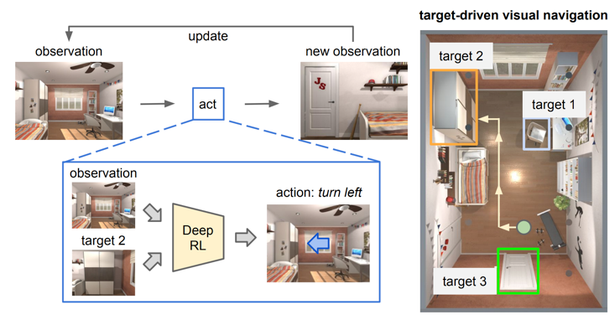
Discussion
Target-driven Visual Navigation in Indoor Scenes using Deep Reinforcement Learning. Y. Zhu, R. Mottaghi, E. Kolve, J. J. Lim, A. Gupta, L. Fei-fei, A. Farhadi. In ICRA, 2017

Slide 27
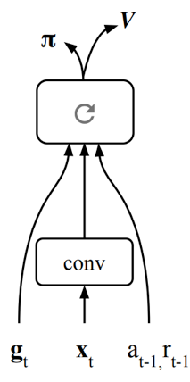
Partial observations
Assumption: image conveys the entire state
True for Atari, not true for real worls
Simple idea: let neural network maintain state internally
Mirowski, Piotr, et al. "Learning to Navigate in Cities Without a Map." arXiv preprint arXiv:1804.00168 (2018).

Slide 28
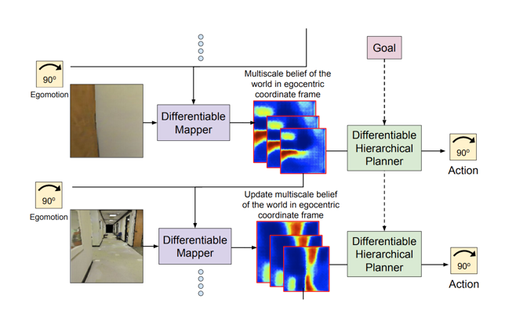
Incorporating domain knowledge
Should we rely on learning entirely?
E.g. for navigation, maintain a map of the environment and of agent’s state within it
Classical solution: SLAM (Simultaneous localization and mapping)
Gupta, Saurabh, et al. "Cognitive mapping and planning for visual navigation." arXiv preprint arXiv:1702.03920 3 (2017).

Slide 29
Reflex agents
Reflex agents
  Map states to actions
  Are feedforward
  Cannot explore / back-track
  Have to be trained on each environment

Slide 30
Planning
If we can predict consequences of actions, we can plan

Slide 31
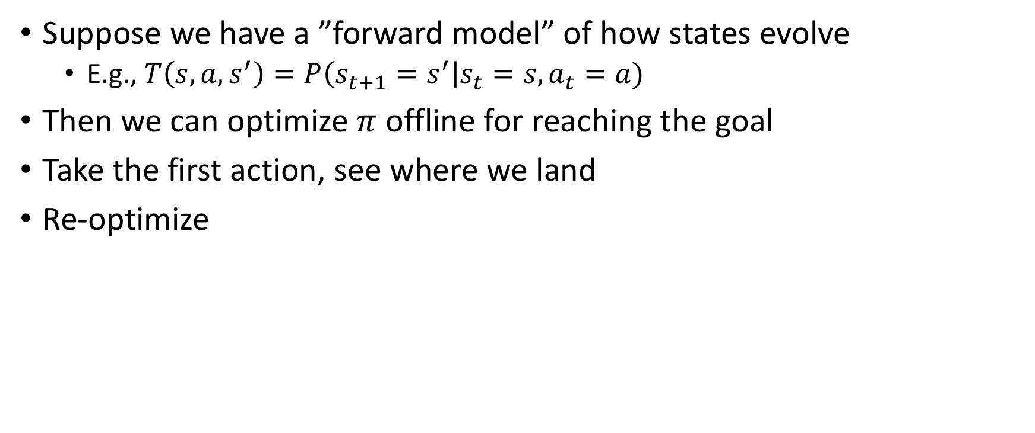
Model-based control
Suppose we have a ”forward model” of how states evolve
  E.g., $T\left(s,a,s^{′}\right)=P\left(s_{t+1}=s^{′}\right|s_{t}=s, a_{t}=a)$
Then we can optimize $π$ offline for reaching the goal
Take the first action, see where we land
Re-optimize

Slide 32
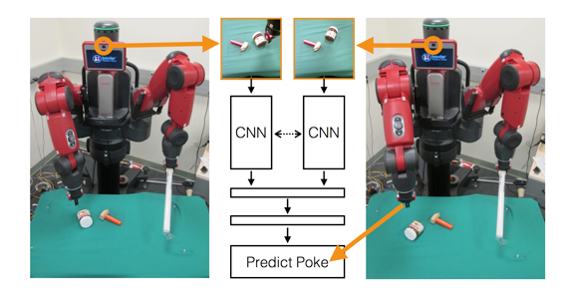
Inverse model
Predicting image pixels is hard
Can also have inverse model: given s and s’, what action takes me from s to s’?
Use inverse model to find an initial action, perform action, then re-evaluate.
Agrawal, Pulkit, et al. "Learning to poke by poking: Experiential learning of intuitive physics." Advances in Neural Information Processing Systems. 2016.

Slide 33
Learning perception independent of goals: self-supervised learning
An embodied agent can’t depend on labels
Reinforcement learning goals are inevitably tied to particular goals / tasks
Need another way to build good feature representation.
How are humans able to do this?

Slide 34
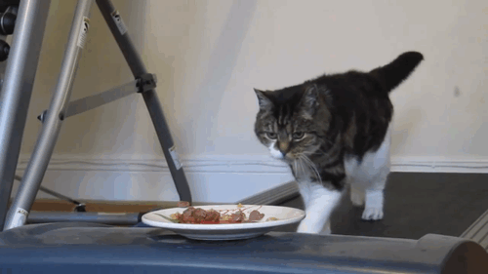
What do humans do?
Notes:
We decided to look at the human visual system more closely to figure out how it is able to learn good representations. One of the first things we realized was that humans don’t see static images, they see a moving scene, kind of like this constant video stream.
In such a video stream, more often than not, objects tend to pop out. This is because they move differently from the background. In this video here, even though the cat is made up of a bunch of different colors, we still see it as a single object because all the cat pixels move together and differently from the rest of the background.

Slide 35
What do humans do?
Elizabeth Spielke. Principles of Object Perception. In Cognitive Science, 1990.
Notes:
There is evidence from human psychology that this is a really important cue. For example, if you show really young infants this static display on the left, then they cannot distinguish between the two options on the right. In other words, they are unable to decide if the two halves of the rod form a single unified object, or whether they are indeed two rods.

Slide 36
What do humans do?
Elizabeth Spielke. Principles of Object Perception. In Cognitive Science, 1990.
Notes:
However, if you show infants this moving display

Slide 37
What do humans do?
Elizabeth Spielke. Principles of Object Perception. In Cognitive Science, 1990.
Notes:
Then they do perceive the rod as connected. This suggests that very young infants are unable to perceive any sort of depth ordering in the static image, but when objects move, they actually use the fact that things that move together form part of a single object.

Slide 38
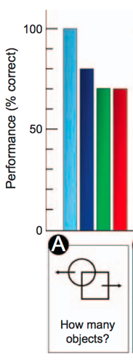
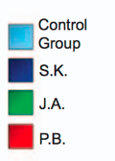
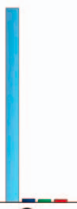
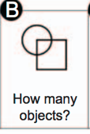
What do humans do?
Patients recovering from blindness
Ostrovsky et al. Visual Parsing After Recovery From Blindness. In Psychological Science, 2009.
Notes:
A similar effect was found in adults and older children who had recently recovered from blindness. In particular, they had trouble grouping correctly overlapping, static shapes, but they had no trouble when the objects moved.
What’s more, their ability to recognize objects was also correlated with if the object moved, that is, if it was a motile object. All of this suggests that motion-based grouping appears early on, and basically bootstraps the other forms of grouping, and even recognition.

Slide 39
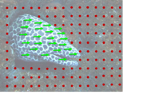
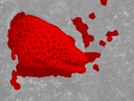
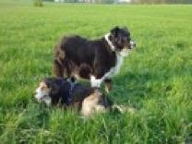

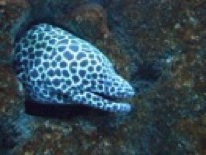
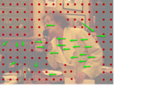
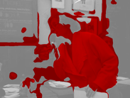
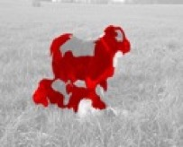
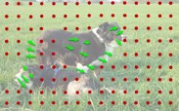
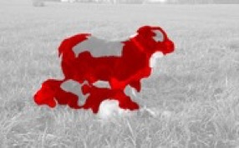

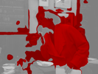
1. Collect videos
2. Segment using motion
3. Train ConvNet
Pathak, Deepak, et al. "Learning Features by Watching Objects Move." CVPR. Vol. 1. No. 2. 2017.
Notes:
This led to a fairly straightforward approach to learning representations in an unsupervised manner: we collected a large number of uncurated videos, we used motion grouping to segment out the foreground in each frame, and then we trained a ConvNet to predict this foreground segmentation

Slide 40
The kitten carousel
Both kittens see same visual input
Active kitten learns well, passive kitten does not. Why?
  Knowledge of motion?
  Actively choosing action?
  Paid more attention?
Held, R. and Hein A. (1963). Movement-produced stimulation in the development of visually guided behavior. Jouranal of Comparative and Physiological Psychology
56(5): 872-876.
Walk, Richard D., Jane D. Shepherd, and David R. Miller. "Attention and the depth perception of kittens." Bulletin of the Psychonomic Society 26.3 (1988): 248-251.

Slide 41
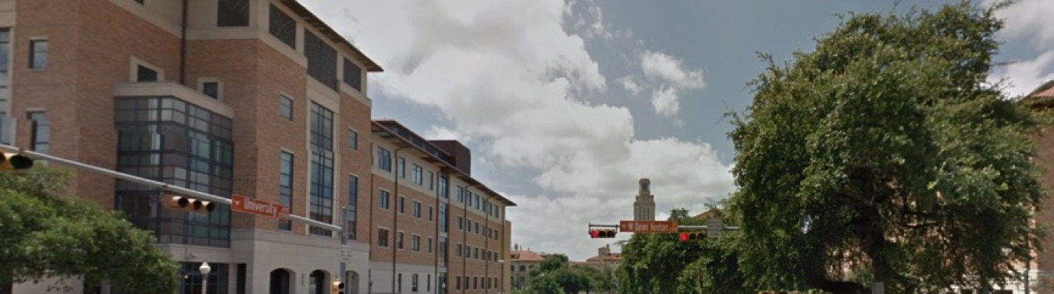
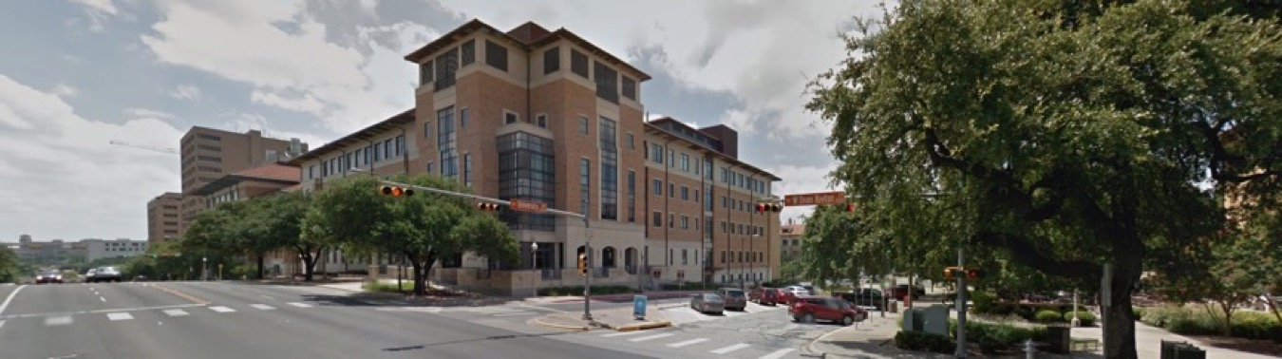

Ego-motion $↔$ vision: view prediction
After moving:
Slide credit: Dinesh Jayaraman

Slide 42
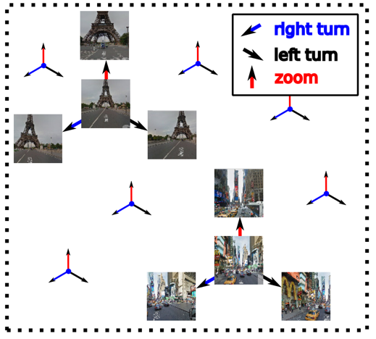

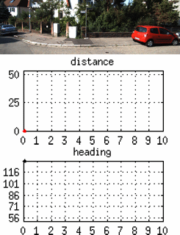








Approach idea: Ego-motion equivariance
Training data
Unlabeled video +
motor signals
Equivariant embedding organized by ego-motions
left turn
right turn
forward
Learn
Pairs of frames related by similar ego-motion should be related by same feature transformation
motor signal
time $→$
Slide credit: Dinesh Jayaraman

Slide 43
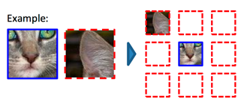
Self supervision by reconstructing hidden data
Doersch et al, ICCV 2015
Zhang et al, ECCV 2016
Pathak et al, CVPR 2016

Slide 44
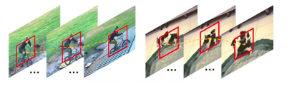
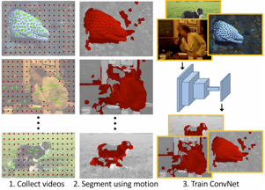
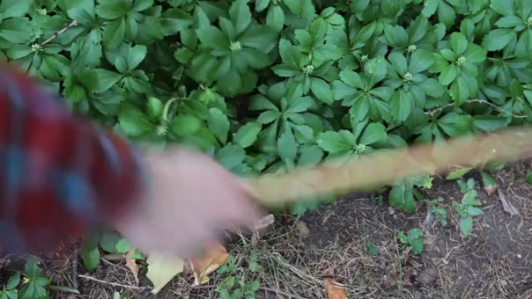
Self supervision by using external information
Wang et al, ICCV 2015
Pathak et al, CVPR 2017
Agrawal et al, ICCV 2015.
Jayaraman and Grauman, ICCV 2015.
Owens et al, CVPR 2016

Slide 45
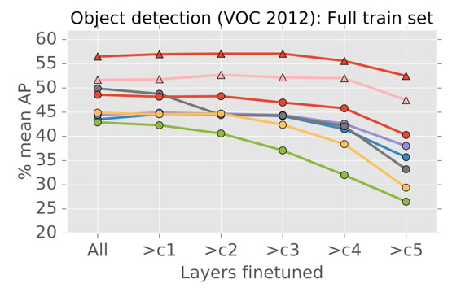
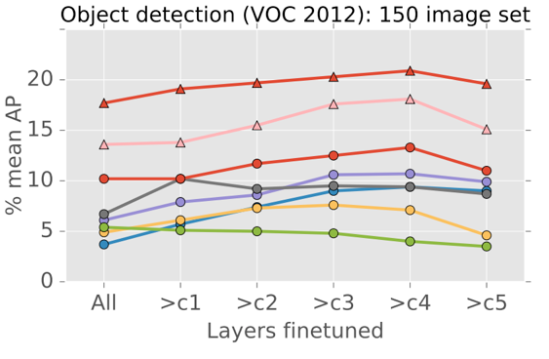
The unreasonable effectiveness of ImageNet

Slide 46
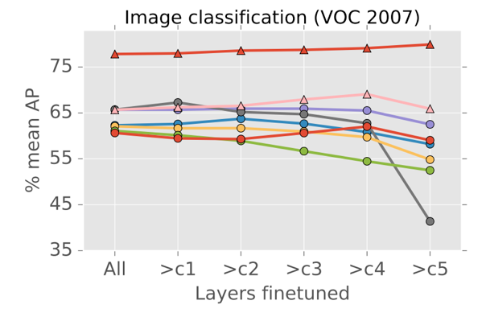
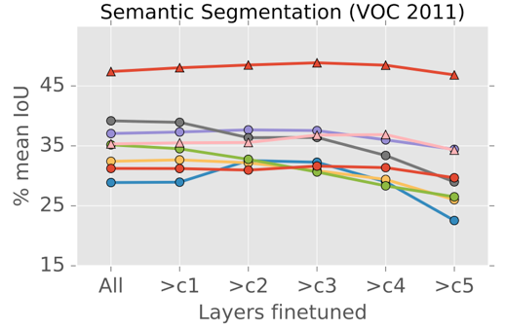
The unreasonable effectiveness of ImageNet

Slide 47
Why is ImageNet so good?
Classification?
Curated images?
Many diverse classes?
Related to target tasks?

Slide 48
Lessons from human cognition
Babies experience of the world is profoundly multi-modal
Babies develop incrementally, and they are not smart at the start.
Babies live in a physical world, full of rich regularities that organize perception, action, and ultimately thought.
Babies explore – they move and act in highly variable and playful ways that are not goal-oriented and are seemingly random.
Babies act and learn in a social world in which more mature partners guide learning and add supporting structures to that learning
Babies learn a language, a shared communicative system that is symbolic.
Smith, Linda, and Michael Gasser. "The development of embodied cognition: Six lessons from babies." Artificial life 11.1-2 (2005): 13-29.

