Slide 1
The correspondence problem

Slide 2
Learning patch similarity for disparity estimation

Slide 3
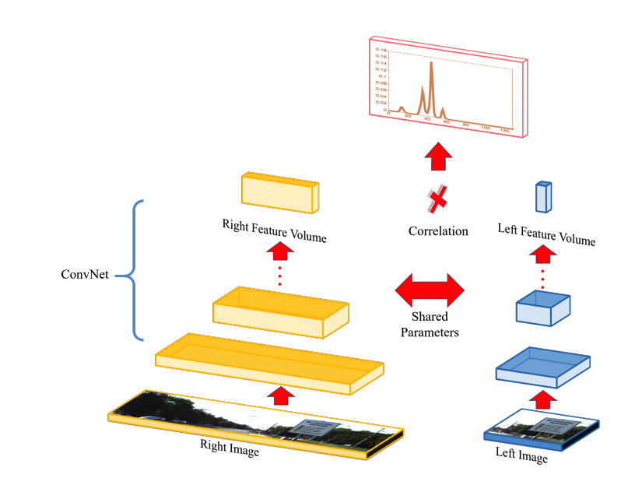
Learning patch similarity for disparity estimation
Efficient Deep Learning for Stereo Matching. Wenjie Luo, Alexander G. Schwing, Raquel Urtasun. In CVPR, 2016

Slide 4
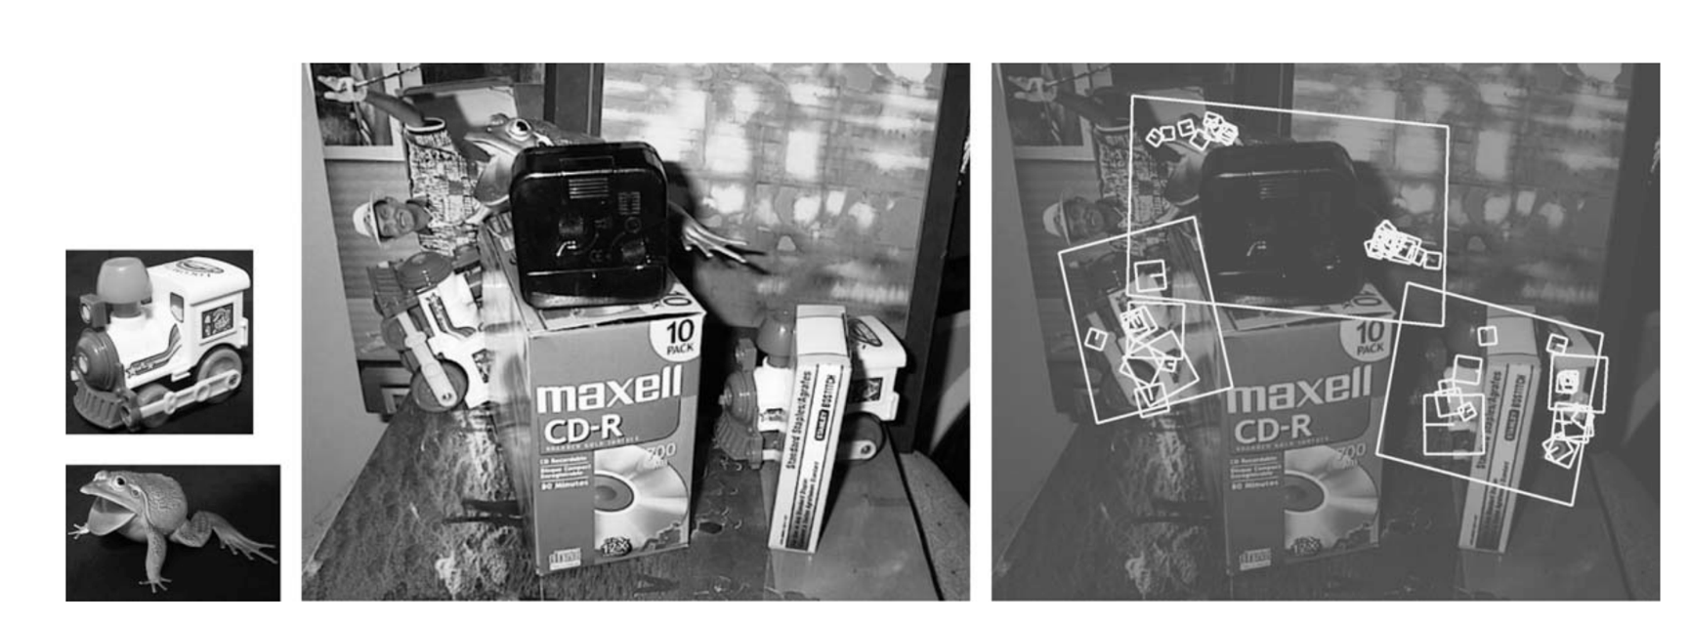
Throwback: SIFT

Slide 5
Stereo

Slide 6
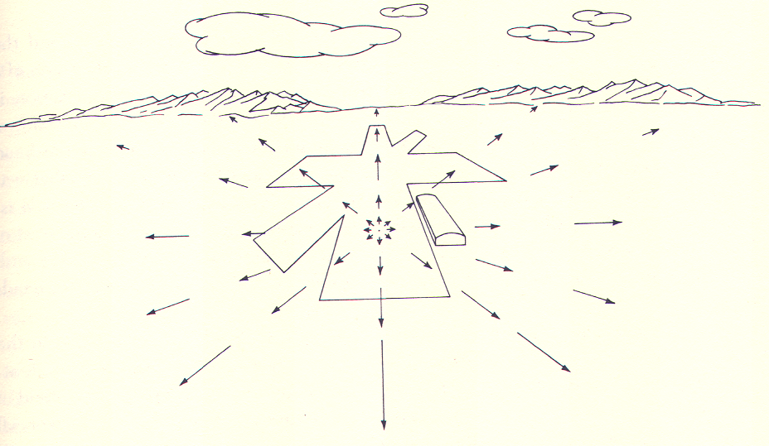
Optical flow
I(x+dx, y + dy, t+dt) = I(x,y,t)

Slide 7
Cross-instance

Slide 8
Cross-instance

Slide 9
Cross-instance = Pose estimation

Slide 10
Correspondence as a general problem
Sparse vs dense
Same instance vs different instance

Slide 11
Correspondence as a general problem
Sparse vs dense
Same instance vs different instance
Nearby cameras (small baseline) vs far away cameras (large baseline)

Slide 12
Correspondence as a general problem
Sparse vs dense
Same instance vs different instance
Nearby cameras (small baseline) vs far away cameras (large baseline)
Rigid scene/objects vs moving scene/objects

Slide 13
Correspondence as a general problem
Sparse vs dense
Same instance vs different instance
Nearby cameras (small baseline) vs far away cameras (large baseline)
Rigid scene/objects vs moving scene/objects
Category-specific vs category-agnostic

Slide 14
Disparity estimation/ Depth estimation
Sparse vs dense
Same instance vs different instance
Nearby cameras (small baseline) vs far away cameras (large baseline)
Rigid scene/objects vs moving scene/objects
Category-specific vs category-agnostic

Slide 15
Optical flow
Sparse vs dense
Same instance vs different instance
Nearby cameras (small baseline) vs far away cameras (large baseline)
Rigid scene/objects vs moving scene/objects
Category-specific vs category-agnostic

Slide 16
Sparse reconstruction from stereo / Estimating camera pose
Sparse vs dense
Same instance vs different instance
Nearby cameras (small baseline) vs far away cameras (large baseline)
Rigid scene/objects vs moving scene/objects
Category-specific vs category-agnostic

Slide 17
Keypoint detection
Sparse vs dense
Same instance vs different instance
Nearby cameras (small baseline) vs far away cameras (large baseline)
Rigid scene/objects vs moving scene/objects
Category-specific vs category-agnostic

Slide 18
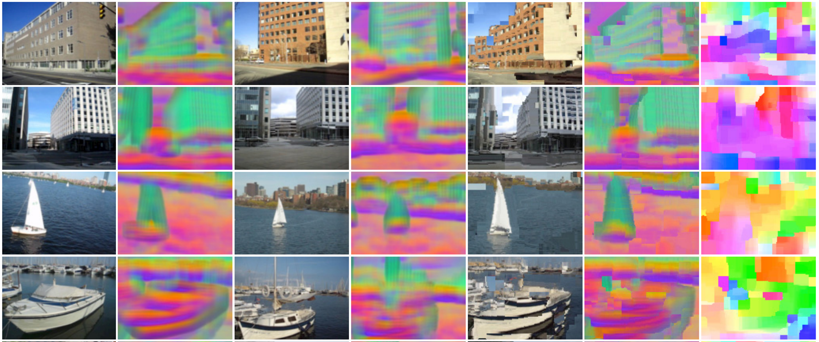
SIFT Flow
Liu, Ce, Jenny Yuen, and Antonio Torralba. "Sift flow: Dense correspondence across scenes and its applications." IEEE transactions on pattern analysis and machine intelligence 33.5 (2011): 978-994.

Slide 19
Learning correspondence
Two main questions:
Training data?
Need pairs of corresponding points for supervised
Model architecture?
Takes two images and outputs a correspondence map
Just compute patch similarity and do post processing, or…
Directly compute finished product?

Slide 20

Simulated data for optical flow
Sintel 1628 frames
A Naturalistic Open Source Movie for Optical Flow Evaluation. Daniel J. Butler, Jonas Wulff, Garrett B. Stanley, and Michael J. Black. In ECCV, 2012.

Slide 21
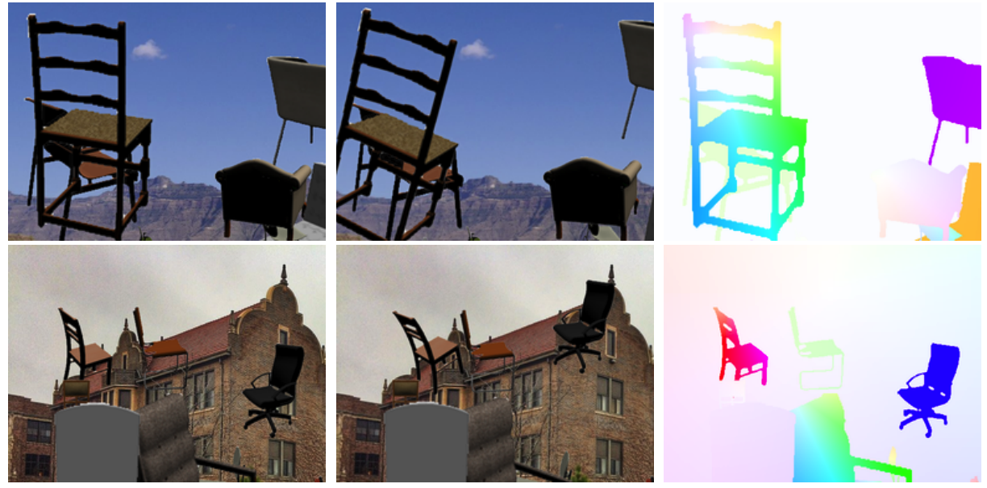
Simulated data for optical flow
FlowNet: Learning Optical Flow with Convolutional Networks. Philipp Fischer, Alexey Dostovitskiy, Eddy Ilg, Philip Hausser, Caner Hazirbas, Vladimir Golkov, Patrick van der Smagt, Daniel Cremers, Thomas Brox. In ICCV 2015.

Slide 22
Optical flow with large displacements
Optical flow constraint equation assumes differential optical flow
“Large displacement”?
Key idea: reducing resolution reduces displacement
Reduce resolution, then upsample?
will lose fine details
3
6
13
24
27

Slide 23
Optical flow with large displacements
Key idea 2: Use upsampled flow as initialization
Changes to initialization will be infinitesimal
compute flow
use as init
compute flow
…
Brox, Thomas, et al. "High accuracy optical flow estimation based on a theory for warping." Computer Vision-ECCV 2004 (2004)

Slide 24
Coarse-to-fine processing
A specific instance of a general idea
Coarse scales:
Global / large structures
Long-range relationships
But: imprecise localization
Fine scales:
Precise localization
But: aperture problem
Idea: start from coarse scales, add fine scale detail

Slide 25
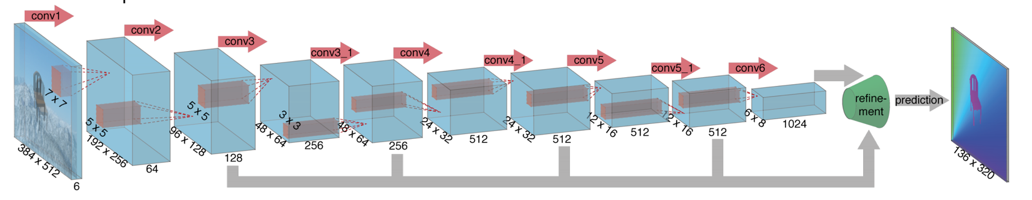
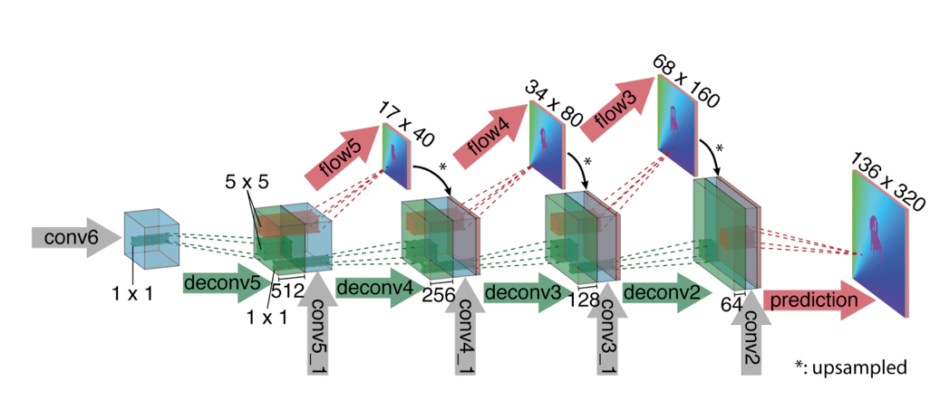
Learning convnets for optical flow
FlowNet: Learning Optical Flow with Convolutional Networks. Philipp Fischer, Alexey Dostovitskiy, Eddy Ilg, Philip Hausser, Caner Hazirbas, Vladimir Golkov, Patrick van der Smagt, Daniel Cremers, Thomas Brox. In ICCV 2015.

Slide 26
Learning convnets for correspondence
Luo et al (Disparity)
Real data from KITTI
Predict matching costs and post-process
Fischer et al (Optical flow)
Simulated synthetic data
Directly predict smooth correspondence

Slide 27
Generalizing across instances
Can we learn from deformations of single instances and correspond across instances / categories?

Slide 28
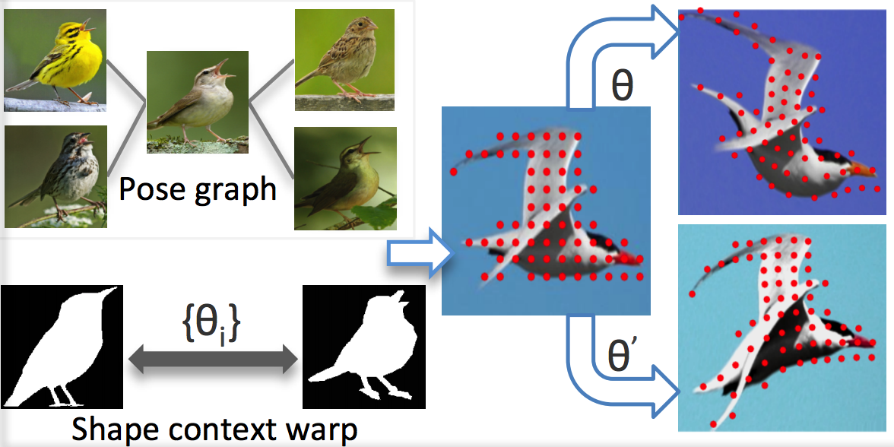
Simulating non-rigid objects
NN
interpolate warp from boundary
WarpNet: Weakly Supervised Matching for Single-view Reconstruction. Angjoo Kanazawa, David W. Jacobs, Manmohan Chandraker. In CVPR, 2016

Slide 29
Evaluating cross-instance correspondence
Idea: Use keypoint annotations
Problem: can only match nearby poses

Slide 30
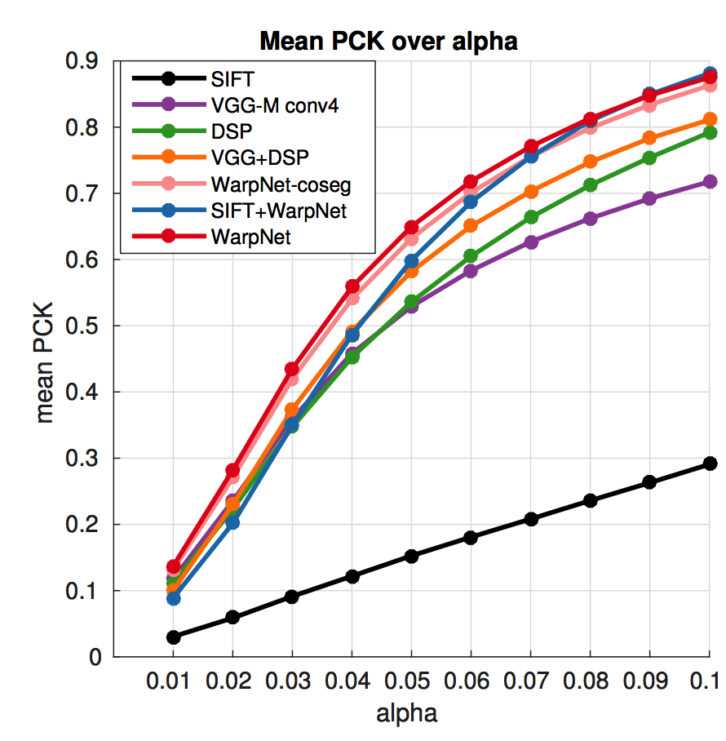
Evaluating cross-instance correspondence

Slide 31
From small to large baselines
Given 3D models, can construct ground truth

Slide 32
From small to large baselines
Additional output required: “matchability”

Slide 33
The cycle consistency constraint
Can we use unannotated images?

Slide 34
The cycle consistency constraint

Slide 35
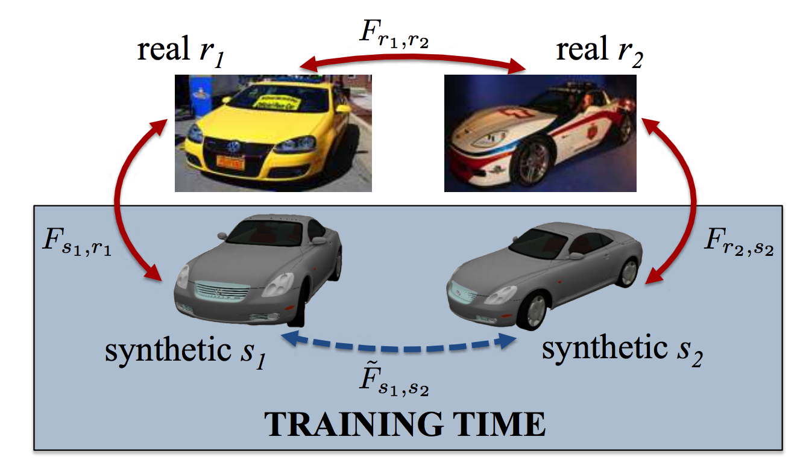
The cycle consistency constraint
Learning Dense Correspondence via 3D-guided Cycle Consistency. Tinghui Zhou, Philipp Krahenbuhl, Mathieu Aubry, Qixing Huang, Alexei A. Efros. In CVPR, 2016.

Slide 36
Vision and Language

Slide 37
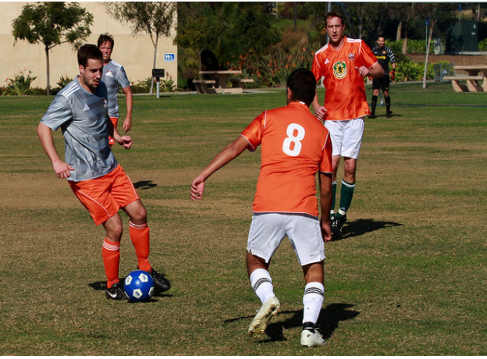
Image captioning - The task
A group of young men playing soccer.

Slide 38
Image captioning - why?
Alt-text for visually impaired
Test for true understanding?

Slide 39
Image captioning - evaluation
Given computer-generated caption and human caption, compute match
BLEU from machine translation community
Computes (modified) n-gram precision
Reference: A group of people playing soccer
Candidate: People playing baseball.
BLEU: 1/3

Slide 40
Image captioning
Long-term Recurrent Convolutional Networks. J. Donahue, L. A. Hendricks, S. Guadarrama, M. Rohrbach, S. Venugopalan, K. Saenko, T. Darrell. In CVPR, 2015.
Deep Visual-Semantic Alignments for Generating Image Descriptions. Andrej Karpathy and Li Fei-Fei. In CVPR, 2015
Show and tell: A neural image caption generator
Oriol Vinyals, Alexander Toshev, Samy Bengio, Dumitru Erhan. In CVPR, 2015.

Slide 41
Generating sequences with Recurrent nets
A
group
of
p₁
p₂
p₃
…
x
x
x

Slide 42
Challenge with RNNs
Long backpropagation paths
Vanishing / exploding gradients

Slide 43

Long short term memory
Key idea: maintain a register and simply add things at each time step
$c_{t}=c_{t−1}+x_{t}$

Slide 44
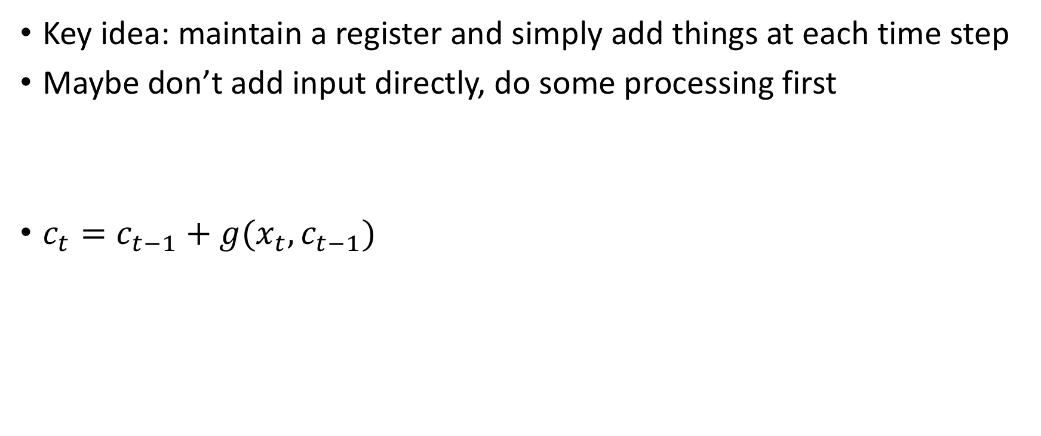
Long short term memory
Key idea: maintain a register and simply add things at each time step
Maybe don’t add input directly, do some processing first
$c_{t}=c_{t−1}+g(x_{t},c_{t−1})$

Slide 45
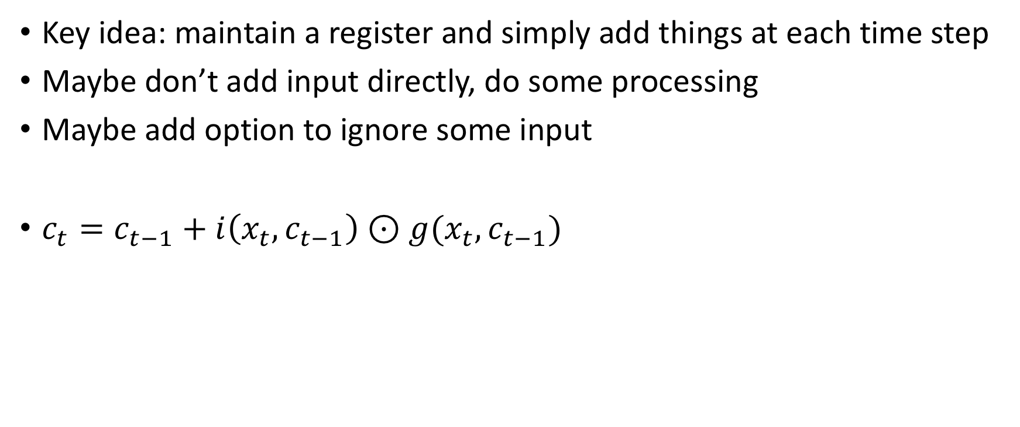
Long short term memory
Key idea: maintain a register and simply add things at each time step
Maybe don’t add input directly, do some processing
Maybe add option to ignore some input
$c_{t}=c_{t−1}+i\left(x_{t},c_{t−1}\right)⊙g(x_{t},c_{t−1})$

Slide 46
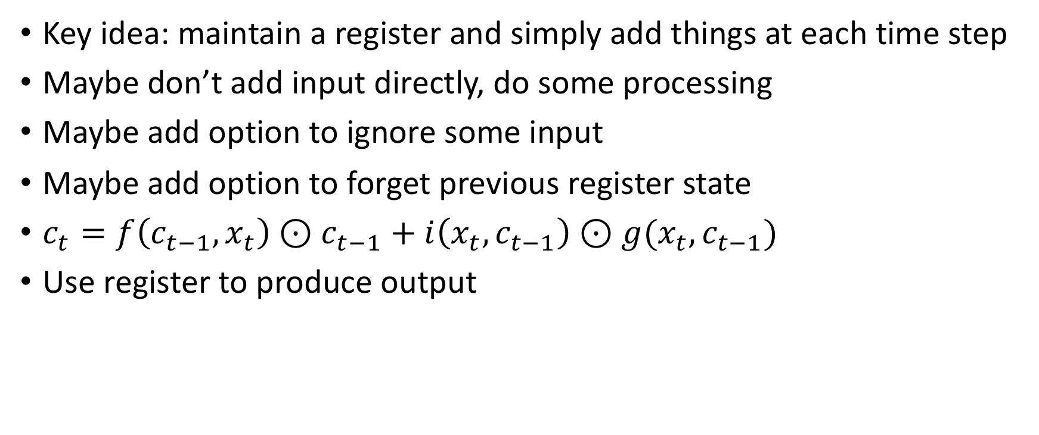
Long short term memory
Key idea: maintain a register and simply add things at each time step
Maybe don’t add input directly, do some processing
Maybe add option to ignore some input
Maybe add option to forget previous register state
$c_{t}=f\left(c_{t−1},x_{t}\right)⊙c_{t−1}+i\left(x_{t},c_{t−1}\right)⊙g(x_{t},c_{t−1})$
Use register to produce output

Slide 47
Evaluation Metrics
Slide credit: Larry Zitnick

Slide 48
Evaluation Metrics
Human captions
Slide credit: Larry Zitnick

Slide 49
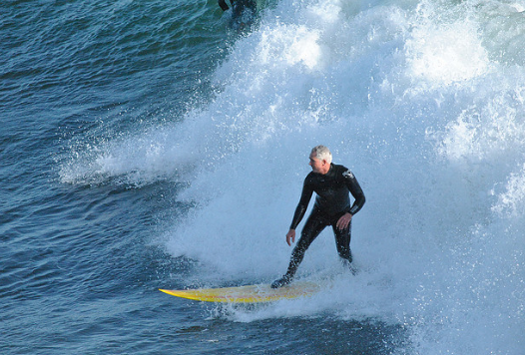
A man riding a wave on a surfboard in the water.
Slide credit: Larry Zitnick

Slide 50
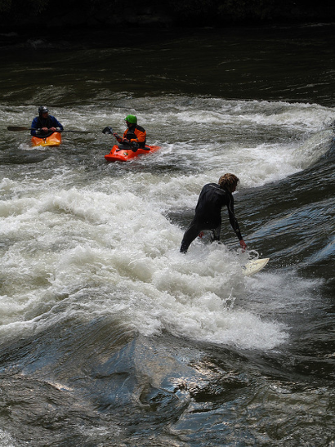
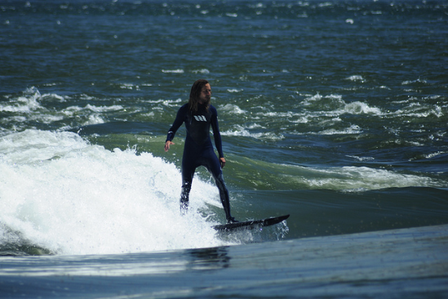
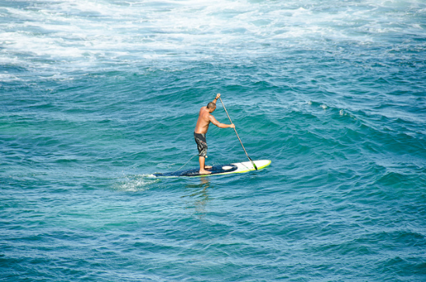
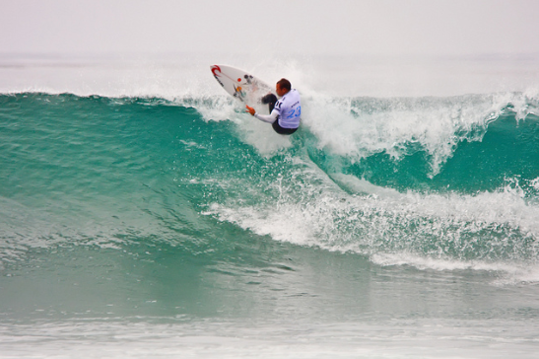
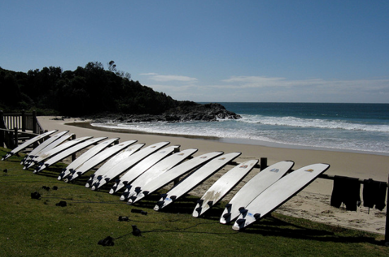
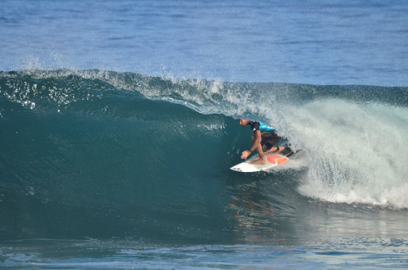
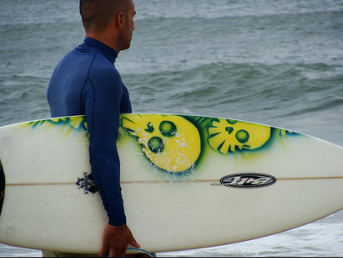
A man riding a wave on a surfboard in the water.
“surfboard”
Slide credit: Larry Zitnick

Slide 51
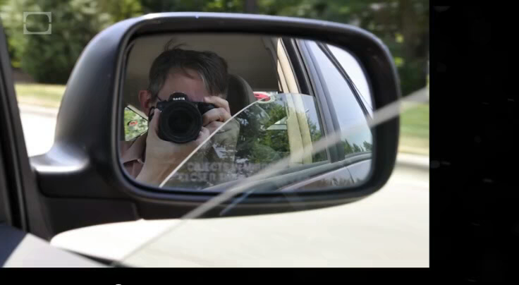
vemödalen - n. the fear that our datasets will never have the diversity we desire
vemödalen - n. the frustration of photographing something amazing when thousands of identical photos already exist
Vemödalen: The Fear That Everything Has Already Been Done
https://www.youtube.com/watch?v=8ftDjebw8aA
Slide credit: Larry Zitnick

Slide 52
The post-captioning world
Captioning is hard to evaluate!
Frame task so that it is easy to evaluate objectively
Datasets are biased!
Control dataset bias

Slide 53
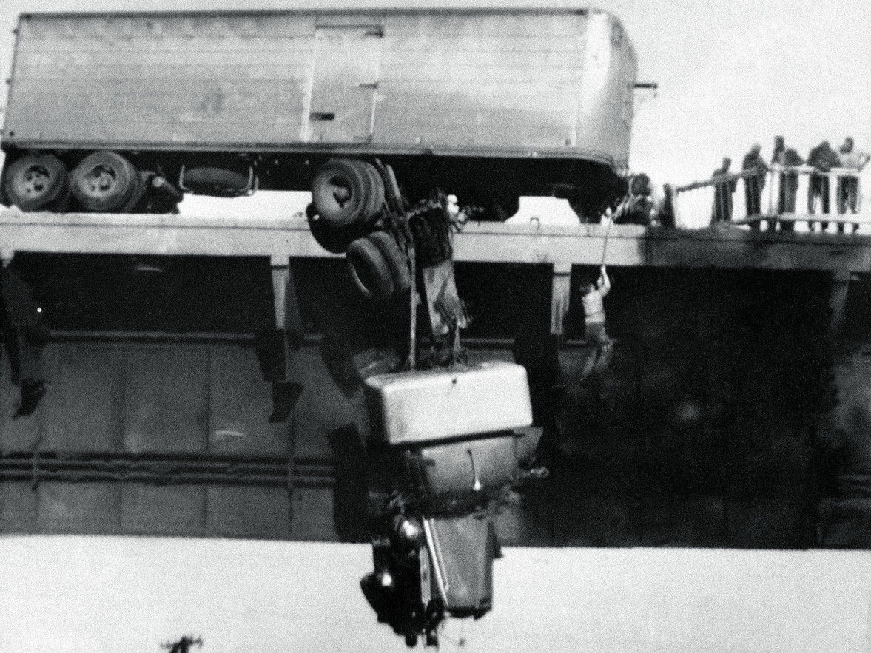
A man is rescued from his truck that is hanging dangerously from a bridge.
Virginia M. Schau
Slide credit: Larry Zitnick

Slide 54
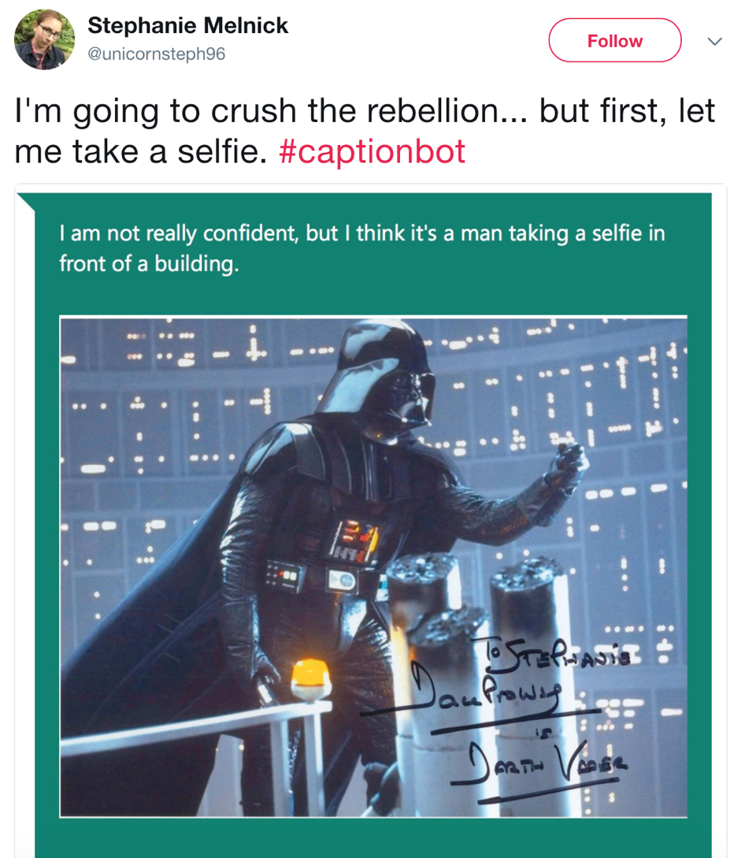

Slide 55
Reasoning
Want vision systems to reason about what is going on
Identify objects and scenes
Identify relationships between objects
Understand physics of the world
Understand social interactions, intent etc.
Incorporate knowledge: common sense, pop culture, …

Slide 56
Visual Question Answering
Direct motivation: assistive technology
Indirect motivation: sandbox for reasoning
VQA: Visual Question Answering. Aishwarya Agrawal, Jiasen Lu, Stanislaw Antol, Margaret Mitchell, C. Lawrence Zitnick, Dhruv Batra, Devi Parikh. In ICCV, 2015.

Slide 57
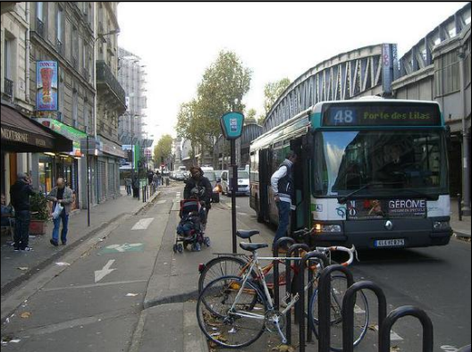
Methods for VQA
Answer
Standard recognition CNN
How
many
bikes
are
there
?

Slide 58
Methods for VQA
Answer
Standard recognition CNN
…
How
many
bikes
are
there
?
Z. Yang, X. He, J. Gao, L. Deng, and A. Smola. Stacked attention networks for image question answering. In CVPR, 2016

Slide 59
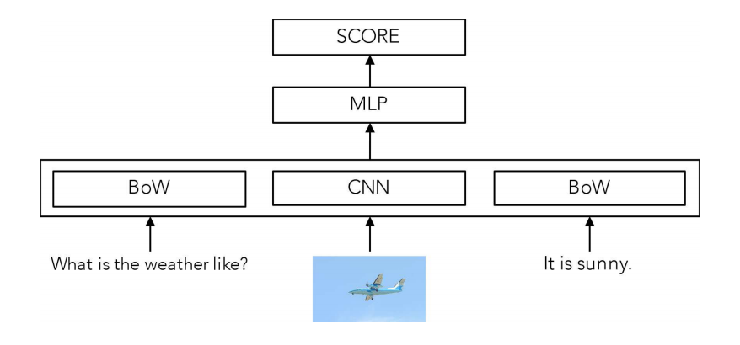
The Unreasonable Effectiveness of Baselines
A. Jabri, A. Joulin, L. van der Maaten. Revisiting visual question answering baselines. In ECCV, 2016.

Slide 60
The problem with VQA
Dataset biases allow cheating
Only-question Bag-of-Words: 53.7% (vs ~65% for state-of-the-art)
Require common sense to answer
“What is the moustache made of?”
Hard to diagnose error
Is the problem understanding the question?
Or understanding the image?

Slide 61
Clever Hans

