Slide 1
Learning for 3D

Slide 2
Recognition and 3D reasoning
Statistical properties of visual world
Recognition
Reconstruction
Physics of image formation

Slide 3
Recognition and 3D reasoning
Statistical properties of visual world
Recognition
Reconstruction
Physics of image formation

Slide 4
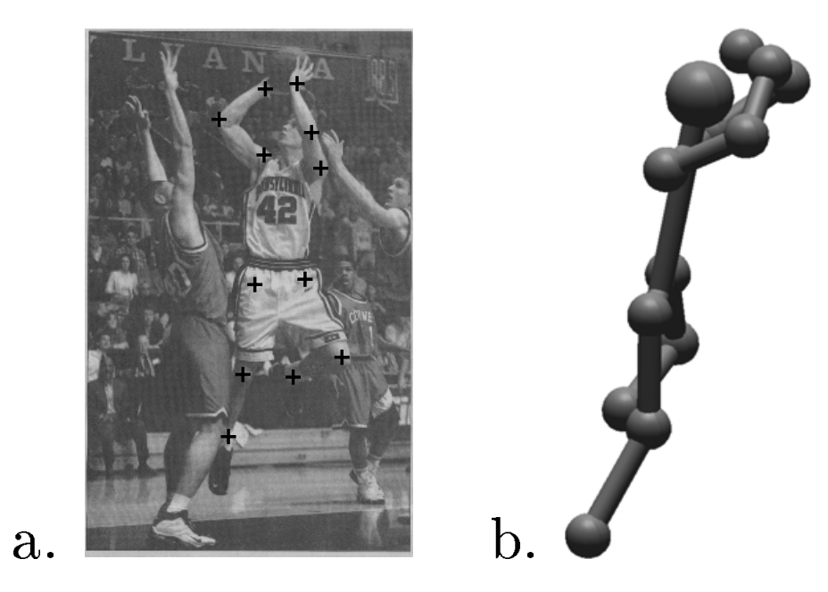
Pose estimation in 3D
Reconstruction of Articulated Objects from Point Correspondences in a Single Uncalibrated Image. C. J. Taylor. In CVPR, 2000

Slide 5
Pose estimation in 3D
Key idea: know relative lengths of each limb4
Assume scaled orthographic projection
Valid when variation in depth much smaller than depth
constant
Reconstruction of Articulated Objects from Point Correspondences in a Single Uncalibrated Image. C. J. Taylor. In CVPR, 2000

Slide 6
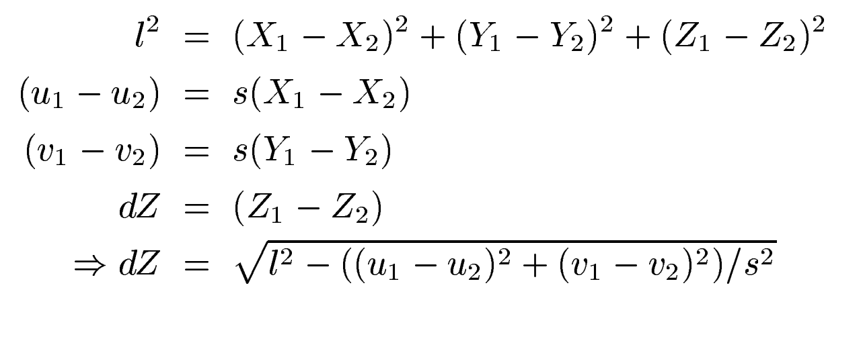
Pose estimation in 3D
Reconstruction of Articulated Objects from Point Correspondences in a Single Uncalibrated Image. C. J. Taylor. In CVPR, 2000

Slide 7
Pose estimation for rigid objects

Slide 8
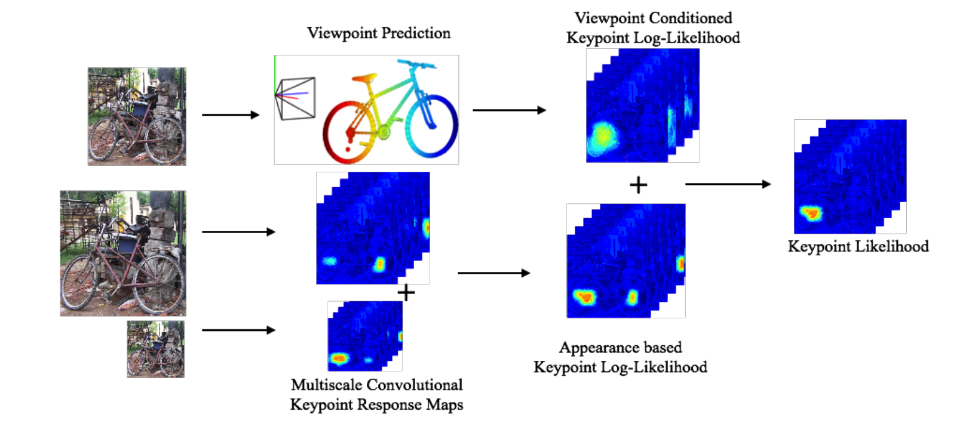
Pose estimation for rigid objects
Viewpoints and keypoints. S. Tulsiani and J. Malik. In CVPR, 2015

Slide 9
Pose estimation for rigid objects
Cyclo-rotation / roll
Azimuth / yaw
Elevation / pitch

Slide 10
Viewpoint-conditioned pose
Viewpoint prediction
Viewpoints and keypoints. S. Tulsiani and J. Malik. In CVPR, 2015

Slide 11
Viewpoint-conditioned pose
Viewpoint prediction
Viewpoints and keypoints. S. Tulsiani and J. Malik. In CVPR, 2015

Slide 12
Recognition and 3D reasoning
Statistical properties of visual world
Recognition
Reconstruction
Physics of image formation

Slide 13
Disparity estimation

Slide 14
Disparity estimation

Slide 15
Disparity estimation
Goal:
Assign disparity value to each pixel
Basic idea:
Disparity image should be smooth
Energy minimization
min E(d), where d is disparity image
E(d) = E_{data}(d) + E_{smoothness}(d)
E_{data}(d) : scores based on NCC (for example)
E_{smoothness}(d) =

Slide 16

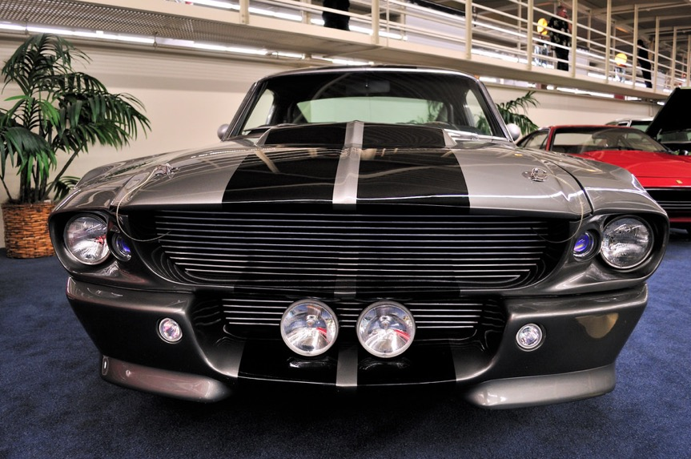
Measuring patch similarity is hard

Slide 17
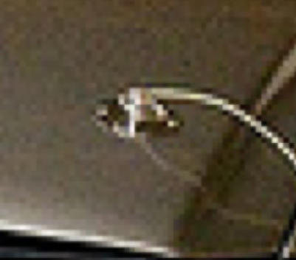
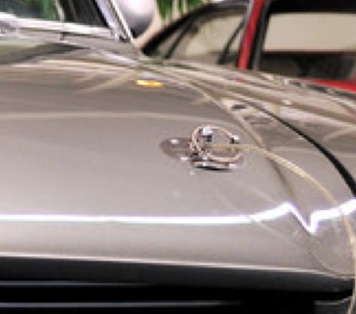
Measuring patch similarity is hard
Idea: learn to compute patch similarity?

Slide 18
The KITTI Dataset and Benchmark
Depth from here
Stereo pair from here

Slide 19
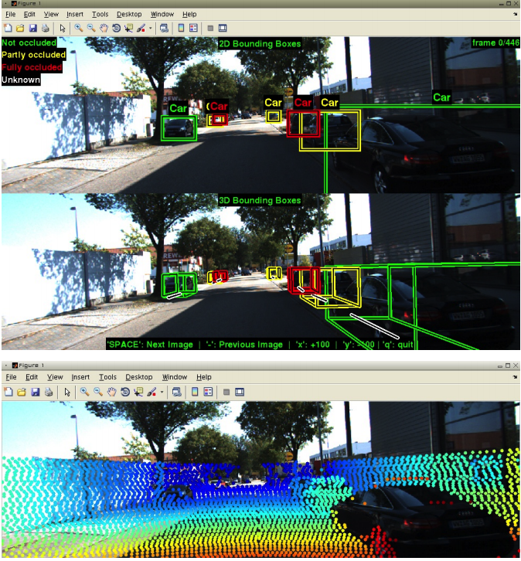
The KITTI Dataset and Benchmark
Vision meets Robotics: The KITTI Dataset. Andreas Geiger, Philip Lenz, Christoph Stiller and Raquel Urtasun. In IJRR, 2013.

Slide 20
Learning patch similarity for disparity estimation

Slide 21
Learning patch similarity for disparity estimation

Slide 22
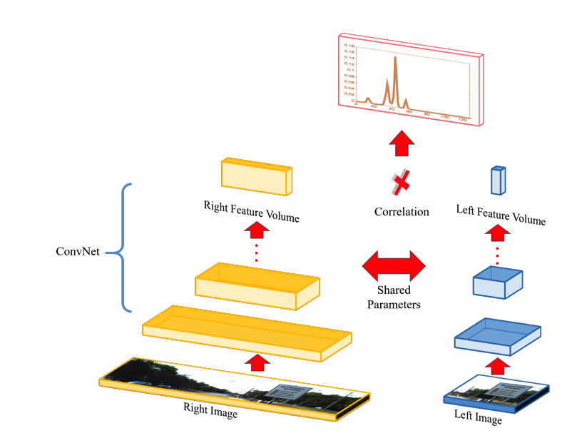
Learning patch similarity for disparity estimation
Efficient Deep Learning for Stereo Matching. Wenjie Luo, Alexander G. Schwing, Raquel Urtasun. In CVPR, 2016

Slide 23
Learning stereo without depth supervision
Given scenes with >=3 rectified views
Use 2 views to produce depth
Compute scores for each disparity
Match pixel to pixel with best disparity
Disparity = 1/depth
Use depth to produce 3rd view
Use reconstruction error

Slide 24
Plane-sweep stereo
Stereo till now:
Go pixel by pixel
For each pixel, compute score for each disparity
Plane-sweep:
Go disparity-by-disparity (or depth-by-depth)
For each disparity, compute scores for all pixels

Slide 25
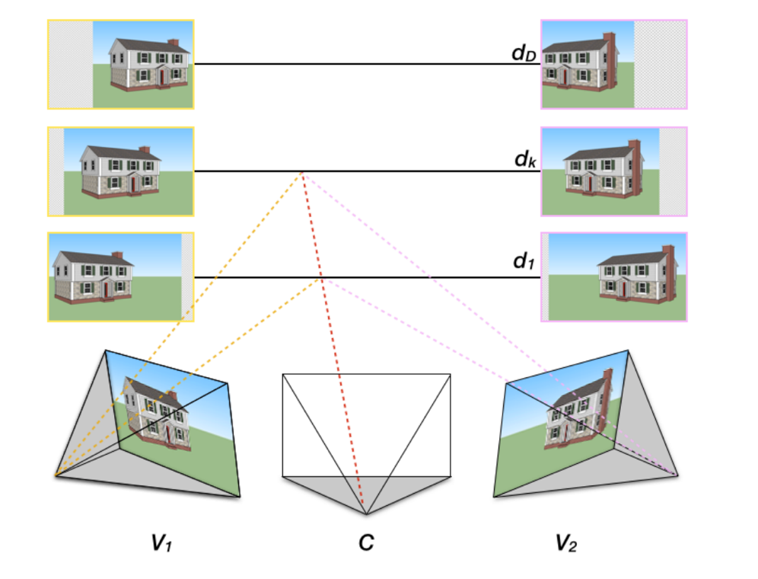
Plane-sweep stereo
For every possible depth value d:
Assume every pixel in middle image has the same depth d
Use d to compute disparity to left and right image
Reproject left and right images to center coordinate system using disparity
Compute score for all pixels

Slide 26

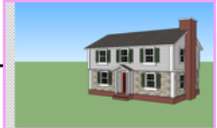
Plane-sweep stereo
If depth is correct, appearance should match!

Slide 27
Plane-sweep stereo
Score for pixel only depends on the two patches at that pixel
Can be computed using convolutions

Slide 28
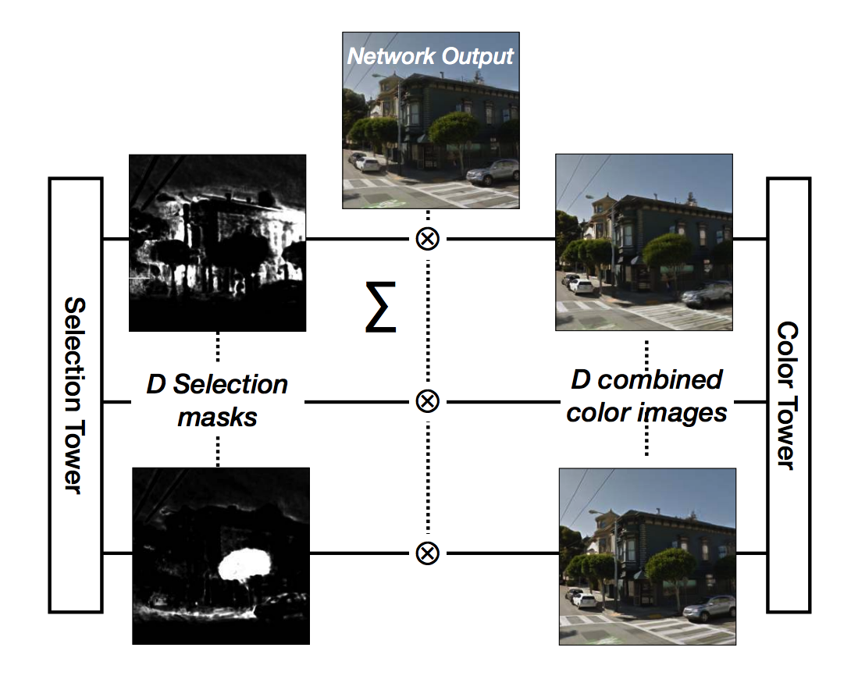
Deep Stereo
DeepStereo: Learning to Predict New Views from the World’s Imagery. John Flynn, Ivan Neulander, James Philbin, Noah Snavely. CVPR, 2016

Slide 29
Estimating depth from a single image
Why is this even possible?

Slide 30
Estimating depth from a single image
Why is this even possible?

Slide 31
Estimating depth from a single image
Why is this even possible?

Slide 32
Estimating depth from a single image
Why is this even possible?

Slide 33
Estimating depth from a single image

Slide 34
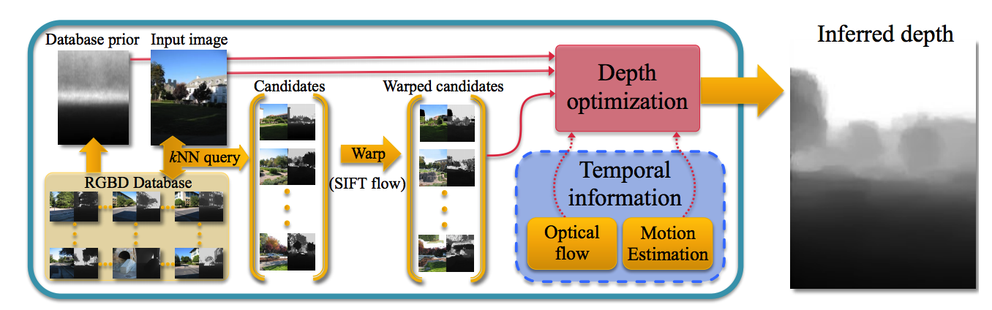
Estimating depth from a single image
DepthTransfer: Depth Extraction from Video Using Non-parametric Sampling. Kevin Karsch, Ce Liu, Sing Bing Kang. TPAMI 2013.

Slide 35
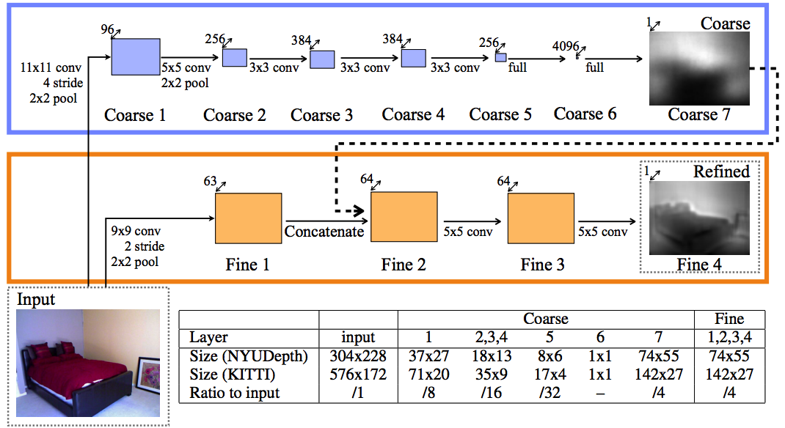
Estimating depth from a single image
Yet another image-to-image translation
Again, resolution issues
Depth Map Prediction from a Single Image using a Multi-Scale Deep Network. David Eigen, Christian Puhrsch, Rob Fergus. In NIPS, 2014

Slide 36
Metric depth is a bad target

Slide 37
Metric depth is a bad target
Only relative depths matter
Only logarithmic scales matter
Depth Map Prediction from a Single Image using a Multi-Scale Deep Network. David Eigen, Christian Puhrsch, Rob Fergus. In NIPS, 2014

Slide 38
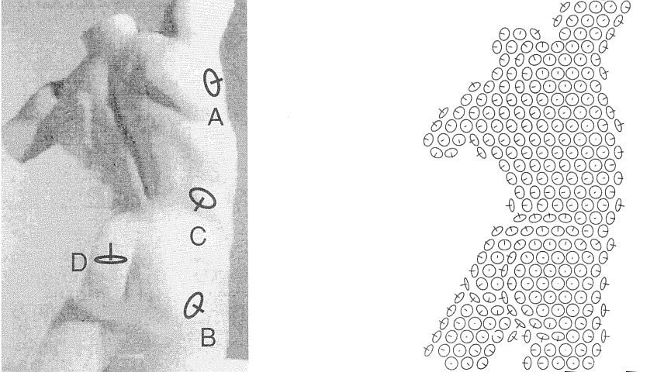
Humans perceive surface normals, not just depth, through a combination of various pictorial cues
Surface perception in pictures. Koenderink, van Doorn and Kappers, 1992
Slide credit: Jitendra Malik

Slide 39
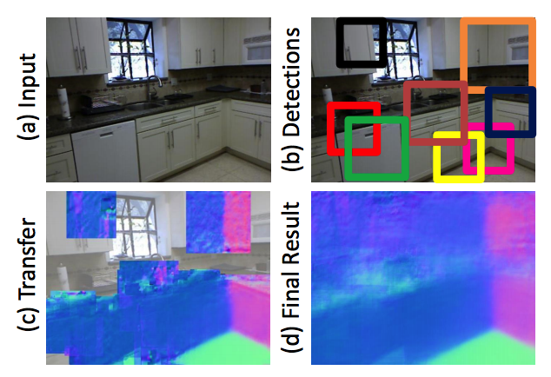
Estimating normals from a single image
Data-Driven 3D Primitives for Single Image Understanding. David F. Fouhey, Abhinav Gupta, Martial Hebert. In ICCV 2013.

Slide 40
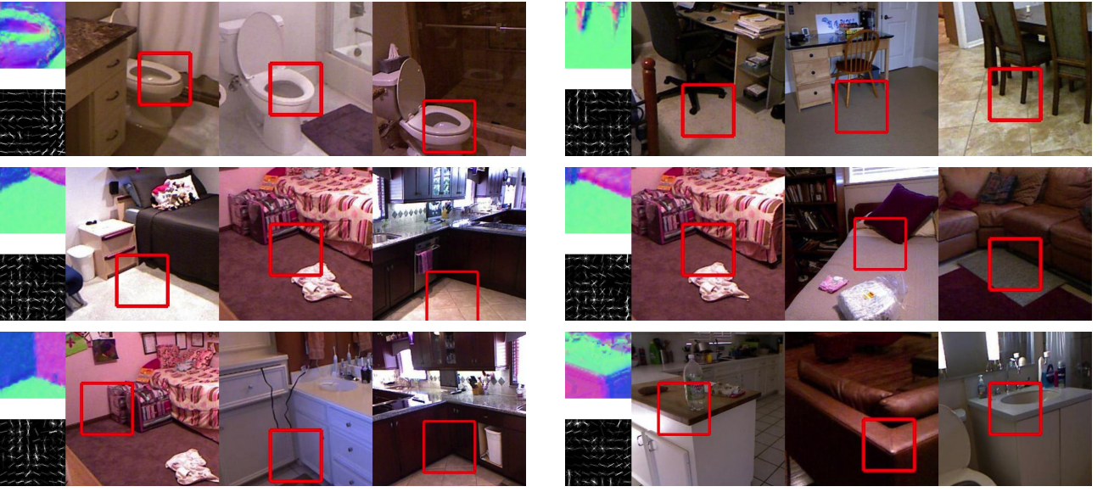
Estimating normals from a single image

Slide 41
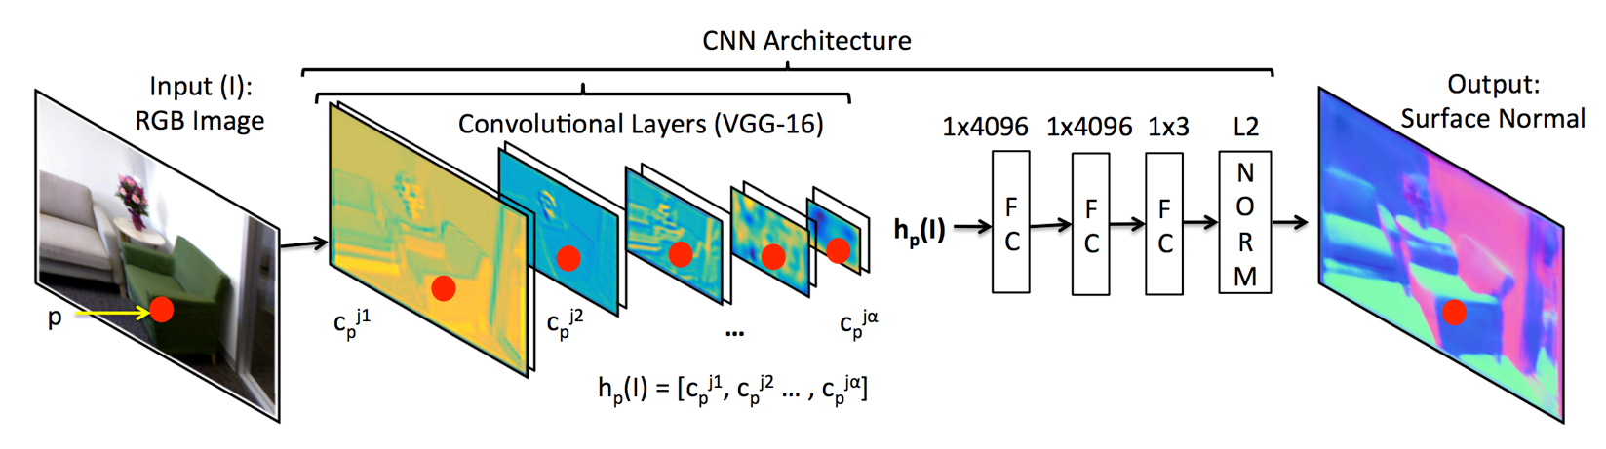
Estimating normals from a single image
Marr Revisited: 2D-3D Alignment via Surface Normal Prediction. Aayush Bansal, Bryan Russell, Abhinav Gupta. In CVPR, 2016

Slide 42
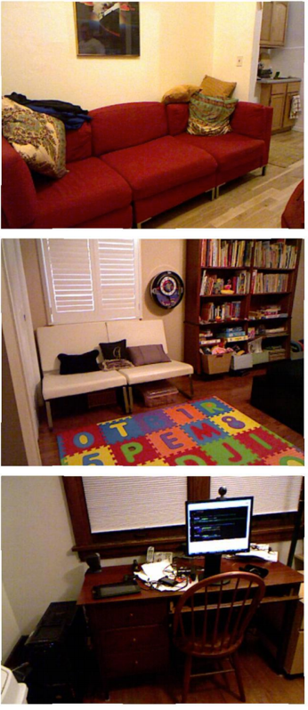
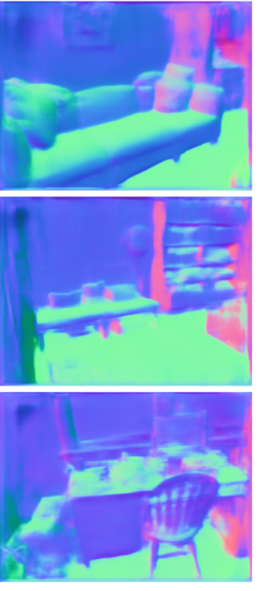
Estimating normals from a single image

