Slide 1
Semantic segmentation

Slide 2
Semantic segmentation using convolutional networks
w
3
h

Slide 3
Semantic segmentation using convolutional networks
c
w/4
h/4

Slide 4
Semantic segmentation using convolutional networks
c
w/4
h/4

Slide 5
Semantic segmentation using convolutional networks
c
w/4
h/4

Slide 6
Semantic segmentation using convolutional networks
c
#classes
Convolve with #classes 1x1 filters
w/4
h/4

Slide 7
Semantic segmentation using convolutional networks
Pass image through convolution and subsampling layers
Final convolution with #classes outputs
Get scores for subsampled image
Upsample back to original size

Slide 8
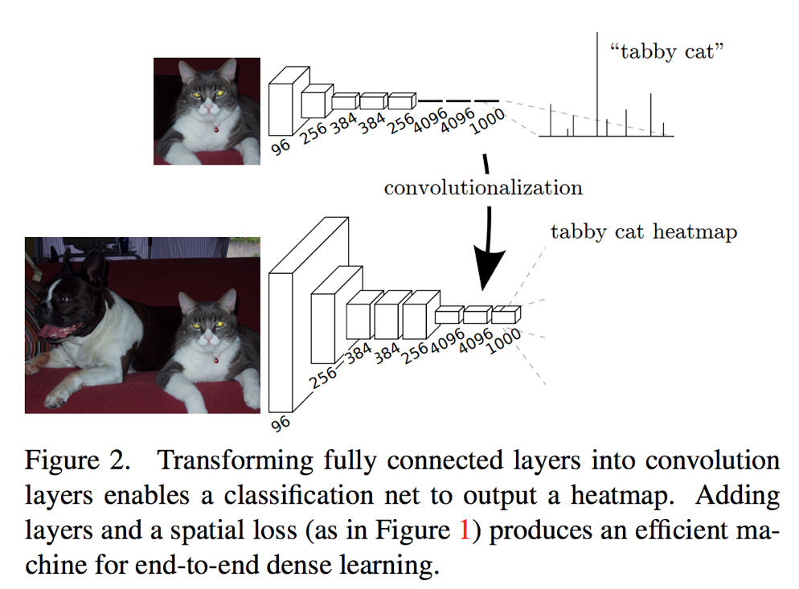
Transfer learning for semantic segmentation
Long, Jonathan, Evan Shelhamer, and Trevor Darrell. "Fully convolutional networks for semantic segmentation." Proceedings of the IEEE conference on computer vision and pattern recognition. 2015.

Slide 9
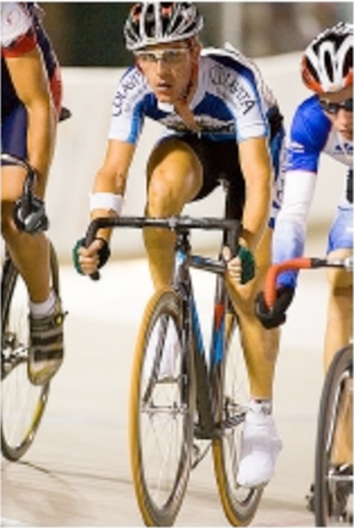
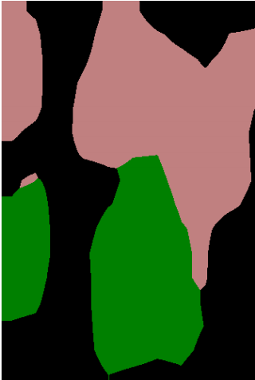
Semantic segmentation using convolutional networks
person
bicycle

Slide 10
The resolution issue
Problem: Need fine details!
Shallower network / earlier layers?
  Not very semantic!
Remove subsampling?
  Looks at only a small window!

Slide 11



Solution 1: Image pyramids
Higher resolution
Less context
Learning Hierarchical Features for Scene Labeling. Clement Farabet, Camille Couprie, Laurent Najman, Yann LeCun. In TPAMI, 2013.

Slide 12
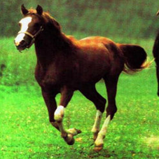
Solution 2: Skip connections
upsample

Slide 13
Solution 2: Skip connections

Slide 14
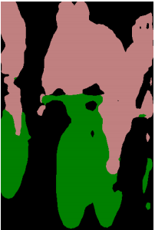
Skip connections
Fully convolutional networks for semantic segmentation. Evan Shelhamer, Jon Long, Trevor Darrell. In CVPR 2015

Slide 15
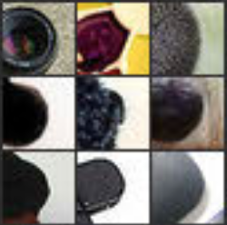
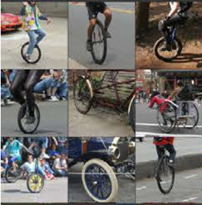
Skip connections
Problem: early layers not semantic
Horse
Visualizations from : M. Zeiler and R. Fergus. Visualizing and Understanding Convolutional Networks. In ECCV 2014.
Notes:
If you look at what one of these higher layers is detecting, here I am showing the input image patches that are highly scored by one of the units. This particular layer really likes bicycle wheels, so if this unit fires, you know that there is a bicycle wheel in the image. Unfortunately, you don’t know where the bicycle wheel is, because this unit doesn’t care where the bicycle wheel appears, or at what orientation or what scale.

Slide 16
Solution 3: Dilation
Need subsampling to allow convolutional layers to capture large regions with small filters
  Can we do this without subsampling?

Slide 17
Solution 3: Dilation
Need subsampling to allow convolutional layers to capture large regions with small filters
  Can we do this without subsampling?

Slide 18
Solution 3: Dilation
Need subsampling to allow convolutional layers to capture large regions with small filters
  Can we do this without subsampling?

Slide 19
Solution 3: Dilation
Instead of subsampling by factor of 2: dilate by factor of 2
Dilation can be seen as:
  Using a much larger filter, but with most entries set to 0
  Taking a small filter and “exploding”/ “dilating” it
Not panacea: without subsampling, feature maps are much larger: memory issues

Slide 20
Solution 4: Conditional random fields

Slide 21
Solution 4: Conditional Random Fields
Idea: take convolutional network prediction and sharpen using classic techniques
Conditional Random Field
Label compatibility
Pixel similarity

Slide 22
Inference in CRFs
Problem: combinatorial optimization
Variational methods: Approximate complex distribution p(y) with simple distribution q(y)
Mean-field approximation: q(y) is independent distribution for each pixel:
If N pixels and K classes, basically N K-dimensional vectors

Slide 23
Mean field inference
If we can find best q, solution is highest probability output for each pixel
Try to match p with q by minimizing Kulback-Leibler Divergence
Iterative process: in each iteration, do coordinate ascent on one q(y_{i})

Slide 24
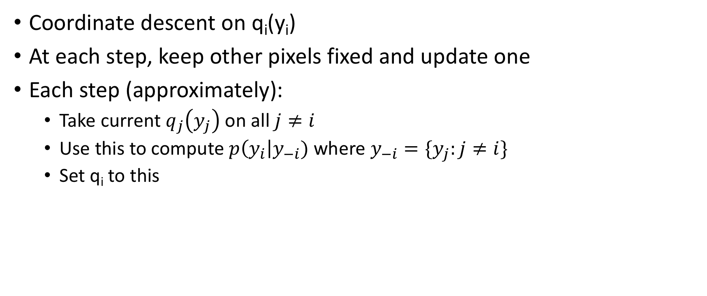
Mean field inference
Coordinate descent on q_{i}(y_{i})
At each step, keep other pixels fixed and update one
Each step (approximately):
  Take current $q_{j}\left(y_{j}\right)$ on all $j≠i$
  Use this to compute $p\left(y_{i}\right|y_{−i})$ where $y_{−i}=\{y_{j}:j≠i\}$
  Set q_{i} to this

Slide 25
Fully Connected CRFs
Typically, only adjacent pixels connected
  Fewer connections => Easier to optimize
Dense connectivity: every pixel connected to everything else
Intractable to optimize except if pairwise potential takes specific form
Efficient Inference in Fully Connected CRFs with Gaussian Edge Potentials. Philipp Krahenbuhl, Vladlen Koltun. In NIPS, 2011.

Slide 26
Gaussian edge potentials
What should f be?
simple answer: color, position

Slide 27
Mean field inference for Dense-CRF
Unary
Label compatibility transform
Message passing

Slide 28
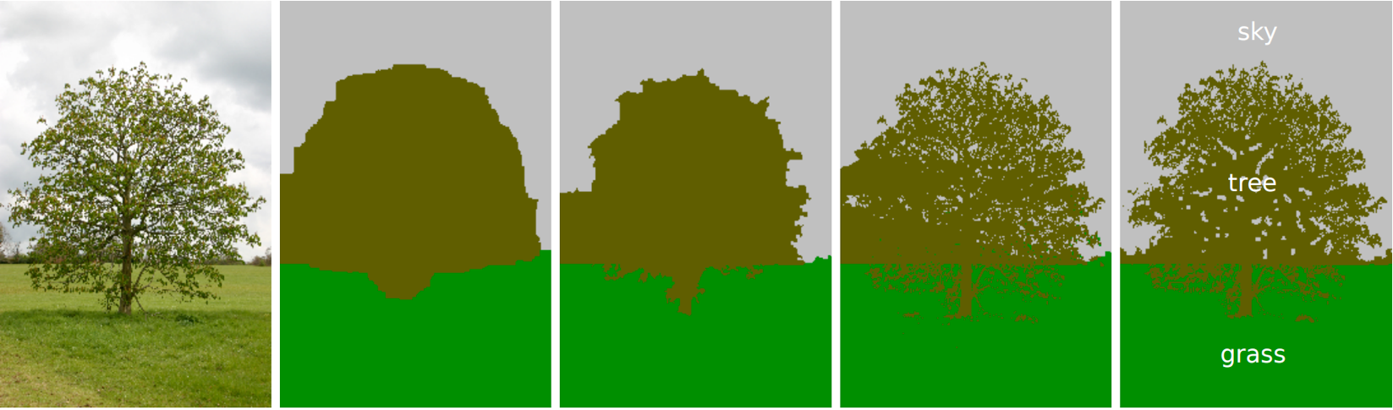
Fully Connected CRFs
Grid CRF
Fully connected CRF
Ground truth

Slide 29
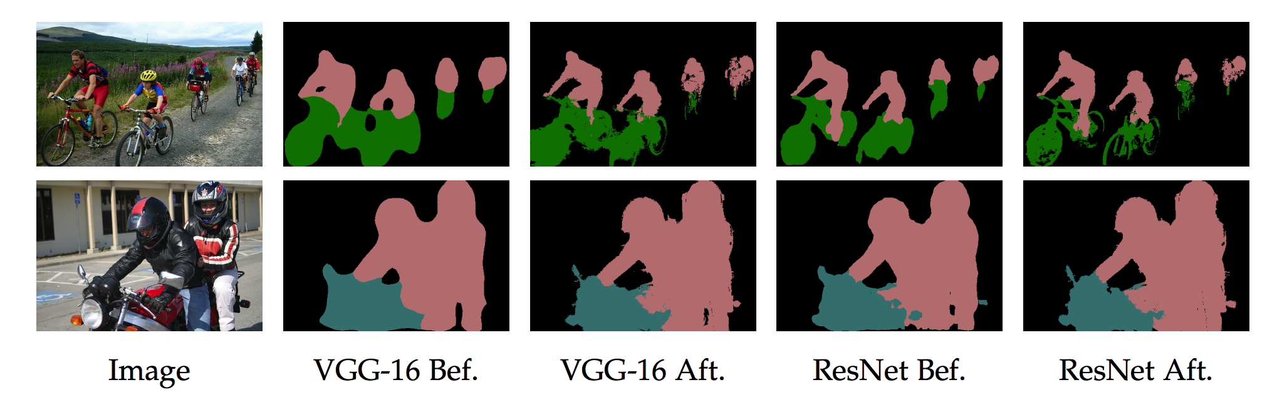
Fully connected CRFs
Semantic Image Segmentation with Deep Convolutional Nets and Fully Connected CRFs. Liang-Chieh Chen, George Papandreou, Iasonas Kokkinos, Kevin Murphy, Alan Yuille. In ICLR, 2015.

Slide 30
Putting it all together
Best Non-CNN approach: ~46.4%
Semantic Image Segmentation with Deep Convolutional Nets and Fully Connected CRFs. Liang-Chieh Chen, George Papandreou, Iasonas Kokkinos, Kevin Murphy, Alan Yuille. In ICLR, 2015.

Slide 31
Other additions
Method | mean IoU (%)
VGG16 + Skip + Dilation | 65.8
ResNet101 | 68.7
ResNet101 + Pyramid | 71.3
ResNet101 + Pyramid + COCO | 74.9
DeepLab: Semantic Image Segmentation with Deep Convolutional Nets, Atrous Convolution, and Fully Connected CRFs. Liang-Chieh Chen, George Papandreou, Iasonas Kokkinos, Kevin Murphy, Alan Yuille. Arxiv 2016.

Slide 32
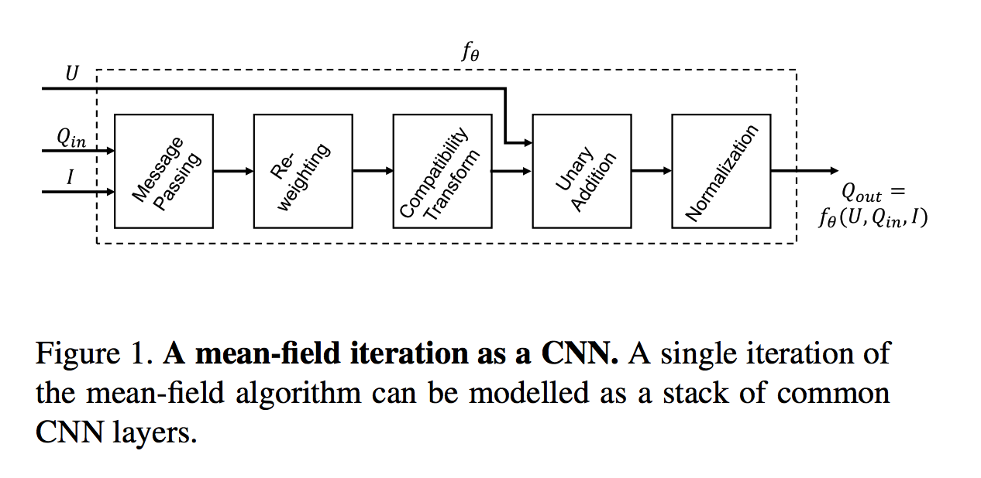
Mean field inference as a recurrent network
Zheng, Shuai, et al. "Conditional random fields as recurrent neural networks." Proceedings of the IEEE international conference on computer vision. 2015.

Slide 33
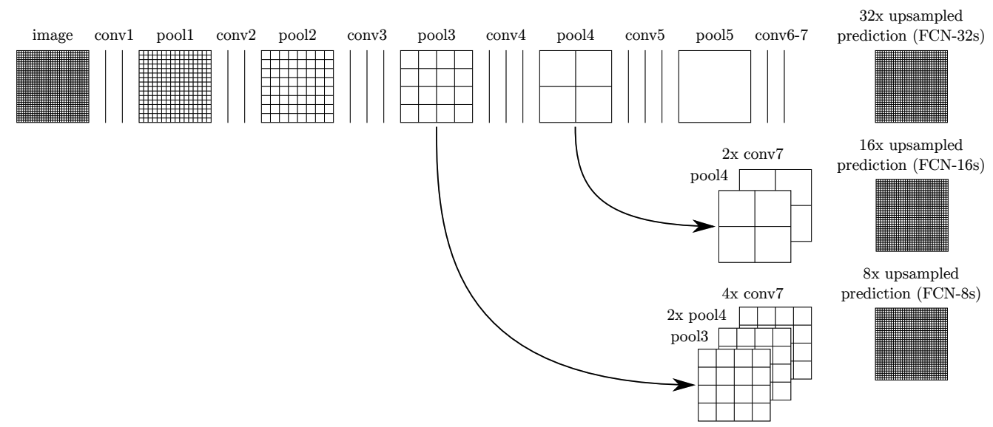
Skip connections
Long, Jonathan, Evan Shelhamer, and Trevor Darrell. "Fully convolutional networks for semantic segmentation." Proceedings of the IEEE conference on computer vision and pattern recognition. 2015.

Slide 34
Alternative: coarse-to-fine prediction
Inspiration 1: we are making independent predictions from each layer
Inspiration 2: CRF-like approaches require iterated inference
Inspiration 3: Coarse-to-fine refinement works because: coarse scales capture large scale structure coarsely, fine scales capture fine-scale structures

Slide 35
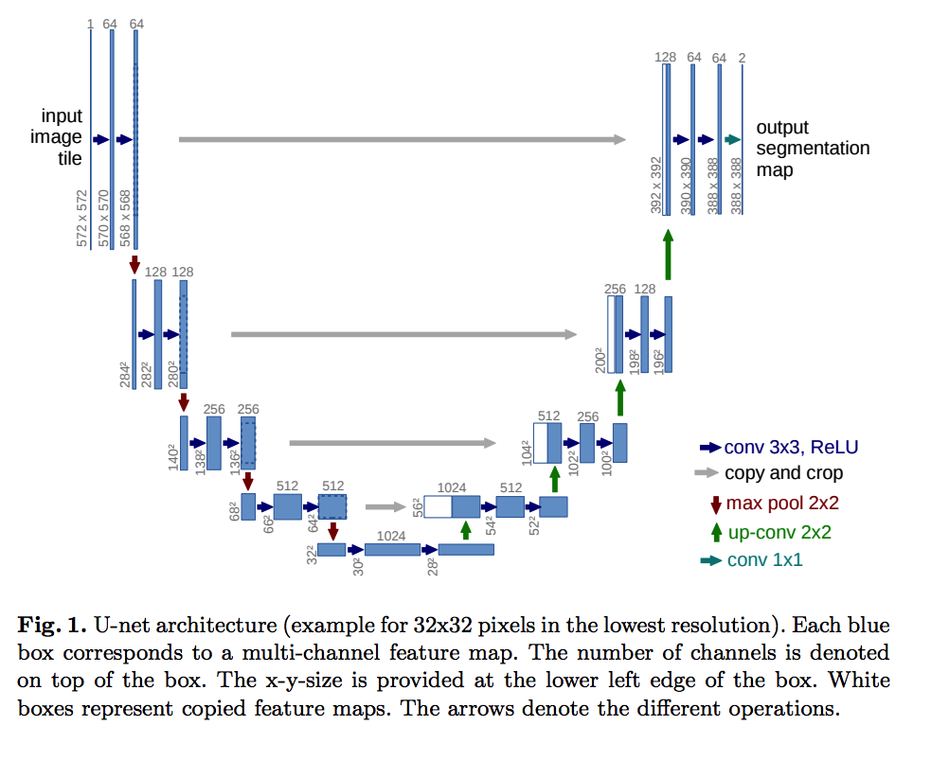
U-Net
Ronneberger, Olaf, Philipp Fischer, and Thomas Brox. "U-net: Convolutional networks for biomedical image segmentation." International Conference on Medical image computing and computer-assisted intervention. Springer, Cham, 2015.

Slide 36
Learned upsampling
Bilinear upsampling
Assume fractional indices in x are 0
Assume w[-1] = w[1] = 0.5, w[0] = 1
Then

Slide 37
Learned upsampling
Looks remarkably like convolution
But output size is twice input size
Filter w can be learnt!
“Up-convolution”, “Transposed convolution”, “Deconvolution”

Slide 38
Image-to-image translation problems

Slide 39
Image-to-image translation problems
Segmentation
Optical flow estimation
Depth estimation
Normal estimation
Boundary detection
…

Slide 40
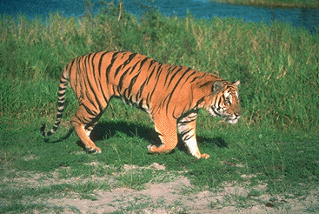
Revisiting contour detection

Slide 41
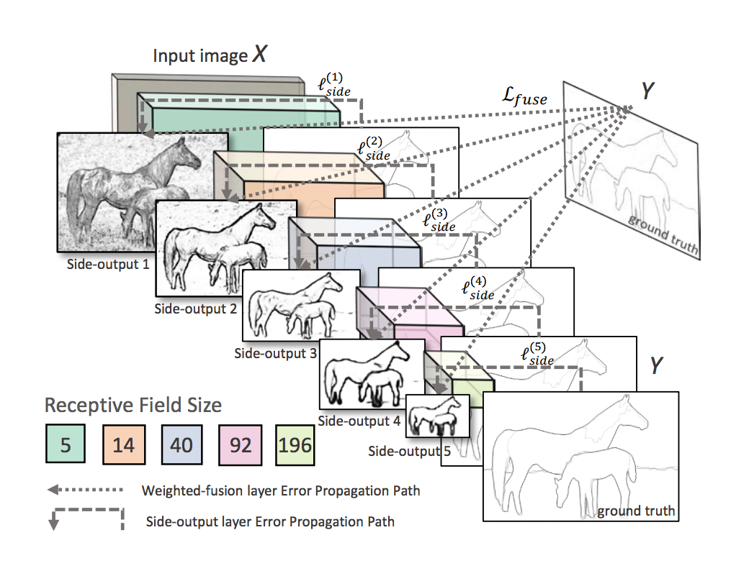
Convolutional network based edge detection
Deep supervision: Skip connections, but additional loss at each layer
Method | Max F measure
Structured Edges | 74.6
HED without deep supervision | 77.1
HED with deep supervision | 78.2
Humans | 80
Holistically-Nested Edge Detection. Saining Xie, Zhuowen Tu. In ICCV, 2015.

Slide 42
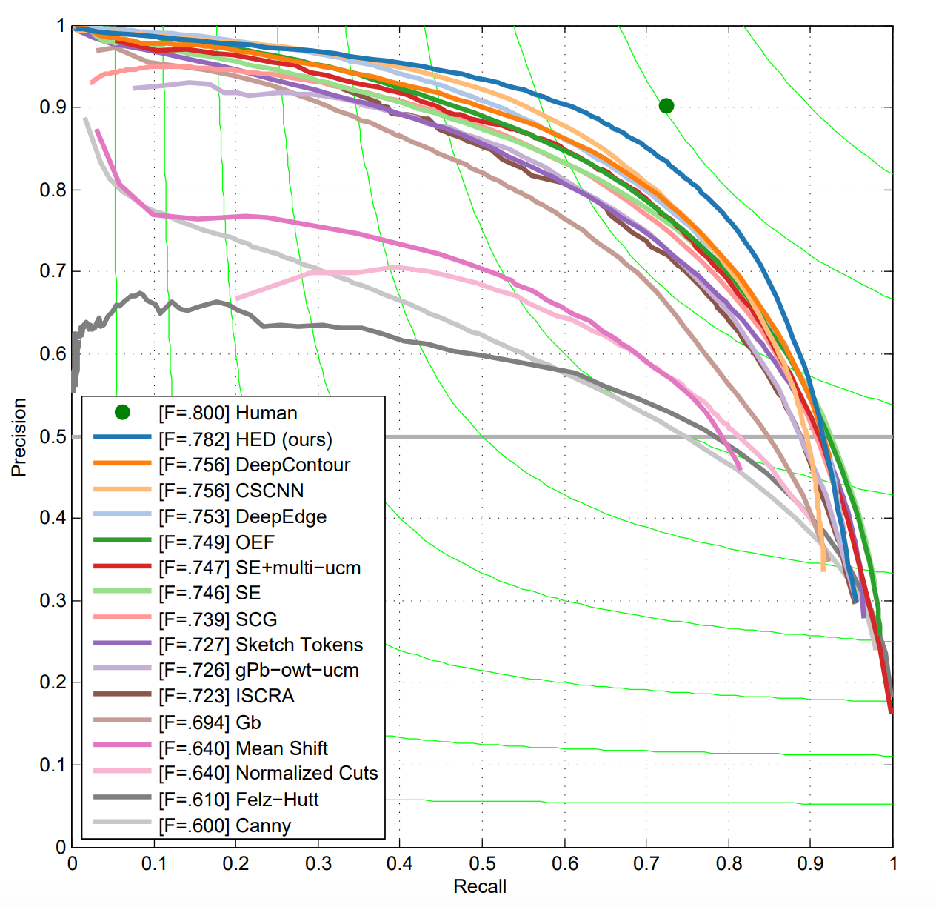
Convolutional network based edge detection

