Slide 1
Neural network training

Slide 2
Vagaries of optimization
Non-convex
  Local optima
  Sensitivity to initialization
Vanishing / exploding gradients
  If each term is (much) greater than 1 → explosion of gradients
  If each term is (much) less than 1 → vanishing gradients

Slide 3
Vanishing and exploding gradients

Slide 4
Sigmoids cause vanishing gradients
Gradient close to 0

Slide 5
Convolution subsampling convolution
conv + non-linearity
conv + non-linearity
subsample

Slide 6
Rectified Linear Unit (ReLU)
max (x,0)
Also called half-wave rectification (signal processing)

Slide 7
Image Classification

Slide 8
How to do machine learning
Create training / validation sets
Identify loss functions
Choose hypothesis class
Find best hypothesis by minimizing training loss

Slide 9
How to do machine learning
Multiclass classification!!
Create training / validation sets
Identify loss functions
Choose hypothesis class
Find best hypothesis by minimizing training loss

Slide 10
MNIST Classification
Method | Error rate (%)
Linear classifier over pixels | 12
Kernel SVM over HOG | 0.56
Convolutional Network | 0.8

Slide 11
ImageNet
1000 categories
~1000 instances per category
Olga Russakovsky*, Jia Deng*, Hao Su, Jonathan Krause, Sanjeev Satheesh, Sean Ma, Zhiheng Huang, Andrej Karpathy, Aditya Khosla, Michael Bernstein, Alexander C. Berg and Li Fei-Fei. (* = equal contribution) ImageNet Large Scale Visual Recognition Challenge. International Journal of Computer Vision, 2015.

Slide 12
ImageNet
Top-5 error: algorithm makes 5 predictions, true label must be in top 5
Useful for incomplete labelings

Slide 13
Convolutional Networks

Slide 14
Why do convnets work?
Claim: ConvNets have way more parameters than traditional models
  Wrong: contemporary models had same or more parameters
Claim: Deep models are more expressive than shallow models
  Wrong: 3 layer neural networks are universal function approximators
What does depth provide?
  More non-linearities: many ways of expressing non-linear functions
  More module reuse: really long switch-case vs functions
  More parameter sharing: most computation is shared amongst categories

Slide 15
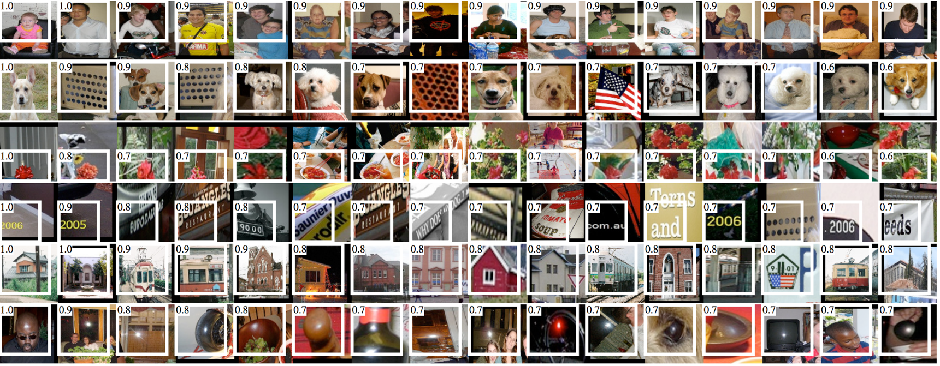
Visualizing convolutional networks I
Rich feature hierarchies for accurate object detection and semantic segmentation. R. Girshick, J. Donahue, T. Darrell, J. Malik. In CVPR, 2014.

Slide 16
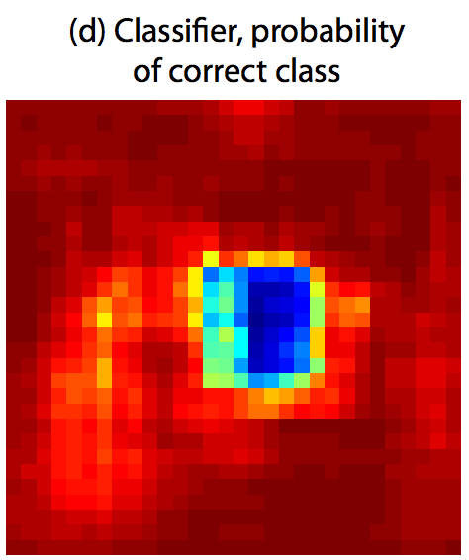
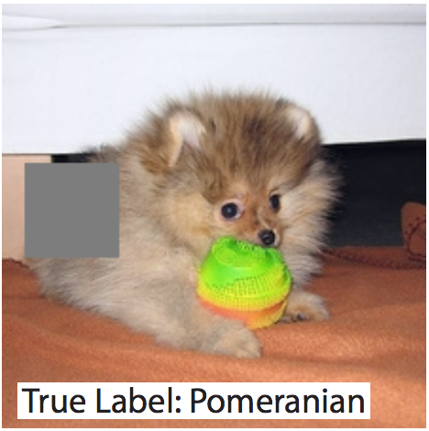
Visualizing convolutional networks II
Image pixels important for classification = pixels when blocked cause misclassification
Visualizing and Understanding Convolutional Networks. M. Zeiler and R. Fergus. In ECCV 2014.

Slide 17
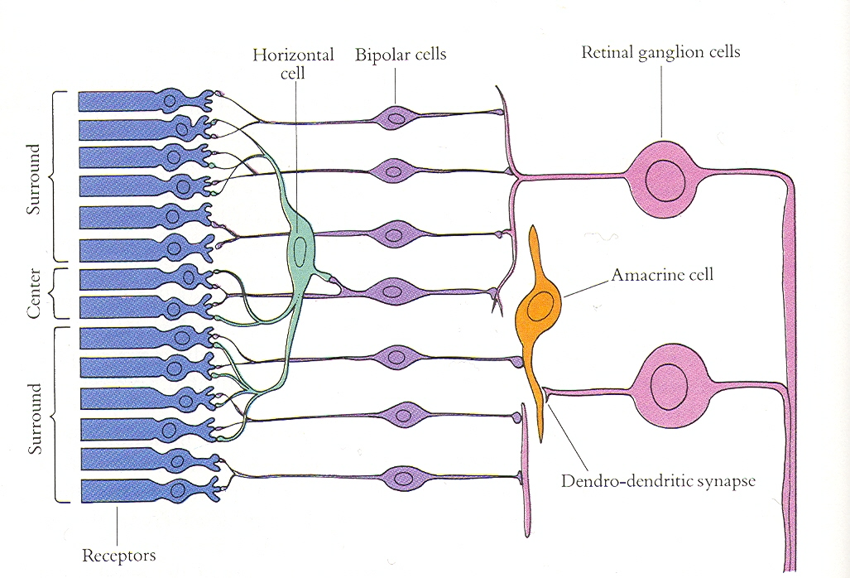
Convolutional Networks and the Brain
Slide credit: Jitendra Malik

Slide 18
Transfer learning

Slide 19
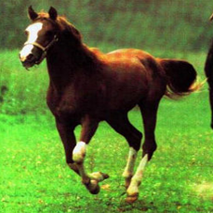
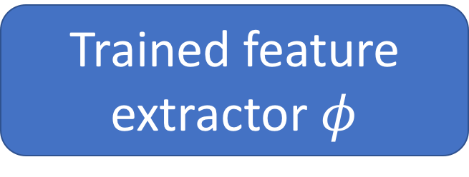
Transfer learning with convolutional networks
Horse
Trained feature extractor $φ$

Slide 20
Transfer learning with convolutional networks
Dataset | Non-Convnet Method | Non-Convnet perf | Pretrained convnet + classifier | Improvement
Caltech 101 | MKL | 84.3 | 87.7 | +3.4
VOC 2007 | SIFT+FK | 61.7 | 79.7 | +18
CUB 200 | SIFT+FK | 18.8 | 61.0 | +42.2
Aircraft | SIFT+FK | 61.0 | 45.0 | -16
Cars | SIFT+FK | 59.2 | 36.5 | -22.7

Slide 21
Why transfer learning?
Availability of training data
Computational cost
Ability to pre-compute feature vectors and use for multiple tasks
Con: NO end-to-end learning

Slide 22
Finetuning
Horse

Slide 23
Finetuning
Bakery
Initialize with pre-trained, then train with low learning rate

Slide 24
Finetuning
Dataset | Non-Convnet Method | Non-Convnet perf | Pretrained convnet + classifier | Finetuned convnet | Improvement
Caltech 101 | MKL | 84.3 | 87.7 | 88.4 | +4.1
VOC 2007 | SIFT+FK | 61.7 | 79.7 | 82.4 | +20.7
CUB 200 | SIFT+FK | 18.8 | 61.0 | 70.4 | +51.6
Aircraft | SIFT+FK | 61.0 | 45.0 | 74.1 | +13.1
Cars | SIFT+FK | 59.2 | 36.5 | 79.8 | +20.6

Slide 25
Exploring convnet architectures

Slide 26
Deeper is better
7 layers
16 layers

Slide 27
Deeper is better
Alexnet
VGG16

Slide 28
The VGG pattern
Every convolution is 3x3, padded by 1
Every convolution followed by ReLU
ConvNet is divided into “stages”
  Layers within a stage: no subsampling
  Subsampling by 2 at the end of each stage
Layers within stage have same number of channels
Every subsampling → double the number of channels

Slide 29
Challenges in training: exploding / vanishing gradients
Vanishing / exploding gradients
  If each term is (much) greater than 1 → explosion of gradients
  If each term is (much) less than 1 → vanishing gradients

Slide 30
Challenges in training: dependence on init

Slide 31
Solutions
Careful init
Batch normalization
Residual connections

Slide 32
Careful initialization
Key idea: want variance to remain approx. constant
  Variance increases in backward pass => exploding gradient
  Variance decreases in backward pass => vanishing gradient
“MSRA initialization”
  weights = Gaussian with 0 mean and variance = 2/(k*k*d)
Delving Deep into Rectifiers: Surpassing Human-Level Performance on ImageNet Classification. K. He, X. Zhang, S. Ren, J. Sun

Slide 33
Batch normalization
Key idea: normalize so that each layer output has zero mean and unit variance
  Compute mean and variance for each channel
  Aggregate over batch
  Subtract mean, divide by std
Need to reconcile train and test
  No ”batches” during test
  After training, compute means and variances on train set and store
Batch Normalization: Accelerating Deep Network Training by Reducing Internal Covariate Shift. S. Ioffe, C. Szegedy. In ICML, 2015.

Slide 34
Residual connections
In general, gradients tend to vanish
Key idea: allow gradients to flow unimpeded

Slide 35
Residual connections
In general, gradients tend to vanish
Key idea: allow gradients to flow unimpeded

Slide 36
Residual connections
Assumes all z_{i} have the same size
True within a stage
Across stages?
  Doubling of feature channels
  Subsampling
Increase channels by 1x1 convolution
Decrease spatial resolution by subsampling

Slide 37
A residual block
Instead of single layers, have residual connections over block
Conv
BN
ReLU
Conv
BN

Slide 38
Bottleneck blocks
Problem: When channels increases, 3x3 convolutions introduce many parameters
  3x3xc²
Key idea: use 1x1 to project to lower dimensionality, do convolution, then come back
  cxd + 3x3xd² + dxc

Slide 39
The ResNet pattern
Decrease resolution substantially in first layer
  Reduces memory consumption due to intermediate outputs
Divide into stages
  maintain resolution, channels in each stage
  halve resolution, double channels between stages
Divide each stage into residual blocks
At the end, compute average value of each channel to feed linear classifier

Slide 40
Putting it all together - Residual networks

Slide 41
Semantic Segmentation

Slide 42
The Task
person
grass
trees
motorbike
road

Slide 43
Evaluation metric
Pixel classification!
Accuracy?
  Heavily unbalanced
Intersection over Union
  Average across classes and images
Per-class accuracy
  Average across classes and images

Slide 44
Things vs Stuff
THINGS
Person, cat, horse, etc
Constrained shape
Individual instances with separate identity
May need to look at objects
STUFF
Road, grass, sky etc
Amorphous, no shape
No notion of instances
Can be done at pixel level
“texture”

Slide 45
Challenges in data collection
Precise localization is hard to annotate
Annotating every pixel leads to heavy tails
Common solution: annotate few classes (often things), mark rest as “Other”
Common datasets: PASCAL VOC 2012 (~1500 images, 20 categories), COCO (~100k images, 20 categories)

Slide 46
Pre-convnet semantic segmentation
Things
  Do object detection, then segment out detected objects
Stuff
  ”Texture classification”
  Compute histograms of filter responses
  Classify local image patches

Slide 47
Semantic segmentation using convolutional networks
w
3
h

Slide 48
Semantic segmentation using convolutional networks
c
w/4
h/4

Slide 49
Semantic segmentation using convolutional networks
c
w/4
h/4

Slide 50
Semantic segmentation using convolutional networks
c
w/4
h/4

Slide 51
Semantic segmentation using convolutional networks
c
#classes
Convolve with #classes 1x1 filters
w/4
h/4

Slide 52
Semantic segmentation using convolutional networks
Pass image through convolution and subsampling layers
Final convolution with #classes outputs
Get scores for subsampled image
Upsample back to original size

Slide 53
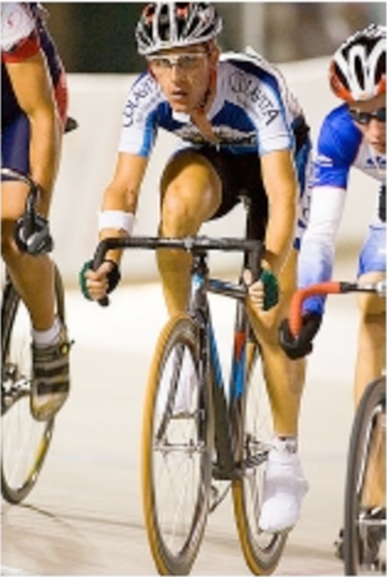
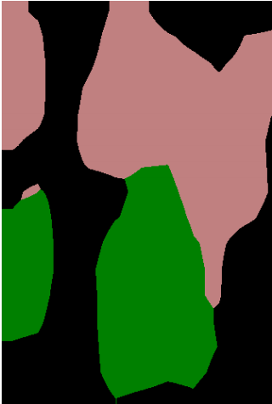
Semantic segmentation using convolutional networks
person
bicycle

Slide 54
The resolution issue
Problem: Need fine details!
Shallower network / earlier layers?
  Not very semantic!
Remove subsampling?
  Looks at only a small window!

Slide 55



Solution 1: Image pyramids
Higher resolution
Less context
Learning Hierarchical Features for Scene Labeling. Clement Farabet, Camille Couprie, Laurent Najman, Yann LeCun. In TPAMI, 2013.

Slide 56
Solution 2: Skip connections
upsample

Slide 57
Solution 2: Skip connections

Slide 58
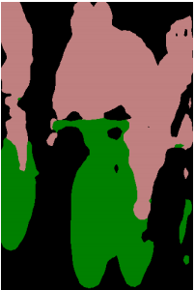
Skip connections
Fully convolutional networks for semantic segmentation. Evan Shelhamer, Jon Long, Trevor Darrell. In CVPR 2015

Slide 59
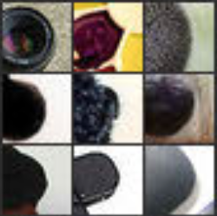
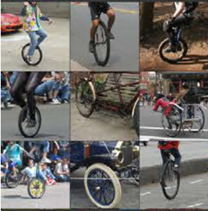
Skip connections
Problem: early layers not semantic
Horse
Visualizations from : M. Zeiler and R. Fergus. Visualizing and Understanding Convolutional Networks. In ECCV 2014.
Notes:
If you look at what one of these higher layers is detecting, here I am showing the input image patches that are highly scored by one of the units. This particular layer really likes bicycle wheels, so if this unit fires, you know that there is a bicycle wheel in the image. Unfortunately, you don’t know where the bicycle wheel is, because this unit doesn’t care where the bicycle wheel appears, or at what orientation or what scale.

