Slide 1
Convolutional networks

Slide 2
Convolution as a primitive
c
c
c’
c’
Convolution
h
h
w
w

Slide 3
Convolution subsampling convolution
conv + non-linearity
conv + non-linearity
subsample

Slide 4
Convolutional networks
conv
subsample
conv
subsample
linear
filters
filters
weights
Parameters

Slide 5
Empirical Risk Minimization
Convolutional network
Gradient descent update

Slide 6
Computing the gradient of the loss

Slide 7
Convolutional networks
conv
subsample
conv
subsample
linear
filters
filters
weights

Slide 8
The gradient of convnets
z₁
z₂
z₃
z₄
z₅ = z
f₁
f₂
f₃
f₄
f₅
x
w₁
w₂
w₃
w₄
w₅

Slide 9
The gradient of convnets
z₁
z₂
z₃
z₄
z₅ = z
f₁
f₂
f₃
f₄
f₅
x
w₁
w₂
w₃
w₄
w₅

Slide 10
The gradient of convnets
z₁
z₂
z₃
z₄
z₅ = z
f₁
f₂
f₃
f₄
f₅
x
w₁
w₂
w₃
w₄
w₅

Slide 11
The gradient of convnets
z₁
z₂
z₃
z₄
z₅ = z
f₁
f₂
f₃
f₄
f₅
x
w₁
w₂
w₃
w₄
w₅

Slide 12
The gradient of convnets
z₁
z₂
z₃
z₄
z₅ = z
f₁
f₂
f₃
f₄
f₅
x
w₁
w₂
w₃
w₄
w₅

Slide 13
The gradient of convnets
z₁
z₂
z₃
z₄
z₅ = z
f₁
f₂
f₃
f₄
f₅
x
w₁
w₂
w₃
w₄
w₅

Slide 14
The gradient of convnets
z₁
z₂
z₃
z₄
z₅ = z
f₁
f₂
f₃
f₄
f₅
x
w₁
w₂
w₃
w₄
w₅

Slide 15
The gradient of convnets
z₁
z₂
z₃
z₄
z₅ = z
f₁
f₂
f₃
f₄
f₅
x
w₁
w₂
w₃
w₄
w₅

Slide 16
The gradient of convnets
z₁
z₂
z₃
z₄
z₅ = z
f₁
f₂
f₃
f₄
f₅
x
w₁
w₂
w₃
w₄
w₅

Slide 17
The gradient of convnets
z₁
z₂
z₃
z₄
z₅ = z
f₁
f₂
f₃
f₄
f₅
x
w₁
w₂
w₃
w₄
w₅

Slide 18
The gradient of convnets
z₁
z₂
z₃
z₄
z₅ = z
f₁
f₂
f₃
f₄
f₅
x
w₁
w₂
w₃
w₄
w₅

Slide 19
The gradient of convnets
z₁
z₂
z₃
z₄
z₅ = z
f₁
f₂
f₃
f₄
f₅
x
w₁
w₂
w₃
w₄
w₅

Slide 20
The gradient of convnets
z₁
z₂
z₃
z₄
z₅ = z
f₁
f₂
f₃
f₄
f₅
x
w₁
w₂
w₃
w₄
w₅

Slide 21
The gradient of convnets
z₁
z₂
z₃
z₄
z₅ = z
f₁
f₂
f₃
f₄
f₅
x
w₁
w₂
w₃
w₄
w₅
Recurrence going backward!!

Slide 22
The gradient of convnets
z₁
z₂
z₃
z₄
z₅ = z
f₁
f₂
f₃
f₄
f₅
x
w₁
w₂
w₃
w₄
w₅
Backpropagation

Slide 23
Backpropagation for a sequence of functions
Previous term
Function derivative

Slide 24
Backpropagation for a sequence of functions
Assume we can compute partial derivatives of each function
Use g(z_{i}) to store gradient of z w.r.t z_{i}, g(w_{i}) for w_{i}
Calculate g(z_{i}) by iterating backwards
Use g(z_{i}) to compute gradient of parameters g(w_{i})

Slide 25
Backpropagation for a sequence of functions
Each “function” has a “forward” and “backward” module
Forward module for f_{i}
takes z_{i-1} and weight w_{i} as input
produces z_{i} as output
Backward module for f_{i}
takes g(z_{i} ) as input
produces g(z_{i-1} ) and g(w_{i}) as output

Slide 26
Backpropagation for a sequence of functions
z_{i-1}
f_{i}
z_{i}
w_{i}

Slide 27
Backpropagation for a sequence of functions
g(z_{i-1})
f_{i}
g(z_{i})
g(w_{i})

Slide 28
Chain rule for vectors
Jacobian

Slide 29
Loss as a function
label
conv
subsample
conv
subsample
linear
loss
filters
filters
weights

Slide 30
Neural network frameworks
Caffe

Slide 31
Beyond sequences: computation graphs
Arbitrary graphs of functions
No distinction between intermediate outputs and parameters
g
k
u
x
f
l
z
y
h
w

Slide 32
Computation graph - Functions
Each node implements two functions
A “forward”
Computes output given input
A “backward”
Computes derivative of z w.r.t input, given derivative of z w.r.t output

Slide 33
Computation graphs
a
f_{i}
b
d
c

Slide 34
Computation graphs
f_{i}

Slide 35
Stochastic gradient descent
Gradient on single example = unbiased sample of true gradient
Idea: at each iteration sample single example x^{(t)}
Con: variance in estimate of gradient → slow convergence, jumping near optimum
step size

Slide 36
Minibatch stochastic gradient descent
Compute gradient on a small batch of examples
Same mean (=true gradient), but variance inversely proportional to minibatch size

Slide 37
Momentum
Average multiple gradient steps
Use exponential averaging

Slide 38
Weight decay
Add -aw^{(t)} to the gradient
Prevents w^{(t)} from growing to infinity
Equivalent to L2 regularization of weights

Slide 39
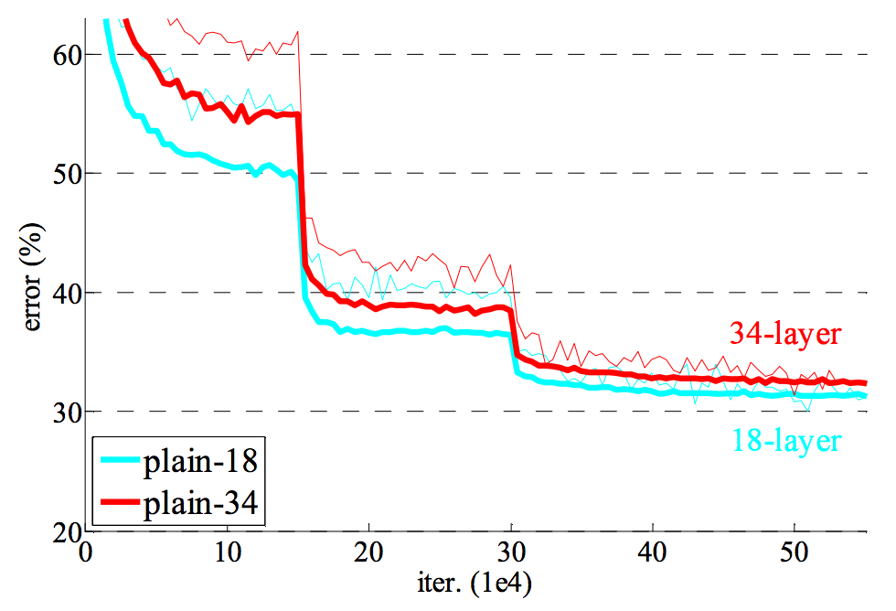
Learning rate decay
Large step size / learning rate
Faster convergence initially
Bouncing around at the end because of noisy gradients
Learning rate must be decreased over time
Usually done in steps

Slide 40
Convolutional network training
Initialize network
Sample minibatch of images
Forward pass to compute loss
Backpropagate loss to compute gradient
Combine gradient with momentum and weight decay
Take step according to current learning rate

