Slide 1
Recognition

Slide 2
Learning
Key idea: teach computer visual concepts by providing examples
Training Set

Slide 3
Example
Binary classifier “Dog” or ”not Dog”
Labels: {0, 1}
Training set
{(
, 1),
(
, 1),
(
, 0) , … }

Slide 4
Choosing a model class
Will try and find P(y = 1 | x)
P(y=0 | x) = 1 - P(y=1 | x)
Need to find
But: enormous number of possible mappings

Slide 5
Choosing a model class
E.g: Assume h is a linear classifier in feature space

Slide 6
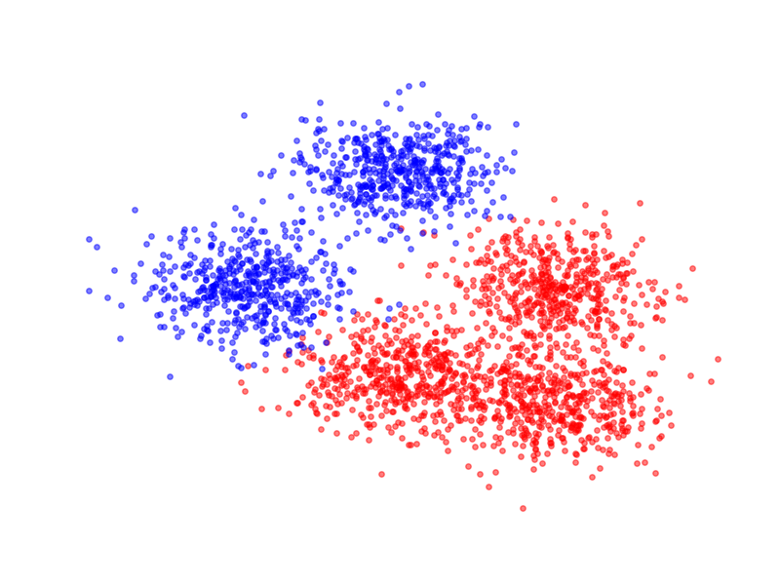
Feature extractor

Slide 7
Linear classifiers

Slide 8
Linear classifiers in feature space
Family of functions
Each function is called a hypothesis
Family is called a hypothesis class
Hypotheses indexed by w
Need to find the best hypothesis = need to find best w

Slide 9
Training: Choosing the best hypothesis
Use training set to find best-fitting hypothesis
Question: how do we define fit?
Loss function
h_{w}(x) is estimated probability label is 1
Log likelihood : negative log of estimated probability of the true label

Slide 10
Training: Choosing the best hypothesis

Slide 11
Training: Choosing the best hypothesis
Likelihood of a single data point
Fit = total likelihood of entire training dataset

Slide 12
Training: Choosing the best hypothesis
Use negative log likelihood
-

Slide 13
Training: Choosing the best hypothesis
Maximizing log likelihood = Minimizing negative log likelihood

Slide 14
Training = Optimization
Need to minimize an objective
Simple solution: gradient descent

Slide 15
Stochastic gradient descent

Slide 16
Stochastic gradient descent
Randomly sample small subset of examples
Compute gradient on small subset
Unbiased estimate of true gradient
Take step along estimated gradient

Slide 17
Logistic Regression!

Slide 18
General recipe
Fix hypothesis class
Define loss function
Minimize total loss on the training set
Why should this work?

Slide 19
Risk
Given:
Distribution
A hypothesis
Loss function L
We are interested in Expected Risk:
Given training set S, and a particular hypothesis h, Empirical Risk:

Slide 20
Risk
By central limit theorem,
Variance proportional to 1/n
For randomly chosen h, empirical risk is an unbiased estimator of expected risk

Slide 21
Risk
Empirical risk unbiased estimate of expected risk
Want to minimize expected risk
Idea: Minimize empirical risk instead
This is the Empirical Risk Minimization Principle

Slide 22
Generalization
Training error
Generalization error

Slide 23
Overfitting
We are minimizing training error
Empirical risk of chosen hypothesis no longer unbiased estimate:
We chose hypothesis based on S
Might have chosen h for which S is a special case
Overfitting:
Minimize training error, but generalization error increases

Slide 24
Controlling generalization error
Variance of empirical risk inversely proportional to size of S
Choose very large S!
Larger the hypothesis class H, Higher the chance of hitting bad hypotheses with low training error and high generalization error
Choose small H!
For many models, can bound generalization error using some property of parameters
Regularize during optimization!
Eg. L2 regularization

Slide 25
Controlling generalization error
How do we know we are overfitting?
Use a held-out “validation set”
To be an unbiased sample, must be completely unseen

Slide 26
Putting it all together
Collect training set and validation set
Pick hypothesis class
Pick loss function
Minimize empirical risk (+ regularization)
Measure performance on held-out validation set
Profit!

Slide 27
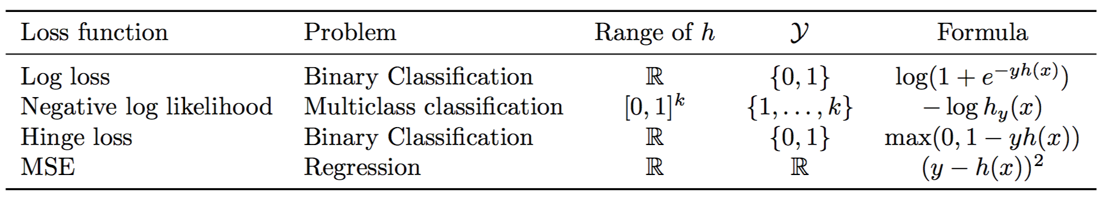
Loss functions and hypothesis classes

Slide 28
Linear classifiers on pixels are bad
Better feature vectors
Non-linear classifiers

Slide 29
Invariance to large deformations
Important aspect of a class: presence / absence of parts?

Slide 30
Bags of words
Last night I dreamt I went to Manderley again. It seemed to me I stood by the iron gate leading to the drive, and for a while I could not enter, for the way was barred to me. There was a padlock and a chain upon the gate. I called in my dream to the lodge-keeper, and had no answer, and peering closer through the rusted spokes of the gate I saw that the lodge was uninhabited….
dream
night
drive
locked
gate
lodge
uninhabited

Slide 31
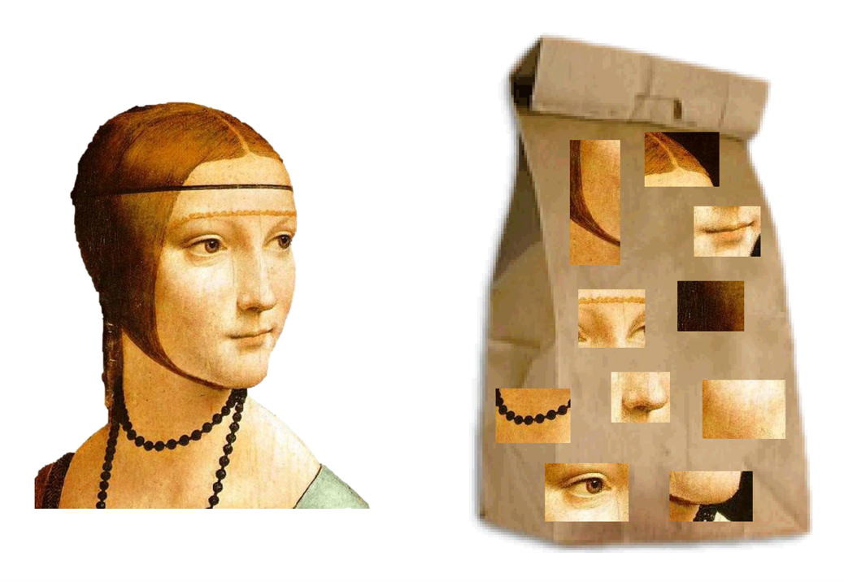
Bags of visual words

Slide 32
What should be visual words?
A visual word is a cluster of image patches that mean the same thing
Object parts
Texture patterns
Idea: collect patches from many different images
Cluster using k-means - cluster centers are words

Slide 33
Detecting visual words
Nearest neighbor

Slide 34
Encoding images as bag of words
Densely extract image patches from image
Assign each patch to a visual word
Compute histogram of occurrence

Slide 35
Multilayer perceptrons
Key idea: build complex functions by composing simple functions
f(x) = Wx
g(x) = max(x,0)
f(x) = Wx
g(x) = max(x,0)
f(x) = Wx

Slide 36
Multilayer perceptrons
Key idea: build complex functions by composing simple functions
Caveat: simple functions must include non-linearities
W(U(Vx)) = (WUV)x

Slide 37
Multilayer perceptrons

Slide 38
Reducing capacity
256
65K
256

Slide 39
Reducing capacity
W
65K
65K
65K

Slide 40
Idea 1: local connectivity
Pixels only related to nearby pixels

Slide 41
Idea 2: Translation invariance
Pixels only related to nearby pixels

Slide 42
Local connectivity + translation invariance = convolution
5.4 | 0.1 | 3.6
1.8 | 2.3 | 4.5
1.1 | 3.4 | 7.2

Slide 43
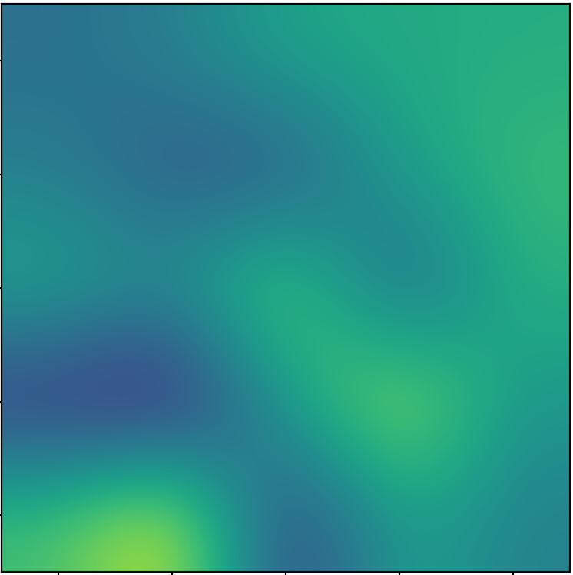
Local connectivity + translation invariance = convolution
5.4 | 0.1 | 3.6
1.8 | 2.3 | 4.5
1.1 | 3.4 | 7.2

Slide 44
Local connectivity + translation invariance = convolution
Feature map
5.4 | 0.1 | 3.6
1.8 | 2.3 | 4.5
1.1 | 3.4 | 7.2

Slide 45
Convolution as a primitive
c
c
c’
c’
Convolution
h
h
w
w

Slide 46
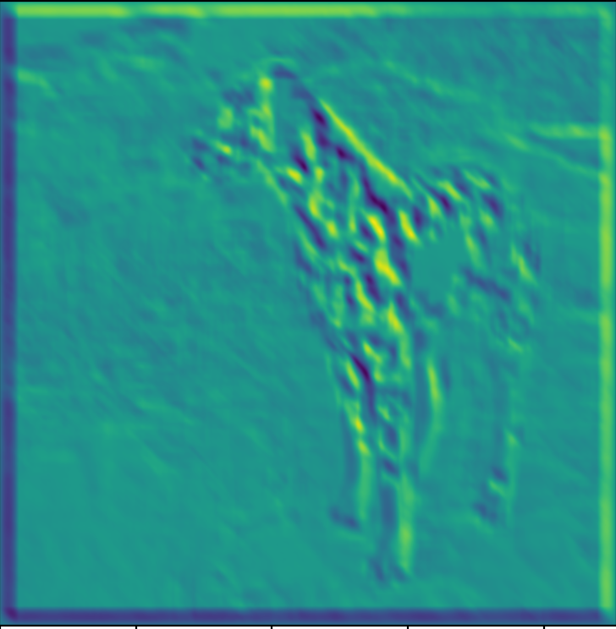

Convolution as a feature detector
score at (x,y) = dot product (filter, image patch at (x,y))
Response represents similarity between filter and image patch

Slide 47
Invariance to distortions

Slide 48
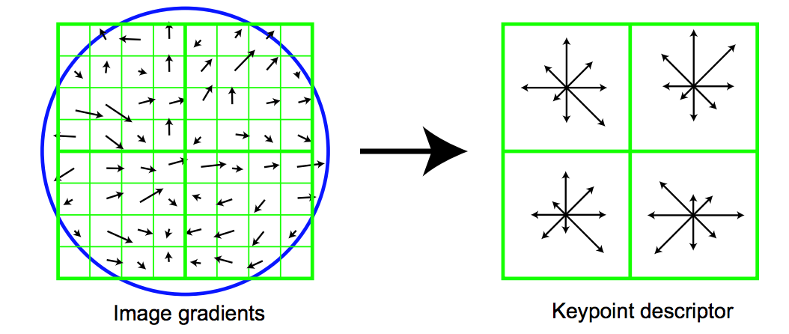
Invariance to distortions

Slide 49
Invariance to distortions: Pooling
…

Slide 50
Invariance to distortions: Subsampling

Slide 51
Convolution subsampling convolution

Slide 52
Convolution subsampling convolution
Convolution in earlier steps detects more local patterns less resilient to distortion
Convolution in later steps detects more global patterns more resilient to distortion
Subsampling allows capture of larger, more invariant patterns

Slide 53
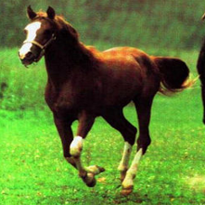
Convolutional networks
Horse

Slide 54
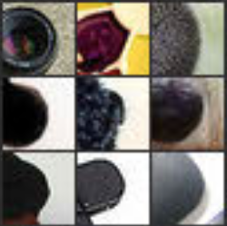
Convolutional networks
Horse
Visualizations from : M. Zeiler and R. Fergus. Visualizing and Understanding Convolutional Networks. In ECCV 2014.
Notes:
In contrast, if you look at the earlier layers, this particular unit here really likes a dark blob at a very precise location and scale in its field of view. If this unit fired, you will know exactly where the dark blob was. Unfortunately, this unit doesn’t care about the actual semantics of the dark blob: you will have no idea what the dark blob actually is.

Slide 55
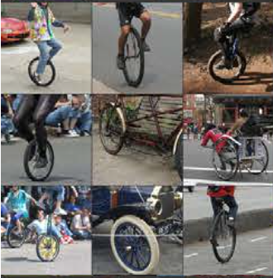
Convolutional networks
Horse
Visualizations from : M. Zeiler and R. Fergus. Visualizing and Understanding Convolutional Networks. In ECCV 2014.
Notes:
If you look at what one of these higher layers is detecting, here I am showing the input image patches that are highly scored by one of the units. This particular layer really likes bicycle wheels, so if this unit fires, you know that there is a bicycle wheel in the image. Unfortunately, you don’t know where the bicycle wheel is, because this unit doesn’t care where the bicycle wheel appears, or at what orientation or what scale.

