Slide 1
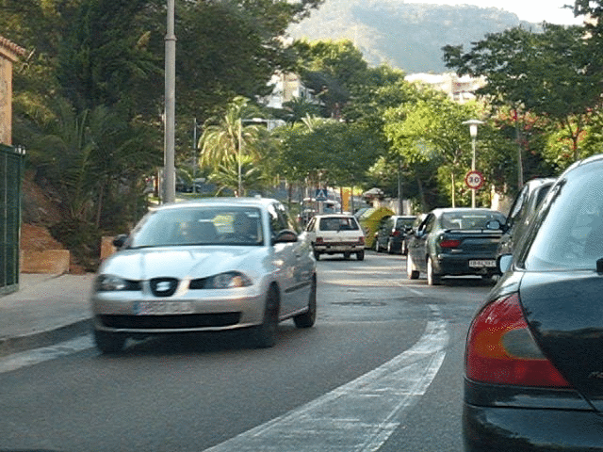
Optical flow for moving scenes

Slide 2
Optical flow for moving scenes

Slide 3
Optical flow constraint equation
Image intensity continuous function of x, y, t
In time dt, pixel (x,y,t) moves to (x + u dt, y + v dt, t + dt)
Optical flow constraint equation: One equation, two variables

Slide 4
Lucas-Kanade
Assume all pixels in patch have the same flow
When will this produce a unique solution?

Slide 5
Aperture problem

Slide 6
Aperture problem

Slide 7
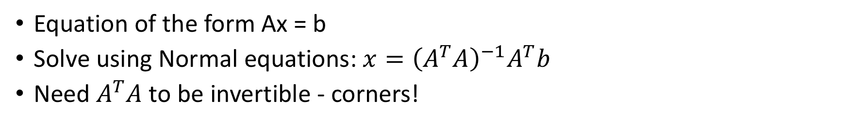
Lucas-Kanade
Equation of the form Ax = b
Solve using Normal equations: $x={\left(A^{T}A\right)}^{−1}A^{T}b$
Need $A^{T}A$ to be invertible - corners!

Slide 8
Lucas-Kanade
What if we consider the whole image as one patch?
Constant optical flow for the entire image?
Better: what if we consider flow as a parametric function of pixel location?
e.g. affine
More generally:
“Motion models”

Slide 9

Lucas-Kanade
Solve by iterating on $θ$
Newton iteration
Can we remove the parametric assumption?
Baker, Simon, and Iain Matthews. "Lucas-kanade 20 years on: A unifying framework." International journal of computer vision 56.3 (2004): 221-255.

Slide 10
Horn-Schunk
Data
Smoothness

Slide 11
Horn-Schunk
Data
Smoothness

Slide 12
Variational minimization
u and v are functions
Euler-lagrange equations
Similar to “gradient=0”

Slide 13
Variational minimization

Slide 14
MPI-Sintel
Open-source animated movie “Sintel”
“Naturalistic” video
Ground truth optical flow
Large motions
Complex scenes

Slide 15
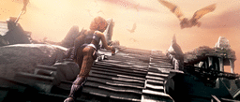
MPI-Sintel results

Slide 16
Optical flow with large displacements
Optical flow constraint equation assumes differential optical flow
“Large displacement”?
Key idea: reducing resolution reduces displacement
Reduce resolution, then upsample?
will lose fine details
3
6
13
24
27

Slide 17
Optical flow with large displacements
Key idea 2: Use upsampled flow as initialization
Changes to initialization will be infinitesimal
compute flow
use as init
compute flow
…
Brox, Thomas, et al. "High accuracy optical flow estimation based on a theory for warping." Computer Vision-ECCV 2004 (2004)

Slide 18
Optical flow for large displacements
Horn-schunk variants match using color - Bad!
Use descriptor matching (e.g. SIFT) on sparse points
Use smoothness to propagate
Brox, Thomas, Christoph Bregler, and Jitendra Malik. "Large displacement optical flow." CVPR, 2009.

Slide 19
Large displacement optical flow (LDOF)

Slide 20
Coarse-to-fine processing
A specific instance of a general idea
Coarse scales:
Global / large structures
Long-range relationships
But: imprecise localization
Fine scales:
Precise localization
But: aperture problem
Idea: start from coarse scales, add fine scale detail

Slide 21
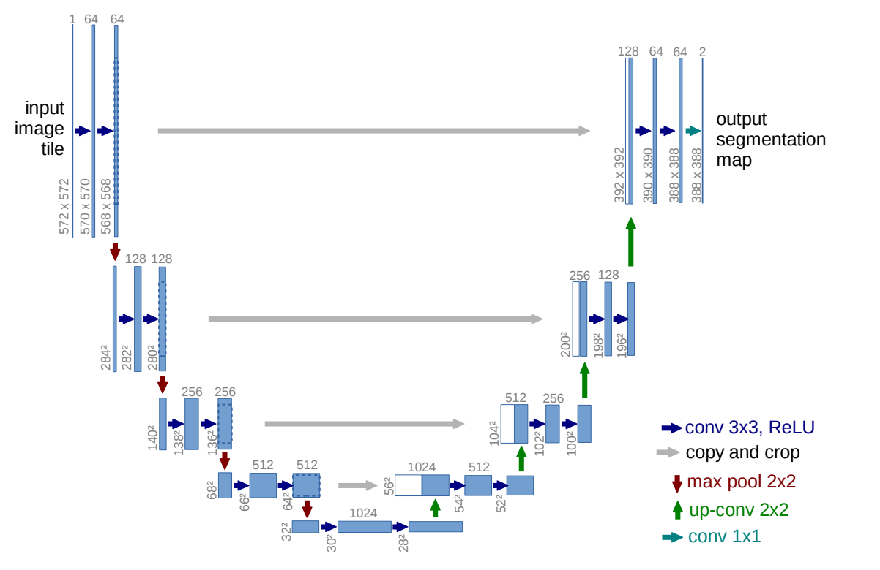
Coarse-to-fine processing
U-Net: Convolutional Networks for Biomedical Image Segmentation. Olaf Ronneberger, Philipp Fischer, and Thomas Brox. In MICCAI, 2015.

Slide 22
Intro to ML

Slide 23
Image classification
Given an image, produce a label
Label can be:
0/1 or yes/no: Binary classification
one-of-k: Multiclass classification
0/1 for each of k concepts: Multilabel classification

Slide 24
Image classification
Is this a dog? Yes

Slide 25
Image classification
Which of these is it: dog, cat or zebra?
Dog

Slide 26
Image classification
Is this a dog? Yes
Is this furry? Yes
Is this sitting down? Yes

Slide 27
MNIST
2D
10 classes
6000 examples per class
1990’s

Slide 28
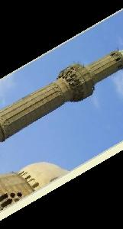
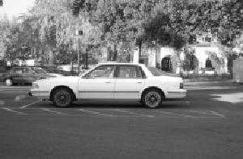
Caltech 101
101 classes
10 classes
30 examples per class
Strong category-specific biases
Clean images
MNIST
1990’s
2004

Slide 29
PASCAL VOC
20 classes
~500 examples per class
Clutter, occlusion, natural scenes
MNIST
Caltech 101
1990’s
2004
2007-2012

Slide 30
ImageNet
1000 classes
~1000 examples per class
Mix of cluttered and clean images
MNIST
Caltech 101
PASCAL VOC
1990’s
2004
2007-2013
2013-2017

Slide 31
Why is recognition hard?
Pose variation

Slide 32
Why is recognition hard?
Lighting variation

Slide 33
Why is recognition hard?
Scale variation

Slide 34
Why is recognition hard?
Clutter and occlusion

Slide 35
Why is recognition hard?
Intrinsic intra-class variation

Slide 36
Why is recognition hard?
Inter-class similarity

Slide 37
Discussion

Slide 38
Learning
Key idea: teach computer visual concepts by providing examples
Training Set

Slide 39
Example
Binary classifier “Dog” or ”not Dog”
Labels: {0, 1}
Training set
{(
, 1),
(
, 1),
(
, 0) , … }

Slide 40
Choosing a model class
Will try and find P(y = 1 | x)
P(y=0 | x) = 1 - P(y=1 | x)
Need to find
But: enormous number of possible mappings

Slide 41
Choosing a model class
Assume h is a linear classifier in feature space
Feature space?
Linear classifier?

Slide 42
Feature space: representing images as vectors
Find a way to project images onto

Slide 43

Feature space: representing images as vectors
Find a way to project images onto

Slide 44
Feature space: representing images as vectors
Find a way to project images onto
(
) =

Slide 45
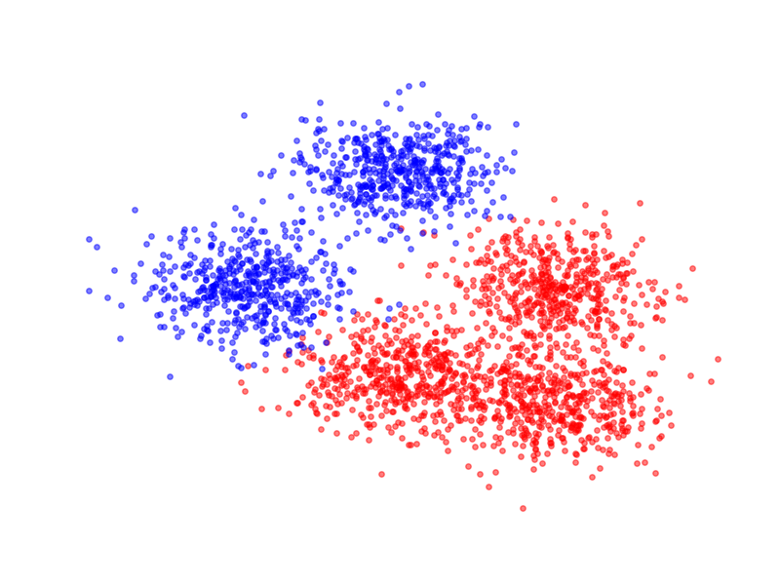
Linear classifiers

Slide 46
Linear classifiers

Slide 47
Linear classifiers in feature space

Slide 48
Linear classifiers in feature space
Family of functions
Each function is called a hypothesis
Family is called a hypothesis class
Hypotheses indexed by w
Need to find the best hypothesis = need to find best w

Slide 49
Training: Choosing the best hypothesis
Use training set to find best-fitting hypothesis
Question: how do we define fit?
Given (x,y), and candidate hypothesis h_{w}
h_{w}(x) is estimated probability label is 1
Idea: compute estimated probability for true label y
Want this probability to be high
Likelihood

Slide 50
Training: Choosing the best hypothesis

Slide 51
Training: Choosing the best hypothesis
Likelihood of a single data point
Fit = total likelihood of entire training dataset

Slide 52
Training: Choosing the best hypothesis
Use log likelihood
Maximize log likelihood

Slide 53
Training: Choosing the best hypothesis
Maximizing log likelihood = Minimizing negative log likelihood

Slide 54
Training: Choosing the best hypothesis
Negative log likelihood is a loss function

Slide 55
Training = Optimization
Need to minimize an objective
Simple solution: gradient descent

Slide 56
Stochastic gradient descent

Slide 57
Stochastic gradient descent
Randomly sample small subset of examples
Compute gradient on small subset
Unbiased estimate of true gradient
Take step along estimated gradient

Slide 58
Logistic Regression!

Slide 59
General recipe
Fix hypothesis class
Define loss function
Minimize total loss on the training set
Why should this work?

Slide 60
Risk
Given:
Distribution
A hypothesis
Loss function L
We are interested in Expected Risk:
Given training set S, and a particular hypothesis h, Empirical Risk:

Slide 61
Risk
By central limit theorem,
Variance proportional to 1/n
For randomly chosen h, empirical risk is an unbiased estimator of expected risk

Slide 62
Risk
Empirical risk unbiased estimate of expected risk
Want to minimize expected risk
Idea: Minimize empirical risk instead
This is the Empirical Risk Minimization Principle

Slide 63
Generalization
Training error
Generalization error

Slide 64
Overfitting
We are minimizing training error
Empirical risk of chosen hypothesis no longer unbiased estimate:
We chose hypothesis based on S
Might have chosen h for which S is a special case
Overfitting:
Minimize training error, but generalization error increases

Slide 65
Controlling generalization error
Variance of empirical risk inversely proportional to size of S
Choose very large S!
Larger the hypothesis class H, Higher the chance of hitting bad hypotheses with low training error and high generalization error
Choose small H!
For many models, can bound generalization error using some property of parameters
Regularize during optimization!
Eg. L2 regularization

Slide 66
Controlling generalization error
How do we know we are overfitting?
Use a held-out “validation set”
To be an unbiased sample, must be completely unseen

Slide 67
Putting it all together
Want model with least expected risk = expected loss
But expected risk hard to evaluate
Empirical Risk Minimization: minimize empirical risk in training set
Might end up picking special case: overfitting
Avoid overfitting by:
Constructing large training sets
Reducing size of model class
Regularization

Slide 68
Putting it all together
Collect training set and validation set
Pick hypothesis class
Pick loss function
Minimize empirical risk (+ regularization)
Measure performance on held-out validation set
Profit!

Slide 69
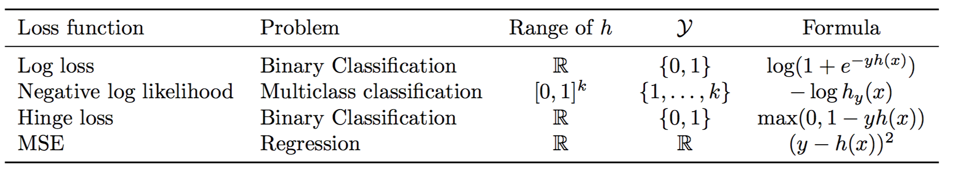
Loss functions and hypothesis classes

Slide 70
Linear classifiers on pixels are bad
Better feature vectors
Non-linear classifiers

Slide 71
Recognition before convnets

Slide 72
Better feature vectors
Need to be invariant to:
Small deformations
Small orientation changes
Color / lightness variation

Slide 73
Rotational invariance by quantization
37
42
Between 30 and 45

Slide 74
Spatial invariance by histogramming
2 blue balls, one red box

Slide 75
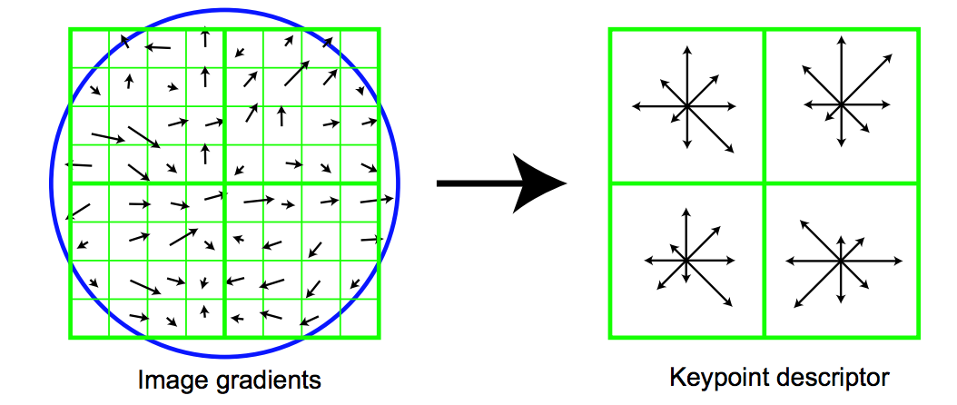
The SIFT descriptor
Compute edge magnitudes + orientations
Quantize orientations (rotational invariance)
Divide into spatial cells
Compute orientation histogram in each cell (spatial invariance)
Distinctive Image Features from Scale-Invariant Keypoints. Lowe. In IJCV 2004

Slide 76
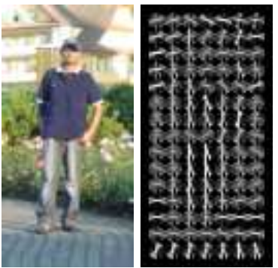
Same but different: HOG
Histogram of oriented gradients

Slide 77
Invariance to large deformations

Slide 78
Invariance to large deformations
Issue: object / object part may occur at any image location
Idea: want to represent the image as a “bag of object parts”

Slide 79
Bags of words
Last night I dreamt I went to Manderley again. It seemed to me I stood by the iron gate leading to the drive, and for a while I could not enter, for the way was barred to me. There was a padlock and a chain upon the gate. I called in my dream to the lodge-keeper, and had no answer, and peering closer through the rusted spokes of the gate I saw that the lodge was uninhabited….
dream
night
drive
locked
gate
lodge
uninhabited

Slide 80
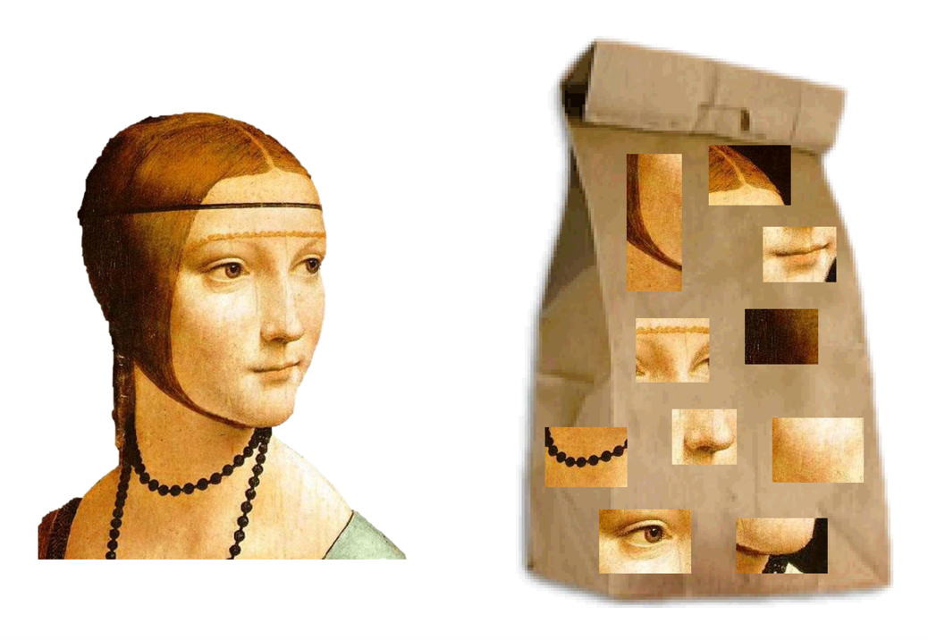
Bags of visual words

Slide 81
What should be visual words?
A visual word is a cluster of image patches that mean the same thing
Object parts
Texture patterns
Idea: collect patches from many different images
Cluster using k-means

Slide 82
What should be visual words?
Cluster in what space?
Need invariance to color, small deformations, orientation changes
Cluster in SIFT space!
Each cluster = visual word

Slide 83
Encoding images as bag of words
Densely extract image patches from image
Compute SIFT vector for each patch
Assign each patch to a visual word
Compute histogram of occurrence

Slide 84
Too much invariance?
Object parts appear in somewhat fixed relationships

Slide 85
Idea: Spatial pyramids

Slide 86
Discussion

